Slide 1
Cable Development and Optimization
E. Barzi
Fermilab High Field Magnet Program Design Review
28-29 April 2016

Slide 2
Outline
CHARGE: Is the cable selection appropriate for this application?
PRESENTATION CONTENT
Strand and Cable parameters for Outer Coil – Same as 11 T Dipole
Cable Development for Outer Coil – Same as 11 T Dipole
Strand and Cable parameters for Inner Coil
Cable Development for Inner Coil
15 T Dipole Short Sample Limits
Sensitivity of I_{c} and RRR to Heat Treatment Parameters
Summary of Strand Procurement and Cable Fabrication
Strand R&D with OST
Conclusions

Slide 3
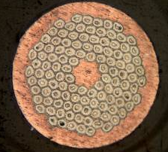
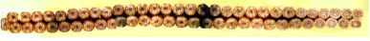

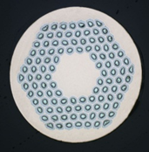
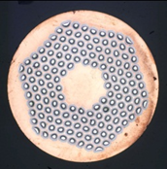
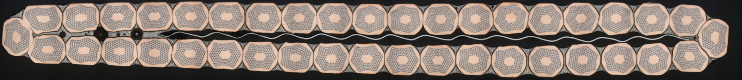
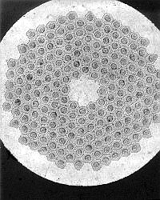
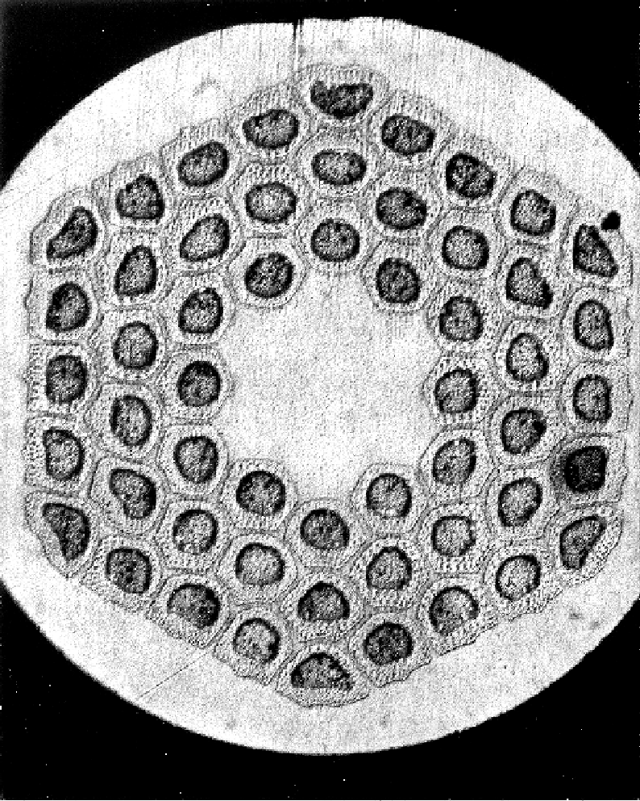
Strand and Cable Previous Landscape
60 x 0.7 mm
27 x 0.7 mm
40 x 0.7 mm
(27-28) x 0.7 mm

Slide 4
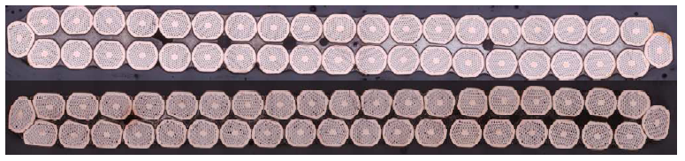
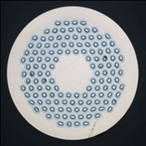
Strands and Cables for 11T Dipole Coil = 15T Outer Coil
0.7 mm strand - to achieve required magnet transfer function of 11 T at 11.85 kA
40 strand cable – CERN cabling machine limit
Critical current degradation due to cabling < 10%
StSt core
Large aspect ratio - cable mechanical stability
  cable geometry, packing factor
Baseline strand
R&D strand

Slide 5
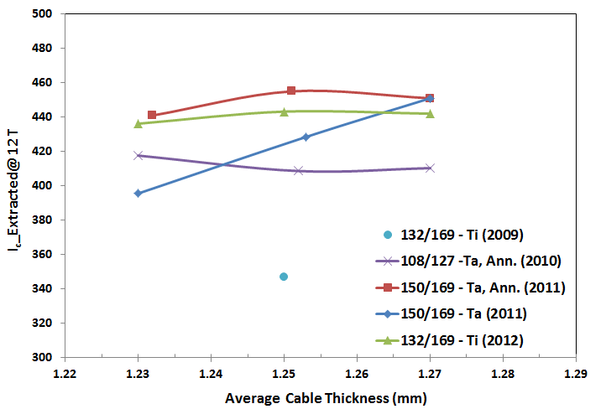
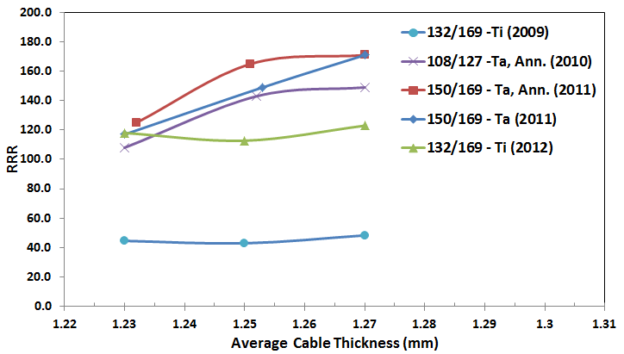
11 T Dipole Cable Studies and Optimization
A mid-thickness spec of 1.25 mm meets the I_{c} degradation requirements also in the case of a cored cable.
The Ti doped wire preserved its current carrying capabilities up to large cable compaction factors, even without any prior annealing.
Maximum I_{c} degradation at 12 T was ~2% at ~89% cable compaction.

Slide 6
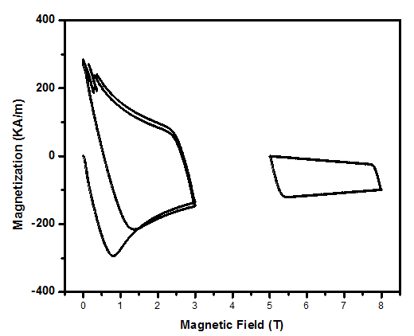
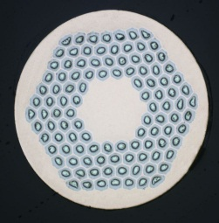

Strand Parameters for Inner Coil

Slide 7
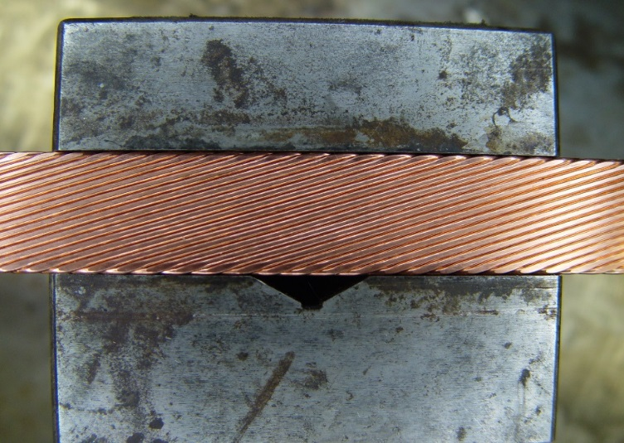
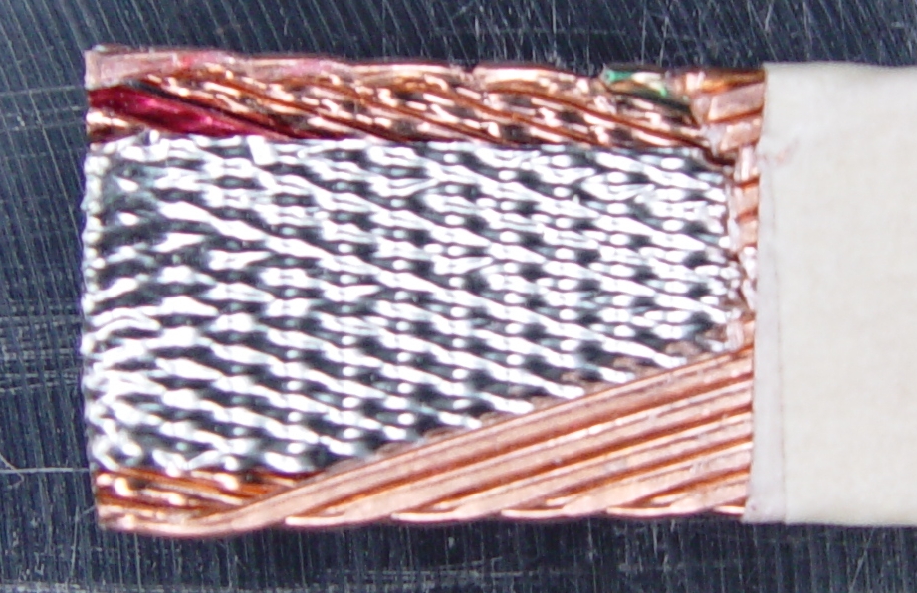

Cables used in Studies for Inner Coil
  Effect of cable Packing Factor (PF) on I_{c} degradation and RRR
  Effect of pre-treating the wires before cabling
  Effect of magnetic field on RRR

Slide 8
Results of Cable Studies for Inner Coil

Slide 9
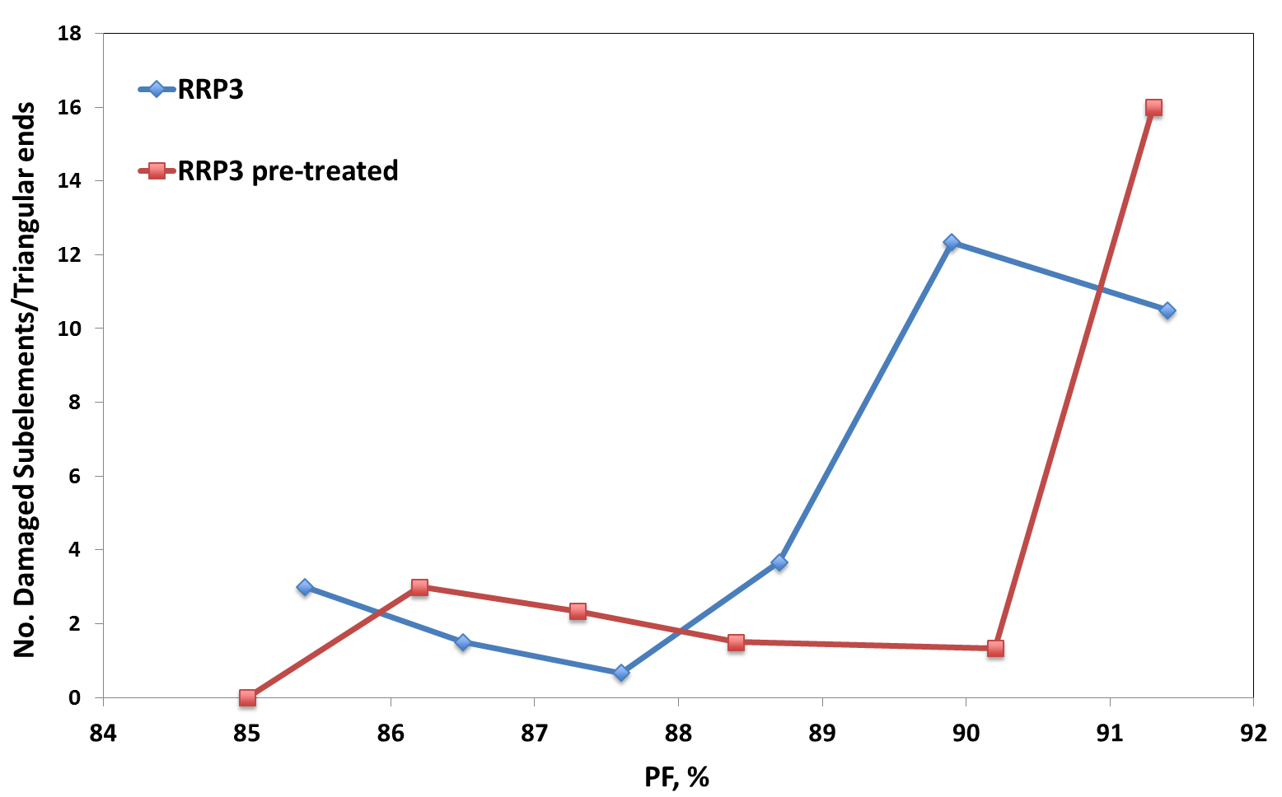
Results of Cable Studies for Inner Coil (cont.)
  Magneto-resistivity effect
  Comparison of transport data with microscopy analysis of cable cross sections

Slide 10
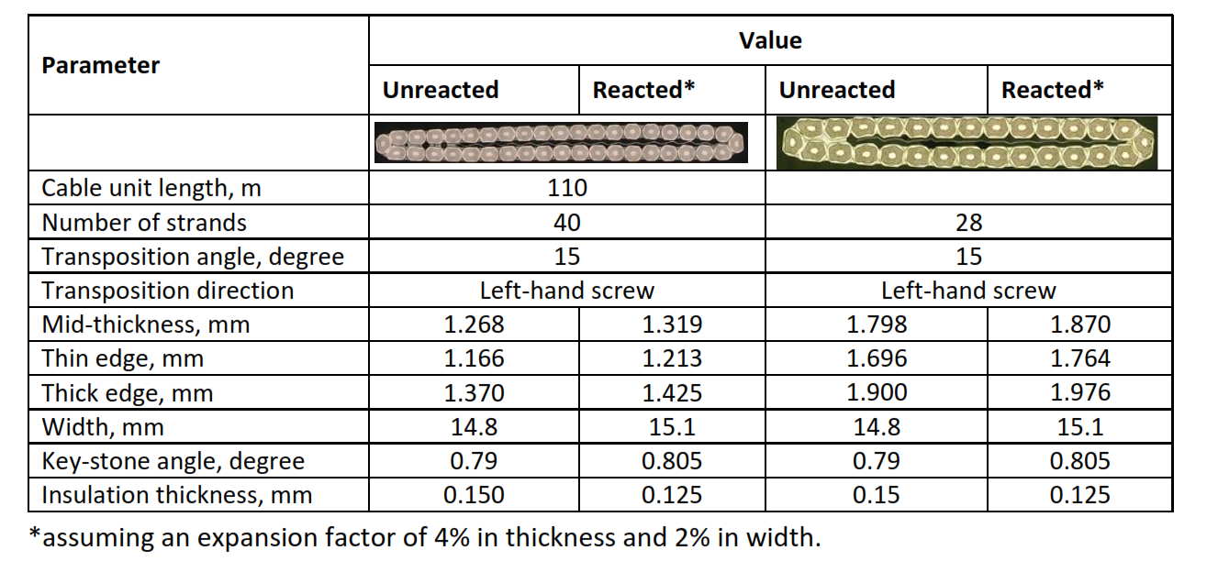
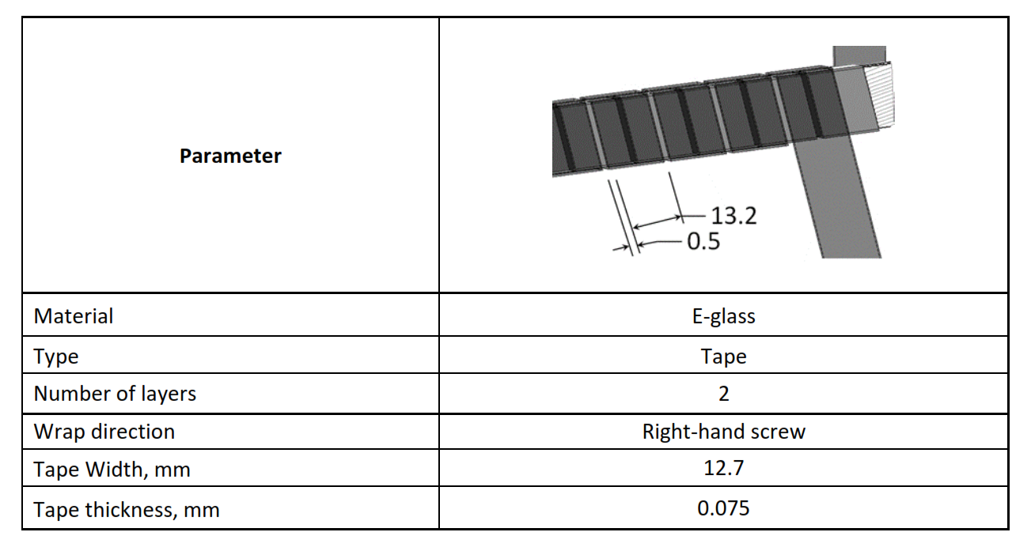
Cables and Insulation Specs

Slide 11
Magnet Short Sample Limit
Magnet short sample limit estimated based on extracted strand data:
  11.05 kA (B_{ap}=15.25 T) at 4.5 K
  12.2 kA (B_{ap}=16.65 T) at 1.9 K

Slide 12
Sensitivity of I_{c} and RRR to Heat Treatment Parameters

Slide 13
Nb₃Sn Strand Procurement FY11-FY16
Year | L, km | W, kg | D, mm | Design | Ternary type
2010 | 17.3 | 59 | 0.7 | 108/127 | Ta
2011 | 42.1 | 144 | 0.7 | 150/169, 108/127 | Ta
2012 | 40.6 | 138 | 0.7 | 108/127 | Ta, Ti
2013 | 53.3 | 182 | 0.7 | 108/127 | Ti
2014 | 17.7 | 120 | 1.0 | 150/169 | Ti
2016 | ~20 | ~135 | 1.0 | 150/169 | Ti
11 T program ~450 kg
15 T program will need ~500 kg (250 kg already procured)

Slide 14
Cable Production FY11-FY16
Coil ID | Cable N x D | Billets ID | Strand Type | Cable length | Cable geometry | Core width | Cable fabrication
MBH02, MBH03 | 40 x 0.7 mm | 12292, 12319, 12521-22, 13062-63, 13090 | 108/127 (Ta) | 414 m | 1.251±0.001 x 14.71±0.01 mm², 15.0 deg | None | Jul. 2011, 2-pass w/intermediate anneal
MBH05, MBH07 | 40 x 0.7 mm | 13538, 13613 | 150/169 (Ta) | 120 m 230 m | 1.251±0.002 x 14.69±0.01 mm², 15.0 deg | 11.0 mm | Sep. 2011, 2-pass w/intermediate anneal
MBH08 | 40 x 0.7 mm | 14144, 14145, 14194, 14195, 9772 | 108/127 (Ta), 114/127 | 138 m | 1.252±0.004 x 14.71±0.01 mm², 14.0 deg | 11.7 mm | Nov. 2012 1-pass
MBH09 | 40 x 0.7 mm | 14144, 14145, 14194, 14195, 14700 | 108/127 (Ta) | 180 m | 1.249±0.002 x 14.70±0.01 mm², 14.8 deg | 11.0 mm | Nov. 2012 1-pass
MBH10, MBH11 | 40 x 0.7 mm | 14144, 14145, 14194, 14195, 14700 | 108/127 (Ta) | 220 m | 1.245 x 14.72 mm², 15.0 deg | 11.0 mm | Nov. 2012 2-pass w/intermediate anneal
Practice coils | 40 x 0.7 mm | 11444 | 132/169 (Ti) | 216 m | 1.251 x 14.73 mm², 15.6 deg | 9.5 mm | Mar. 2013 1-pass
 | 40 x 0.7 mm | A101 | Hard Cu | 600 m | 1.250 x 14.71 mm², 16.8 deg | 11.0 mm | Oct. 2013 1-pass
15 T Dipole Outer Layer | 40 x 0.7 mm | 15043, 15044, 15045, 15244, 15245, 15290 | 108/127 (Ti) | 374 m | 1.251±0.001 x 14.71±0.01 mm², 16.8 deg | 11.0 mm | Oct. 2013 1-pass
15 T Dipole Inner Layer | 28 x 1 mm | 16638, 16639, 16640 | 150/169 (Ti) | 420 m | 1.803±0.002 x 14.79±0.02 mm², 15.5 deg | 11.0 mm | Dec 2015 1-pass

Slide 15
RRP Strand R&D (with OST)
Goal: increase J_{c}(15T) with an ultimate target of 2000 A/mm² for a 169 stack strand at 1.0 mm (D_{s}~58 µm)
  Present subelement design - average J_{c}(15T)~1500 A/mm²
Approach: modifications to the subelement designs
Chemical optimization
  Produce a half height high-J_{c} subelement billet having Nb and Nb-Ti filaments with a Nb-Ta diffusion barrier
  Deliver ~45 kg of 1 mm wire
Local Area Ratio (LAR) optimization
  Produce two half height high-J_{c} subelement billets having Nb and Nb-Ti filaments with variable LAR from annulus to barrier
  Deliver ~90 kg of 1 mm wire
  0.8, 0.9, 1.0, 1.1 and 1.2 mm wire samples
Next: 1-1.2 mm RRP-217 stack design.

Slide 16
Conclusions
SC wires and cables are key elements of the 15 T Dipole Demonstrator
Cables were designed and optimized based on the properties of present Nb₃Sn wires
Sensitivities studies are being performed to allow for variations in temperature and time during coil heat treatment
Wire R&D continues with OST on layout and chemical optimizations to increase Jc, which is important for margin
SBIR are being submitted within a number of agencies to probe further Jc increases acting on the inherent flux pinning mechanisms

