Slide 1
15 T magnet instrumentation and test plan
Stoyan Stoynev
(material contributions from my colleagues)

Slide 2
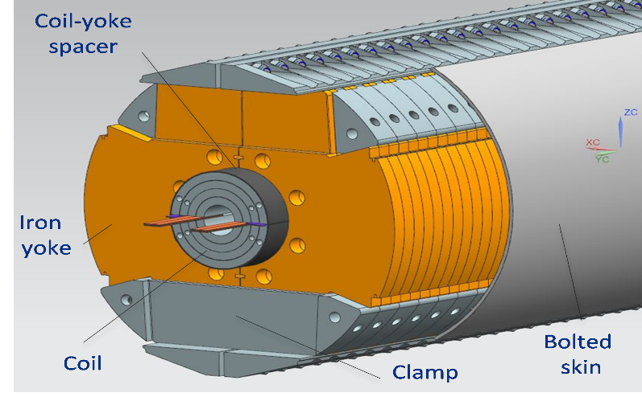
Outline
Introduction
Magnet instrumentation – past and future
Test plan and measurements
  Quench training and current dependencies
  Magnetic measurements
  Protection heater and energy extraction tests
  Splice resistance and inductance measurements
  Spike and RRR measurements
Summary
15 T

Slide 3
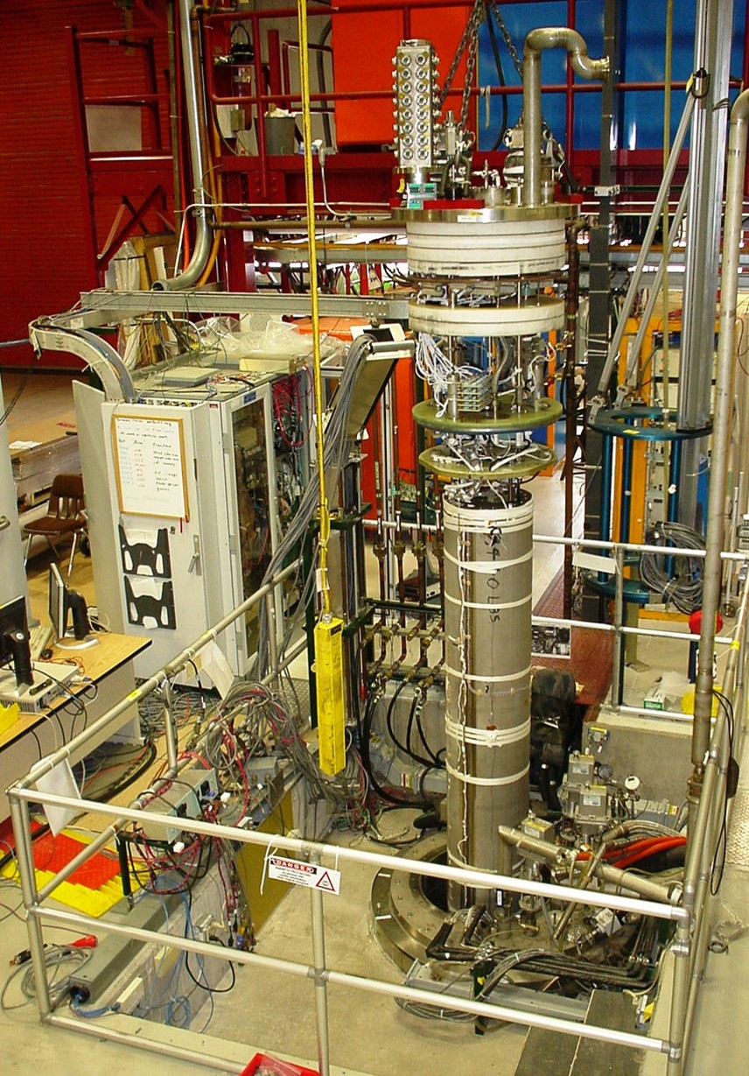
Introduction
A large number of “11 T” and LARP magnets
were tested at the VMTF (TD)
Significant experience was gained
A successful and prompt accomplishment
of goals for new magnets does benefit
from this experience
Well established routines and procedures
in both instrumentation and testing techniques
are the back-bone of our success

Slide 4
Magnet instrumentation
Voltage taps – for quench detection and characterization
(up to 104 channels can be instrumented for characterization)
  the quench detection system is technically more related to the VMTF than to the magnet although
  it brings safety to the magnet operations
Strain gauges on coils, poles, bullets/rods and shell – strain monitoring during assembly, cool down, warm up and quenches to build the full stress picture vs conditions
Quench antenna – for independent quench characterization
Temperature sensors – magnet temperature needed for various tests
Protection heaters – for quench protection of the superconducting magnet
  In addition to heaters the magnet is protected by an energy extraction system
  (through a parallel to the magnet dump resistor); it is part of the testing facility set up

Slide 5
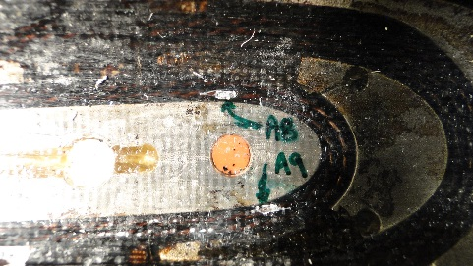
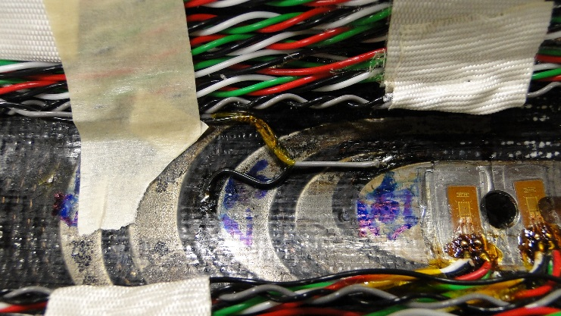
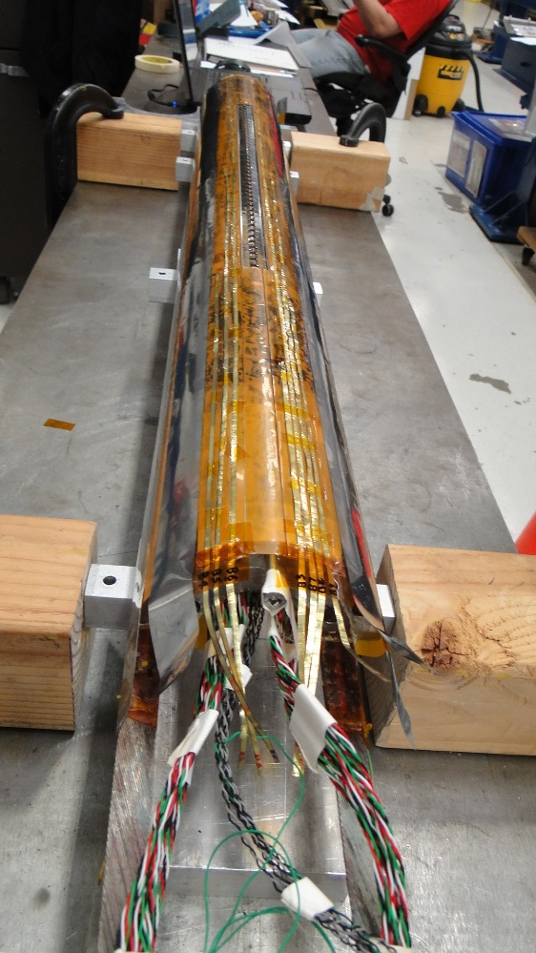
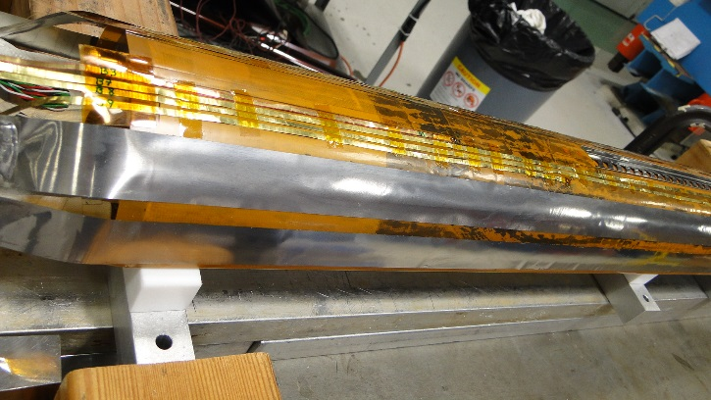
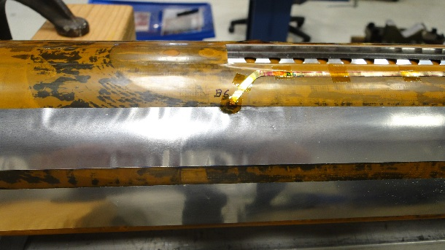
Voltage taps (VT) and heaters in past
VT
VT
11 T
Inner surface voltage taps are connected with wires whereas
outer layer voltage tabs are instrumented with thin metallic
films (strips) due to limited space.
Protection heaters are laid on outer layer surfaces only.
VT
Heater (strip)
multiple VT strips
Heater strips

Slide 6
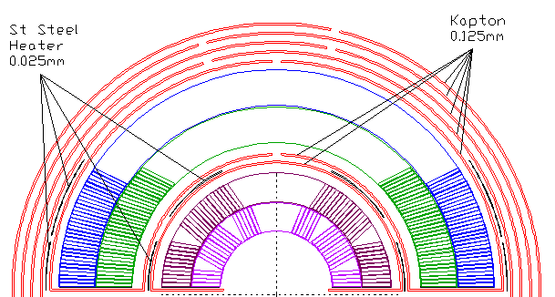
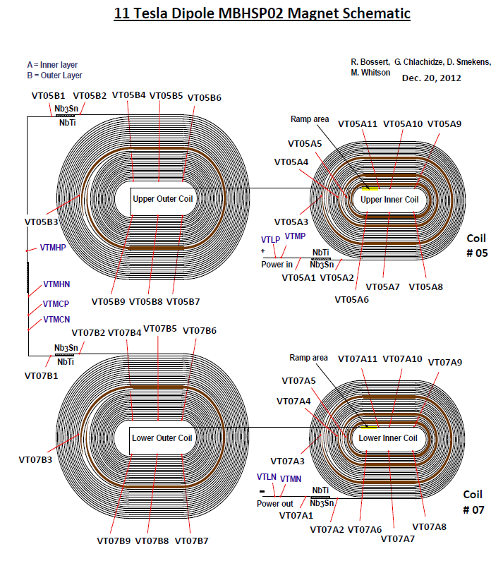
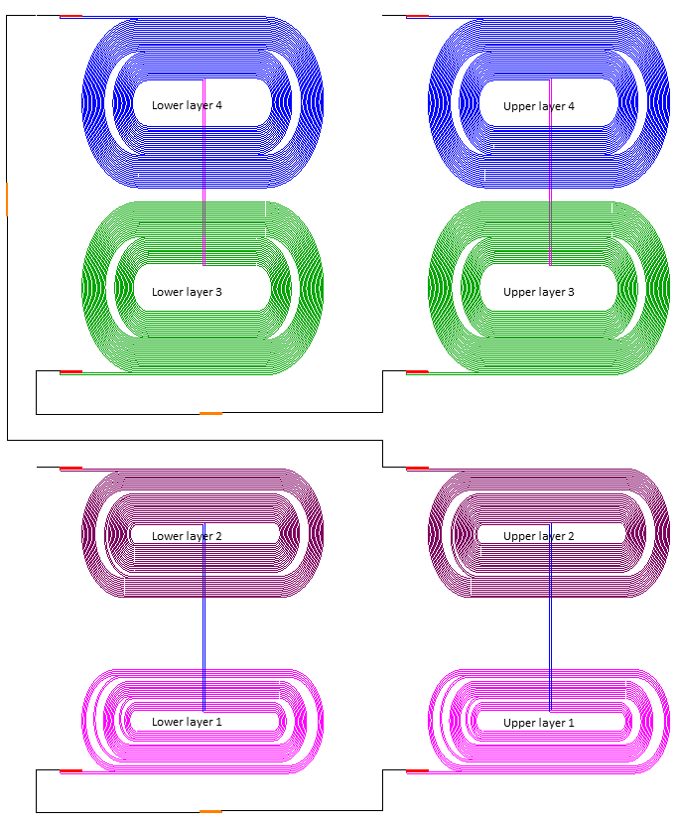
Voltage taps and heaters for 15 T
heaters
insulation
Layers 1 and 2 resemble the structure of a two-layer magnet
  To be instrumented in a similar to past magnets way
  Voltage tabs at the inner- and outer-most surfaces of the structure
  Heaters at the outer-most surface
Layer 4 resembles the outer layer of a two-layer magnet (or layer 2 in our case)
  To be instrumented in a similar to past magnets way
  Voltage tabs and heaters at the outside surface
Layer 3 is very different and presents a challenge
  We need to understand how much space we can squeeze and where we can put voltage tabs
{
15 T
Layers: 4 3 2 1
Very similar
11 T
4
3
2
1
15 T

Slide 7
Voltage taps for 15 T
heaters
insulation
15 T
Possible locations of VT are shown ( )
We need to instrument well the splices (could be a major source of trouble if problems occur)
More VT in the regions we expect a quench (pole, inner layer; sharper surfaces like wedges )
We could have up to 104 VT but “over-instrumentation” carry its own risks
Space is limited in some locations

Slide 8
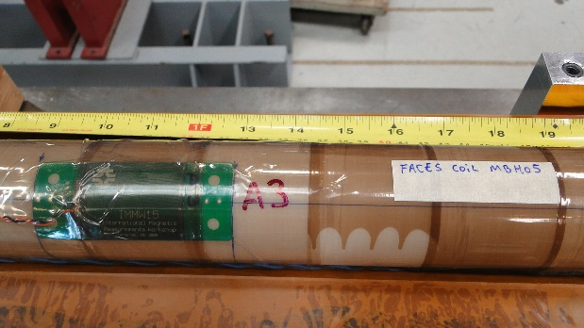
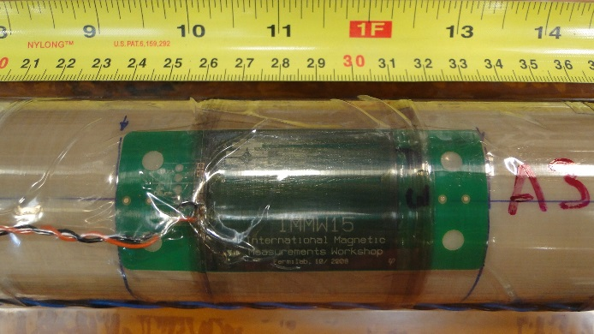
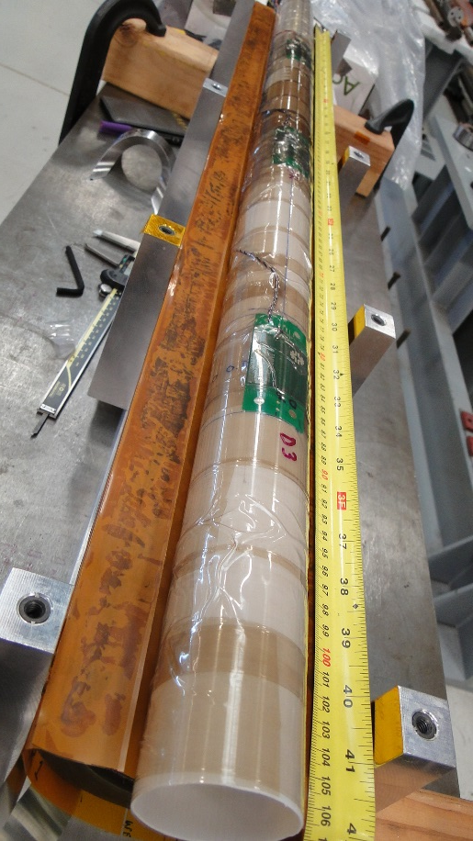
Quench antenna and temperature sensors
11 T
A quench antenna is placed at the inner surface of the innermost coil – additional axial information on quench locations.
We’re to have five channels along the length of the magnet.
Temperature sensors are placed before putting the magnet to the cryostat – typically at the top and bottom of the magnet (we can instrument up to five sensors).

Slide 9
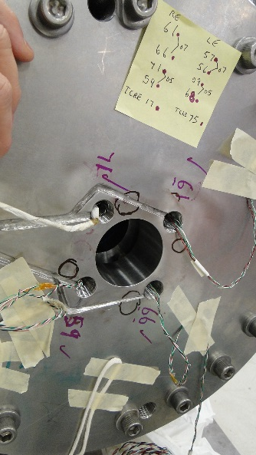
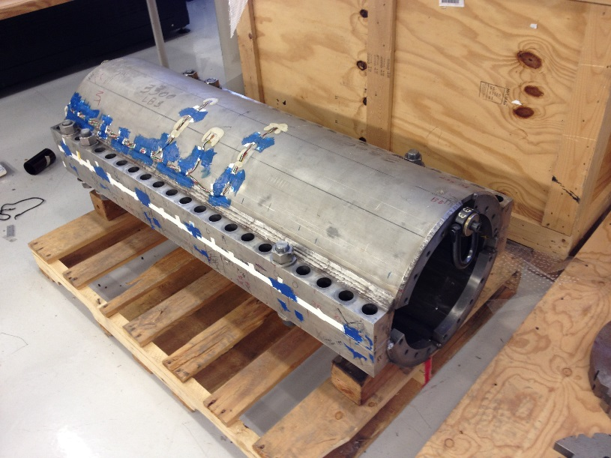
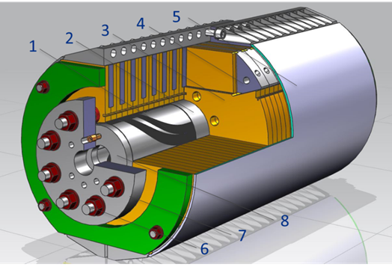
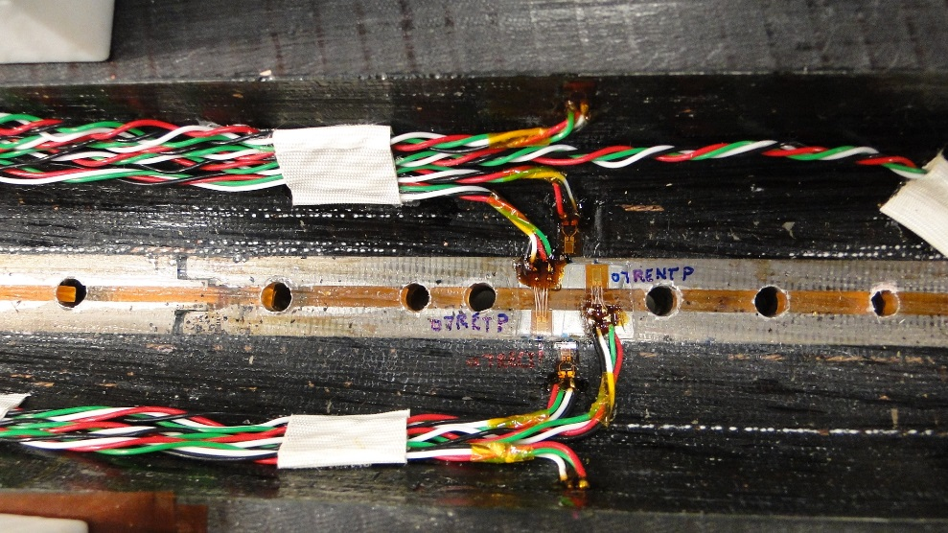
Strain gauges (SG) for 15 T
SG to be instrumented on coil, pole, skin and bullets as we did in past – up to 64 SG channels
Instrumented skin SG
11 T
Bullets and bullet holes
Instrumented coil and pole SG
15 T

Slide 10
Strain gauges for 15 T (2)
To know and control the axial stress
  six bullet SG per end
  two temperature compensators
For handling the stress on the shell (skin)– SG on the welded skin
  at mid-plane close to the lead-end and non-lead-end
  same axial positions but at 60 degrees angle (around the skin)
  two temperature compensators
  a copy of those on the opposite side
Setting the proper pre-stress level in the magnet
requires SG on the coils and poles
  SG around the pole and close to the mid-plane
  SG on the pole
  two locations along the axial direction
  on both coils
Mid-plane
coil
Pole
Magnet axis
In total – 46 SG foreseen
Generally we have good readings and interpretation for the SG except
cold data from coil SG – we need to use full-bridges SG sensors!

Slide 11
Test plan overview
Tests before cool down
  “warm” HiPot tests according to the QA document
  check all magnet instrumentation
  magnetic measurements
Tests during cool down
  controlled cool down: 100-150 K delta T was applied previously
  magnetic measurements
Tests at 4.5 K
  “cold” HiPot tests
  checkout quench detection and protection systems, 120 mOhm dump resistor
  heater induced quenches at low currents (up to 6 kA)
  magnetic measurements
Tests at 1.9 K (30 mOhm dump resistor)
  quench training at 20 A/s
  ramp rate dependence
  holding current test
  temperature dependence study
  magnetic measurements
  splice resistance and inductance measurements , spike studies
Quench protection tests at 1.9 K
  heater and quench propagation tests
  quench integral study – need to calculate maximum allowed MIITs first
Tests during warm up
  RRR
  magnetic measurements
These constitute
the primary part of
the magnet studies

Slide 12
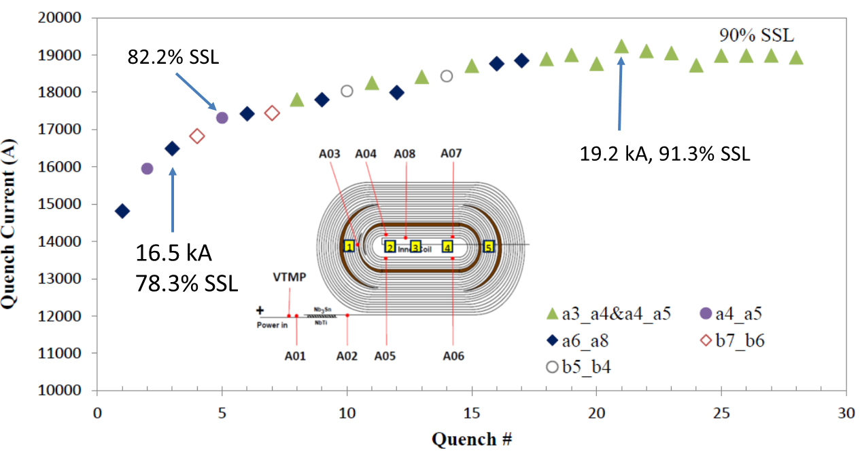
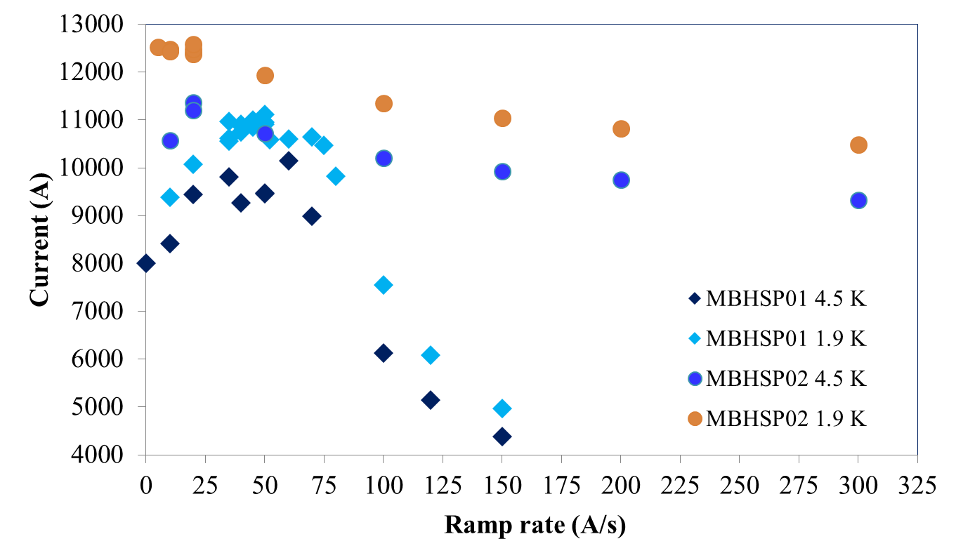
Quench training and quench current dependencies
Training
The quench training patterns and
locations characterize the training
Quench current dependences
bring additional information about
characteristics and operational
margins
MQXFSM1
(LARP)
Temperature dependence
Ramp rate dependence
HFM

Slide 13
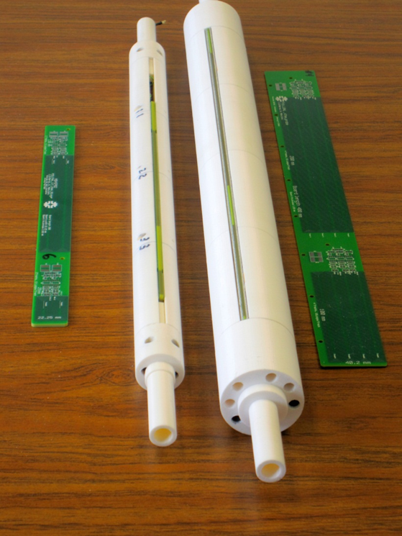
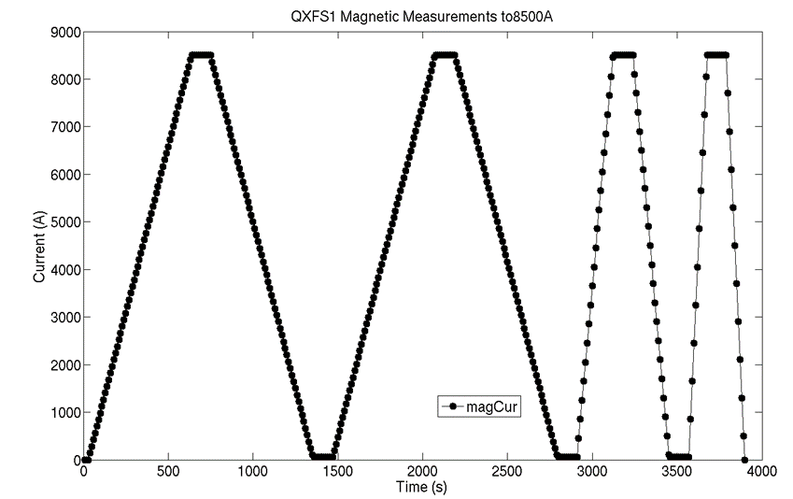
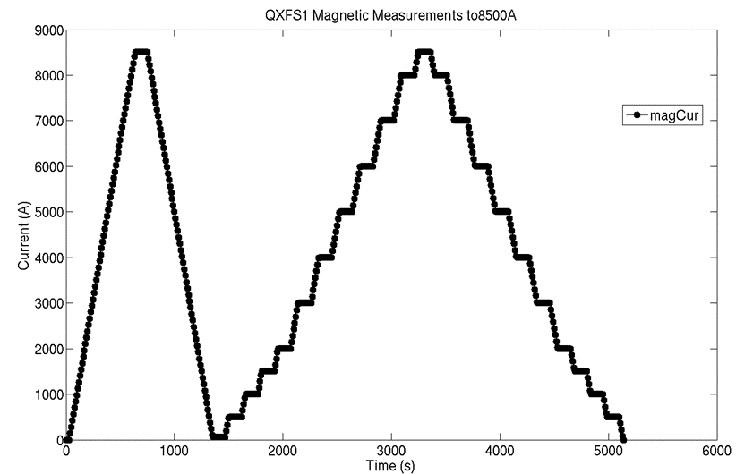
Magnetic measurements
Measurement probe(s)
  measurements by the rotating probe system at VMTF
  need to clarify the needed sensitivity at reference radius
  existing probes can be used or new boards (PCB) developed
Warm (room temperature) measurements
  obtain the geometric field before cryogenic changes and high
  current operations
  perform axial scan through the magnet including ends (± 10-20 A)
  determine the probe reference location with respect to the
  magnetic center
Measurements during cool-down (warm-up later)
  obtain geometric field changes as a function of temperature
  perform axial scan over short central region of the magnet at ± 10-20 A
  (~150 K, ~100 K, ~50 K)
Low-current measurements at 1.9 K before training
  set of field quality data in case of unwanted magnet/system behavior later
  ramp-rate dependence to characterize the dynamic behavior –
  20, 40, 80 A/s to low maximum current (should be agreed on, 8.5 kA for now)
  stair step measurements to characterize the static behavior
  Z-scan for axial variation (at 6.5 kA or anyway lower than the
  low maximum current)
High-current measurements at 1.9 K after training
  the same as low current except the flat-top current level
  the Z-scan is at the same high-current level
  the current is at least 300 A below the training plateau
Printed circuit board
(PCB) probes

Slide 14
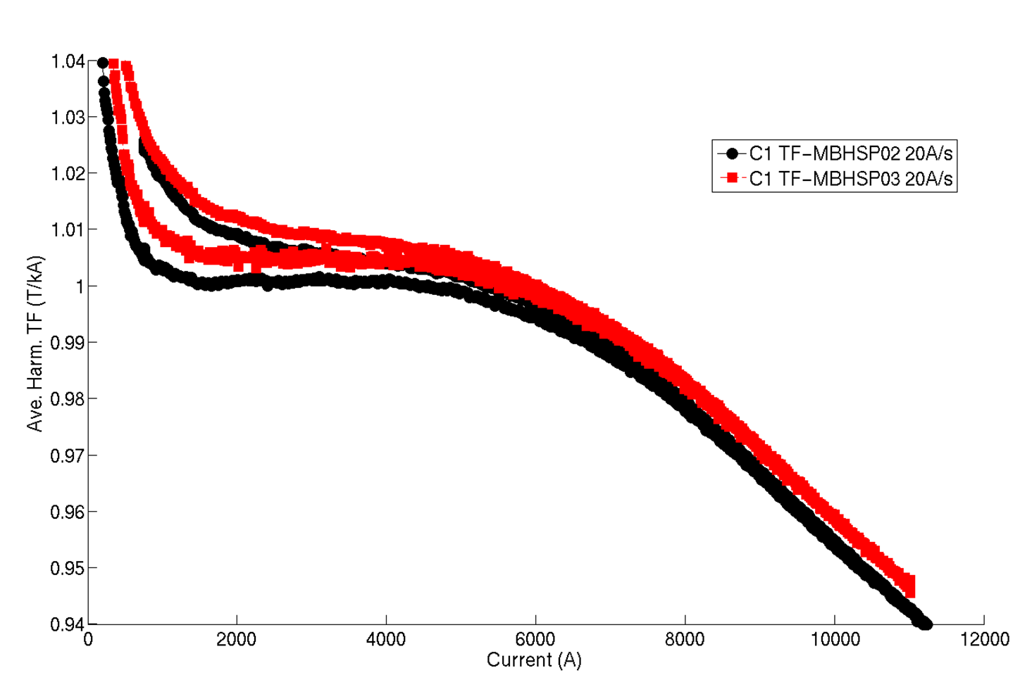
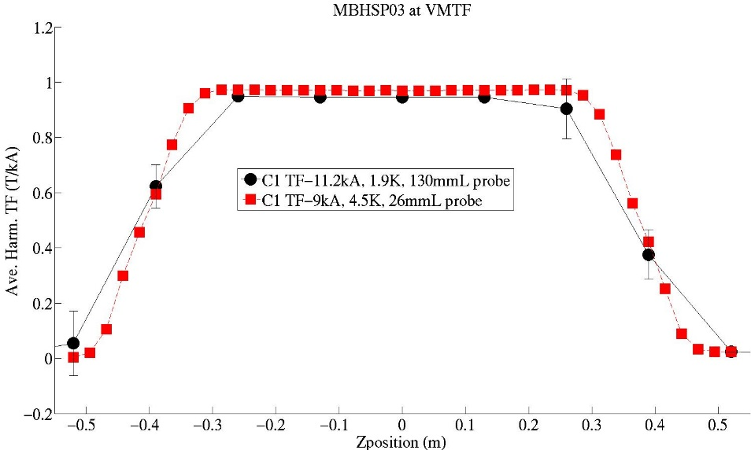
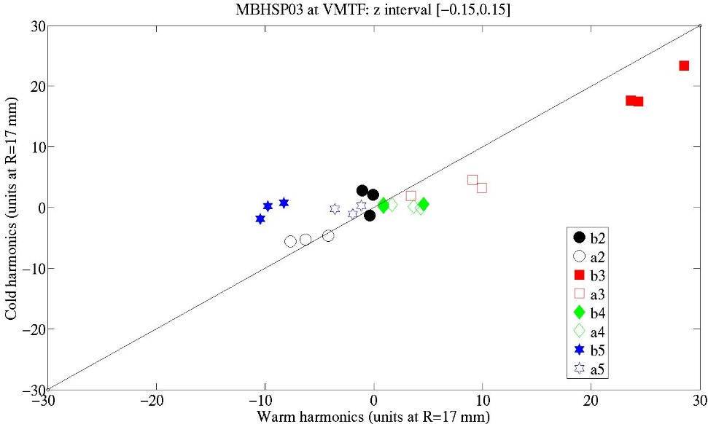
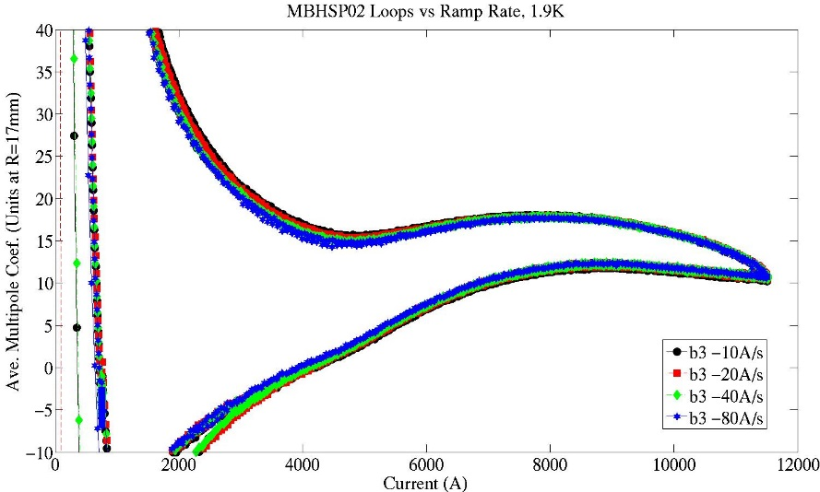
Magnetic measurement examples
Axial profile measurements
Transfer Function
Saturation ~6%
Warm/cold correlation (harmonics)
Measurements vs ramp rate

Slide 15
Protection heater (PH) tests
Main objectives for the 15 T test
  Get heater efficiencies for the different heaters
  (hard to deduce from 11 T configurations)
  Radial propagation of the induced quenches
  (longitudinal one can be inferred from tests already done in the 11 T program)
  Quench integral with different dump resistors (assessing PH as stand alone devices)
Differences with respect to 11 T
  heater configurations (including insulation)
  (heater) heating area
  coil volume
  different cables in different layers
In most of the tests one (set of) heater(s) is used to induce
a quench and the rest are used to protect the magnet.
The (two) heater firing units in use can discharge independently 400 V through the heaters
(and we try to avoid more than ~200 A through each heater).

Slide 16
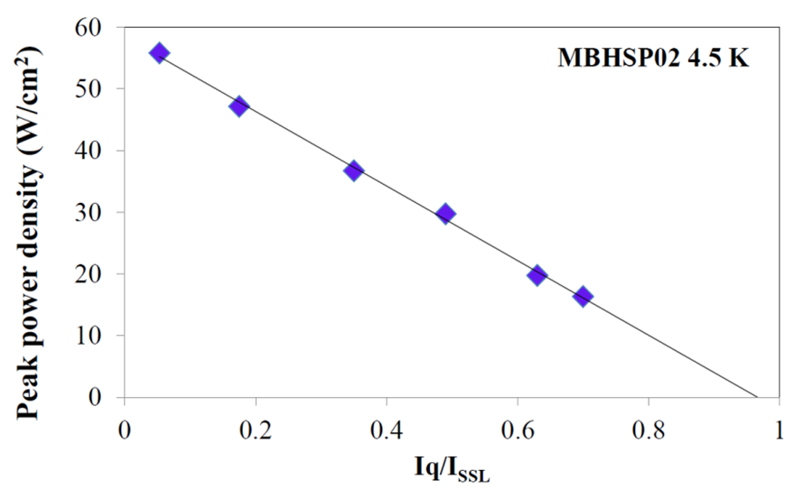
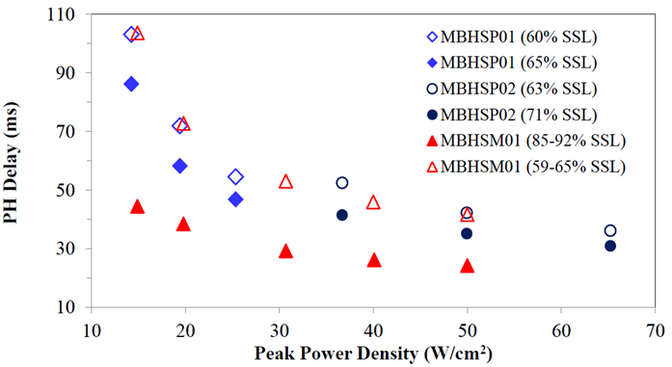
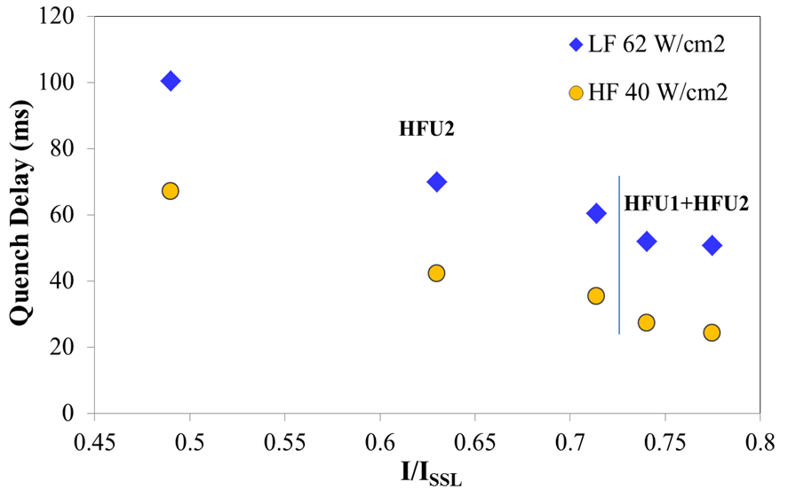
PH efficiency and delay studies
Minimum peak power density required to quench a
magnet – it gives us operational limits for the heaters
(at low current in particular)
Heater delays affect the quench integral
(and the quench spot temperature)
Delays depend on insulation among other parameters
like peak power density, time constant, current.
Delays in different field areas
(high/low here) will differ too

Slide 17
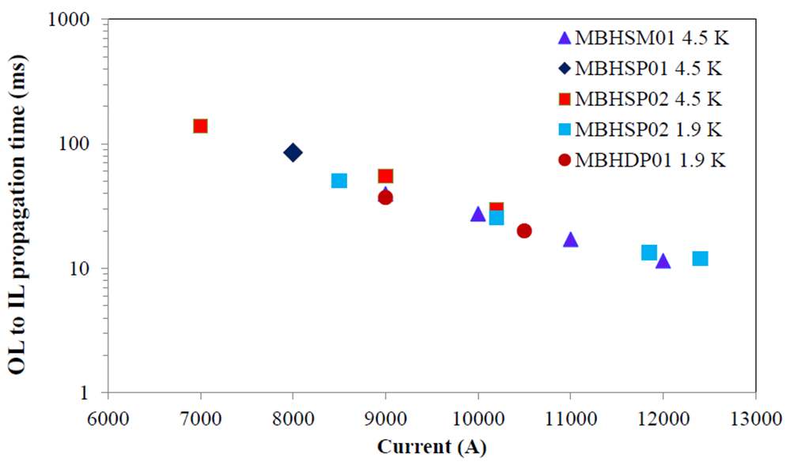
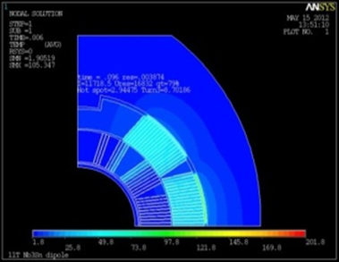
Quench propagation and quench temperature measurements
Simulations are used to obtain quench
propagation parameters and other characteristics
Temperature
distribution
after given time
VT and QA signals are used to locate a quench and also to calculate the quench propagation speed.
The magnet current decay curve and quench times give the hot-spot temperature in the coil (adiabatic approximation). Simulations give safe upper limits; dependencies can be compared to measurements.

Slide 18
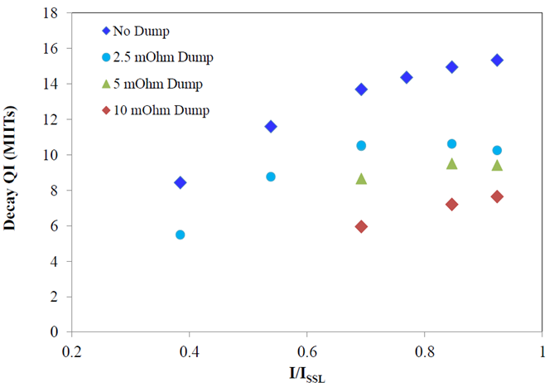
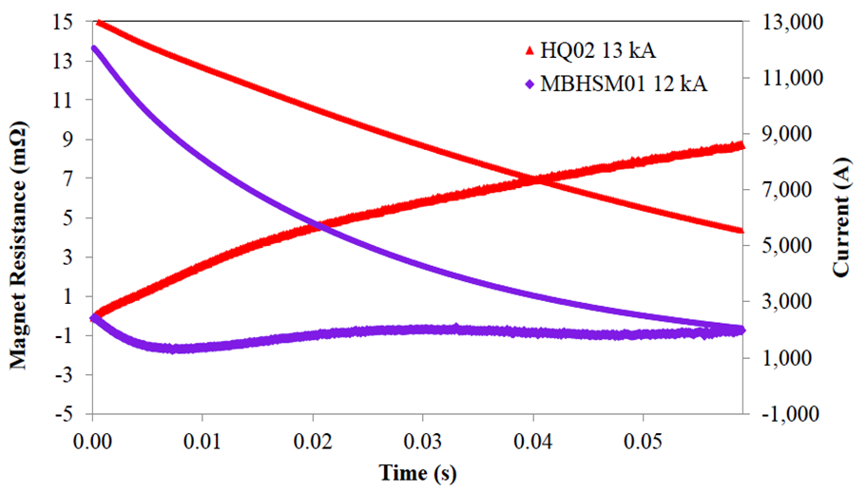
Quench integral and fast extraction
Quench integral (of the current squared) is
measured with different dump resistors. It is
related to the hot-spot temperature in the coil.
Given the calculated maximal values from
simulation we can decide what margins we have.
The fast extraction is with no heaters –
only the dump resistor is used.
From it we can deduce the effect of
quench-back (resistive growth during extraction)
which depends on the coil/cable properties.

Slide 19
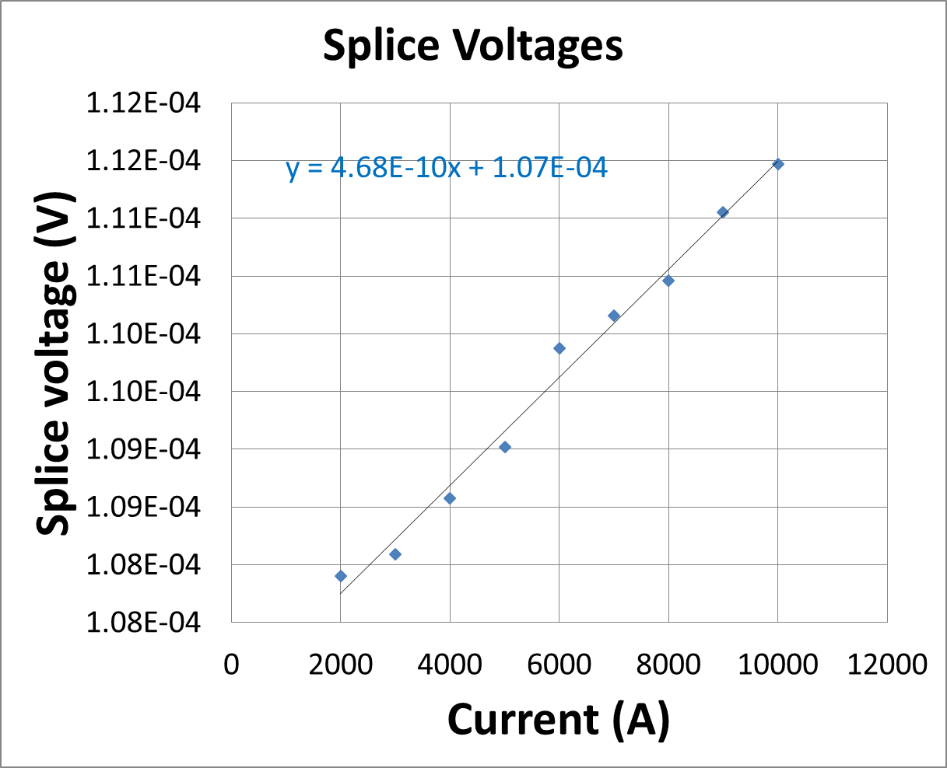
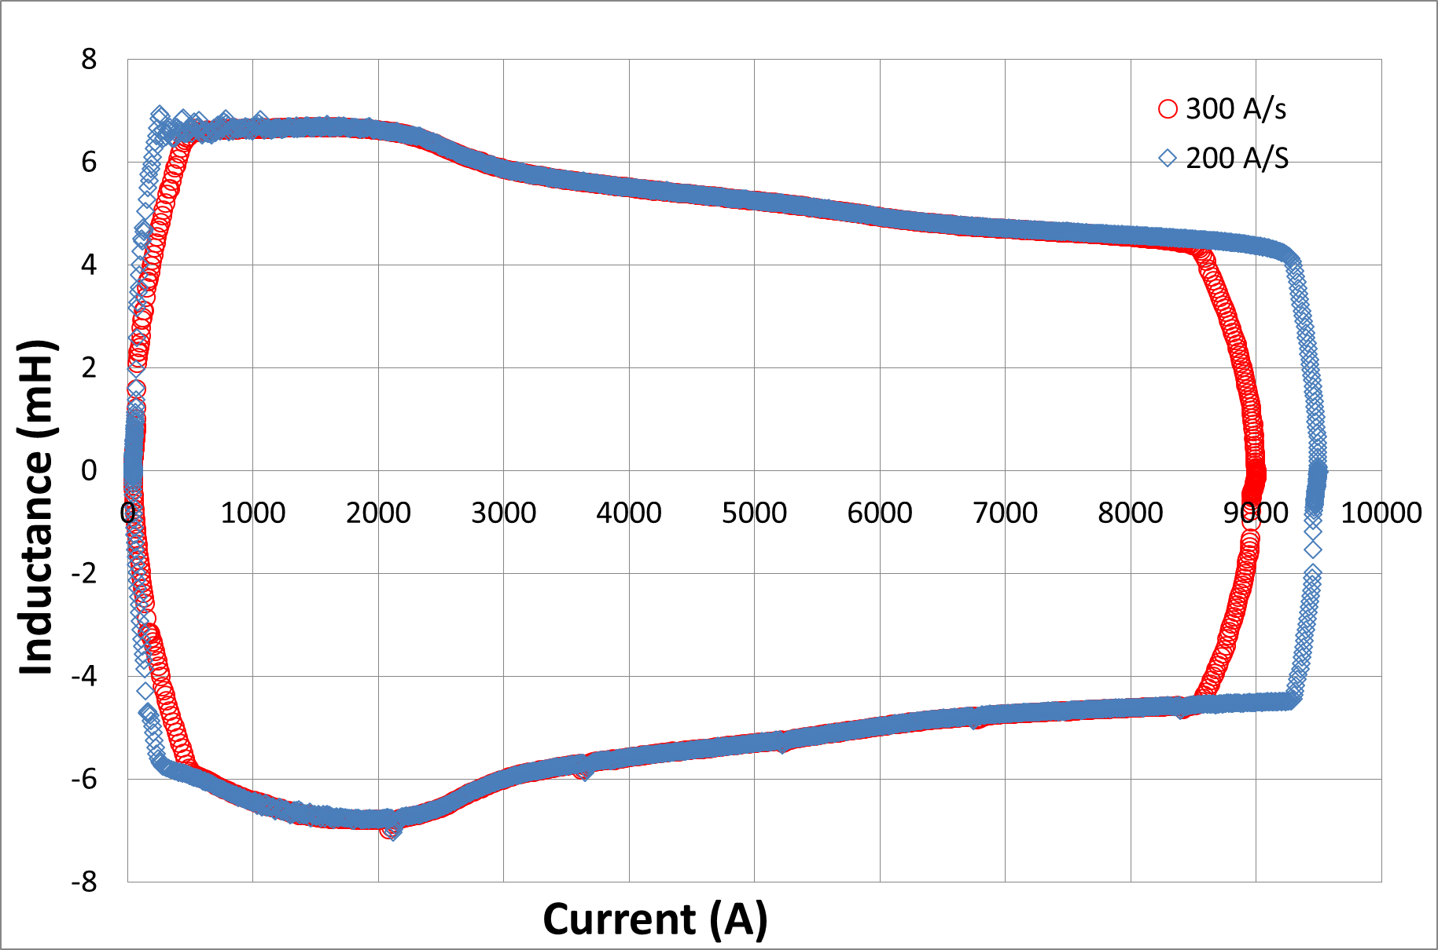
Splice resistance and inductance measurements
MBHSP04 (NbTi-Nb₃Sn splice)
Splices between coils or coils and leads can be significant heat sources.
It is important to verify their resistance is within acceptable limits.
It is important to have a proper splicing technique.
R = 0.5 nOhm
MBHSP04
The magnet inductance plays role in various other phenomena (quench integral, quench-back, etc.).
It is important to measure its dependence on the current and compare the magnitude with typical
warm measurements.

Slide 20
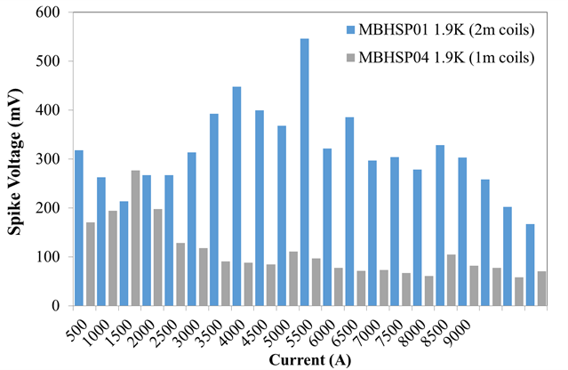
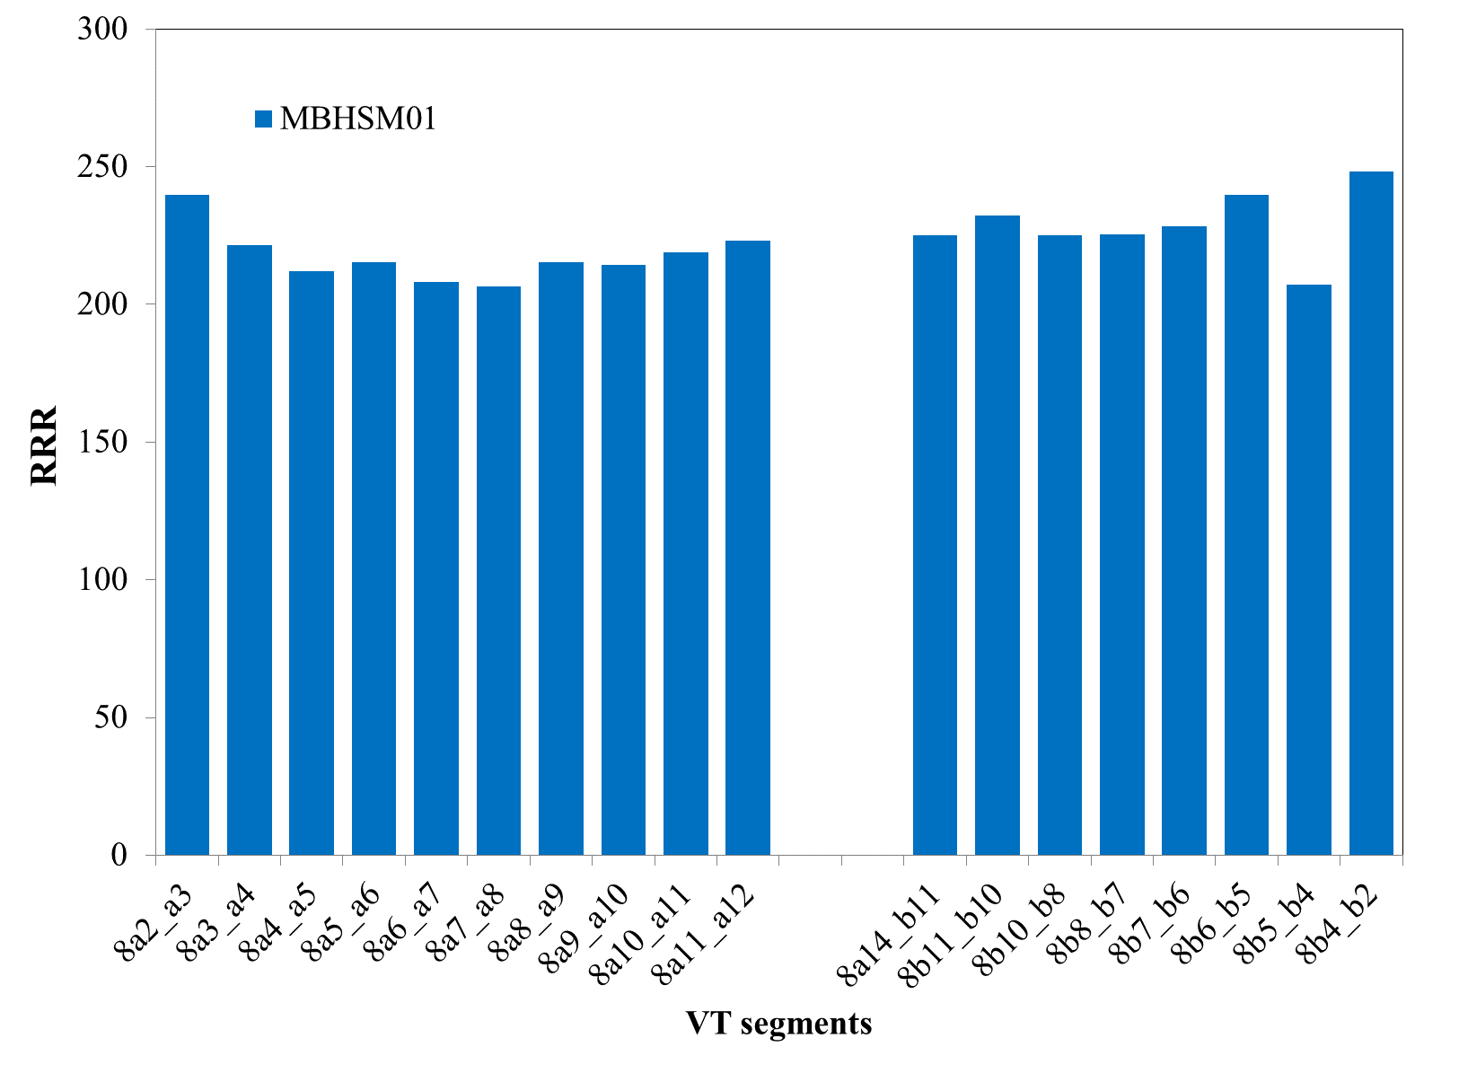
Spike and RRR measurements
(Voltage) Spikes relate to flux jumps in the cable – instabilities can cause quenches or trips
The Residual Resistivity Ratio (RRR) of a wire Cu matrix is a measure of its purity, which affects magnet stability and quench protection.
How does the bigger coil volume in 15 T
affect the flux jumps (instabilities)?
Which blocks are affected more?
Can the behavior be inferred from shorter
magnets (with different structure)?
Can we extrapolate further?
What are the temperature dependences?
RRR is defined as the ratio between
warm and cold (near but above critical
temperature) cable resistances.
How does the magnet assembly affects
the quality of the copper matrix in the cable?
Do we observe performance instabilities
linked to RRR irregularities?

Slide 21
Summary
“11T” and LARP R&D activities brought us a lot of experience
  magnet and test stand instrumentation
  test sequences and data analysis
The magnet instrumentation is largely developed and reliable
  voltage tabs and quench antenna
  strain gauges and temperature sensors
  protection heaters
A test plan follows typical steps well understood and practiced
  warm and cold magnet tests and preparations
  magnet quench training and quench current dependencies
  magnetic measurements
  protection heater studies
  variety of other studies (splice resistance, spikes, RRR)
Extensions or changes in the plan can be accommodated
The 15 T program can follow the good testing examples of its predecessors with few adjustments as necessary

Slide 22
Back up
Typically we have a (minimal) set of measurements to characterize a magnet
Training quenches
  The magnet current is ramped-up until a quench occurs
  Higher and higher current is typically reached after each quench (training) until a given limit
  We record detailed information about each quench – pattern, times, etc.
  This information is further explored
Ramp rate dependence
  Given a limit (plateau) is reached the magnet quench current depends on the ramp (up) rate
  The shape of the curve depends on cable parameters and composition
Temperature dependence
  at different temperatures the quench current is different
  this is related to the superconductor critical surface (field, current, temperature)
  in a trained magnet the quench current is constant in terms of Short Sample Limit
Magnetic measurements
  Magnetic field is fully calculable from the magnet design parameters
  The main issue usually is the field quality - getting higher order harmonics under control
  (and ways to do it are based on MC simulations)
Magnet protection studies
  Relate to the safe operation of the magnet (could affect performance)
  Operational levels are chosen based on magnet input parameters and initial tests
22

Slide 23
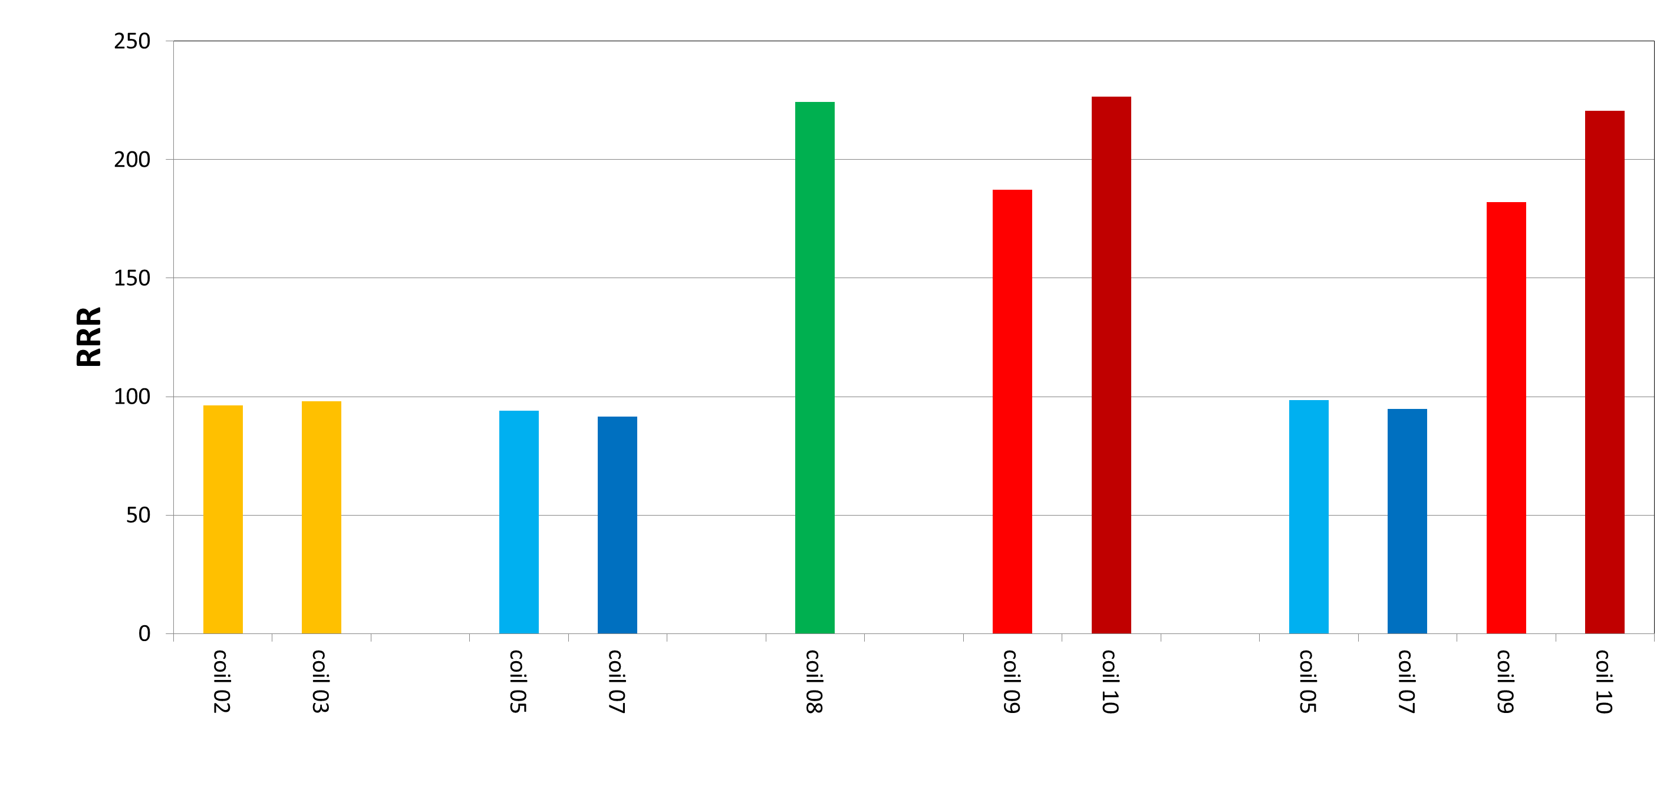
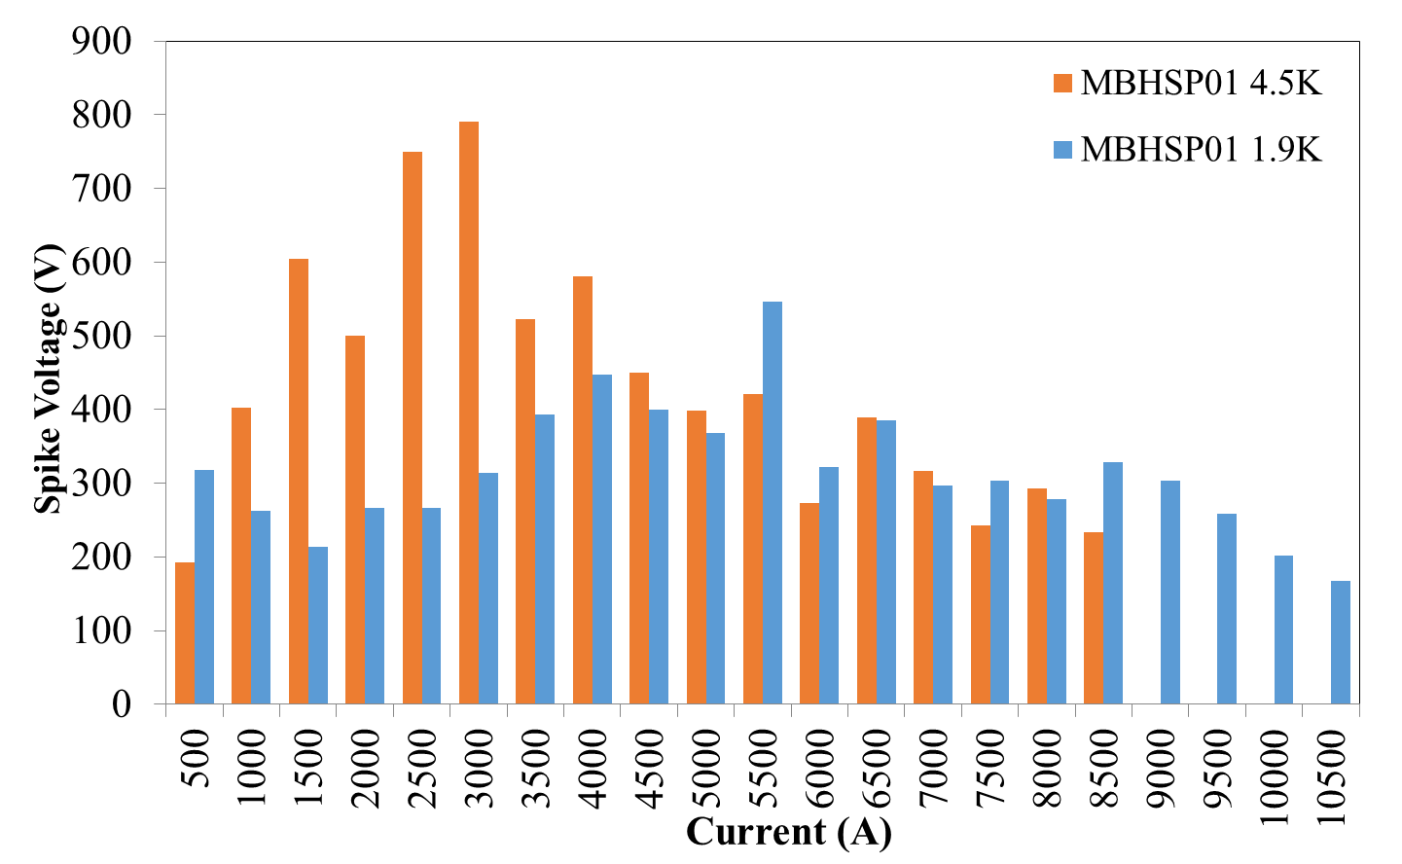
Back up
RRR
Spikes
HFM
187
227
221
224
182
96
98
94
92
99
95
23

Slide 24
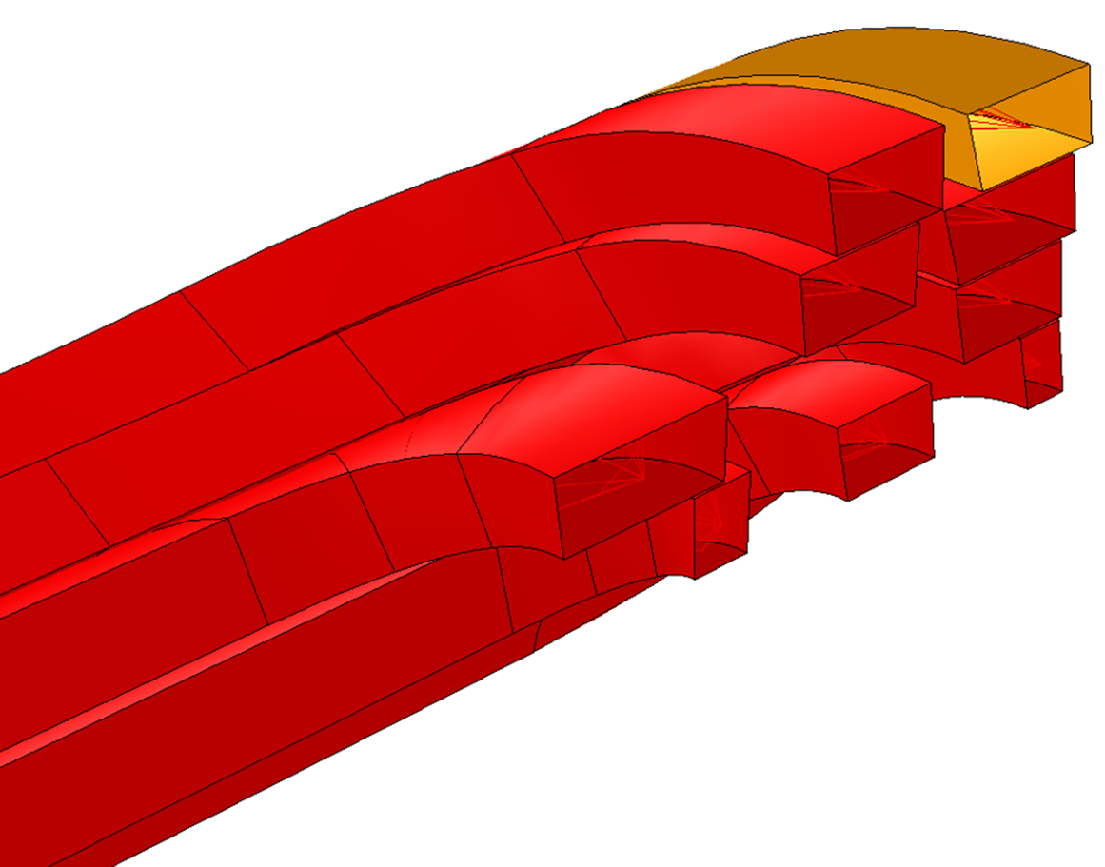
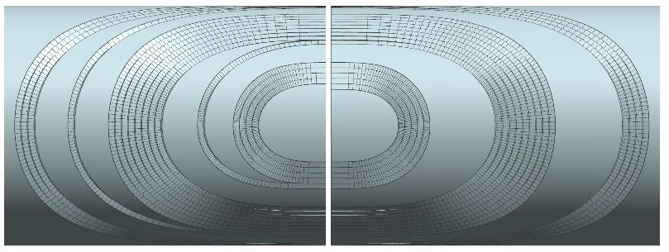
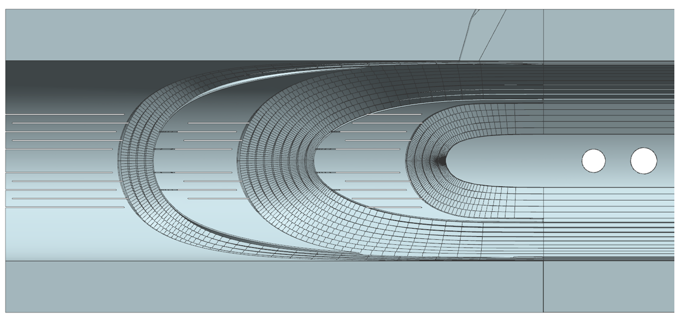
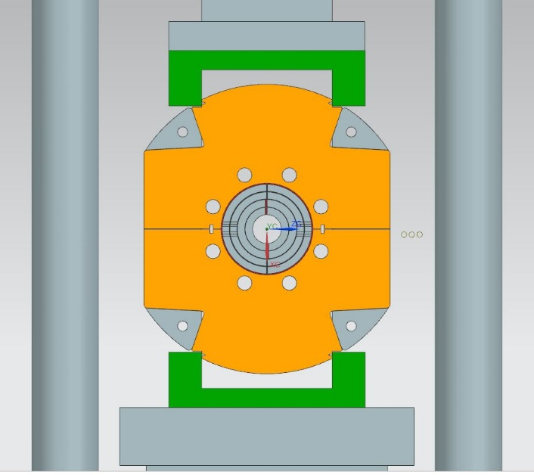
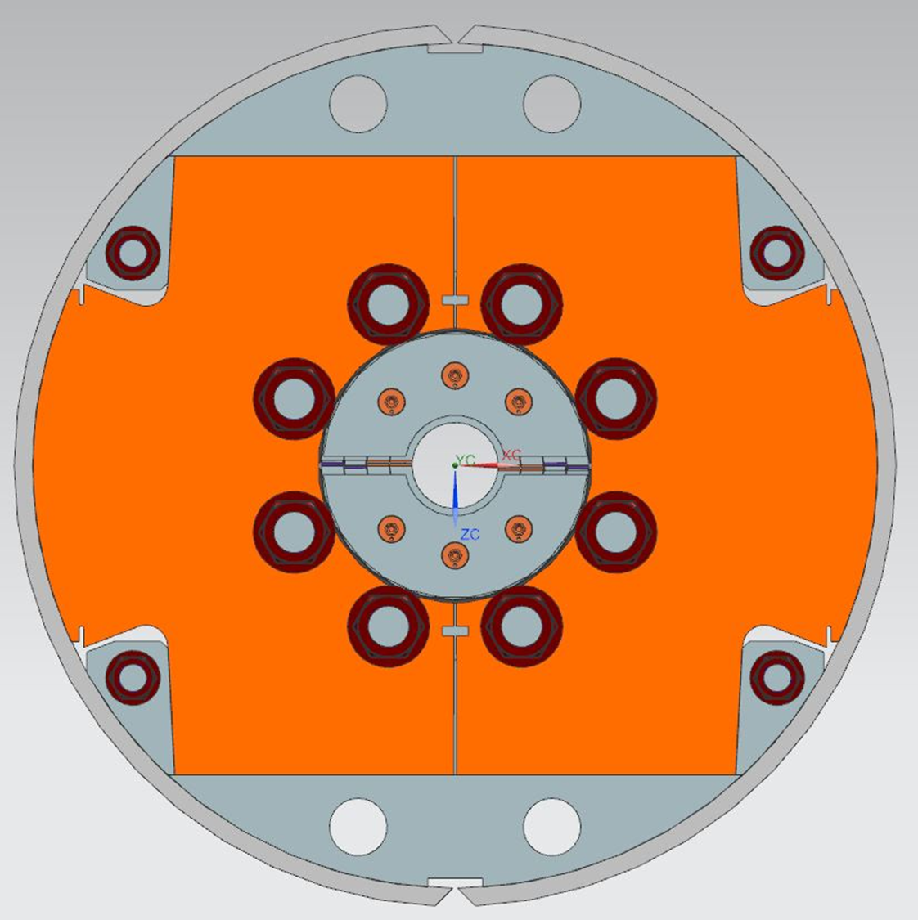
Back up
15 T

Slide 25
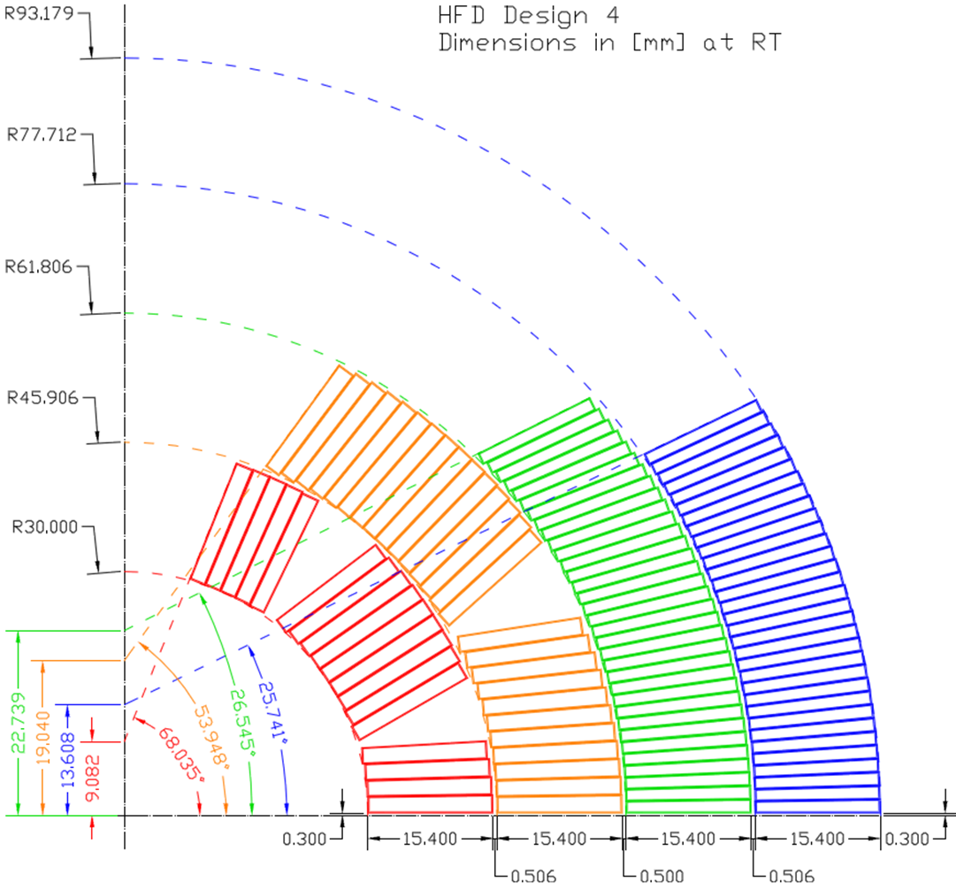
Back up
15 T

Slide 26
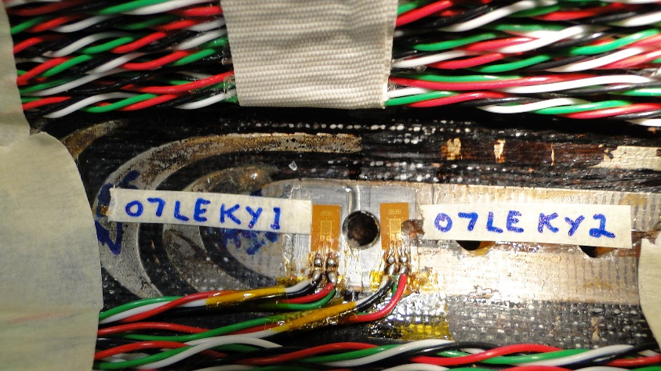

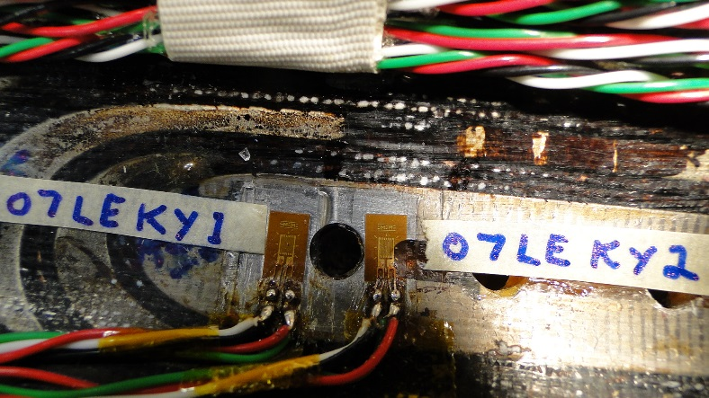

MBH Coil 7 (5)

Slide 27

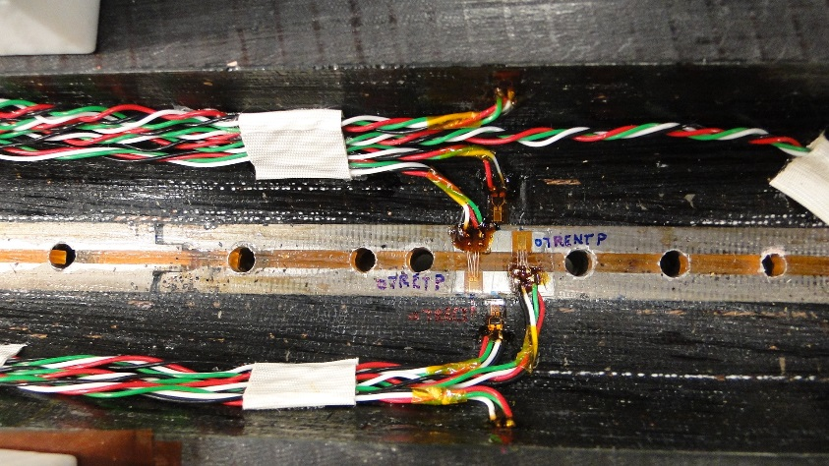

MBH Coil 7 (5)

Slide 28
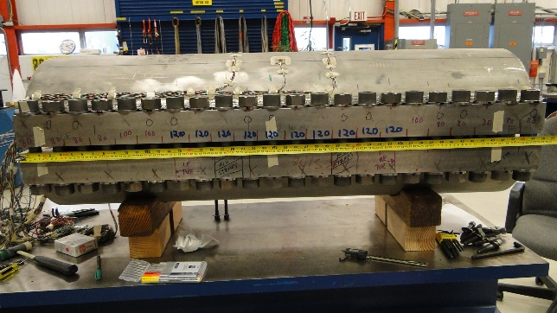

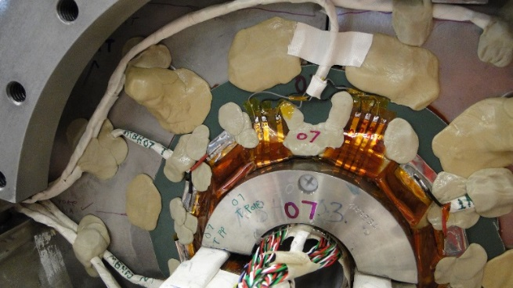


Back up
MBHSP02
MBHSP04

Slide 29


QA

Slide 30

Quench locations (and propagation)
MQXFSM1
(LARP)
Simultaneous start in a3_a4 and
a4_a5 segments, QA signals originate
mostly in segments #1 and #2

Slide 31







Back up
3 kA (from stairsteps)
$$b_{n}=\frac{B_{n}}{B_{2}}∗10000,$$
$$a_{n}=\frac{A_{n}}{A_{2}}∗10000$$
- MBHSP03 harmonics (b3)
at injection vs. Time
- (Harmonics) Decay and
snapback at injection (760 A)
(from accel. cycle)

Slide 32





Back up
Skin SG
Rotated 90°
MBHSP02
MBHSP03
MBHSP03
MBHSP02
During assembly
32

Slide 33




Back up
Bullet SG
MBHSP02
MBHSP03
During assembly
33

Slide 34
Cu
Copper lead
Relevant QD instrumentation above the magnet
V1_VoTapClXXXM_1 : Cu-SC1
XXX=Pos, Neg
SC1
“bs” – before splice
Lambda plate
V1_VoTapSlbsXXXM_1 : SC1-SC2
V1_VoTapSlsXXXM_1 : SC2-M1 (SC2-SC3)
V1_VoTapSlXXXM_1 : SC1-M1 (SC1-SC3)
SC2
splice
Support plate
Sometimes there is no pizza box
When there is: splices between coils
are done at the pizza box
(quarter signals are from there)
WC
Pizza box
SC3
WC is used to define whole/half/quarter
coil signals.
However, often SC3 is close to M1
(and is inside the magnet).
Magnet
(volume)
M1
splice
V1_VoTap***M_1 : M1-M2
is the first segment inside the magnet
M2

