Slide 1
HFM Design Review Quality Assurance / Quality Control
Adam A. Bracero
HFM Design Review
28 April 2016

Slide 2
Introduction
Adam A. Bracero
Manufacturing Process / Quality Engineer
Technical Division
Quality & Materials Department
Process Engineering

Slide 3
What we will cover:
The Process Flow of parts and how Quality Assurance and Quality Control is implemented throughout our processes.

Slide 4
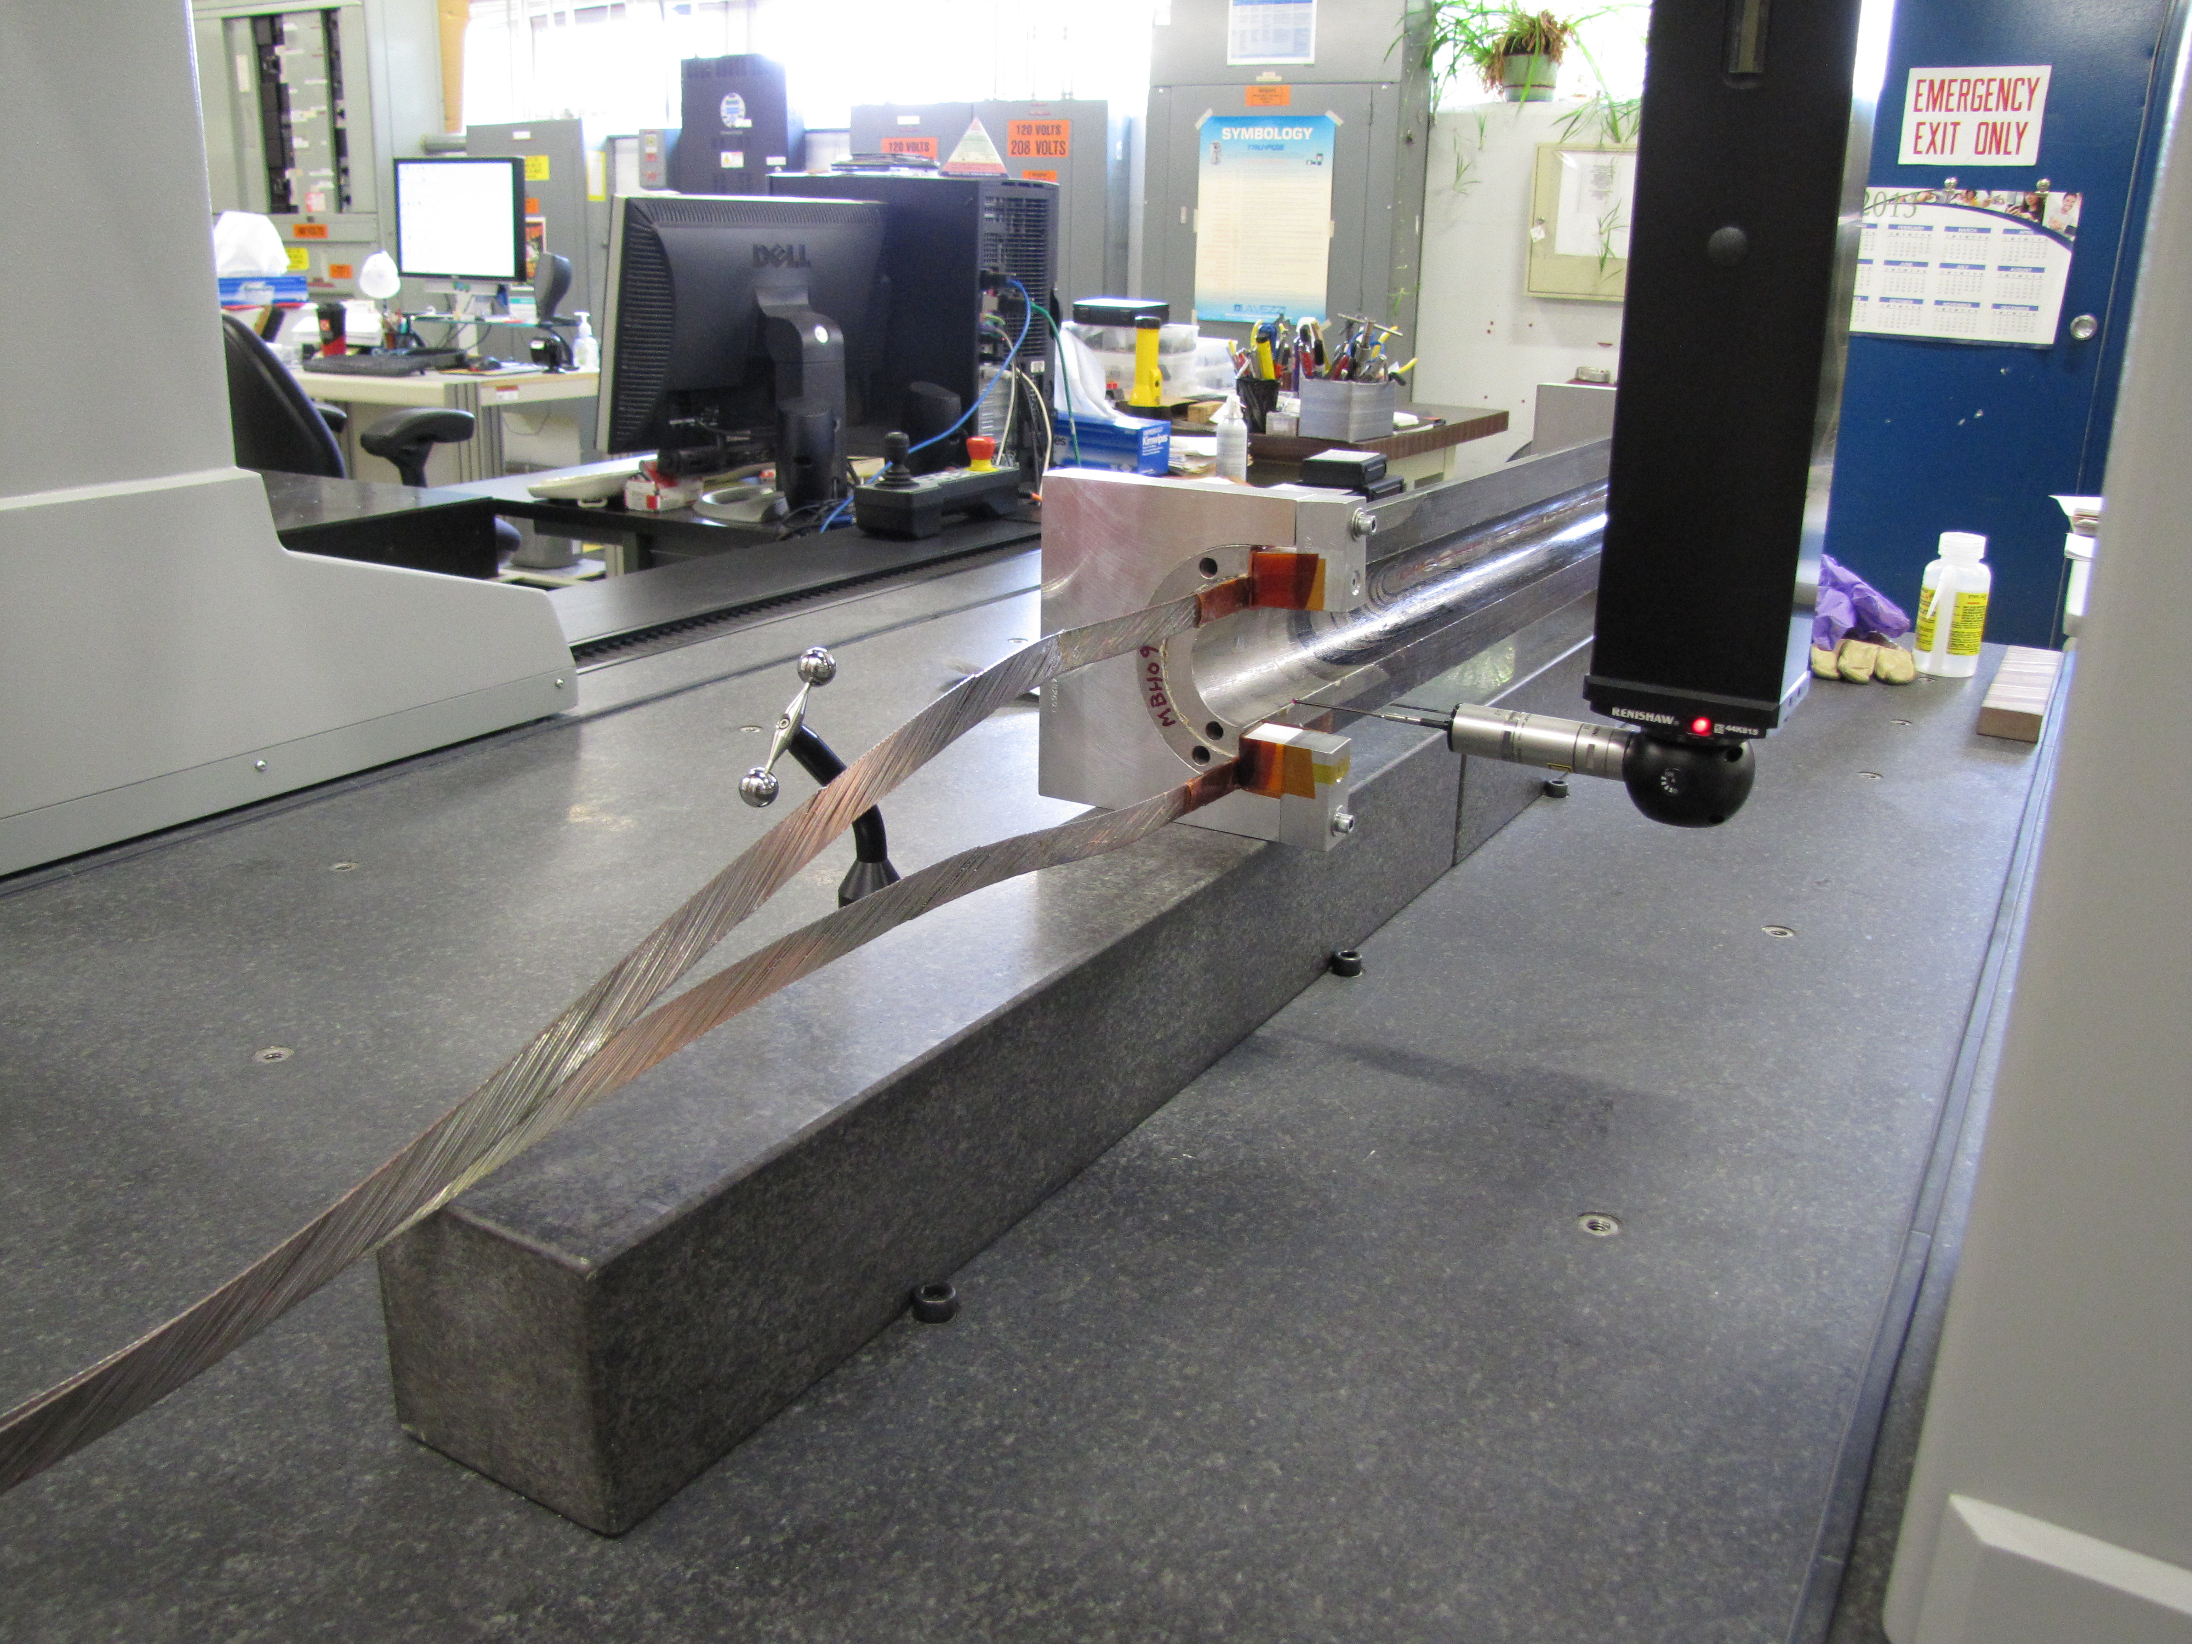
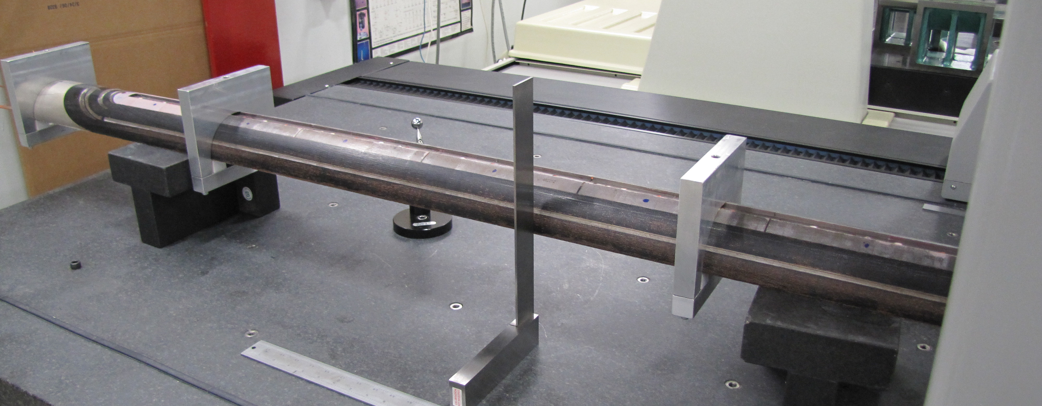
Process Flow
Receiving Department
Quality Control
Parts tested
Spec Reports sent to Project Engineer
11T Coil on CMM
11T Coil on CMM
CMM Analysis

Slide 5
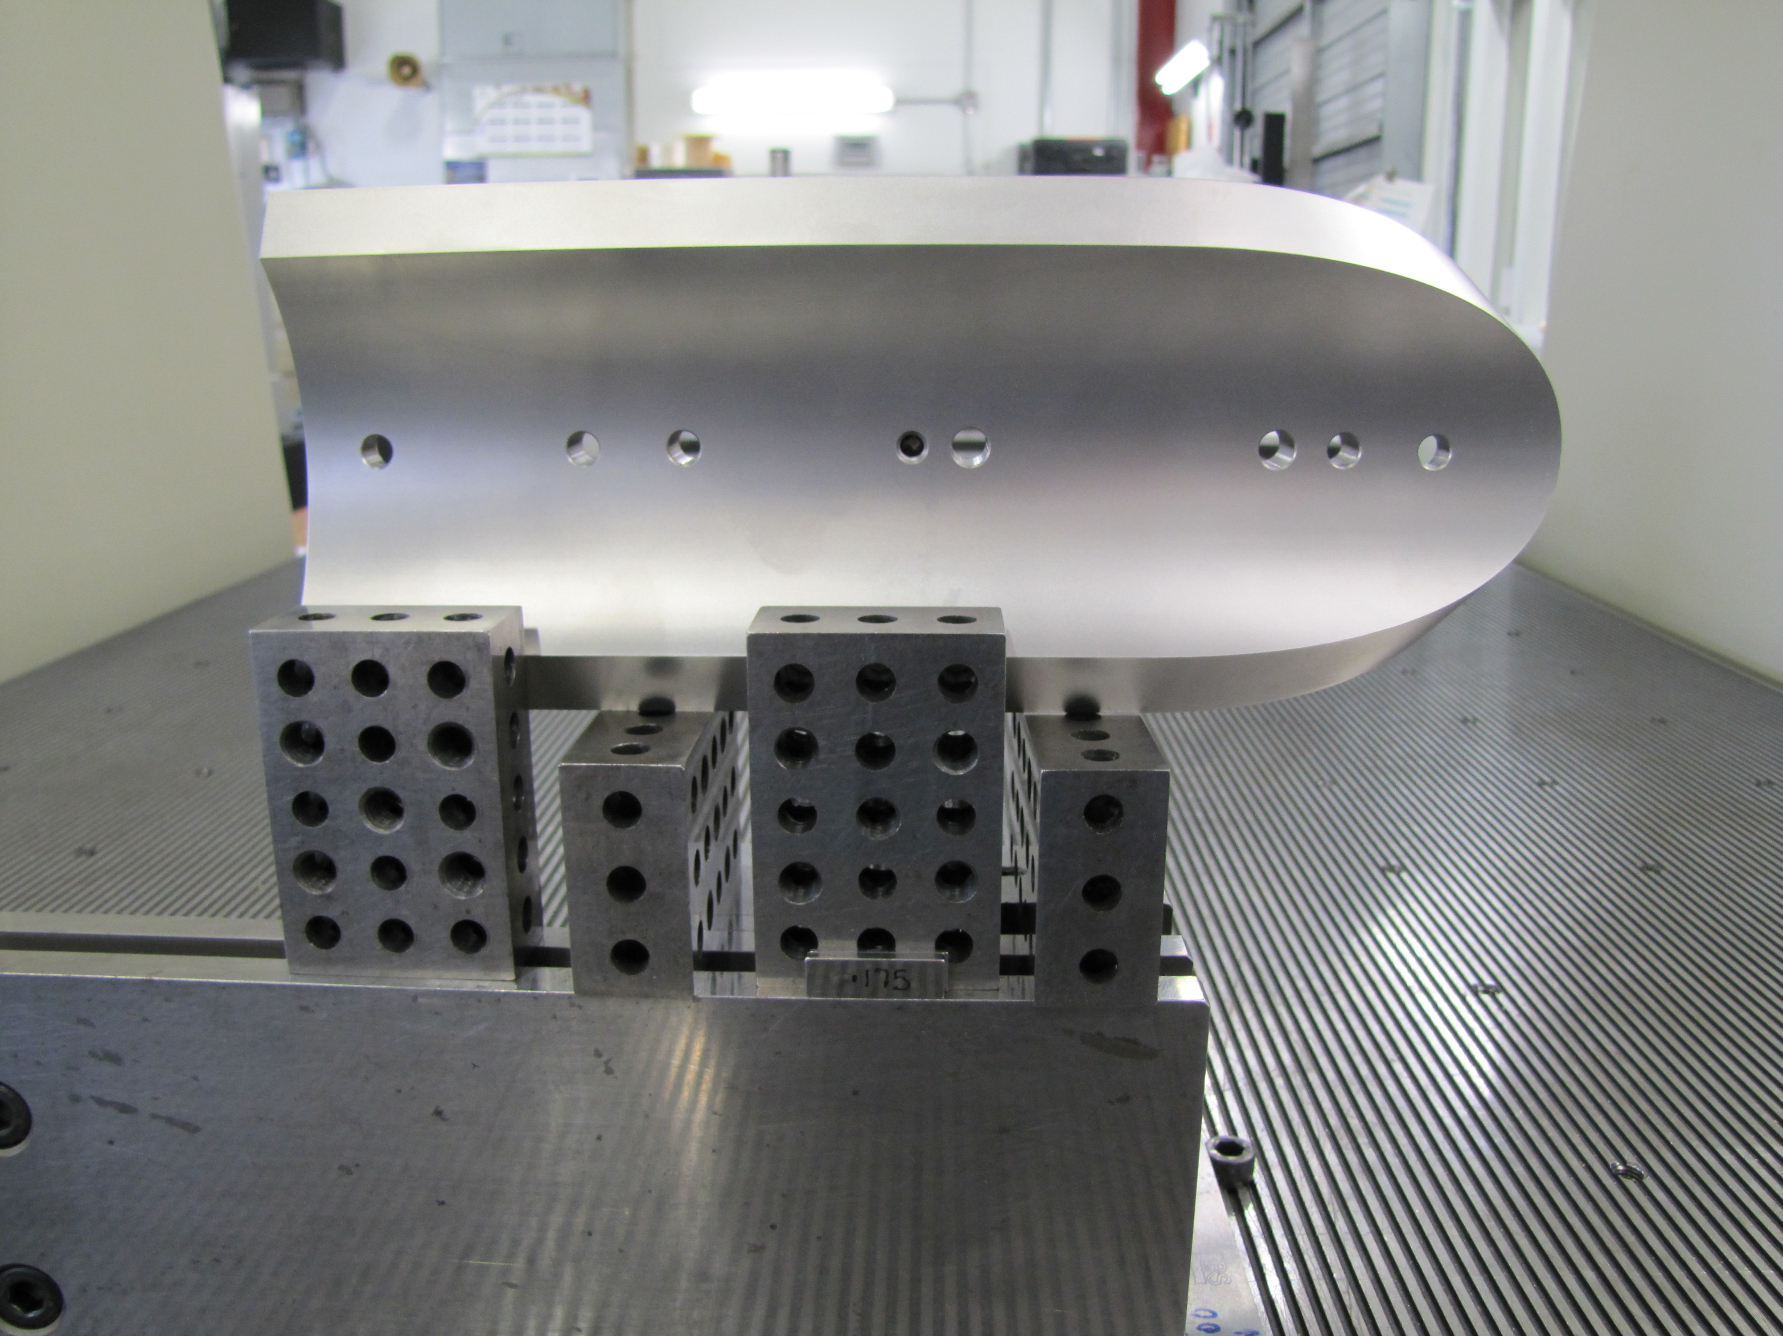
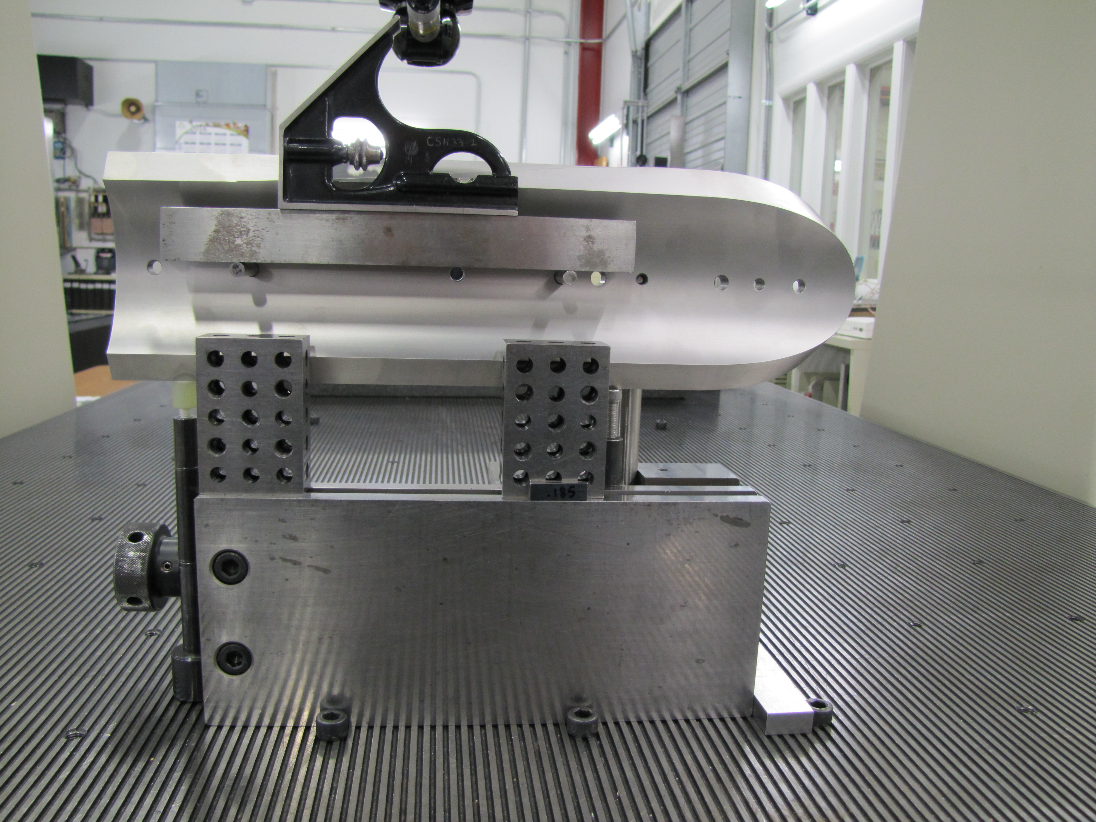
15 Tesla Parts on CMM
L3 RE Pole (F10038775)
L3 LE Pole (F10038776)

Slide 6
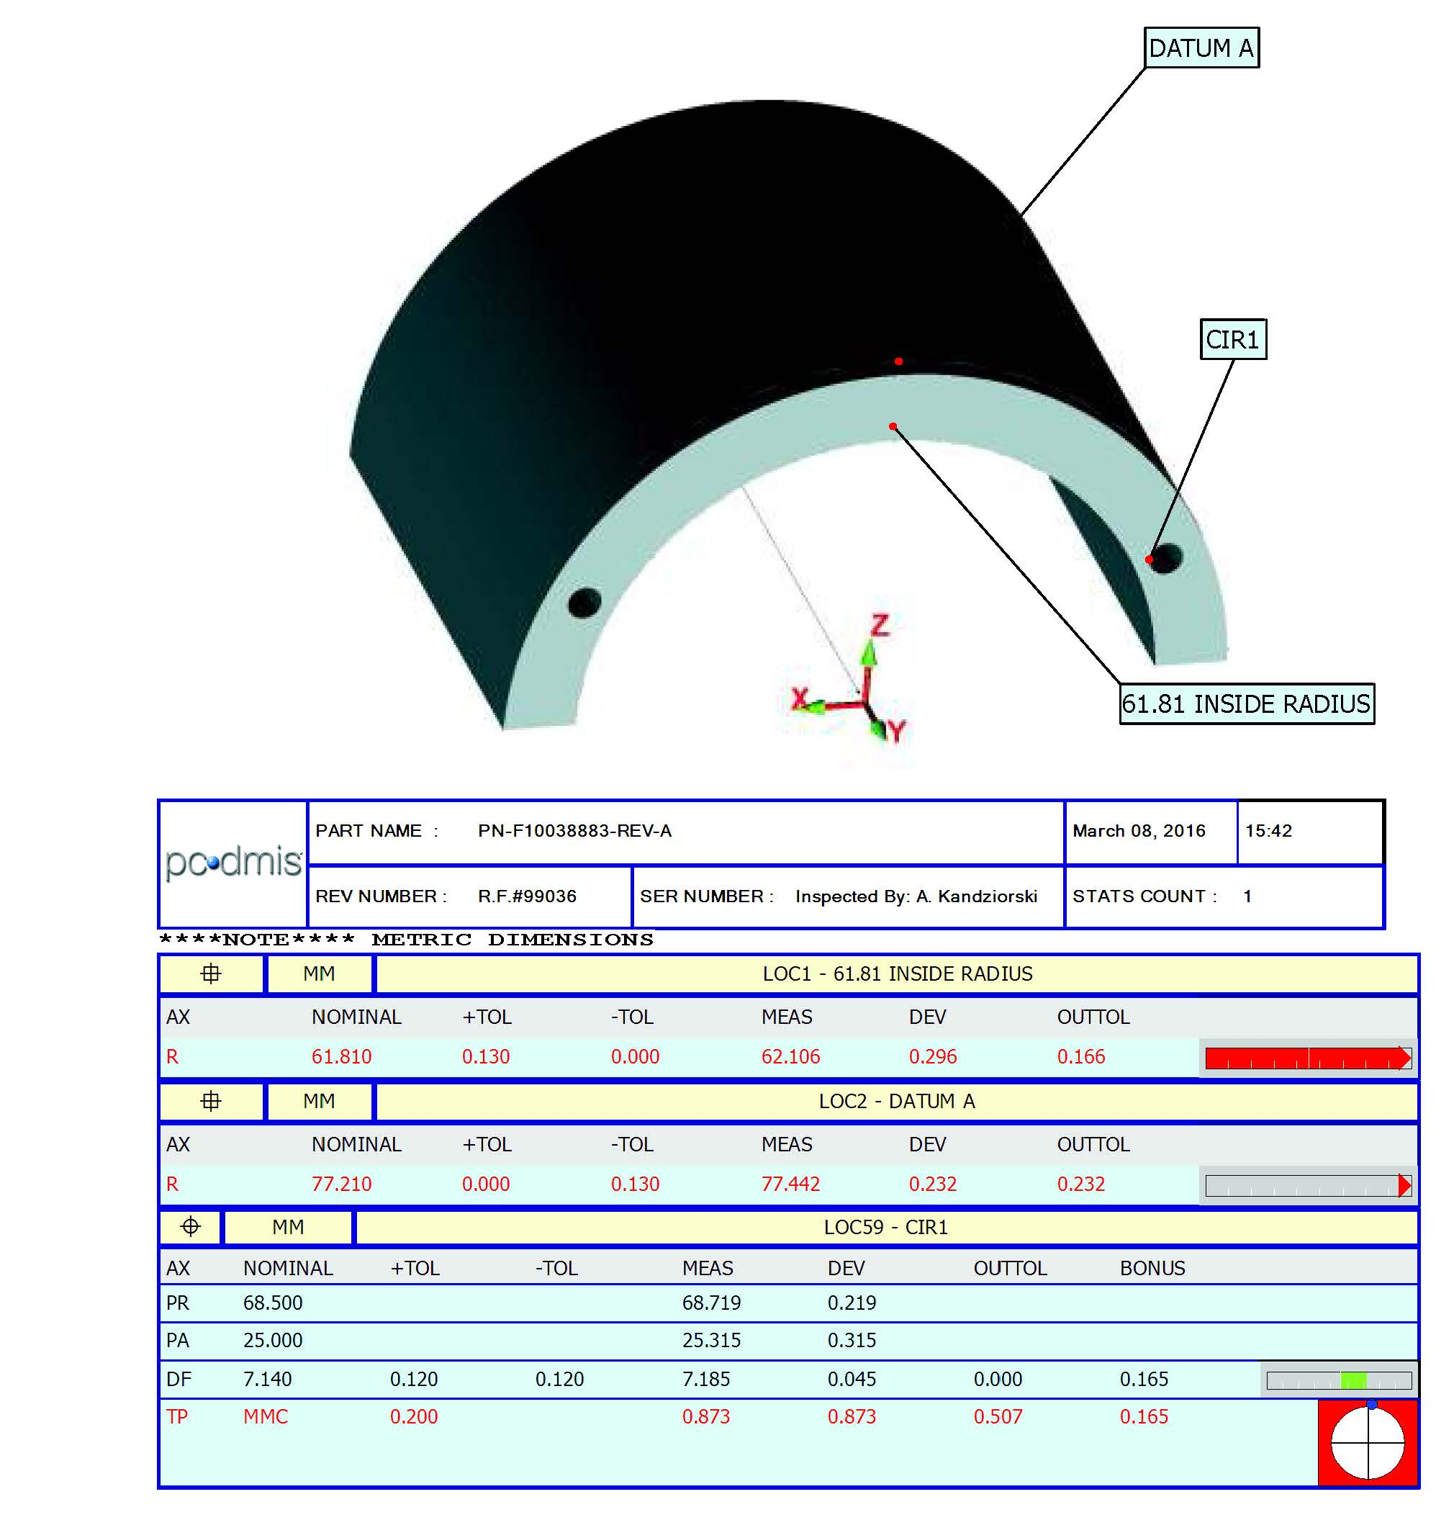
Receiving Department
Quality Control
Proj Engineer Accepts or Rejects
Proj Engineer requests Traveler / Parts Kit from Process Engineering
15T L3 Splice Block (F10038883)

Slide 7
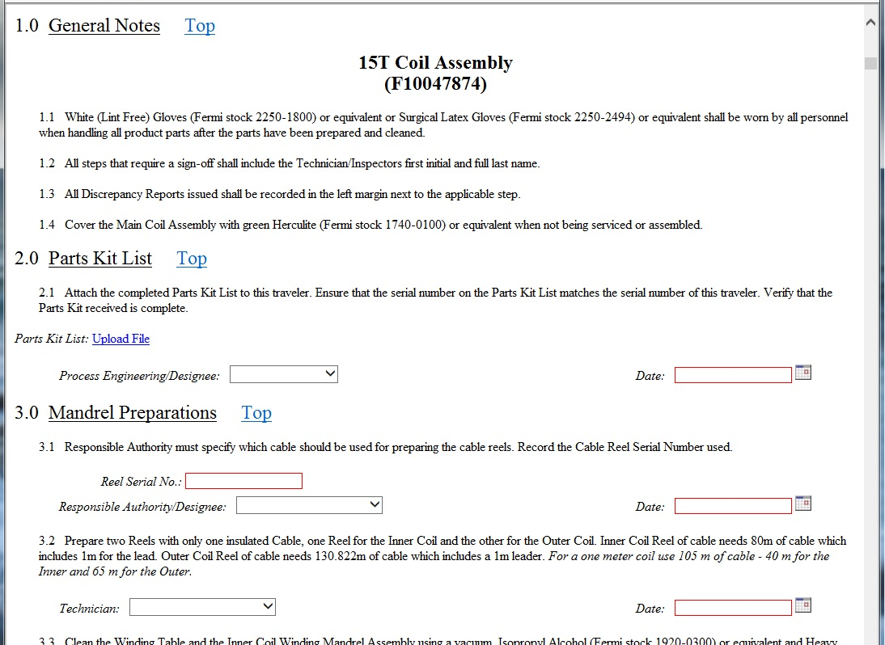
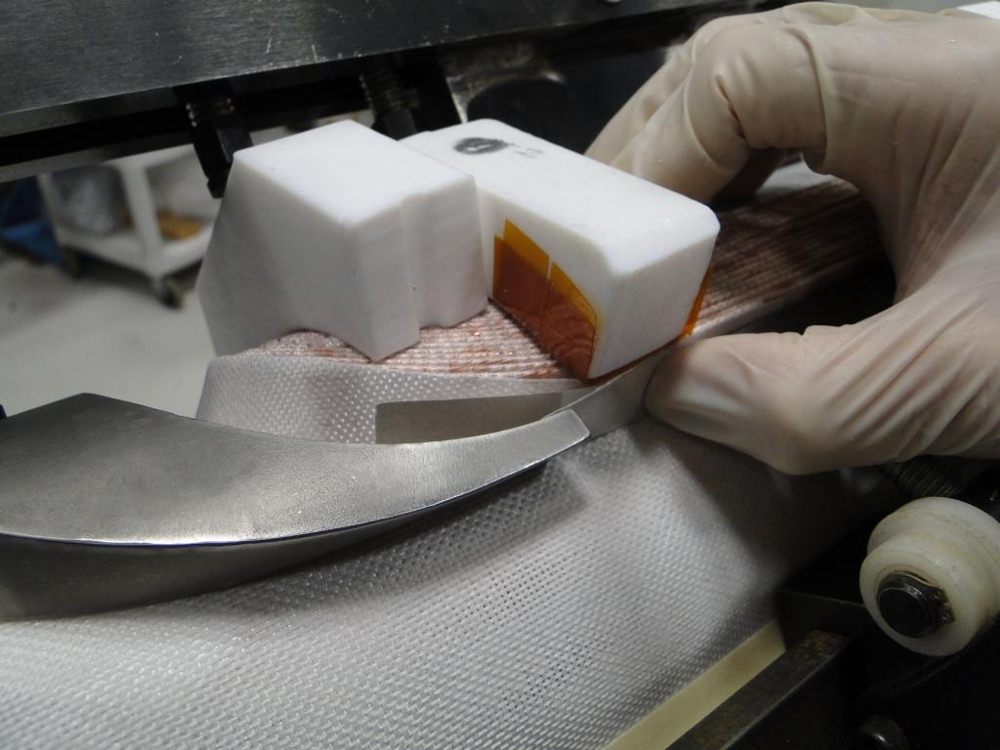
Process Engineering
Traveler Issued
Parts Kit sent to Acquisition

Slide 8
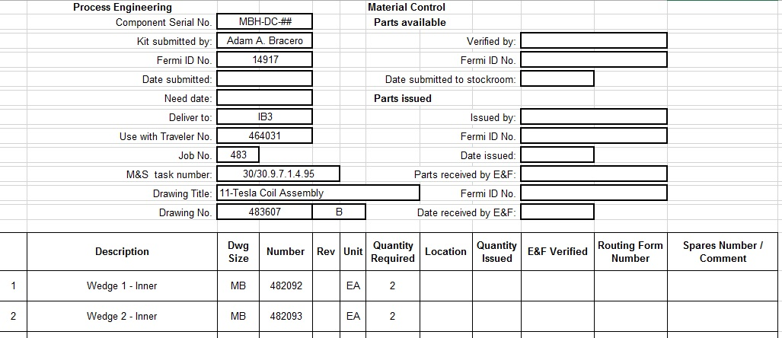
Acquisition
Confirms all parts are in stock
Submits Parts Kit to Receiving - Component Storage

Slide 9
Receiving – Component Storage
Collects all the parts and delivers to Floor
Process Engineering or on-site Tech verifies Parts Kit
Signed and completed Parts Kit is electronically faxed to Process Engineering and attached to traveler

Slide 10
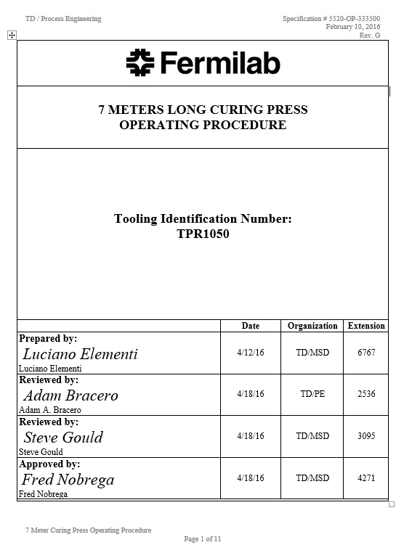
Process Engineering Documentation
Operating Procedures
Instructions for equipment
Tech Training

Slide 11
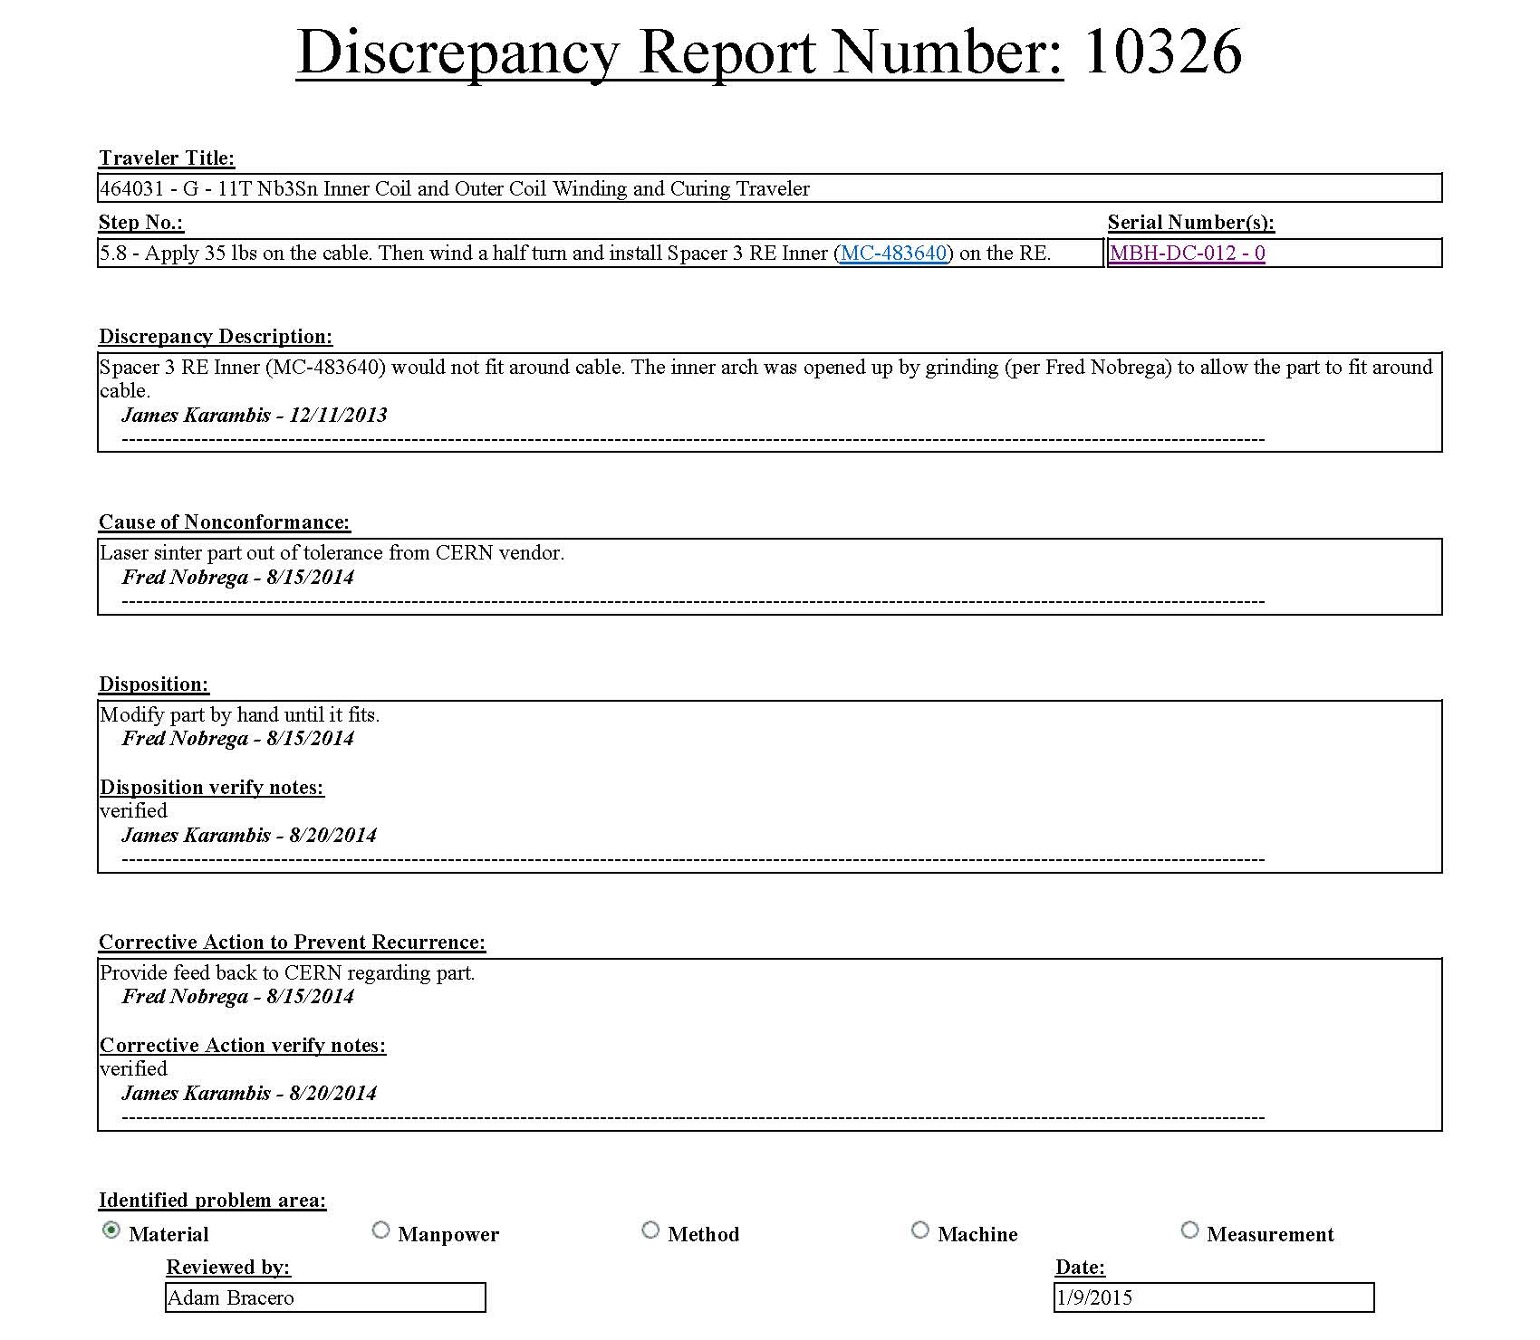
Travelers
Instructs and collects data (photos, test results, notes)
Discrepancy Reports
Process Rework
Traveler Closeout
List of 11 Tesla Travelers:
11T Inner Coil & Outer Coil Winding & Curing Traveler
11T Coil Assembly Reaction Traveler
11T Splice Epoxy Impregnation Traveler
11T Assembly Traveler

Slide 12
Closing
Questions?

