Slide 1
SEY measurement and RFA simulations
Yichen Ji

Slide 2
Table of content
SEY measurement and analysis
  Newest SEY result
  SEY vs time, beam intensity, integrated intensity
RFA related POSINST simulations
  SEY, intensity scan
  Analysis based on simulation result and RFA data
Future works

Slide 3
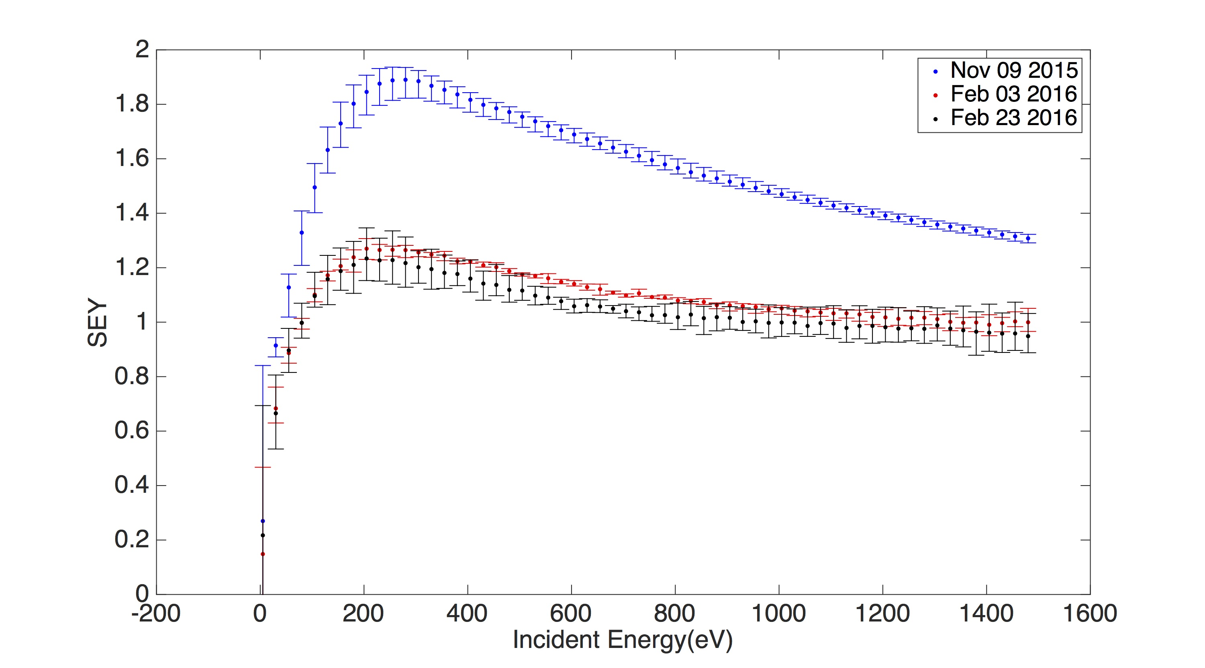
TiN

Slide 4
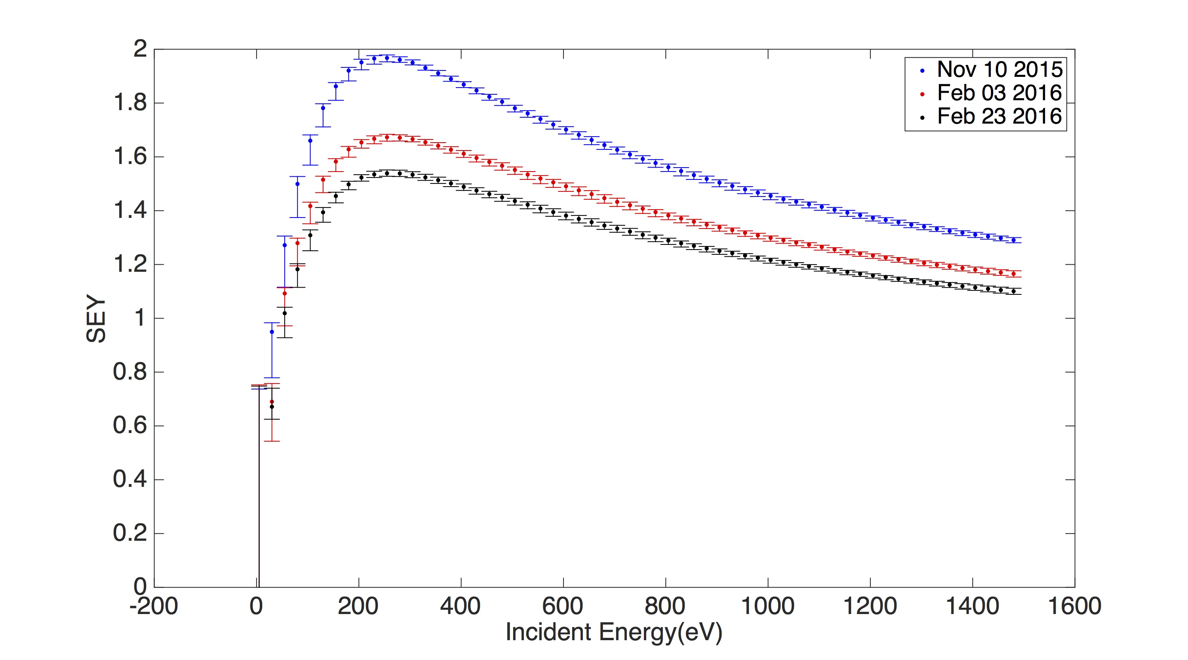
Stainless steel

Slide 5
Intensity Hisory

Slide 6
SEY over time

Slide 7
SEY over Beam Intensity

Slide 8
SEY over Integrated beam intensity

Slide 9
RFA related simulation

Slide 10
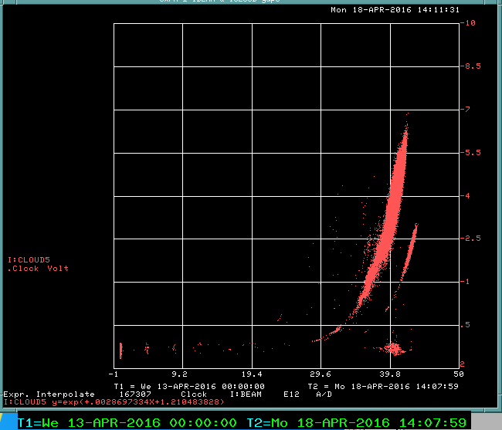
RFA signal to bombardment rate fudge factor estimation
Based on RFA circuit
  1V~1.4e8#/s/cm²
  off by one order of magnitude
Turned on RFA amplifier on April 11th
  Factor of 8 change in fudge factor
Based on POSINST and Feb 23rd SEY measurement
  Before Apr 11th 1V~4.2e13#/s/cm²
  After Apr 11th 1V~5.3e12#/s/cm²
Rule of thumb: 1C/m² causes a noticeable change in SEY
  6e14#/cm²
Estimate current SEY
  1.4

Slide 11
Future work
More SEY measurement
  Conclude The TiN experiment
  Compare with the SEY estimation
More accurate RFA simulation
  Details such as bunch length, beam size, bunch structure, better SEY curve, Magnetic field and etc.
  SEY condition publications

