Slide 1
APA Design Review Introduction
Robert Paulos and
Mitch Soderberg
July 13 -14, 2016
Physical Sciences Lab
University of Wisconsin - Madison

Slide 2
Topics
Introduction
History
Organization
Schedule

Slide 3
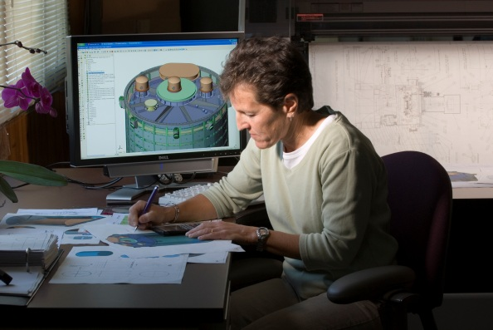
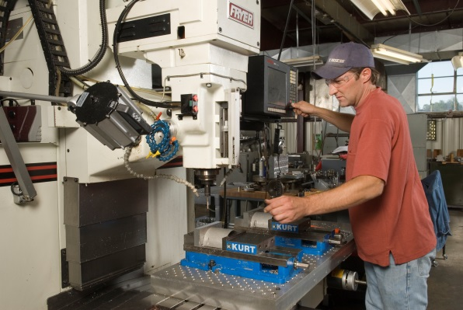
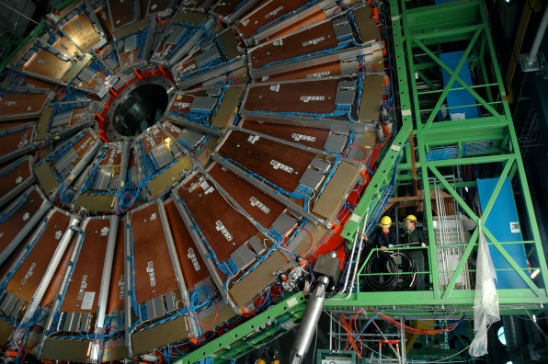
Welcome to PSL!
Our priority is to collaborate with researchers Worldwide in the development of unique, high value instrumentation. We have five decades of experience in a broad range of activities from: conceptual design, detailed engineering design and analysis, prototyping, testing, calibration, project management, system engineering, proposal development, integration, instrument fabrication, and assembly.
http://www.psl.wisc.edu/

Slide 4
Some current and past projects at PSL:
CMS
IceCube
Daya Bay
DUNE
LZ
Pulse Burst Laser Systems
SBND

Slide 5
Review Charge
1. Does the APA design meet the requirements? Are the requirements/justifications sufficiently complete and clear?
2. Are APA risks captured and is there a plan for managing and mitigating these risks?
3. Does the design lead to a reasonable production schedule, including QA, transport, installation and commissioning?
4. Does the documentation of the APA technical design provide sufficiently comprehensive analysis and justification for the APA design adopted?
5. Are all APA interfaces to other detector components and cryostat documented, clearly identified and complete? Does the TPC integrated 3D model adequately represent the mechanical interfaces to the APAs and between adjacent APAs?
6. Are the APA 3D model, top level assembly drawings, detail/part drawings and the material and process specifications sufficiently complete to demonstrate that the design can be constructed and installed?
7. Does the design provide adequate signal response characteristics? Is it optimized for the proposed electronics? Is the grounding and shielding of the APA understood and adequate?
8. Are operation conditions (loads and temperature) listed, understood and comprehensive?
9. Are the APA engineering analyses sufficiently comprehensive for safe handling, installation and operation at the CERN Neutrino Platform? Is the installation plan for the APAs sufficiently well developed? Is the design for the installation tooling adequate for installation of the APAs?
10. Does the APA quality assurance plan include applicable and sufficient features of internationally recognized quality programs? Have applicable lessons-learned from previous LArTPC devices been documented and implemented into the QA plan? Does the plan appropriately account for APA production at multiple international sites with different standards (metric/imperial) for available stock materials?
11. Are the APA quality control test plans and inspection regimes sufficiently comprehensive to assure efficient commissioning and safe and operation of the NP04 experiment? Does the QC plan appropriately account for APA production at multiple international sites?

Slide 6
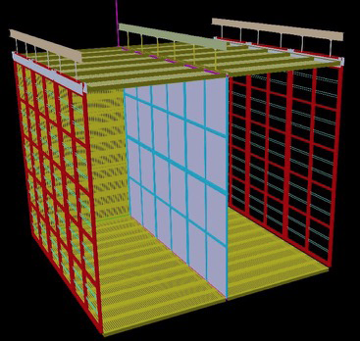
What is the ProtoDUNE Single Phase TPC?
Anode planes
Three anode plane assemblies hung
vertically, side-by-side
Field cage –
top, bottom,
and ends
3.6 m drift
Cathode plane assembly
Between APAs

Slide 7
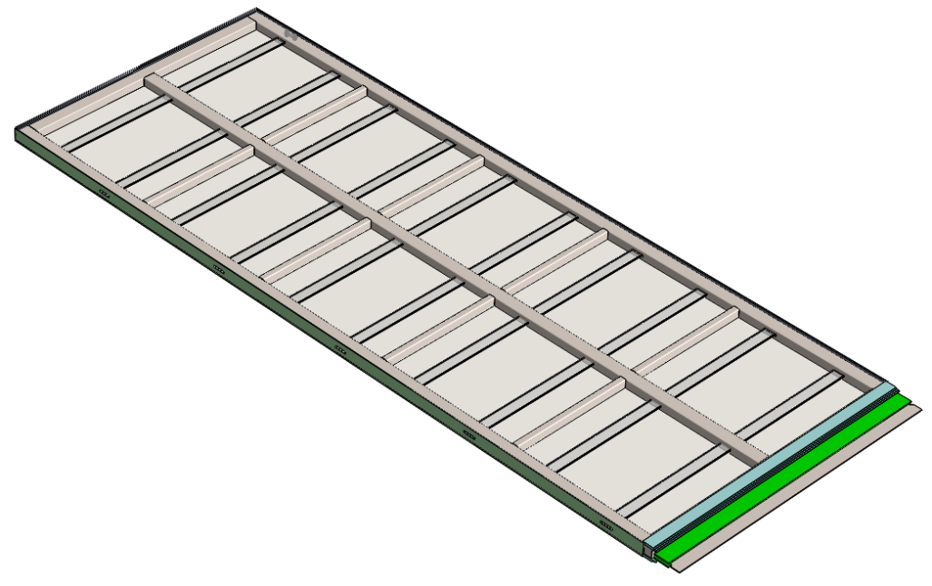
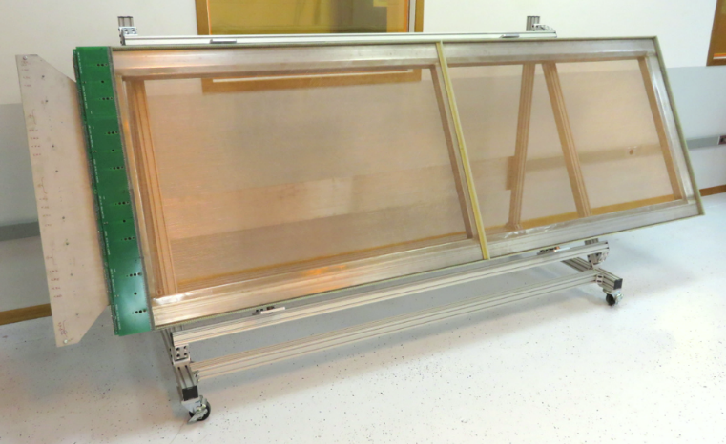
The Anode Plane Assembly “APA”
The APA consists of a stainless steel frame with 4 planes (on both sides) of BeCu wires supported above its surface.
6m long x 2.3m wide
Much more on this in subsequent talks!
CAD model of full-sized APA
Photo of 40% size prototype APA - built at PSL

Slide 8
History of APA Development at PSL
PSL started collaborating with BNL and FNAL on APA R&D in 2011
We have already built:
40% of full size prototype (2012)
Four functioning prototypes, varying lengths, for the 35T test. These are approximately 20% of full width. (2014)
One full size welded steel frame prototype and two modular full-scale frames
We have developed techniques for:
building frames
adding mesh and combs
winding wires
monitoring and testing of fabrication steps
safe over-the-road transport
Considerable analysis and testing has been done on:
frame strength and distortion
frame and electronics compatibility with cryogenic temperatures
long term stability of wire anchoring methods
layer transparency to electrons as a function of wire plane voltages

Slide 9
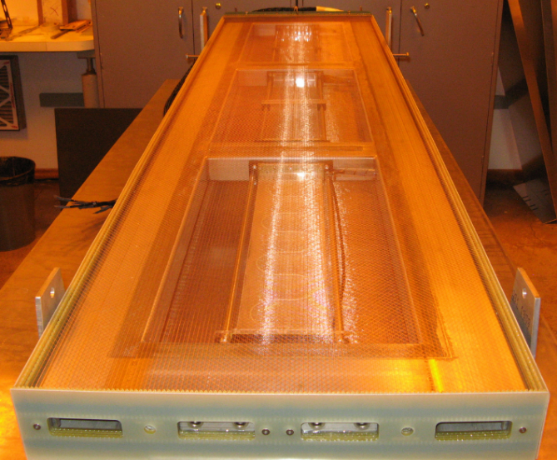
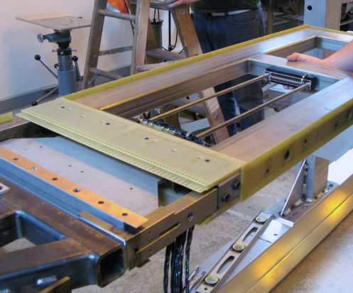
Fabrication – Prototypes
The upper left shows the 40% APA constructed in 2012.
The image above is of one of the four 35T prototype APAs constructed in 2014.
At left is one of the 35T APAs during the fabrication process.

Slide 10
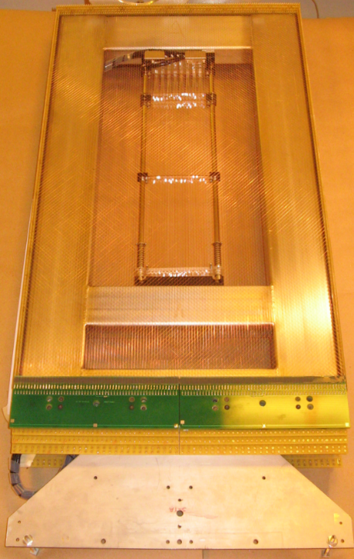
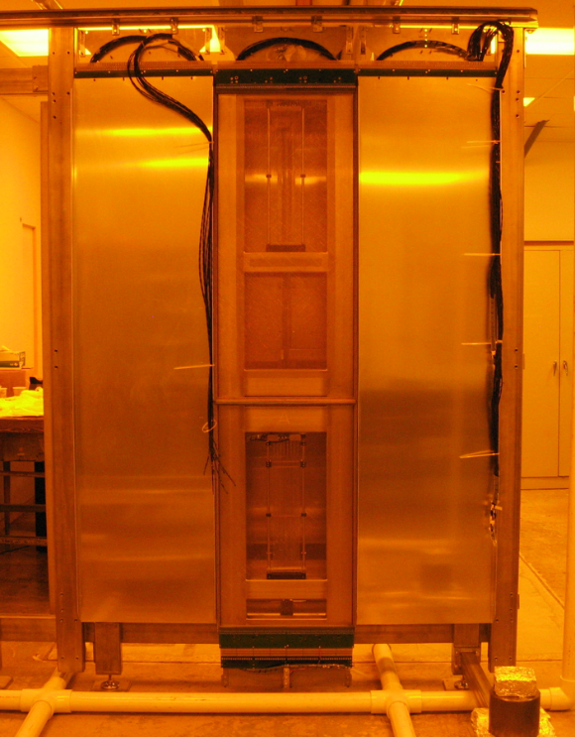
35T Prototype APAs
Long APAs on either side – covered for protection
A small APA for test. 20% of full - scale width.
Small APA hanging in APA plane in trial assembly of 35T TPC.

Slide 11
Organization
The organization has increased its technical and scientific capability with new support from the United Kingdom, Syracuse, UTA, and Yale
Coordination and management is a joint effort between Mitch Soderberg and Bob Paulos.
Mitch; Collaboration coordination and scientific leadership, strong experience in LAr technology
BobP; management and technical support, experience in management and instrumentation development
Bo Yu provides technical and scientific guidance to the team and plays an important leadership role working with Mitch and Bob.
The UK protoDUNE effort was recently funded and will allow us to produce 3 of the 6 planned APAs there!!
Coordinating the two efforts will be a challenge – however, we have a simple plan to duplicate efforts started in the US to minimize new engineering development
Discussions have just started between the two groups, a plan will be developed on how to efficiently share resources and documentation in the next two months.

Slide 12
APA Coordination and Management
Mitch Soderberg - Convener, Syracuse University
Robert Paulos - Manager, UW-Madison PSL
Bo Yu – TPC Project Scientist, Brookhaven National Laboratory
Michelle Stancari, Fermilab
A. Szelc, University of Manchester
Physical Sciences Lab
Univ. of Wisconsin
QA and Testing
Jonathan Asaadi –
Univ. of Texas Arlington
UK APA Production
Justin Evans
Alan Grant
Christos Tourananis
Universities & Labs
Manchester
Sheffield
Liverpool
Lancaster
Daresbury
Engineers
Lee Greenler
Dan Wenman
Ken Kriesel
Andy Laundrie
Bill Mason
Kevin Koehler
Bb7 - contractor
Technicians
D. Hamilton
Mary Severson
Greg Vlasic
Fabrication
and Test Support
Serhan Tufanli
Yale University
Students
Jake Nesbit
Barb Birittella
Lexi Oxborough
Tyler Doering
Tyler Trickle
Matt Szekely

Slide 13
ProtoDUNE APA Summary Schedule

