Slide 1
TPC Signal Formation and Processing
Xin Qian
BNL
APA Review
July 13th 2016

Slide 2
Outline
TPC Signal Formation
TPC Signal Processing
Electronic Noise
Ongoing Work

Slide 3
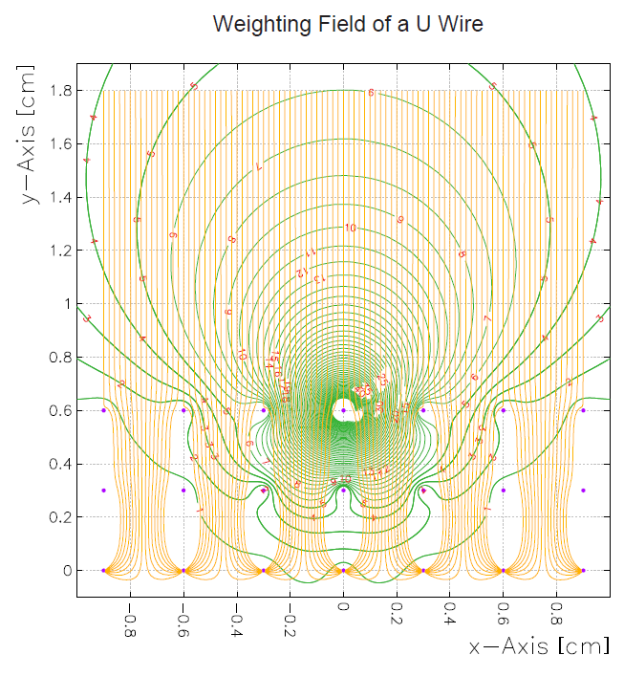
Single-Phase TPC Signal Formation
Weighting Potential of a U Wire
Number of ionized electrons
Shockley–Ramo theorem
Field Response
Example
Signal on Wire Plane
Electronic Response
v_{q}: velocity
E_{w}: weighting field
q: charge
Signal to be digitized by ADC
(Charge Extraction)
Number of ionized electrons
Induction plane signal strongly depends on the local charge distribution, collection plane signal is much simpler

Slide 4
Example I: ideal track (uniform charge density)
Black lines are used to illustrate the wire boundary (+- half wire pitch)
Q
Collection plane signal
Q_{eff}
Time
Taking into account distance effect for induction plane signal
Time
Q_{eff}
Time
Taking into account induced signal from charge passing through next wire

Slide 5
Now look at the raw signal after convolute with bi-polar signal
Q
Q_{eff}
Collection plane
Effective charge in Induction plane
Time
Time
Q
Q_{eff}
Induction plane
Raw signal in induction plane
Time
Time
In the middle, the raw signal will be close to zero due to the cancellation of bipolar response function
If the signal is rising slowly, the net contribution on the raw digit will be small, however the signal will be long
The induction plane signal can be very small in height → importance of data compression scheme
No such complication for collection plane
Notes:
Collection plane is good
Induction plane …
Direct them to the content
No zero suppression in data compression scheme

Slide 6
Outline
TPC Signal Formation
TPC Signal Processing
Electronic Noise
Ongoing Work

Slide 7
1-D Deconvolution
Time domain
Good for Collection plane
There is NO universal “average” response function for induction plane
A deconvolution assuming universal response function would lead to gaps in the images which CANNOT be explained by the dead channels
Vertex activity
EM shower
Track with various angles
Fourier transformation
Frequency domain
Back to time domain
Anti-Fourier transformation
Notes:
Explain
1. What is filter like in the frequency domain?
2.Why filter is necessary (e.g. plot results w and w.o. filter )
3. Why we need a zero at zero frequency?

Slide 8
2-D Deconvolution
With induced signals, the signal is still linear sum of direct signal and induced signal
R₁ represents the induced signal from i+1th wire signal to ith wire
S_{i} and S_{i+1} are not directly related
The inversion of matrix R can again be done with deconvolution through 2-D FFT

Slide 9
Just 2D deconvolution will not be enough → ROI + Adaptive Baseline
The bi-polar nature of induction signal amplify the low-frequency noise during deconvolution
One can improve the situation through ROI (Bruce Baller, Robert Sulej) and adaptive baseline technique (M. Mooney)
Given N time bins with 2 MHz digitization frequency,
The highest freq. is 1 MHz
The lowest freq. (above 0) is 2/N MHz 200 bins → 10 kHz
Obviously not sensitive to noise < 2/N MHz
Adaptive baseline → linear baseline correction instead of flat baseline correction

Slide 10
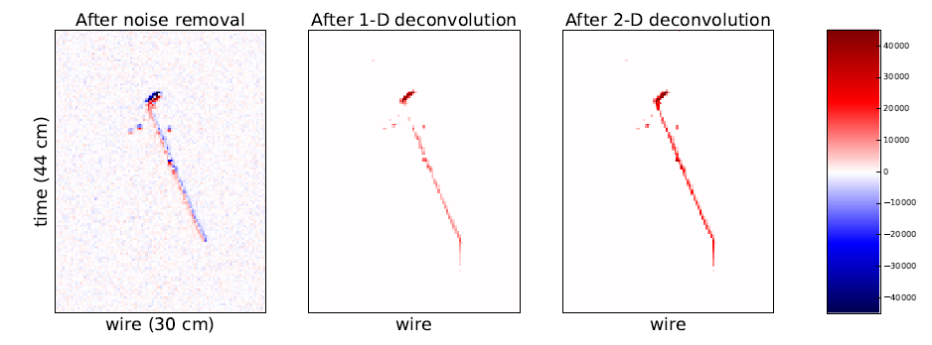
Example Event Display
MicroBooNE Preliminary
After removing excess noise
V plane
Significant improvements achieved in the signal processing
Notes:
After (excess) noise removal

Slide 11
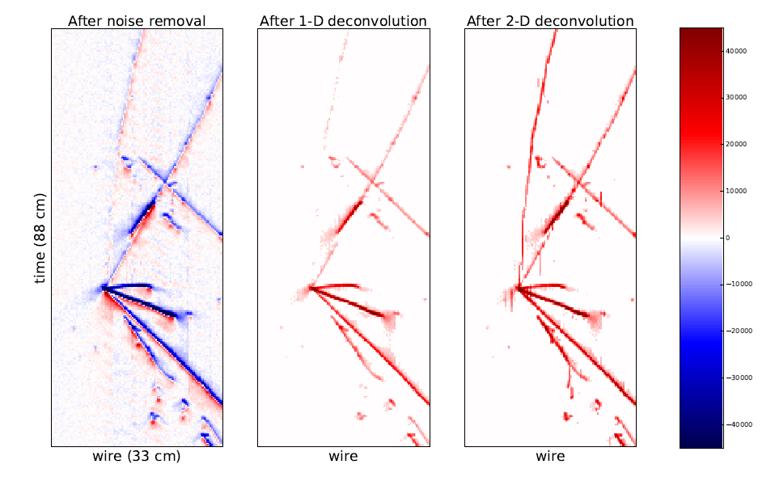
Example Event Display
U view
MicroBooNE Preliminary
After removing excess noise
U plane
Notes:
Added the view

Slide 12
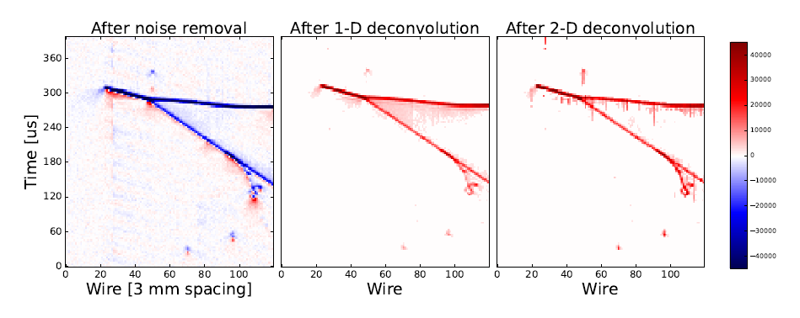
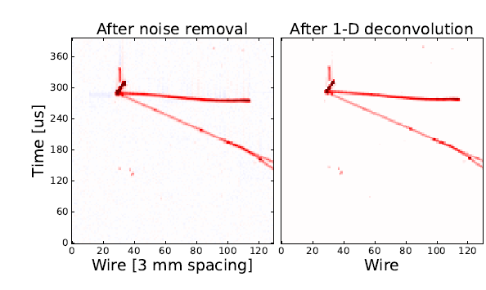
After removing excess noise
U plane
After removing excess noise
MicroBooNE Preliminary
2D deconvolution is not needed for the collection plane signal
Y plane

Slide 13
Outline
TPC Signal Formation
TPC Signal Processing
Electronic Noise
Ongoing Work

Slide 14
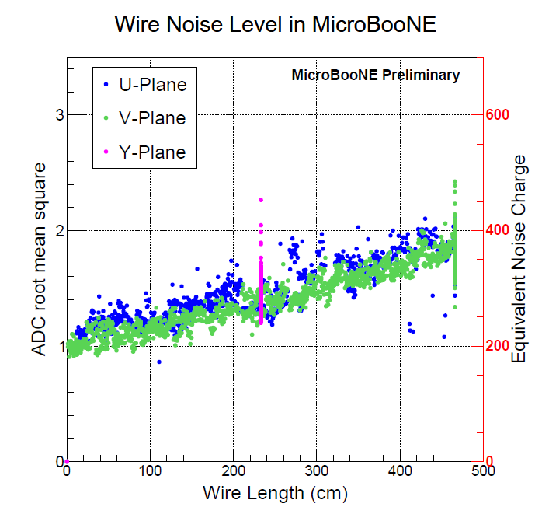
Noise Performance in MicroBooNE
ENC after (excess) noise filtering is consistent with the expectation!
Projected protoDUNE noise 500-600 e⁻ due to longer wire length
Notes:
Choice of Wire Technology (two slide)
Noise performance slide …

Slide 15
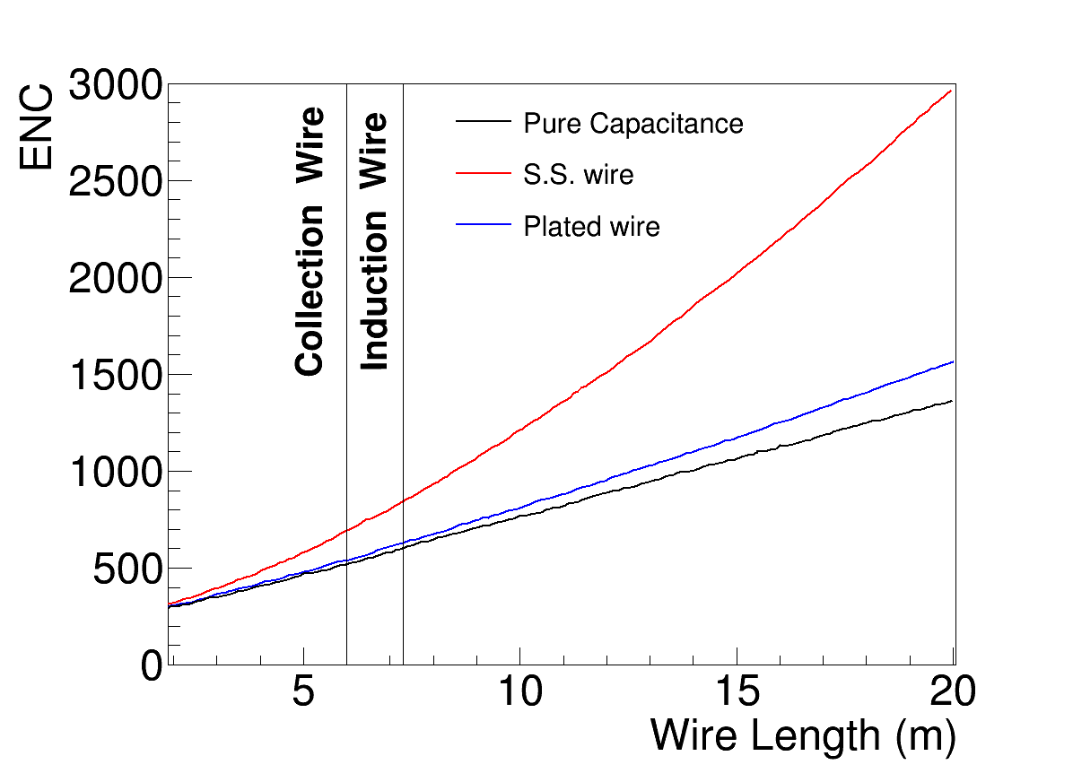
Projected Noise Performance in ProtoDUNE
MicroBooNE: Cu-Au plated stainless wire
Much lower resistance than stainless wire
DUNE: Copper-beryllium wire
Similar resistance as Cu-Au wire
Much lower cost
Slight worse strength, but mitigated by the mechanical structures (i.e. spacers)
2

Slide 16
Excess Noise in LArTPC
Beyond intrinsic electronic noise
Noise from power supplies
Noise from LV regulator (MicroBooNE + 35 ton) → hardware fix is in order
Noise from HV power supply (MicroBooNE), existing filter is not enough, additional filter is in order
Pick up noise → better shielding and grounding
900 kHz noise in MicroBooNE (burst noise outside cryostat)

Slide 17
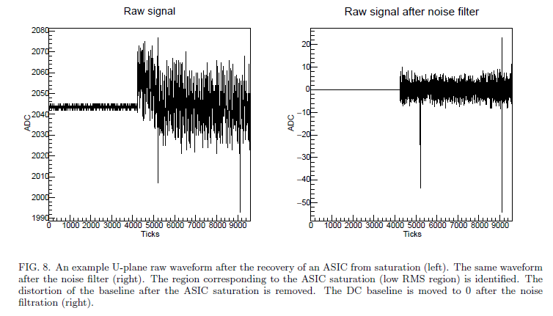
Microphonics
Wire motion inside E-field due to liquid motion (< 20 Hz)
Beyond the dynamic range of the signal → not contributing to the noise level
However, can lead to periodic ASIC saturations
O(10) channels in MicroBooNE at 500 pA leakage current setting
After removing excess noise
ASIC saturation
Notes:
Use Veljko’s slide

Slide 18
Improvement in DUNE APA design
A grid plane is added in front of the first induction wire plane (Mitch’s talk)
Reduce impact of long-range induced signal
Reduce impact of potential noise from HV power supply
Spacers are added to support wires to reduce the vibration of the wires
1.5 m in DUNE instead of 5 m long wires in MicroBooNE
A mesh plane is added behind the collection plane to suppress signal from behind (Mitch’s talk)
Also more leakage current settings are added to the frontend ASIC (1 nA and 5 nA) for ASIC saturation due to wire motion
500 pA one is still the likely one to use

Slide 19
Summary of TPC Signal Processing
 | Longitudinal (Drift) | Transverse
Digitization length | 0.8 mm | 3-5 mm
Diffusion (σ) | <1.7 mm | <2.4 mm
Electronic Shaping (σ) | 1.3 mm | N/A
Field Response Function | ~1.1 mm (derived) | 3-5 mm
Based on MicroBooNE, we estimate DUNE with change in wire length and wire pitch
MIP (2.1 MeV/cm) moves parallel to wire plane and perpendicular to wire@anode
(Peak Height)/(Noise σ) ratio for collection plane ~ 68:1 (~40:1 based on 35-ton experience)
(Peak Height)/(Noise σ) ratio for induction plane ~ 17:1
For Induction plane, the above ratio
Decrease with angle to the wire plane (0 degrees for parallel)
Increase with smaller angle to the wire (90 degrees for perpendicular)
Finite electron lifetime will reduce the above ratio

Slide 20
A word about unusable channels
The expectation of dead electronics is O(0.1%) (ATLAS, Lariat)
Currently, MicroBooNE have ~4% cold preamplifier dead due to startup problem, ~6% of cold ADC having problem in 35 ton, expected to be improved with improved design, rest of dead channels are due to disconnected wires or integration issues
In Single-phase APA, the dead region is dominated by APA gap (2 cm / 2.3 m + 7.5 cm/ 7.2 m) with about 1.9%
The volume efficiency due to unusable channels can be estimated as ~ ε³
The goal of unusable channels is O(0.1%)
The requirement of unusable channels is < ~0.6%

Slide 21
Metrics for Signal Processing
There are only two solid metrics can be used to evaluate the noise and signal processing
ENC (equivalent noise charge) → basically proportional to the pedestal RMS in terms of ADC
Straight forward for collection plane, but not enough for induction plane
DNC (deconvoluted noise charge) for induction plane, can be compared with the number of ionized electrons from real signal, it depends on
ENC (noise level) and frequency content
Response function used for deconvolution (field response for the real signal)
Time window (band width)

Slide 22
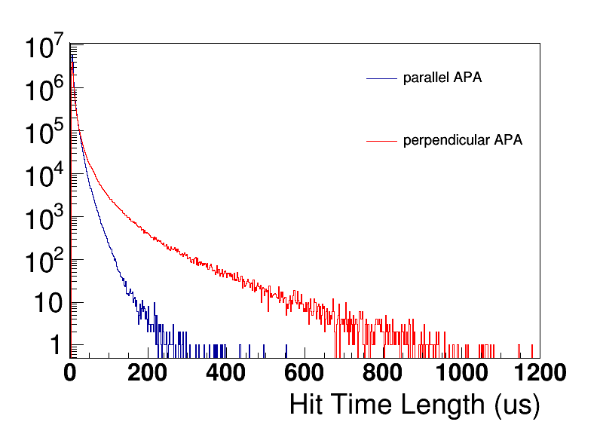
Simulated Induction DNC Results
MIP traveling 3.2 mm assuming no attenuation
Smallest signal is a MIP 3.2 mm (2 us) track segment perpendicular to the wire plane (i.e. wire pitch is ~ 5 mm)
Given the expected signal length, for the smallest signal that we can have for induction, expect a 4~8:1 signal to noise ratio
Factor of ~2 margin exists for electron lifetime and electronic noise before hit inefficiency entering

Slide 23
Outline
TPC Signal Formation
TPC Signal Processing
Electronic Noise
Ongoing work
Notes:
Ongoing work …
Mesh plane will suppress
Grid plane will suppress

Slide 24
What are these shadows?
After removing excess noise
U plane
After removing excess noise
MicroBooNE Preliminary
V plane

Slide 25
Brett Viren (BNL) , also Leon Rochester (SLAC)

Slide 26
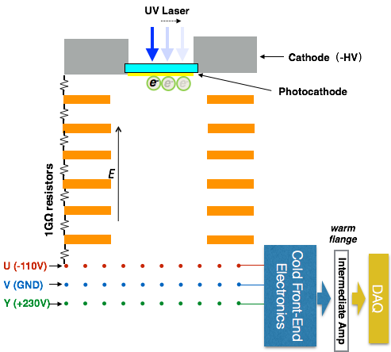
Requirements of a Field Response Calibration System
A bright point-like electron source is favored
The multiple known source positions are crucial
The electron spot is close to the wire plane to limit diffusions
Averaging is needed to minimize electronic noise → trigger is desired
Distortion by digitization must be minimized
Negligible influence on the drift field
Yichen Li
We will perform direct calibration of field response with photocathode driven by pulsed laser → better understanding the induction signal
Notes:
Add a plot to estab
Add a slide for the charge …

Slide 27
Summary
The design of DUNE APA benefits from the experience of noise and TPC signal processing from MicroBooNE and ICARUS
We have figured out a robust way to do TPC signal processing to extract time and charge information from both collection and induction wire planes
3D field calculation and direct calibration of the field response are in progress → better understanding the induction signal
Minimizing noise and disconnected wires is the key to success!
Aim at O(0.1%) unusable channels (requirement < 0.5%)
Reaching expected noise level is the key to reach high quality performance for the induction plane signal (collection is much better)
Need to evaluate revising the 3 ms lifetime requirement for ProtoDUNE-SP (aiming for ~10 ms)

Slide 28
Response to Charge
Are the requirements/justifications sufficiently complete and clear?
Choice of grid plane, mesh plane, TPC wire length, wire material, and wire spacer are clearly justified
Requirement of number of unusable channels is clearly justified
Does the design provide adequate signal response characteristics ?
Yes, signal to noise ratio for both collection (ENC) and induction (DNC) wire planes are sufficient at expected noise level
Is it optimized for the proposed electronics?
Choice of bias voltage fit the proposed electronics, various event topology can be properly processed with electronics and recovered by the TPC signal processing procedure

Slide 30
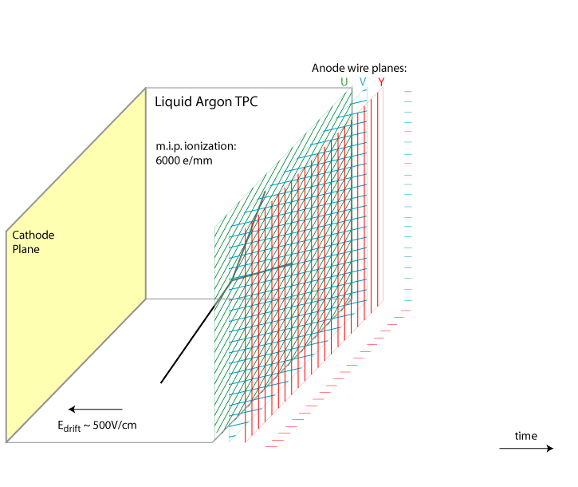
Principle of Single-Phase LArTPC
Number of ionized electrons
Field Response
Signal on Wire Plane
Electronic Response
Signal to be digitized by ADC
Noise Filter Charge Extraction
Number of Ionized electrons
time
(Induction) wires are essential due to i) lack of electron amplification in liquid, ii) power consumption of electronics, and iii) costs
High-level tracking …

Slide 31
Example II: Parallel Track seen by U
MicroBooNE Preliminary
When we include the contribution from the near by wires, the field response is further deviated from the simple bipolar signal
→0 : close to parallel to wire plane (perpendicular to drift E field)
→ 90 : close to perpendicular to the wire plane (parallel to the drift E field)

Slide 32
What do we know for sure
Cold preamplifier can reach expected ENC (MicroBooNE and LARIAT)
The remaining excess noise in MicroBooNE are reducible with hardware solutions
No software filter is needed for LARIAT
We have figured out a robust way to do TPC signal processing
There are some problems with our current modeling of the induction field response → need this better understood for the induction plane

Slide 33
What do we want to know?
Reliable calculation and calibration of field response function
3D field calculation
Direct calibration of field response
How can we control the unusable channel to O(0.1%)?
Fix the cold ASICs issue in the new design (~3% ASICs with the startup problem)
Fix the stuck bits problem in cold ADC
Eliminate touching wires

Slide 34
Coupling Capacitance
For V plane wire, it crosses with ~ 870 collection wire, so the induced signal due to coupling capacitance will be suppressed by about O(1000)
For Collection wire, it crosses with ~ 720 V plane wires, so the induced signal will be suppressed by O(700)
For U plane wire, it crosses with ~800 V plane wires, so the induces signal will be suppressed by O(800)
Based on charge calibration study in MicroBooNE, the cross talk is at about 2% level before the suppression above
Effect is expected to be negligible
Notes:
Excess noise, “noises” → “noise”

Slide 35
Summary of 35-ton Noise
Known problems:
Low voltage regulator ~ 11 kHz noise (seen in uBooNE)
Remnant startup ~4% of the preamplifier ASIC (seen in uBooNE)
ADC ASIC “stuck bits”
Unknown problems:
Origin of the High Noise State (ENC ~ 4 fC)
Not likely due to ASIC oscillation
Observation of HNS with spectrum analyzer and photo detector readout suggest noise source outside the cryostat
What worked (next slide)
Some observations (next two slides)

Slide 36
From Veljko’s talk

Slide 37
From Veljko’s talk

Slide 38
Charged Particle Traveling in LAr
Number of ionized electrons
Recombination effect
Electron lifetime due to impurities
Ionized electron transportation
Drift Velocity
Diffusion

Slide 39
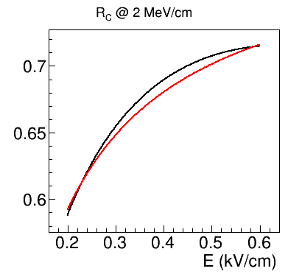
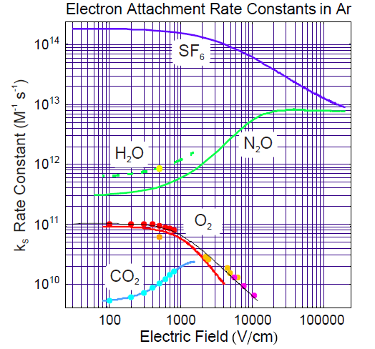
Recombination and Electron Lifetime
Recombination:
Modified Box Model vs. Birks Model
Large dE/dx → more recombination
Large E-field → less recombination
Electron lifetime
1012 times collisions with atoms every second

Slide 40
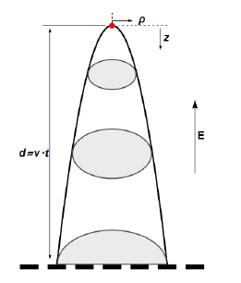
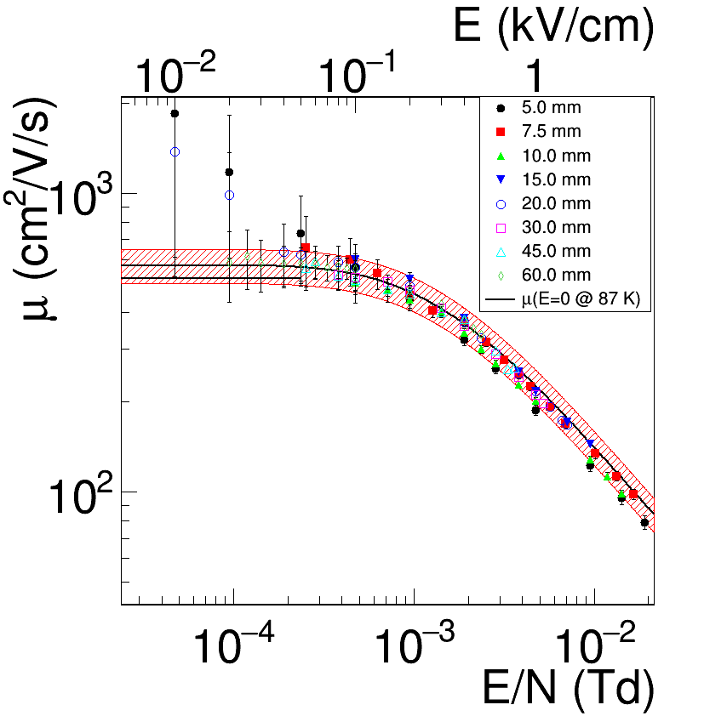
Electron Drift Velocity and Diffusion
Drift velocity
~1.6 mm/us @ 500 V/cm
2.3 ms for 3.6 m travel distance
Diffusions: Y. Li et al. NIMA 816 160 (2016)
Drift Dis. | Longitudinal σ | Transverse σ
1.8 m | ~1.2 mm | ~1.7 mm
6.0 m | ~2.3 mm | ~3.1 mm
http://lar.bnl.gov/properties/

Slide 41
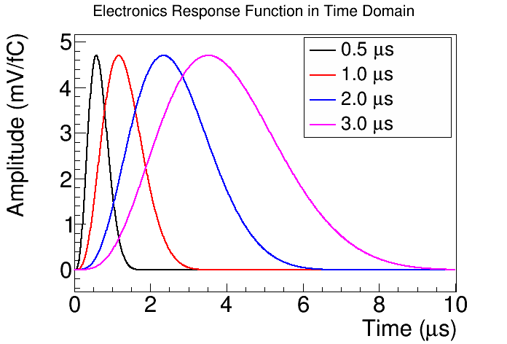
Electronic Response
Electronic Response in Frequency Domain (2 us)
Cold electronic:
4 shaping time (0.5, 1.0, 2.0, 3.0 us)
4 gain (4.7, 7.8, 14, 25 mV/fC)
0 Hz
1 MHz

Slide 42
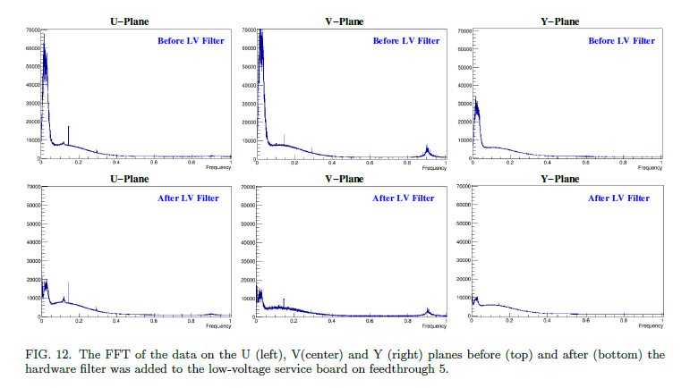
Impact of hardware filter on LV filter regulator

Slide 43
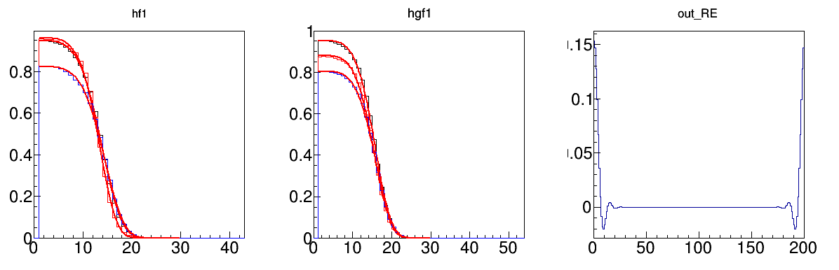
Use the Following “Wiener-like” Deconvolution Filter Functions
To implement in, set [0] = 1, so that the filter will normalize to 1
Filter (in frequency domain) is essential a smearing function (in time domain)

Slide 44
Electronic Shaping Function for cold ASIC
Transfer function is obtained from Hucheng
p0 = {1.477/To/cTo}
rp1 = {1.417/To/cTo}
ip1 = {0.598/To/cTo}
rp2 = {1.204/To/cTo}
ip2 = {1.299/To/cTo}
cAo = {2.7433/(pwr(To*cTo,4))}
cTo = {1/1.996}
Ao = 1.4
To = 0.5us
Transfer function is Laplace transformation of the shaping function in the time domain

Slide 45
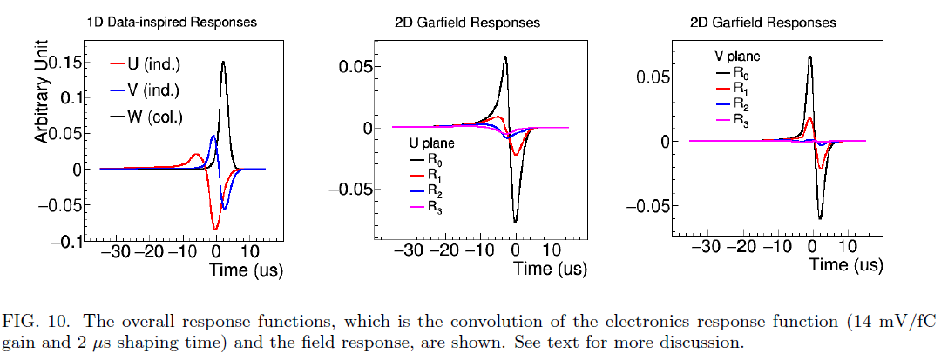
Example Field Response Functions

Slide 46
Example of the MIP (2.1 MeV/cm) traveling 3 mm parallel to the wire plane
Average diffusion
Typical waveform

Slide 47
Estimation of Peak to Noise Ratio
Collection Wire plane
Induction Wire plane
1.4/1.67 from the field response function between 3 mm and 5 mm wire pitch
1.15 for collection (1.1 for induction) takes into account the different drift voltage (273 V/cm vs. 500 V/cm)

Slide 48
Signal from behind the collection

Slide 49
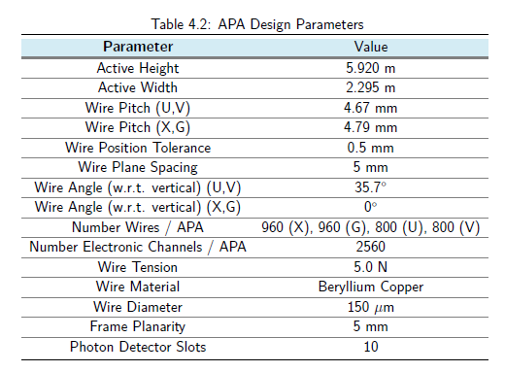
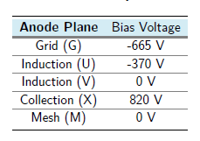
APA Design Parameters
FEM calculation
G
U
100% transparency checked with analytical calculation based on conformal representation theory (Glenn Horton-Smith, uBooNE db-4708)
V
X

Slide 50
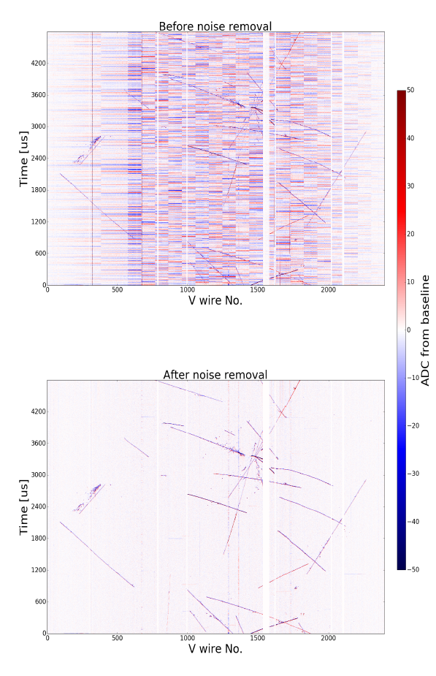
Noise in MicroBooNE
There are three sources:
10-30 kHz coherent noise → low voltage regulator on the mother board
Hardware fix in order
900 kHz noise → some sort of pick-up noise due to its position dependence
Beyond signal bandwidth
36 kHz harmonic noise → Drift high voltage power supply (mainly see in the first plane)
Hardware fix in order
All noise in MicroBooNE are accounted for and have hardware solutions

