Slide 1
APA Design: Physics Motivation and Detector Performance
Mitch Soderberg
APA Design Review
July 13, 2016

Slide 2
Content
Introduction
Brief refresher on LArTPC principle.
Reminder of DUNE/protoDUNE LArTPC arrangement.
APA Design Parameters
Physics Motivations
Detector Performance

Slide 3
Introduction
This talk will provide an overview of the protoDUNE APA design.
I will address the physics and detector performance aspects of the charge question: “Does the APA design meet the requirements? Are the requirements/justifications sufficiently complete and clear?”. Lee Greenler’s talk will address the engineering aspects of this charge question.
I will present some information on anticipated detector performance, using available tools in LArSoft framework. Xin will have much more of the underlying technical details in his talk.

Slide 4
LArTPC Principle
Why liquid argon (LAr)?
Atomic Number | 2 | 10 | 18 | 36 | 54
Boiling Point [K] @ 1atm | 4.2 | 27.1 | 87.3 | 120 | 165
Density [g/cm³] | 0.125 | 1.2 | 1.4 | 2.4 | 3
Radiation Length [cm] | 755.2 | 24 | 14 | 4.9 | 2.8
dE/dx [MeV/cm] | 0.24 | 1.4 | 2.1 | 3 | 3.8
Scintillation [γ/MeV] | 19,000 | 30,000 | 40,000 | 25,000 | 42,000
Scintillation λ [nm] | 80 | 78 | 128 | 150 | 175
Cost ($/kg) | 52 | 330 | 5 | 330 | 1200
LAr combines abundant signal (ionization/scintillation), good dielectric, and low cost.

Slide 5
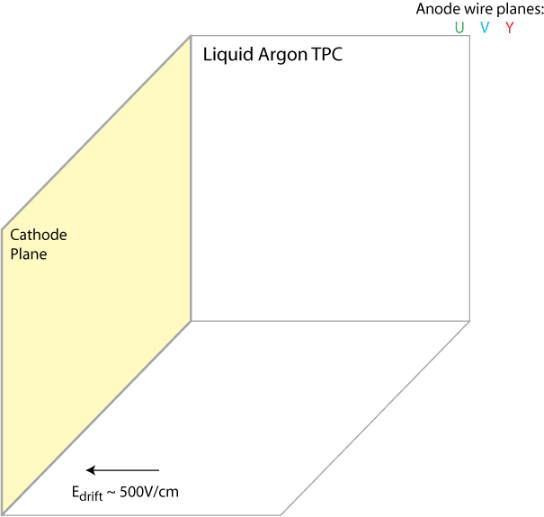
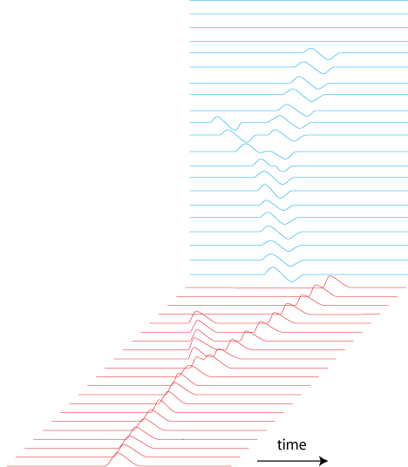
LArTPC Principle
credit: Bo Yu
-180kV
Max. Drift: 3.6 m

Slide 6
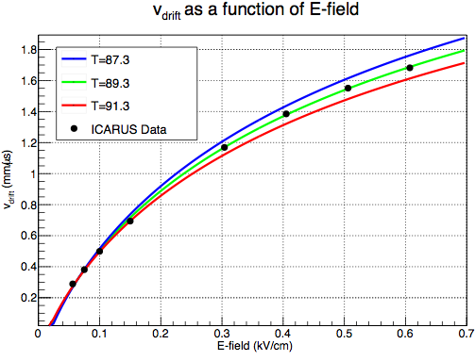
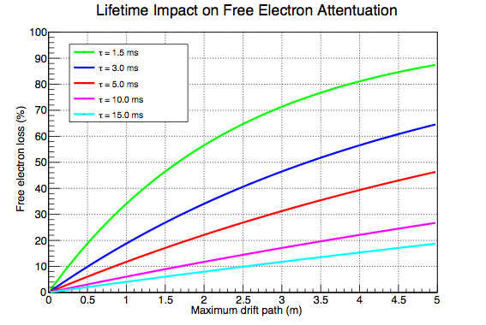
LArTPC Principle
At operating field of 0.5 kV/cm, drift velocity is ~1.6 mm/us.
protoDUNE max. drift length is 3.6 m, which corresponds to 2.25 ms drift time.
Want electron lifetime >3 ms to keep attenuation (i.e. charge loss) tractable.
protoDUNE
protoDUNE

Slide 7
LArTPC Principle
Collection Plane
Each instrumented plane provides a 2D image of the ionization present in the LArTPC.
Analysis must combine data into 3D picture/understanding of what occurred in the detector.
Task made challenging by: dead wires, noisy wires, non-uniform drift-field, LAr impurities, long drift length, etc… see Xin’s talk next.
Pixel size:
4mm x 0.3mm
Drift Coordinate →
~47cm
~96cm
Color is proportional to amount of charge collected
Drift Coordinate →
Wire Coordinate →
Induction Plane

Slide 8
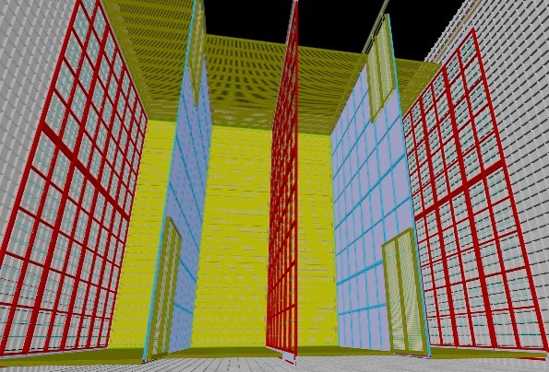
DUNE Single-Phase TPC
10 kTon DUNE FD module features 150 Anode Plane Assemblies (APAs), arranged in 3 rows of 50 double-stacked APAs.
Field Cage
A portion of a 10kTon DUNE module
50 APAs
CPAs
50 APAs
CPAs
50 APAs
3.6 m
CPA = Cathode Plane Assembly

Slide 9
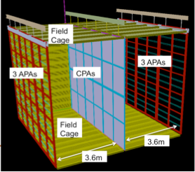
protoDUNE Single-Phase TPC
protoDUNE will feature 6 full-sized DUNE APAs, arranged in 2 rows of 3 single-stacked APAs.

Slide 10
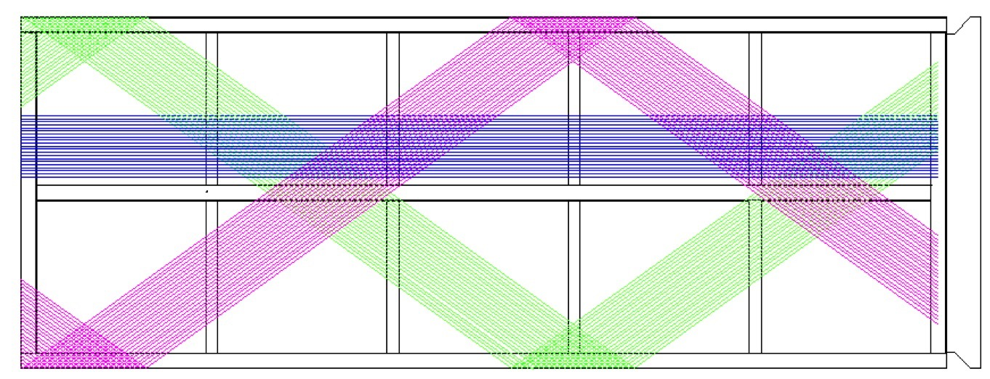
APA Design Parameters
APAs are double-sided, including Induction plane wires that wrap in a helical fashion around long edge. A single Induction wire can thus sense signals from both sides of the APA.
Design allows footprint taken up by electronics/cabling to be minimized, and allows APAs to tile the total active area of the detector.
APAs sized to be assembled off-site and transported/installed underground.
Photon Detectors
Stainless Steel frame
Collection (X)
2.295 m
Electronics Plate
Induction (V)
Induction (U)
5.920 m

Slide 11
APA Design Parameters
Parameter | Value | Note
Active Height | 5.920 m | Height of X wires.
Active Width | 2.295 m | Distance between outermost X wires.
Wire Pitch (U,V) | 4.67 mm | Chosen for particle ID and to keep integral number of readout boards
Wire angle w.r.t. vertical (U,V) | 35.71 degrees | Based on reducing reconstruction ambiguity
Wire pitch (X) | 4.79 mm | Chosen for particle ID and to keep integral number of readout boards
Wire angle w.r.t vertical (X) | 0 degrees | Based on forward beam direction.

Slide 12
APA Design Parameters
Parameter | Value | Note
Wire Type | Copper Beryllium, 150um diameter. | Chosen for cost/solderability/electrical properties
Wire Tension | 5.0 N | Chosen to limit sag to <0.5mm, and stay below break-point of BeCu (~30 N)
Collection/Grid Wires/APA | 960 (X), 960 (G) | Matches modularity of electronics
Induction Wires/APA | 800 (U), 800 (V) | Matches modularity of electronics
Length of Longest Wire | 7.3 m | Compatible with electronics noise requirements.
Longest Unsupported Wire Length | ~1.2 m | To reduce possibility of touching wires.
Mesh layer | Yes (27 m² per APA). | Remove “reflection tracks”, shield from noise.
Photon Detector slots | 10

Slide 13
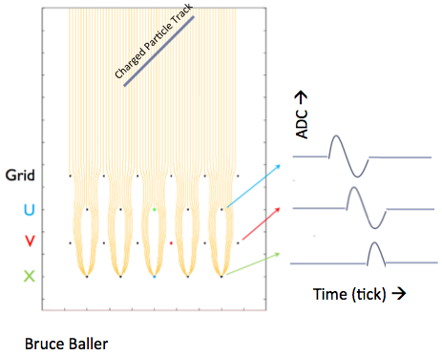
APA Design Parameters
Anode Plane | Nominal Bias Voltage
Grid (G) | -665 V
Induction (U) | -370 V
Induction (V) | 0 V
Collection (X) | 820 V
Mesh (M) | 0 V
Mesh
Operating voltages are based on achieving >99% transparency for drifting ionization, and maintaining 500 V/cm drift field up to grid plane.

Slide 14
Physics Motivations
protoDUNE detector is a full-scale replica of DUNE FD to provide data-based input to design choices and physics performance.
protoDUNE is intended to provide comprehensive input on a DUNE-design LArTPC’s capability for:
electron/photon separation
particle identification for all species (𝝁/𝝅/𝜥/p/e/𝜸) across momentum range expected in DUNE beam.
low-E physics (< 100 MeV, e.g. SuperNova)
Data will be used to tune simulations for DUNE.
Analysis techniques developed for protoDUNE will be directly transferable to DUNE FD.

Slide 15
Physics Motivations
Physics Requirement (APA-centric) | Value
MIP Identification | 100% efficiency anywhere in active detector volume.
Efficiency for charge reconstruction. | - >90% for >100 MeV of visible energy. - “High efficiency” for <100 MeV.
Vertex Resolution | (1.5 cm, 1.5 cm, 1.5 cm) to ensure <1% uncertainty of fiducial volume.
𝝁/𝝅/𝜥/p Identification | - Muons: <(18%) 5% momentum resolution (non)contained - Hadronic energy resolution for stopping hadrons: 1-5% 90% efficiency for stub-finding (electron stubs >5 MeV momentum)
e/𝜸 Identification/Separation | - <1% photon mis-ID, and >90% electron efficiency, in 0.2-6.0 GeV range <5% electron energy scale uncertainty

Slide 16
Detector Performance
To meet Physics requirements, these detector parameter requirements are necessary.
Parameter (APA-centric) | Design Requirement | Note
Wire Tension | 5.0 N [1.0 N] | Chosen to limit sag to <0.5mm, and stay below break-point of BeCu (~30 N)
APA Frame Planarity | 5 mm | To maintain anode plane transparency.
Bias voltage | Must hold >100% of max. operating voltage. | Headroom in case anode voltages need to be adjusted.
S/N | >9:1 | To allow MIP measurement with high-efficiency everywhere in TPC.
Wire pitch | ~5 mm | To provide enough granularity for PID, particularly e/gamma separation.
Wire position tolerance | 0.5 mm | To achieve reconstruction precision.
Induction Wire angle | 35.71 degrees | To reduce Hit ambiguity during reconstruction.
Missing/unusable wires | <0.5% (~13 wires). No blocks of ≥3 in a row. | Missing wires impact anode field, and thus, reconstruction.

Slide 17
Detector Performance
Other relevant parameters, not strictly APA-related.
Parameter | Design Goal | Note
LAr purity (electron lifetime) | 3 ms | To allow MIP measurements at longest drift; SuperNova events.
Drift field | 500 V/cm | Leads to max. drift time of 2.25 ms for 3.6 m drift distance. Requires -180kV cathode voltage.
Electronics Noise | ENC<600 at 90 K. | To allow MIP measurement with high-efficiency.
APAs, like rest of TPC, subject to requirements from Cleanliness and Electrical Grounding/Shielding.

Slide 18
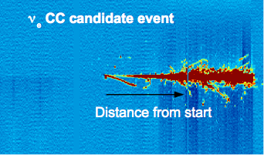
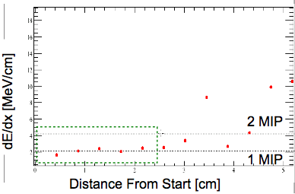
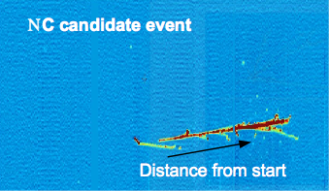
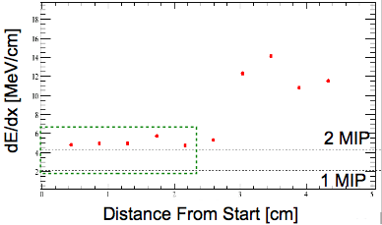
Detector Performance
Critical for protoDUNE to demonstrate ability to identify electrons and reject photons.
dE/dx profile in early stage of electromagnetic shower provides a handle for this.
Plot Credit: Andrzej Szelc

Slide 19
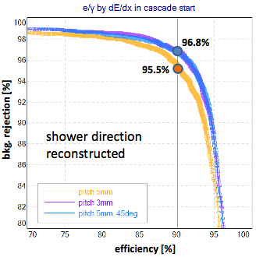
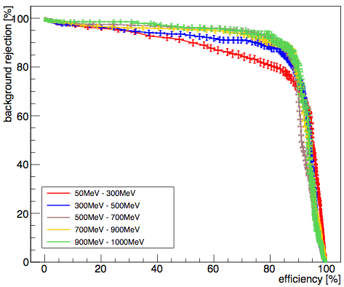
Detector Performance
Goal is 90% 𝜈e efficiency and <1% NC mis-identification.
Studies with single-particle MC and automated reconstructed, for three different values of wire pitch and Induction wire angle (5mm, 37 degrees), (5mm, 45 degrees), (3mm, 37 degrees) show these goals are almost met just using dE/dx. Folding in topology and other techniques will further reduce background.
Credit: Dorota Stefan, Robert Sulej

Slide 20
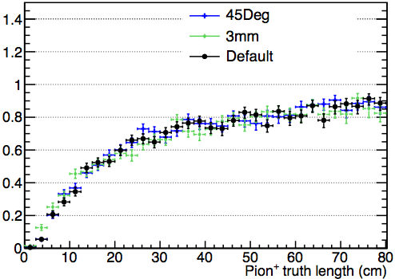
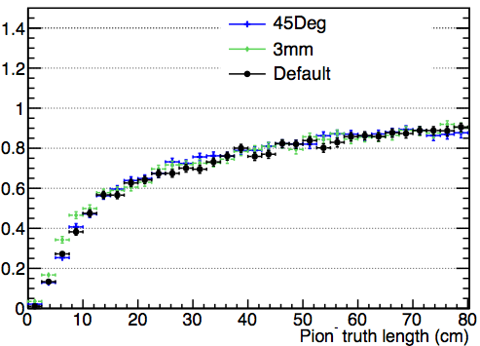
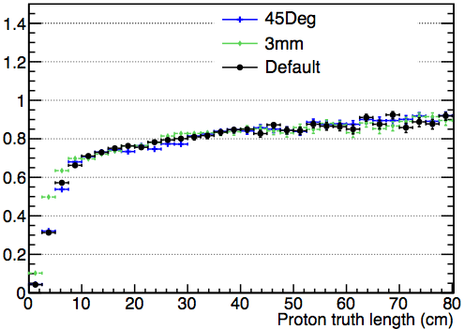
Detector Performance
Impact of wire pitch/angle on tracking efficiency of charged particles is also being studied.
Very good efficiency for simulated neutrino (CC 𝜈𝜇) interactions, with lowest efficiency coming for very short tracks (<30cm).
Plot/Table Credit: Aaron Higuera

Slide 21
Detector Performance
Induction wire angle (35.7 degrees) chosen such that no wire crosses a Collection wire more than once.
Triplets of U,V,X wires never intersect more than once.
Hits still need “disambiguation” due to unknown location along a wire length, and combinatorics when multiple isochronic Hits present on different planes.
V wire
35.7º
2.295 m
X wire
Intersection Point
35.7º
U wire
5.920 m

Slide 22
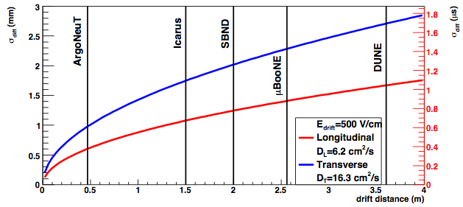
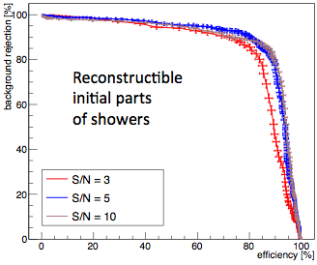
Detector Performance
At longest drift distance (3.6 m), diffusion/electron-lifetime/wire-pitch all impact S/N and detector performance.
APA design parameters chosen to allow MIP reconstruction at this distance.
Plot Credit: Michelle Stancari
Plot Credit: Dorota Stefan, Robert Sulej

Slide 23
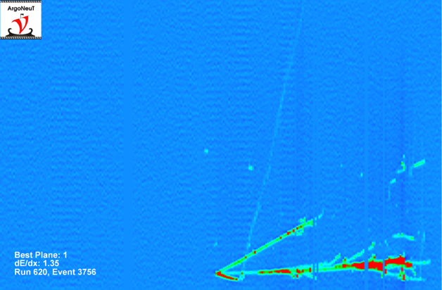
Detector Performance
Why have mesh?
Particles passing through the Collection plane will deposit ionization “behind” the plane that will drift (in a non-uniform field) to the positively biased Collection wires. Leads to “reflection” tracks, which can confuse reconstruction.
Grounded mesh block this charge and removes reflections.
Collection Plane
Induction Plane
“Reflection” track
Track passing through collection plane.
Track passing through collection plane.

Slide 24
Detector Performance
Why have mesh?
PMTs behind anode planes have been observed to induce signals.
protoDUNE not using PMTs…using scintillator bars + SiPMs.
Mesh can shield any pickup noise that might otherwise be present.
PMT pick-up
PMT pick-up

Slide 25
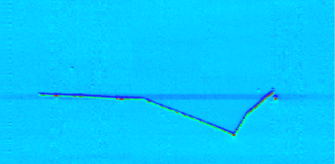
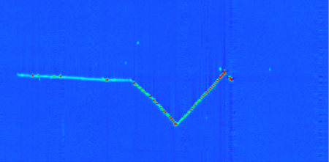
Detector Performance
Why have a grid?
Grid shields first instrumented Induction plane from drifting charge, leading to narrower pulses with higher S/N, improving reconstruction performance of that plane.
Grid also shields instrumented planes from any noise originating from the cathode and high-voltage supply.
Need to be careful…grid can induce signal on first Induction plane if not properly configured (see “shadow” in LArIAT image….fixed by reconfiguring RC filtering).
Induction Plane
Collection Plane
Grid pick-up “shadow”
𝝅⁻ double scatter and capture in LArIAT

Slide 26
Conclusions
APA is designed to meet Physics goals for protoDUNE and DUNE.
Design and understanding of performance builds heavily on extensive experience gained with previous LArTPCs.
Data from protoDUNE will be invaluable in advancing understanding of detector performance, which will provide great benefit to the DUNE physics program.
Construction and operation of protoDUNE will retire risks for DUNE.

Slide 27
Comparing LArTPC Anodes
Anode design parameters for selected LArTPCs…
Experiment | Number of Wires | Number of Electronic Channels | Grid | Mesh | Wire | Notes
ArgoNeuT/LArIAT | 706 | 480 | x |  | BeCu
35-ton | 2496 | 2048 | x | x | BeCu
MicroBooNE | 8256 | 8256 |  |  | SS+Cu/Au
SBND | 11264* | 11264 |  | x | BeCu | *jumpered
protoDUNE | 21120 | 15360 | x | x | BeCu
ICARUS | 53248 | 53248 |  | x* | SS | Mesh on PMTs
DUNE (10kTon) | 528,000 | 384,000 | x | x | BeCu

