Slide 1
DUNE APA Design Overview
for
Technical Design Review
July 13&14, 2016
Lee Greenler
University of Wisconsin Physical Sciences Lab

Slide 2
APA requirements from physics requirements
APA parameter requirements to meet physics requirements
Parameter (APA Centric) | Design Requirement | Impact on APA Design
Wire tension | 5.0 N +/- 1N | Frame must be rigid enough to carry several thousand tensioned wires.
APA frame planarity | 5mm | Careful fabrication of frame components, inspection survey.
Bias voltage | Must hold 150% of max operating voltage | Wire holding parts made of clean insulating material – mostly G10.
S/N | >9:1 | Helps determine optimum wire pitch and wire material
Wire pitch | ~5mm | Determines pin and slot spacing.
Wire position tolerance | 0.5mm | In plane spacing depends on wire board accuracy. Plane to plane spacing on frame flatness as well.
Induction wire angle | 35.71 degrees | Helps determine pin and slot spacing.
Missing/unreadable channels | <0.5% (~13 channels) | Attention to fabrication details that minimize broken wires.

Slide 3
APA requirements from physics requirements
Other APA Requirements
Argon purity requires attention to cleanliness of components and clean environment during fabrication.
Keeping noise to a minimum depends (among other things) on having a good ground path between APA components
cold electronics
mesh
frame

Slide 4
APA requirements from physics requirements
Requirement: Large area with closely spaced fine wires
Closely spaced wires that don’t touch need to be under tension.
1000’s of wire under tension, over a large area, mean a rigid frame.
The frame is made of stainless steel rectangular hollow tubing. Outer tubes 4” x 3” x 0.120” wall thickness. Cross tubes 2” x 3” x 0.120”

Slide 5
APA requirements from physics requirements
Requirement: Precisely spaced wires and wire planes
The boards that hold and locate wires are machined or injection molded for accuracy.
The boards are attached to the steel frame by accurately machined holes that lie in a plane around the perimeter of the frame.

Slide 6
APA requirements from physics requirements
Requirement: Frame flatness
The frames can be made with either machined joints or with welded joints. If joints are welded, weld stresses must be carefully balanced to avoid distortion.
Frame will be surveyed after fabrication and have a means for remediation if it’s found to be out of flatness tolerance.

Slide 7
APA requirements from physics requirements
Requirement: Minimize number of missing/unreadable channels
Most wire breakage in previous APAs came from situations where a wire was attached to two different boards in a short distance (<~20mm).
In the 35T APAs about 9% of the signal wires had this condition – about 192 wires. Of the 22 wires that developed breaks, all but 1 were in this set.
In this case flexing of frame or other relative movement between boards could stretch wire to break point.
Design has been changed to eliminate these points.
Wire breakage during winding of a layer can be repaired before starting next layer.

Slide 8
APA requirements from physics requirements
Requirement: Wire position accuracy
Addressed later in talk

Slide 9
Wire properties:
The chosen wire is a tempered copper-beryllium alloy (UNS 17200). There are other reasonably choices but this one was picked because:
Beryllium Copper
Diameter | 150μ (0.006”)
Composition | 98% Cu, 1.9% Be, other trace
Tension target | 5 N (1.12 lb)
Approx. breaking tension | 25.6 N (based on vendor test of sample from each spool)
Approx. yield tension | 21.7 N
Coeff. thermal expansion | -2.9 mm/m (integrated to 87K)
very high yield strength
cheaper than copper and gold plated SS
low electrical resistance
good solderability
Other CTE for reference | (integrated to 87K)
304 stainless steel | -2.7mm/m
G10 – warp direction | -2.1 mm/m
Aluminum (avoided) | -3.8 mm/m

Slide 10
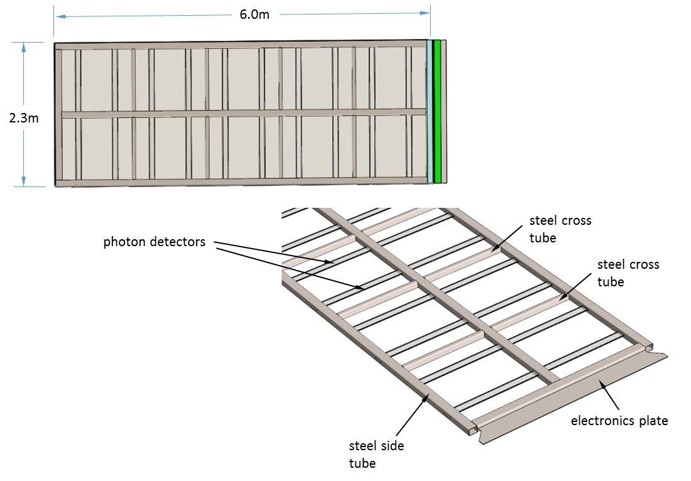
Frame
The current design has a fin for the mounting of cold electronics components but this is being reworked to use modular versions of the cold electronics (details in later slide).

Slide 11
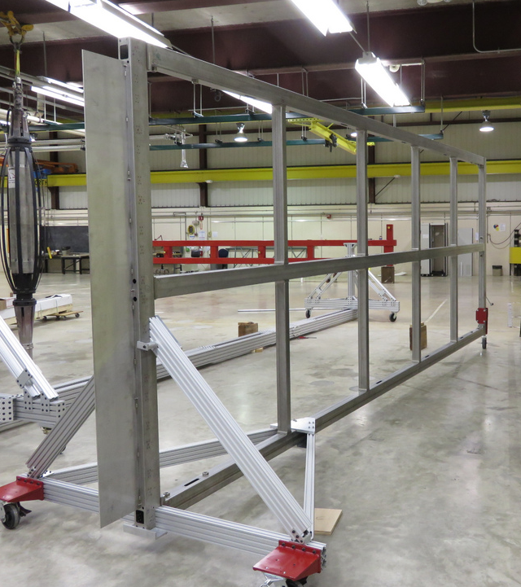
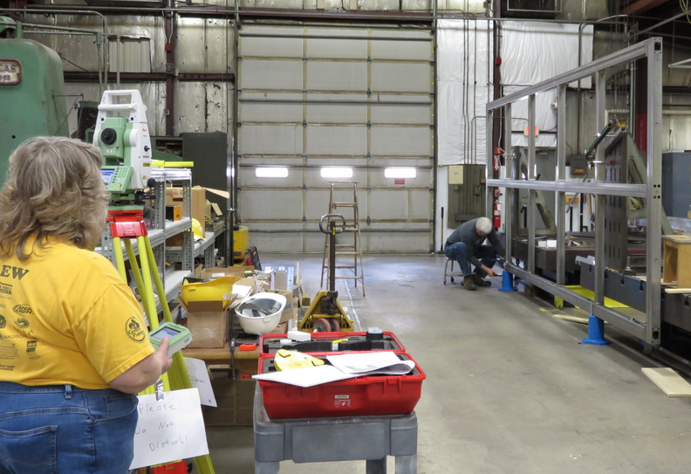
Frame
The frame on transport gear used to moved it from the machine shop to the fabrication area.
APA frame being surveyed to determine dimensional accuracy.

Slide 12
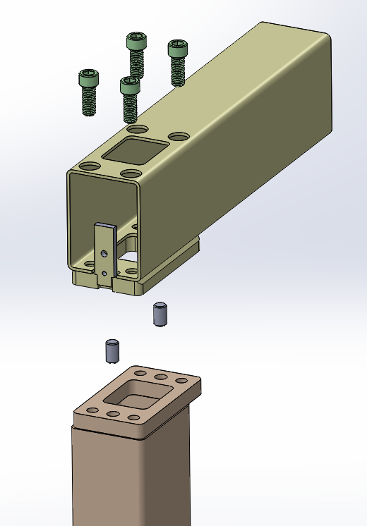
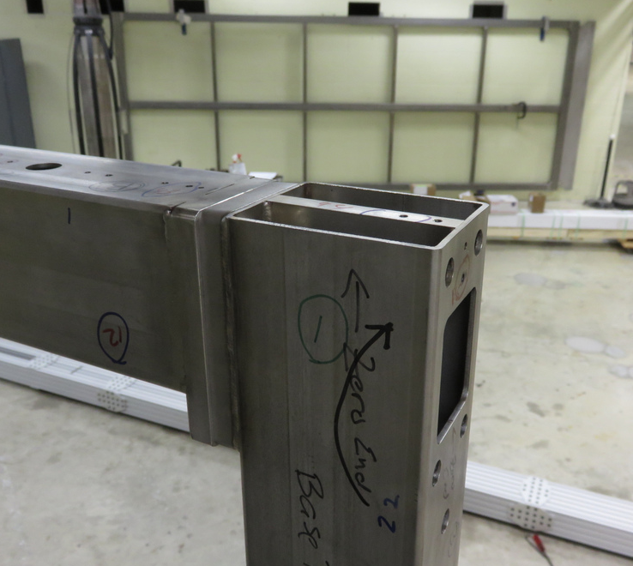
Modular Frame Design (Bolted Joints)
The 40% APA and the 35T demo APAs used a welded frame construction. After building these APAs, a modular design with bolted joints was adopted.

Slide 13
Modular Frame Design (Bolted Joints)
Keeping a large steel frame flat during welding takes great care – including many turns from side to side to keep the amount of weld balanced. This is a time-consuming process.
With the modular approach, connection pads are still welded to the tubes but they are machined flat and square after welding. This ensures good alignment of the mating tubes. Also, at this point the welding is being done to a tube instead of an entire frame.
It also:
makes handling/storing of pieces between welding and clean assembly easier because it can be done as separate pieces.
allows easier replacement of a part found to be defective (no grinding apart of welded joints).
allows for shimming in welded joints to fine tune dimensions and alignment.
allows correction of frame that’s out-of-flatness-spec by loosening and retightening the appropriate joints – or even replacing a tube.

Slide 14
Of the finite element analyses (FEA) and hand calculations done to the APA frame the cases of most interest are:
The APA supported horizontally by its ends – its ends allowed to rotate. This is the weakest orientation of the APA and it’s put in this position at times during fabrication.
Hanging under its own weight by a single support at the top center. This is its normal installed postion.
The effect on the frame of compression from the wires.

Slide 15
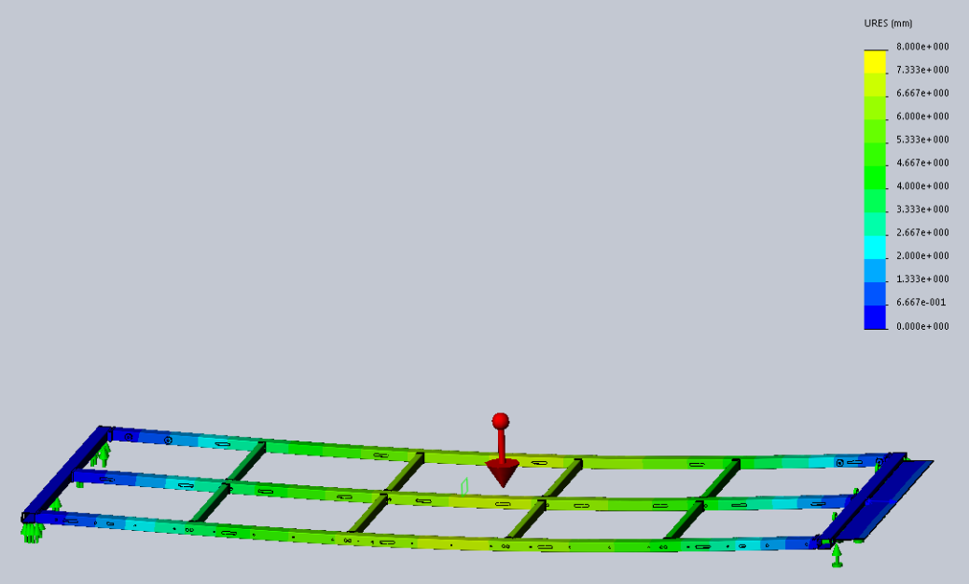
APA held horizontally, simply supported at end
max. deflection = 6.7 mm
Center of mass
Although APA won’t be used in this orientation it will be put in this orientation during fabrication so it’s important that it can tolerate it.

Slide 16
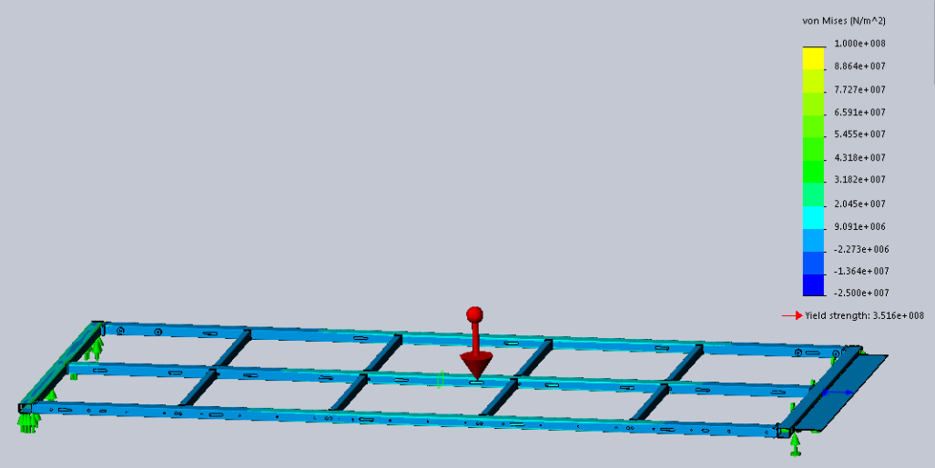
APA held horizontally, simply supported at end
σ_{beam} = 17.3 MPa
Center of mass
yield strength 240 MPa

Slide 17
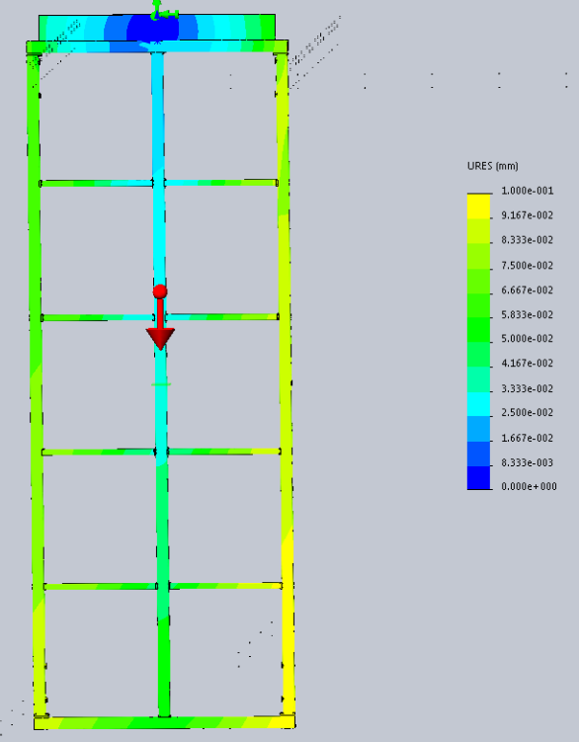
APA hanging vertically under its own weight, supported at center of top plate.
max deflection
0.1mm

Slide 18
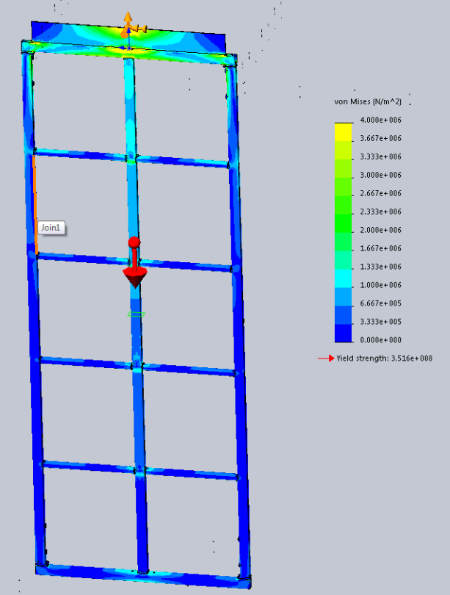
max. stress ~4 MPa
APA hanging vertically under its own weight, supported at center of top plate.
yield strength 240 MPa

Slide 19
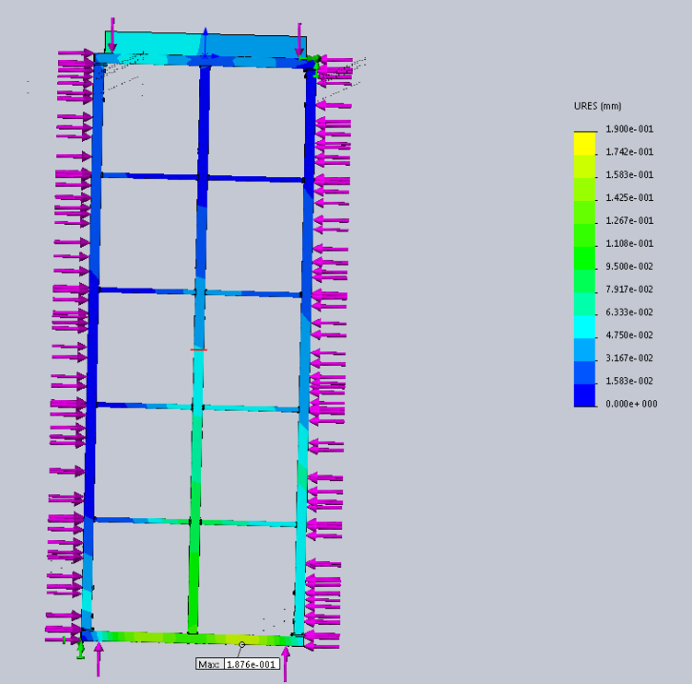
Distortion of the APA frame under wire load. Arrows are not shown across end tubes but loading is present as an evenly distributed load.
The maximum in-plane distortion seen with this loading is under 0.2mm.

Slide 20
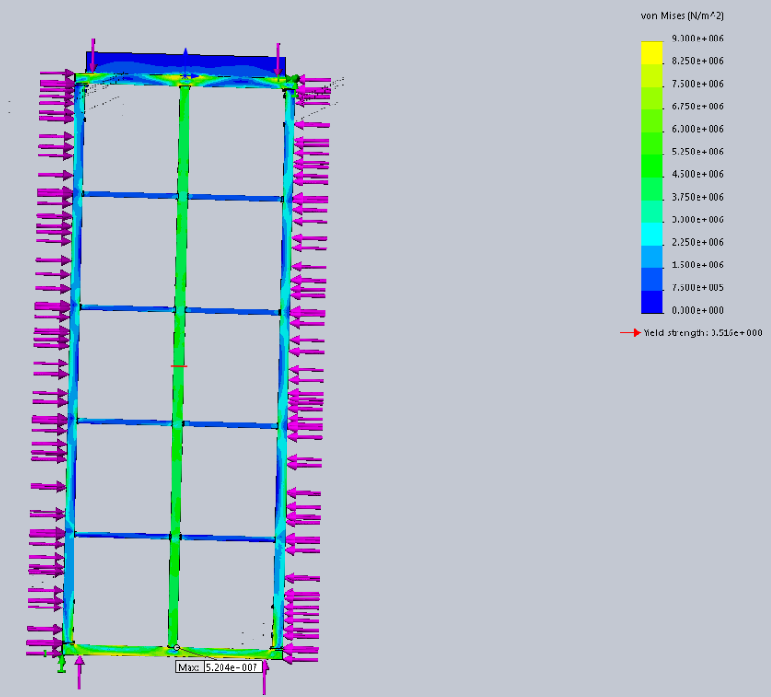
Stress due to wire load. The maximum is 52 MPa. The yield stress of 304SS is around 240 MPa
Yield stress = 240 MPa

Slide 21
Buckling:
Although the compressive long direction load has raised concern about buckling, that is not an issue here:
The loads at opposite ends do not remain collinear as the frame deforms (like they do in buckling cases) because the wires are constrained to stay close to the surface of the APA – eliminating the buckling mechanism.
If the frame were to start to bow, tilting of the boards that hold the wires would cause a change in wire tension strongly countering that bowing – opposite of the increasing sort of effects that lead to buckling.

Slide 22
Frame distortion
Specifications have been set for flatness of the APA frame and for deviations in wire to wire spacing as well as spacing between wire planes.
Wire to wire spacing depends on accurate location of the wire holding boards.
Out-of-flatness of the frame can cause a variation in wire plane spacing. The relationship between these two is complicated.
The frame material itself, stainless steel rectangular hollow tubing, is not a precision item. We have searched suppliers to find those with better than average quality tubing.
The APA has also been designed to isolate the crookedness in the tubing from the location of the wire holding boards.

Slide 23
In plane distortion
Blue dots show the theoretical position of the surveyed APA frame points. The orange points show the actual position with the error magnitude exaggerated by a factor of 100.
The in-plane positional accuracy of the board mounting features is better than 1.0mm.
The overall flatness (not shown in this plot) is 3.5mm.

Slide 24
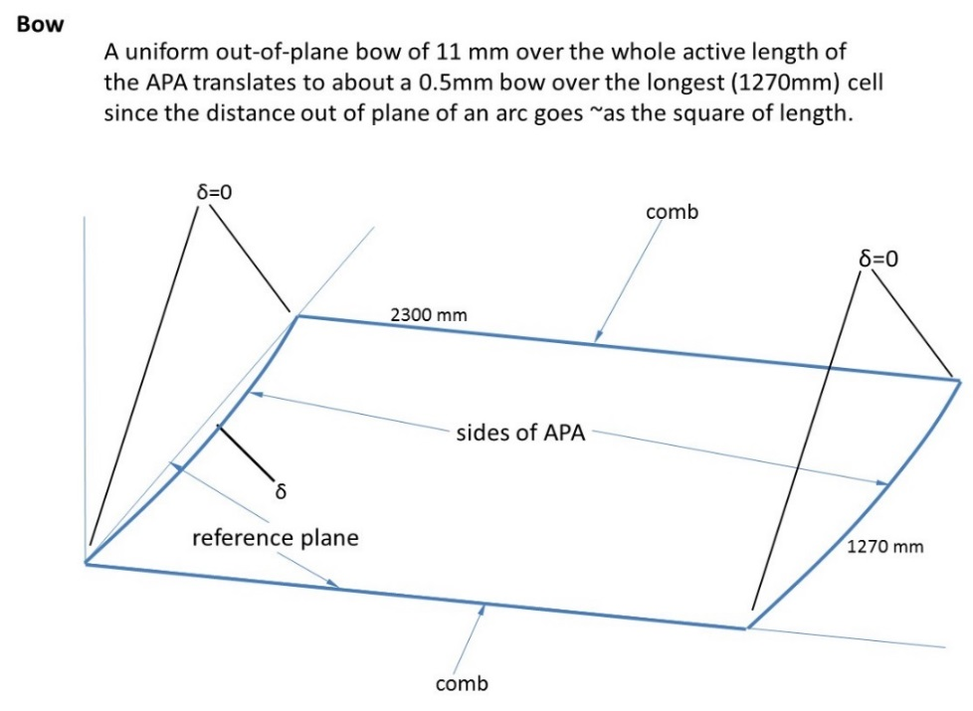
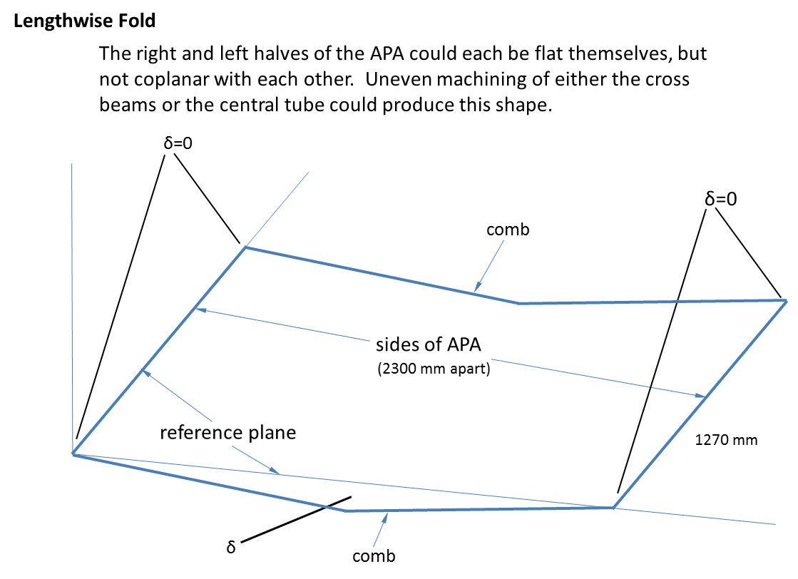
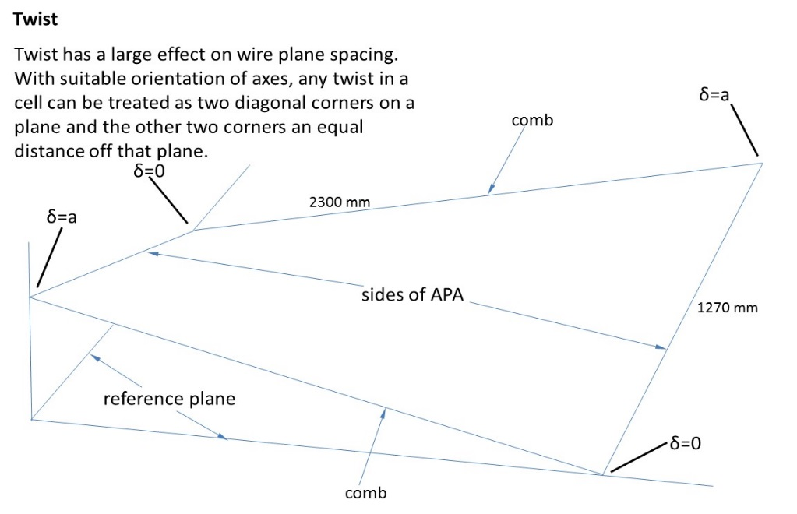
Out of plane distortion
The major modes of frame distortion have been examined for their effect on wire plane spacing.
Each of these shows a single “cell” of the APA.

Slide 25
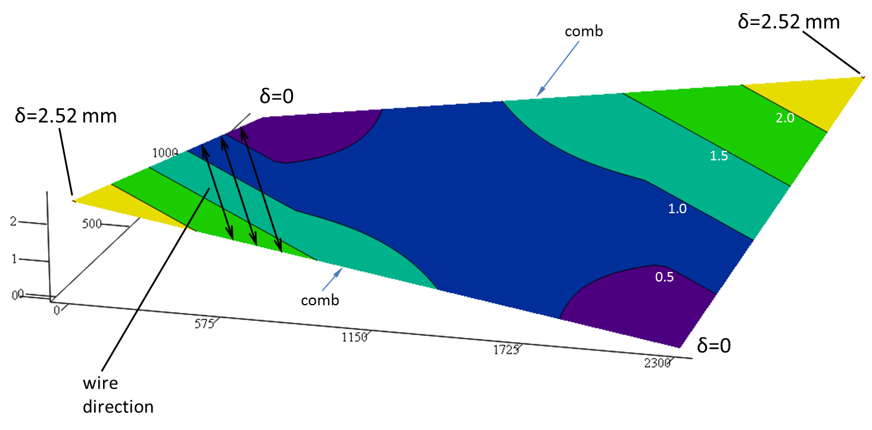
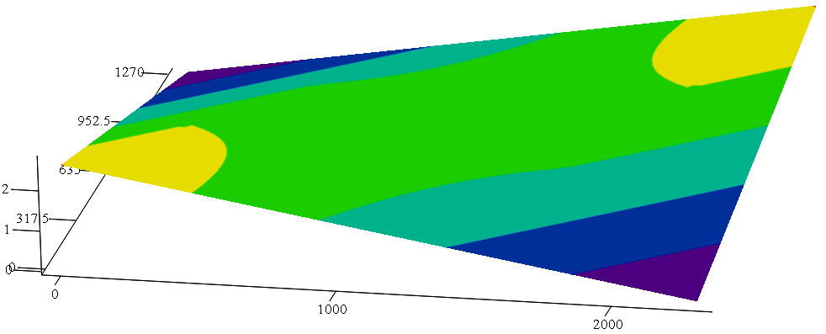
Example: Twist
The first step is to calculate the shape of the wire plane due to each distortion
Deformed shape of U layer in the case of twist.
δ=2.52 mm
comb
δ=2.52 mm
δ=0
2.0
1.5
Deformed shape of V layer in the case of twist.
wire direction
1.0
0.5
δ=0
comb

Slide 26
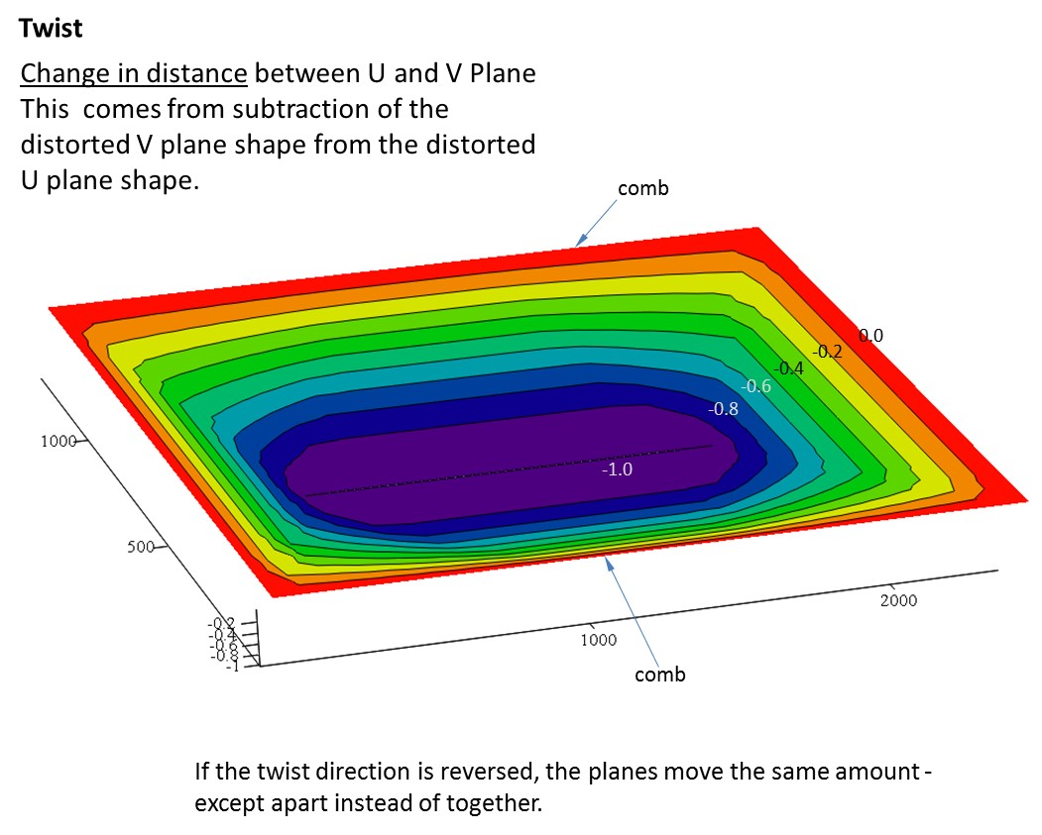
This shows the change in wire spacing from the nominal 4.75mm.

Slide 27
This 1.0 mm wire plane spacing change came from a twist of 2.52 mm in one cell. This translates to a twist of ~12 mm over the length of the whole APA. For a plane spacing change of 0.5mm we are, therefore, allowed an overall twist of 6 mm.
However, to be more careful, we want the twist in each cell to be limited to this amount - 1 mm/meter of APA length (6 mm divided by the 6 m length of the APA).

Slide 28
This was done for all 3 modes of distortion. The distance change between all layers was examined. More details in:
Layer distortion summary_6m frame.pptx
(in reference documents)
In summary, a 0.5 mm change in wire plane spacing could come from:
6mm overall out-of-flatness in the frame due to twist (1mm per meter of APA length)
11 mm out-of-flatness due to bow
1.2 mm out-of-flatness due to a “fold” down the center

Slide 29
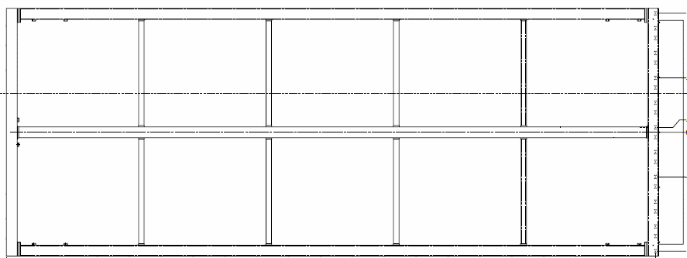
Process prototype results
Twist
 | Cell Length | Twist
 | (m) | (mm/m)
Cell 1 | 1.27 | -0.75
Cell 2 | 1.184 | -0.53
Cell 3 | 1.184 | -0.81
Cell 4 | 1.184 | -0.37
Cell 5 | 1.184 | 0.44
 | limit= | +/-1.0
Bow
Right side | -0.44
Left side | 1.63
limit= | +/-11.0
Fold
 | Fold depth
Position | (mm)
Foot | 0.39
P1 | -0.41
P2 | -0.35
P3 | -0.53
P4 | -0.54
P5 | -0.26
P6 | -0.50
Head | 0.00
limit= | +/-1.2
Cell 1
pt. 1
head
foot
pt. 2
pt. 3
pt. 4
pt. 5
pt. 6

Slide 30
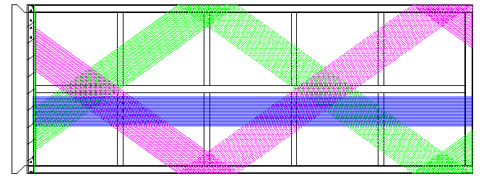
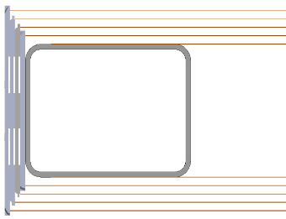
Wire path and wire constraint
The APA has four wire planes on each side with 4.75mm spacing between the planes (and from the frame surface to the first plane).
All wires start at one end of the APA and terminate at the other.
The wires in the first plane, closest to the frame, are oriented parallel to the long axis of the APA.
The wires in the 2nd and 3rd layers are oriented at plus and minus 35.71 deg with respect to the first.
The wires in the 4th layer are parallel to the wires in the 1st.
The wire to wire spacing in each plane is around 4.7mm (slight difference between longitudinal and angled layers).
longitudinal
longitudinal
longitudinal
longitudinal
diagonal
diagonal
diagonal
diagonal
mesh
mesh
Cut through non-electronics end of APA
U layer
V layer
This amounts to a total of 3520 top-to-bottom wires - of which 2560 are signal wires.
X or G layer

Slide 31
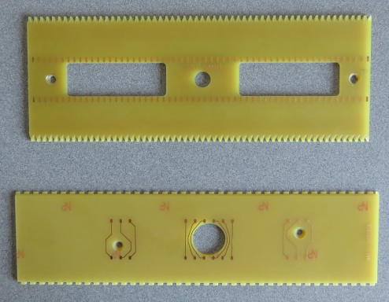
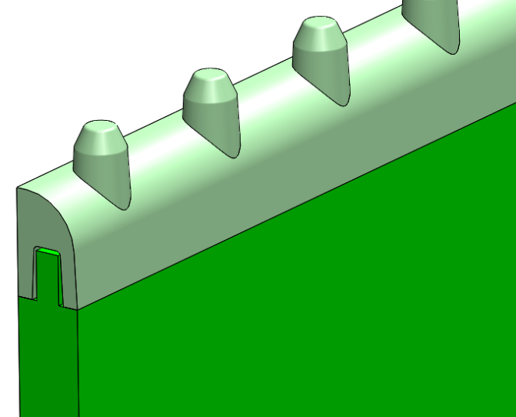
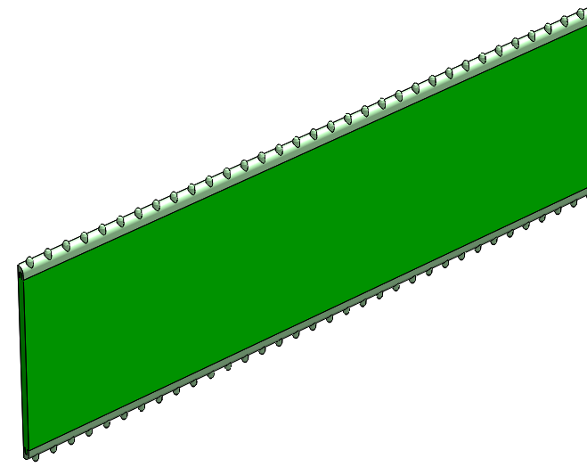
Injection molded teeth for the edge boards
G10 board made by circuit board fabricators
Teeth were machined into circuit boards for the 40% and 35 ton APAs.
Injection molded strip glued to edges of boards. The material is 30% glass-filled LCP (liquid crystal polymer)
Molds for injection molding allow complex detail. The ideal plastics candidates for these strips are expensive per kg but this doesn’t matter since so little is needed.
All the internal features of the board: traces, holes, countersinks, relief, can be provided accurately and cheaply by circuit board vendors.

Slide 32
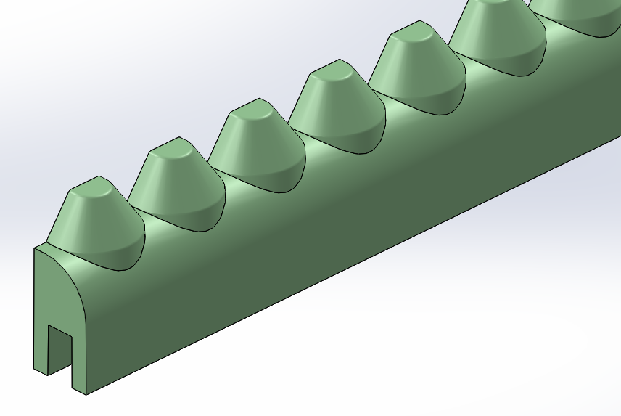
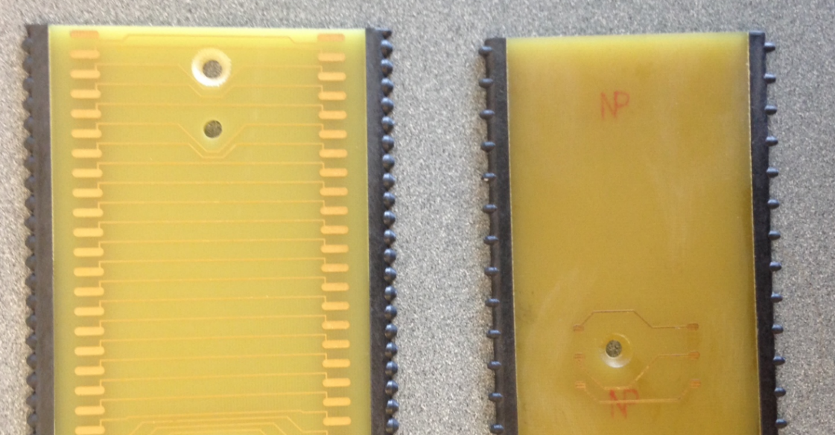
The end boards have slots rather than pins.
Strips glued to circuit boards:
left is end, longitudinal wire board
right is diagonal, side board
Traces replace segments of wire that would run over necessary openings in the side boards.

Slide 33
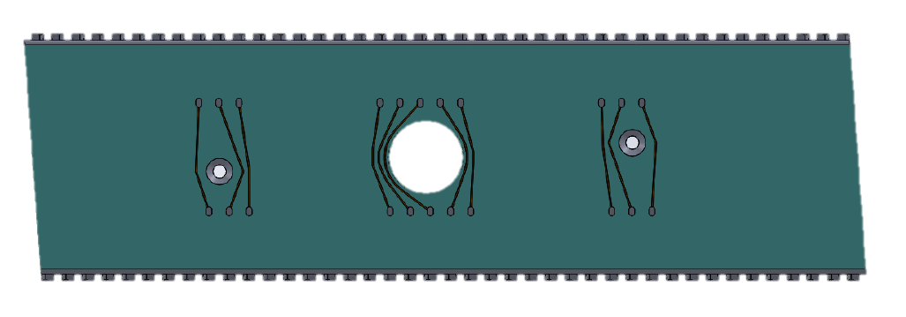
Glue and Solder Attachment to Boards
All wires are glued to the boards they run across. Any wire that terminates at a board is soldered to a solder pad as well.
If a wire doesn’t terminate at a board there is no net force between the glue and wire so soldering is not essential.
All wires terminate at foot boards so these are attached to solder pads with no traces.
Epoxy strip
Epoxy strip
The glue used is epoxy 2216 by 3M. The solder is a 62%/36%/2% tin/lead/silver. The eutectic 63/37 is the best of the tin/lead solders but the addition of 2% silver improves the creep strength of the joint.

Slide 34
Long term tension tests led us to increase the solder pad length from 3mm to 7mm between the 40% and the 35T APAs.
We also found that the 2216 epoxy must be thoroughly cured for maximum holding strength. Although it is hard after 12-24 hours it takes 7 days to completely cure at room temperature (or a couple hours at 150 degrees F).
After making these changes we ran more tests and got promising results.

Slide 35
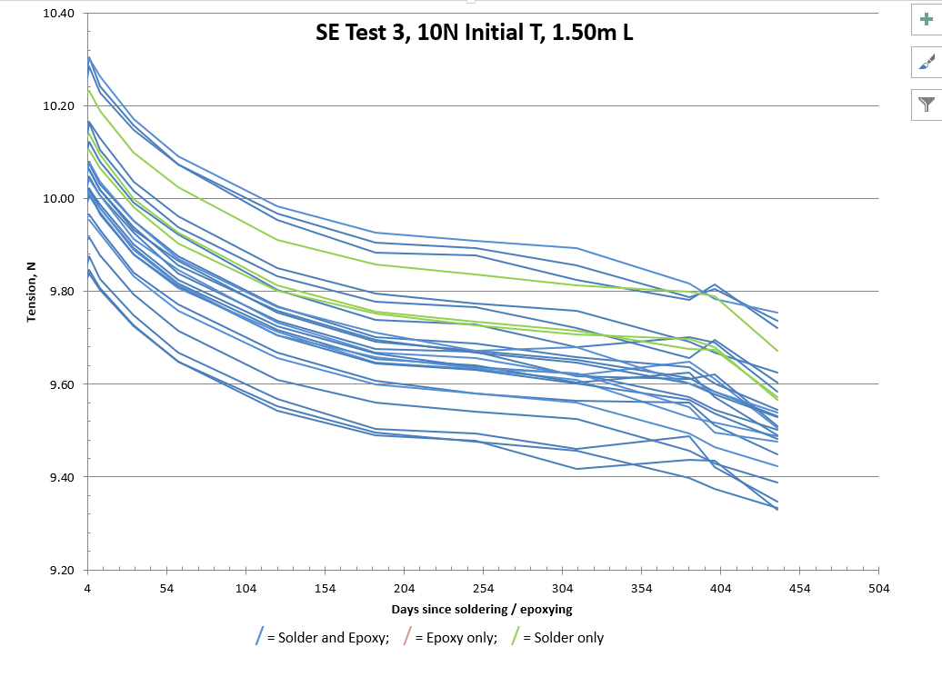
tension stabilizing
more about this section in a minute
These are the results from one of our long term tension tests over ~430 days. Over the first 300 days the wires lost 4-5% of their tension but then stabilized. Since the wires all lost tension equally, whether glued only, soldered only or both, it is not credible that this is due to joint slippage – it must be due to stress relaxation in the wire.

Slide 36
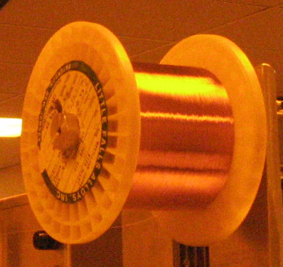
Indeed CuBe wire is known to exhibit stress relaxation. These wires were started at 10 N, twice the DUNE tension, and lost around 0.5 N over time. Wires started at 5N lost around 0.2 N due to stress relaxation.
The relaxation does appear to plateau.
The wire in this test is “tempered” wire from Little Falls Alloy – mechanically hardened and heat treated.
They also make a “hard” wire that is mechanically hardened but not heat treated. It only loses about 1% due to stress relaxation but it has a lower yield strength (around 10 N vs 20+ N for tempered). The wire with the higher yield strength is a better choice.

Slide 37
Early Feb. 2016
Early June 2016
5 deg. F
The results from 300 to 430 days are disturbing but:
The wobbly traces are just due to problems with the measuring setup.
it was realized after the latest measurements that AC was off in the room for the later readings and that the tension, at our level of interest, is sensitive to room temperature. (ΔT = ~0.04N/°C – independent of length)

Slide 38
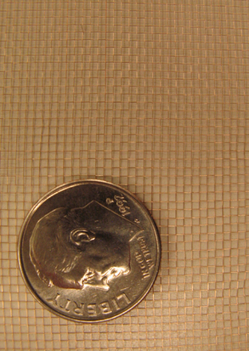
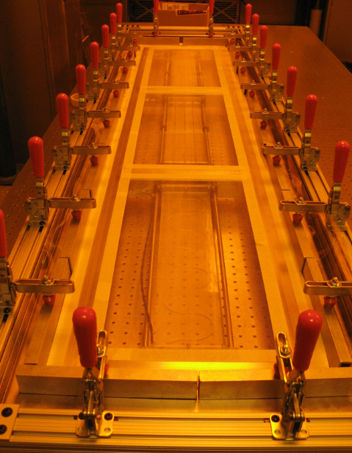
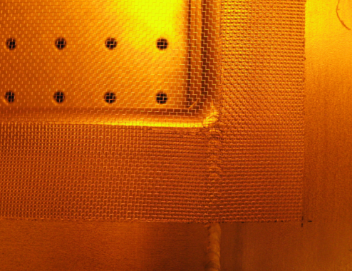
Mesh
fine mesh
mesh glued around openings
Mesh is being applied here to a 35T APA. Clamps and bars are used to hold down mesh; they are loosened one or two at a time while the mesh is pulled tight. Areas to be glued are masked off.

Slide 39
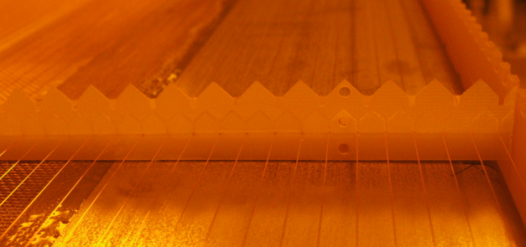
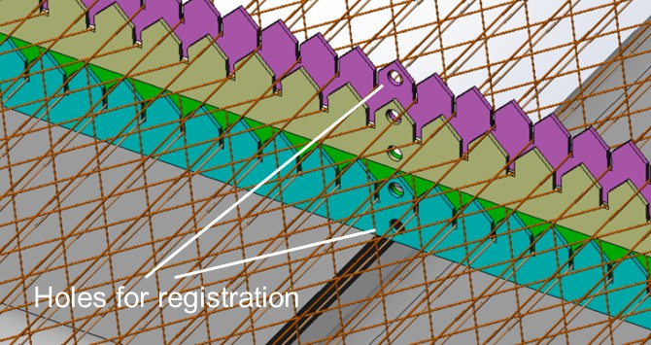
Combs
comb locations
The combs are toothed pieces of 0.5mm thick G10 that are placed across each cross bar to support and align the wires at intermediate positions.

Slide 40
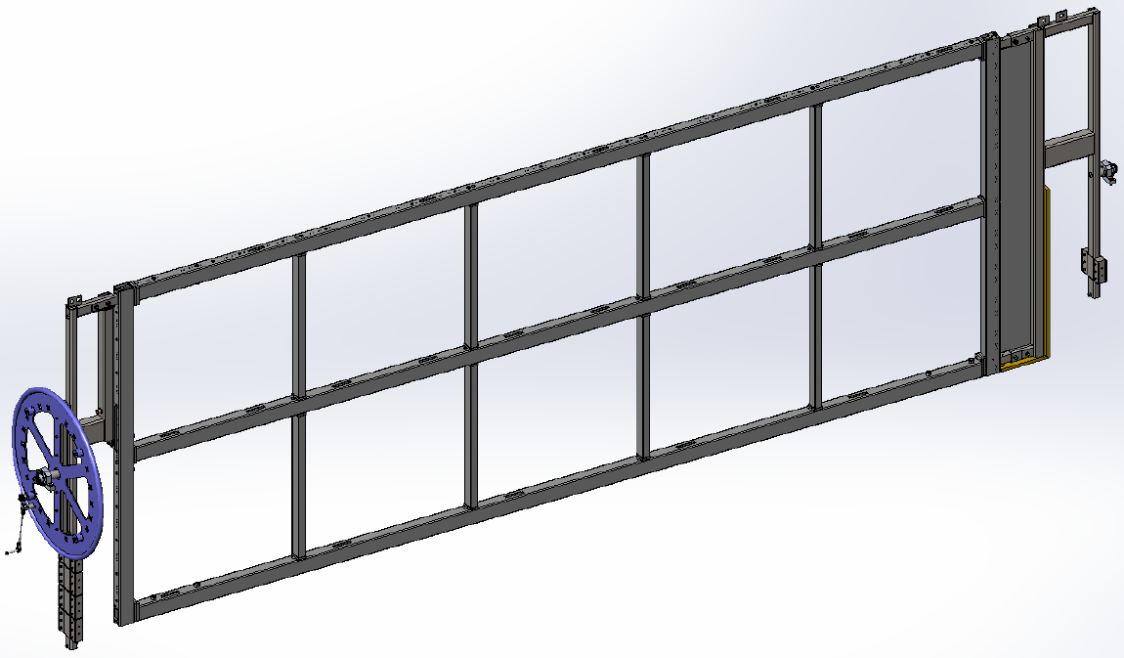
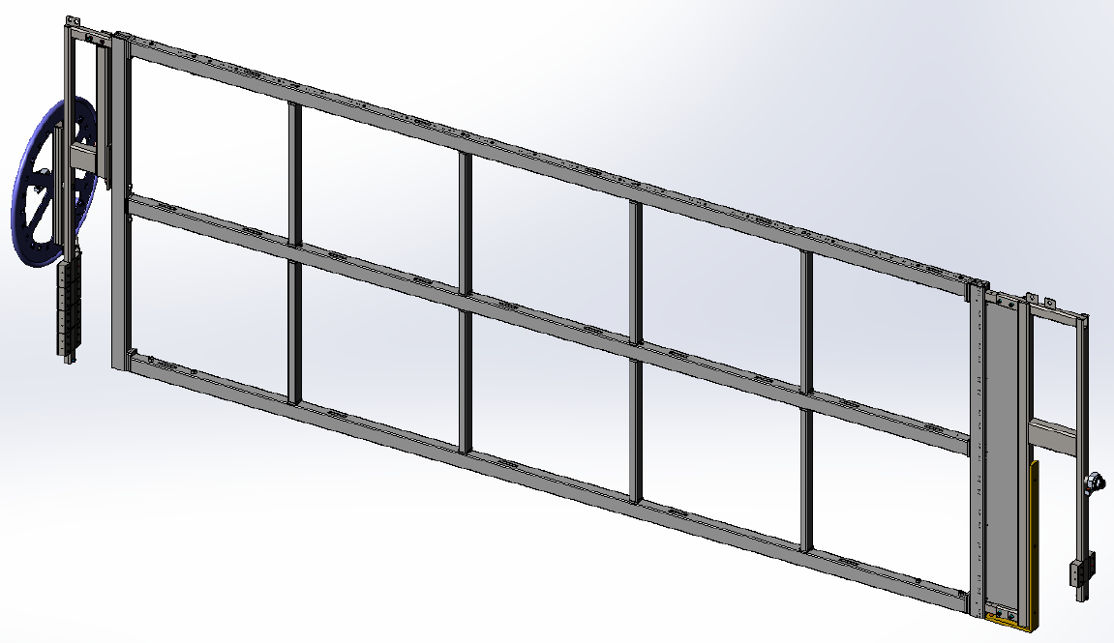
Interface - APA to Winding Machine
trunnion
trunnion
The APA is supported in the winding machine by “interface frames” that mount with arms that extend into the side tubes and anchor to 20mm bolts through the side tube walls.
Trunnions on the interface frames rest in winding machine bearings.
The wheel on the foot tube interface frame gives a hand-hold for manual rotation of the APA and provides a place to lock the rotation.

Slide 41
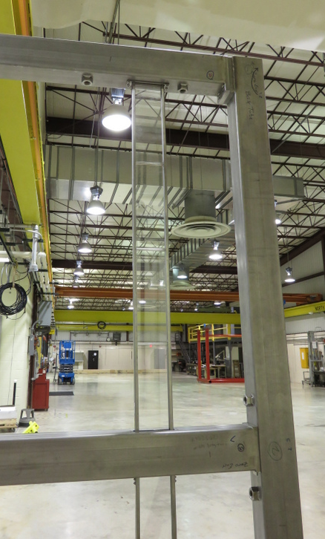
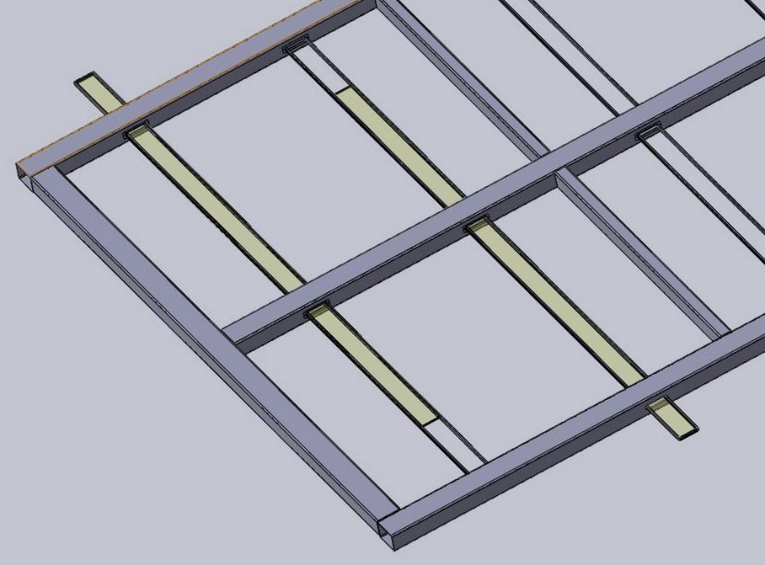
Interface – APA to Photon Detectors
The photon detector interface consists of slots in the side tubes to allow side installation of the PDs after completion of wire winding. There are screw holes near the slots to anchor PDs.
Five PDs are inserted from one side of the APA and five from the other into pre-mounted channels. Each side tube has five slots through two walls and the center tube has ten slots through two walls.

Slide 42
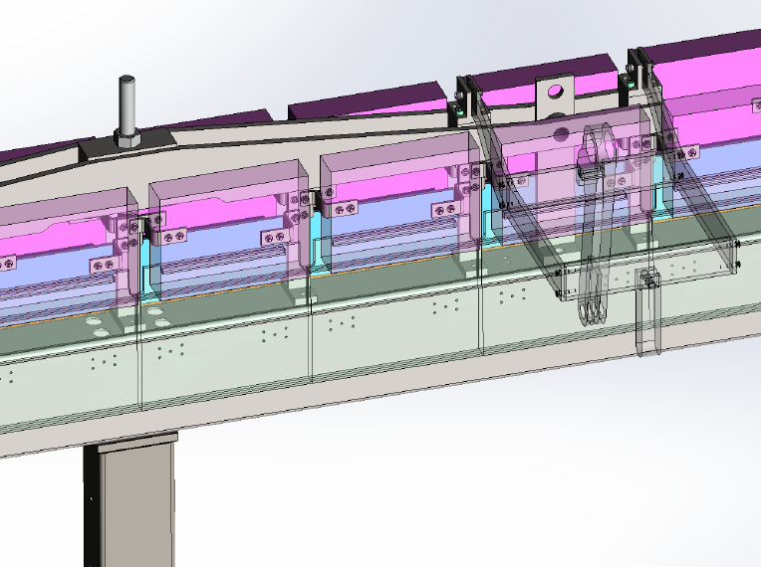
Interface – APA to Cold Electronics
Cold electronics boxes – 1 per board stack – 20 total per APA
APA Hanger
Field cage latch
APA Head tube

Slide 43
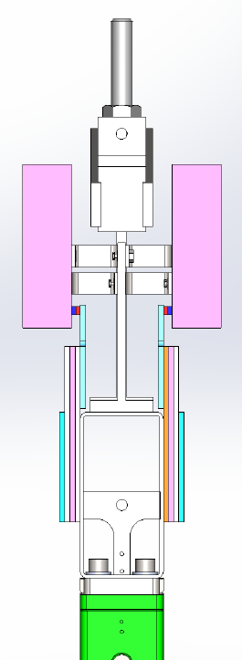
Interface – APA to Cold Electronics
APA Hanger
Cold electronics boxes – 1 per board stack – 20 total per APA
CR board (capacitor-resistor board)
Wire boards (electronics ends of wires attach to these)
APA head tube
APA side tube

Slide 44
Backup Slides

Slide 45
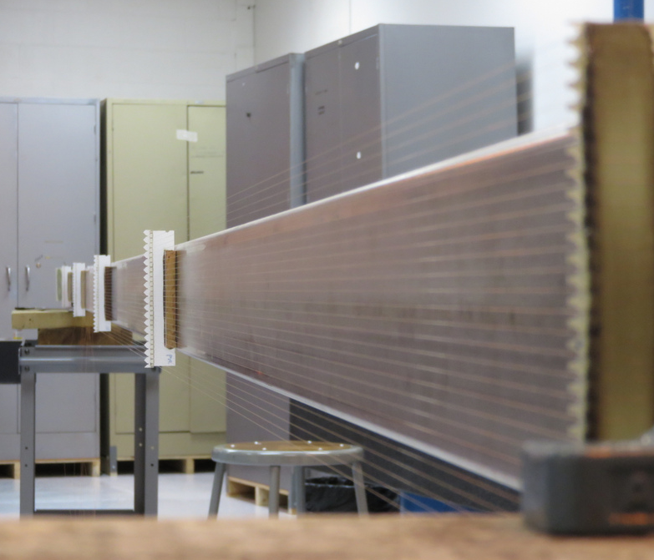
Wire wear at combs
The wire openings in the comb stack are small enough that the wires are accurately positioned at the combs. They are not, however, deliberately glued at the combs. To address the question of wire wear we ran a test where wires were mounted on a long tube going through combs. The tube was then mounted on a device that rotated it on its long axis. After many more rotations than the wires will ever see, the wires were removed and examined. No cases were found of significant erosion of the wire. The only handling that could, possibly, yield this number of cycles would be vibration during travel. A shipping suspension with low transmissibility at these higher frequencies will be used to prevent this kind of vibration from moving the wires against the combs.

Slide 46
Wire properties / stresses
Diameter | 150μ (0.006”)
Composition | 98% Cu, 1.9% Be, other trace
Tension target | 5 N (1.12 lb)
Stress at target tension | 280 MPa (41,000 psi)
~ Breaking tension | 25.6 N
~ Breaking stress | 1450 MPa (210,000 psi)
~ Yield tension | 21.7 N
~ Yield stress | 1230 MPa (180,000 psi)

Slide 47
APA – Dimensions and Numbers
Active height (not incl. edge and wire boards) | 5984 mm
Active width (not incl. edge boards) | 2300 mm
Side tube length | 6060.1mm (19’10.6”)
U and V angle (deg.) | 35.71 deg
U and V wire to wire pitch | 4.67
X and G wire to wire pitch | 4.79
Number and length of top boards | 10 @ 230 mm
U & V wire spacing along top boards | 5.75 mm
Number of U or V wires per top board | 40
Number of X or G wires per top board | 48
Number of U, V and X channels per board stack | 40 + 40 + 48 = 128
Number and length of side boards | 20 @ 296 mm (end board longer)
Side board wire spacing (U & V wires) | 8.00 mm
Layer to layer spacing | 4.76 mm

Slide 48
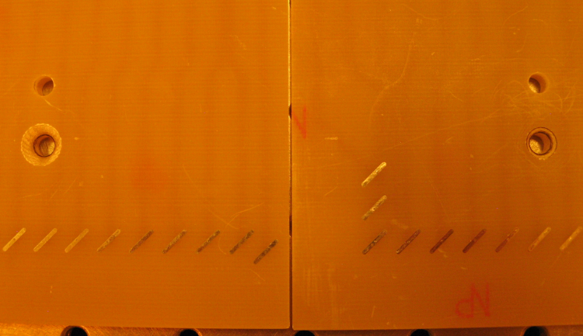
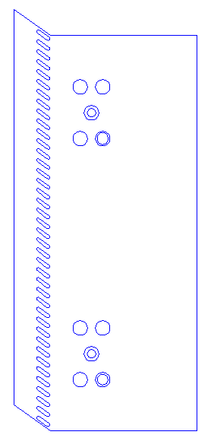
Board shape to prevent wire breakage.
Approximate location of glue strip
With this shape wires are glued to the same board they are soldered to – and only glued to one board.
These 3 wires can end up attached to both boards.

