Slide 1
APA Electronics Update
Andrew Laundrie
Lead Electrical Engineer
UW Physical Sciences Laboratory
July 2016

Slide 2
Presentation Outline
Electronics overview
Wire-board designs
Board-to-Board connections
Wire-board stack-up
CR board design status
Remaining design tasks

Slide 3
Electronics Overview
Four wire planes on each side of an APA frame
G-plane wires: -665V
U-plane wires: -370V
V-plane wires: 0V
X-plane wires: +820V
U and X wires are coupled through capacitors to Cold Electronics; V wires are direct-coupled

Slide 4
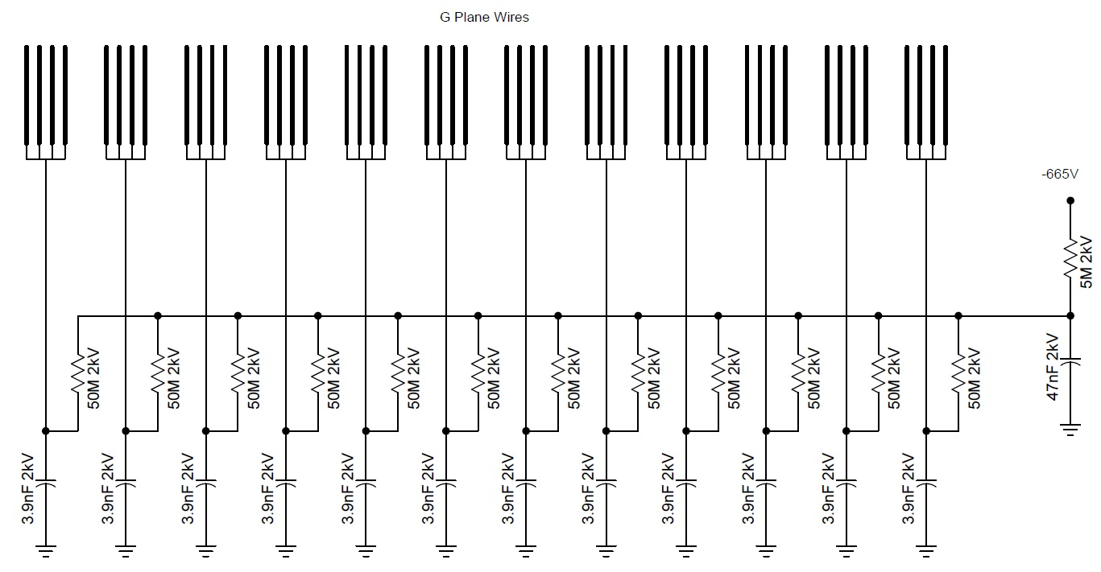
G-Plane bias components are carried on the wire board:
G Plane Wires
-665V

Slide 5
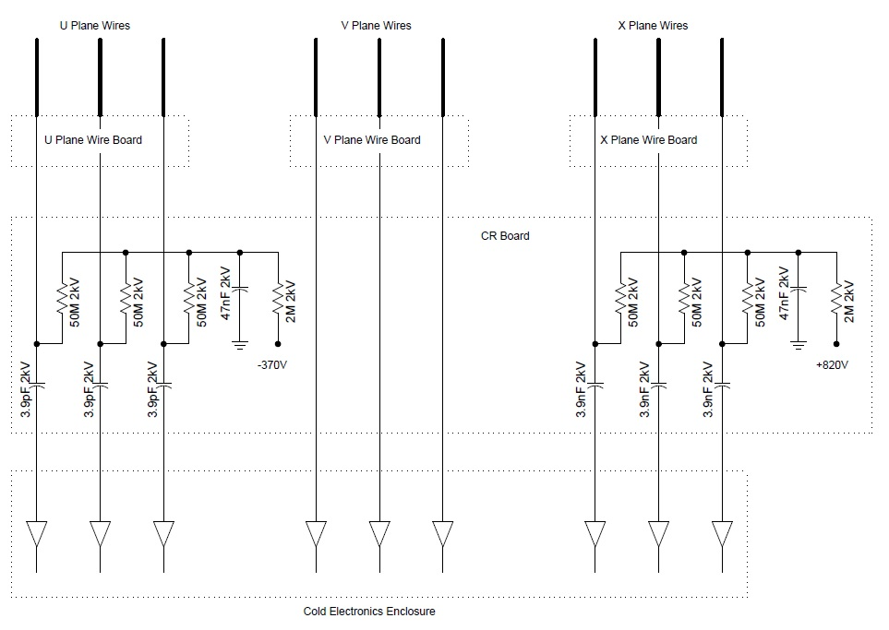
N = 40
N = 40
N = 48
CR Board
Cold Electronics Enclosure

Slide 6
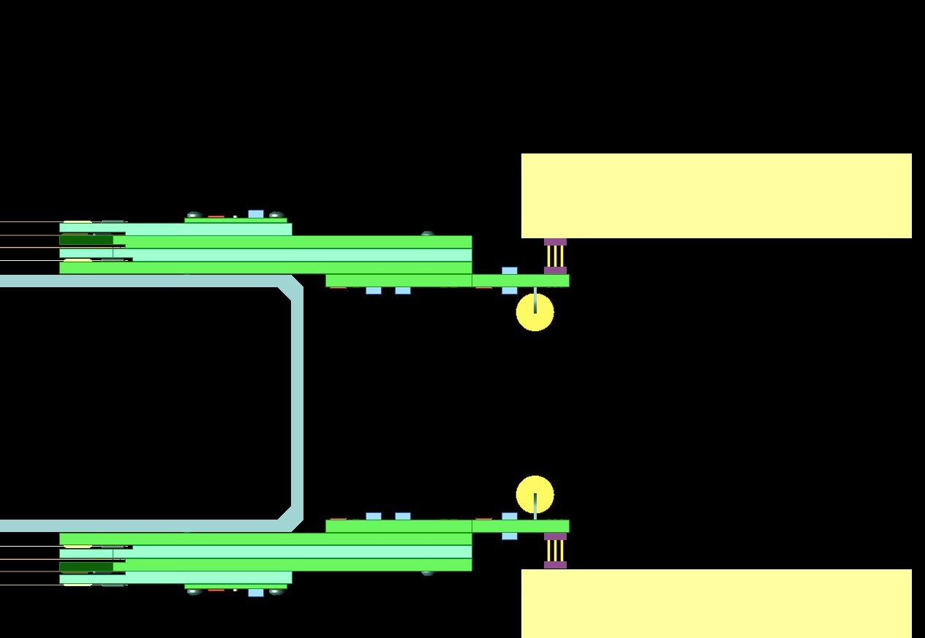
Electronics Overview
Cold Electronics
Mesh Wires
Wire Board Stack
CR Board
APA Frame

Slide 7
Wire-board functions
Anchor APA wires
Provide secure electrical connections from the wires to the CR boards
Mechanically support CR boards

Slide 8
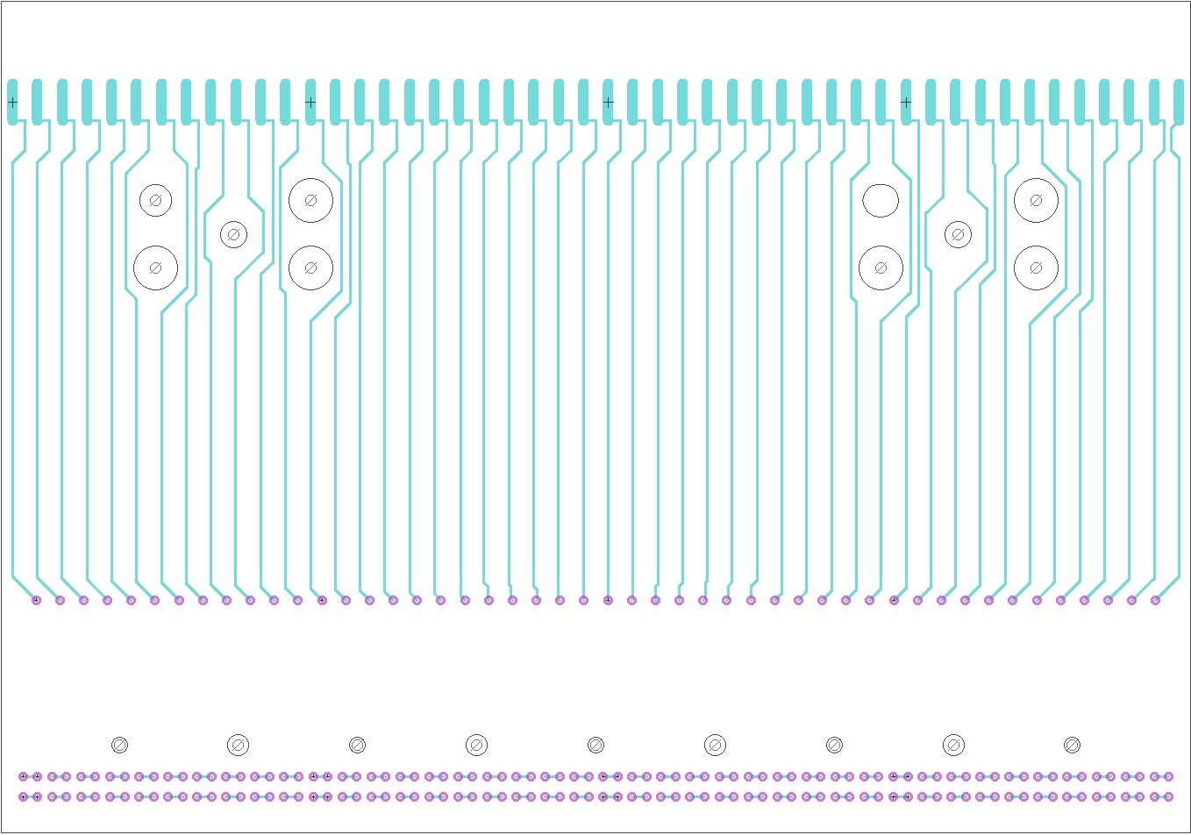
X-Plane Wire Board
APA Wire Termination Pads
Pressed-in Mill-Max sockets receive pins from the CR board
More Mill-Max sockets receive pins from the CR board and the V board

Slide 9
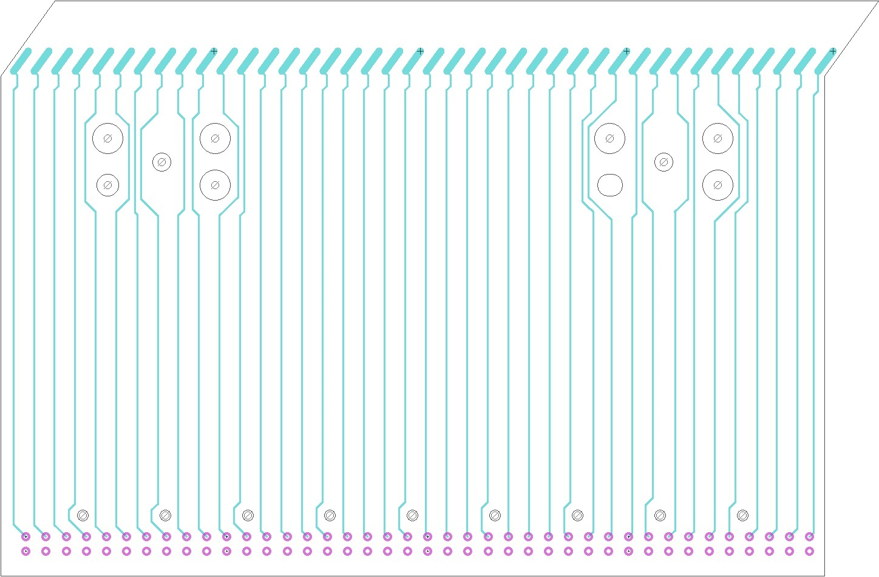
V-Plane Wire Board

Slide 10
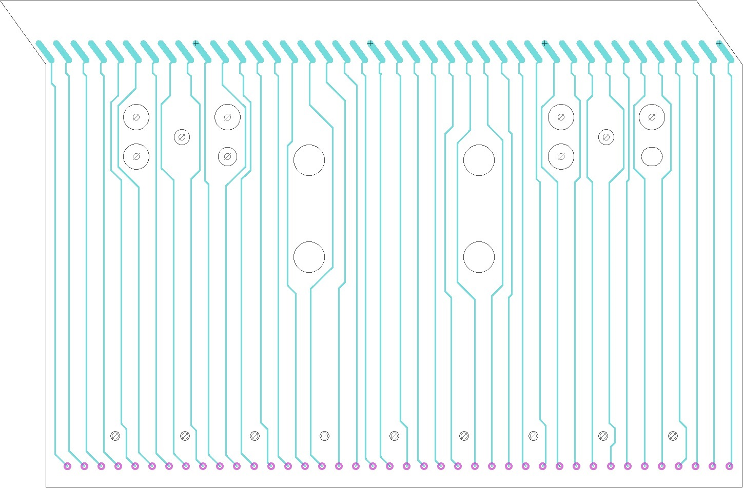
U-Plane Wire Board

Slide 11
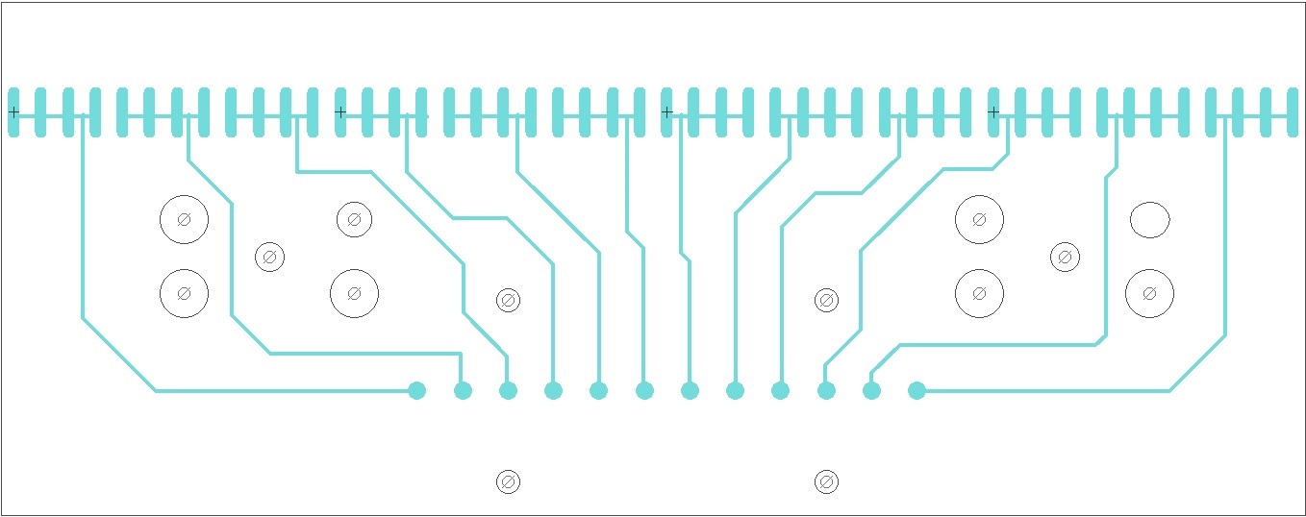
G-Plane Wire Board
A daughter board contains bias components and
mounts on the top side after winding is completed.

Slide 12
Connections Between Boards
35T wire boards were connected using Mill-Max pins and sockets
Insertion of long pins between boards was difficult and time-consuming
Inspection of inserted pins was challenging
New strategy: Use different Mill-Max pins and sockets, simplify assembly procedures, and still achieve reliable connections

Slide 13
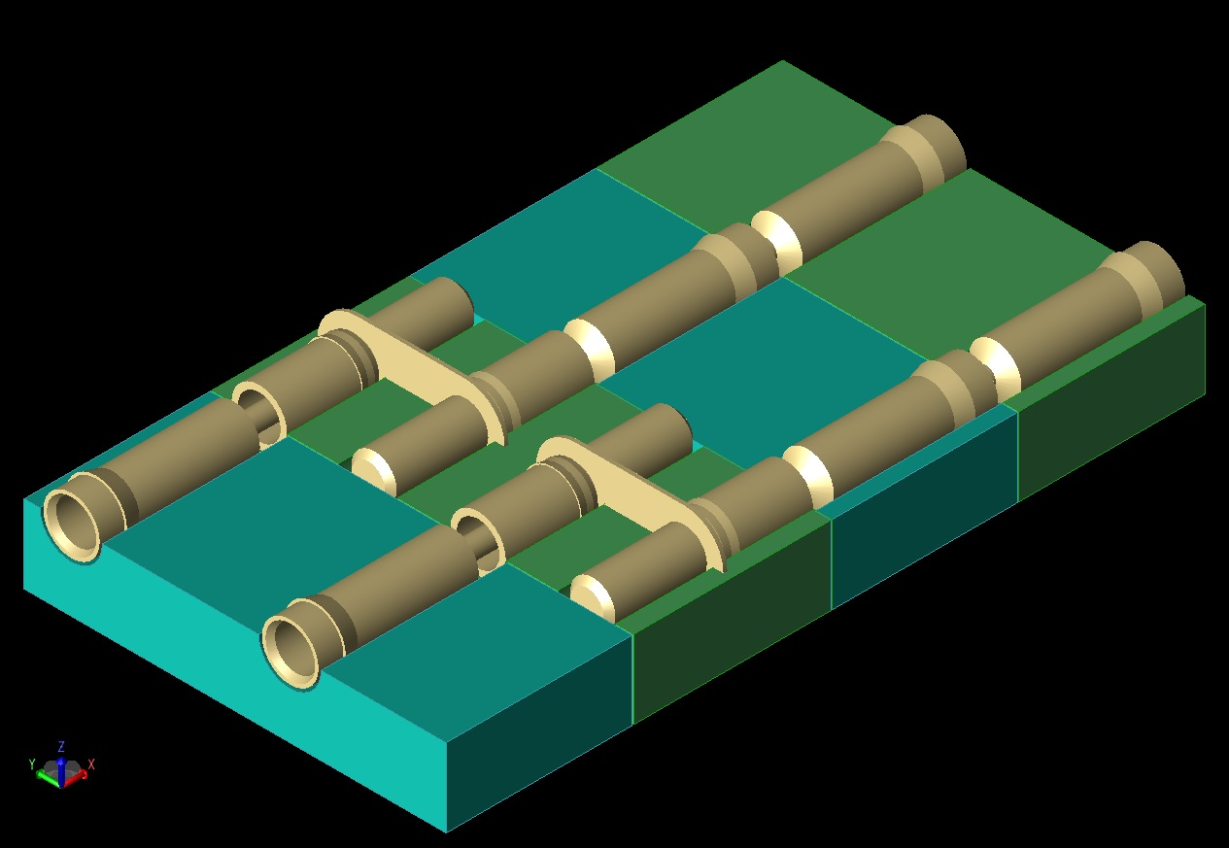
Connections Between Boards
U
V
X
CR

Slide 14
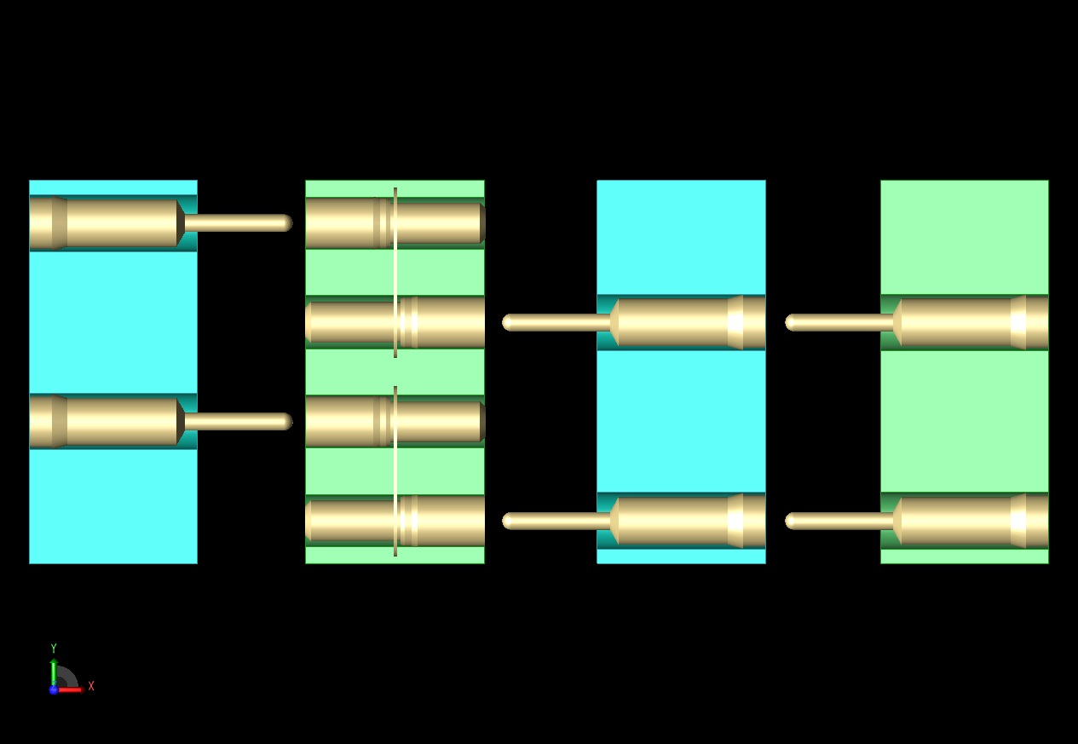
Mill-Max socket: 1701-0-15-84-30-14-10-0
Pin/Socket combo: 0307-0-15-15-30-27-04-0
CR
X
V
U

Slide 15
Wire Board Requirements
Mounted boards must not have any upward protrusions that could interfere with winding
No pins may protrude from any board during APA winding (prevents unrepairable damage)
Joining of boards must be facilitated by screws that align pins and pull boards together (up to 40 lbs of force required)

Slide 16
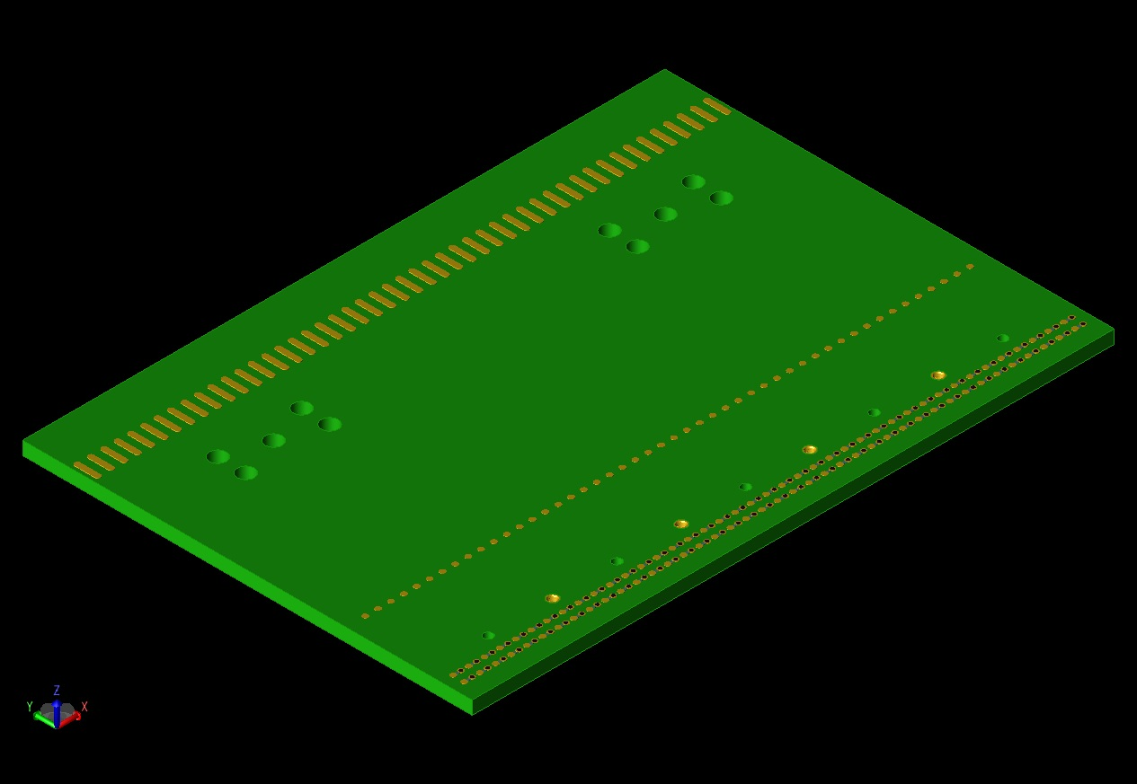
X-Plane boards
48 solder pads for X-plane wires
48 sockets accept pins from CR board
More sockets pass U and V
signals to the CR board

Slide 17
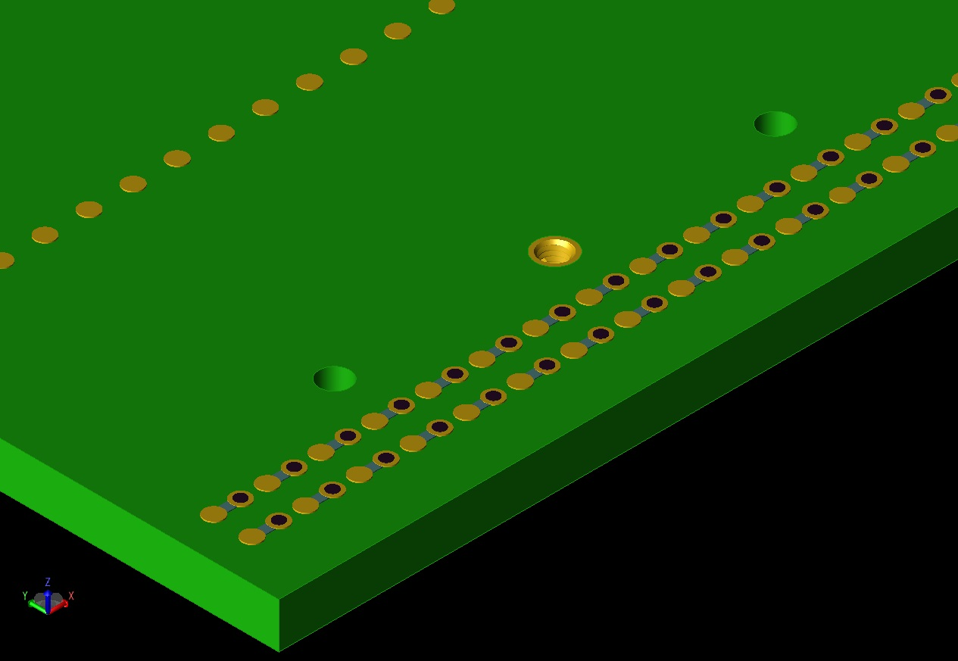
X-Plane boards
Threaded inserts receive screws
to pull boards together

Slide 18
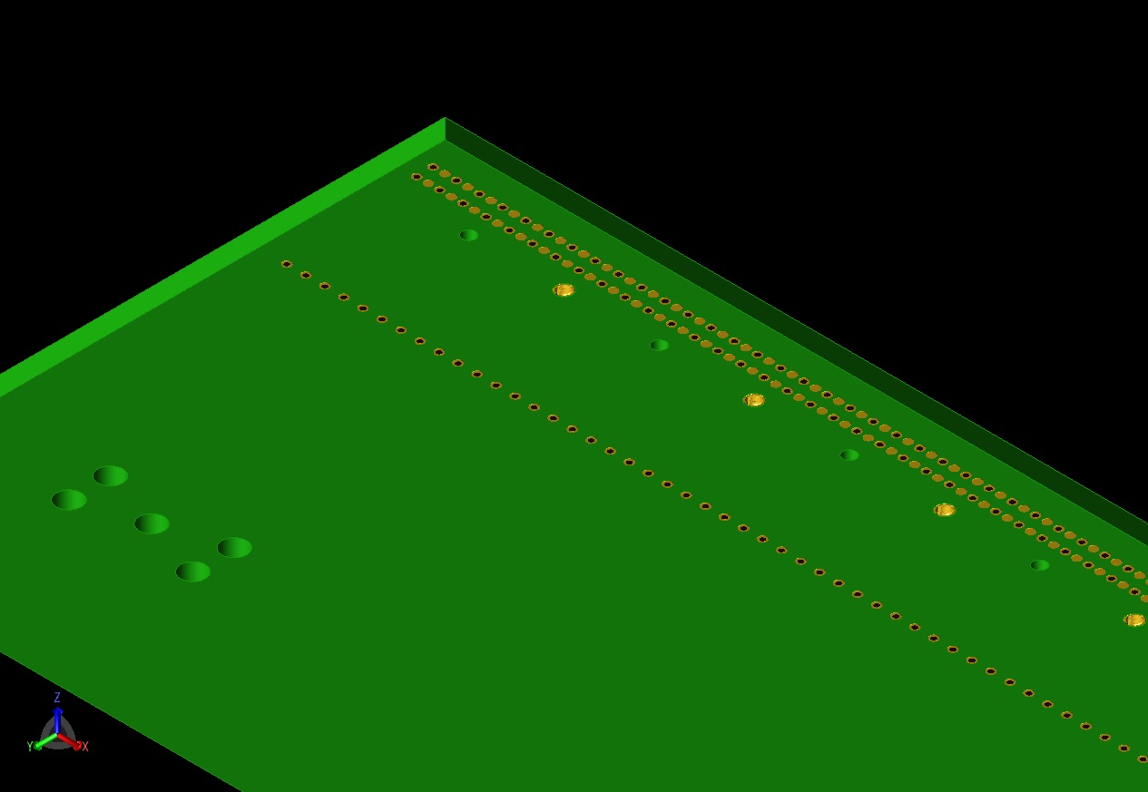
X-Plane boards (bottom view)

Slide 19
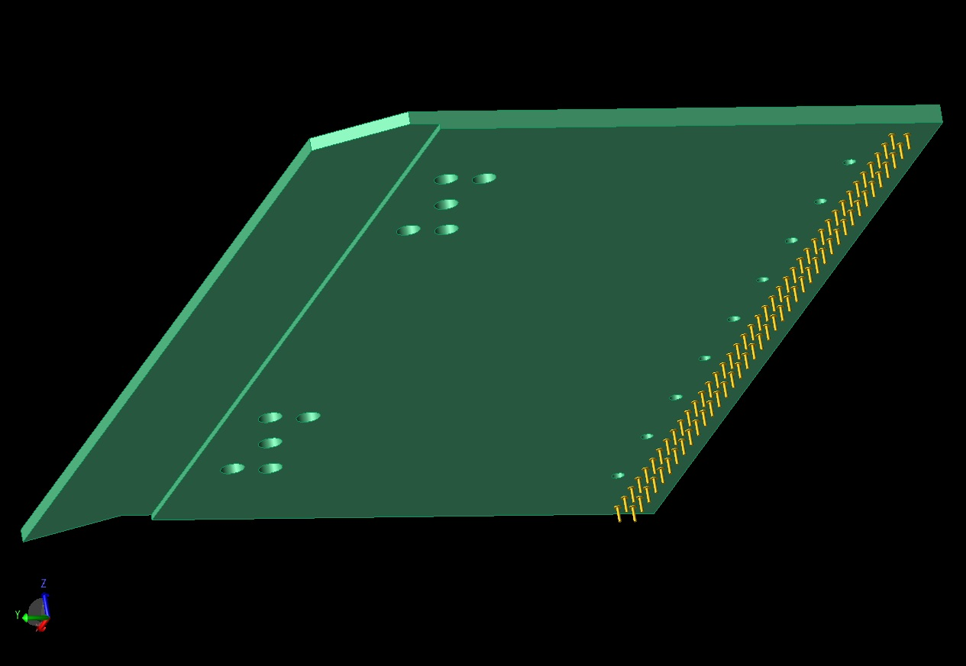
V-Plane boards (bottom view)
Edge is milled to make
room for X-plane wires
Pins plug into the
X-plane board

Slide 20
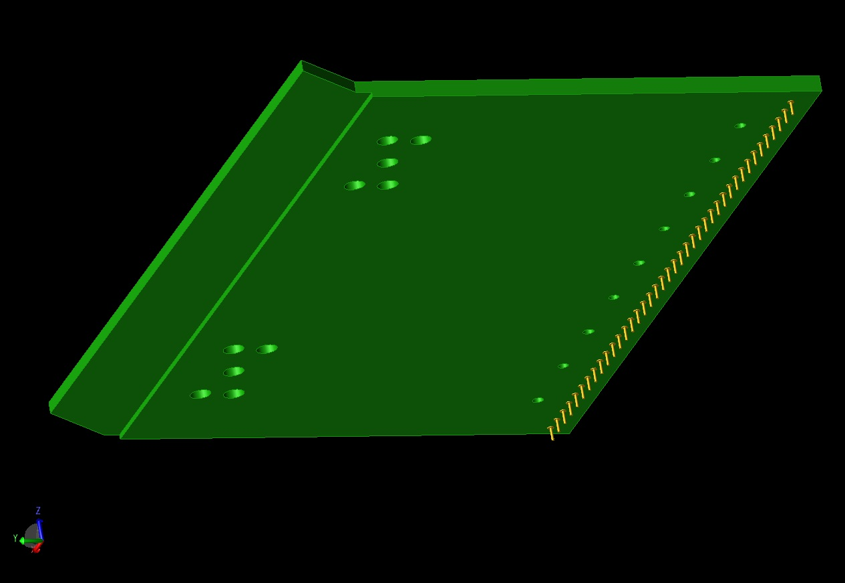
U-Plane boards (bottom view)
Edge is milled to make
room for X-plane wires
Pins plug into the
X-plane board

Slide 21
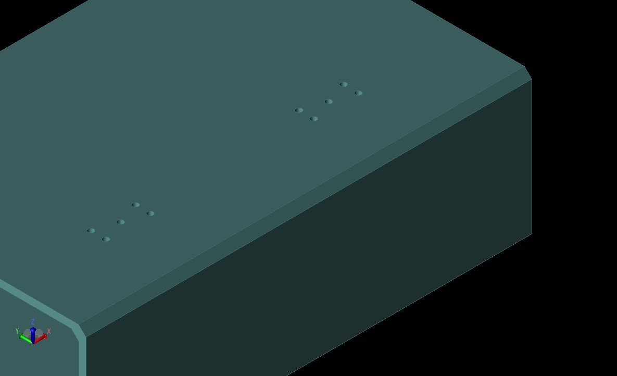
Middle section of APA frame:
Threaded holes in the frame support the wire boards

Slide 22
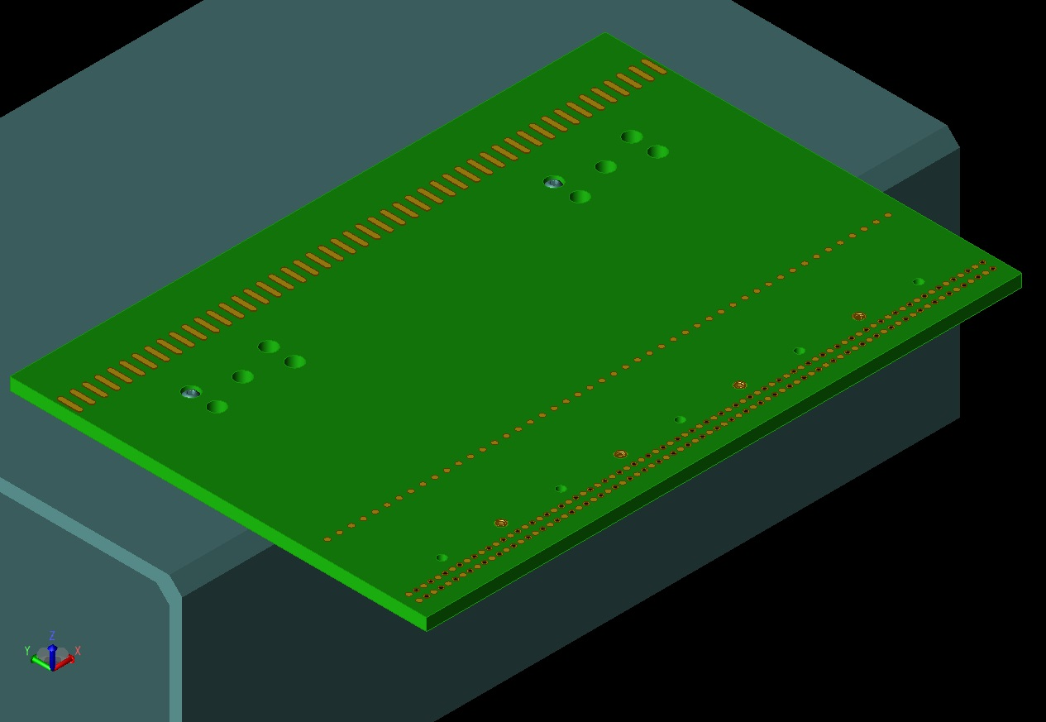
X-Plane boards attach first
Screws are seated in
counter-bored holes

Slide 23
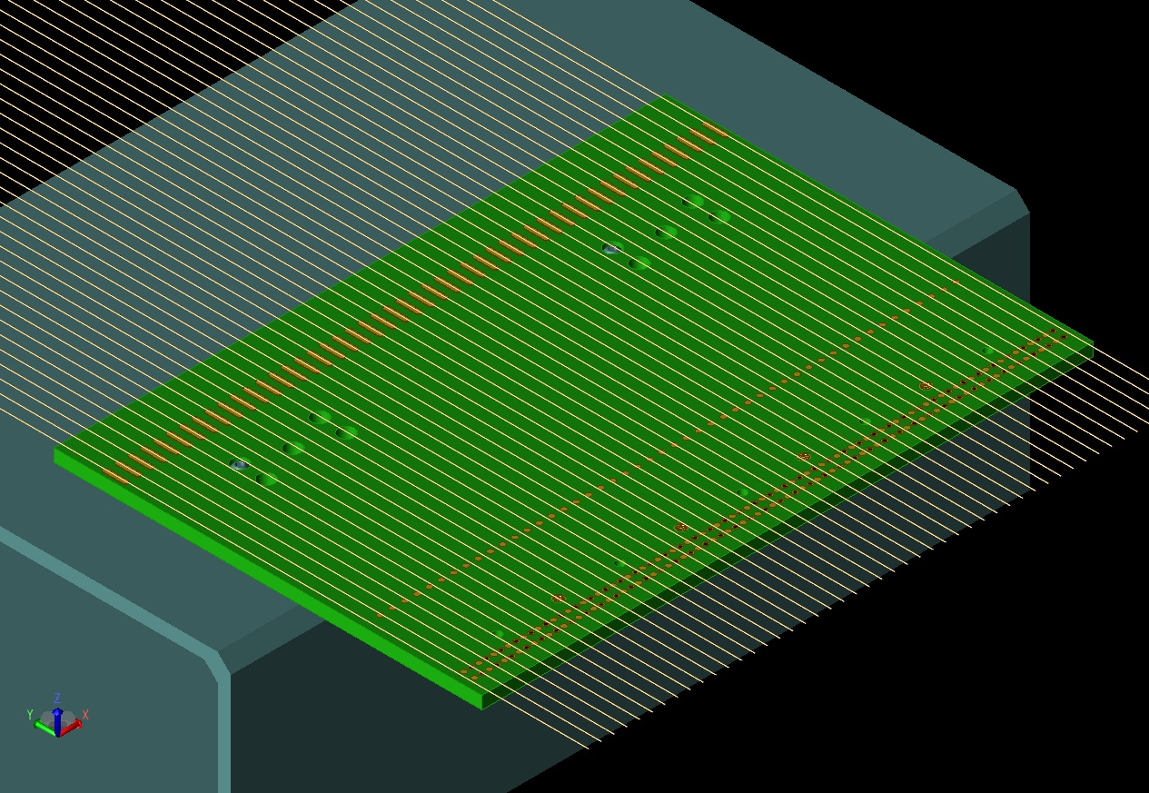
X-Plane wires cross the entire board during winding

Slide 24
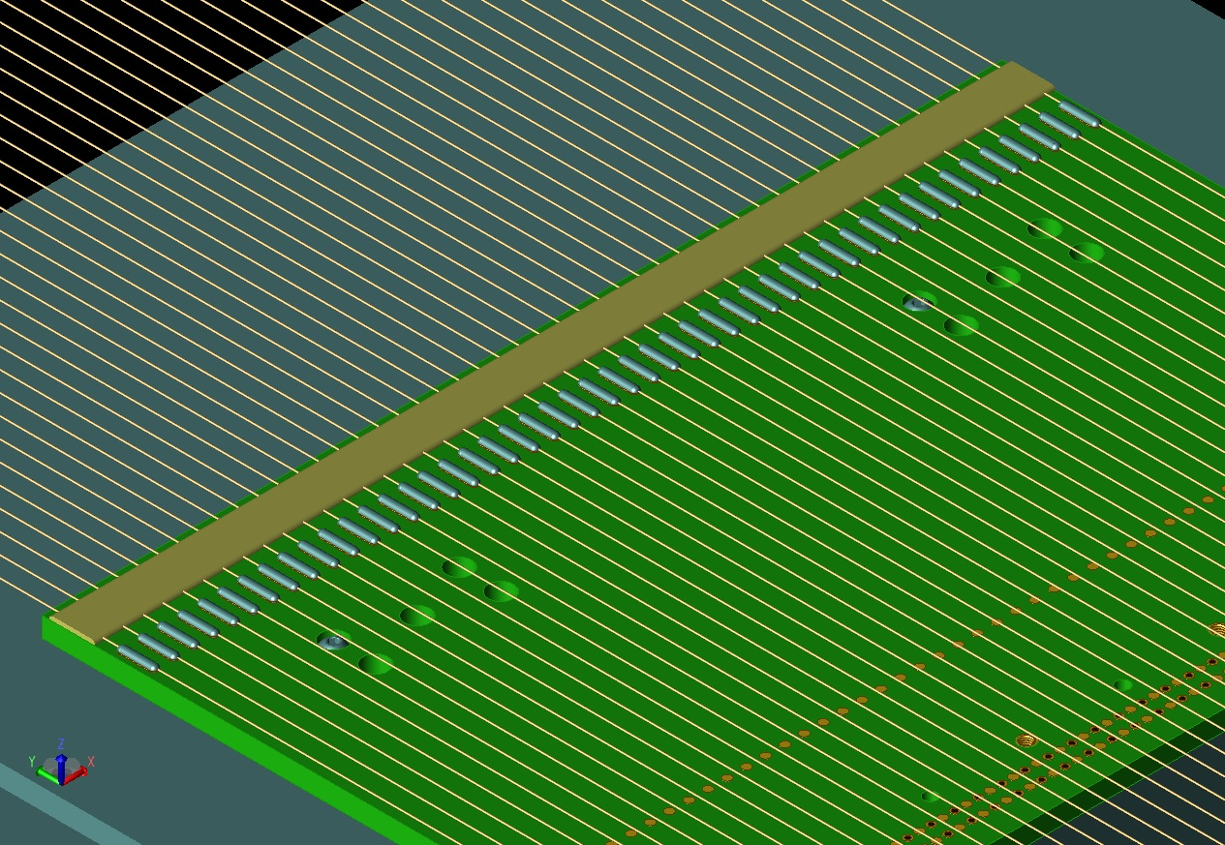
X-Plane wires are soldered and glued

Slide 25
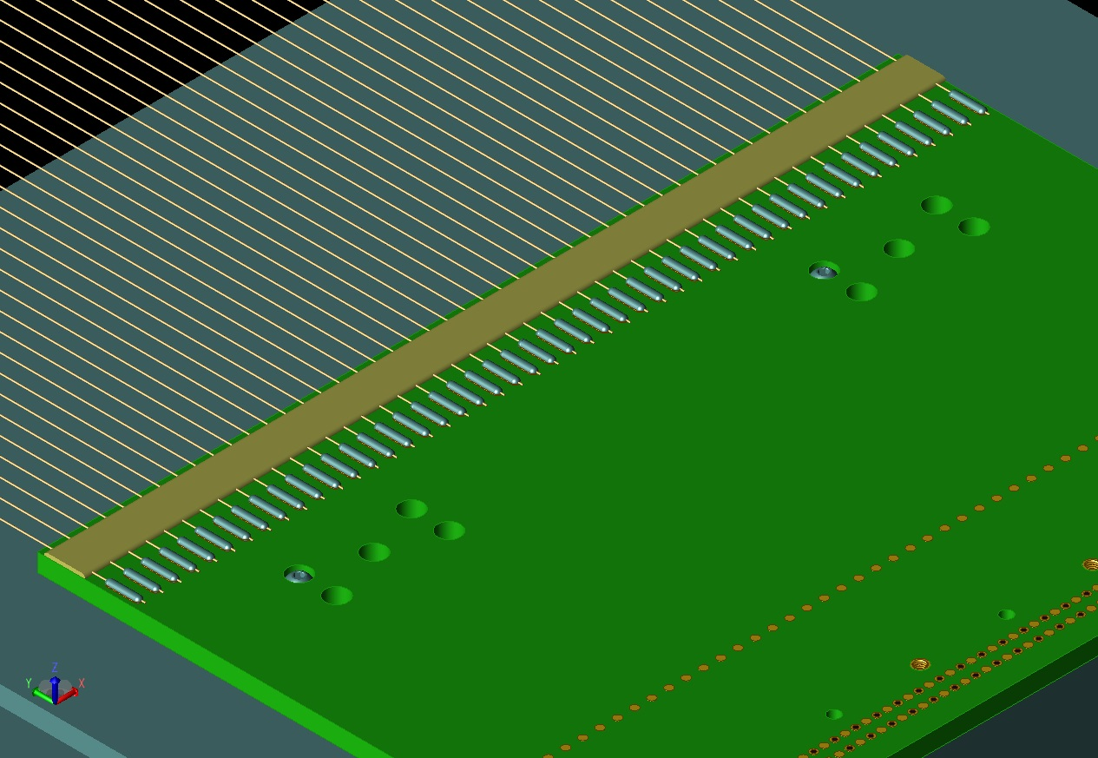
X-Plane wires are trimmed

Slide 26
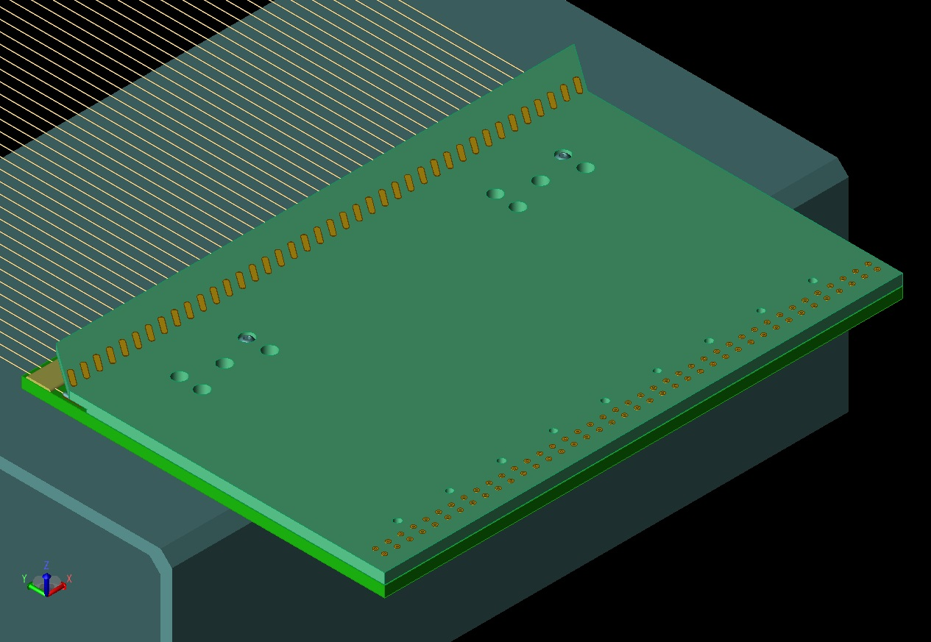
V-Plane boards plug in next:

Slide 27
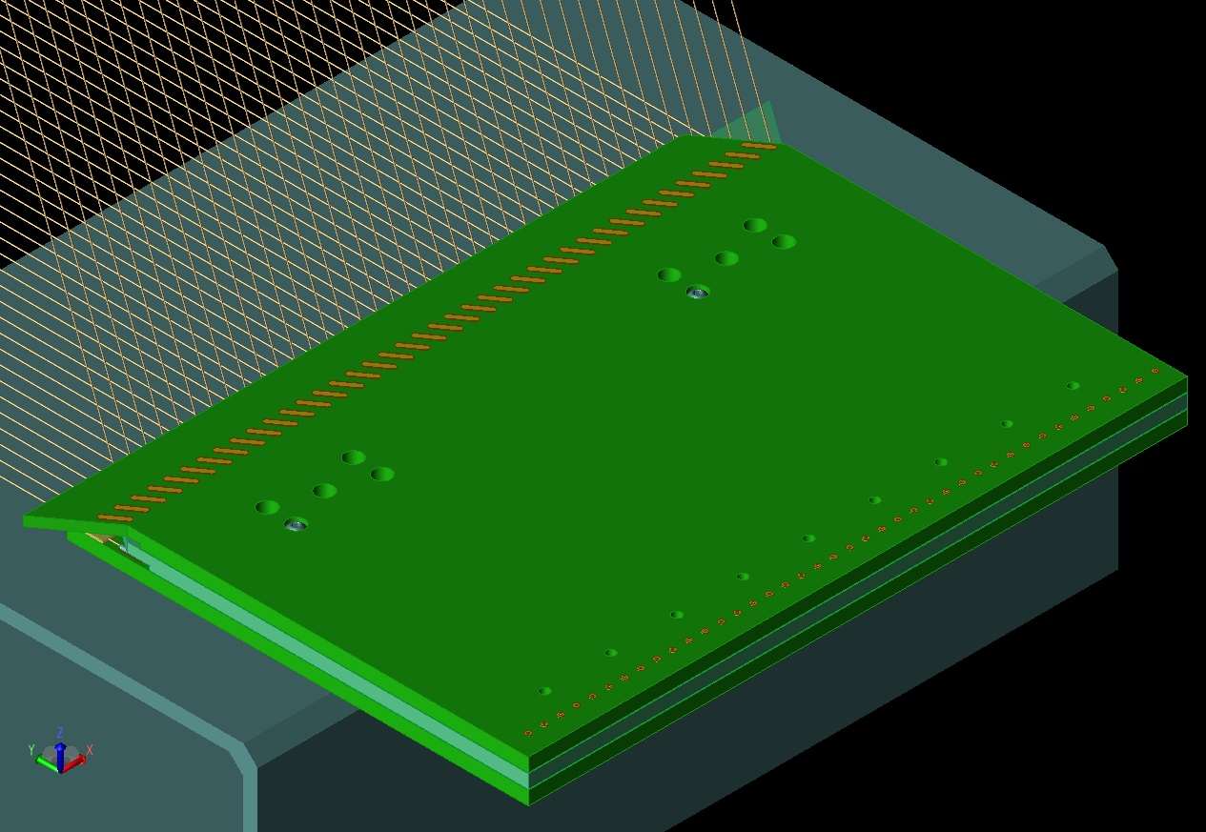
U-Plane boards follow

Slide 28
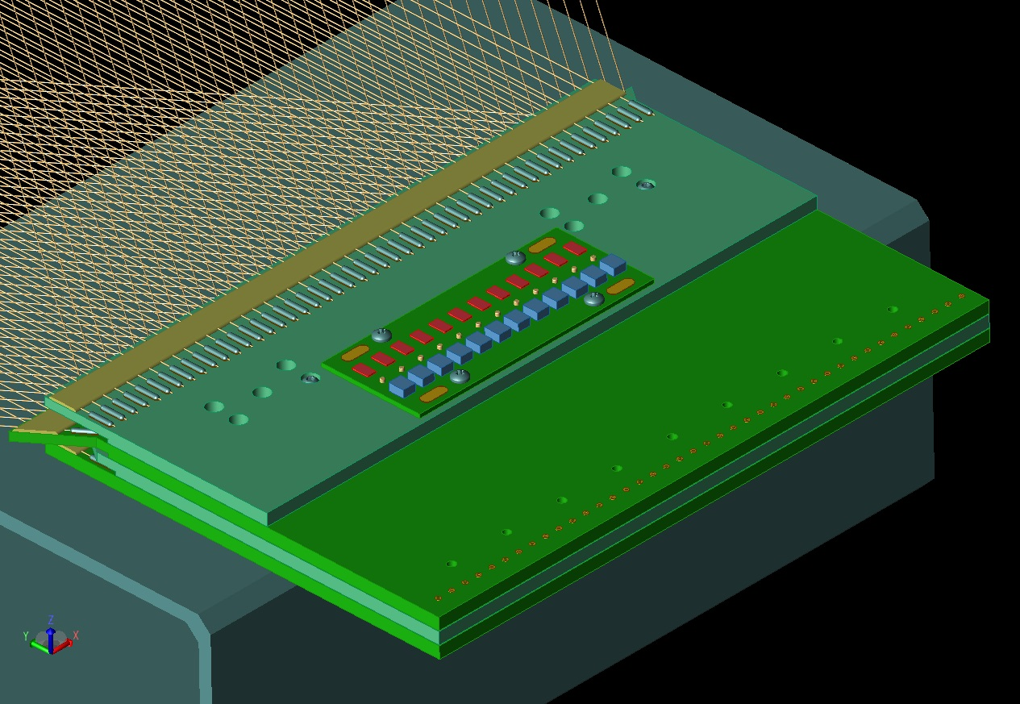
G-Plane boards on top of the stack

Slide 29
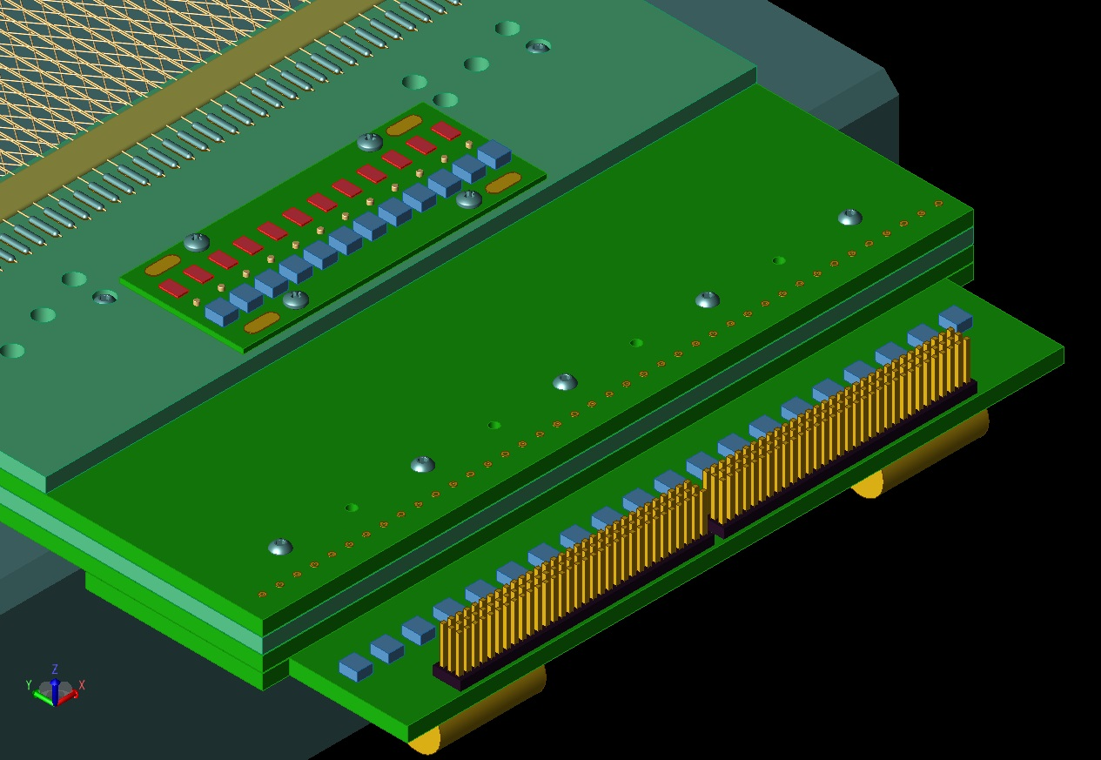
The CR board plugs into the bottom of the X-plane wire board

Slide 30
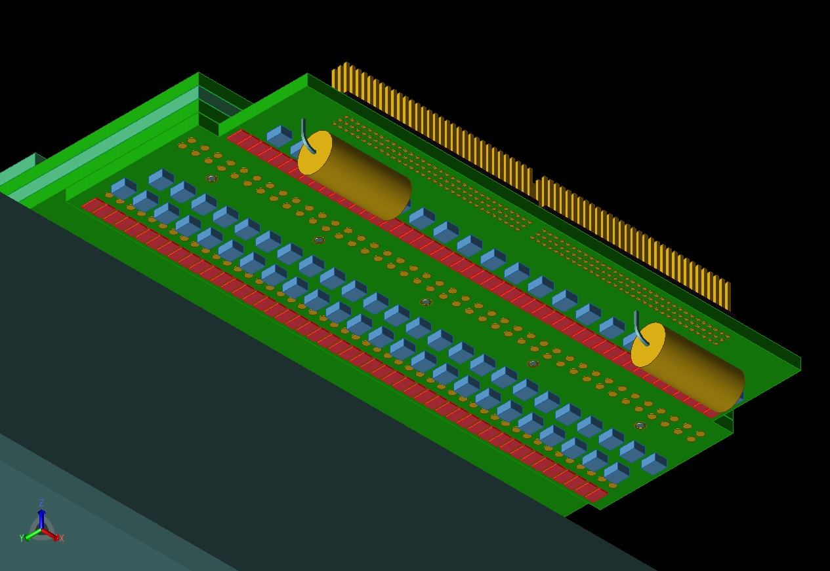
View from below shows most components are on the bottom

Slide 31
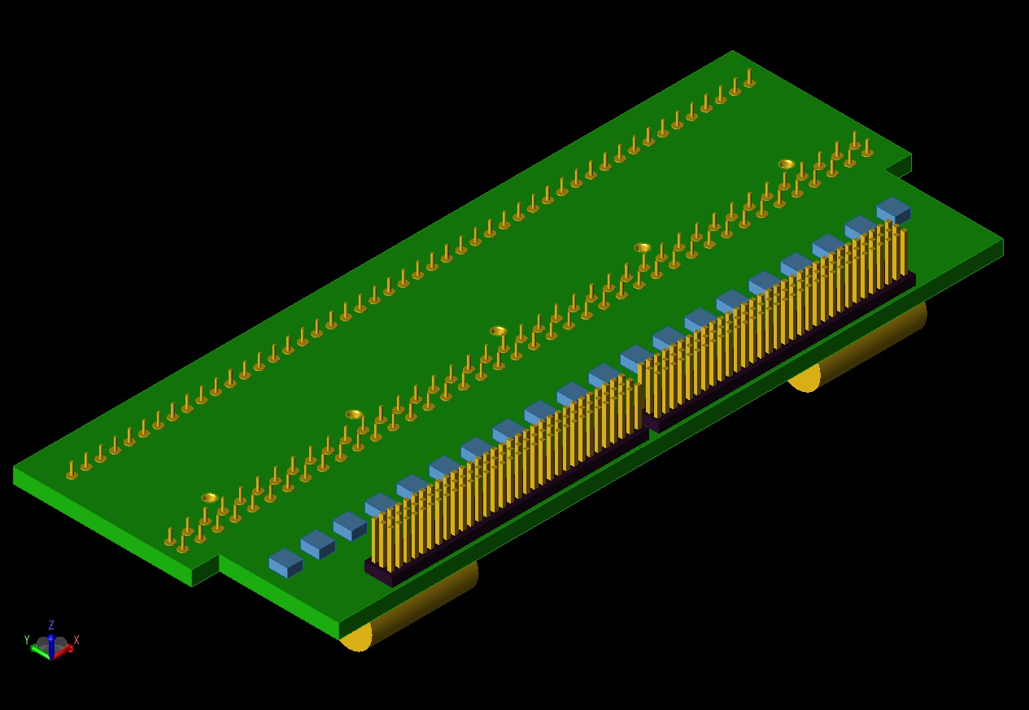
CR Board Top Side:

Slide 32
CR Board Design Status
Board dimensions are determined
Connector locations are determined
Trace-routing strategy is developed
Component packages are selected (required to validate above items)
Components and trace locations are being evaluated relative to IPC standards
Designing for Manufacturability

Slide 33
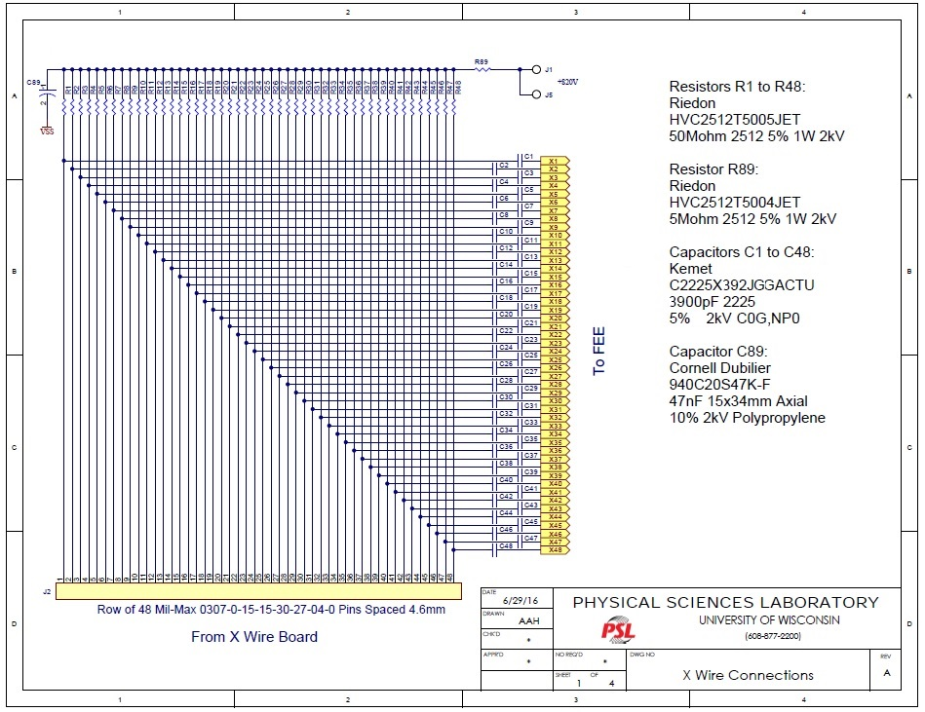

Slide 34
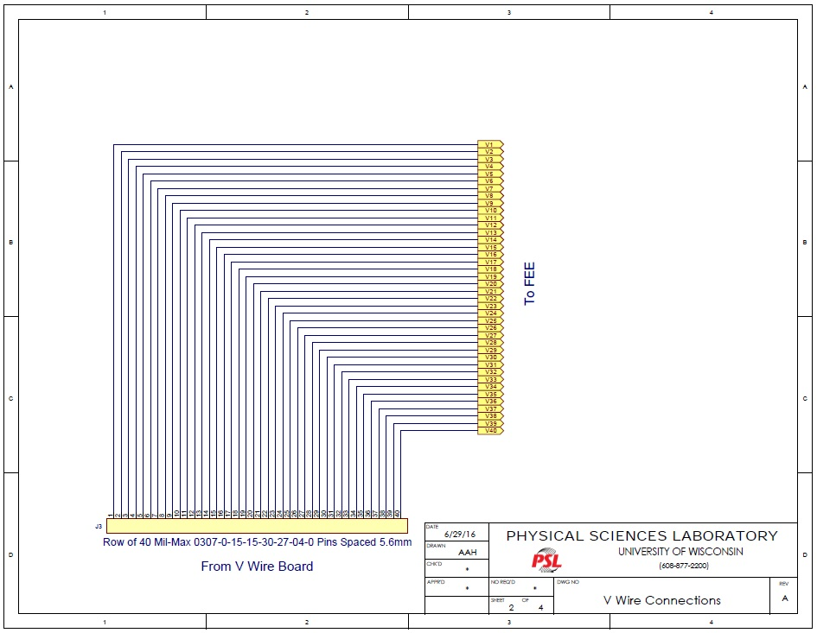

Slide 35
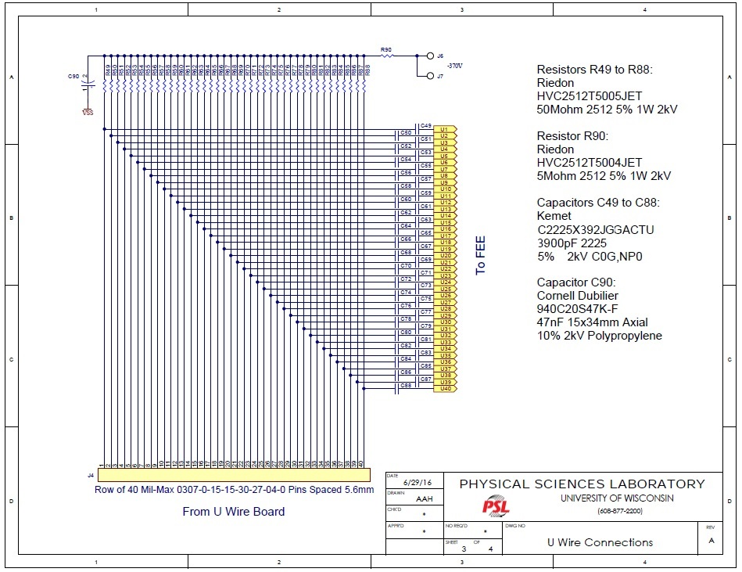

Slide 36
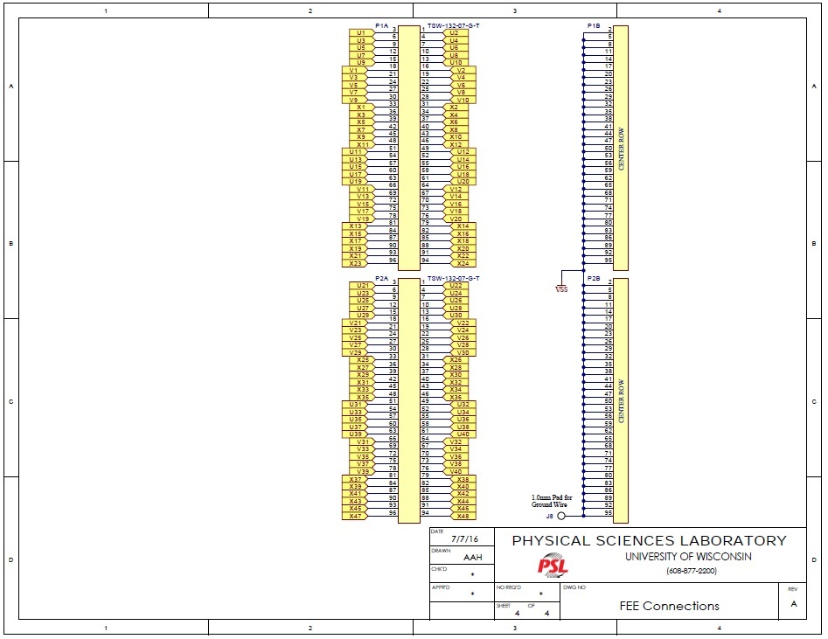

Slide 37
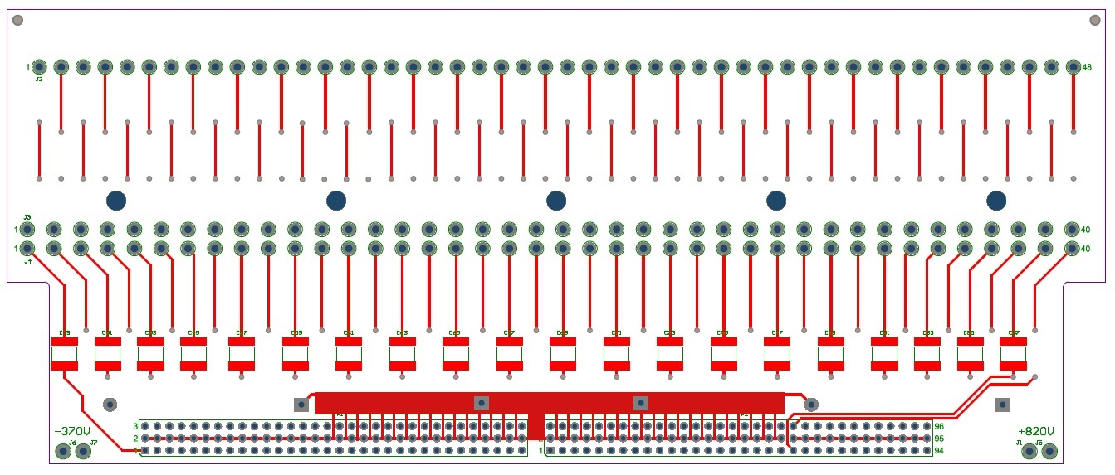
Preliminary CR board layout, Top layer

Slide 38
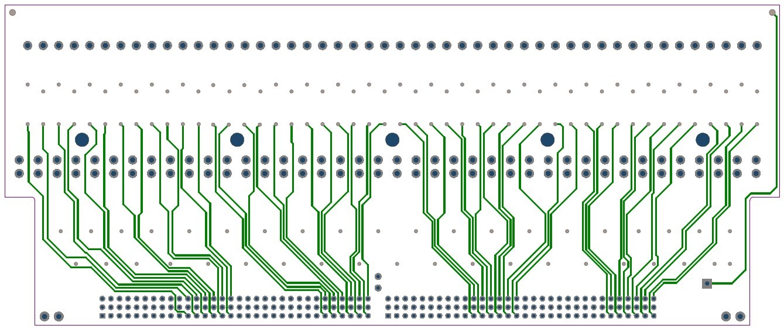
Preliminary CR board layout, Mid-1 layer

Slide 39
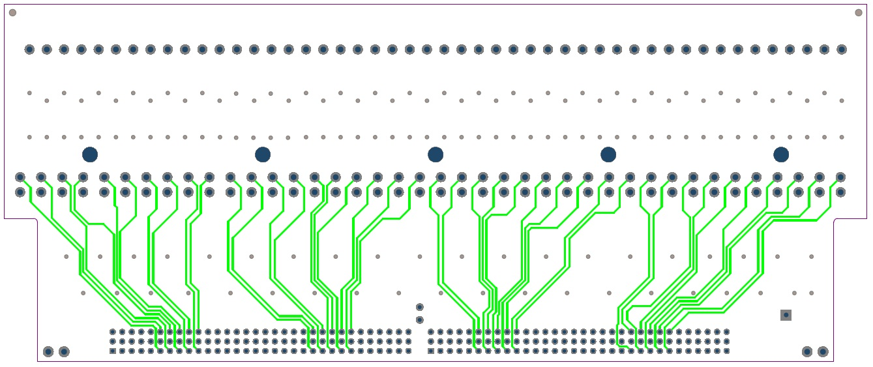
Preliminary CR board layout, Mid-2 layer

Slide 40
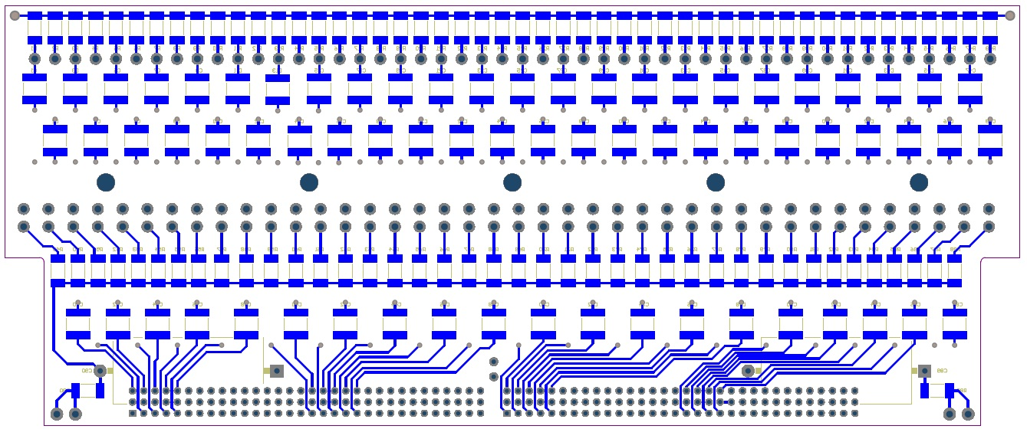
Preliminary CR board layout, Bottom layer

Slide 41
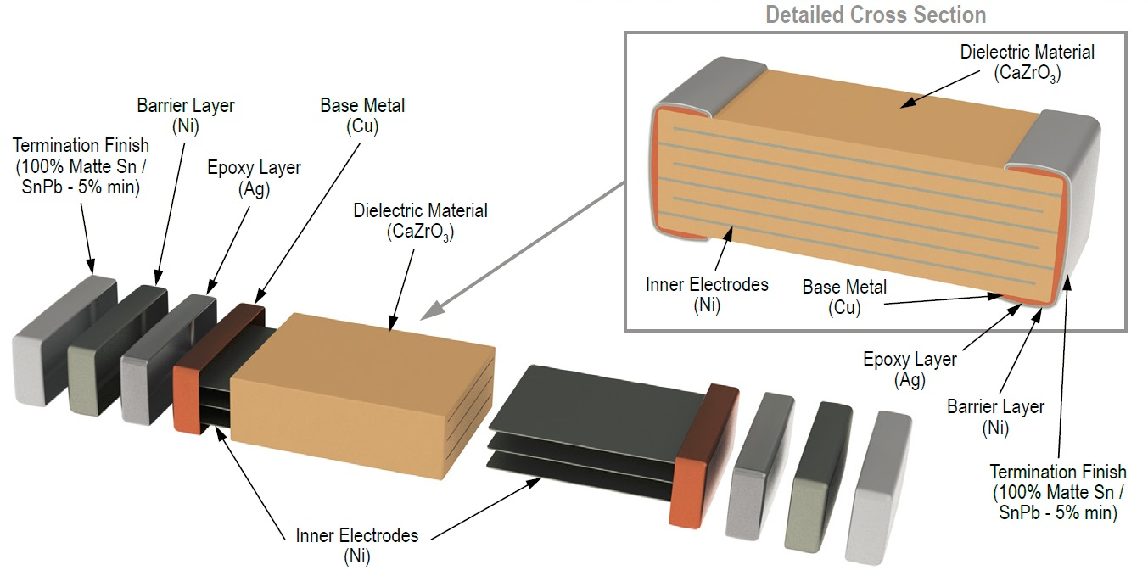
3.9nF 5% 2kV NPO Capacitor, 2225 Package

Slide 42
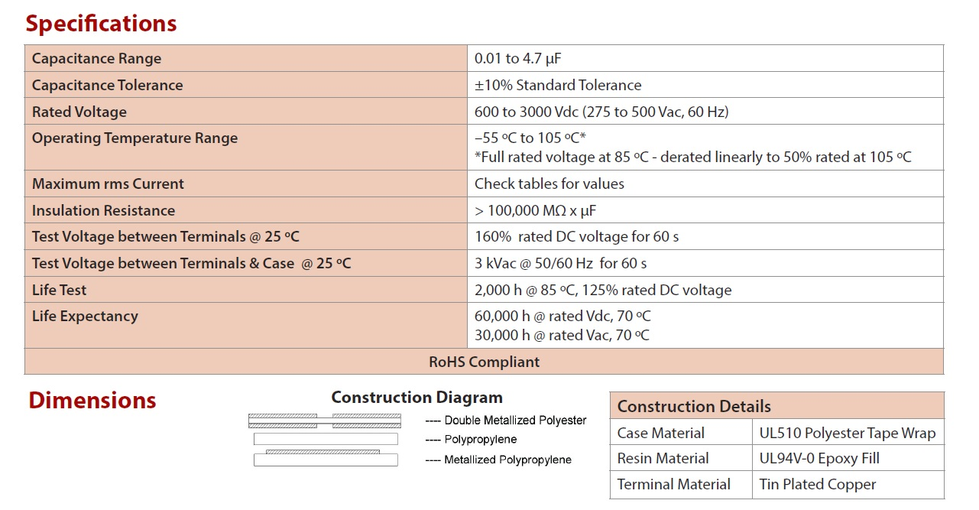
47nF 10% 2 kV capacitor, axial package (bias filter)
ESR = 12 mOhms ESL = 22 nF

Slide 43
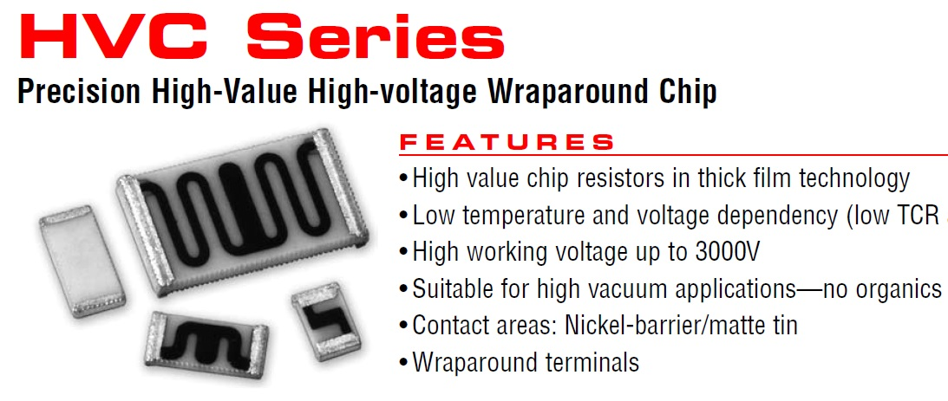
50 Meg 5% 2 kV Resistor, 1225 Package
(Ohmite)

Slide 44
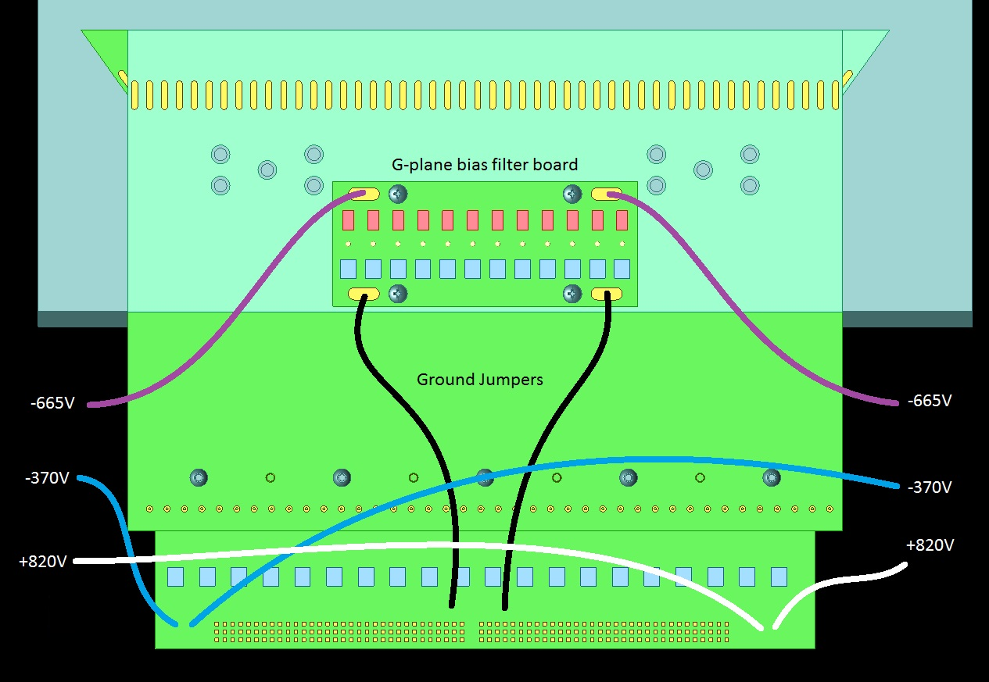
Bias-voltage wiring (details pending)

Slide 45
Design Principles
Select electronic components based on 35T and other LAr experience
Qualify new materials and components for operation in LAr
Meet or exceed IPC standards for circuit board design and manufacturing methods
Apply IPC-A-610 Acceptability of Electronic Assemblies, J-STD-001 Requirements for Soldered Electrical and Electronic Assemblies

Slide 46
Remaining CR Board design tasks:
Adjust traces and component locations to minimize electric field intensities
Evaluate ground connections to minimize resistance and inductance
Develop manufacturing and test plans
Evaluate and select electronic components
Test samples, order long-lead items
Caps: 12 to 20 weeks Resistors: 14 weeks

