Slide 1
Fabrication and Assembly Plans
Dan Wenman
APA Design Review
13 July, 2016

Slide 2
Fabrication and Assembly Plans
Facility
Inventory and process control
APA frame fabrication
Handling the APA
APA with bonded components (mesh and combs)
Assembling the basic APA
Board Assembly
Winding
Tension Checking
Wire anchoring

Slide 3
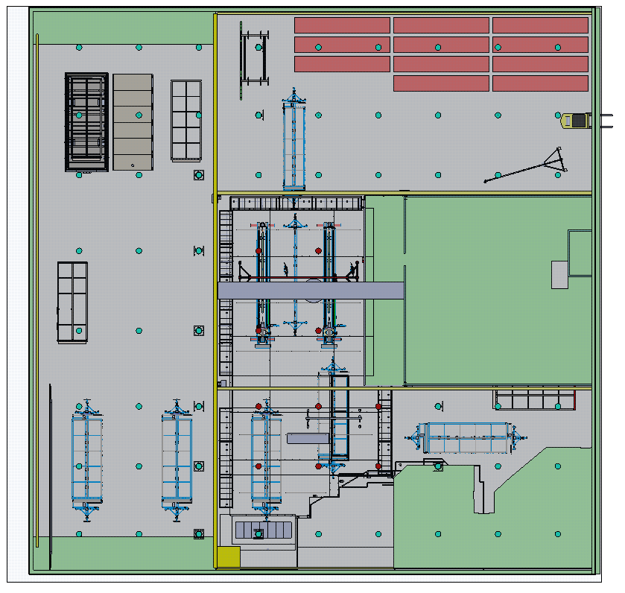
Facility at PSL
The total available space for APA production is 43 x 43 meters (1850m^2).
A clean room with a space of approximately 12 x 24 meters (268m^2) has been built in this space. The target for cleanliness is a class 100k.
N
Clean space
Image: Ken Kriesel

Slide 4
Inventory Control - protoDUNE
All incoming protoDUNE material will be kept in an incoming storage location until it is inspected.
Non-conforming materials will be segregated and tagged as non-conforming until a disposition is made.
Accepted materials will be placed in one of two inventory locations.
Materials that are clean and ready for APA assembly will be kept in the APA factory inventory.
Materials that need further processing in the PSL shop will be kept in a DUNE designated inventory location in the PSL shop and upon completion will be moved to the APA factory inventory.
Parts needed for a specific task will be picked and kitted for the task as needed.

Slide 5
Process Control - protoDUNE
Simple components like machined parts will be inspected against specifications and accepted and rejected per PSL quality procedures.
The APA frame, the CR board, and APA assembly will be serialized and processed according to written procedures. The assembly process, inspection results and test results will be recorded in an associated traveler.
For an examples of a protoDUNE procedures please see the APA review document site. Paper forms of the travelers exist and electronic versions are being developed for use on a tablet.
Procedures and travelers have been written. Some are in draft form and will be finalized as the process prototype is built.

Slide 6
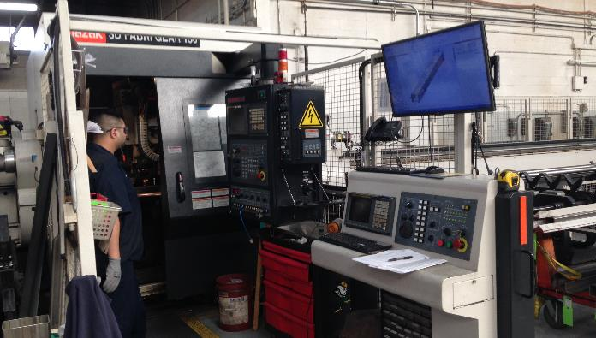
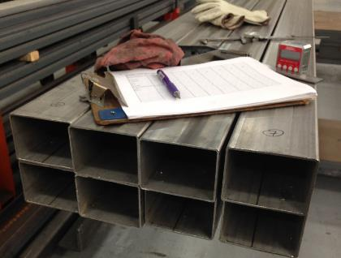
APA frame fabrication
The five major structural elements of the bolted frame subcontracted.
We purchase the tube stock and have it dropped ship to our subcontractor and fully inspect it on site before fabrication.
Goals of inspection
Make sure stock meets industry standards.
Assign stock to frame components in a manner to increase frame accuracy.
Upon receipt of stock, the components are inspected against print tolerances.
Long side tubes require further processing at PSL. Endcaps are welded and machined to final length.
Inspection of SS tubing at Ace Metalcraft
Tube processing machine

Slide 7
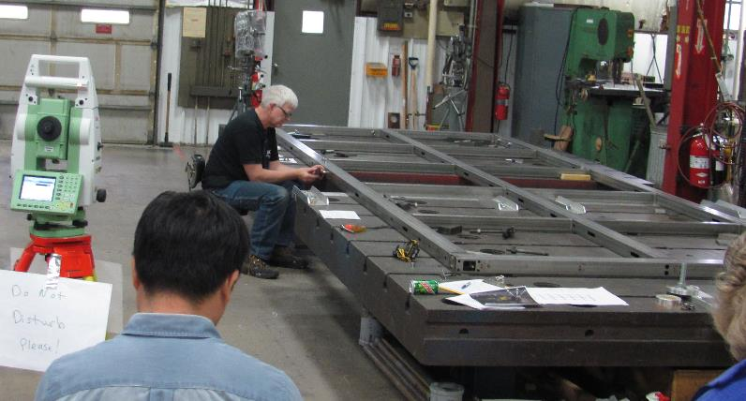
APA frame fabrication
The bolted frame is then assembled following the Frame Assembly Procedure . Each frame is serialized and the assembly process will be documented with a frame traveler.
The frame is assembled on our 24 x 10 foot flat assembly table.
A procedure of careful alignment, clamping and shimming is used to maximizethe frame accuracy and minimize stored energy in the frame that may cause frame twist when the clamping is released.
The completed frame is then inspected against tolerances for feature location and frame flatness.
Frame is carefully aligned and shimmed

Slide 8
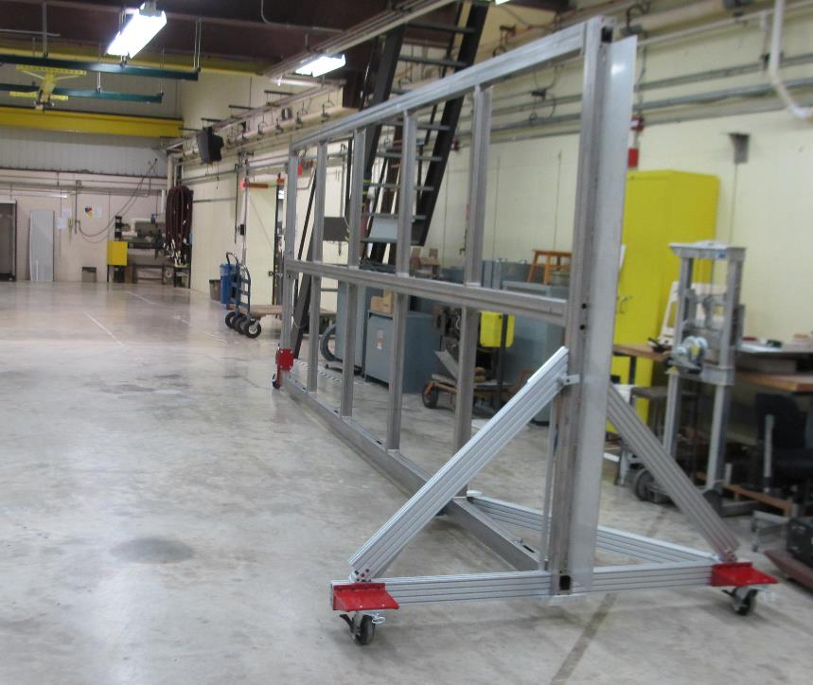
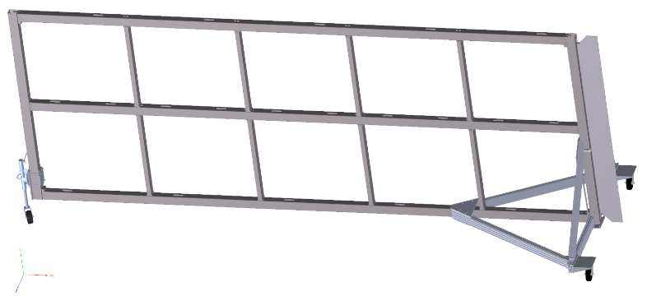
Handling the APA frame
Transport cart for delivery of the frame from the shop to the factory
Image: Ken Kriesel

Slide 9
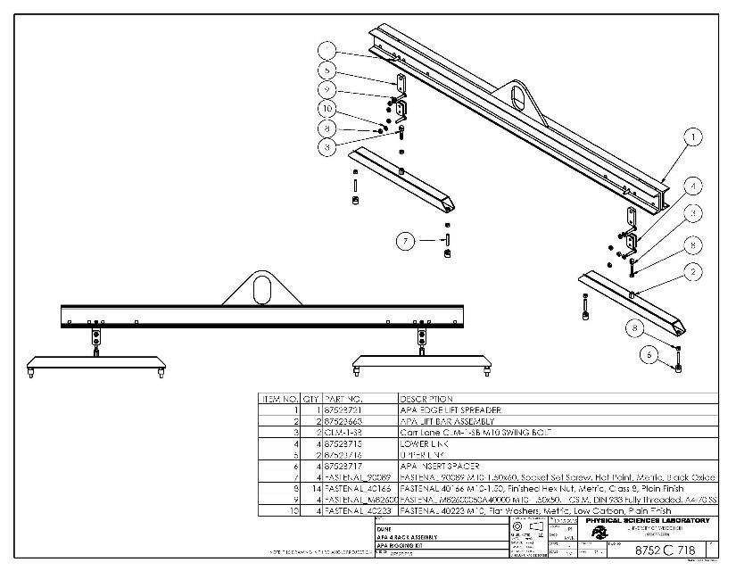
Handling the APA frame
The APA vertical (edge) lift kit
This rigging kit connects to four 10mm rivnuts crimped into the edge of the APA frame. Holes in the edge boards allow for access to the rivnuts through the assembly process. (The rivnuts are also available for crating and installation purposes.)
Status – complete.

Slide 10
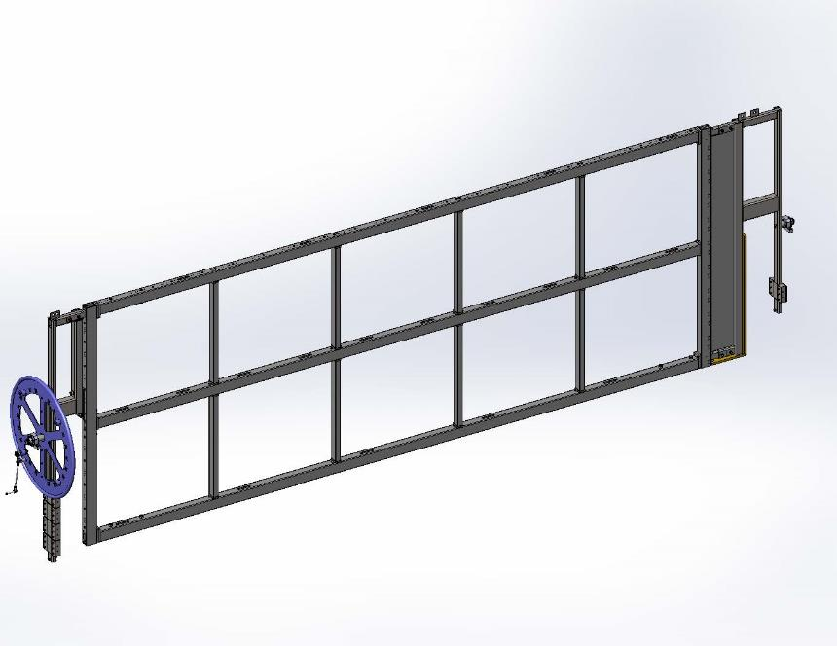
Handling the frame
The APA trunnion assembly.
“Interface frames” mount to the head and foot end of the APA frame and provide a trunnion mount to the assembly to add in handling during winding and other processing steps.
Interface frame – head end
Interface frame – foot end

Slide 11
Handling the frame
The APA trunnion assembly – cont.
To install the interface frame, the APA frame is supported with the vertical lift kit and the interface frame is supported on a mobile hand operated crane.
The trunnions have a pillow block mounted spherical bearing on each end. The bearing is fixed axially in the trunnion on the “”wheel” end and can slide axially on the head end. The pillow blocks are pinned to maintain registration as needed.
Counter balance weights on the interface frame allow for fine balancing of the interface frame to prevent twisting the APA frame.
FEA has been used to analyzed the stress and deflection of the interface frames. The design was driven by keeping the APA trunnion assembly deflection less than 4cm. The results can be found on the APA review document site.

Slide 12
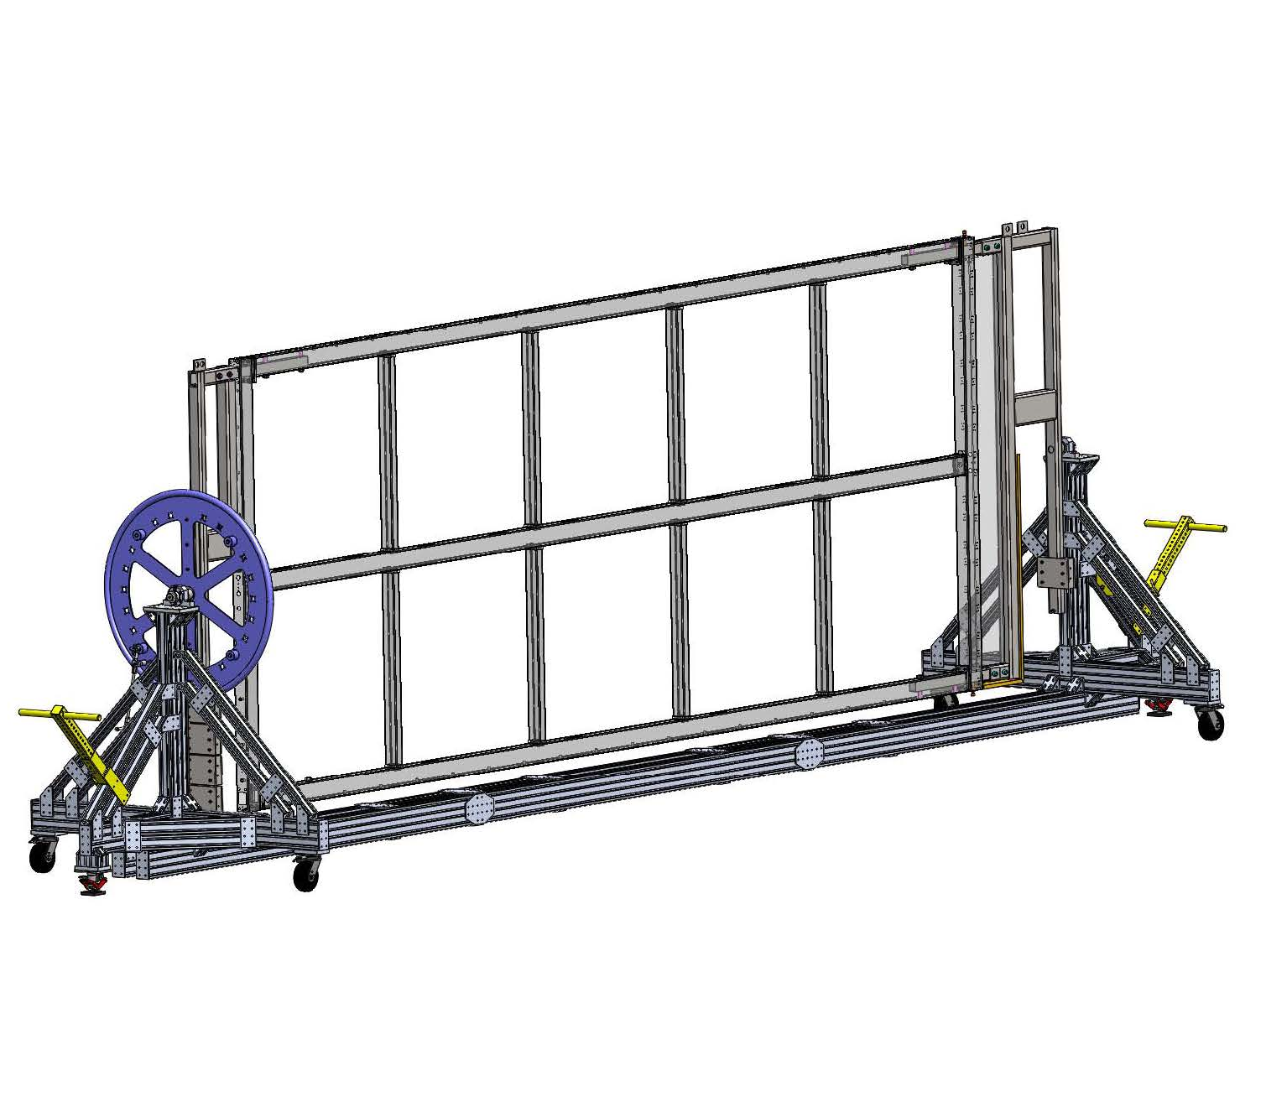
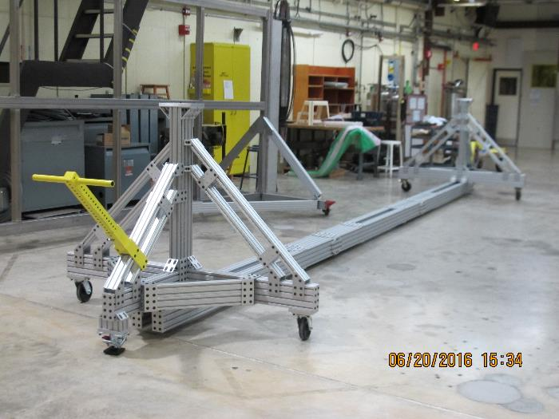
Handling the APA frame
The Process Cart.
The APA with Trunnion can then be mounted in the process cart.
Allows for rotating the APA on its long axis 360 degrees.

Slide 13
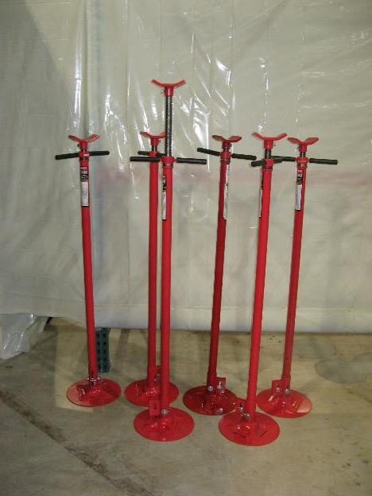
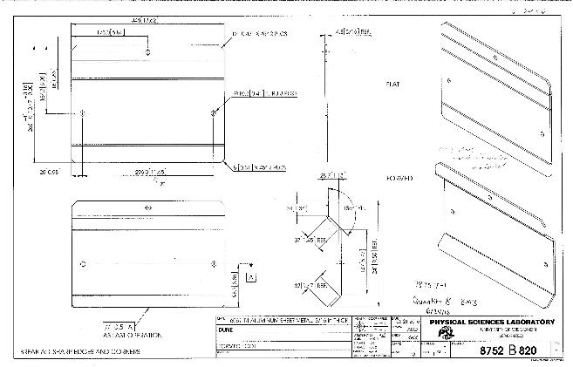
Handling the APA frame
The Process Cart.
Most operations in the process cart will be done with the APA horizontal and supported on its edge with jack stands. The load will be transferred to the APA through “feet” attached to the rivnuts on the edge of the frame.
Holes for mounting to frame rivnuts
APA feet
Jack stands

Slide 14
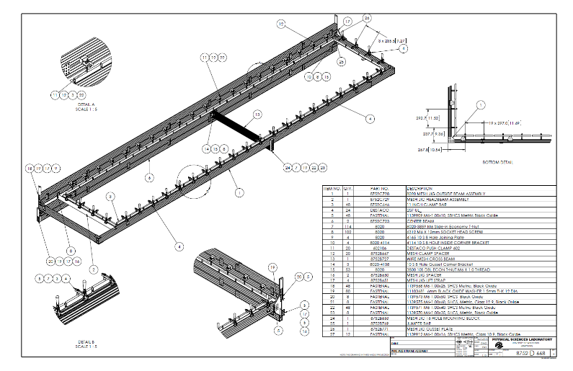
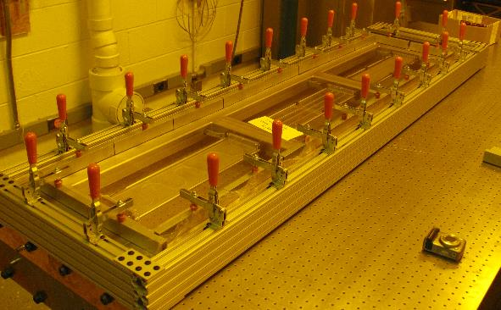
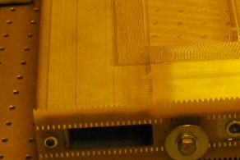
APA frame with epoxied components
The first assembly step of preparing a frame for assembly is to bond the mesh on to the APA frame.
Commercially available mesh is 1380 mm wide and is applied to one half of an APA at a time.
A custom mesh jig is used to stretch and clamp the mesh to the APA frame during epoxy application and cure.
After cure, the jig is removed and the mesh is trimmed.
35ton Mesh jig
Bonded mesh
protoDUNE mesh jig

Slide 15
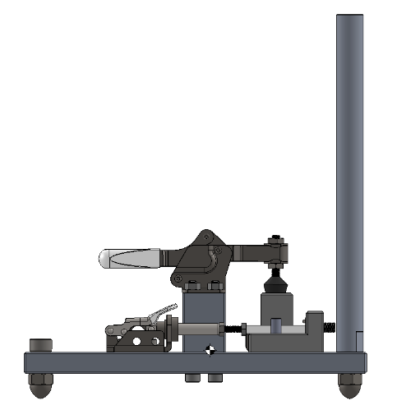
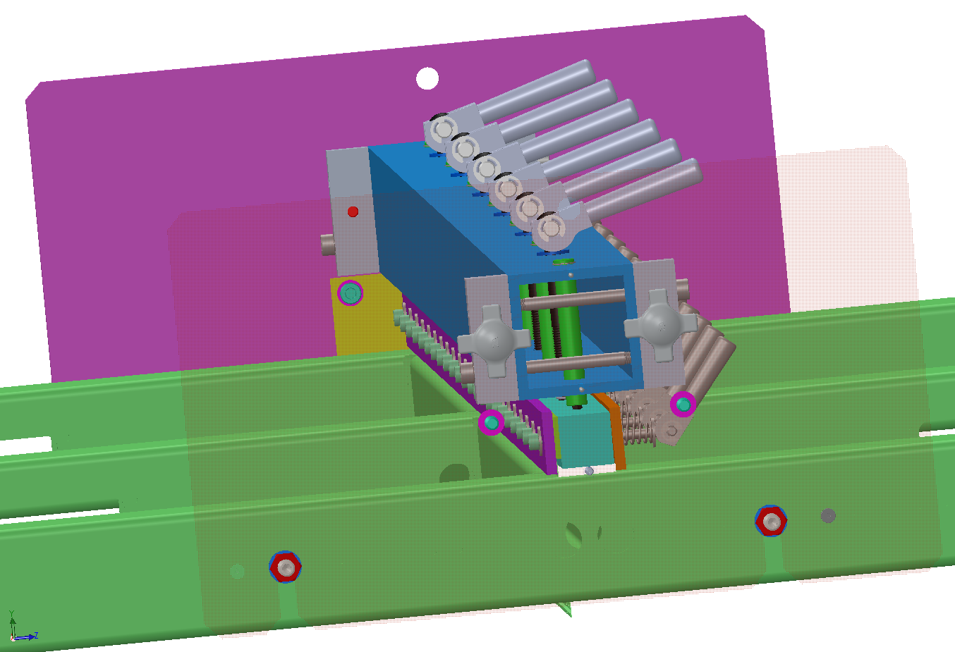
APA frame with epoxied components
The second step of preparing a frame for assembly is to bond the wire combs on to the APA frame.
A “comb base prep jig” and comb base install jig is required for this process.
Comb base prep jig – registers and clamps the x layer comb to its base. Status: Design is complete and fabrication has begun.
Comb base install jig – registers and clamps the x layer comb to the frame. Status: Design is complete and fabrication has begun.
comb
Images: Ken Kriesel
base
Comb and comb base assembly

Slide 16
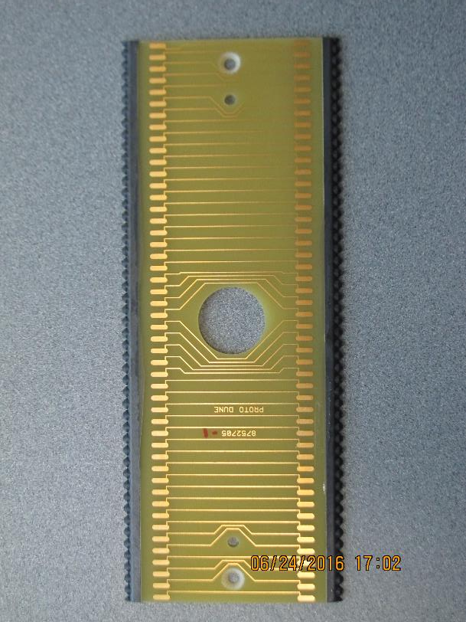
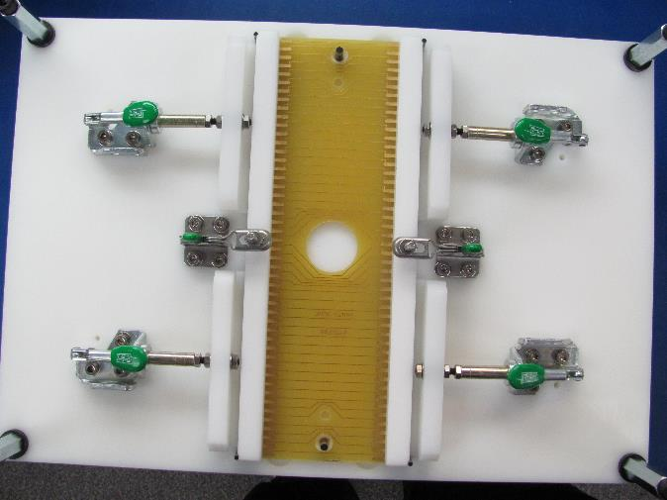
Board assembly
Assembled edgeboards are needed for the to begin the assembly of the basic APA.
Edge board tooth strips are bonded to the edge of the G-10 boards using custom tooling jigs.

Slide 17
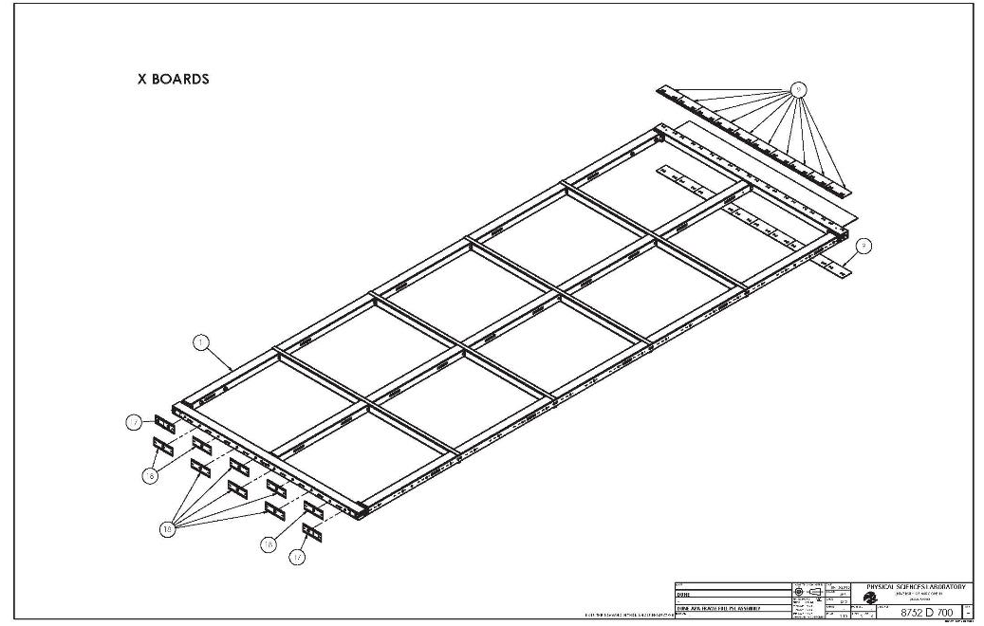
Board assembly
Edgeboard assembly
With the APA frame horizontal in the process cart the X-layer edgeboards and wireboards are mounted to the frame using board alignment sleeves and mounting screws.

Slide 18
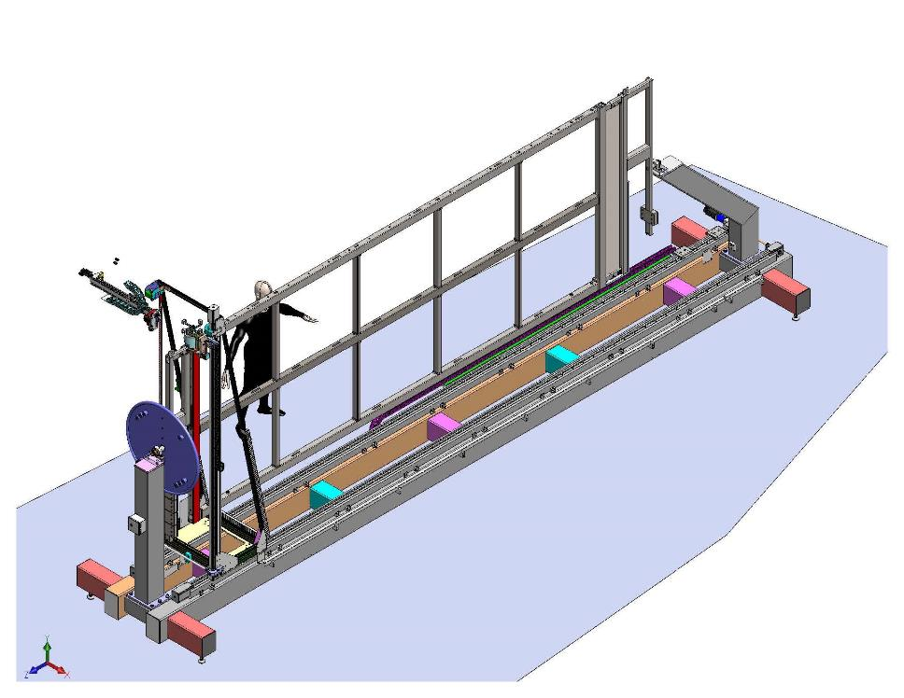
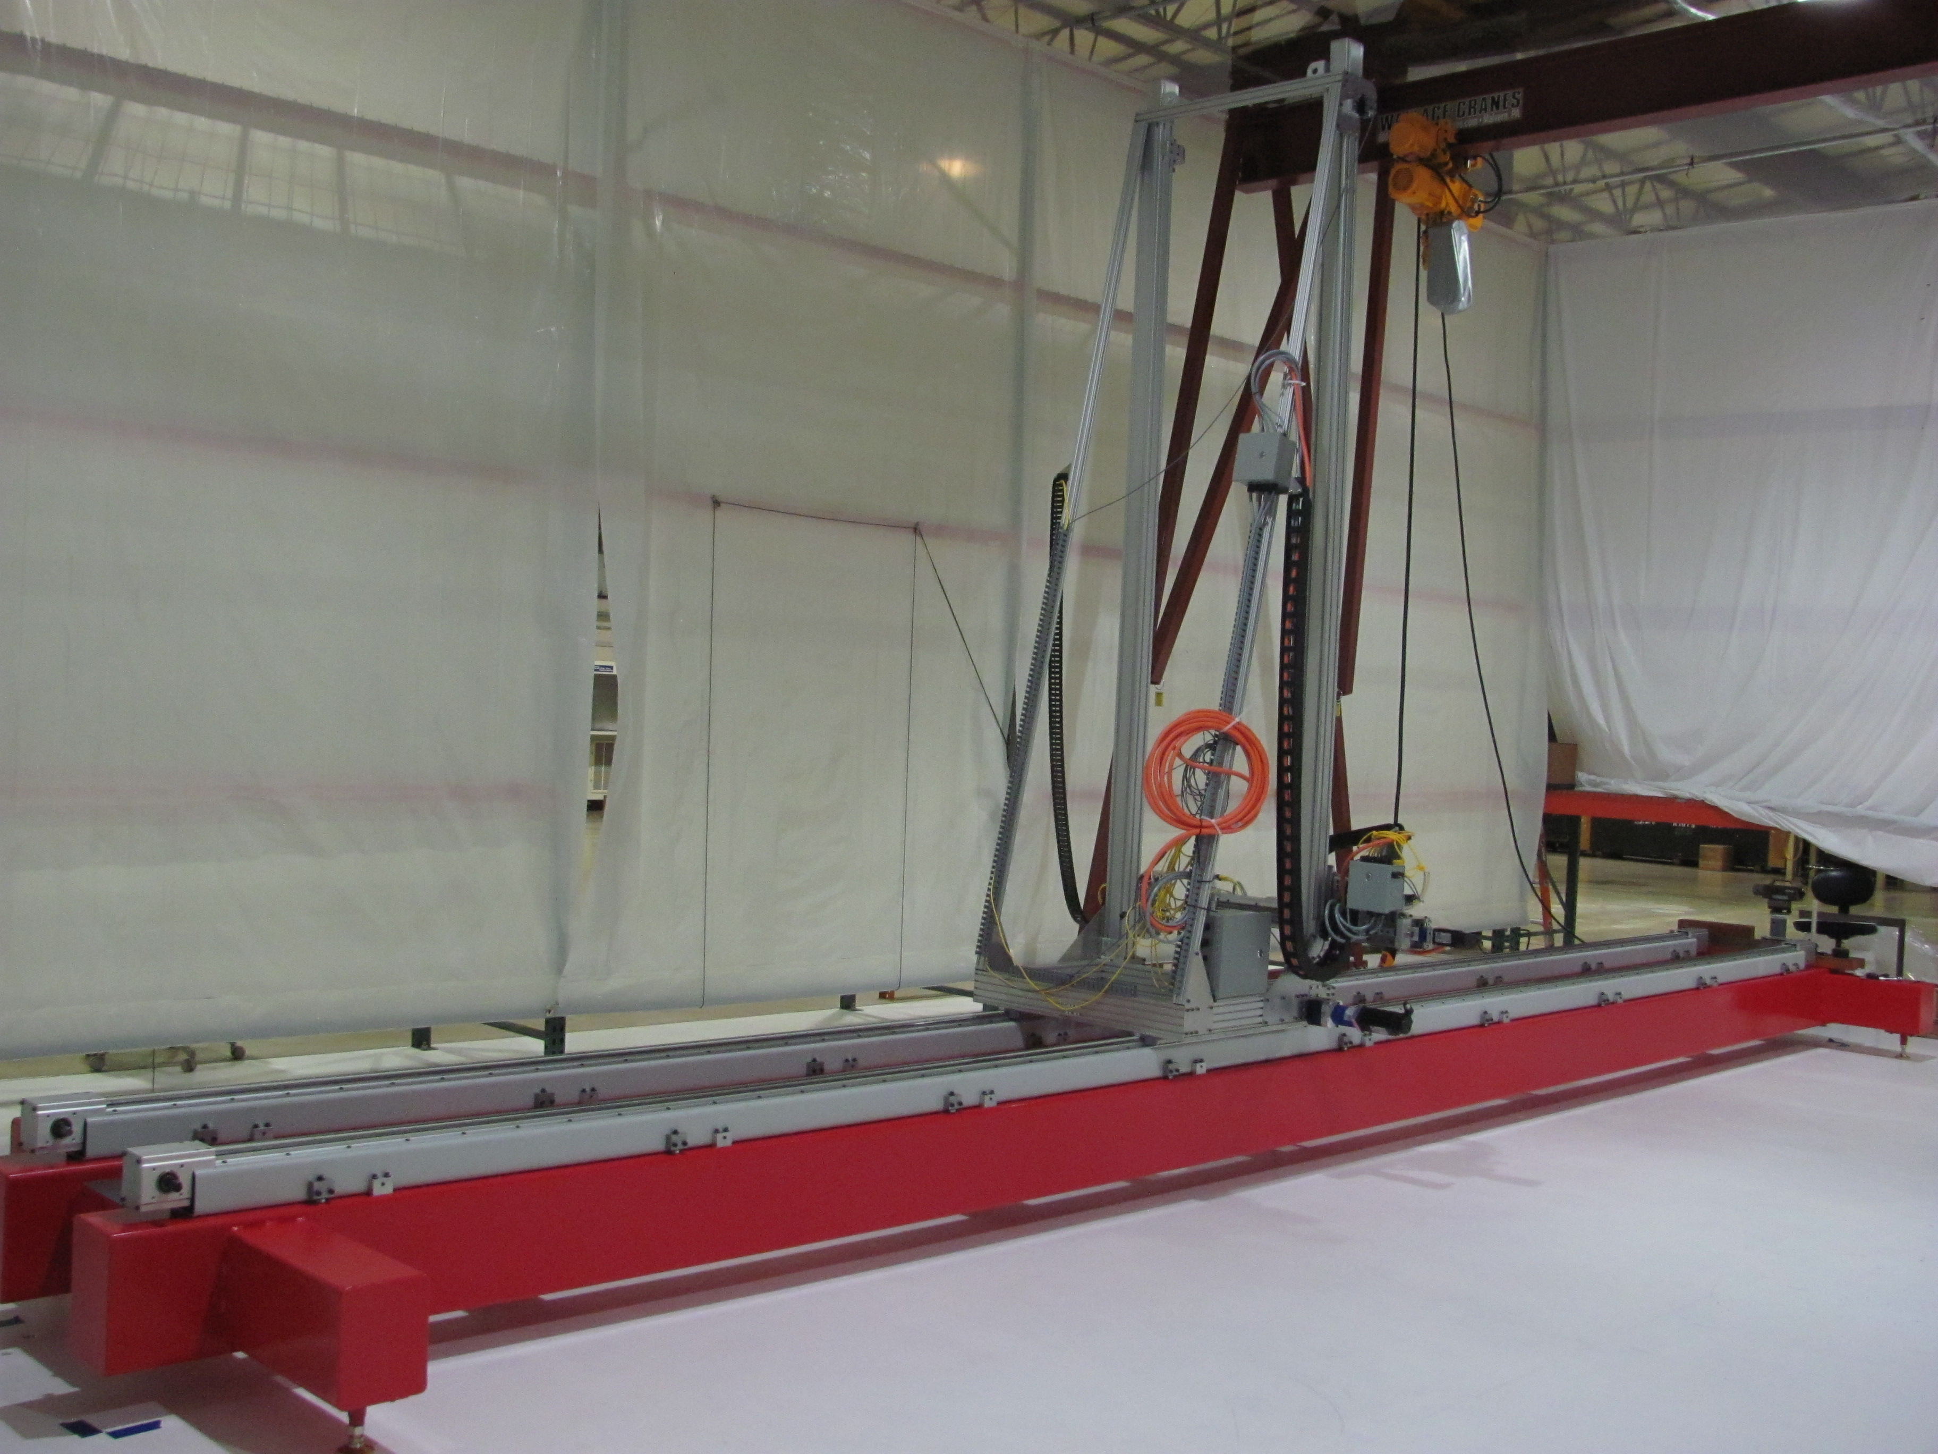
Winding
After the boards are mounted, the APA is rotated vertical (on edge) and the APA trunnion assembly is lifted into the winding machine with the vertical lift kit.
Iso view of the winding machine
Status as of June 22, 2016

Slide 19
Winding
The winding machine
Under development for a little over a year.
Wraps 28km of wire on each APA. ( A few of these km are eventually trimmed off in the process.)
Accurately passes a winding head that wraps tensioned wire around the APA in a continuous process. (Wires will be periodically soldered to limit redo if a wire breaks.)
A vision system accurately measures the location of the edgeboard pins in the machine coordinate system.
The design passed an external design review in December of 2015.
Many documents including the system requirements document, software requirements document, FMEA, and the test and integration plan can be found on the APA review document site.
Near term schedule:
Process prototype to be in the winder the week of the 18th.
The vision system to be tested the week of the 25th.
Start winding the process frame on August 2.

Slide 20
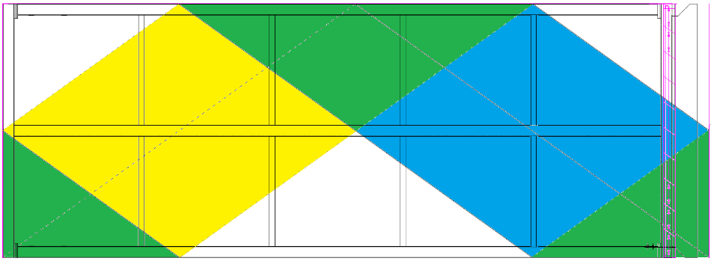
Wire distribution after winding a half layer
Top edge in winding
Both sides in green
Back wires in yellow
Front wires in blue
image: Ken Kriesel
One half of a layer is wound at a time and then the wires are anchored and the APA is rotated 180 degrees and the second half of the layer is wound.

Slide 21
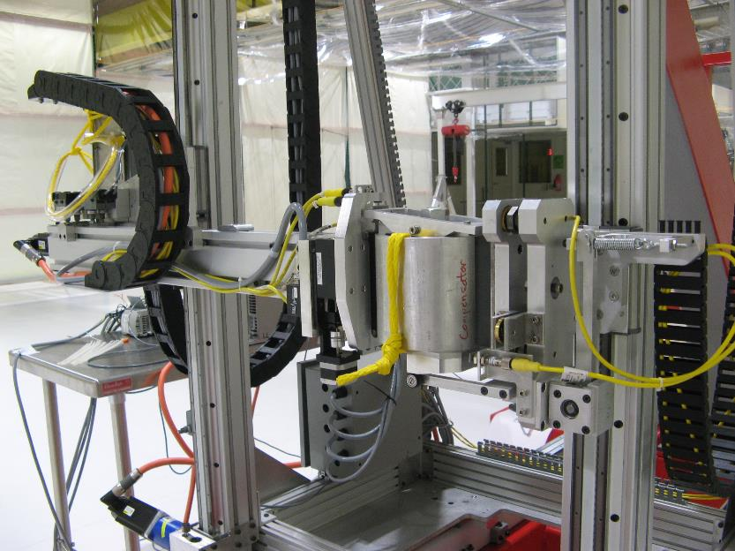
Key components of the winding machine
The winding head delivers tensioned wire to the APA and incorporates the latching blocks that secure the winding head as it is passed from one side of the APA to the other.
The compensator compensates for misalignment between the moving side and the fixed side of the z stage assembly.
Alignment compensator
Z stage
Latch stage
Winding head

Slide 22
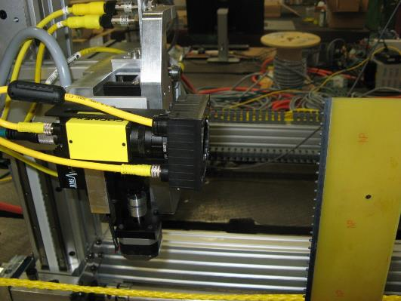
Key components in the winding machine
The vision system
The vision system can measure the location of a line of pins in the winding machine coordinate system as it travels the edge of the frame at more then 25mm/ sec.
Edge board pins
Camera

Slide 23
Winder Safety
Personal safety
A light curtain will be used to keep personal away from the machine during normal operation.
E-stops are present on both ends of the machine and on the operator interfaces.
Machine and detector safety
Absolute encoders are used to ensure that the machine knows where it is and the operating system will use encoder feedback to drive the machine safely as it winds.
The safety system will use independent sensors to shut the operating system down before any unsafe conditions can occur. For example:
Z enable ensures the z stage can not drive into the APA
Latch sensors ensure that the winding head is present and latched before the z stage can consider a transfer complete.
End of travel limits make sure the motion stages do not reach their mechanical stops.

Slide 24
Winder users interface
Winder interface displays live position of the winding head and sensor states

Slide 25
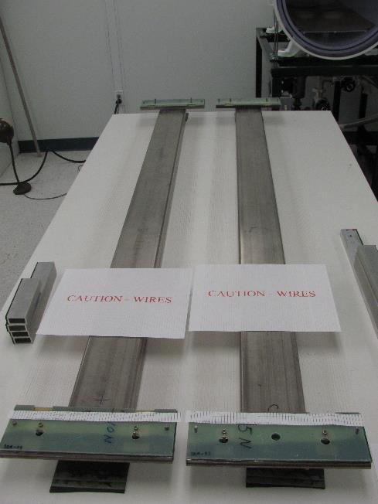
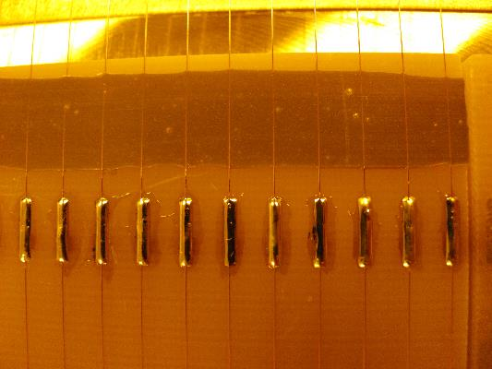
Wire anchoring procedure
Wire anchoring procedure
Epoxy areas are masked to keep them clean.
Wires are soldered and cut.
Controlled beads of epoxy are applied to the bottom surface of the next board layers before clamping these boards to the board stack - “Sandwich method”.
Epoxy and solder anchor – 35 ton
Epoxy transferred using mylar tape
Life test of sandwich method
Epoxy transferred using the next board layer

Slide 26
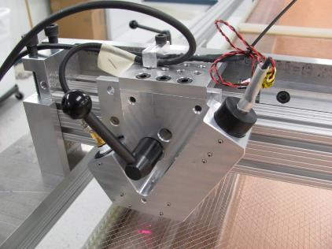
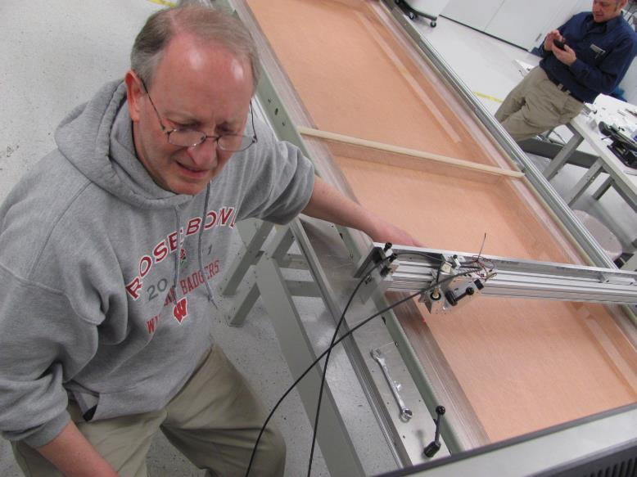
Tension checking
After winding each layer, the APA trunnion assembly is transfer back to the process cart.
Wire tension is determined by measuring the natural frequency of the wire and calculating the corresponding tension. The natural frequency is measured by focusing a laser at the wire, exciting the wire with compressed air, and measuring the frequency of the intensity of the reflected wire.
Wire tension will be 100% inspected and recorded.

Slide 27
Reconfiguring the interface frame
After wires are anchored, the interface frames need to be remounted.
The APA is lifted from the process cart with the vertical lift kit.
The interface frames are removed with the aide of a mobile hand operated crane, a temporary lift point is added on the counter balance end, the frames are rotated 180 degrees and reconnected.
The trunnion assembly is then transferred back to the winder and rotated 180 degrees.
Interface frame – head end
Interface frame – foot end

Slide 28
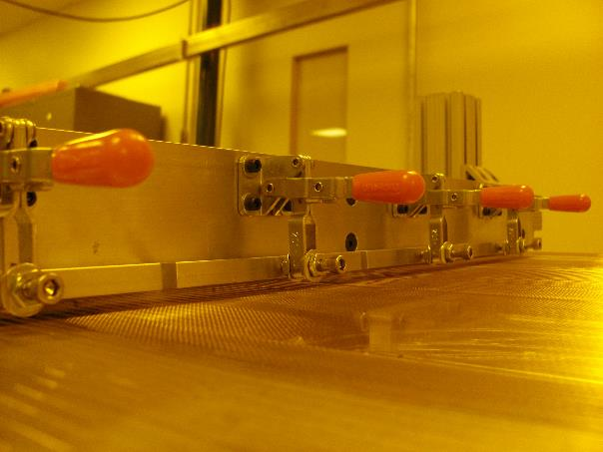
Installation of combs after winding
After a full layer is wound the APA trunnion assembly is transferred back to the process cart and the wire anchoring and tension checking processes are repeated for the second half.
After a full wire layer is completed, the combs for the next layer must be bonded to the combs for the layer just completed.
A “comb to comb jig” is required for this process.
Comb to comb jig – registers and bonds the comb for the layer about to be wound to the layer that has just been wound.
Comb jig for the 35ton APA’s

Slide 29
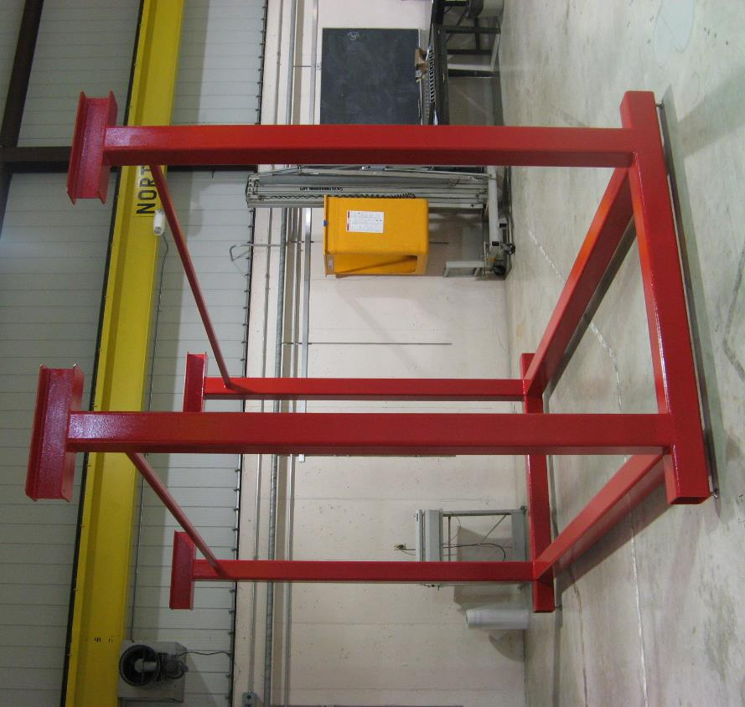
Storage Frame
Four position storage rack for in process or finished APAs.
Image: Ken Kriesel

Slide 30
Back up slides

Slide 31
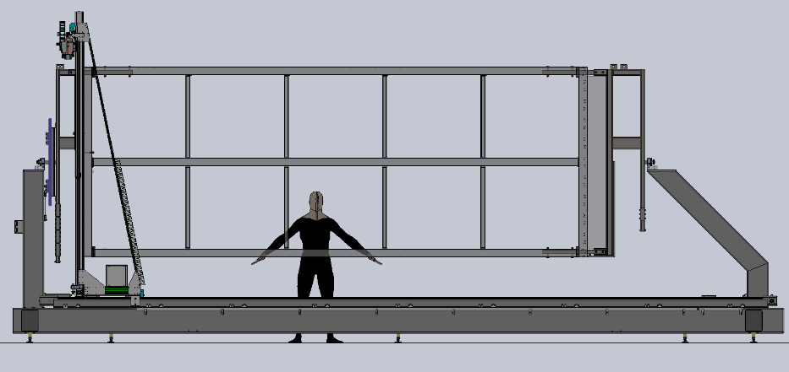
Assembly of the basic APA
Z enable safety system of the winding machine electrically shuts down the winder if the operating system tries to drive the Z axis into the APA
=Metal target for proximity switch
C Y1
D Y2 Y sensors
X sensors
A Park
B X

Slide 32
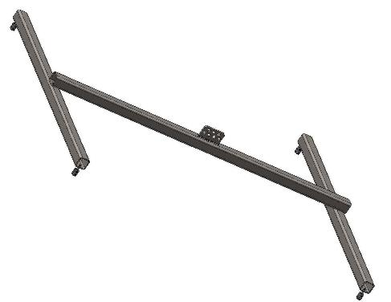
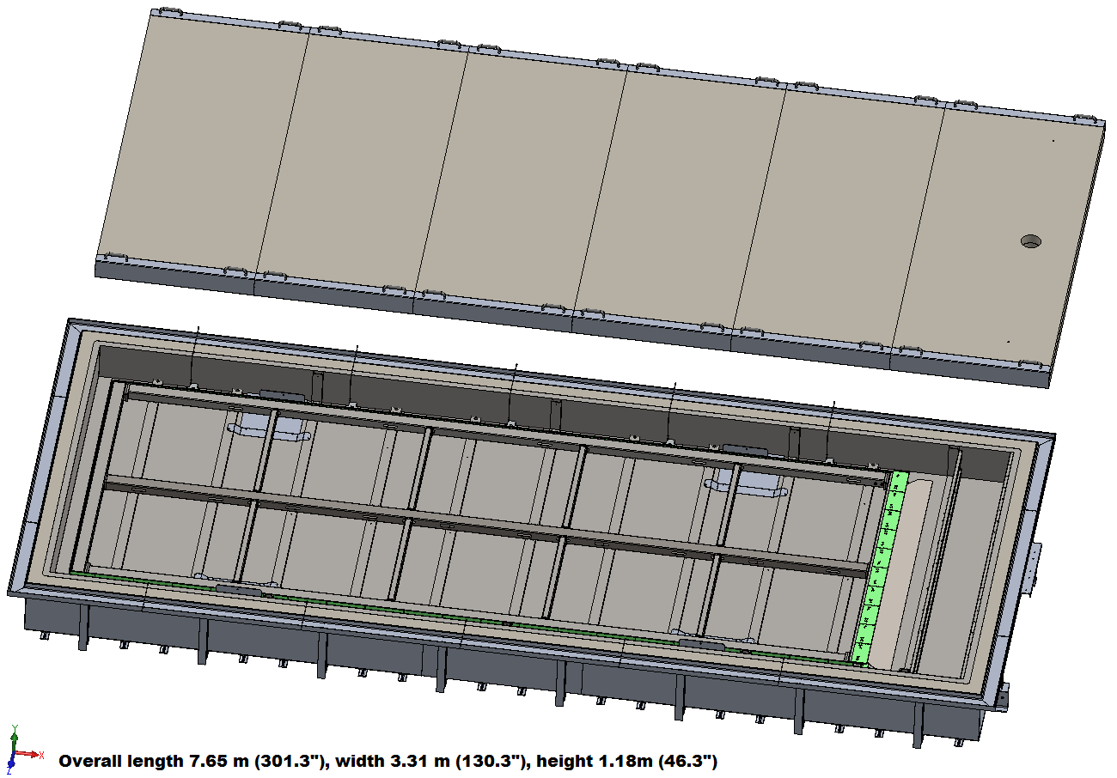
APA testing
After all the wires are installed the APA will be cryo-tested
A cryostat has been designed that is cable of testing in liquid, but current plans are to test in gas.
After cryo-testing the APA will be high voltage tested in room temperature conditions.
H spreader beam for lifting a horizontal APA
Image: Ken Kriesel

