Slide 1
APA Electrical Overview and Interfaces
Bo Yu
13-July-2016

Slide 2
Outline
CPA lifting bars
APA Electrical Overview (Interface to Cold Electronics)
APA signal readout
ProtoDUNE readout scheme
APA integrated readout concept
Grounding and electrical insulation
Wire bias and electron transparency
Bias circuit and component choices
Interfaces
Interface to Photon Detectors (PD)
Interface to Field Cage (FC)
Interface to Detector Support System (DSS) & Installation
Interface to Cryogenic System
Summary
Relevant charge questionss:
5. Are all APA interfaces to other detector components and cryostat documented, clearly identified and complete? Does the TPC integrated 3D model adequately represent the mechanical interfaces to the APAs and between adjacent APAs?
7. Does the design provide adequate signal response characteristics? Is it optimized for the proposed electronics? Is the grounding and shielding of the APA understood and adequate?

Slide 3
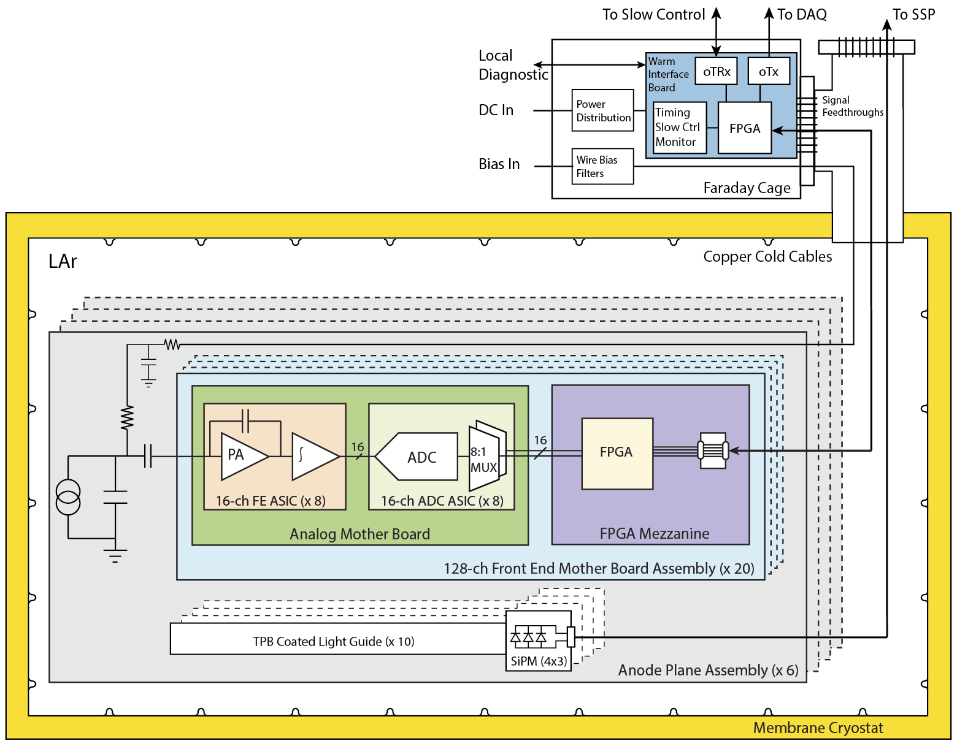
NP04 TPC Readout
On the APAs, there are 3 types of circuits: cold electronics, photon detectors, bias and filter networks

Slide 4
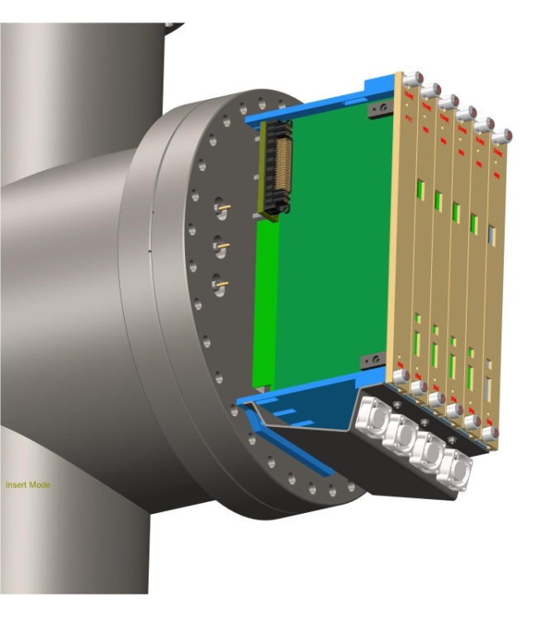
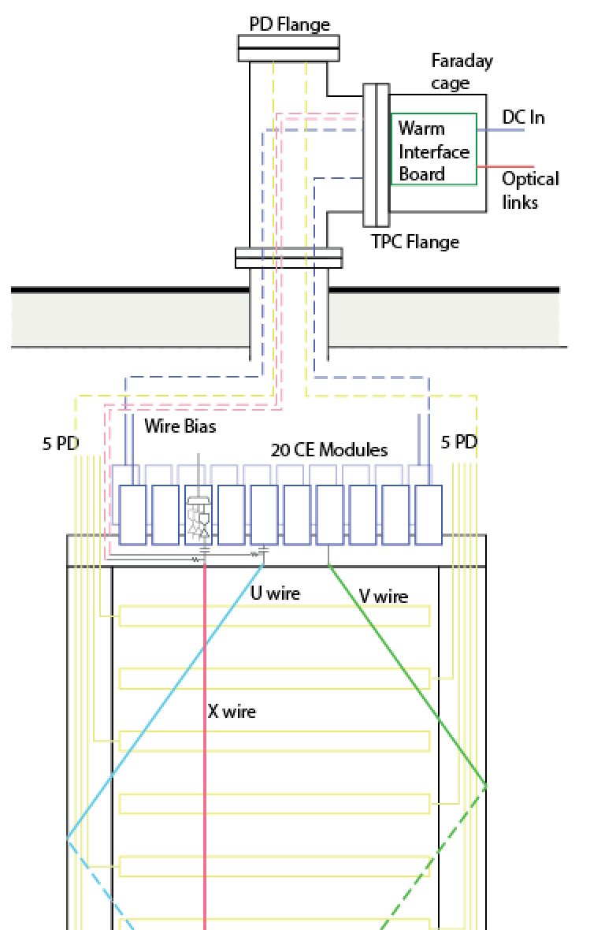
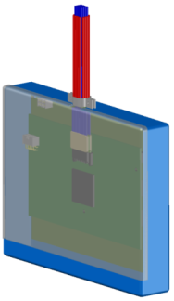
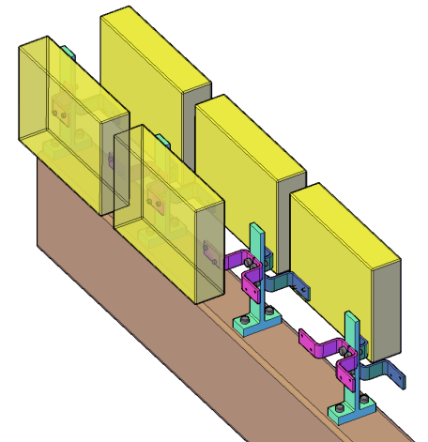
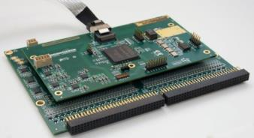
APA with Integrated Cold Electronics
Cold electronics module and its attachment to the APA frame

Slide 5
ProtoDUNE electrical connections within the cryostat The Commandments:
APA frame shall be connected to the COMMON of all FE ASICs.
All electrical connections (power and signal) from an APA shall lead to a single feedthrough.
APAs shall be insulated from each other.
The COMMON of the FE ASIC and of the rest of cold readout shall be connected to the common plane/enclosure of the cold FE module.
APA Power line return leads and any shields shall be connected to the common plane of the cold FE module at one end and to the flange of the feedthrough at the other end. This shall be the only connection of the APA frame to the cryostat.
APA mechanical suspension from the frame to the cryostat shall be insulated.
The last stage of the sense wire and grid bias filters shall be connected to the frame (i.e., ASICs common).

Slide 6
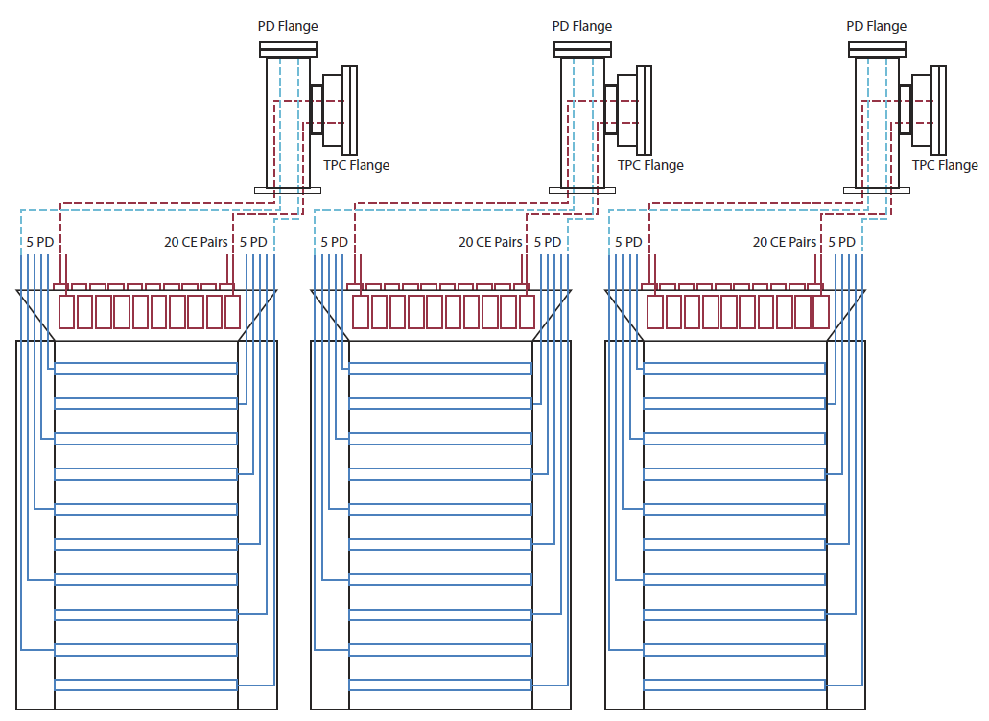
ProtoDUNE APA Cable Routing Plan

Slide 7
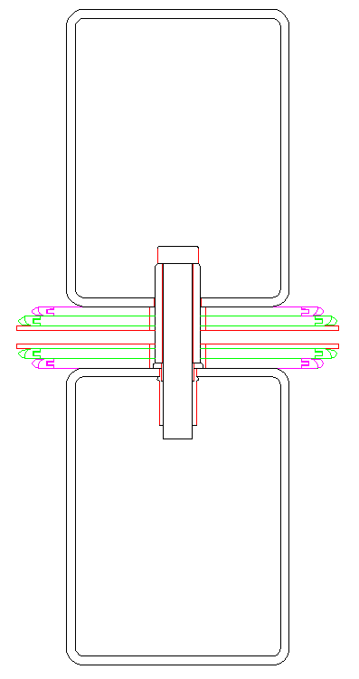
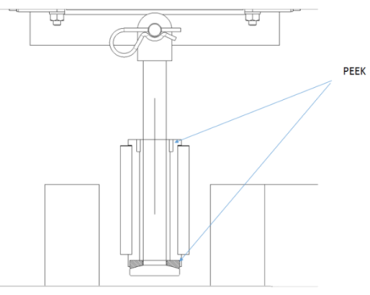
APA Mechanical Interconnect (electrically insulated)
Electrically, the tie bar is insulated from one APA by a G10 mounting block.
APA to detector support rail
Between adjacent APAs
G10 sleeve
alignment guide pin
The alignment guide pin screws into a threaded insert in the outside surface of one of the long APA side tubes. It engages with a slot in the outer side wall of the adjacent APA.
These alignment pins will have a G10 sleeve where they engage the other APA to maintain electrical insulation between APAs.
The capacitance between two adjacent APAs is about 1nF calculated from the facing area and distance.
CE box
CE box
Electrically, the lifting rod holding the APA is insulated from the APA lifting yoke by PEEK washer and sleeve.

Slide 8
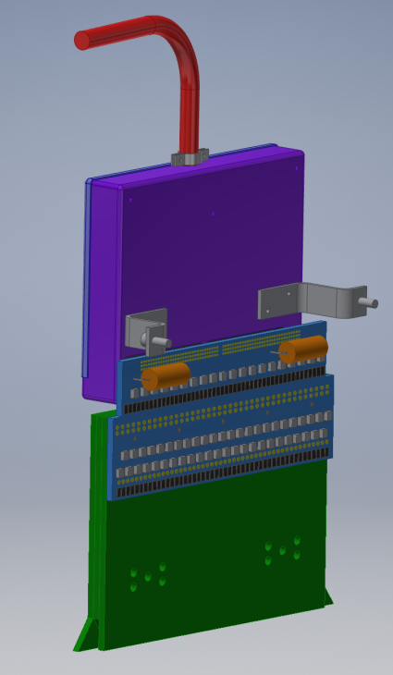
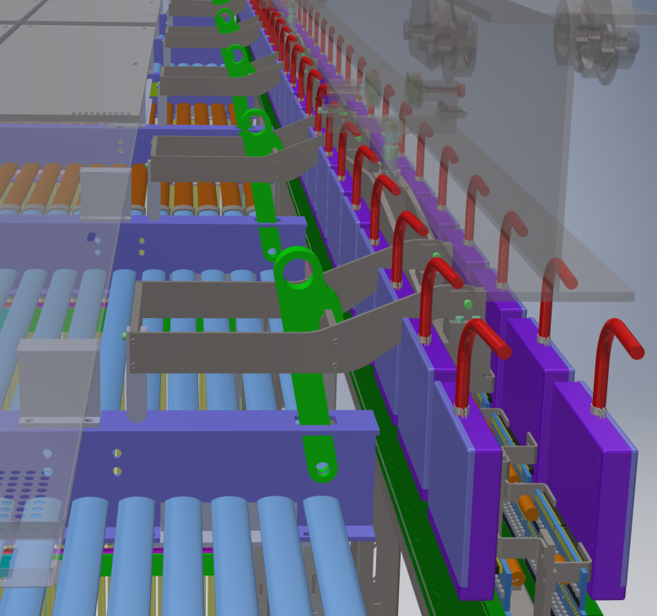
Mounting Cold Electronics Modules
To ensure good electrical connection between the FEMB and the APA frame, a “grounding” braid may be needed between the CE box and the APA frame
CE Box
CR board
Wire Bonding Board Stack

Slide 9
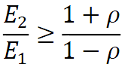
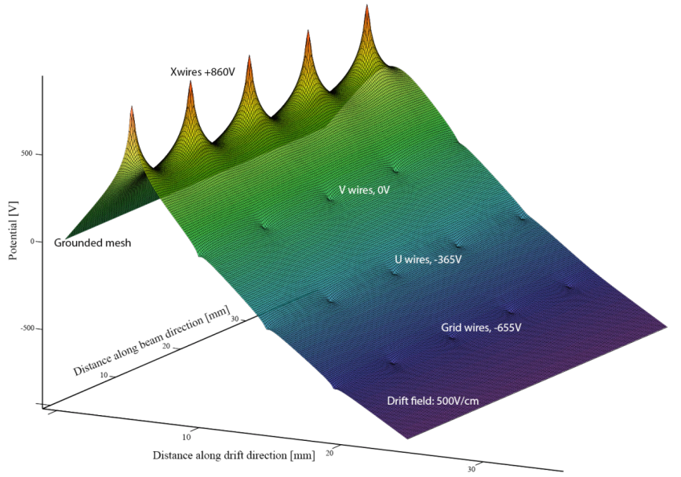
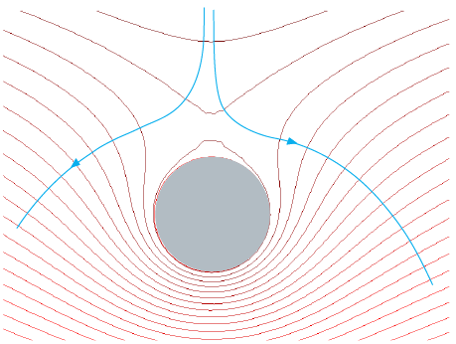
Bias Voltages on the Wires
Transparency condition: (O. Bunemann et al., Canadian Journal of Research, v A27 (1949) pp191‐206)
The field ratio needs to be greater than 1.22 for a grid with 150 μm wires at 4.7 mm pitch.
To get the field between the wire plane, we need to run electrostatic FEA.
Boundary conditions: 500V/cm drift, 0V on the mesh.
Used Maxwell 2D, adjust the bias voltages on the wire planes until saddle points emerge on the upstream side of the induction wires.
wire
At 4.7/4.8mm wire pitch, the minimum bias voltages needed are:
V_{G} = -655V
V_{U} = -365V
V_{V} = 0
V_{X} = +860V
Glenn Horton-Smith has developed analytical calculations to derive the transparency conditions: MicroBooNE docdb 4708

Slide 10
Bias Voltages Sensitivity to Wire Plane Spacing
❶ gap increases, field decreases. Must increase V_{GU} to pull all electrons through G
❷ field increases due to ❶ and smaller gap
❸ field ratio to ❷ is insufficient. Must increase V_{UV} to pull all electrons through U
❹ field increases due to ❸ and smaller gap
❺ field ratio to ❹ is insufficient. Must increase V_{VX} to pull all electrons through V
In order to be transparent on both sides of this view, the minimum bias voltages must be:
If we don’t tightly control the wire plane spacing, we might have to dramatically increase the bias voltages in order to maintain transparency everywhere on the APA. Higher bias voltages require larger, hard to find and expensive capacitors.
Here is an example of a possible wire plane cross section view due to a distorted wire frame: Grid and X wires remain at designed position, U & V wires moves by +/-0.5mm off designed position (a twist in the frame)
U & V each moves 0.5mm closer (U-V gap reduced by 1mm)
U & V each moves 0.5mm farther (U-V gap increase by 1mm)
Correct wire positions
G
U
V
X
 | +/- 0.5mm | +/- 1mm | nominal
Vg | -695 | -700 | -665
Vu | -415 | -430 | -370
Vx | +1150 | +1600 | +820
❶
❷
❹
❸
❺
At nominal bias, the surface E field on the X wires is already about 20kV/cm!
This study was done with an old LBNE wire geometry. LBNE docdb 7370

Slide 11
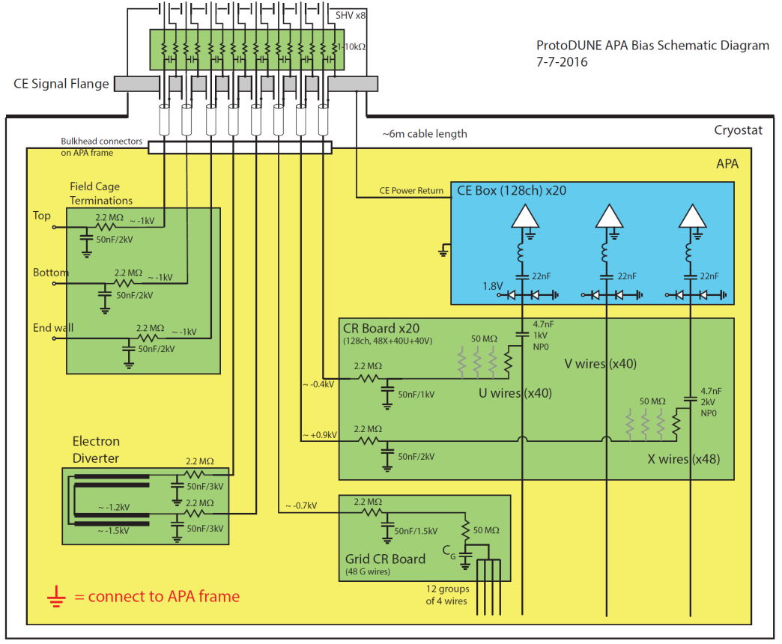
ProtoDUNE APA Bias Schematic Diagram
Up to 8 SHV connectors are on the CE feedthrough flange.
The cables (RG316) need to be terminated on the APA top end on a patch panel, with single ended wires reaching various connection points around the APA.
The filters for the field cage termination lines can be implements on a small PCB mounted on this patch panel.

Slide 12
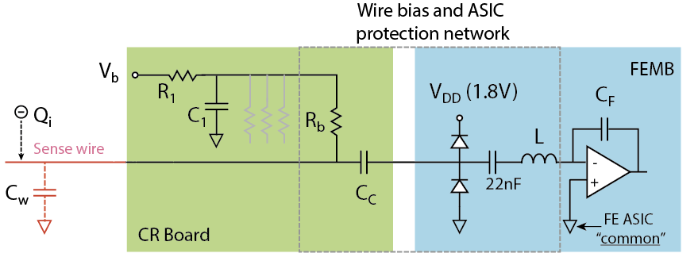
Choice of the Bias Circuit Components
FE ASIC input impedance ~50Ω (only input stage is shown).
L is a component of the ESD protection circuit.
22nF taken into account in accurate C_{c} calculations
C_{C} minimum value given by charge calibration accuracy and capacitor tolerance:
with C_{W}~200 pF, and a 10% precision in ∆C_{C}/C_{C} , to reach for ∆Qi/Qi=0.5% requires C_{C}>4 nF.
Choose 4.7 nF @ ~10% tolerance , or 2.2 nF @ 5% tolerance
C_{C} voltage rating: WVDC>1.5x operating voltage
C_{W}/C_{C} ratio also determines the fraction of charge Q_{i} is NOT being transferred to the amplifier therefore impact signal to noise ratio. For example, if C_{C}=2.2nF, ~8% of signal charge is not measured by the amplifier.
$$\frac{∆Q_{i}}{Q_{i}} ≅\frac{C_{w}}{C_{c}}×\frac{∆C_{c}}{C_{c}}$$

Slide 13
Choice of the Bias Circuit Components
R_{b}C_{c} time constant >~25 x electron drift time, to make any undershoot due to ac coupling small and easily correctable:
R_{b}C_{c}=50Mx4.7nF~=230 ms
R₁C₁ is a filter for the bias bus on the CR board (40 to 48 wires). It should be very effective in removing ripples in the bias power supply.
Chosen value: R₁=2.2MΩ, C₁=50nF, tolerance not critical
R_{b} minimum value >20MΩ for negligible noise contribution to the preamps. It limits the current flowing through the bias network in case of a shorted sense wire.
Chosen value: 50MΩ, tolerance not critical
R₁/R_{b} ratio determines the fractional drop in voltage on the entire wire group if one or more wires are shorted to another wire plane. To minimize impact to the electron transparency in the region covered by this wire group, choose R₁<<R_{b}.
Signal charge Qi transfer onto the feedback capacitance C_{F} is fast (time constant C_{w}R_{in}~ 10 ns to minimize wire-to-wire crosstalk.

Slide 14
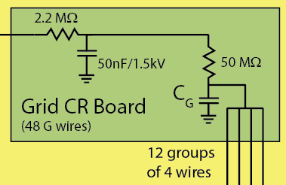
Choice of the Bias Circuit Components
The grid wires are not read out
They improve the timing and amplitude characteristics of the first induction (U) signal
They also serve as ESD protection during APA handling
They need to have good ac coupling to signal ground (C_{G}>>C_{W}) to minimize cross talk to the U wires
Since the cross talk is shared over many ~100s of U wires, the pickup amplitude on the U wires is expected to be small. It might not need to have a dedicated C_{G} for each wire.
Chosen value: C_{G}=4.7nF (tolerance not critical) per 4 wires
Other notes:
Short out the bias input connectors after APA assembly, especially during CE installation to prevent ESD damage to the CE.
Follow standard practices for ESD protection during and after CE installation

Slide 15
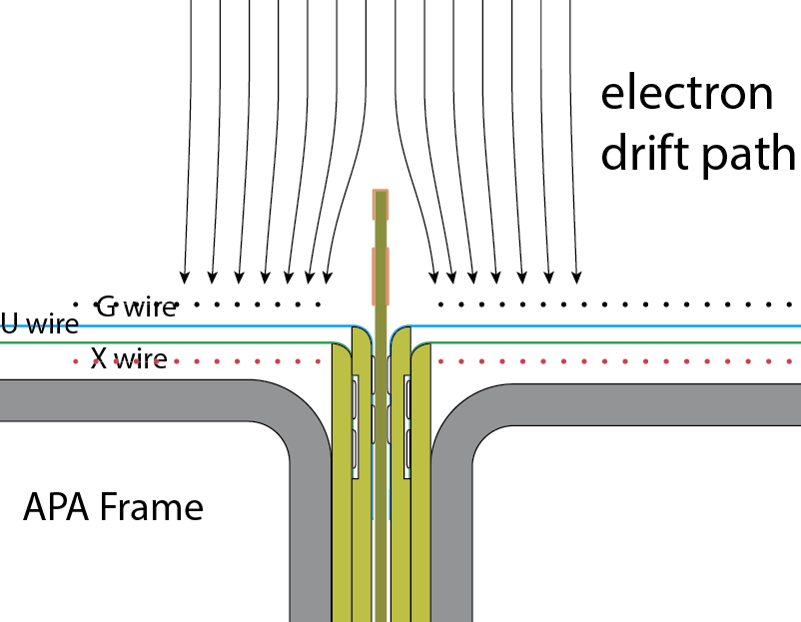
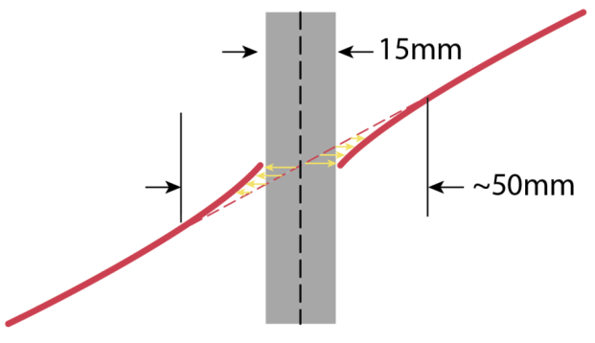
Field Shaping Near the Gap Between APAs
Instead of living with the uncertainties in the electron drift path near the gaps, we can instrument a simple field shaping electrode above the gap to better define the electric field above the gap:
Insert a printed circuit board with some strip pattern in the physical gap between the two APAs, and bias the strips in a voltage distribution such that the incoming electrons will be deflected away from this gap and land in the active region of the wire frame.
In this field configuration, we do not lose any electrons, but reconstructed inclined tracks will appear distorted at this gap. The width of this distorted region could reach ~5cm. This is a fixed distortion that can be easily mapped out and corrected.
Electrode installed in 35ton

Slide 16
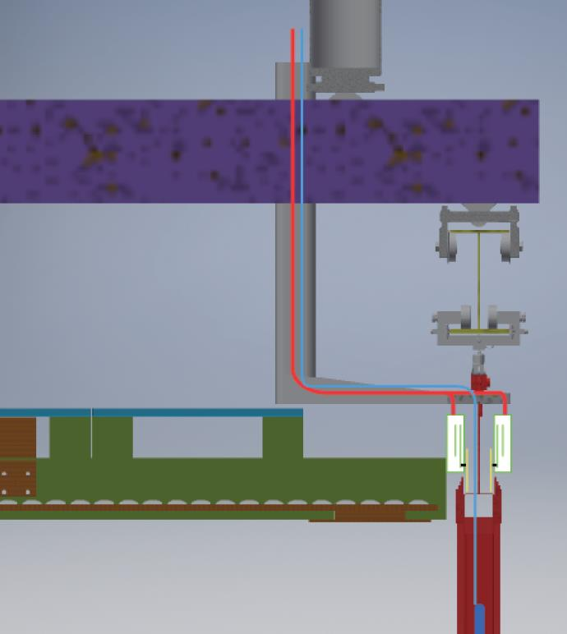
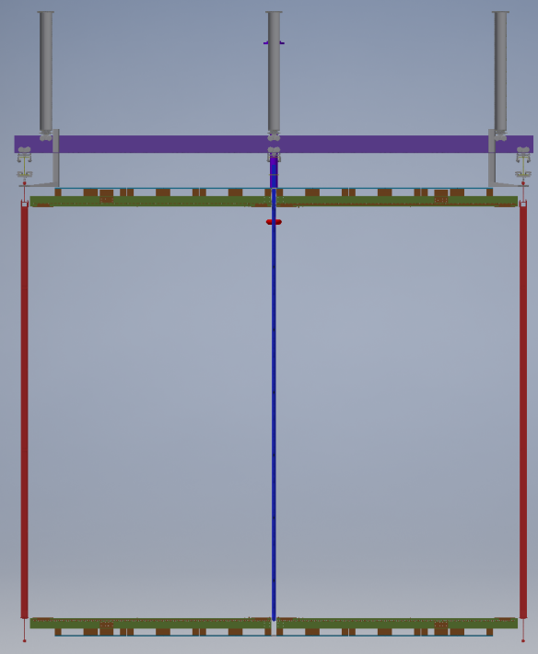
APA Interfaces
insulation
Upper TPC Rail
Field Cage (top)
Field Cage (top)
Cable Tray
Lower TPC Rail
Ground plane
APA
CPA
APA
CE box
FC profiles
CR boards
Field Cage (bottom)
Field Cage (bottom)
APA
PD

Slide 17
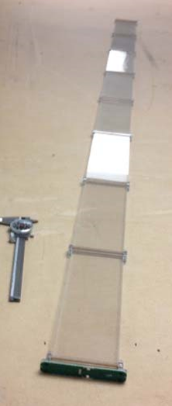
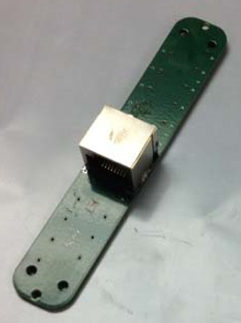
Interface to the Photon Detectors (electrically connected to the crysostat only at the PD feedthroughh)
PD Module Components

Slide 18
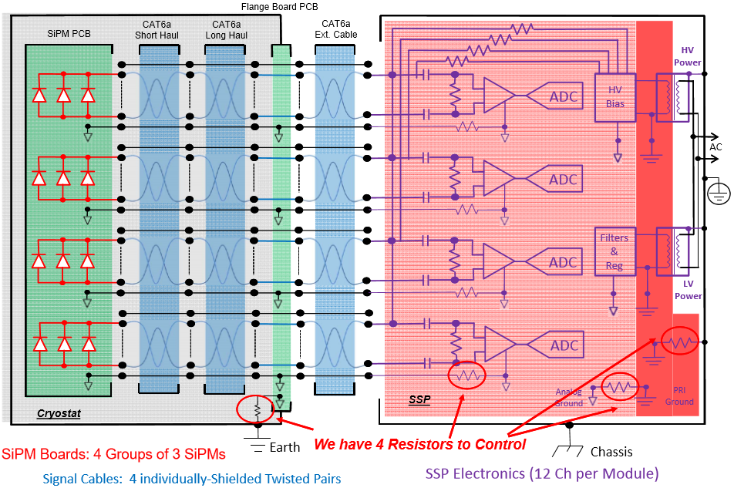
Interface to the Photon Detectors
Schematic of the PD Readout System (docdb 1319)
Only connection of the PD

Slide 19
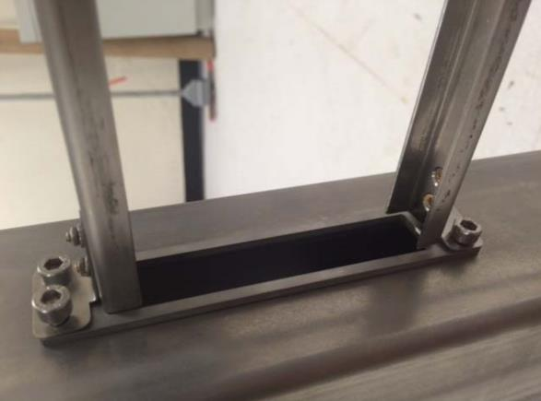
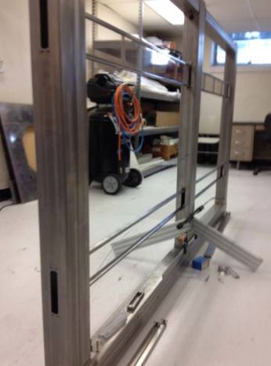
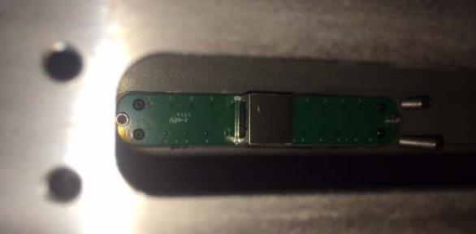
Interface to the Photon Detectors
PD Module Installation into APA

Slide 20
Interface to the Photon Detectors
Connections of the PD metallic components:
The PDs are supported in a stainless steel fame which is screwed directly to the APA frame
PD frame is connected to the APA frame
The PD mounting screws, 2X #4-40 screws –Reside inside the long APA side tube –Screwed into the side tubes to hold the PD in place – Screws are electrically isolated from the SiPM PCB
In contact to the APA frame
8 X M5 screws (Provisional) –Anchor the insulating support block for the end of the short haul cable to the APA cold electronics fin
In contact to the APA frame
The PCB shield layers are connected to the signal cable shields
Not in direct contact to the APA frame
Report of the initial assessment of the PD grounding scheme is available at docdb 1330
Interface Control Doc: DUNE docdb 1372

Slide 21
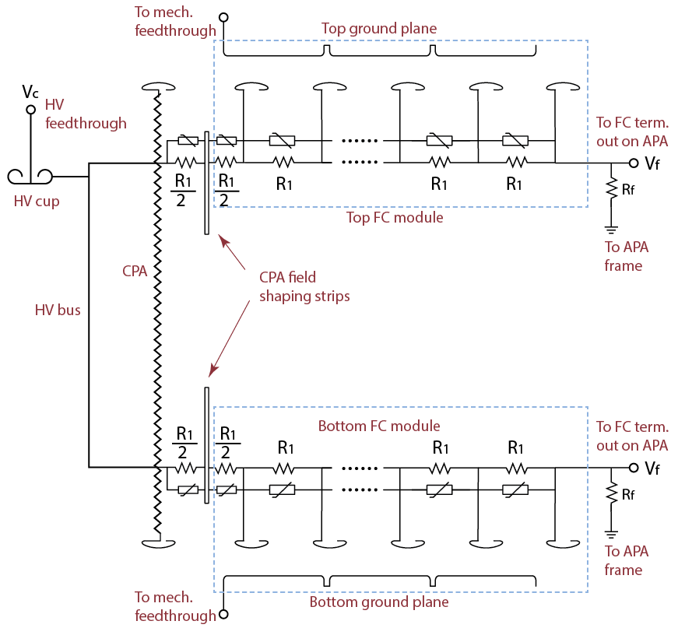
Interface to the Field Cage
The schematic diagram is for the top and bottom field cage modules connected to the CPAs.
The end wall FC modules do not have the ground planes. The rest of the circuits are the same
From each FC module, two electrical connections need to be made to an APA at installation time:
a divider return connection to an APA frame
a field cage termination bias/monitor connection to an SHV connector on the CE feedthrough. This line should have been pre-routed to a convenient spot on the APA.
Interface Control Doc: DUNE docdb 1345

Slide 22
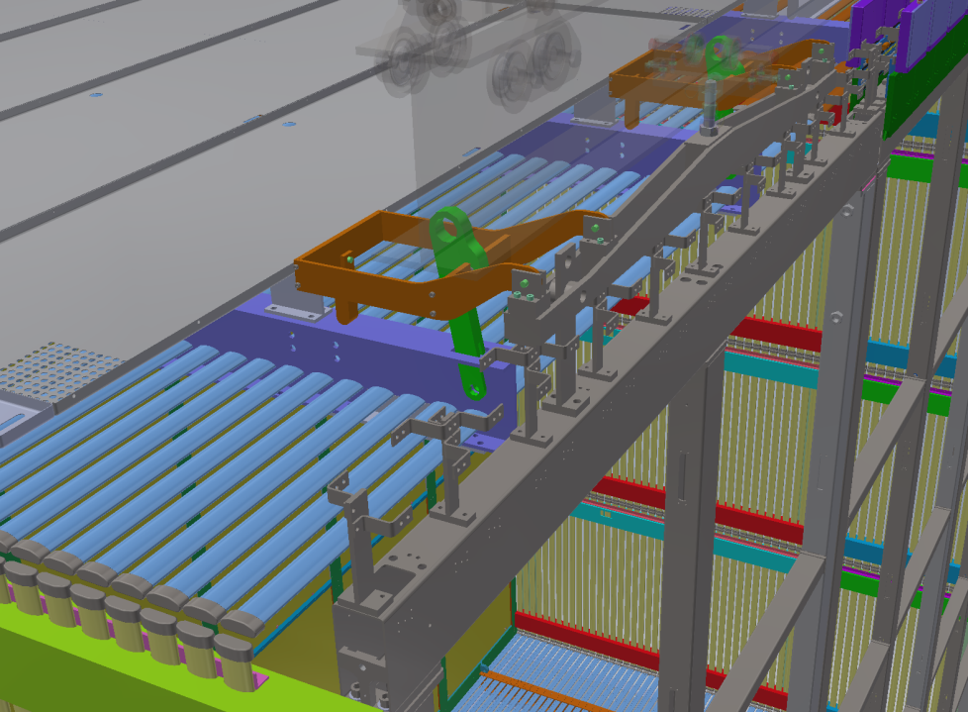
Interface to the Top Field Cage, Mechanical
The figure shows the latched support structure on the APA for the top field cage modules.
This support structure does not impart a moment load to the APA frame
The latches need to be manually engaged during installation time
A similar structure will be designed for the bottom field cage modules.

Slide 23
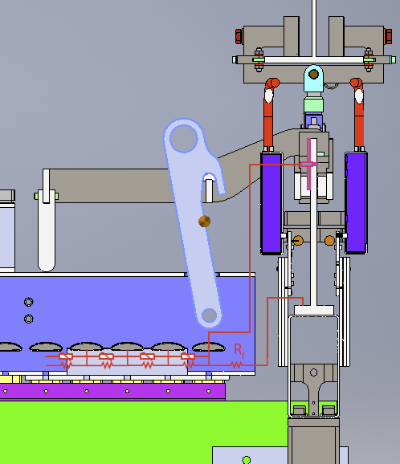
Interface to the Top Field Cage, Electrical
The figure shows the latched support structure on the APA for the top field cage modules.
The two required electrical connection to the APA will be made manually after each FC module has been secured by the latch, assuming personnel access to this height is available.
Monitor point
Ground connection

Slide 24
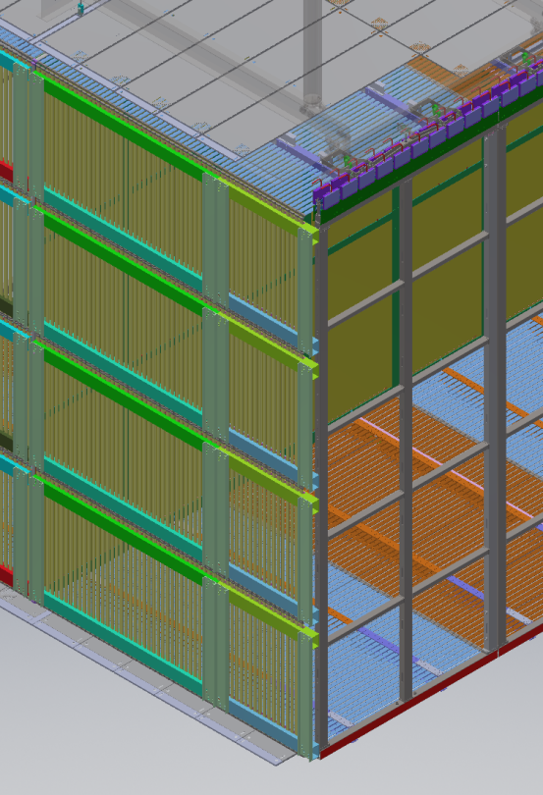
Interface to the End Wall Field Cage
4 End Wall FC modules are mechanically linked and suspended on the APA and CPA rails after installation. This structure has 2 mechanical linkages (nominally not load bearing) to the nearby APA.
Each FC module has its own resistive divider network so we need to connect to 4 pairs of divider returns and bias lines.
We plan to gang the 4 pairs of connections into one common return, and a common bias line when the 4 modules are assembled together outside of the cryostat. These two connections are made to the adjacent APA frame and the pre-routed bias wire through the side tube of the APA at a bottom corner.

Slide 25
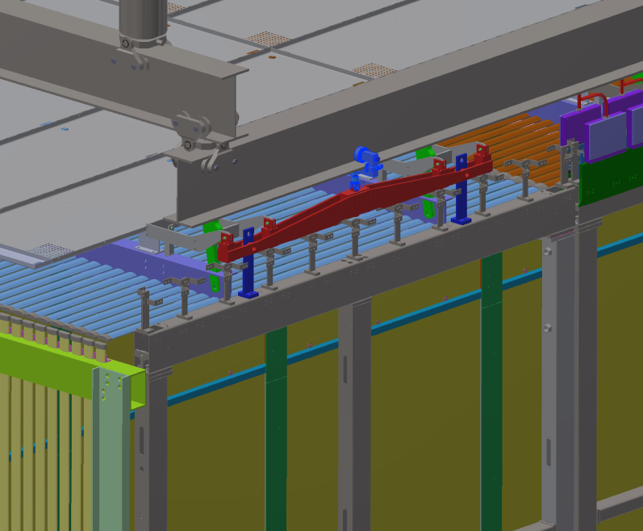
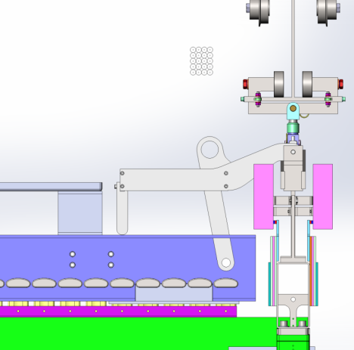
Interface to the Detector Support System
The mechanical support of the APAs by the DSS is detailed in Dan Wenman’s talk.
Electrically, the lifting rod holding the APA is insulated from the APA lifting yoke by PEEK washer and sleeve.
Interface Control Doc: DUNE docdb 1465

Slide 26
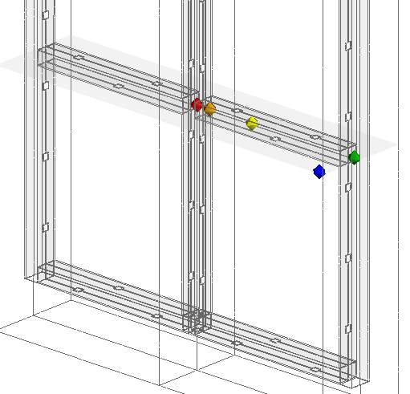
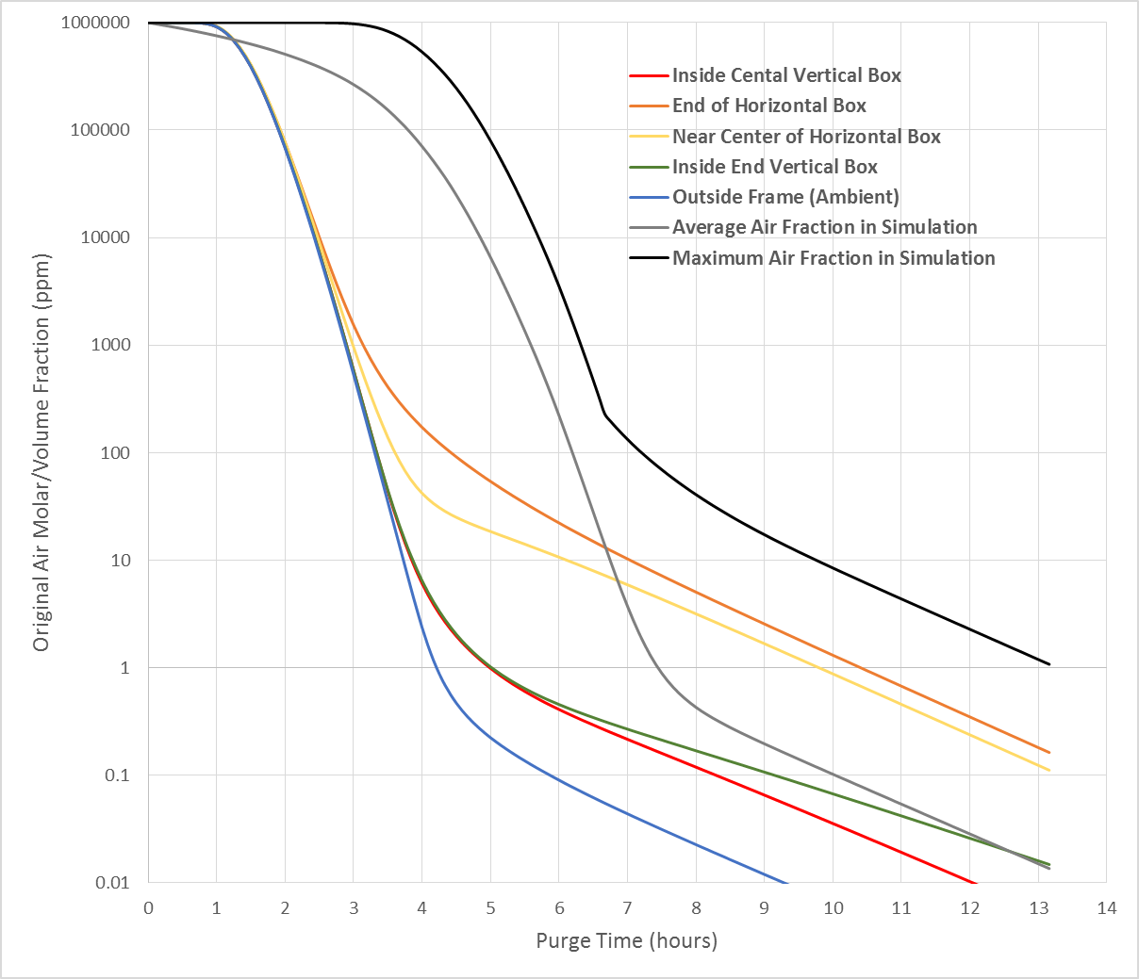
Interface to the Cryogenic System
Cool down rate and warm up rate <40K/hr
Maximum temperature gradient: 10K/m
This applies to both the cool down phase and warm up phase
APA frame members will be vented to avoid trapped volumes
CFD studies were performed for:
MicroBooNE field cage tubes (2.5cm OD tube, 3mm hole every 25cm)
SBND APA frame (10cmx15cm tube, 5cm hole every ~40cm ).
The results show that the inner volume of the tube can be purged to 1ppm level through argon piston purge and diffusion in about half a day.
ProtoDUNE APAs will have venting configuration in between these two cases
Cold Electronics boxes will be vented
Facilitate initial argon gas purging
Allow boil off gas to escape (for FD version, the bottom APA CE boxes must vent the gas into the APA frame to be directed up).

Slide 27
Summary
A clear set of guidelines on APA grounding and shielding has been approved by the DUNE Grounding and Shielding Committee, and is closely followed by the engineers working on the mechanical and electrical aspects of the design.
These guidelines will be strictly enforced during the TPC assembly and installation stage.
APA interfaces to the rest of the detector system have been identified.
Interface control documents (ICDs) have been created between APA and CE, PD, DSS, Cryogenic system.
Documentation and implementation of the interfaces are at various stages of completion.
3D models showing key mechanical interfaces exist, they are yet to be included in the official integrated model.

Slide 28
Backup slides

Slide 29
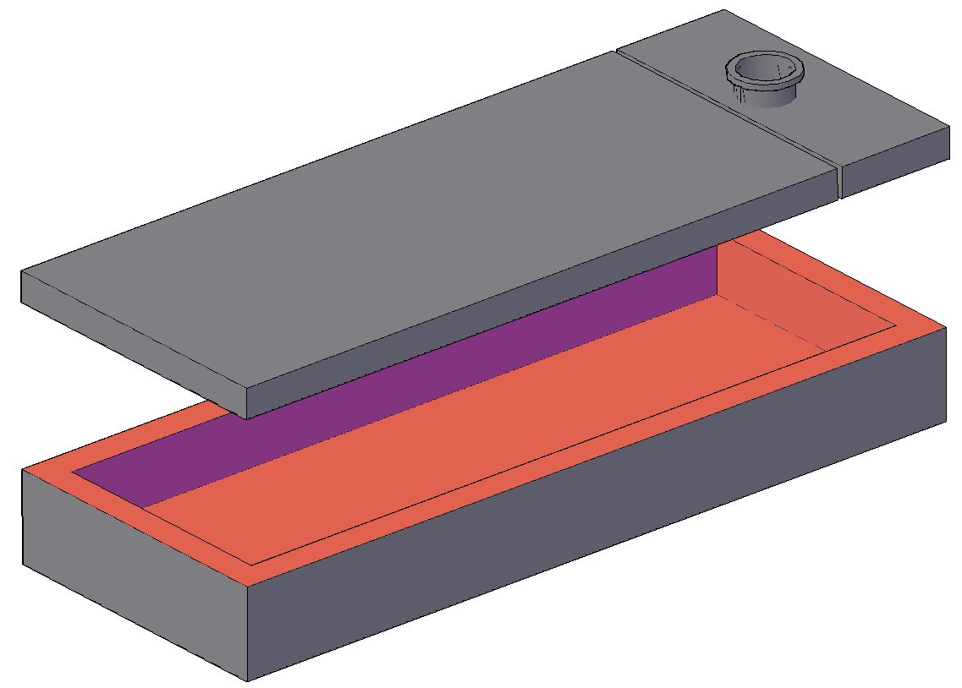
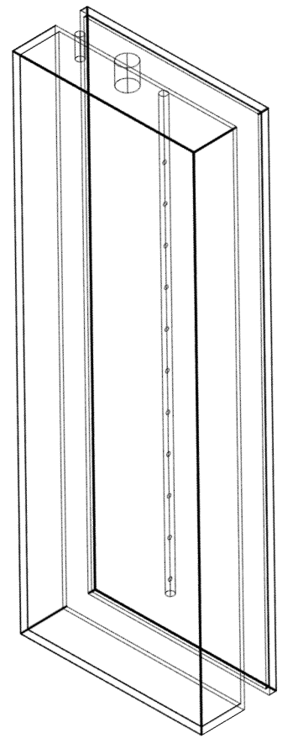
APA-CE Integration Tests
BNL small APA vertical slice cold test
Use the UW-PSL 40% APA adapted to SBND / ProtoDUNE FEMB
Test both SBND and ProtoDUNE feedthrough and CE systems
Electronics noise test @ FNAL
Use a RF shielded room with 35ton APA, and possible SBND prototype wire frame
CERN
A cold box/faraday cage with controlled cool down and warm up rate
Test each fully assembled APAs with CE and PD in vertical orientation in cold gas
Full vertical slice test with signal feedthrough, warm interface, DAQ
APAs move into cryostat after passing the test

Slide 30
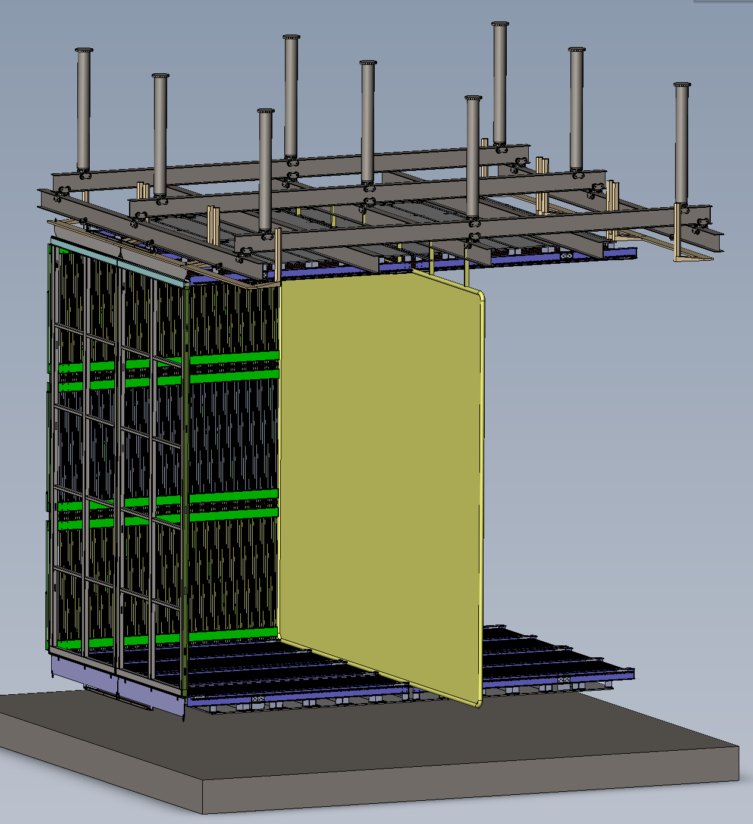
Ash River Trial Assembly
Install final quadrant of TCP using a minimum of these proto-type parts:
1 APA frame (not strung)
2 CPA columns
Top and Bottom Field Cage (both sides
End Wall Field Cage
Structure is designed to support 2 quadrants of APA,CPA and FC
Help develop final sequencing and test assembly procedures, access equipment and any required lifting fixtures
Be prepared for installation at CERN, including trained supervisors & techs

Slide 31
Other Grounding Related Items
APA ground mesh connection: one conductive epoxy bead 1cm diameter every 1m?
cable tray: connect to either APA or feedthrough but not both.

