Slide 1
ProtoDune APA Risks and 35t Lessons Learned
APA Design Review
July 13 – 14
Physical Sciences Lab
Robert Paulos

Slide 2
Risk Topics
ProtoDUNE specific risk register.
Schedule
Winder not ready in time
Wire breakage
Microphonics susceptibility
Lack of simulation support

Slide 3
Risks Dune/ProtoDUNE
Dune is starting a ProtoDUNE specific risk register.
The Dune risk register is reviewed regularly

Slide 4
Schedule Related Risks (APA production Slow, Problems with multiple APA, and UK startup)
Risk description: The overall schedule for the design, construction, test, shipment, and installation at CERN is very tight with no float.
Mitigation 1: increase APA production capability by adding a second shift for assembly
Mitigation 2: Plan the manufacture of a 4th APA if needed in the event one site runs late or an APA is damaged
Mitigation 3: consider alternative TPC configuration with fewer APAs

Slide 5
Winder Risk
Risk description: Commissioning and winder operation takes longer than planned and is not available for APA construction
Explanation: The winder is a complex machine and it is not yet commissioned. This raises the uncertainty in the time estimate for setup.
Mitigation 1: Consider quick turnaround of alternative winding method (manual plus tool, SBND style) – Will evaluate status in 2-3 months.
Mitigation 2: Seek additional expertise in motion control.

Slide 6
Wire Breakage or Loose Wire
Risk description: a) wire breaks or pulls loose during test or after shipment b) wire breaks during operations in cryostat
Mitigation 1: All wires are both glued and soldered to minimize the risk of slippage
Mitigation 2: for case (a) clip wire to eliminate potential damage to adjacent wires/planes
Mitigation 3: follow good quality practices; e.g. inspect wire as it is re-spooled for damage, perform sample break tests to determine if lot meets spec., over-tension all wire, control tension applied to all APA wires and verify by measurement
Mitigation 4: Noise is monitored continuously after assembly in the cryostat to identify any developing issues.

Slide 7
Microphonics susceptibility
Risk description: there is some evidence from MicroBoone that microphonics pickup (wire vibration) from mechanical disturbances (e.g. pumps, LAr motion) can effect data
Mitigation 1: Electronics is designed such that the bandwidth of the shaper is far away from the wire vibration frequency (~10Hz) See Xin’s talk.
Mitigation 2: The mechanical design provides relatively short unsupported wire lengths (1.2 m).
Mitigation 3: The FE ASIC is modified to allow setting larger bias currents if needed for additional immunity.

Slide 8
Lack of simulation support
Risk description: detailed verification of physics requirements by simulation is lacking in some areas
Mitigation: flow down engineering requirements from physics based on collective prior experience on MicroBoone, LARIAT, ICARUS experiments

Slide 9
35t Lessons Learned
Valuable experience was gained from the 35t prototype
Lessons learned were reviewed and documented (see docdb 1315)
The following is a summary

Slide 10
28 page report
DocDB 1315
APA Lessons Learned:
Broken induction plane wires during APA cold tests.
Identifying the broken wires in offline channel space continues to be an issue.
The photon detectors were installed inside the APAs roughly 24 months before the APAs were installed in the cryostat because they had to be inserted into the frame before the wires were wrapped around the frame.

Slide 11
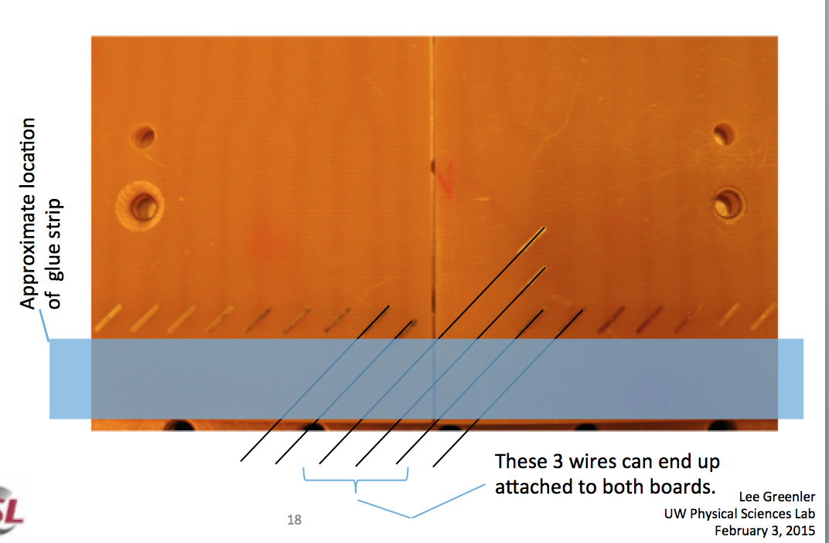
Broken induction plane wires during APA cold tests.
The 35t wire bonding boards were positioned such a few wires spanned two boards. These wire could break in thermal cycling.
Lesson learned:
The boards are designed so that both the glue joint and the solder joint are always on the same board
Electrical testing is required as mechanical tension testing does not detect breaks after the glue joint
Docdb 913 - 29 pages

Slide 12
Identifying broken wires in offline channel space continues to be an issue.
Channel mapping must be carefully documented and channel 1 must be clearly identified on each APA.
35t APA are rotationally symmetric
A channel mapping document needs to be developed prior to installation.

Slide 13
The photon detectors were installed inside the APAs nearly 24 months before the APAs were installed in the cryostat because they had to be inserted into the frame before the wires were wrapped around the frame.
The design of the APA has been changed to allow PD installation after APA construction and shipping. This will allow PD development to continue as long as possible and will allow repair prior to installation.

Slide 14
Construction of the 35t APAs was a critical learning experience!

