Slide 1

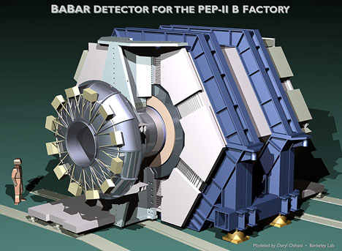

Rethinking Particle Identification For B Factories: DIRC Imaging Cherenkov Detectors
Outline:
• Prologue
• The BaBar DIRC
• Future directions
Blair Ratcliff

Slide 2
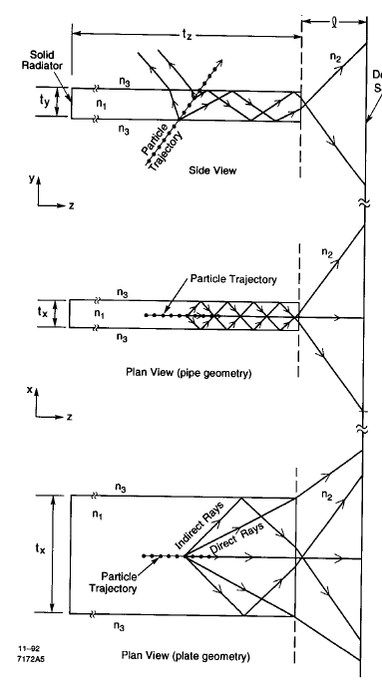
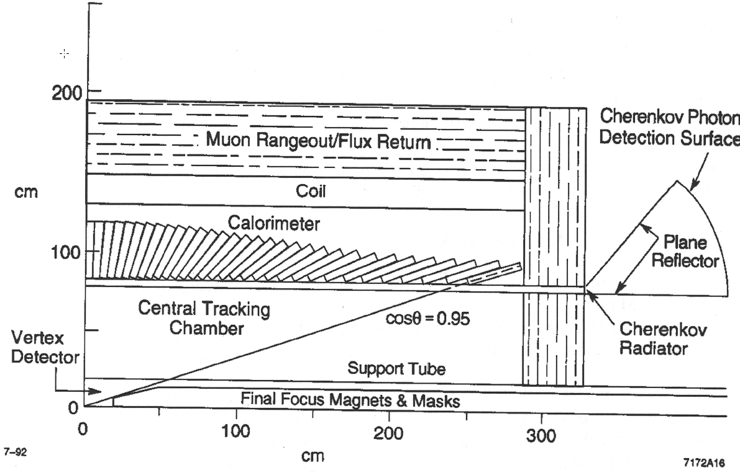
Circa 1992-The DIRC Counter for BaBar”.
From “The DIRC Counter: A Particle Identification Device for the B Factory” BaBar Note 92 (1992) and ICHEP(92) , B. Ratcliff (DIRC=Detector of Internally Reflected Cherenkov light)

Slide 3
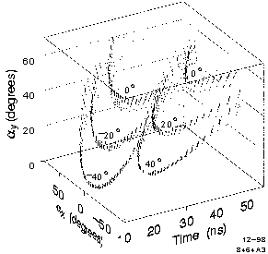
3 measurements (α_{x}, α_{y}, t_{p}(α_{z})) available to measure the 2 Cherenkov angles (θ_{c}, ϕ_{c}) with respect to a known track => nominal over-constraint at the single p.e. level.
Depending on the resolutions achieved, single photon timing can provide:
  Spatial separation of events along the bar.
  A reliable tag of beam crossings (~ 4 ns intervals at BaBar)
  Separation of signal hits from backgrounds
  Separation of many of the ambiguities
  A measurement of Cherenkov polar angle via t_{p}, and the TOF resolution on each track that both improve like 1/√N_{PE} . .Many modern counters (see below) exploit this using very fast modern parallel multiplication PMTs or MCP-PMTs.
  Can also measure the wavelength photon by photon and correct for chromatic dispersion. This possibility wasn’t understood until we had DIRC data. It has now been demonstrated in the FDIRC prototypes (see below).
Issues above the line were understood by the time of BaBar Note 92 (1992).

Slide 4
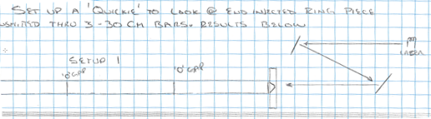
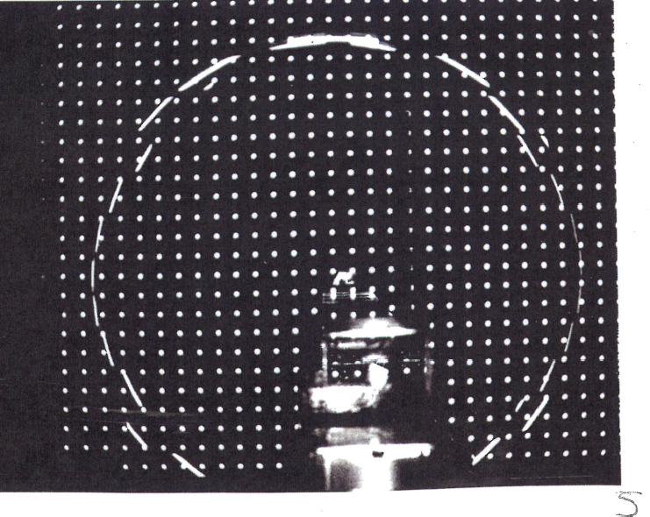
The first (laser) ring image in a long bar- Page from my log book 5/93
Note that photon angles are unsmeared after >1m
Single point diamond turned cone produces ring
1992-1994: Long Bar Conceptual DIRC Prototype
1994-1996: Large Scale Pre-production DIRC Prototype
1995-1999: BaBar DIRC Construction
1999-2008: BaBar Operations
2000-Now: BaBar Physics

Slide 5
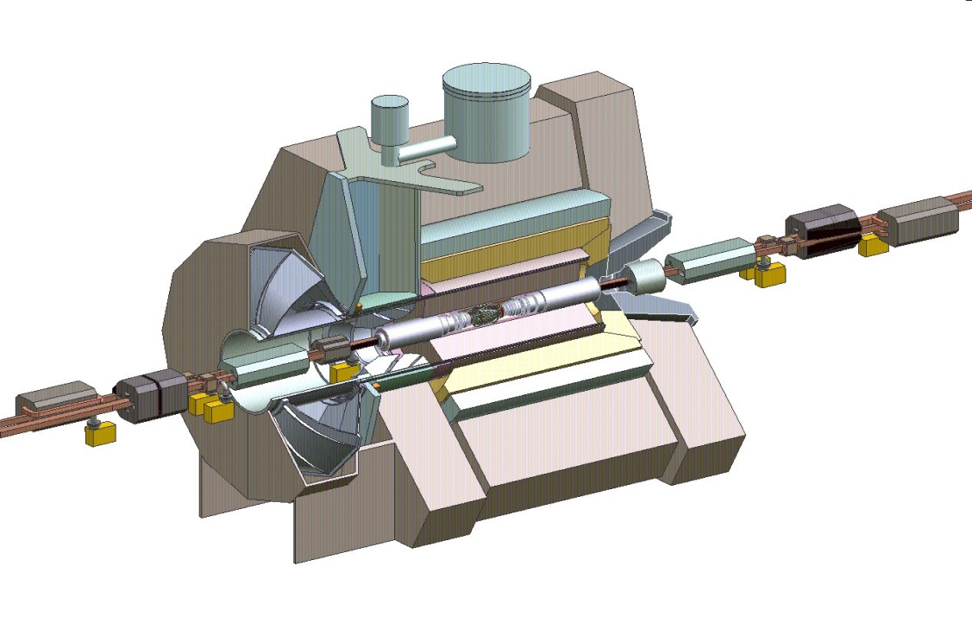
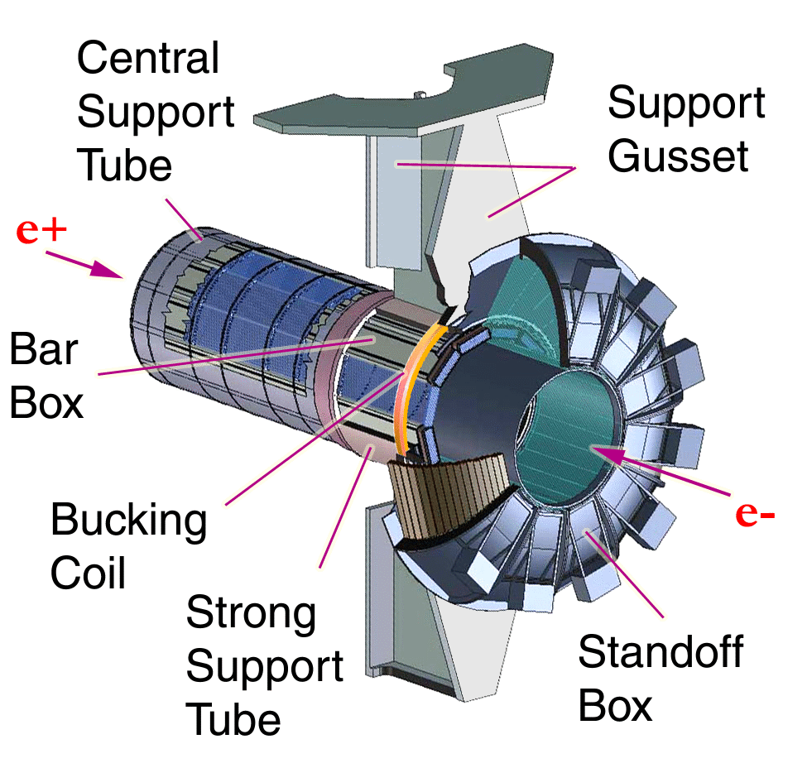
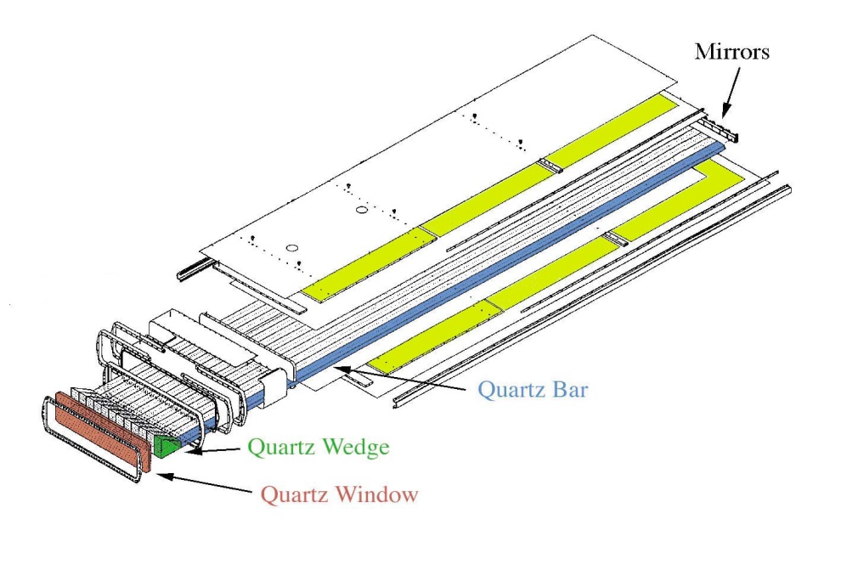
THE DIRC IN BABAR
Instrumented Flux Return
1.5 T Solenoid
DIRC thickness:
8 cm radial incl. supports
19% radiation length
at normal incidence
DIRC radiators cover:
94% azimuth,
83% c.m. polar angle
DIRC Radiators
Drift Chamber
e⁺ (3.1 GeV)
e– (9.0 GeV)
Electromagnetic
Calorimeter
Silicon Vertex
Detector
DIRC Camera and Magnetic Shielding

Slide 6
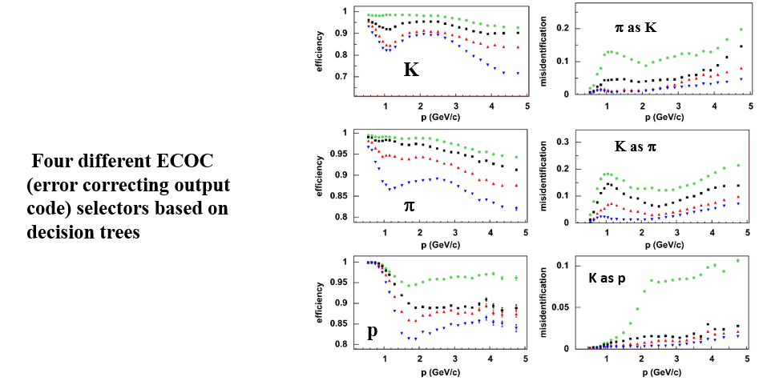
2013 Full BaBar Detector PID Performance
π as K
K
Κ as π
Four different ECOC (error correcting output code) selectors based on decision trees
π
K as p
p

Slide 7
Next Generation DIRCs
Modern DIRC designs typically utilize much faster pixelated PMTs than BaBar with more (and smaller) pixels. (MCP-PMTs can operate inside a magnet)
Typically emphasize one or more time sensitive elements including;
  Time imaging of Cherenkov angles (via T_{p}),
  Chromatic correction photon by photon (via T_{p}),
  TOF of particle.

Slide 8
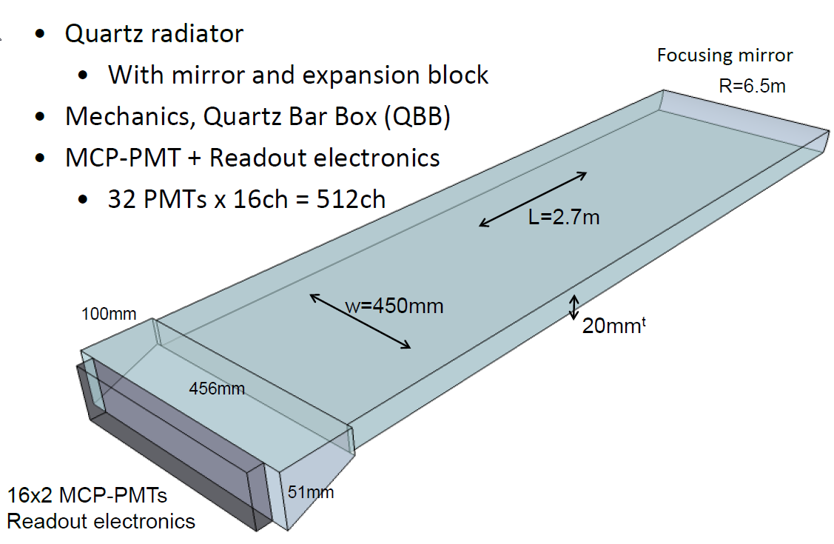
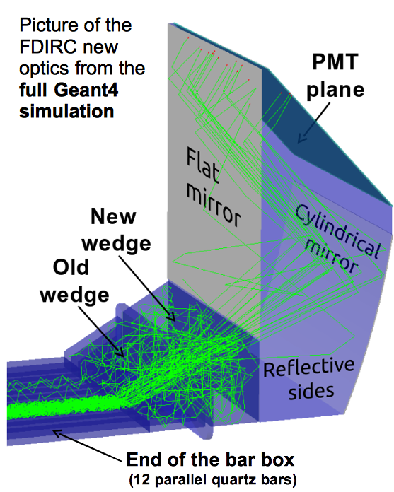
E.G., Modern DIRC Counters for B Factories
TOP Counter at BELLE-II
Compact device with PID performance similar to BaBar DIRC.
3-d readout emphasizing T_{p} with ~100ns timing/photon
Challenging Reconstruction- many ambiguities and multivariate PID separation
Commissioning now. Phase 2 operations soon.
FDIRC
3-D readout device emphasizing angular reconstruction.
position readout and chromatic correction.
Timing used to correct chromaticity, resolve ambiguities, separate signal from background, and provide modest separation performance improvement in T_{p} /TOF.

Slide 9
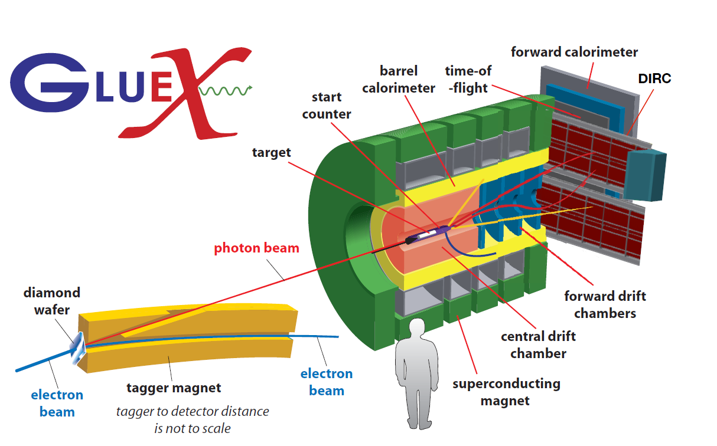
E.G., Modern DIRC Counters in Nuclear Physics Experiments
Particle ID with DIRC barboxes and FDIRC-like readout.
Final design uses 4 BaBar Barboxes, which will be transported very soon to JLAB
½ Barrel
TDR
7/17
PANDA

Slide 10
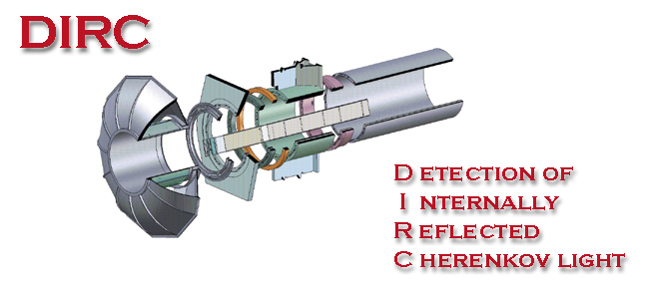


BABAR-DIRC COLLABORATION
DIRC combines with dE/dx from CDC and SVT (mostly in the 1/β² region) as
hadronic particle identification system for BABAR.
The BABAR-DIRC Collaboration
I.Adam,ª R.Aleksan,^{b} D.Aston,ª D. Bernard,^{e} G.Bonneaud,^{e} P.Bourgeois,^{b}
F. Brochard,^{e} D.N.Brown,^{f} J.Chauveau,^{c} J.Cohen-Tanugi,^{c} M.Convery,ª S.Emery,^{b} S.Ferrag,^{e} A.Gaidot,^{b} T.Haas,ª T.Hadig,ª G.Hamel de Monchenault,^{b} C.Hast,^{d}
A.Höcker,^{d} R.W.Kadel,^{f} J.Kadyk,^{f} M. Krishnamurthy,^{h} H. Lacker,^{c} G.W.London,^{b}
A.Lu,^{g} A.-M.Lutz,^{d} G.Lynch,^{f} G.Mancinelli,^{i} B.Mayer,^{b} B.T.Meadows,^{i} D.Muller,ª J.Ocariz,^{c} I. Ofte,^{i} S.Plaszczynski,^{d} M.Pripstein,^{f} B.N.Ratcliff,ª L.Roos,^{c}
M.-H.Schune,^{d} J.Schwiening,ª V.Shelkov,^{f} M.D.Sokoloff,^{i} S.Spanier,ª J.Stark,^{c}
A.V.Telnov,^{f} Ch.Thiebaux,^{e} G.Vasileiadis,^{e} G.Vasseur,^{b} J.Va'vra,ª M.Verderi,^{e}
W.A.Wenzel,^{f} R.J.Wilson,^{h} G.Wormser,^{d} Ch.Yéche,^{b} S.Yellin,^{g} M.Zito.^{b}
ª Stanford Linear Accelerator Center
^{b} CEA-Saclay,
^{c} LPNHE des Universités Paris 6 et Paris 7
^{d} LAL, Universite Paris Sud
^{e} Ecole Polytechnique, LPNHE
^{f} Lawrence Berkeley National Laboratory
^{g} University of California, Santa Barbara
^{h} Colorado State University
^{i} University of Cincinnati
See photos below

Slide 11

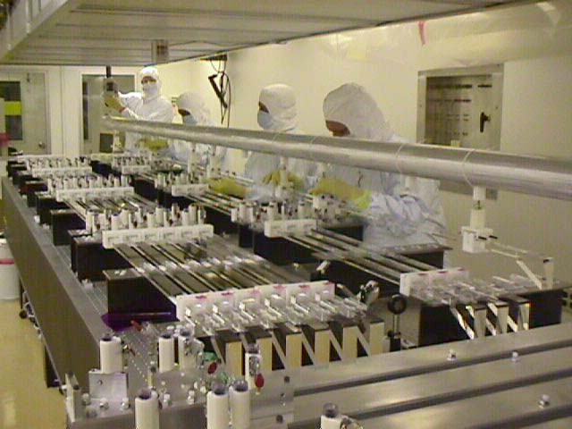
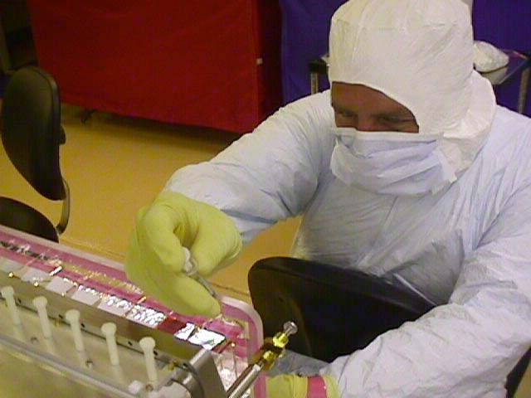
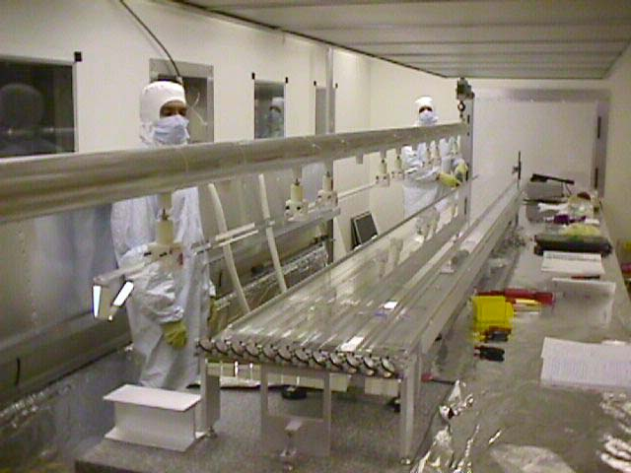
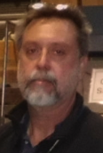
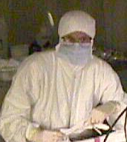
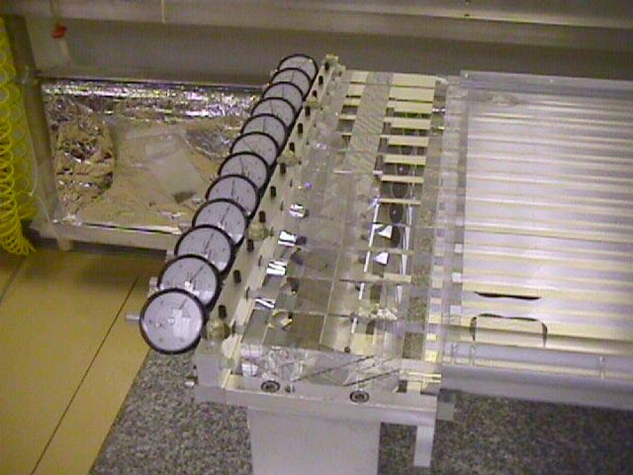
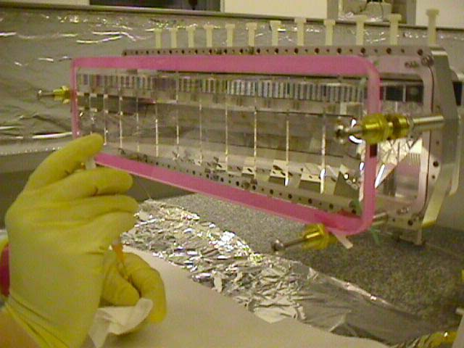
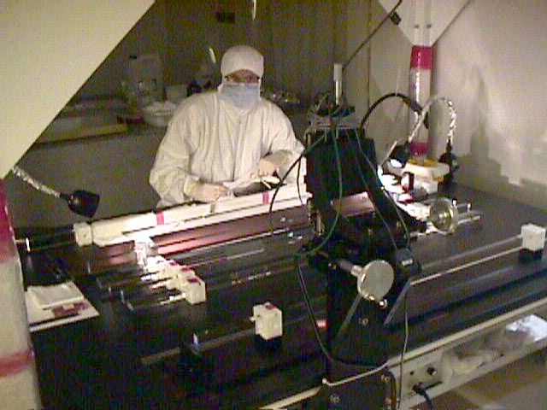
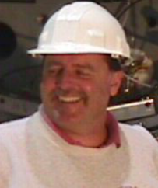
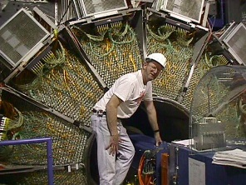
DIRC BarBox Assembly
DIRC Barbox Assembly crew had 4 technicians and 2 physicists.

Slide 12
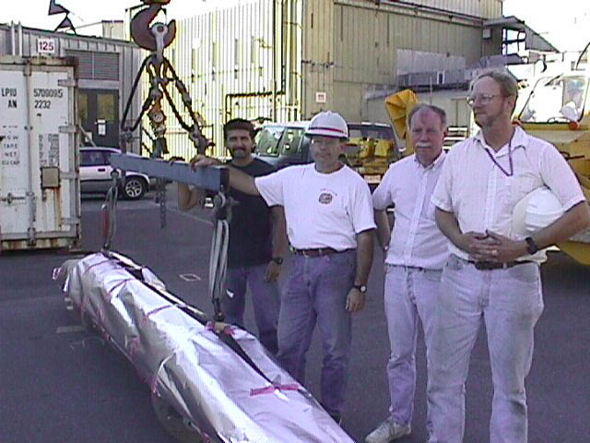
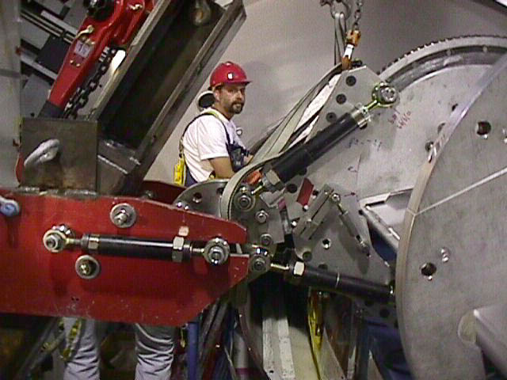
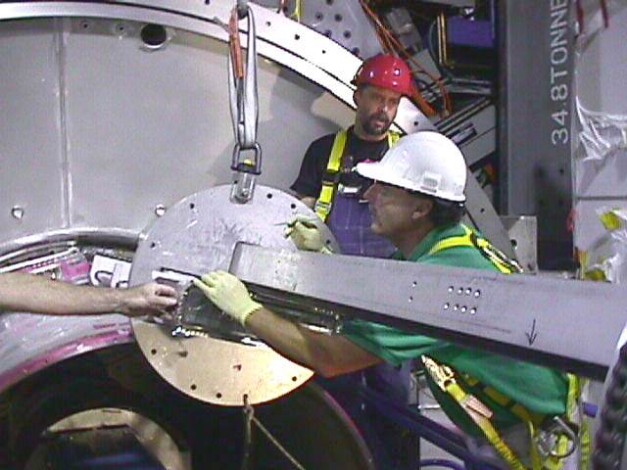
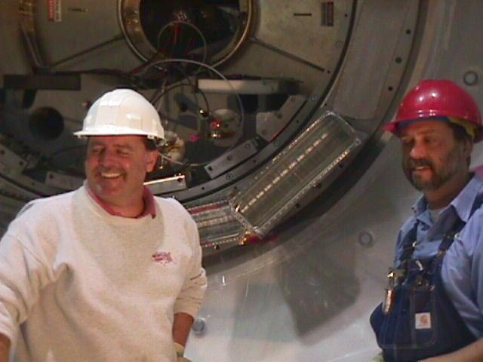
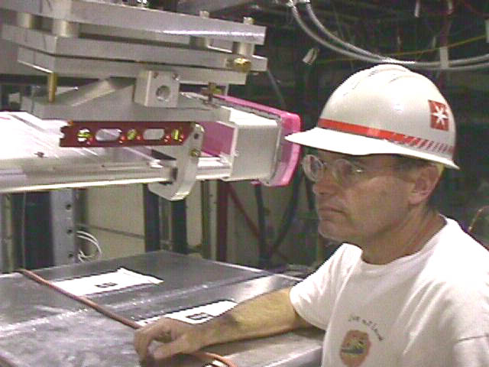
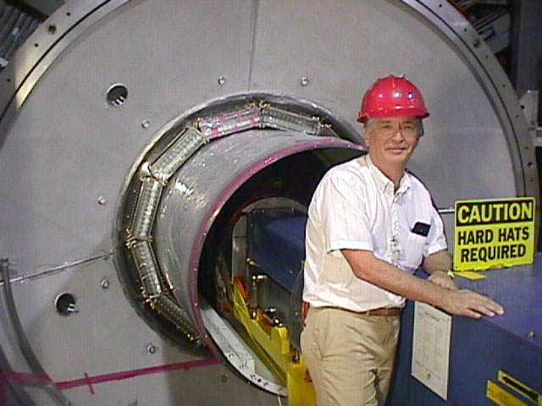
DIRC Installation into BaBar
Installation into BaBar was done by a group of 6 technicians.

Slide 13
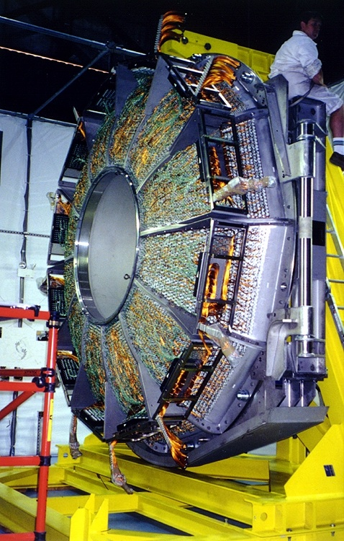
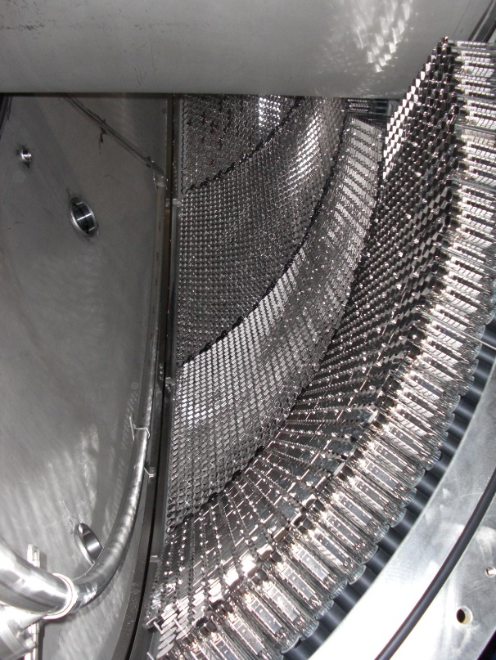
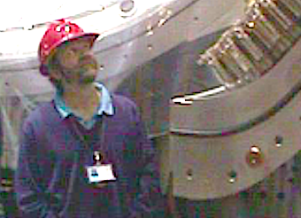
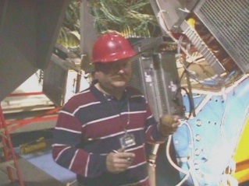
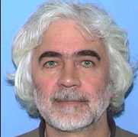
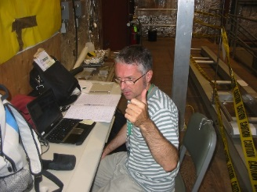
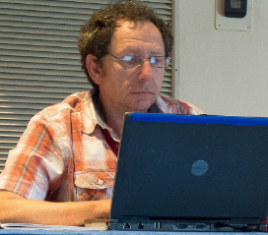
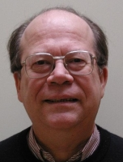
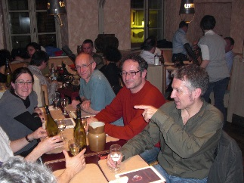


Photon Detector and Electronics
~11,000 1”-dia. PMTs.

Slide 14
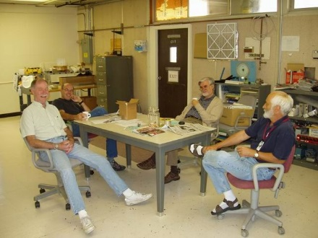
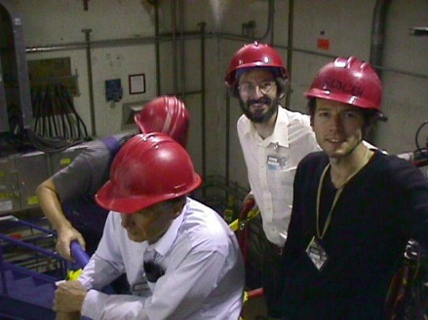
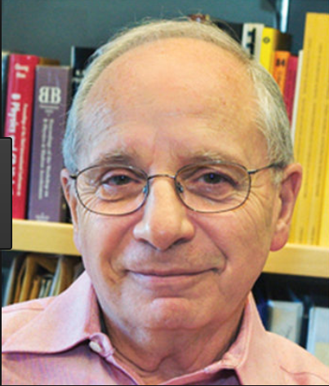
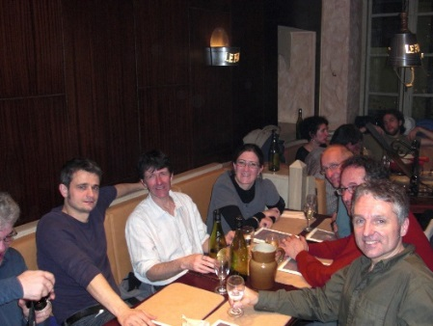

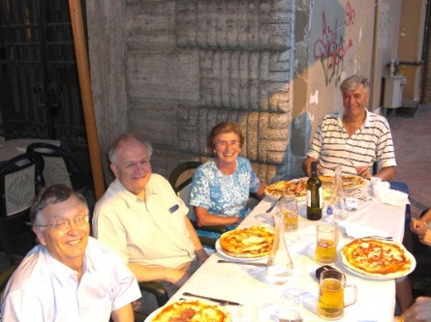
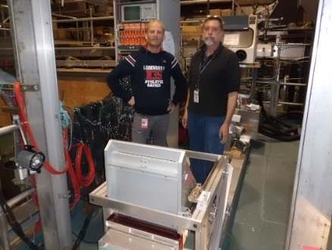
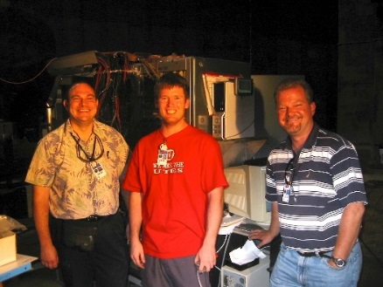
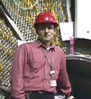
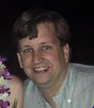
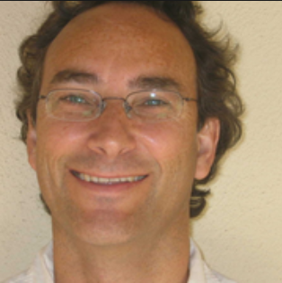
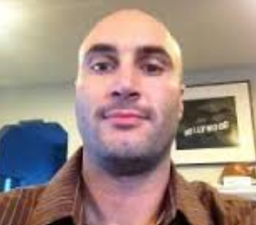









Software, Mechanical Design, and More
+ many more!
DPF2017 FERMILAB Blair Ratcliff, SLAC

