Slide 1
Office of High Energy Physics (HEP)
Detector R&D Program
DOE-HEP PI Meeting @ DPF 2017, Fermilab
August 3, 2017
Helmut Marsiske
Program Manager for Instrumentation
(Helmut.Marsiske@Science.DOE.gov)

Slide 2
Outline
P5 and the HEP Program
HEP Budget
HEP Detector R&D Program
DOE-HEP Comparative Review
DOE-SC Early Career Research Program

Slide 3
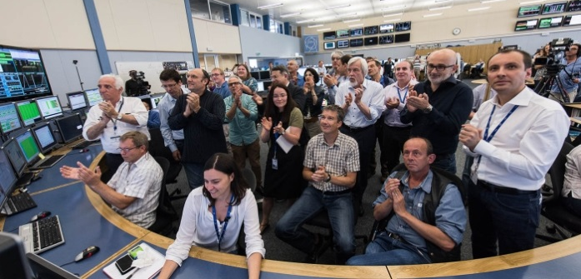
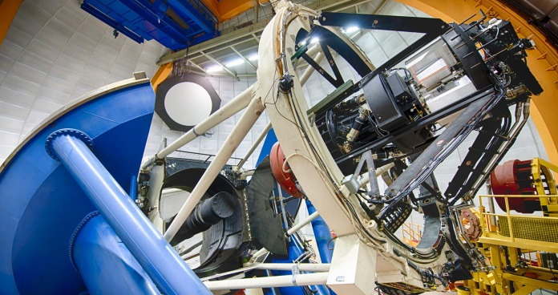
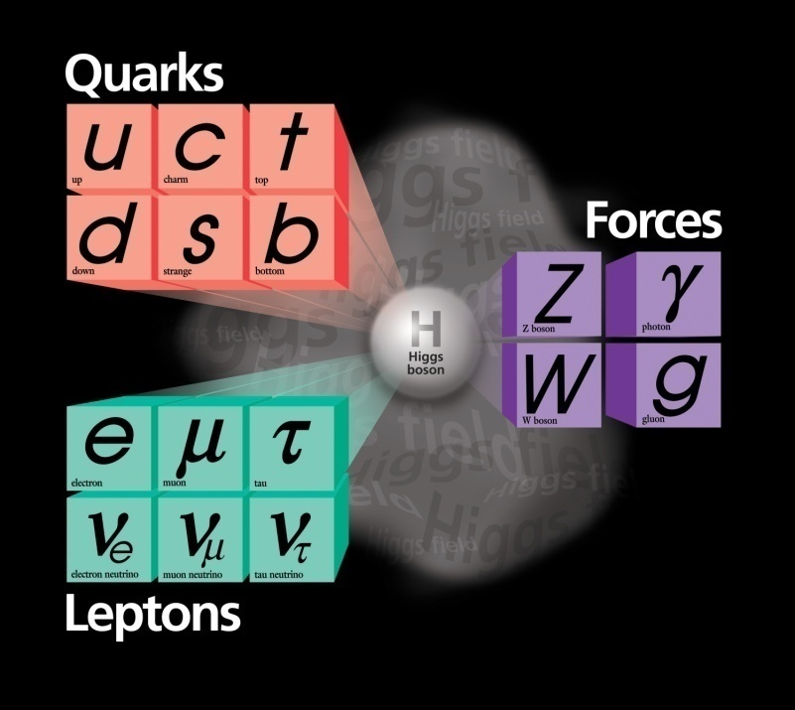
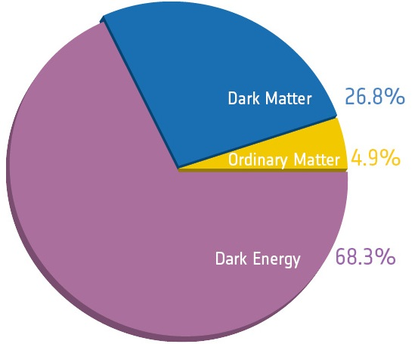
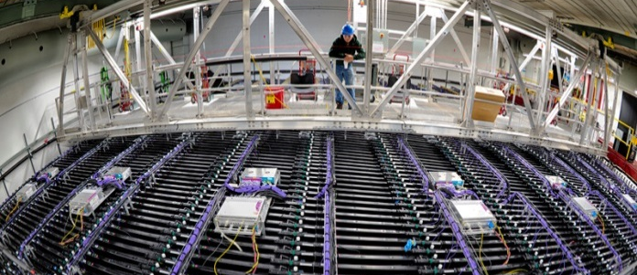
The High Energy Physics Program Mission
…is to understand how the universe works at its most fundamental level:
Discover the elementary constituents of matter and energy
Probe the interactions between them
Explore the basic nature of space and time
The Office of High Energy Physics fulfills its mission by:
Building projects that enable discovery science
Operating facilities that provide the capability to perform discovery science
Supporting a research program that produces discovery science

Slide 4
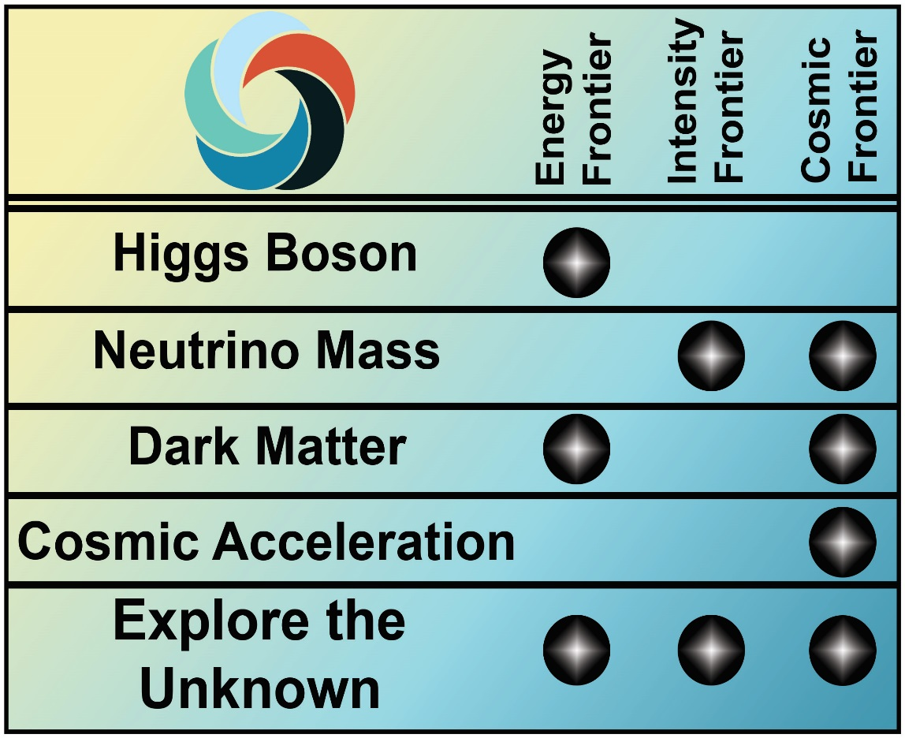
Enabling the Next Discovery
Science drivers identify the scientific motivation
Research Frontiers are useful categorization of experimental techniques and serve as the basis of the budget process
Research Frontiers are complementary
No one Frontier addresses all science drivers
Each Frontier provides a different approach to address science driver
Enables cross-checking scientific results
Detector R&D Program supports research in all three Frontiers

Slide 5
HEP Research Priorities: Snapshot
Energy Frontier
Analysis of LHC Run 2 data
Contribute to operational responsibilities and complete “Phase I” upgrades
Support preparations for HL-LHC program
Intensity Frontier
Neutrino Program
NOvA, T2K/SK, Minerva, MicroBooNE data analysis
Implement Fermilab Short-Baseline Neutrino Program and Intermediate Neutrino Program
Support ProtoDUNE, LBNF/DUNE, and PIP-II
Muon Program: Complete Mu2e, take data with Muon g-2
Heavy Flavor Program: Complete Belle-II and take data
Cosmic Frontier
Dark Matter: Complete G1 analysis, construct G2 experiments, modest R&D towards lower mass/higher sensitivity
Dark Energy: Complete BOSS, DES analysis; construct LSST and DESI
Continue planning for CMB-S4
Accelerator R&D
Focus on outcomes and capabilities that will dramatically improve cost effectiveness for mid-term and far-term accelerators
Hosting workshops to develop and implement R&D plan following P5 and GARD panels
Detector R&D
Near-term, low-risk R&D in support of high-priority P5 projects
Long-term, high-risk R&D with potential for wide applicability and/or high-impact
“Blue-Sky” research on innovative technologies not already in contention for implementation in future DOE-HEP projects
In the process of seeking community input to identify promising areas for long-term R&D
HEP Theory
Maintain an overall “thriving” program as per P5

Slide 6
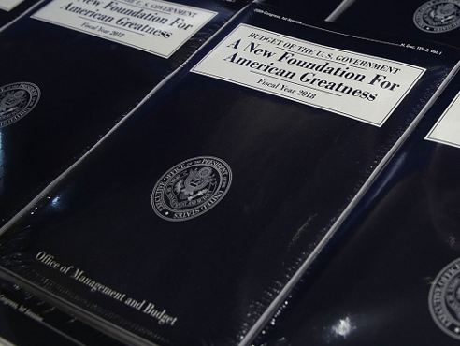
U.S. Government Budget Process

Slide 7
The Federal Budget Cycle
Typically, three budgets are being worked on at any given time:
Executing current Fiscal Year (FY; October 1 – September 30)
White House Office of Management and Budget (OMB) review and Congressional Appropriation for coming FY (FY+1)
Agency internal planning for second FY from now (FY+2)
FY 2017 Budget | Spend the Fiscal Year Budget
FY 2018 Budget | OMB Review |  |  |  | Budget Release | Congressional Budget and Appropriations |  |  |  |  |  |  | Spend the Fiscal Year Budget
FY 2019 Budget | DOE Internal Planning with OMB and OSTP Guidance |  |  |  |  |  |  |  |  |  |  |  | OMB Review |  |  |  | Budget Release | Congressional Budget and Appropriations |  |  |  |  |  |  | Spend the Fiscal Year Budget
 | Oct | Nov | Dec | Jan | Feb | Mar | Apr | May | Jun | Jul | Aug | Sep | Oct | Nov | Dec | Jan | Feb | Mar | Apr | May | Jun | Jul | Aug | Sep | Oct | Nov | Dec | Jan | Feb | Mar | Apr | May | Jun | Jul | Aug | Sep
 | CY 2016 |  |  | Calendar Year 2017 |  |  |  |  |  |  |  |  |  |  |  | Calendar Year 2018 |  |  |  |  |  |  |  |  |  |  |  | Calendar Year 2019
You are here

Slide 8
HEP FY 2018 President’s Budget Request
HEP Funding ($ in thousands) | FY 2016 Enacted | FY 2017 Enacted | FY 2018 Request | FY 2018 vs. FY 2016 |  | FY 2018 vs. FY 2017 Enacted
Research | 341,663 | 347,852 | 272,887 | -68,776 | -20% | -74,965 | -21%
Facility/Operations | 258,236 | 255,162 | 213,813 | -44,423 | -17% | -41,349 | -16%
Projects & Constr. | 195,101 | 221,986 | 186,000 | -9,101 | -4% | -35,986 | -16%
Total | 795,000 | 825,000 | 672,700 | -122,300 | -15% | -152,300 | -18%
The 2018 President’s Budget Request (PBR) for HEP is an overlay of Administration, DOE Office of Science/HEP, and P5 priorities
FY18 Budget Request reduces near-term science in favor of P5-guided investments in mid- and long-term program
All projects continue, some with delays
Research maintained at 40% of the program budget, but PBR will reduce activities at the National Labs and Universities, with higher priority given to:
Laboratory research programs that are critical to executing the P5 recommendations
R&D that requires long-term investments (i.e., “seeding the future”) including Accelerator Stewardship, Detector R&D, and Quantum Information Science (QIS)
Operations support for ongoing experiments reduced to make this possible
The new Administration and Congress support the overall P5 strategy, which continues to define investments into the future of the field

Slide 9
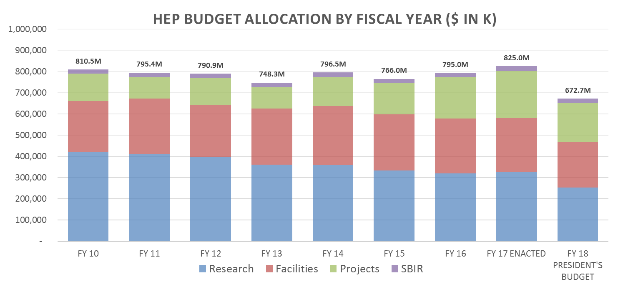
Overall HEP Budget Trend
Current drafts of House/Senate FY18 appropriations bills are flat/up compared to FY17 and above the FY18 President’s Budget Request
Congressional marks are a good budget indicator, but funding level not set until final appropriation bill is passed
-- Senate Mark: $860M
– House Mark: $825 M
All funding shown in “then-year” U.S. dollars

Slide 10
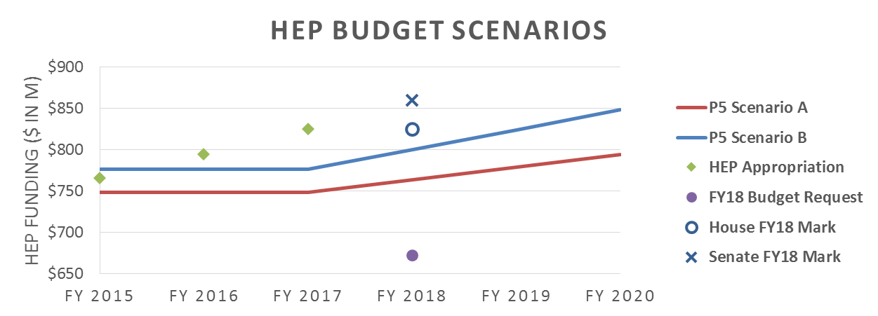
HEP Budget vs. P5 Funding Scenarios
P5 was charged to consider three 10-year budget scenarios for HEP within the context of a 20-year vision for the global field
Scenario A was the lowest constrained budget scenario
Scenario B was a slightly higher constrained budget scenario
Scenario C was “unconstrained,” but not considered unlimited
FY 2018 appropriations process is progressing
President’s Budget Request was released on May 23, 2017
Congressional Appropriations Committees are drafting legislation
Often includes language directing funding levels for specific projects/programs
Final language of appropriations bill (and report) impact how funding is directed

Slide 11
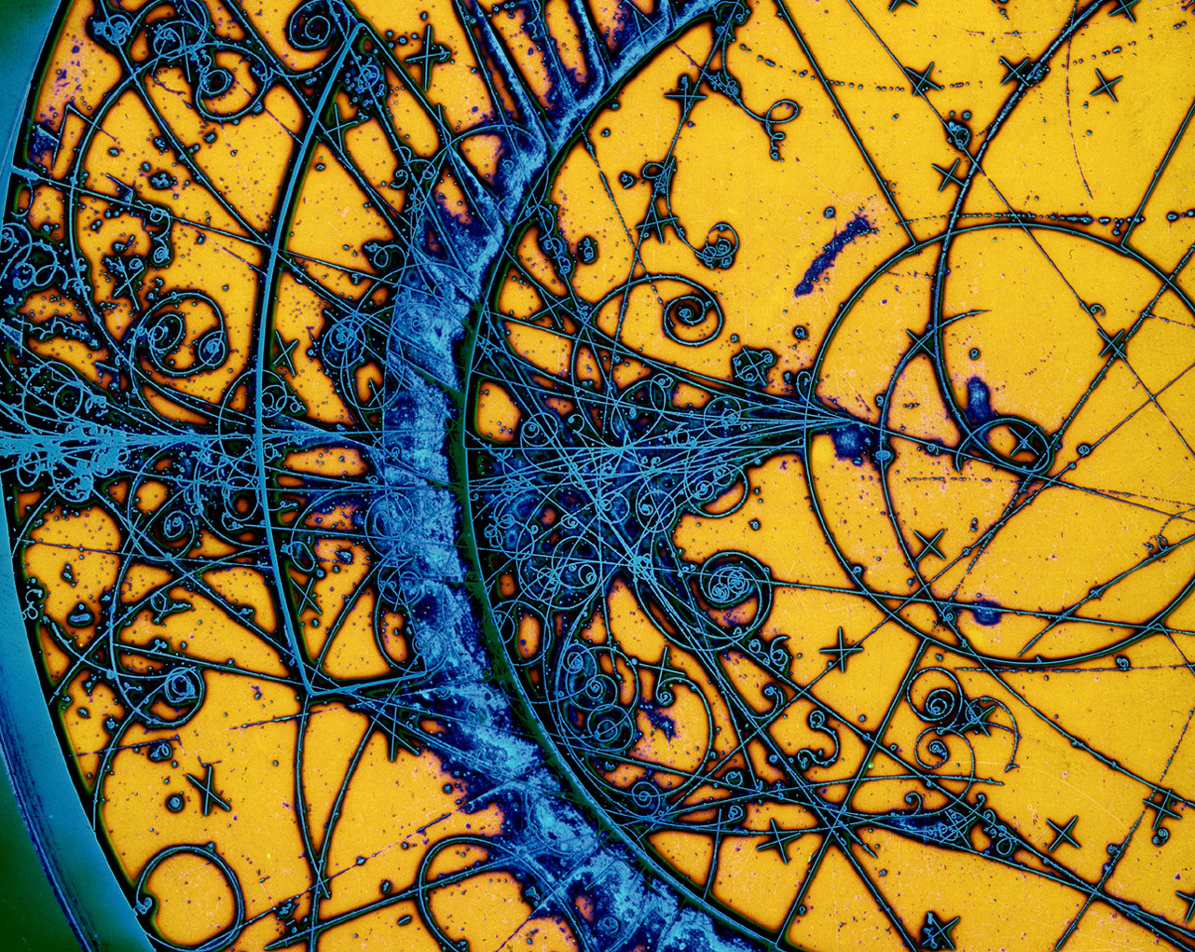
HEP Detector R&D Program

Slide 12
HEP Detector R&D Program Goals
Support research leading to fundamental advances in the science of particle detection, and develop the next generation of instrumentation for HEP
Need program properly balanced between incremental, near-term, low-risk and transformational, long-term, high-risk R&D
Project-oriented vs. Generic/Blue-Sky R&D
Focus on strategic areas (future promise; U.S. leadership)
Provide graduate and post-doctoral research training in instrumentation ⬅ next generation of detector experts
Support “infrastructure”—technical personnel, equipment, “facilities”, and test beams—required for experimental detector R&D and fabrication

Slide 13
P5 Recommendations
Recommendation 27: Focus resources toward directed instrumentation R&D in the near-term for high-priority projects. As the technical challenges of current high-priority projects are met, restore to the extent possible a balanced mix of short-term and long-term R&D.
⬅ Flavor of R&D has changed: less generic, more project-oriented Total R&D funding shrinking because of other, higher-priority initiatives
Recommendation 28: Strengthen university-national laboratory partnerships in instrumentation R&D through investment in instrumentation at universities. Encourage graduate programs with a focus on instrumentation education at HEP-supported universities and laboratories, and fully exploit the unique capabilities and facilities offered at each.
⬅ Find appropriate laboratory/university balance to optimize overall productivity; foster university instrumentation programs in a challenging budget environment

Slide 14
Program Funding and Effort and Process
Total funding in FY2017 is ~$23M
Research is ~$16M
75-80% of research funding to national labs
Facilities/test beam operations is ~$7M
Efforts at National Labs and Universities
7 national labs (60-80 FTEs at ANL, BNL, FNAL, LBNL, LLNL, PNNL, SLAC)
~20 universities ( 20-30 FTEs)
Process to determine funding/effort
National Labs: annual budget briefings, field work proposals (FWPs), and lab comparative review (last in 2016)
Universities: annual funding opportunity announcement (FOA) and university comparative review (since 2012)
Special solicitations (last in 2011 for Advanced Detector R&D and Collider Detector R&D)

Slide 15
Detector R&D Efforts by Frontier
Energy Frontier
LHC phase-II upgrades
“Future Colliders” further off into the future
Intensity Frontier
DUNE/SBN
Liquid Argon TPC, etc
Cosmic Frontier
Dark Matter/Dark Energy
Cosmic Microwave Background
“Instrumentation” Frontier
Large Area Picosecond Photon Detector (LAPPD)
Blue-Sky/Grand Challenges?
Most R&D efforts also supported out of the corresponding Research Frontier, or out of Operations programs (e.g., LHC operations)

Slide 16
Interim Summary
Innovation in Instrumentation historical strength of HEP
Need to preserve and invigorate this core competency
Near-term focus is on high-priority P5 projects
LHC phase-II upgrades
Long- and short-baseline neutrino program
Dark Matter/Dark Energy and CMB
Need to restore short-/long-term balance: more Blue-Sky
Stewardship of instrumentation efforts has historically rested with national labs and (some) university groups
Need to establish new, collaborative models to do more with less, and to better engage universities in the R&D enterprise
Continue to examine raison d’etre of existing detector facilities within the (changing) national HEP program
Community plays key role in identifying scientific and technological opportunities and in making them happen
Engaging CPAD for general- and special-purpose Detector R&D workshops

Slide 17
HEP Funding Opportunities

Slide 18
FY 2018 Research Opportunities in High Energy Physics

Slide 19
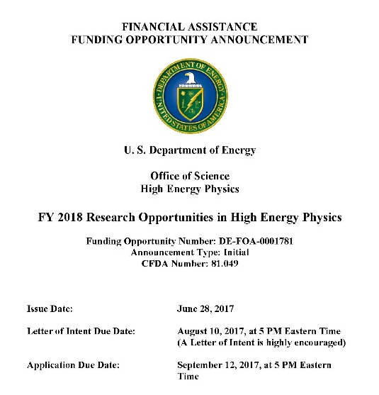
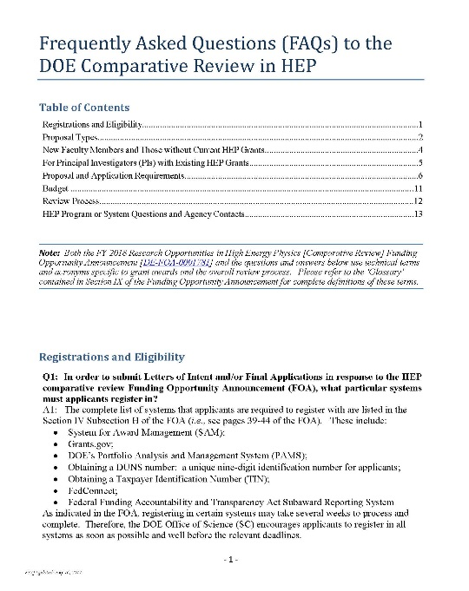
FY 2018 HEP Comparative Review FOA and FAQ
DE-FOA-0001781 issued June 28, 2017
Six HEP research subprograms
Energy, Intensity, and Cosmic Frontiers
HEP Theory
Accelerator Science and Technology R&D
Detector R&D
Letter of Intent due August 10, 2017 by 5 PM Eastern Time
Strongly encouraged
Final Proposal deadline September 12, 2017 by 5 PM Eastern Time
In addition to the FOA, a FAQ is available and addresses topics on:
Registration and eligibility requirements
Proposal types and proposal requirements;
Guidance for new faculty and those without current HEP grants
Guidance for PIs with existing HEP grants
Budget information and guidance on scope of request(s)
Letter of Intent
Information on overall scientific merit review process
Contacts for program- or system-related questions
Both the FOA and FAQ available at: http://science.energy.gov/hep/funding-opportunities/

Slide 20
Items to Keep in Mind
Read the FOA carefully and follow the requirements on content, length, etc.
Several requirements in the FOA are set from outside the DOE-HEP office, and there is little or no flexibility to modify. Non-compliant proposals submitted to the FOA will be declined without review
In recent years, 10-15% of incoming proposals were declined w/o review. Requirements that are most often missed or overlooked include: page limits, data management plans, separate budget sheets for each Frontier (if needed), and inclusion of Personally Identifiable Information (PII)

Slide 21
Items to Keep in Mind, cont.
Proposed research will review best if aligned with the DOE-HEP mission, its program, and the P5 strategy
Investigators in experimental HEP research frontiers (Energy, Intensity, Cosmic) will review best if they are closely integrated into HEP experimental collaborations and have key roles and responsibilities on those experiments
“Generic” detector research that is not specific to a single HEP experiment but broadly applicable should be directed to the HEP Detector R&D program
Concern about program balance ➔ “Proposals for “Blue-Sky” scientific research on innovative technologies not already in contention for implementation in future DOE HEP projects are specifically encouraged”
Would like to see university-lab collaborative proposals

Slide 22
Cross-cut Proposals
Applications where a PI is proposing to conduct research across multiple HEP research subprograms during the project period will be considered
PIs are encouraged to submit only one application, describing:
Overall research activity, including fractional time planned in each subprogram
FOA requirement: In proposal’s Budget Justification material (Appendix 7), include level of effort table for any transitions of effort during project period, as appropriate
As part of the comparative review process, DOE PMs will provide the panel with details regarding research plans that cross multiple HEP thrusts
Reviewers with appropriate topical expertise in the research area(s) will assess the full scope, relevance, and impact of the proposed research in the merit review process — e.g., merit review questions consider:
Are the plans for such cross-cutting efforts reasonably developed and will the proposed activities have impact?
Does the scope of the full proposed program provide synergy or additional benefits to the HEP mission beyond the individual thrusts?
Will PI’s overall efforts across multiple thrusts add value in the context of HEP program goals and mission?

Slide 23
Supported HEP Research Activities
Efforts that are in direct support of HEP programs ⬅ Depending on merit review and programmatic factors
Research efforts (mainly scientists) on R&D, experiment design, fabrication, installation, physics commissioning, data-taking, analysis-related activities
Theory, simulations, phenomenology, computational studies
Some engineering/technician support may be provided for Generic and Pre-project R&D, generally through the Detector R&D program
Faculty support
Support of up to 2-months summer salary based on merit reviews and/or optimizing the number of research personnel supported by financial assistance awards
Must ensure that sufficient effort (from the PI or others) is being provided to make the research feasible
Principal Investigator’s research effort commitment is an integral part of the award
Indicated in the approved budget pages, which becomes part of the legal agreement of the award
Research Scientists
Support may be provided, but due to long-term expectations, need to consider case-by-case on merits:
Roles/responsibilities well-matched with individual capabilities? Cannot be fulfilled by a term position?
Efforts are related towards research, not long-term operations and/or project activities
What’s not supported by research grants
Any significant experimental operations and/or project-related (past CD-0) activities:
Engineering, Major Items of Equipment, consumables for prototyping or production
Non-HEP related efforts
Gravity waves (LIGO), Heavy Ion (RHIC or LHC), Polar Science, AMO Science, Astronomy
Neutrinoless double beta decay is under the DOE Office of Nuclear Physics

Slide 24
Proposal Project Narrative
Project Narrative comprises the research plan for the project
Should contain enough background material in the introduction to demonstrate sufficient knowledge of the research
Devote main portion to a description and justification of the proposed project, include details of the methods to be used and any relevant results
Indicate which project personnel will be responsible for which activities
Include timeline for the major activities of the proposed project
Must not exceed 9 pages per senior investigator at sponsoring institution when printed on standard 8 ½” x 11” paper with 1-inch margins (all sides). Font must not be smaller than 11 point
Senior investigator ≡ active tenured or tenure-track faculty member at sponsoring institution
Non-tenure track faculty (e.g., research scientists) or senior research staff with term appointments are not included in the 9-page limit per senior investigator unless they are the sole senior investigator on the application
Faculty members at collaborating institutions listed on the proposal are not included in the count
Refer to Section IV of the FOA for useful information to help prepare the narrative
What to address for the Background/Introduction
Multiple Investigators and/or Multiple Research Subprograms or Thrusts
Common narrative with overview of each group’s activities in different research areas
Discussion of any synergies and connections between areas
Proposed Project Objectives, Research Methods, Resources
Timetable and Level of Effort of different activities, …

Slide 25
Comparative Merit Review Criteria
For Reviewers/Panelists
Merit review criteria and corresponding questions are given in Section V of the FOA. Given to all reviewers to use in preparing their reviews
Serves as a guide to address each review criteria for written reviews
Are highlighted by DOE PMs at the beginning of panel deliberations
Are presented and discussed by individual panelists for each proposal
For Principal Investigators
Merit review criteria and corresponding questions are given in Section V of the FOA
Serves as an additional guide for PIs to address in their proposal’s project narratives
PIs should integrate and adapt these (as appropriate) when narrating the group’s activities and research plans
Do not write an explicit paragraph answering each question!

Slide 26
Recent FOA Changes
All Research proposals to DOE-SC must have a Data Management Plan (DMP)
Includes HEP comparative review and Early Career, but not conferences, workshops, operations, projects
Any research thrust in a proposal without a DMP will be declined without review
All Renewal proposals must submit “proposal products” (publications, etc.) after the application is submitted
PIs will be notified by PAMS and have 5 days to respond
We cannot review incoming proposals until this step is completed
These will eventually be captured with your annual Progress Report, but must be entered by hand during the transition phase
Eligible Applications (new in FY 2018):
“All applications … requesting support for more than one person must propose a Program Director/Principal Investigator who is currently in a tenure-track appointment.”
Recurring Submissions of Research Applications (new in FY 2018):
“A previously declined application may be resubmitted to this FOA, but only after it has undergone substantial revision. An application submitted to this FOA that has not clearly taken into account the major concerns from prior DOE reviews may be declined without review and will not be considered for funding.”

Slide 27
Office of Science (SC) Data Management Plan
Focus of Digital Data Management is the sharing and preservation of digital research data
Data management involves all stages of the digital data life cycle including capture, analysis, sharing, and preservation
See Dr. Laura Biven’s presentation on SC Digital Data Management, Sept. 2014 HEPAP meeting: http://science.energy.gov/hep/hepap/meetings/201409/
FOAs issued after October 1, 2014 require a Data Management Plan (DMP) and compliance with the SC Statement on DMP available at http://science.energy.gov/funding-opportunities/digital-data-management/
See Section IV, the subsection on Appendix 8 of the FOA, for requirements pertaining to DMPs that must be included in your application
Most experiments have developed DMPs for their collaborations
When applying for financial assistance (or submitting FWPs), PIs can cite the DMPs for their experiments with the appropriate links
If DMP is cited, PIs must briefly describe how proposed research relates to the experiment
Theorists need DMPs: explain how theoretical/simulated data can be accessed/validated
If there is no data of any sort generated by the proposed research, the DMP must state this. A DMP that is blank or states “not applicable” is not acceptable
Each research thrust in a proposal requesting DOE research support,
including the FY 2018 Comparative Review FOA, will require addressing the DMP
requirements for it to be reviewed, and hence, to be considered for funding

Slide 28
Renewal Proposal Products
If you have received an award through the Comparative Review process, you are likely submitting a “Renewal” proposal
Contact your PM if you have a question as to whether it is more appropriate to submit a “New” or “Renewal” proposal
Renewal Proposal Products [see Section II.G of the FY17 comp rev FOA]
Since Feb 2015, PI must complete and submit ‘Renewal Proposal Products’ section in PAMS by entering each product created during the course of the previous project period
Details with step-by-step instruction set in PAMS Users’ Guide, Sec. 9.2: https://pamspublic.science.energy.gov/WebPAMSEPSExternal/CustomInterface/Common/ExternalUserGuide.pdf
Types of products include:
Publications (for collaborators on large experiments, list those where you were primary)
Intellectual property, technologies or techniques
Databases or software (made public)
Renewal Proposal Products are submitted after the application submission
DOE will assign the renewal proposal to a Program Manager, resulting in an automated email from PAMS to the PI with instructions ← watch for this email in your inbox
Navigate in PAMS to ‘Tasks’ and enter all products within 5-days after the proposal submission
Application will not be considered complete and therefore cannot be reviewed until the product list has been submitted

Slide 29
Guidance Checklist for Comparative Review
As a convenience and courtesy, DOE-HEP has provided a checklist in the FOA
The list, on the opening pages of the FOA, is not intended to be complete; applicants should review the FOA in-detail and follow all instructions
FY 2018 Comparative Review FOA – GUIDELINE FOR APPLICATION REQUIREMENTS | COMPLETED
Is the proposed research scope aligned with programmatic priorities of DOE-HEP? | R
Personally Identifiable Information (PII): Do not supply any information, such as birth date or place, citizenship, home address, personal phone nos., etc., that should not enter into the merit review. | R
A Data Management Plan is required for each research thrust (e.g., ATLAS, LSST, lattice gauge theory, etc.). It must appear in Appendix 8 of the application and comply with page-limit requirements specified in the FOA. | R
Project Summary/Abstract Page: contains the name(s) of the applicant, the project director/principal investigator(s) and the PD/PI’s institutional affiliation, and any Co-Investigators and their affiliations. | R
DOE Cover Page: list each HEP research subprogram (e.g., Energy Frontier, HEP Theory) for which funding is requested. If there is more than one, be sure to attach the Cover Page Supplement. | R
Page limits for each section comply with the FOA requirements (as defined in Section IV of the FOA). | R
Biographical sketches carefully follow the FOA instructions and avoid PII. | R
Current and Pending Support information completed, including an abstract of the scope of work. | R
In addition to the budget information for the full proposal: separate budget and budget justification narratives for each HEP research subprogram in the proposal for each year in which funding is being requested and for the cumulative funding period has been provided in Appendix 7. | R
Level of Effort Tables completed in Budget Justifications in Appendix 7: for each person for whom funding is requested in a research thrust, on the scope of activities during proposed project period. | R
Post-submission of the application, timely submitted the Renewal Proposal Products (RPP) in PAMS. | R

Slide 30
Comparative Review and Award Process
Pre-review
August: Letter of Intent (LOI) received from PI. Program planning at DOE-HEP.
Panel Review
Sept-October: Proposals assigned to at least three merit reviewers via DOE’s Portfolio Analysis and Management System (PAMS);
November: Panel discussion of all proposals and all senior personnel. Add additional reviews and make comparative reviews & evaluations.
Post-review and award
December: Assessment of each proposal and each PI by DOE-HEP using merit review, grant monitor input, programmatic priorities, budget constraints.
Early-to-mid January: Prioritized budget guidance sent to PIs and requests for revised budgets and budget justifications using proper DOE forms.
March-April: Awards to university from DOE Chicago Operations Office.
September: Proposal received. FOA compliance checks at DOE-HEP: PI qualifications, scope, page limits, budget pages, etc.
End-January - March: Route proposal’s procurement packages through DOE-SC and DOE Chicago Operations Office for approval.
October-November: Reviewers’ input written evaluations in PAMS.

Slide 31
Early career research program (ECRP)

Slide 32
How to Prepare for an Early Career Proposal
Address the following questions:
What challenges/problems are you trying to solve?
Is someone else doing it already? If you carry out these efforts, why are they unique and require ‘you’?
How does this research exploit/engage the unique capabilities of your institution?
What resources are needed to complete the project?
Does your proposal outline a 5-year timeline, with key deliverables and personnel profiled during this project period?
Have you led the activities that you are proposing? Why are you a future leader in high energy physics?
Reviewers look for innovative, balanced proposals
Can be speculative, but not implausible
Needs to have the potential for impact
Should have a detector physics component
Prior to submission, applicants may want to seek guidance from senior faculty/staff, and/or topical experts, and /or previous applicants while preparing proposals (including the budget material)

Slide 33
HEP Detector R&D Summary
Need to preserve/invigorate innovation in instrumentation within constrained budgets
Near-term priority is to support P5 research priorities
Long-term priority is to support research into transformational, broad-impact technology advances
Need to optimize the program across the lab/university divide using cost-effective, collaborative models
Community needs to step up identifying strategic Detector R&D opportunities and making them happen
HEP program needs to find adequate resources to support balanced program, including Blue-Sky research

Slide 34
Take Away Messages
HEP is maintaining the core of the DOE Science Mission
We are delivering exciting discoveries, important scientific knowledge, and technological advances
We must stay focused and continue to deliver these outcomes for the nation
HEP is executing the P5 plan
Program priorities will continue to be driven by the P5 strategy
Research funding will remain competitive
FY 2017 funding actions are moving forward
FY 2018 FOAs will progress the same as FY 2017
The FY 2018 budget process is moving forward
President’s Budget Request was released
House and Senate are drafting legislation that include some significant differences
Next steps are with Congress to finalize appropriations bills

Slide 36
Need Ideas for “How to Do More with Less”
More (detector) science
Also from other fields
More generic/high-risk/high-impact R&D
Strategic Directions? Grand Challenges?
More university involvement
Large, under-utilized intellectual potential
More young people
Future instrumentation leaders
More communication/interaction
Workshops/conferences
More cost-effective
E.g., more sharing of resources; better execution
Non-HEP funding sources: other SC, other agencies, SBIR, etc.

Slide 37
University HEP Comparative Reviews
Since FY 2012, DOE-HEP uses a process of comparative grant reviews for new and renewal university research grant proposals
Most incoming FY 2018 Funding Opportunity Announcement (FOA) applicants with typical 3-year university grants that plan to renew will have been reviewed at least twice
Process was recommended by several DOE advisory committees, including the 2010 and 2013 HEP Committee of Visitors (COV):
“In several of the cases that the panel read, proposal reviewers expressed negative views of the grant, but only outside of their formal responses. Coupled with the trend in the data towards very little changes in the funding levels over time, this suggests that grants are being evaluated based on the historical strength of the group rather than the current strength or productivity of the group. This is of particular concern when considering whether new investigators, new science, or high-risk projects can be competitive. Comparative reviews can be a powerful tool for addressing these issues and keeping the program in peak form.”
Recommendation of 2010 COV: Use comparative review panels on a regular basis;
and 2013 COV: Continue comparative reviews. Augment with independent mail-in reviews.
Goal: improve overall quality and efficacy of the HEP research program by identifying the best proposals with highest scientific impact and potential

Slide 38
Research Scientists (RS)
Panel will evaluate RS efforts where support is requested in a proposal
Guidance to PIs given in Q&A of FAQ
Requests to support RS dedicated full-time (and long-term) to operational and/or project activities for an experiment will not be supported by respective frontier research areas
If RS conducting physics research-related activities, requests [scaled to % of time on such efforts] can be included
Any final support will be based on the merit review process
Common [past] reviewer comments that result in unfavorable merit reviews:
“RS conducting scope of work typically commensurate at the postdoctoral-level…”
“RS involved in long-term ops/project activities with minimum physics research efforts…”
Such efforts may review well in the operation/project program but not in a review of the experimental research program
What are “physics research-related activities?”
Object reconstruction/algorithm development, performance studies, data taking and analysis, and mentorship of students & postdocs in these areas
Scientific activities in support of detector/hardware design and development
From the research program, cases become an issue when operations/projects become the dominant activity in the long-term
A well-balanced portfolio that includes physics research-related activities is encouraged
Important to narrate complete plans in 2-page “appendix narrative” + provide 1-page bio

Slide 39
Comparative Merit Review Criteria
[Sub-questions are provided in Section V of FOA and to merit reviewers/panel to evaluate proposal and PI(s)]
Scientific and/or Technical Merit of the Proposed Research e.g., What is the scientific innovation of proposed effort? What is the likelihood of achieving valuable results? How might the results of the proposed research impact the direction, progress, and thinking in relevant scientific fields of research? How does the proposed work compare with other efforts in its field, both in terms of scientific and/or technical merit and originality? What is the merit of the proposed research, compared to other efforts within the same research area for a) applications submitted to this FOA and b) those in the overall HEP field? Is the Data Management Plan suitable for the proposed research and to what extent does it support the validation of research results? Please comment individually on each senior investigator.
Appropriateness of the Proposed Method or Approach e.g., How logical and feasible is the research approach of each senior investigator? Does the proposed research employ innovative concepts or methods? Are the conceptual framework, methods, and analyses well justified, adequately developed, and likely to lead to scientifically valid conclusions? Does the applicant recognize significant potential problems and consider alternative strategies?
Competency of Research Team and Adequacy of Available Resources e.g., What is the past performance of each senior investigator? How well qualified is each senior investigator and their team, and what is the likelihood of success in carrying out the proposed research? Are the research environment and facilities adequate for performing the research? Are PIs or any members of the group leaders on proposed effort(s) and/or potential future leaders in the field? Does the proposed work take advantage of unique facilities and capabilities? Are any proposed plans for recruiting any additional scientific and/or technical personnel including new senior staff, students and postdocs reasonable, justified, and appropriate? For PIs proposing work across multiple research thrusts, are the plans for such cross-cutting efforts reasonably developed and will the proposed activities have impact?
Reasonableness and Appropriateness of the Proposed Budget e.g., Are the proposed budget and staffing levels adequate to carry out the proposed work (scope)? Are all travel, student costs, and other ancillary expenses adequately estimated and justified? Is the budget reasonable, appropriate for the scope?
Relevance to the mission of the DOE Office of High Energy Physics (HEP) program e.g., How does the proposed research of each senior investigator contribute to the mission, science goals and programmatic priorities of the subprogram in which the application is being evaluated? Is it consistent with HEP’s overall priorities and strategic plan? For PIs proposing to work and/or transition across multiple research thrusts during the project period, will their overall efforts add value in the broader context of HEP program goals? How likely is the research to impact the mission or direction of the overall HEP program?

Slide 40
Programmatic Considerations
Generally very useful to have head-to-head reviews of PIs working in similar areas, particularly for large grants
Discussion of relative strengths and weaknesses of individual proposals and PIs
Many factors weigh into final funding decisions
Compelling research proposal for next ~3 years
Interesting? Novel? Significant? Plausibly achievable?
Incremental? Implausibly ambitious? Poorly presented?
Significant recent contributions (past 3-4 years)
Synergy and collaboration within group (as appropriate)
Contributions to the research infrastructure of experiments
Balanced program of R&D/design, support of construction or operations, data analysis
Alignment with programmatic priorities
Supportive of excellent people, including excellent new people, even when times are tough!
Corollary: Some proposals or senior personnel ranked below average will not be funded

