Slide 1
Process of the 2nd update of the European Strategy for Particle Physics
DPF2017, Chicago
Sijbrand de Jong
CERN Council President

Slide 2
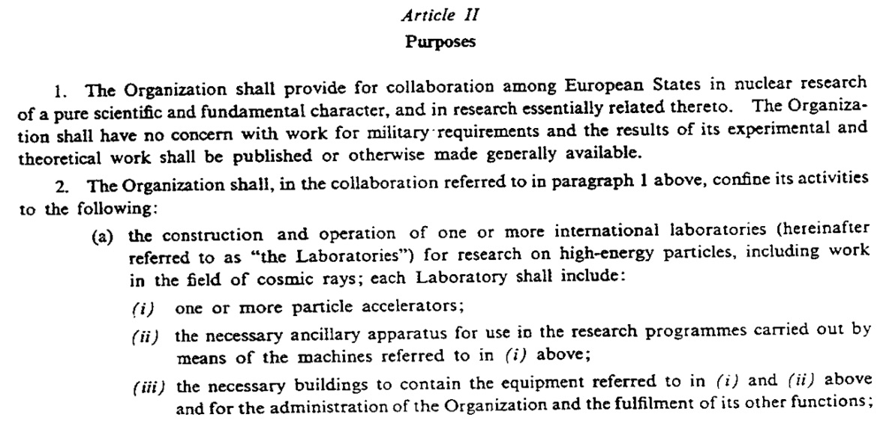
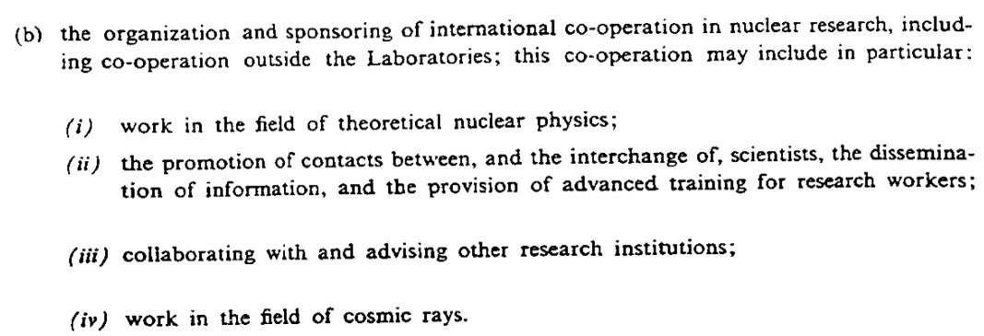
Convention
CERN shall be:
a)
Lab(s) with
accelerators
b)
Organising
co-operation
In particular:
co-ordinate
with other labs

Slide 3
Purpose
of
CERN
Realise
a
large
machine !

Slide 4
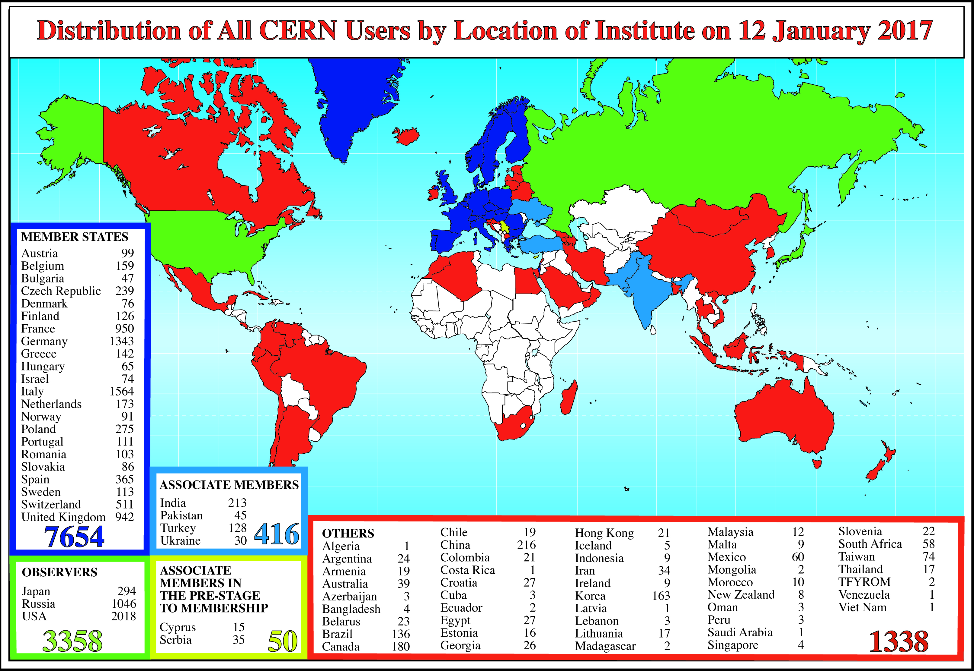
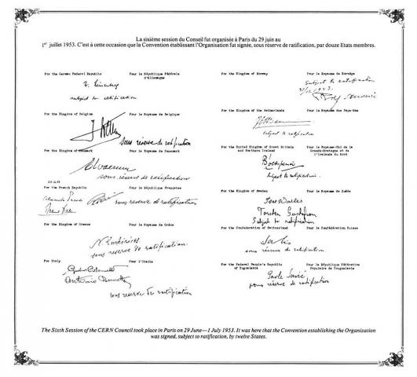
USA:
>2000 users

Slide 5
Present* European Strategy: Preamble
Europe should preserve this (CERN, SdJ) model in order to keep its leading role, sustaining the success of particle physics and the benefits it brings to the wider society.
The European Strategy takes into account the worldwide particle physics landscape and developments in related fields and should continue to do so.
=> Marching order for next update
* Established in 2013

Slide 6
Present European Strategy: High-priority large-scale scientific activities
Europe’s top priority should be the exploitation of the full potential of the LHC, including the high-luminosity upgrade of the machine and detectors with a view to collecting ten times more data than in the initial design, by around 2030. This upgrade programme will also provide further exciting opportunities for the study of flavour physics and the quark-gluon plasma.
CERN should undertake design studies for accelerator projects in a global context, with emphasis on proton-proton and electron- positron high-energy frontier machines. These design studies should be coupled to a vigorous accelerator R&D programme, including high-field magnets and high-gradient accelerating structures, in collaboration with national institutes, laboratories and universities worldwide.
There is a strong scientific case for an electron-positron collider, complementary to the LHC, … The initiative from the Japanese particle physics community to host the ILC in Japan is most welcome, …
Europe looks forward to a proposal from Japan to discuss a possible participation.
CERN should develop a neutrino programme to pave the way for a substantial European role in future long-baseline experiments. Europe should explore the possibility of major participation in leading long-baseline neutrino projects in the US and Japan.
✔
✔
✔

Slide 7
Present European Strategy: Other essential scientific activities
Europe should support a diverse, vibrant theoretical physics programme, ranging from abstract to applied topics, in close collaboration with experiments and extending to neighbouring fields such as astroparticle physics and cosmology. Such support should extend also to high-performance computing and software development.
Experiments in Europe with unique reach should be supported, as well as participation in experiments in other regions of the world.
Detector R&D programmes should be supported strongly at CERN, national institutes, laboratories and universities. Infrastructure and engineering capabilities for the R&D programme and construction of large detectors, as well as infrastructures for data analysis, data preservation and distributed data-intensive computing should be maintained and further developed.
In the coming years, CERN should seek a closer collaboration with ApPEC on detector R&D with a view to maintaining the community’ s capability for unique projects in this field.
The CERN Laboratory should maintain its capability to perform unique experiments. CERN should continue to work with NuPECC on topics of mutual interest.
CERN should be the framework within which to organise a global particle physics accelerator project in Europe, and should also be the leading European partner in global particle physics accelerator projects elsewhere. Possible additional contributions to such projects from CERN’s Member and Associate Member States in Europe should be coordinated with CERN.
CERN and the particle physics community should strengthen their relations with the European Commission in order to participate further in the development of the European Research Area.
✔
✔
✔
✔
✔
✔
✔

Slide 8
Next* Update of European Strategy: Set in motion in December 2016
Council decisions in December 2016:
Aim at adopting an updated strategy in May 2020
Arguments for time frame:
2013-2020 is 7 years between updates
End of LHC run 2 at end of 2018
FCC conceptual design report by end 2018
CLIC update (staged implementation plan, cost, etc.) by end 2018
Report of Physics Beyond Colliders Study Group by end 2018
Japanese decision on ILC should be known by end 2018
Advances in Neutrino physics
Appoint a Strategy Secretary early, i.e. September 2017
Input/work needed to organize the strategy discussion
* A first strategy (after the convention) was decided in 2006 and first updated in 2013

Slide 9
Next Update of European Strategy: Organizational Structure
Decided by Council in March 2014:
Permanent Strategy Secretariat abolished
Monitoring responsibility moved to the DG
Three bodies to be installed at opening of update process:
European Strategy Group (ESG): establish the draft
Physics Preparatory Group (PPG): prepare Briefing Book for
the ESG
Strategy Secretariat: Organization & ancillary documents

Slide 10
Next Update of European Strategy: Strategy Secretariat
Membership:
the Strategy Secretary (acting as Chair),
the SPC Chair,
the ECFA Chair,
the Chair of the European Laboratory Directors’ meeting.

Slide 11
Next Update of European Strategy: Physics Preparatory Group
Membership:
the Strategy Secretary (acting as Chair),
four members appointed by the Council on the recommendation of the SPC,
four members appointed by the Council on the recommendation of ECFA,
the SPC Chair,
the ECFA Chair,
the Chair of the European Laboratory Directors’ meeting,
one representative appointed by CERN,
one representative from Asia appointed by the respective regional representatives in ICFA,
one representative from the Americas appointed by the respective regional representatives in ICFA.

Slide 12
Next Update of European Strategy: European Strategy Group
Membership:
the Strategy Secretary (acting as Chair),
one representative appointed by each CERN Member State,
one representative for each of the Laboratories participating in the major European Laboratory Directors’ meeting, including its Chair,
the CERN Director-General,
the SPC Chair,
the ECFA Chair.
Invitees:
the President of the CERN Council,
one representative from each of the Associate Member States,
one representative from each Observer State,
one representative from the European Commission,
the Chairs of ApPEC, FALC, ESFRI and NuPECC,
the members of the Physics Preparatory Group.

Slide 13
Next Update of European Strategy: 2019 – A year of consultation
Precise format will be decided in 2018, but there will be
At least 1 town meeting
Possibility to enter any relevant documentation
(e.g. position papers)
Gather of all relevant information at a global scale by the Preparatory Group
Input from all parts of the world necessary
for a proper European Particle Physics Strategy

Slide 14
Next Update of European Strategy: Approximate Timeline
Now here
September 2017 Appointment of Strategy Secretary
and installation of Strategy Secretariat
September 2018 Appointment of ESG and PPG by the Council
Formal opening of the process
2019 Preparation of the briefing book, including
1 or 2 town meetings
other consultations of the field
January 2020 Drafting of the proposed strategy by the ESG
March 2020 Discussion of proposed strategy by the Council
May 2020 Adoption of new strategy by the Council
about the beginning
of the US P5 process

