Slide 1
Fast timing detectors development at Fermilab
Anatoly Ronzhin
July 31, 2017
DPF FNAL meeting

Slide 2
Fast timing can suppress PU at LHC upgrade
The high luminosity upgrade of the Large Hadron Collider (HL-LHC) at CERN is expected to provide instantaneous luminosities of 5x10to34/cm2s. This emphasize the need in detectors with very high counting rate.
One of the goal is to associate calorimeter measurements with primary vertex location. Needs in time resolution (TR) of ~few tens ps in association with the measured energy of the photon, the goal is to suppress pileup in collisions. 30 ps corresponds to 1cm in z of collision vertex and approximately corresponds to reduction in pileup from 200 → 20. Objective is to achieve time of flight (TOF) resolution of ~20ps using EM calorimeter.
The association of the time measurement to the energy measurement is crucial, leading to a design that calls for the time and energy measurements to be performed in the same active detector element.
One of the possible option for calorimetry upgrade is to use single sensitive layer inside of the calorimeter (like SM) with very high TR. The possible single layer could be Silicon. We focus our timing measurements on these possible options.
We continue to work on improvement of used tools for time measurements and analysis (like DRS4, fast scops0.

Slide 3
Main parameters of detectors for fast timing
Very important parameters for fast timing detectors are: signal rise time, signal shape (both should be as short as possible) and low noise level; Single Photodetector Time Resolution (SPTR). Our goal is to develop detectors with picoseconds time resolution (TR). The simplified formula for detector time resolution is: σ=Tr x 1/(S/N), where Tr is signal rise time and S/N is Signal to Noise ratio.
We used PiLas laser trigger signal as start (time jitter ~3ps relative to laser light signal) and photodetector output signal as stop under photodetector illumination by the laser light. The start signal was not introduced significant time jitter in measurements of photodetectors timing. We tested timing of fast photodetectors: MCP PMT (Photek240, Photonis, Hamamatsu), also as SiPMs (last decade we directly contacted with producers, tested many types SiPMs, (from MPPC, STM, IRST, FBK, SensL Kotura, KETEK, MePhy..).
As readout was used DRS4 to measure signal shape, time jitter, noise floor of detectors.
Some of application:
Beam line TOF, need start and stop counters (FTBF, Minerva, CERN…).
Calorimeters and showers maximum (SM) detectors.
Medical (PET TOF, pCT).
.

Slide 4
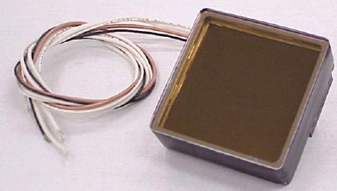
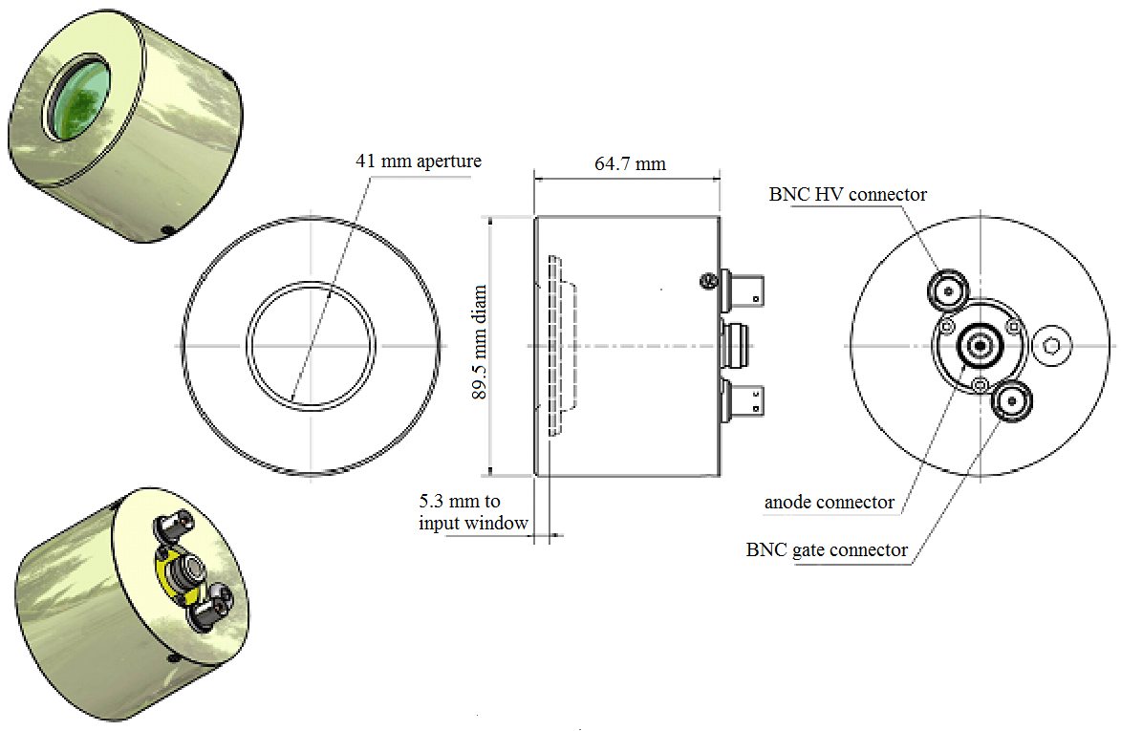
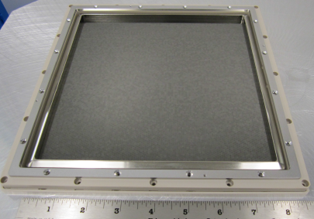
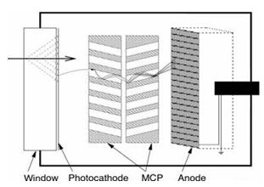
Photek 240, Photonis MCP-PMT and LAPPD, 8”x8” transverse size.
Photek240
Photonis XP85012
SPTR of MCP-PMT ~ 10-20 ps
Noise less
of 1 uA, or
less of few
counts/mm2
LAPPD MCP
200mm x 200mm
Could be single layer
for SM, thickness ~mm
A micro-channel plate (MCP) is a slab made from highly resistive material of typically 1 mm of thickness with a regular array of tiny tubes (micro channels) leading from one face to the opposite, densely distributed over the whole surface. MCP is sensitive to MIP with less of 100% efficiency.

Slide 5
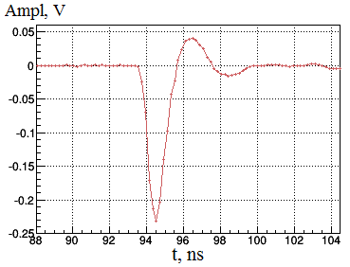
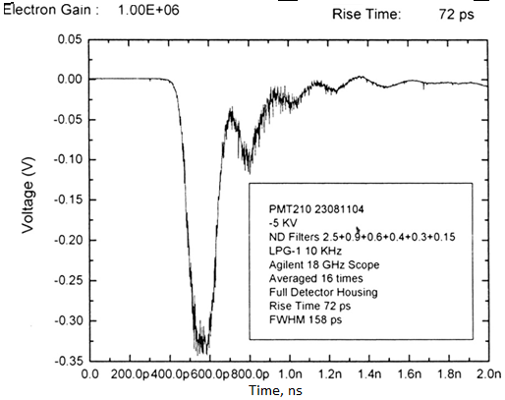
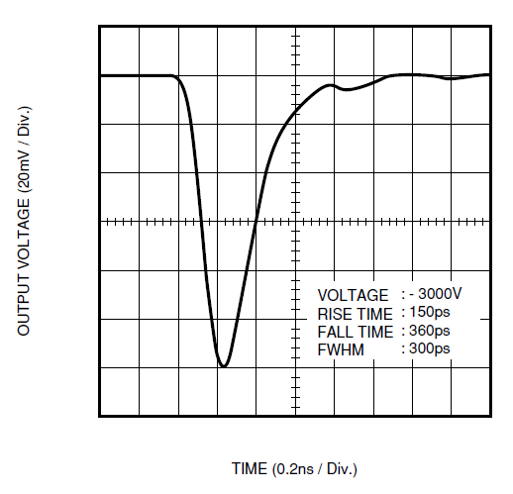
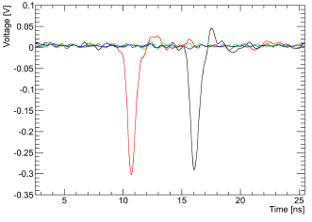
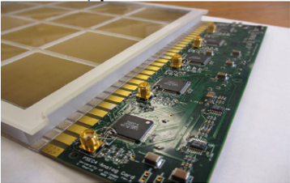
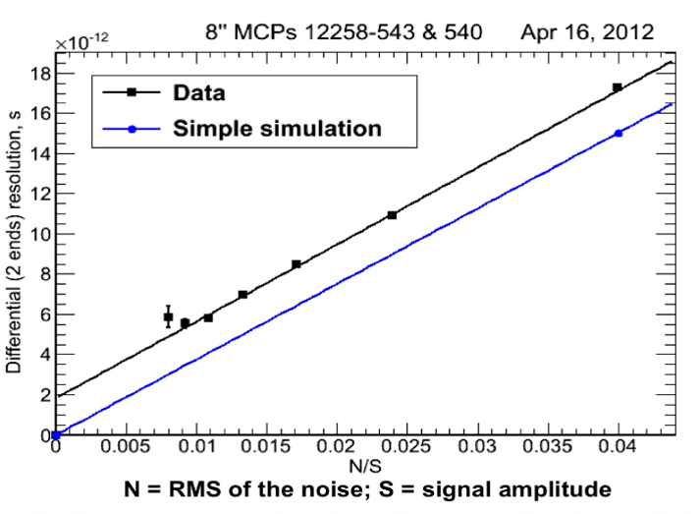
MCP-PMTs: Photek240, Hamamatsu, LAPPD. Signal rise time ~100ps, signal to noise ratio ~ 1/100
Photek 210
rise time 73 ps
Photek 240,
rise time 260ps
Hamamatsu
rise time 150ps
LAPPD
LAPPD
LAPPD
Signal,
~1ns, FWHM
Strip line Readout.
LAPPD
5 Anatoly Ronzhin, Fermilab, DPF, Fast timing detectors, July 31, 2017

Slide 6
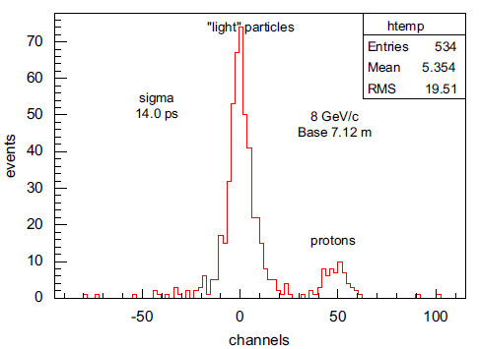
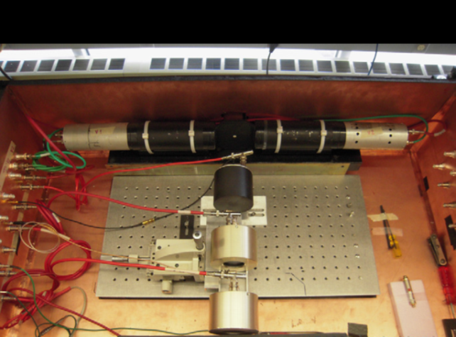
TOF system at FTBF based on 2 Photek 240, TR~14.5 ps, (~9 ps TR for close each to other location of the 2 Photek 240), 8 GeV/c momentum, NIM, A623, (2010) 931-941.
.
9 ps TR,
Photek1, Photek 2,
120 GeV protons
Both start and stop counters Photek 240, TOF TR 14.5 ps,
Distance between them 7.12m

Slide 7
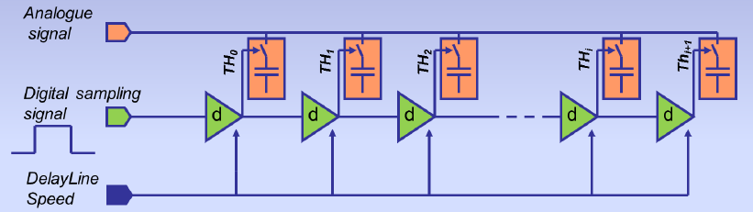
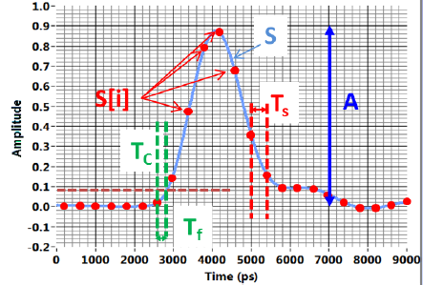
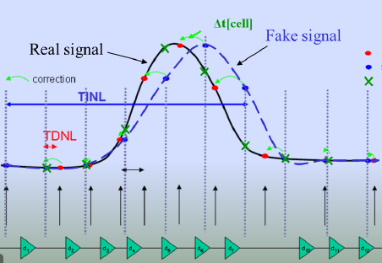
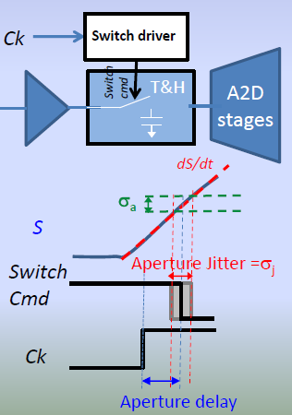
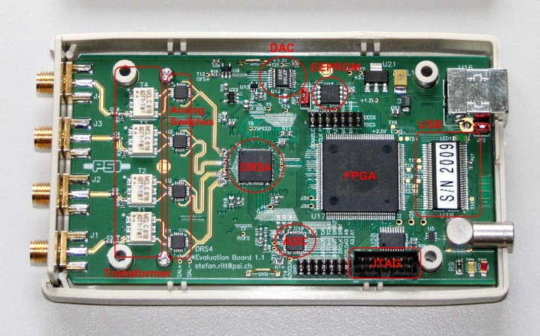
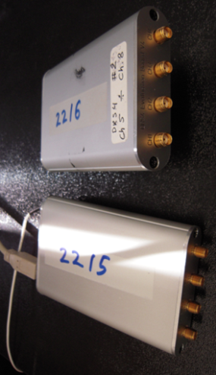
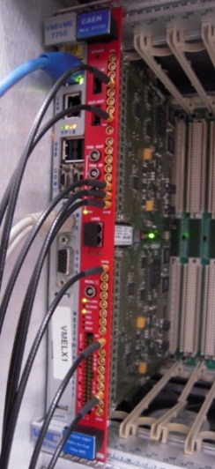
DRS4, (Domino Ring Sampler), introduced by Stefan Ritt.
Principle: Sample & Store an incoming signal in an array of capacitors, waiting for (selective) readout and digitization= bank of Track & Holds. DRS4 can replace old classic TDC, ADC traditional readout. PH and TR measured by the same unit. Used one is capable to digitize 4 input channels at sampling rates 5 Giga-samples per second (GSPS, 200ps/cell). Individual channel depth of 1024 bins and effective range of 12 bits. BW is up to 850 MHz. DRS4 is based on Switch Capacitor Array (SCA). “Aperture” and “random” time jitter. Correction of “aperture” jitter. Noise floor ~1 mV/50 Ohm (Slides below taken from Stefan Ritt (DRS4) and Eric Delagnes (LAPPD).
Switch Capacitor Array (SCA).
Signal sampling
Correction of “aperture” jitter
Key parameters of DRS4: 200ps/cell, 1024 cells;
CAEN V1742

Slide 8
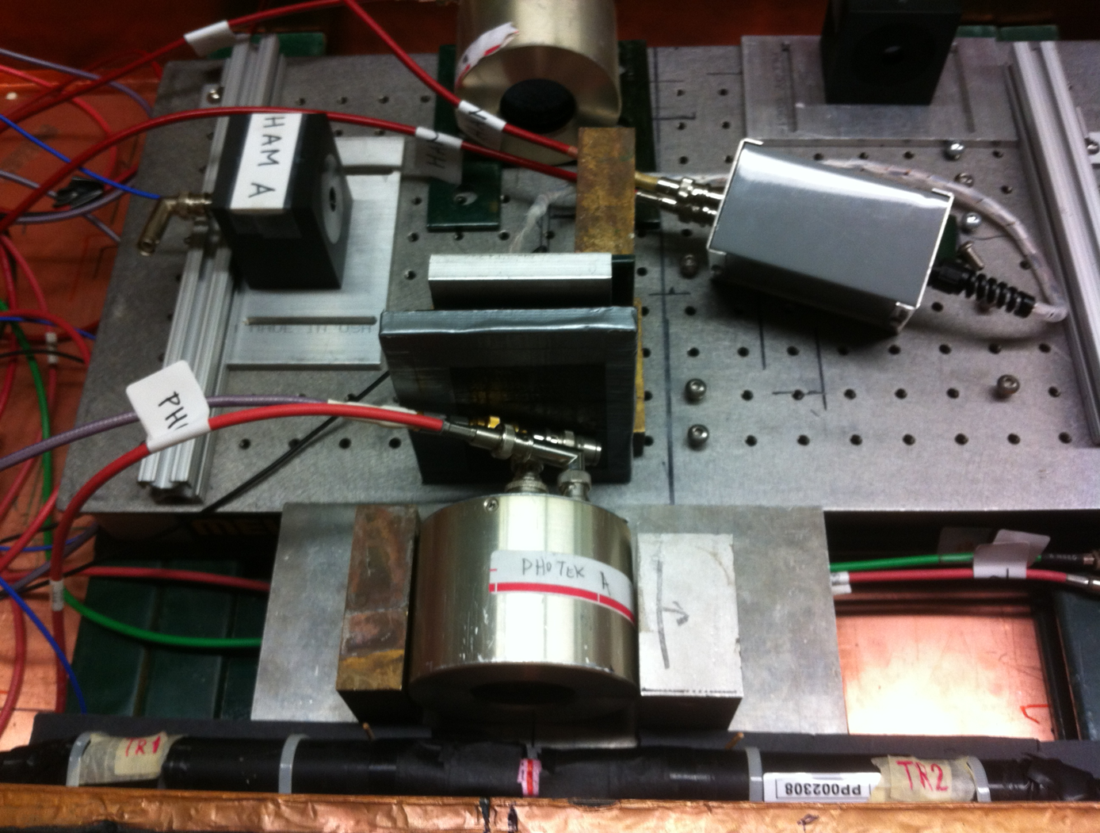
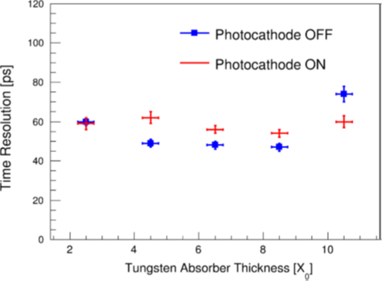
TR of shower max (SM), based on Photek 240 (top 3 slides) and Photonis MCP-PMT (4x4 cells, cell size 6x6 mm2) in dependence of absorber thickness. Beam 8 GeV/c
.
Photek 240
Absorber is between
2 Photek 240, TR~13ps
Photonis
Photonis, PC ON and OFF

Slide 9
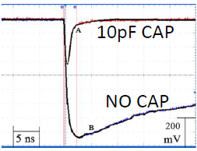
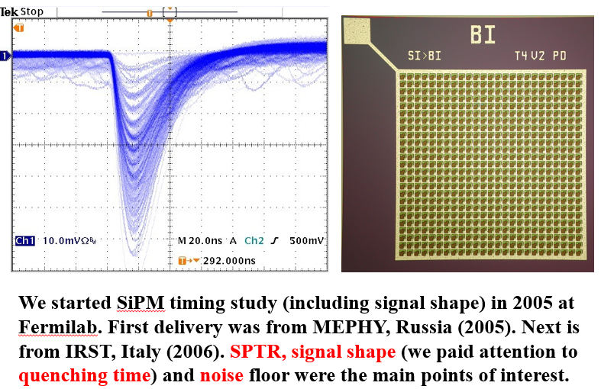
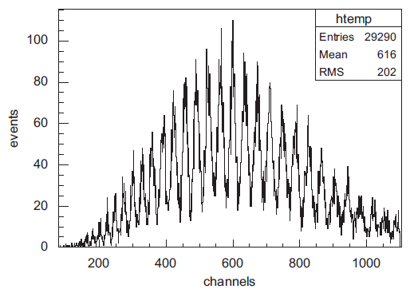
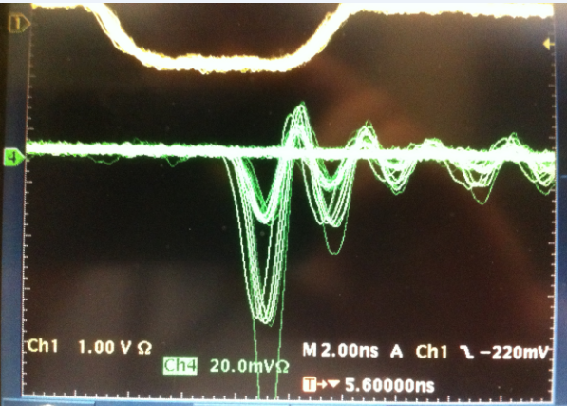
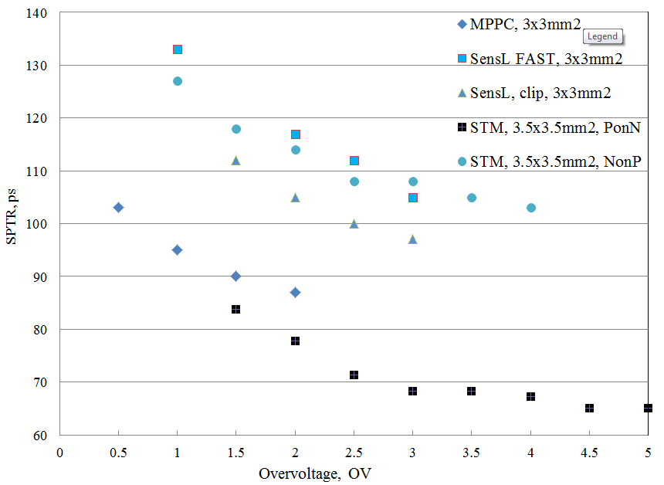
Hamamatsu SiPM, 120 GeV protons, TR 14.5 ps
.
SPTR on OV
2007
SiPM PH spectrum under PiLas laser light
Time resolution (TR) obtained with Hamamatsu MPPC 3x3mm2 (start) plus Cherenkov radiator ~14.5ps. Stop counter Photek240 w/o radiator. 120 GeV proton beam used, base distance ~8 m.
9 Anatoly Ronzhin, Fermilab, DPF, Fast timing detectors, July 31, 2017

Slide 10
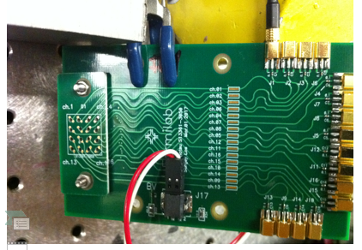
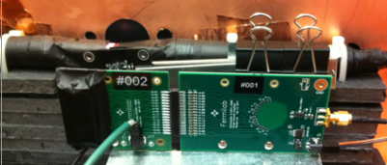
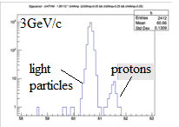
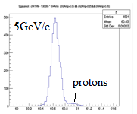
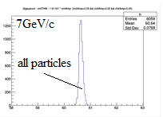
.
.
FTBF TOF prototype. “Start counter”: SiPm matrix of 16 chs; 4x4 SiPms (3x3mm2 each, total size ~12x12mm2. Radiator LYSO crystal, 3 mm thickness, optical contact through air gap. “Stop counter” Photek 240, TR ~50ps (preliminary). Base 5.6 m.

Slide 11
Silicon timing study
.
11 Anatoly Ronzhin, Fermilab, DPF, Fast timing detectors, July 31, 2017

Slide 12
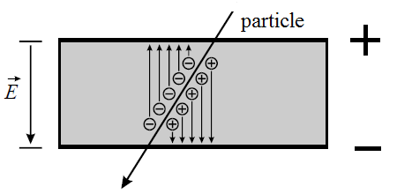
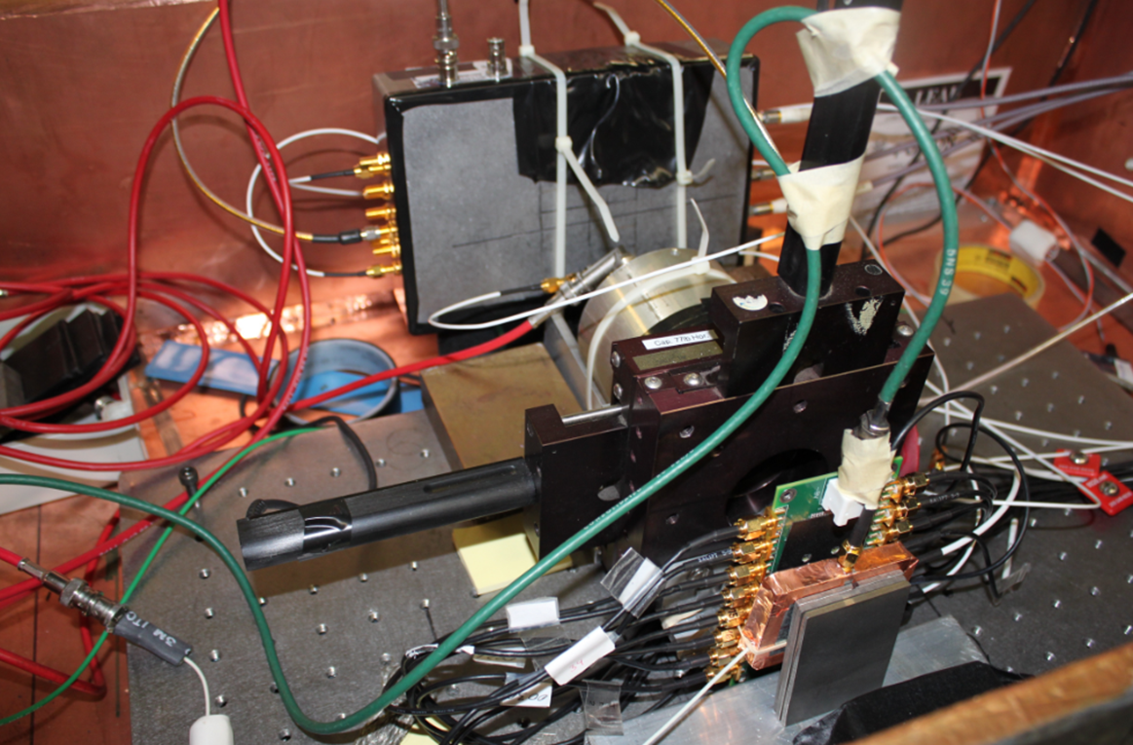
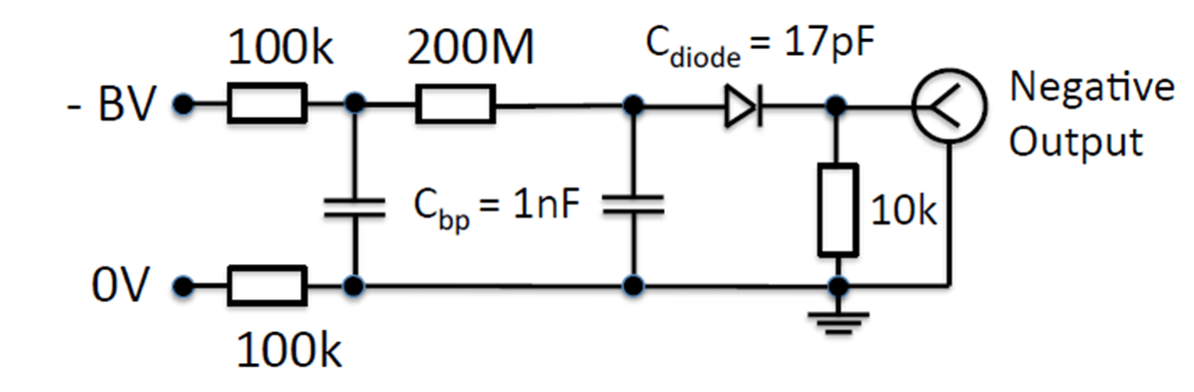
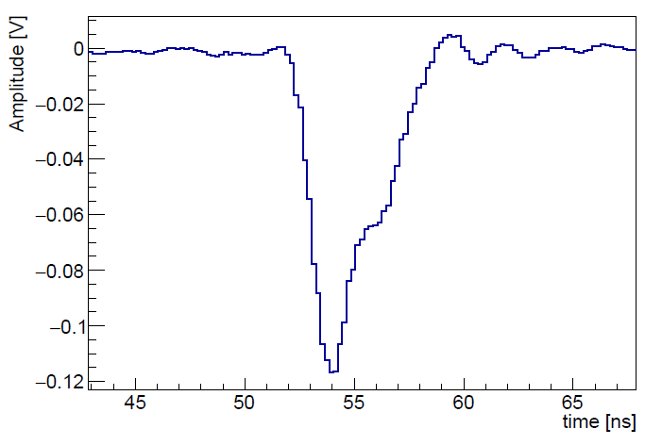
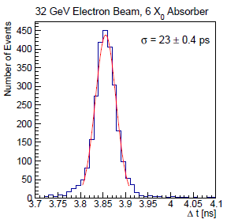
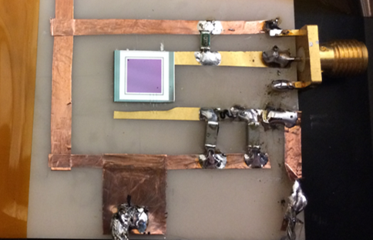
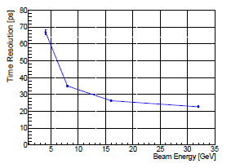
Silicon timing response to 32 GeV/c electrons for SM ~23 ps.
325 um

Slide 13
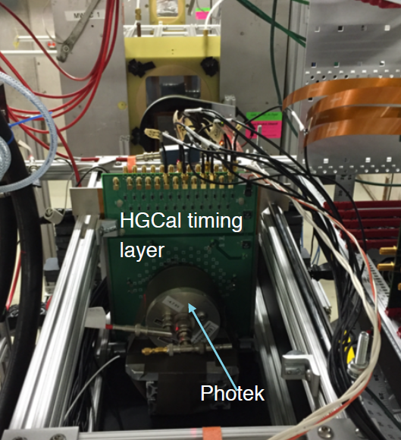
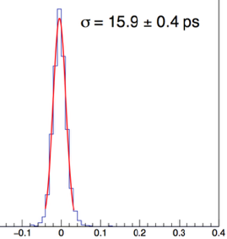
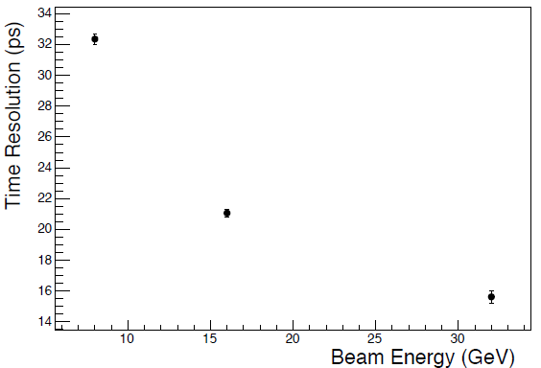
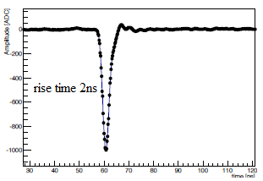
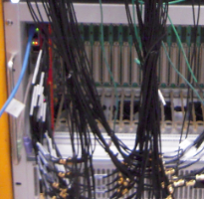
HGCal timing layer, TL, 32 GeV/c electrons
S. Los design, TL
32 GeV electrons, 6Xo of W before TL,
7 chs taken
Of TL for analysis
25 chs readout

Slide 14
Summary
We concentrated on silicon timing study now. 23 ps time resolution (TR, sigma) obtained for SM with silicon as an active layer, 32 GeV electrons.
We proposed to use secondary emitters as active layer for fast and radiative resistant SM in 1990. Detailed measurements done with Photek 240 MCP-PMT and SM as an active elements. The time and space resolution obtained are ~13 ps and 0.3 mm. (32 GeV el., 6 Xo).
We are using DRS4 as main readout in our picosecond measurements. We obtained 13 ps TR for the SM based on Photek MCP-PMT. We see almost NO dependence of the time resolution (TR) on the absorber thickness (tungsten or lead as absorber material) in the range of 2-12 radiation lengths.
We proposed to use SiPMs as an active layers for EM shower maximum (SM) detectors and made some preliminary study.
The TOF time resolution (TR) <9 ps obtained with MCP-PMT Photek 240 (aperture is 41 mm of the photodetectors). Different algorithms to get best signal’s timing tested. Leading edge, CF, MF are among them.
Strip Line (SL) readout for SiPms produced and studied. 9 ps TR along Strip Line (SL) obtained at FTBF beam. (Sergey Los design). Study of reliable multichannel picosecond readout continue.
We continue work on improvement start counter TOF TR for FTBF.

Slide 15
.
Continue
Electronics time resolution (ETR) is the time jitter for two signals applied as “start” and “stop” (from the same source) to electronics, measuring the time jitter of the time interval between them. The “electronic” time resolution should be much smaller
that time jitter of used detectors, ~2.5 ps currently.
We use Pilas laser as light source (17 ps, sigma, light pulse) with 405 nm
(blue) and 635 nm (red) light in our potodethectors bench test. Fermilab test beam Facility (FTBF) successfully used ~10 years for test of the detectors timing.
Continue improve FTBF TOF with thin “start” counter.
We continue transfer our TOF experience to some FNAL projects, to different Universities, etc. The best TOF TR obtained with MCP-PMT is ~10 ps in beam line
and ~14.3 ps with SiPMs. About 7 ps time resolution along Strip Line (S. Los design), obtained at FTBF (~2.5 ps, ETR). Few algorithms to get best signal’s timing (“time stamps”) tested. Leading edge, CF.
Our results for PET-TOF ~77 ps TR and 10% of PH (with MPPCs and 3x3x15
mm3 LYSO crystals) resolution are among the best. So far the project is “frozen”.
Setup for new SiPms study arranged at SiDet, with Wiener USB CAMAC. We have studied timing properties of several SiPms producers (STM, MPPC, IRST, FBK, SensL, Kotura, MePhy, CPTA, etc.). The maximum transverse size of the SiPMs tested so far is 12x12mm2 (4x4matrix). Single SiPm tested is 5x5 mm2.
.

Slide 16
APPENDIX
Continue work on electronic time resolution (ETR). Currently ETR with DRS ~2.5ps. Stephan Ritt obtained 1ps with improved DRS version.
Current FNAL fast timing activity
Test of optical coupling of photodetectors
Testing timing of fast crystals and scintillators
• Tomography
• Secondary emission calorimetry, SEC
• ANL LPPD help
• Study of strip line (SL) readout. (Sergey Los)
• Support of different “fast timing” efforts.

Slide 17
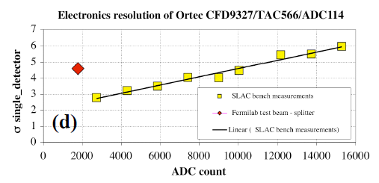
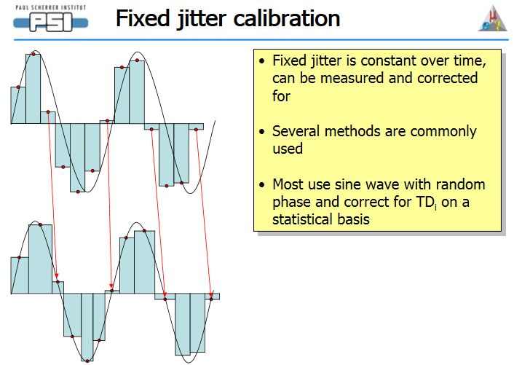
Electronics TR (ETR), noise, cables length influence, bench and beam ETR time difference. When working with less of 10 ps TR detectors the ETR is does matter, even SMA cables length, change of temperature etc…Our target to get ~1ps ETR. We have ~2.5 ps so far with DRS4
Our new method of the DRS timing calib, TR~2.5 ps
Oscillcops with 20 ps sampling allow to suppress the aperture time jitter.

Slide 18
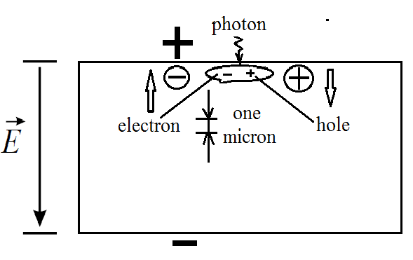
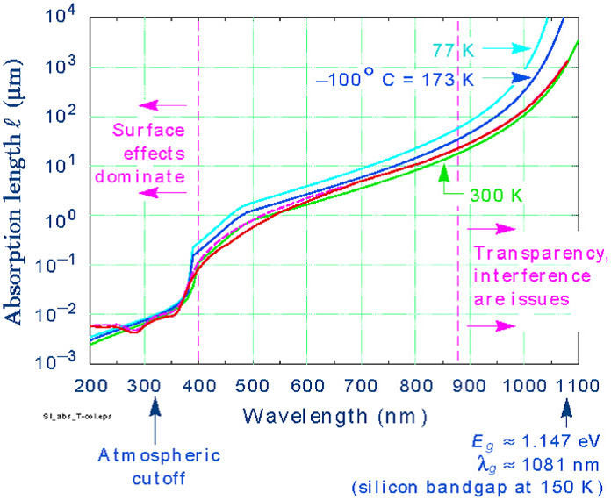
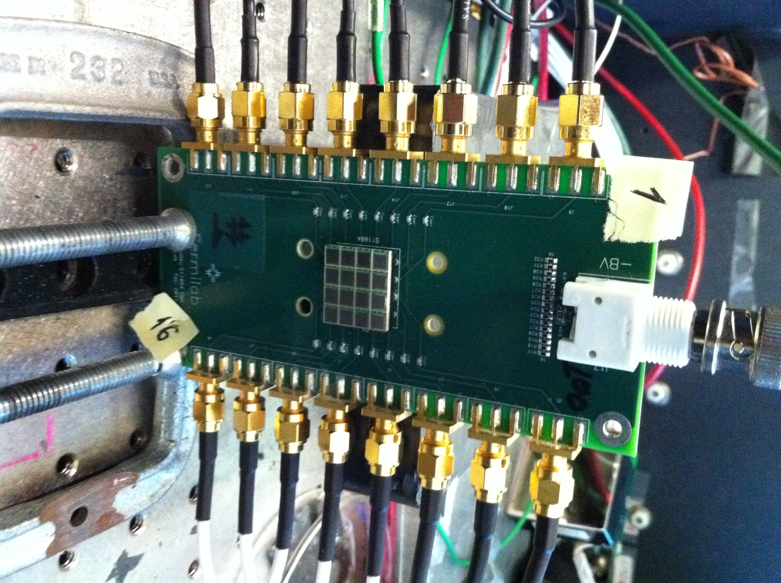
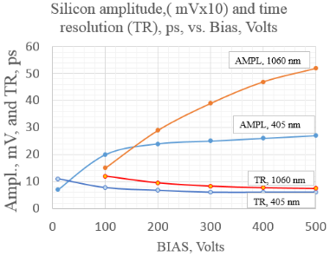
Silicon under light illumination, 405 nm, 635 nm, 1060 nm

Slide 19
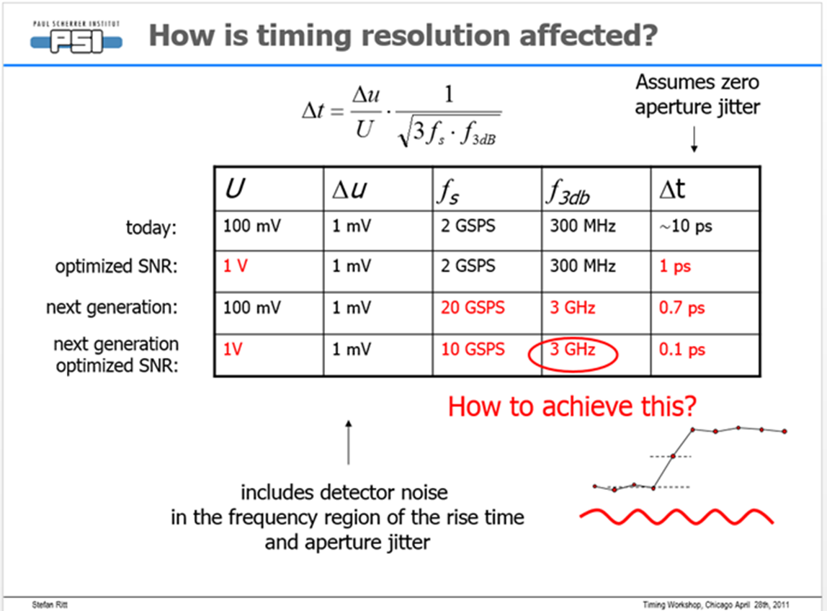
Stefan Ritt made estimation of achievable time resolution with the DRS
.

Slide 20

Shower max test with direct MCP, no PC”

Slide 21

TOF method used to measure time interval between two signals named “start” and “stop”. Time jitter jitter between them define time resolution (TR).
.

