Slide 1
Brief Introduction to Wire-Cell
Xin Qian
BNL
For the Wire-Cell Team
http://www.phy.bnl.gov/wire-cell/

Slide 2
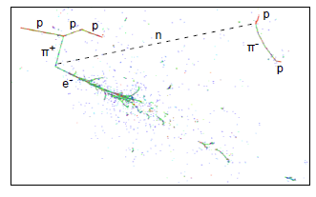
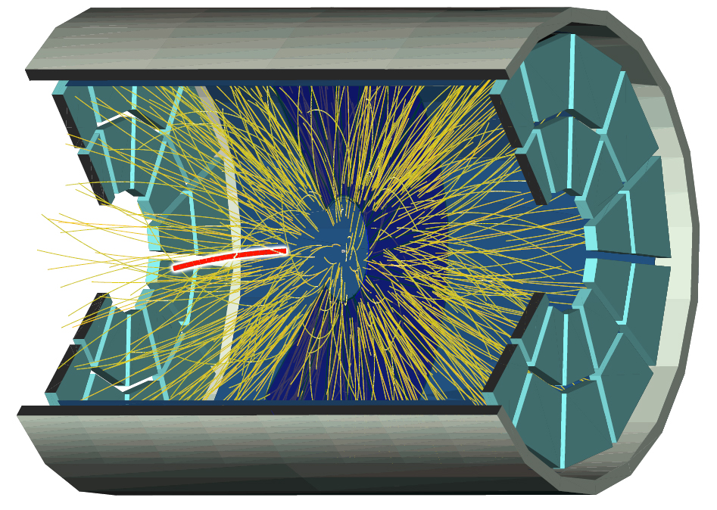
Challenges of Event Reconstruction in LArTPCs
Event topology:
Tracks, showers, unknown vertex in LArTPCs
Simple tracks in collider’s gas TPCs
Wire vs. Pixel readout
Large LArTPCs has to use wire readout due to power consumption of electronics and costs
Puedo-3D detector

Slide 3
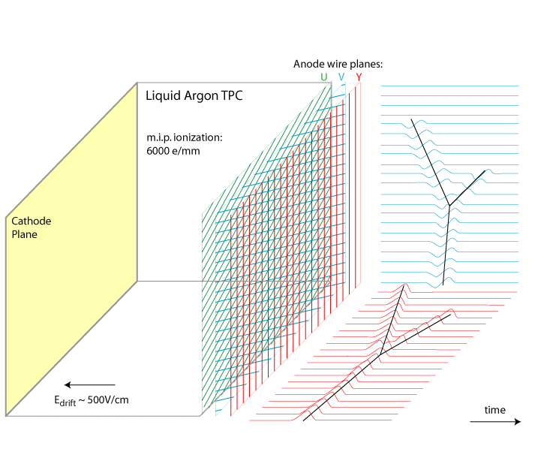
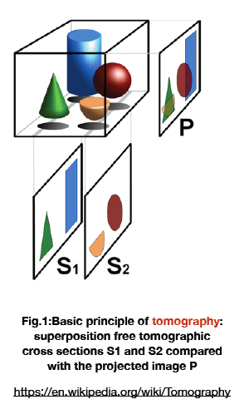
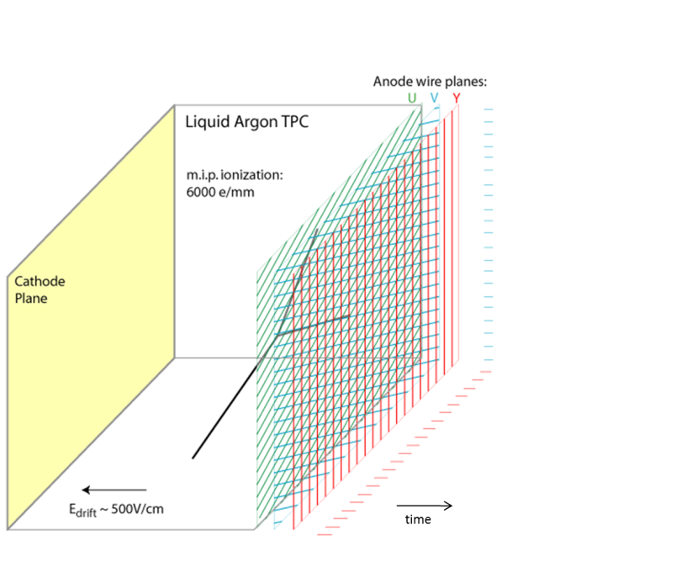
Review of Existing Approaches
2D matching → 3D
Wire-Cell Approach

Slide 4
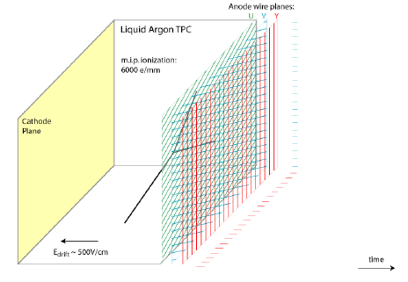
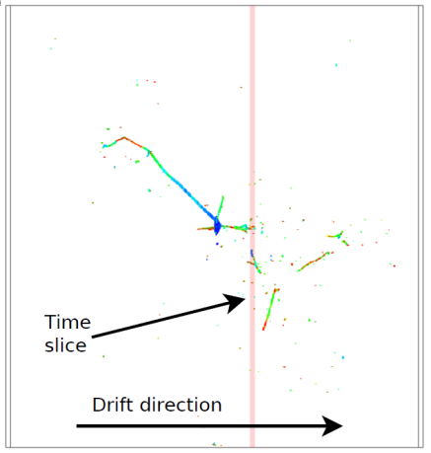
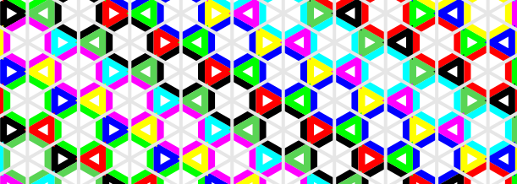
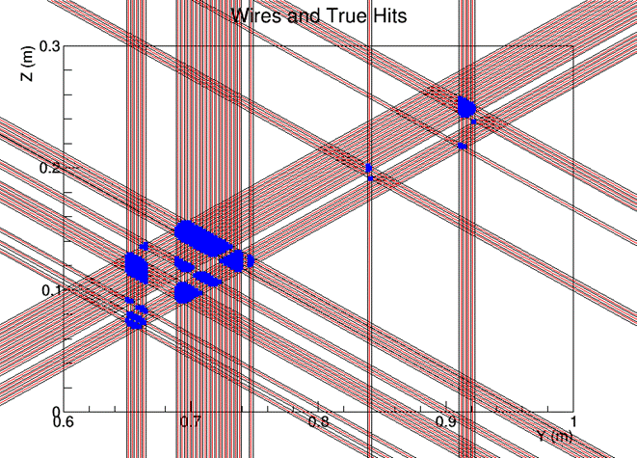
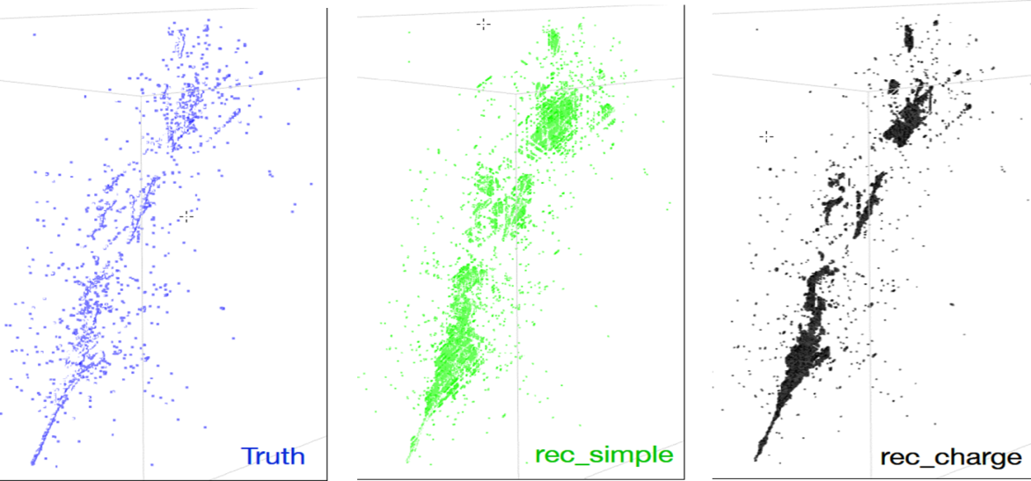
Wire-Cell Imaging
LArTPC Signal Formation
slicing
tiling
merging
solving

Slide 5
Solving for Images
u2
v3
True Hits
v2
u1
v1
Fake Hits
At fixed time
C: charge in each (merged) cell
G: Geometry matrix connecting cells and wires
W: charge in each single wire
B: Geometry matrix connecting merged wires and single wires
V_{BW}: Covariance matrix describing uncertainty in wire charge
Use two-plane as an example
Red points are true hits
Blue ones are fake hits

Slide 6
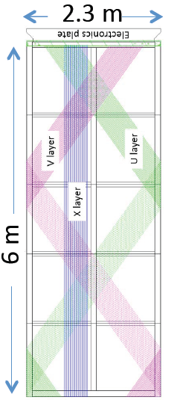
Same formulism for DUNE Wrapped Wire
C: charge in each (merged) cell
G: Geometry matrix connecting cells and channels
W: charge in each single channel
B: Geometry matrix connecting merged channels and single channels
V_{BW}: Covariance matrix describing uncertainty in channel charge
Xiaoyue Li (Stony Brook)

Slide 7
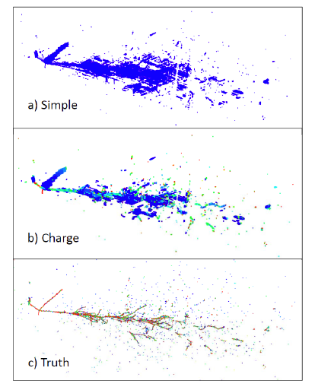
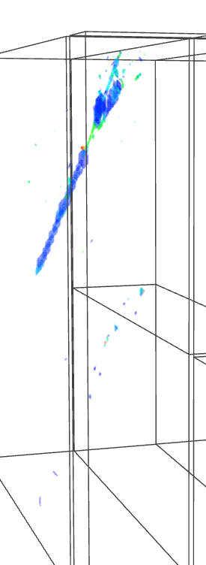
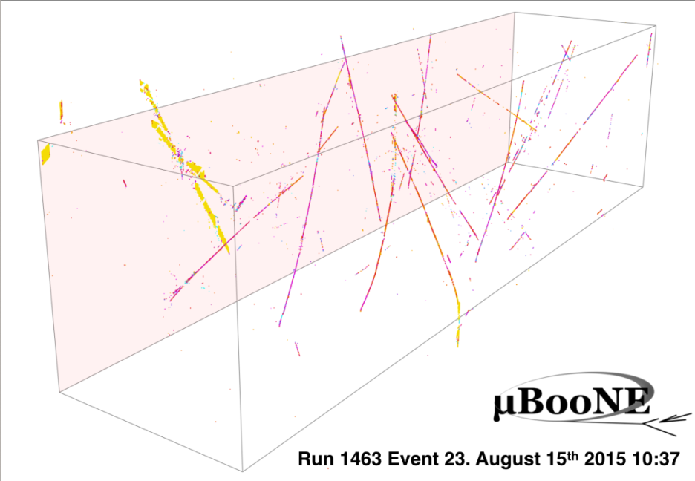
With Charge
Without Charge
More 3D events can be found at
http://www.phy.bnl.gov/wire-cell/bee/
Bee: interactive 3D display (Chao Zhang)

Slide 8
The Usage of Connectivity
We can add penalty to χ² based on connectivity and single channel assumption
For example, if we remove a merged cell that are connected to good cells in the adjacent time slice, we can add penalty in χ² to increase the chi-square value → less chance to be chosen as the optimal solution
For later pattern recognition, we can also cluster with all merged cell, and then remove bad ones taking into account connectivity

Slide 9
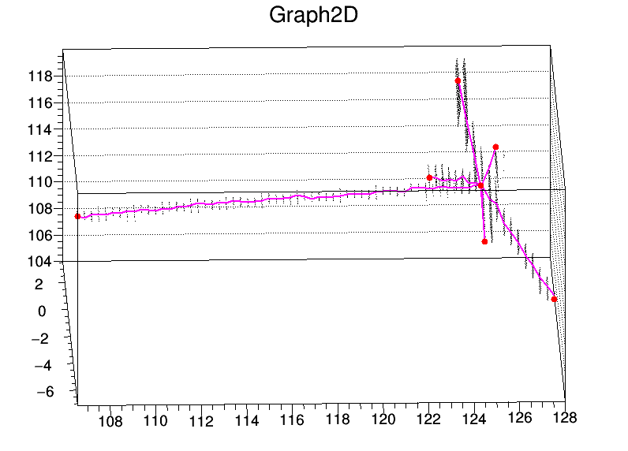
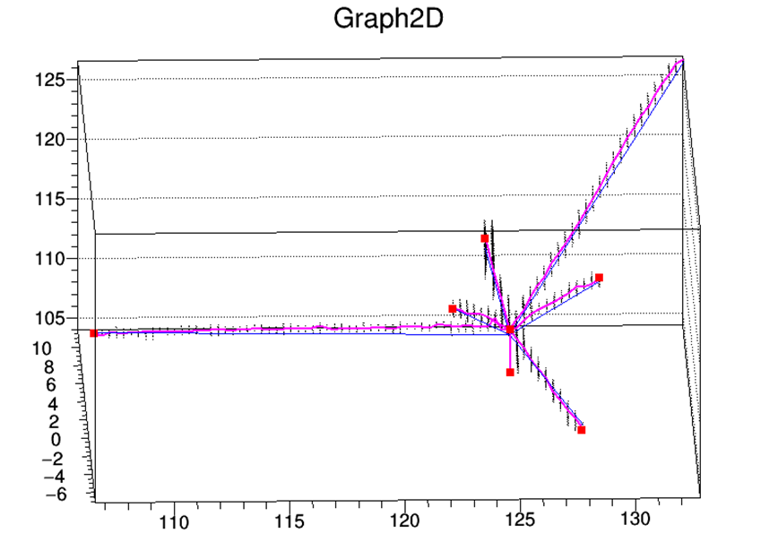
Connectivity information
Use the connectivity information to choose the optimal imaging solution
Penalty term added in chisquare
Without Connectivity
With Connectivity

Slide 10
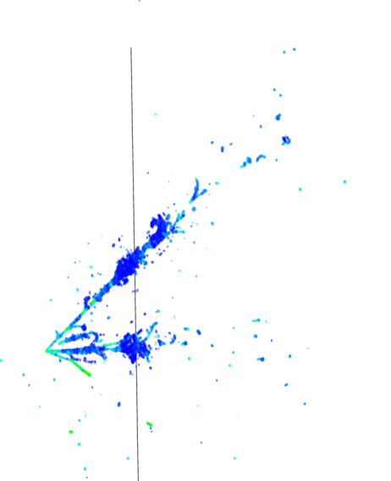
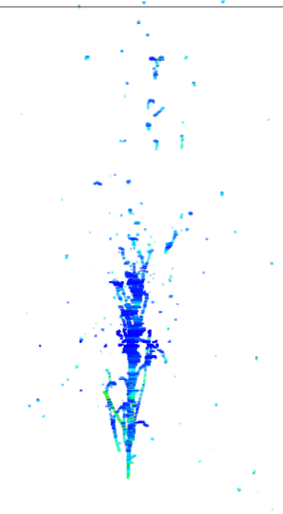
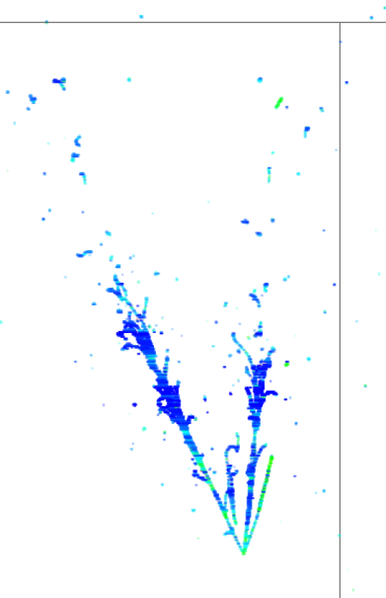
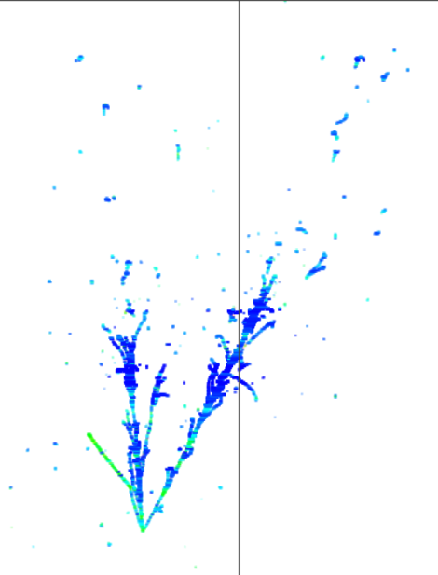
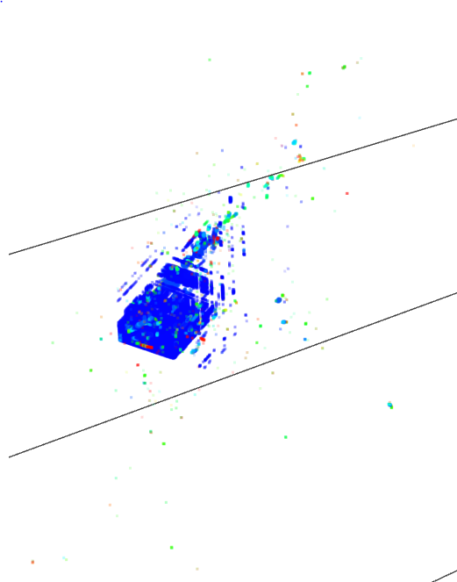
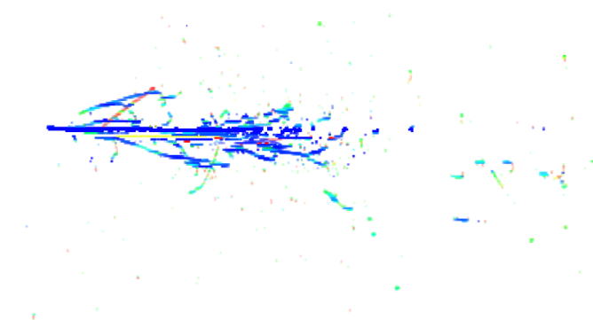
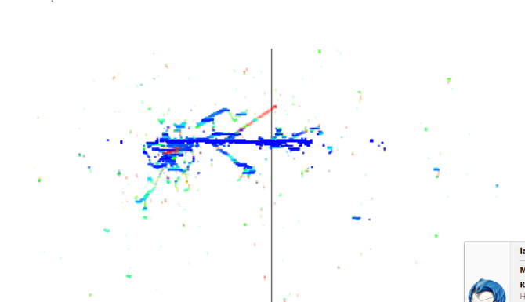
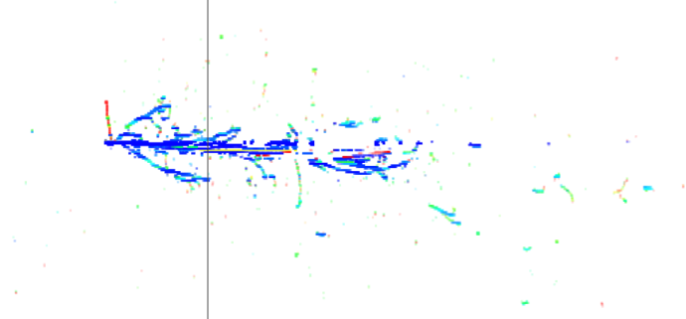
Parallel vs. Perpendicular APA
Perpendicular APA
X-Z View
X-U View
X-V View
Parallel APA
The improvement in imaging is from every 2D view!

Slide 11
Strategy Comparison
2D Matching
3D Tomography
Start with 2D (time+wire x 3)
2D pattern recognition
Particle track/cluster information
Matching 2D patterns into 3D objects
Time information (start/end of clusters)
Geometry information
Some charge information to remove ambiguities in matching
Start with 2D (wire+wire+wire at fixed time slice)
2D image reconstruction
Explicit Time + Geometry + Charge information
Some connectivity information can be used
3D image reconstruction
Straight forward
3D pattern recognition
Particle track/cluster information (tracks, showers)
Each approach uses the same set information in different order!

Slide 12
Discussion (Pros)
Wire-Cell Imaging tells us which hits CANNOT be associated together
Hits from different time slice CANNOT be associated together (time information)
Hits from wires that are not crossing each other CANNOT be associated together (geometry information)
Hits with “different” charge is UNLIKELY to be associated together (charge information)
Advantages:
Utilize full TPC information (time/geometry/charge)
Natural way to suppress electronics noise
Track/shower hypothesis not used, delay the pattern recognition process → better automated
Expected to be better for complicated topologies

Slide 13
Discussions (Cons)
Likely worse performance for 2-plane configuration
With 2-plane configuration, the power of the geometry information is strongly reduced
It is important to use track/shower hypothesis early to reduce ambiguities
Stringent requirements on TPC performances
Relative time among hits from different planes
Charge reconstruction from induction plane
Use this feature for calibration purpose
Also dead channels (more sensitive to inefficiency)
High resources requirement on the memory and speed

Slide 14
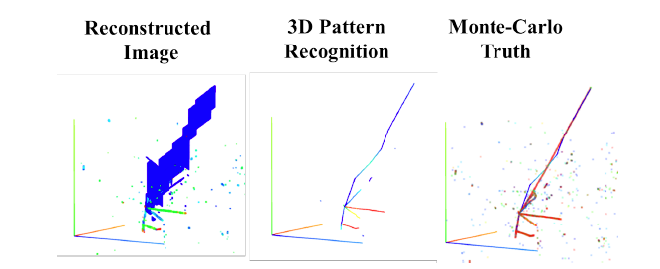
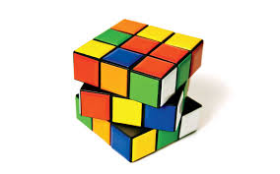
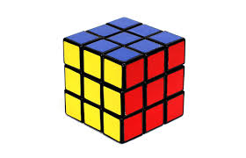
Wire-Cell Pattern Recognition
Given the 3D images, pattern recognition is performed with the track and shower hypotheses
Operations are all “local” i.e. Hough transformation, Crawler, Vertex fitting/merging …
Too many different topologies → many corner cases

Slide 15
Wire-Cell Solve the Reconstruction Problem?
No!
The 3D pattern recognition is still an open question → Pandora 3D pattern recognition, PMA, LineCluster …
With recognized pattern, how to do the fine tracking? → Projection Matching Algorithm
Energy calculation, angle determination, PID …
What’s the ultimate solution for pattern recognition?
Human-directed pattern correction is being developed with modern web-based tools → Bee 2.0
Deep learning?

Slide 16
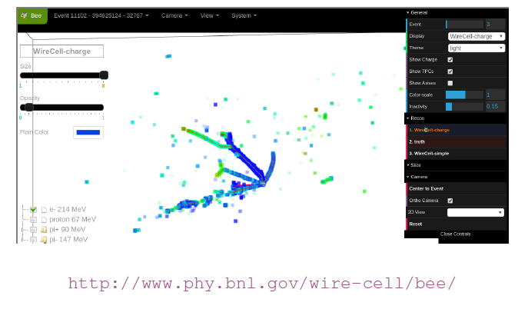
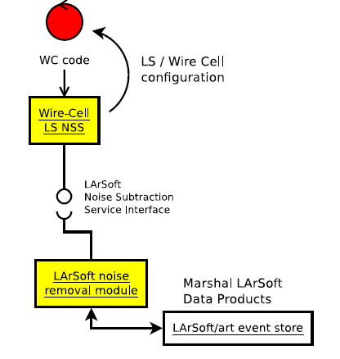
Related Technical Progress
Brett Viren
Chao Zhang
David Adam
Bee:
Improved on memory usage and UI responsiveness and added object picking.
Further performance improvements and a UI redesign coming.
Wire Cell:
Excellent results from prototype noise removal on MicroBooNE data.
Porting to Wire Cell Toolkit is underway.
LArSoft Noise Subtraction Service Interface developed.
WCT NSS implementation will provide first LS/WC integration.
Will adopt service-based model for future WC imaging, etc, integration.

Slide 17
Summary
Advantages and disadvantages of Wire-Cell approach are discussed
Wire-Cell imaging is in a good shape
More work is needed for the 3D pattern recognition
Bee 2.0 is under development
Integration with LarSoft is in progress

