Slide 1

Calorimeter
Mu2e Grounding & Shielding Review
I. Sarra, Mu2e Calorimeter Photosensors L3 Manager
10 May 2016

Slide 2
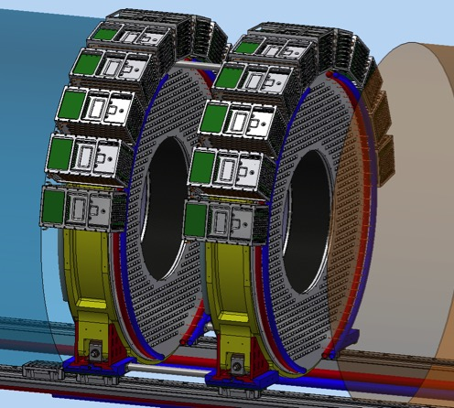
Mu2e Calorimeter
~ 680 CsI crystals (Square, side: 34 mm) for the first disk
~ 680 CsI crystals (Square, side: 34 mm) for the second disk
~ 1360*2 = 2720 SiPM photo-sensors
20 FADC channels per board
6/7 boards per crate
11 crates per the first disk
11 crates per the second disk

Slide 3
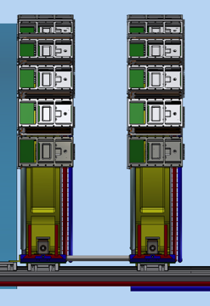


Calorimeter routing
Detector Solenoid
DAQ room
Floating LV
+28V / negative
Floating positive HV
230 V (MPPC)
ground
~7-8 m
overall cross section
~180 cm²
~60-80 m
overall cross section
~210 cm²
LV
HV
isolation
OVP filter
Floating Structures
Safety
Ground
Detector Ground
2
Notes:
isolation transformer

Slide 4
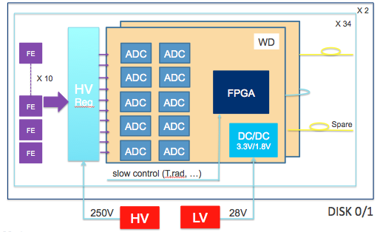
INSIDE the DS - Calorimeter Electronics Scheme
Overview of the calorimeter readout electronics:
each disk (~ 680 crystals per disk) is subdivided into 34 groups of 20 crystals.
  Groups of 20 left (right) Amp-HV chips, controlled by a dedicated mezzanine board that distributes the LV and the HV reference value, while setting and reading back the locally regulated voltage
  Groups of 20 amplified signals are sent to a digitizer module where they are sampled and processed before being optically transferred to the DAQ system.

Slide 5
WD block diagram
HV Reg
FE
ADS 4229
1
1
FE
ADS 4229
FPGA
SM2 150T
FIBER
2
2
FE
ADS 4229
FIBER
3
3
FIBER
Differential
Signals
FIBER
FE
ADS 4229
9
9
DC/DC
6 V
LTM8033
DC/DC
3.3V/1.8V
LTM8033
FE
ADS 4229
10
10
4

Slide 6
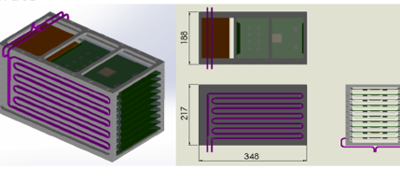
Calorimeter Crates
There are therefore 11 crates per disk, hosting 6/7 sets of AMP-HV and WFD boards;
The crates are placed in the outermost region of each disk;
The crates are designed to provide heat dissipation for the electronics boards.

Slide 7
Calorimeter FEE
Provide both the amplification stage and a local linear regulation for the Silicon photosensor bias voltage
HV
HV
2 Settable Gain values: 15/30
Dynamic range in output: 2 Volt
Rise time: 15 ns
Power supply: up to 200 V and 3 mA
Differential output: between -1 and +1 Volt
Monitoring of the current
Input resistance ~ 10 Ω
It will also provide a pulse signal to test the FEE
3
S
I
P
M
s
3
S
I
P
M
s
j3
j1: Monitoring of the temperature
j2: Monitoring of the current
j3: Settable Gains
j4: Differential output
j5: Pulse Signal
j1
j2
AMP
j4
j5

Slide 8
Transimpedance Preamplifier
Transimpedance 750Ω to 1.5KΩ
Dynamic differential 2V
Bandwidth 200Mhz
Rise time 15ns
Polarity Differential
Output impedance 100 Ω
Coupling output end source AC
Filter Shaper 3-pole
Noise, with source capacity 2 pC / channel
→ MEASURED with the Photosensors using cosmic rays test
Power dissipation 20mW
Power supply 6V
Input Protector over-Voltage 10mJ

Slide 9
Linear Regulator shunt architecture.
CATHODE
Linear
Regulator
Current limit
ADC
I2C
Adjustment range Vout 20V to 200V
Accuracy, reading and writing, 16 bit
Current limiter can be adjusted max. 3mA
Noise tot. 2mVpp
Long-term stability 100ppm
Settling Time “local feedback” < 500 us ρ< 1
Double filter high Voltage, attenuation 56db
Temperature measurement -20 to 40°C
DAC

Slide 10
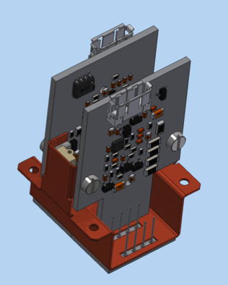
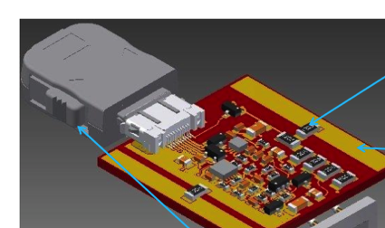
Engineering of the final packaging
Thermal Contact
SiPM Holder
Therma
Bridge
resistor
Board
Power to dissipate 150mW
Case
(Cu)
Thermal conducting layer inserted in the SIPM package to
cool them in vacuum

Slide 11
OUTSIDE the DS
The high voltage required for the SiPMs is provided by power supplies that reside outside the detector in the DAQ room. Each supply generates a voltage of 230 V using low-noise switching technology. For each crate, there are four cables, resulting in 176 high voltage signal pairs (power and return) penetrating the cryostat.
The low voltage power supplies for the detector will also reside also in the DAQ room. The supplies will be powered by 120V, 60 Hz main power. The outputs are +28 VDC, with isolated returns. The front-end electronics will use local point-of-load (POL) regulators to produce the voltages needed by individual circuit from the +28 V. Each crate will have eight low voltage connection, resulting in 352 low voltage signal pairs (power and return) penetrating the cryostat.
The connector has not been specified, but may be multi-conductor.
The total power required, including a safety factor of 40%, is about 2 kW for the high voltage and about 4.5 kW for the low voltage.

Slide 12
Calorimeter routing
Detector Solenoid
DAQ room
Floating LV
+28V / negative
Floating positive HV
230 V (MPPC)
ground
~7-8 m
overall cross section
~180 cm²
~60-80 m
overall cross section
~210 cm²
LV
HV
isolation
OVP filter
Floating Structures
Safety
Ground
Detector Ground
11
Notes:
isolation transformer

Slide 13
Calorimeter Grounding - Conceptual Design -
The calorimeter electronics will be isolated. The LV and HV will have isolated power returns at the supplies.
They will also have isolated power returns at the supplies, using either active or passive over-voltage protection on the output power returns in the power supply unit to protect against abnormal faults. This will require approval from safety personnel. (Note that this is a backup protection scheme.)
The ground reference for the high voltage power return will be made at the detector panel through the connection to Detector Ground.
The power connections through the vacuum penetration will be electrically isolated from the detector support structure. Ground loops are eliminated by having isolated power supply outputs.

Slide 14
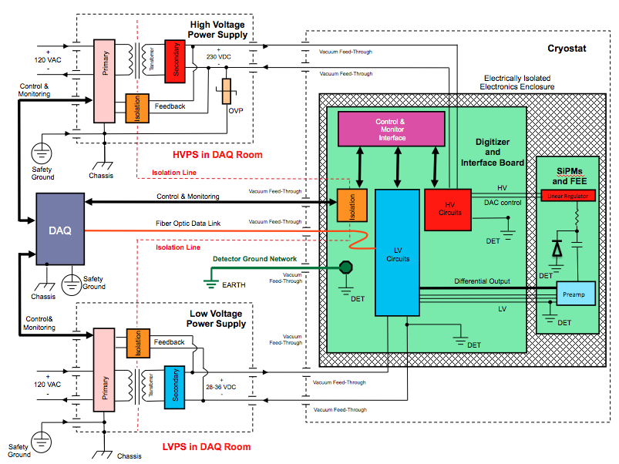
Calorimeter grounding diagram

Slide 15
Grounding Connection
The idea is to have two ground cables (one per disk), made of copper braid of 3 cm wide with an insulating jacket, going through the flange and then to connect them to the Ground Cable.
The ground will be distributed on the disk using a copper braid going along the disk circumference. The copper braid will be connected to the ground cable (one for each disk) or directly or using a high power connector.
The ground connection must pass through the vacuum flange. This will be accomplished using one of the hermetically-sealed 25-pin connectors (Positronics #XAVAC-25-M/S-I.0), the same type that will be used to pass the low voltage through the vacuum flange. The braids will be connected to the connector using all 25 pins, in a similar fashion as described for the tracker.
Outside the flange, the 25 pins in the mating connector will be connected to an insulated braid, which in turn will connect to the Detector Ground main line.

Slide 16
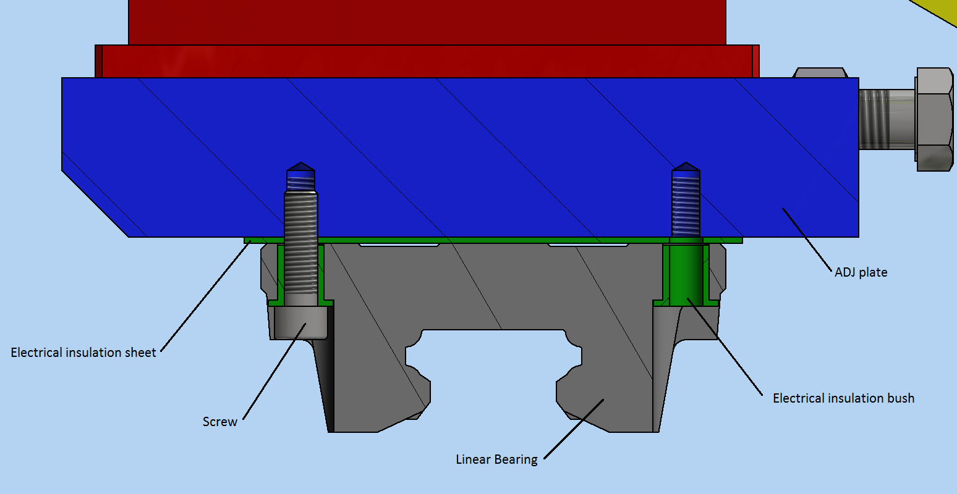
Calorimeter Insulation -Feet-
The calorimeter insulation will be done using insulation material in many sectors. The isolation material is the G11 with a thick of 2 mm.

Slide 17
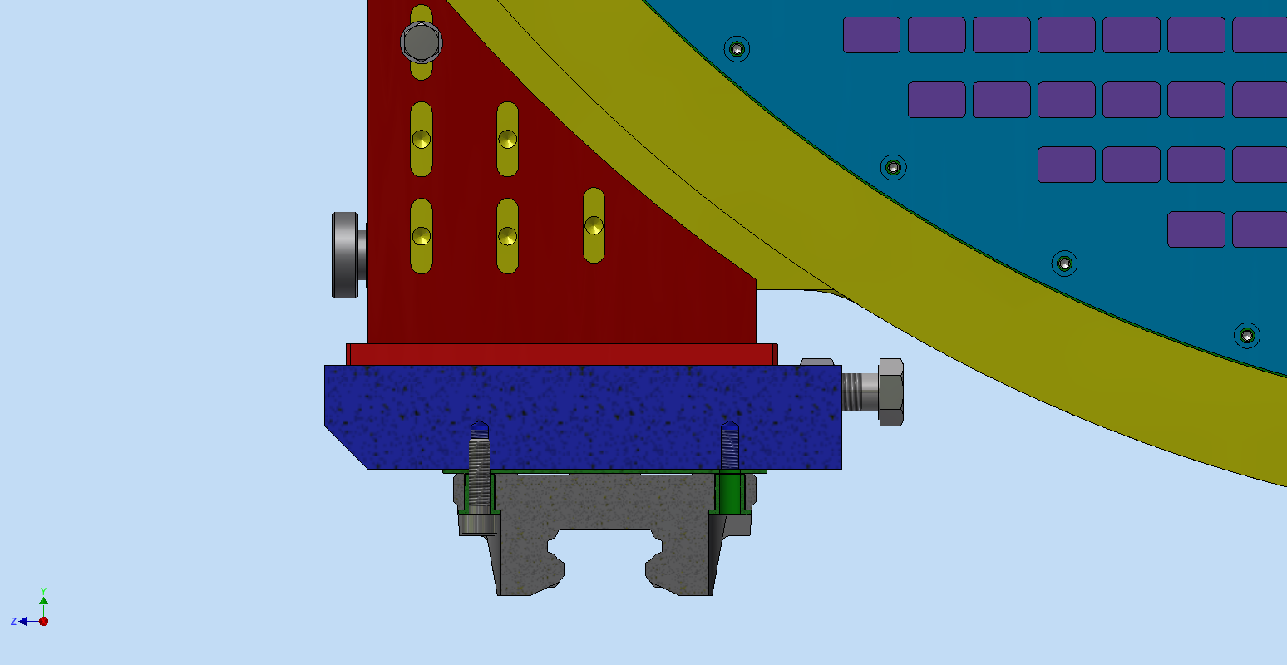
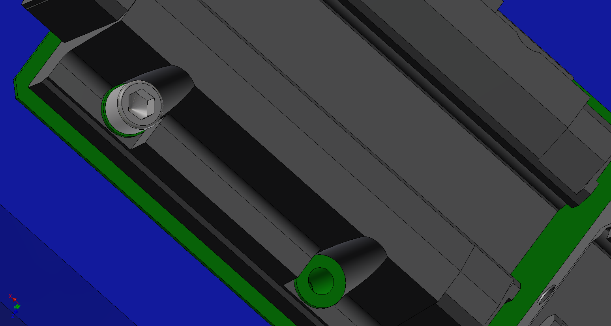
Calorimeter Insulation - FEET 2 -
If we need to ground the structure we could remove the insulation at this level

Slide 18
Calorimeter Insulation - Back plate -
The back plate houses the Front End electronics and SiPM holders and provides cooling.
Made of a supporting block of plastic material, FR4/PEEK
It embeds a series of conveniently shaped copper cooling pipe in the insulating supporting plate. Advantages with respect to use metal:
  The cooling power is not wasted to cool down unneeded plate material
  The plate is not going to expand and distort much
  The plate can play a structural role being firmly connected to the cylinders
  No risk of leaks since we are going to use pipes
  A dedicated calorimeter cooling station runs fluid
  at about -15º / 0º C.
  The back plate is thermally isolated from the outer
  ring and from the crystals (vacuum gap)
  The thermal resistances between the plate
  and the electronic holders are minimized

Slide 19
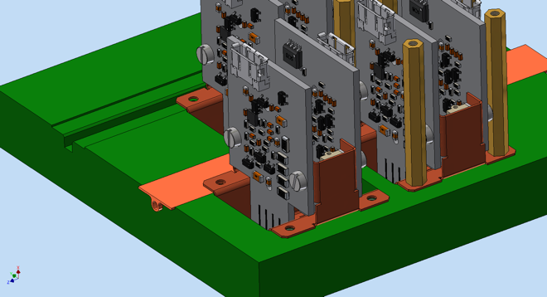
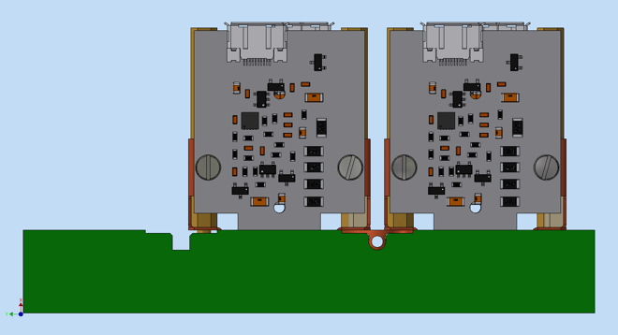
Cooling plate and Front End electronics
The front end electronic and the sensor are kept in place and cooled by a copper holder.
The design of the Faraday cage is under development.

Slide 20
Issues to deal with
The front-end electronics and the digitizer boards are under development:
The radiation hardness study of the main components are already in progress → Results are more than satisfying.
The LV and HV power supplies must be still dimensioned and designed.
Extraction and intervention procedures on electronics are not yet fixed.

Slide 21
Summary
1. Does the Calorimeter address potential noise problems? Will the Calorimeter achieve desired performance?
– The electronics of the calorimeter has been tested in many test beam. Noise results are satisfying.
2. Is the design technically sound? Any outstanding issues?
– Isolation and commercial electronics are well understood. No known outstanding issues.
3. Significant risks? Mitigation plans?
– Environment in DAQ room must be reasonable for commercial electronics.
4. Safety concerns?
– Standard racks (208 VAC)

Slide 22
SPARES

Slide 23
Design Maturity and Path to Completion
WD design components have already been selected and tested for radiation and high magnetic field immunity (docdb 6782)
  FPGA: Smartfusion II SM2150T (qualified by producer)
  ADC : ADS4229
  DCDC : LTM 8033
A first pre-prototype has been designed assembling demo boards and custom interconnecting boards. The obtained prototype is functionally identical to a single channel WD
The design of the final WD is almost complete and the PCB
is being laid out
The first prototype of the 20 channels board is foreseen for end of July
22
F. Spinella | CD-3c Director's Review
4/19/16

Slide 24

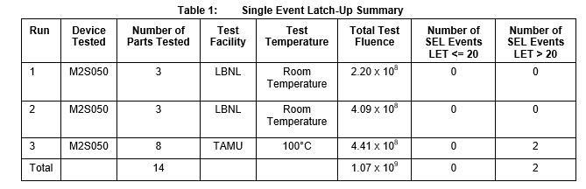
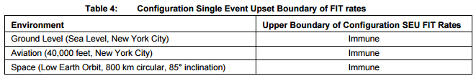
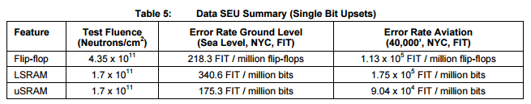
Performance: FPGA
The choice is almost unique (at moment)
Microsemi SmartFusion2 family (SoC: FPGA + CPU)
  Specs:
    Flash (and not RAM) based
    SEL free ( see tables)
    Configuration Flash SEU free( up to 90 MeV ions)
    Data SEU low
    Very low power
We will use the largest and fastest one
SM2150T-1 (1152 pins)
In principle we do not need to
qualify this part as a single
element
5x10¹⁰ n/cm²/y
5 Mbits RAM
1 SEU/board/hour
1 each 200000 events
(pessimistic)
http://www.microsemi.com/document-portal/doc_view/134103-igloo2-and-smartfusion2-fpgas-interim-radiation-report
23
F. Spinella | CD-3c Director's Review
4/19/16
Notes:
23

Slide 25
Architecture of Front-end
Serial voltage regulator
SiPMs polarization
Amplifier
Pulse signal
Temperature and current monitoring

Slide 26
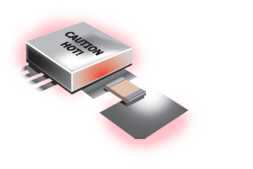
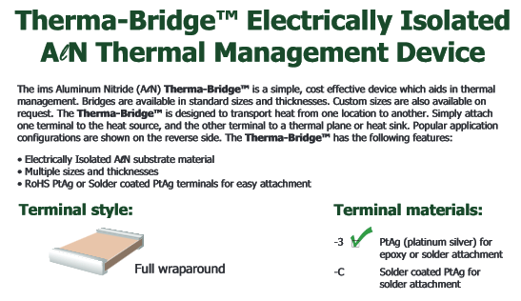
Cooling problem for Amp-HV
We solve the problem of cooling in Vacuum by
transferring the heat from the Amp-HV to the
mechanical support, through a therma-Bridge
An example is shown in the side view.
The heat transfer must take place in isolation
from common ground.

