Slide 1
Redefining Events in art
Tom Junk
art Users' Meeting
17 June 2016

Slide 2
Many Thanks
Many thanks to the team who put it all together
I'm 35-ton centric, but have a bit on LArIAT's slicer
artist help: initial version. Marc Paterno, Chris Green, Kyle Knoepfel
DUNE team: Karl Warburton. Advice, channel maps etc: Tom Junk, Michelle Stancari, Tingjun Yang, Mike Wallbank
LBNE discussions about reformatting data: Jonathan Davies, Jeff Hartnell, Alec Habig, Brett Viren, Maxim Potekhin
LArIAT's event slicer: Johnny Ho, Jason St. John, Kyle Knoepfel, among others.

Slide 3
Different Definitions of "Event"
"Event" is a highly overloaded word
Not really a source of confusion but it does require extra words to explain what we are talking about
Physics: A point in (x,y,z,t) space, whether or not anything happened there.
Physics: An interaction such as a collision or a particle traversing a detector
Experimental HEP: A triggered readout of a detector. Defined by the trigger and DAQ. May contain data from multiple interactions (pileup "vertices" just to avoid re-use of "event")
From the art workbook: art::Event is the smallest unit of information that art can process.
Statistics: A set of experimental outcomes to which a probability is assigned. Your entire experimental data set is an "event".

Slide 4
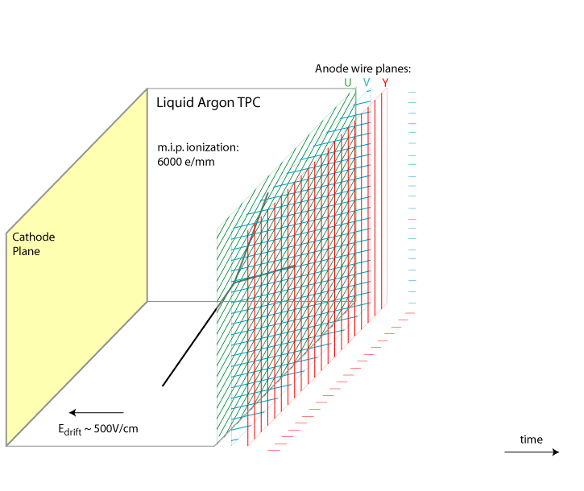
Single-Phase LArTPC Charge Deposition
3D charged
particle
tracks and
showers
projected
onto 2D
time vs. wire
views
time

Slide 5
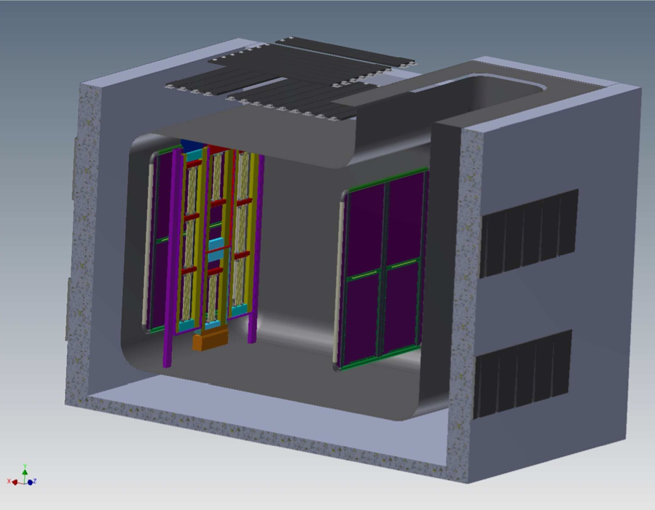
An Unusual LArTPC – DUNE 35-ton Prototype
Cosmic Ray Counters (CRCs)
Two-sided anode planes
U, V, Collection
Long and short drift
volumes
No beam – just cosmic
rays. Approx. 1 per 3 ms
long drift time.
External scintillator
counters for triggering
20 cm short drift region
CRCs
2.2 m drift region
CRCs
Photon Detectors
(8 total) in 4 APAs
Cathode Plane
Cathode Plane
Field Cage not shown
J. Fowler
Annotated picture from M. Stancari

Slide 6
A Larger Detector – WA105
Simulated event
from Elisabetta
Pennacchio,
Dec. 2015
Data rolls by on
a conveyor belt

Slide 7
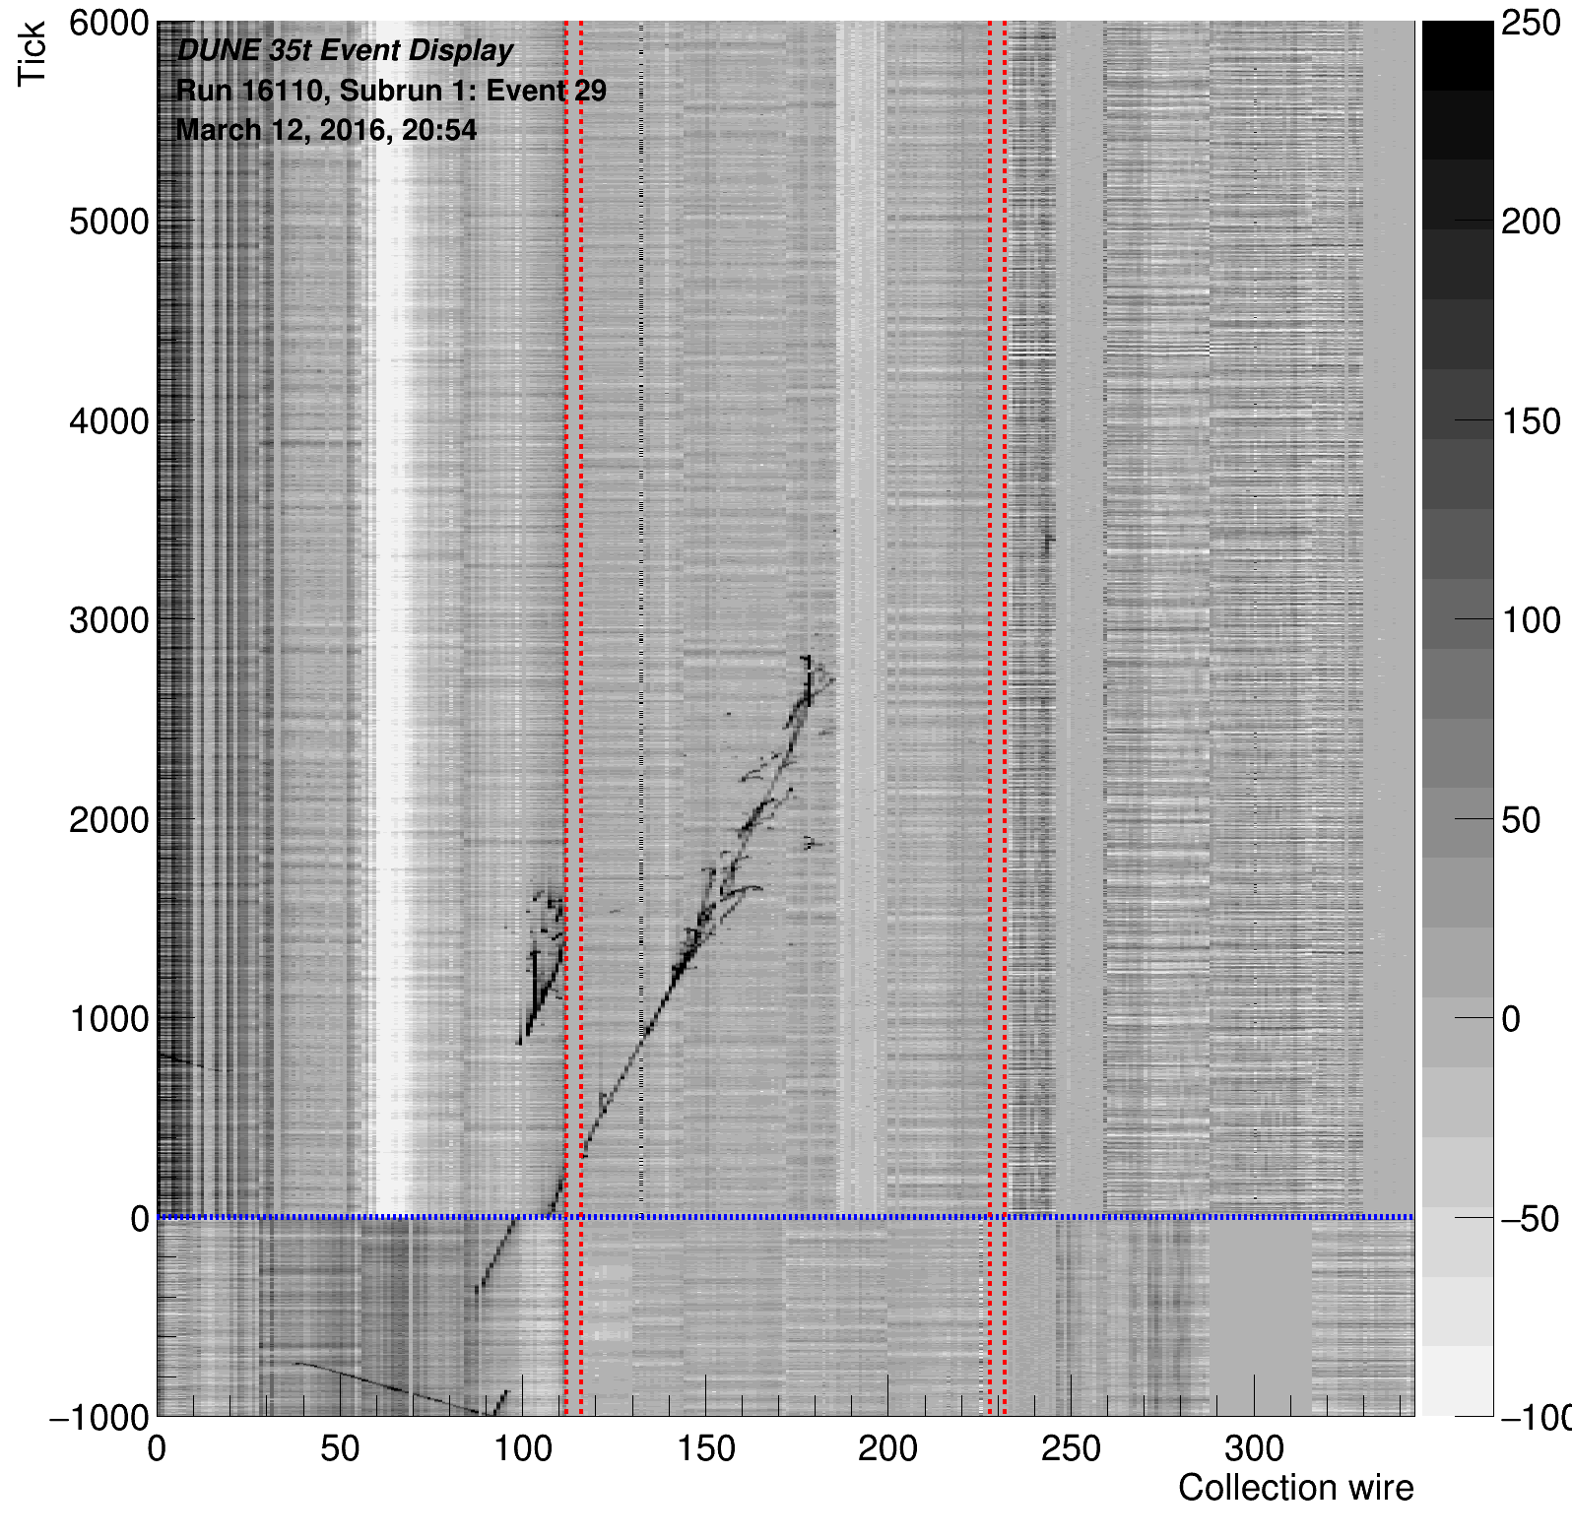
An Online Event Display from 35t
Tick
Collection Wire

Slide 8
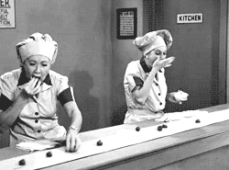
Triggering and Data Acquisition
We would like to collect data
from interesting interactions
and store them for later use.
Not every interaction is
interesting.
Sometimes they pile up too fast
Deadtime when we cannot read out fast enough.
External counters or photon detectors or analysis of the TPC
data can provide triggers

Slide 9
Original Motivations for DUNE Splitter
Early plans – run untriggered, continuous readout. Need large data reduction from zero suppression.
Pre-time service code – assumed that interactions happened at t=0.
Convert ticks to x needs a t₀
Need to know t₀ in order to apply fiducial cuts
Stopping muon analysis: throughgoing cosmics can look like
stopping muons if t₀ is wrong.
There is not a complete symmetry in (x-v_{drift}t).
electron lifetime
charge diffusion
Idea was to center the interaction of interest at the same time
for all events in an analysis

Slide 10
artdaq and Events
Earlier example: LongBo input Source (M. Stancari) read
in a custom-formatted input file and handed data to
art to package in events. Lots of flexibility in reading
a flat file.
35-ton used artdaq – events are defined by the DAQ.
More information tied to events in an art-formatted file than
just a flat file.
event counts
event indexes
TBranch indexes and members.
More difficult to rearrange information than if the data were
recorded in a flatter format

Slide 11
Steps Needed for the Splitter
A replacement for the RootInput Source
Opens and closes files
Reads data from appropriate branches (Data and MC are
different!)
Reformats data from DAQ to offline format (Data only)
artdaq::Fragments to raw::RawDigit
artdaq::Fragments to raw::OpDetWaveform
artdaq::Fragments to raw::ExternalTrigger
Check data integrity – all pieces of the detector reporting?
Runs a trigger algorithm on the reformatted data
Compares timestamps and shifts data into appropriate
containers and fills in the EventPrincipal
Different subdetector components have different formats for their timestamps
Number of ticks for output event is configurable
Assigns a new event number (worry if > 2^32)
dunetpc/dune/daqinput35t/SplitterInput_source.cc

Slide 12
Stitching Events Too!
Chris Green observed that if we wanted to be able to divide events into smaller ones, there would be nothing preventing us from stitching events together.
Previous discussions in LBNE S&C focused on the need for this.
Interactions of interest could cross a record boundary
Even if not, we would like time before and after the interaction of interest in order to reconstruct and filter cosmic overlays.
An idea that didn't get much traction – duplicate data near record boundaries so each record has extra non-fiducial data on the ends.

Slide 13
35-ton DAQ Format Forces Stitching, Even for Single Events
Matt Graham, SLAC

Slide 14
Issues Raised by Stitching
When combining data from different DAQ events to make an offline event:
Timestamps must match what is expected so that data can be laid end to end. No missing ticks.
The same portions of the detector must contribute data to all input events, for all ticks.
In 35t, some RCE's were flaky
For much of the run, one of the APA's was not read out at all.
LArIAT – different subdetectors may contribute for different amounts of time.
No attempt to stitch events in different files.
Input source needs to be able to open and close files, and flush its buffers when moving to a new file.
Events are sorted using art's index branch – tree indexes can give events out of order.

Slide 15
The Channel Map
Mapping online channels to offline channels has to be done
somewhere
Initial attempts had wrong channel assignments
Checked with data – tracks zig-zagging around in ways easily
explained by wrong channel ID's
Geometry services and helpers: ChannelMapAPAAlg for
DUNE encodes the offline channel sorter. Could have
encoded it there.
Wanted an upstream map fixer so that all plots, even of just
charge vs. channel, could be made without looking it up
at each step.

Slide 16
Split Data for Analysis Use
Reformatting raw data is slow (possibly some low-hanging fruit here)
Need to reformat the data on readin so the same trigger algorithms and split/stitch algorithms can be applied in data and MC.
We didn't have time or inclination to devise many trigger algorithms.
Settled on external counters.
Code is flexible to allow other algorithms (photon detectors, things that depend on TPC data, or just chop events into uniform pieces)
Re-slicing with a different trigger means run and event numbers aren't constant for the same data.
Pre-split data samples created and registered in SAM as a separate data tier: "sliced".
Need to re-split data when channel map is updated. Or other problems found.
Helps reproducibility to store sliced data.

Slide 17
Pushing DAQ work offline
Talk of skipping the artdaq event builder step in order to increase readout speed. BoardReaders write disk directly.
Multiple streams easily defined if data are not funneled through an event builder.
Offline input source can build events.
Ugh – difficult to do DQM or tell online if data are corrupt.
Similarly – sequential events in data may not be in the same file, due to parallel writes.
This is okay, as long as we don't have to stitch offline. Otherwise, we may need an event sorting step

Slide 18
Splitting MC
Data are already in the right format.
MC events are independent – same initial timestamp so you cannot stitch them.
35-ton MC events simulate long DAQ events
Need to split MC truth information too.
MCParticles
MCTruth
sim::SimChannel

Slide 19
LArIAT's Slicer
LArIAT front-end units send data packets on each trigger
Except for the wire chamber (momentum measurement of beam particles) – saves up all triggered packets and sends it all at the end of a spill
artdaq wraps all data from a spill (plus a bit of pre and post-spill cosmic data) into four LariatFragments, each of which gets its own art::Event
All four of these input fragments must be read in before offline event assembly can proceed, similar to 35t's offline event building.
Many thanks to Jason St. John, Johnny Ho, Kyle Knoepfel, and others.

Slide 20
Summary
Event redefinition is something experiments need to do.
There is no completely general procedure of what it means to redefine events – intimiately tied to the online and offline data products
art's flexibility of using alternate input sources is very welcome by the experiments.
Examples are very useful. We are grateful for the help of the artists in getting started, and customization was straightforward.

