Slide 1
Risk Modeling and Monte Carlo Analysis
Mohammed Elrafih
Mu2e CD-3c DOE IPR
14-16 June 2016

Slide 2
Mohammed Elrafih – Background
Honors Business Administration (HBA)
Focus in Operations and Project Management
Project Coordinator & Project Controls Experience in:
Major Oil & Gas Construction Projects
Current roles
Project Controls Specialist, “LBNF – Cryogenics Infrastructure”
Fermilab Risk Manager in Training
Enterprise risk, Lab-standard project risk process, risk register, tools
Risk workshops, risk analysis, MC modeling, reviews

Slide 3
Risk Modeling

Slide 4
Risk Modeling – Objectives
Model probabilistic risk events and response plans in the project schedule using Monte Carlo (MC) techniques, in order to
Assess scenarios and risk responses
Aggregate cost and schedule impacts and determine the cost and schedule risk drivers
Determine contingency needed to deliver the project within budget and on time (at 80 % C.L.)
Schedule contingency for risk
Notably float before CD-4
Cost contingency for risk
Distinct from cost estimate uncertainty
Plan Risk Management
Iterate / Communicate / Review / Improve
Identify
risks
Analyze risks
Develop risk responses
Monitor and
Control risks

Slide 5
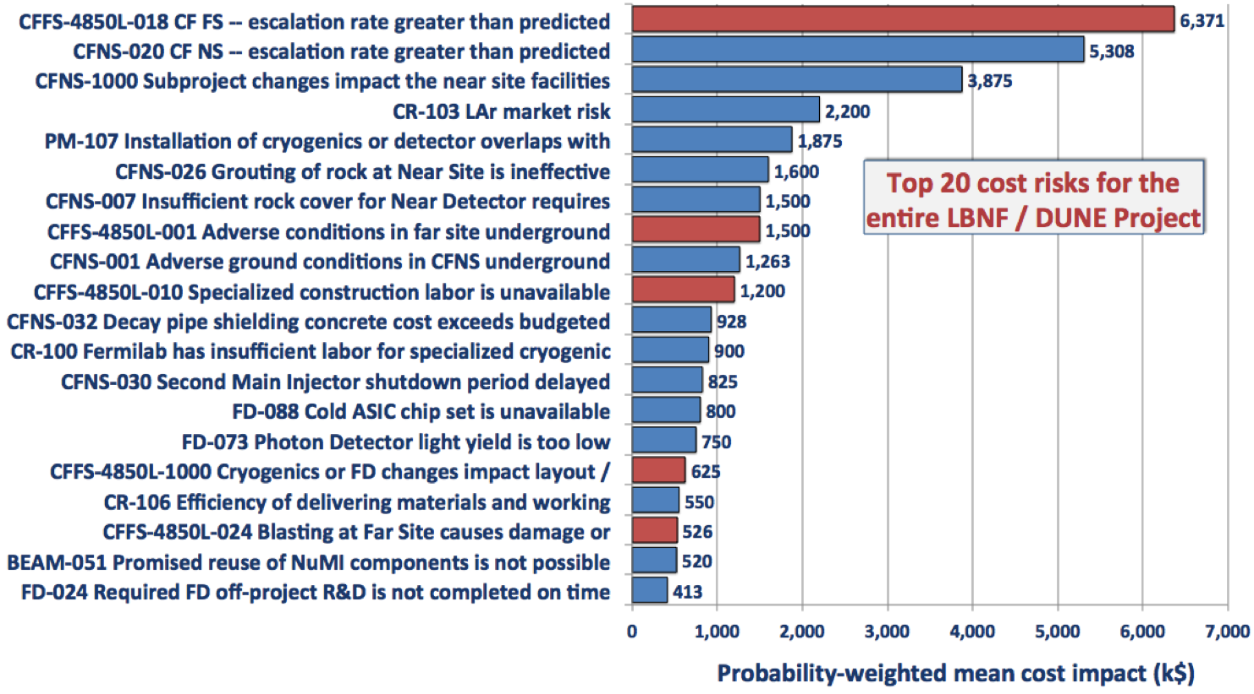
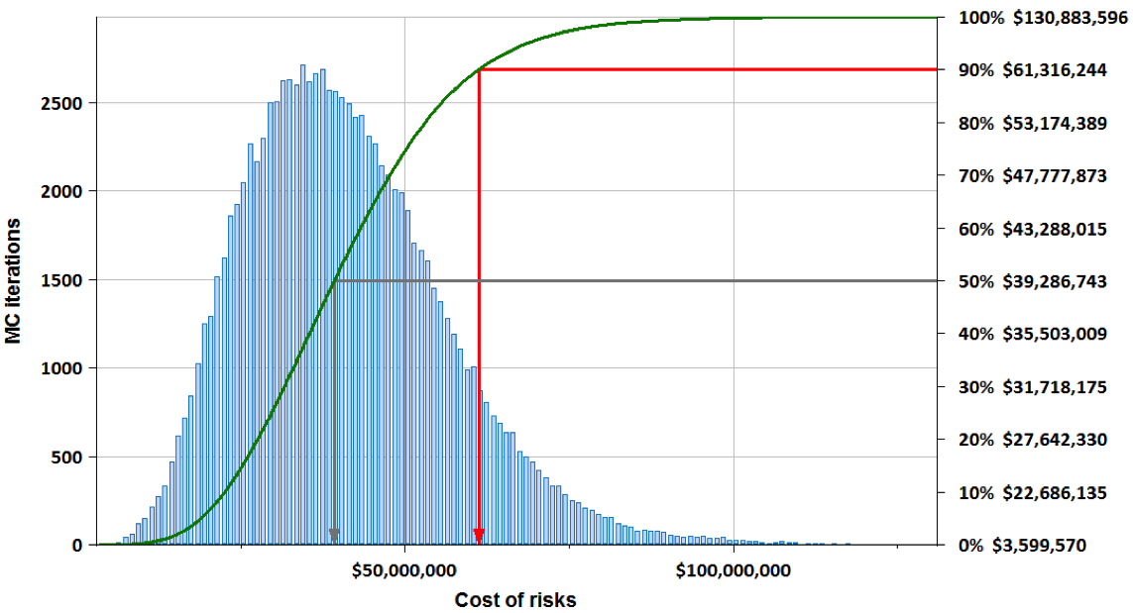
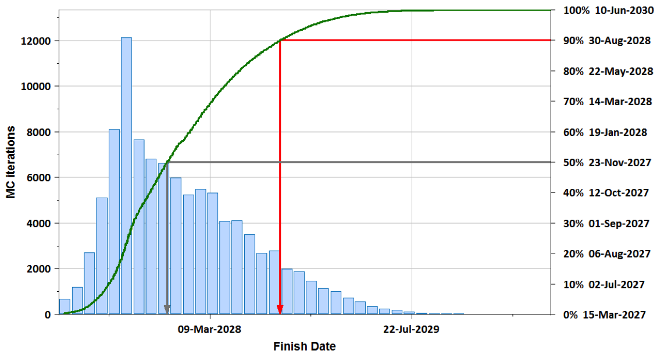
Risk Modeling – Monte Carlo
Risk Register captures risk probabilities, impacts, and response plans
More Details
(documents)
Risk Register
(Web tool)
Full
Schedule
Summary Schedule
P6 Project Plan includes all project activities, linked in time-sequence. The risk analysis uses a summary schedule derived from the full schedule.
DocDB
Risk
DB
P6
DB
Risk Model simulates probabilistic risk events, with ranges of impacts, in the project schedule
Risk Model
(Primavera Risk Analysis - PRA)
Costs of risks and contingency
Completion dates and float
Cost and schedule drivers

Slide 6
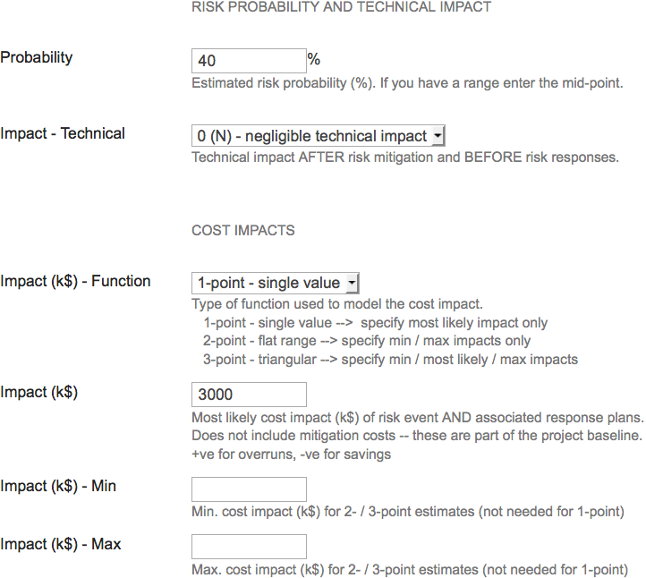
1-point estimate
60 % chance of no overrun
40% chance of an overrun
Overrun is exactly 3 M$
1-point estimate
60 % chance of no overrun
40% chance of an overrun
Overrun is exactly 3 M$
Probability, P
60% (risk does
not happen)
40% (risk
happens)
Impact
I (M$)
0
1
2
3
4
5
6

Slide 7
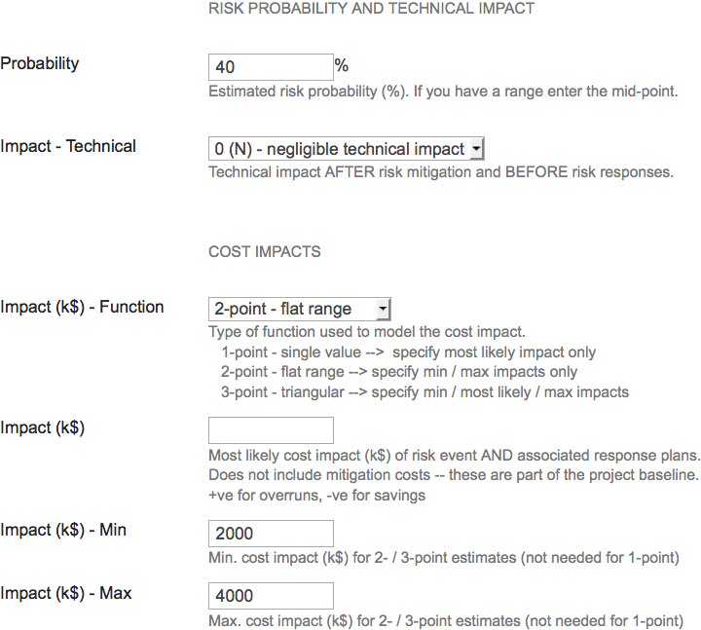
2-point estimate (range)
60 % chance of no overrun
40% chance of overrun
Mean overrun is 3 M$
Overruns from 2–4 M$ are all equally likely
Probability, P
60% (risk does
not happen)
40% (risk
happens)
I (M$)
0
1
2
3
4
5
6

Slide 8
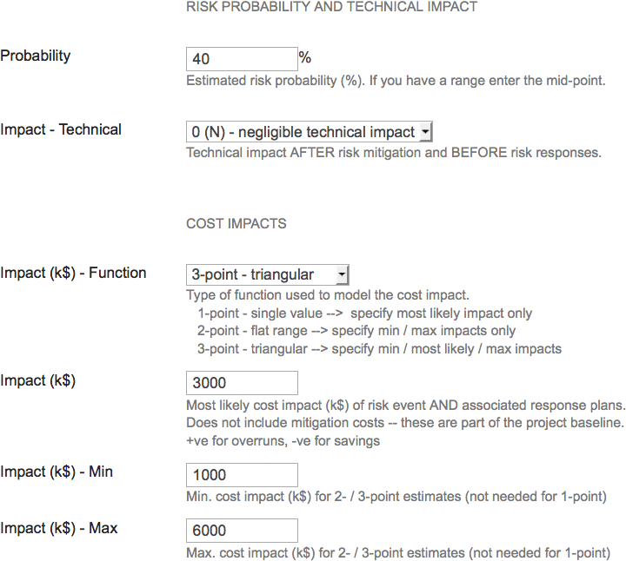
3-point estimate (triangle)
60 % chance of no overrun
40% chance of overrun
Most likely overrun is 3 M$
Overrun as low as 1 M$ but this is unlikely
Overrun as high as 6 M$ but this is unlikely
3-point estimate (triangle)
60 % chance of no overrun
40% chance of overrun
Overrun amount is probably small (up to a few M$)
Small chance of a large overrun (up to 6M$)
Probability, P
60% (risk does
not happen)
40% (risk
happens)
I (M$)
0
1
2
3
4
5
6

Slide 9
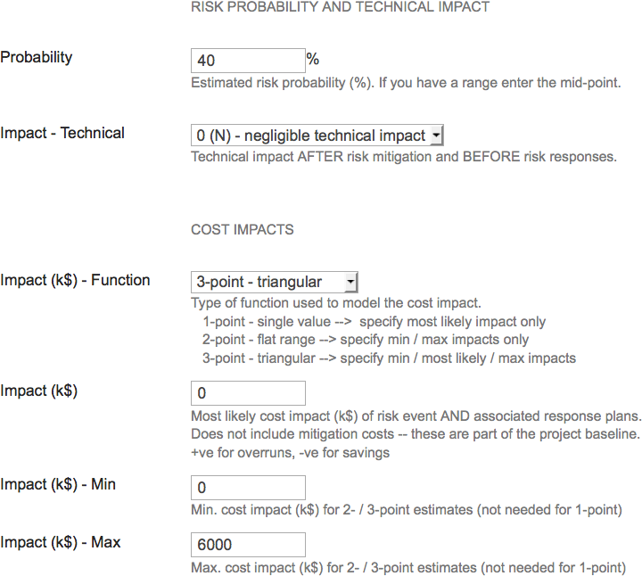
3-point estimate (triangle)
60 % chance of no overrun
40% chance of overrun
Overrun amount is probably small (up to a few M$)
Small chance of a large overrun (up to 6M$)
Probability, P
60% (risk does
not happen)
40% (risk
happens)
Schedule impacts are similarly modeled with 1-, 2-, and 3-point probability distributions
I (M$)
0
1
2
3
4
5
6

Slide 10
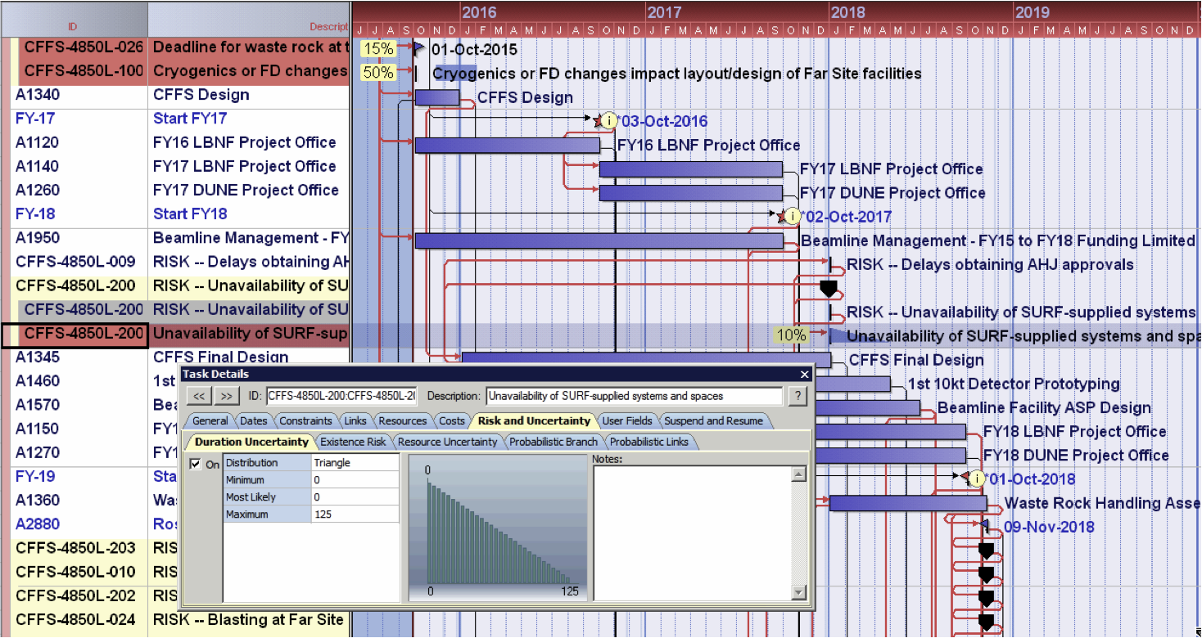
Risk Modeling – Monte Carlo
Placeholder risk events are inserted into schedule with zero cost and zero duration
(1) Throw dice – if risk happens, risk activity is assigned risk impacts (cost and duration)
Primavera Risk Analysis (PRA) framework
(2) Choose cost and schedule impacts from distributions
(3) Update entire schedule to generate one complete project outcome (scenario)
Repeat steps (1) – (3) 100,000 times and study the statistical behavior of many scenarios

Slide 11
Risk Modeling Results – Cost

Slide 12
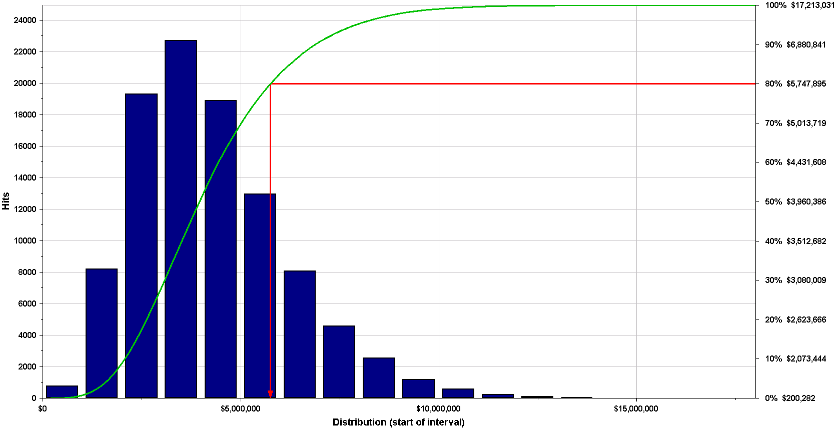
Total cost of all Mu2e risks
5.7 M$
Mu2e risk cost contingency = 5.7 M$ (at 80% C.L.)

Slide 13
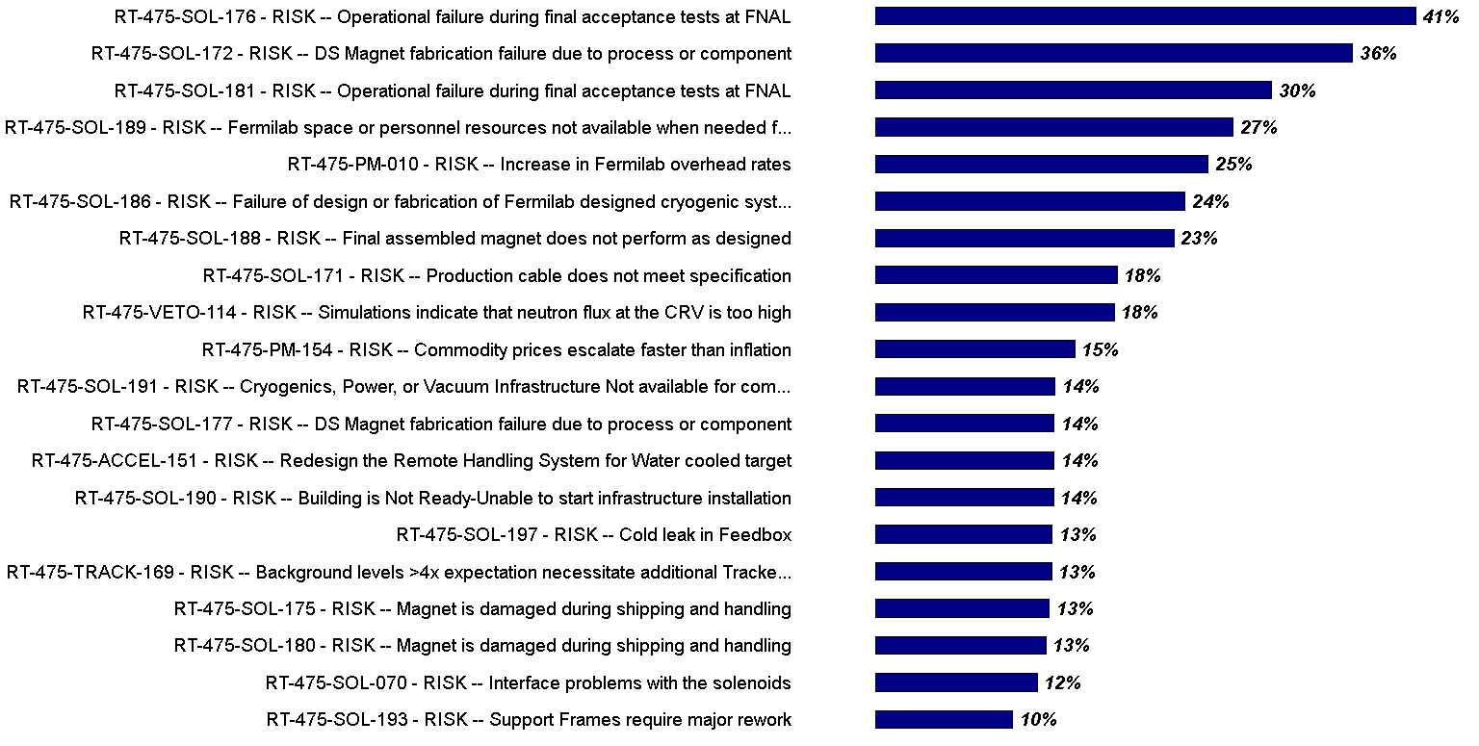
Top 20 cost risks

Slide 14
Risk Modeling Results – Schedule

Slide 15
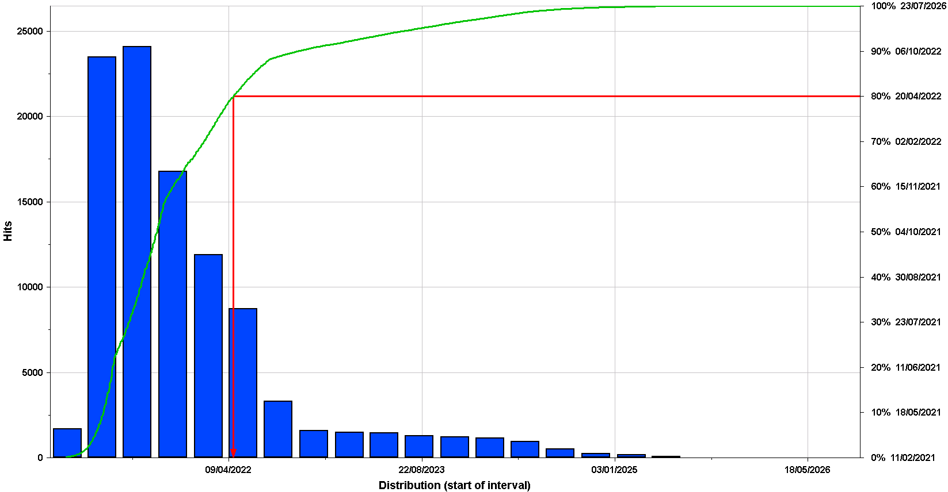
All LBNF/DUNE risks – Schedule contingency
Mu2e Project will finish before Dec 29 2022 (at 80% C.L)

Slide 16
Risk Modeling Results – Burn Rate

Slide 17
Burn rate – Mu2e Overall
Burn rate is the fixed cost per unit time incurred due to delays
Standing army costs for Project Offices and management of: subproject, control accounts, design, construction (50%)
Escalation costs of delayed expenditures – 3% on remaining work: blend of labor (2.7%/yr), M&S (1.9%/yr), and CF (3.4%/yr)
Mu2e average burn rate = 5.0 M$ / year
→ Mu2e risk contingency for burn rate = 4.9 M$ (80% C.L.)
(i.e. 11.8 months * 5.0 M$ / year)

Slide 18
Summary

Slide 19
Summary – the numbers
Risk contingency (at 90 % C.L.)
No. risks (High / Medium / Low) | 69
Cost contingency from risks | 5.7 M$
Cost contingency from burn rate | 4.9 M$
Total risk cost contingency | 10.65 M$
Risk schedule contingency | 16 months

Slide 20
Questions?

