Slide 1
All Experimenters’ Meeting
Daniel Johnson
Accelerator Complex Status
16 May 2016

Slide 2
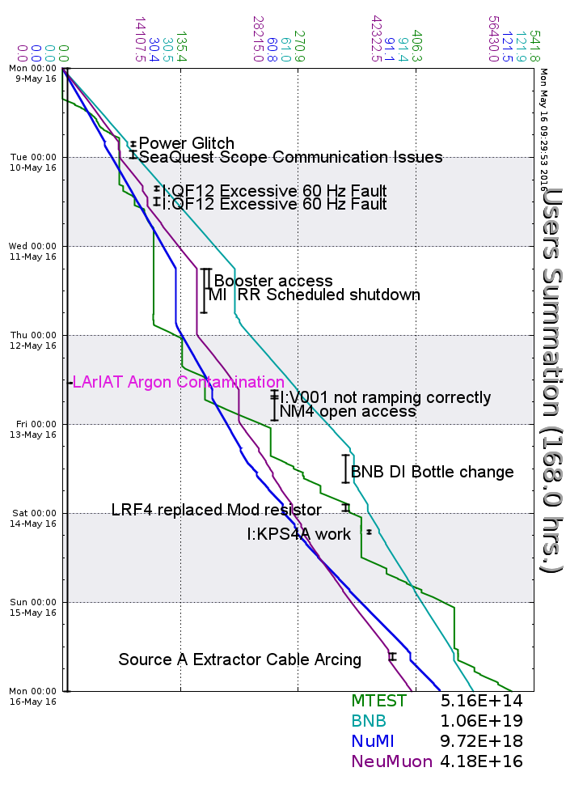
Accelerator Operations Summary
From: May 09, 2016 (0000 hours)
To: May 16, 2016 (0000 hours)
Calendar Week # 19
NuMI Weekly Integrated Intensity 9.72 E18 protons
Beam Hours To NuMI 140.0 hours
BNB Weekly Integrated Intensity 1.03 E19 protons
Beam Hours To BNB 138.9 hours
NMuon Weekly Integrated Intensity 4.18 E16 protons
Beam Hours To NMuon 125.7 hours
MTest Weekly Integrated Intensity 5.15 E14 protons
Beam Hours To MTest 57.1 hours
MCenter Weekly Integrated Intensity 0.00 E12 protons
Beam Hours To MCenter 0.0 hours

Slide 3
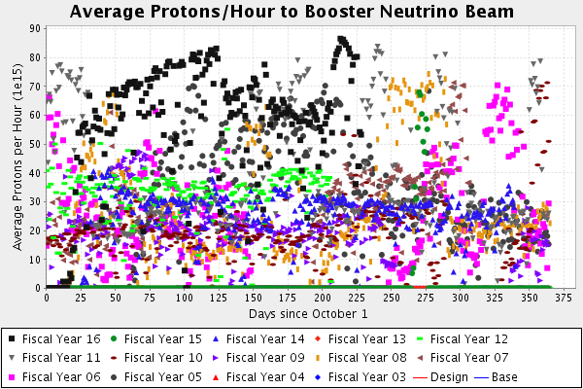
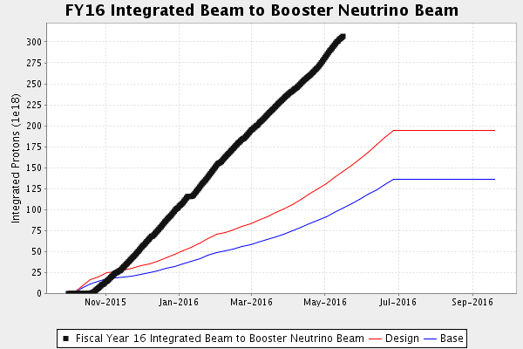
Performance measures: BNB

Slide 4
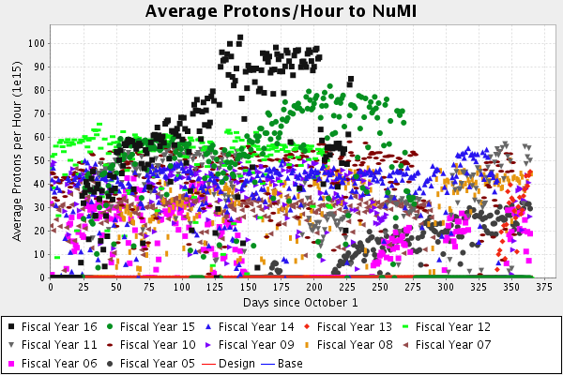
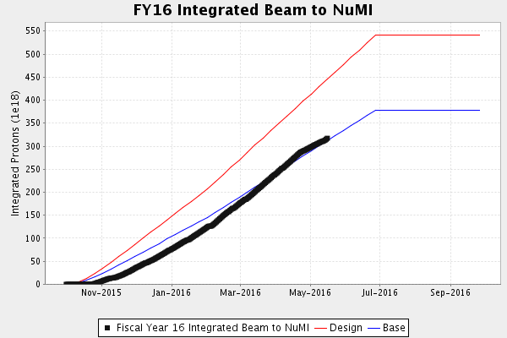
Performance measures: NuMI

Slide 5
Complex Status
LINAC
  Running well
  LRF1 Marx Modulator
Booster
  Booster rate: ~11 Hz
  Tuning up / studies
    Beam to BNB
    Beam to Main Injector
MI/RR
  Delivering beam to NuMI & Switchyard
  Standard operation: 2As (1.33 Sec MI ramp rate) with 4+6 slip stacking again
  Down one RF station, opportunistic downtime
NuMI
  Took beam when available-
    Beam Power ~510 kW
Booster Neutrino Beamline (BNB)
  Receiving Beam
    ~2.5 Hz operation
Switchyard
  Meson beam
    MTest using beam
    MCenter off with Argon issues
  SeaQuest
    Using beam
General
  Wednesday, June 1st
    Tentative shutdown day
    Will probably move later
  Monday, August 1st
    New Start Date of Summer Shutdown
    Beam probably off on Friday

Slide 6
Controlled Accesses
Controlled Access Event (3/01/2016)
  Four people performed a controlled access into Booster
  One had the wrong key (Verification is important)
  Enclosure dropped as training requires
  Similar to incident in 2014
  Controlled accesses were not permitted
Controlled Access Modification (3/02/2016)
  No more group controlled accesses
  Controlled accesses can resume in pairs
  Each person must manipulate their key for entry
  Interim procedure until investigation has been completed, corrective actions identified/implemented

Slide 7
Schedules and Links
Schedule can be accessed from the Operations Home Page
  - Schedules -> Operations Schedule
Direct link to schedule
  - http://www-ad.fnal.gov/ops/schedule.html

