Slide 1
Notes on reviews/descope

Slide 2
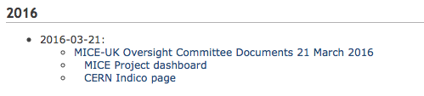


05 & 06 April 2016

Slide 3
Consensus outcomes
Excellent progress in:
  Commissioning and operations;
  Software and analysis;
  Publication of results.
Step IV science programme:
  Important and must be completed:
    Including operation with both LiH and LH2
Cooling demonstration:
  Important and should be completed.
http://micewww.pp.rl.ac.uk/attachments/6188/2016-05-04-Descope.pdf

Slide 4
STFC MICE-UK cost-to-completion
Risks (financial, reputational, schedule) associated with recovery of SSD too large;
  Also; timing of the long ISIS shutdown may start just as the recovered solenoid is delivered;
Maximise scientific yield from Step IV:
  Extend operations to Aug17 if project does not proceed to mount descoped cooling demonstration
C2C panel recommended MICE-UK be asked to prepare proposal for the execution of the cooling demonstration that:
  Exploits those components that are already in hand or are being manufactured:
    Within three months
http://micewww.pp.rl.ac.uk/attachments/6188/2016-05-04-Descope.pdf

Slide 5
Constraints
Integrated cost to the UK significantly lower than presented to C2C review
Minimum risk:
  Of further delay, cost overrun, equipment failure or reduced availability
Significant data-taking before the long ISIS shutdown (around 2019)
http://micewww.pp.rl.ac.uk/attachments/6188/2016-05-04-Descope.pdf

Slide 6
Possible routes forward
Either:
  Configuration with only one SS is shown to yield satisfactory performance
  The downstream spectrometer solenoid (E-C-E only or E-C-E and M2) is shown to be stable through operation at Step IV; or
  It is demonstrated that the downstream solenoid E-C-E combination can be made stable through a low-risk intervention.
http://micewww.pp.rl.ac.uk/attachments/6188/2016-05-04-Descope.pdf

Slide 7
Options under consideration [1]
Pasternak, Lagrange
Two-solenoid configurations:
  SS1 is either upstream or downstream
  Evaluation:
    Performance, cost, schedule, risk
      Example: rotate SSD by 180 degrees
    Investigation of stablisation vs doing nothing:
      Cost, schedule, risk
http://micewww.pp.rl.ac.uk/attachments/6188/2016-05-04-Descope.pdf

Slide 8
Options under consideration [2]
Use only one spectrometer solenoid:
  Two "generic" possibilities
Rajaram,
Franchini
http://micewww.pp.rl.ac.uk/attachments/6188/2016-05-04-Descope.pdf

Slide 9
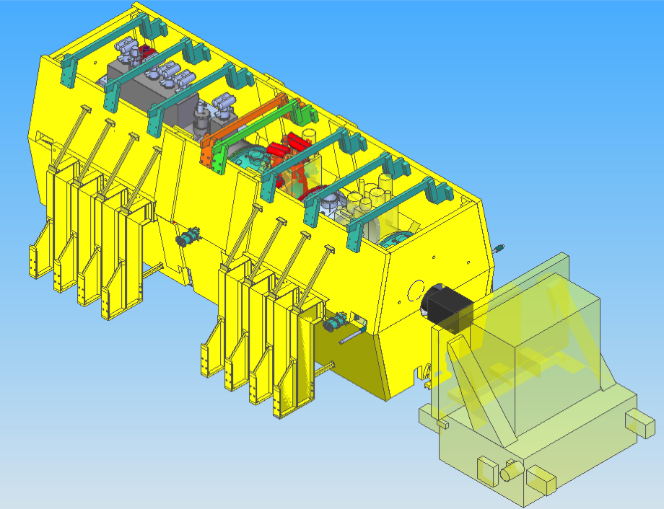
J. Tarrant

Slide 10
“Option A”: solenoid upstream
Rogers
Initial estimate of performance:
  Cooling effect: 8% at emittance of 7.9 mm;
    Comparable to baseline
  Transmission 85% vs 91% of baseline:
    Issue is systematic error:
      Believe that effect of modest decrease in transmission can be understood and systematic error can be kept under control

Slide 11
Indicative risk, cost and schedule estimate
Risk reduction:
  Do not assume use of SSD;
    All magnets will have been commissioned in the Step IV lattice for which the inter-magnet coupling is larger than in the descoped cooling demo configuration
  Hall refit significantly simplified;
  RF system commissioning significantly ahead of requirement
  Spares (solenoid and RF amplifier):
    Enhanced “availability” in operation
Schedule:
  Initial estimate indicates that reconfiguration and commissioning completes such that data-taking for physics can start Mar18; significantly in advance of the long ISIS shutdown
Cost:
Whyte, Grant, et al

Slide 12
International perspective
Demonstration of ionization cooling:
  Seminal measurement; unlocks high-brightness muon beams for particle physics;
Ionization cooling requires by energy loss and acceleration
  Demonstration of ionization cooling therefore requires the beam to be accelerated.
Initial evaluation indicates that:
  There is a cost-effective, low-risk programme by which a quantitatively-compelling demonstration can be delivered with equipment that is already available or that is already being manufactured;
Step IV:
  Study of the material properties that determine the ionzation-cooling effect.
Delivering the seminal demonstration of ionization cooling in this manner will maximise the scientific return on the substantial investments made in MICE by the STFC and its international partners.

