Slide 1
All Experimenters’ Meeting
Duane Newhart
Accelerator Complex Status
23 May 2016

Slide 2
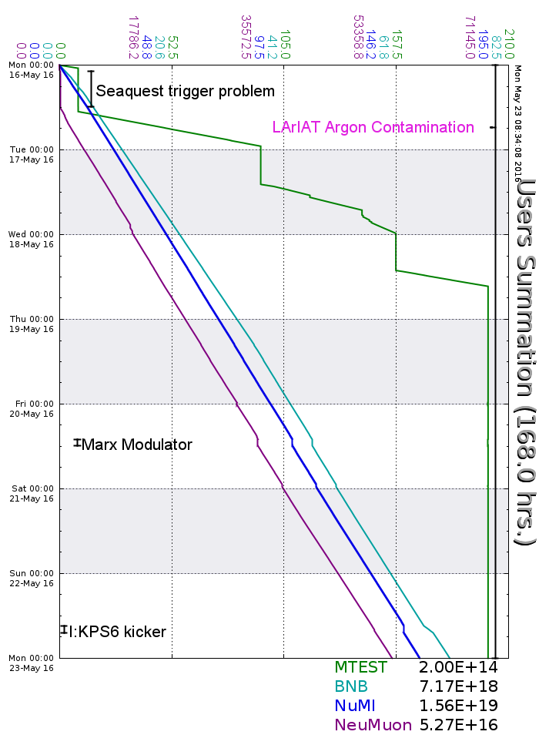
Accelerator Operations Summary
From: May 16, 2016 (0000 hours)
To: May 23, 2016 (0000 hours)
Calendar Week # 20
NuMI Weekly Integrated Intensity 1.56 E19 protons
Beam Hours To NuMI 161.6 hours
BNB Weekly Integrated Intensity 6.97 E18 protons
Beam Hours To BNB 163.9 hours
NMuon Weekly Integrated Intensity 5.27 E16 protons
Beam Hours To NMuon 149.2 hours
MTest Weekly Integrated Intensity 2.00 E14 protons
Beam Hours To MTest 24.0 hours
MCenter Weekly Integrated Intensity 0.00 E12 protons
Beam Hours To MCenter 00.0 hours

Slide 3
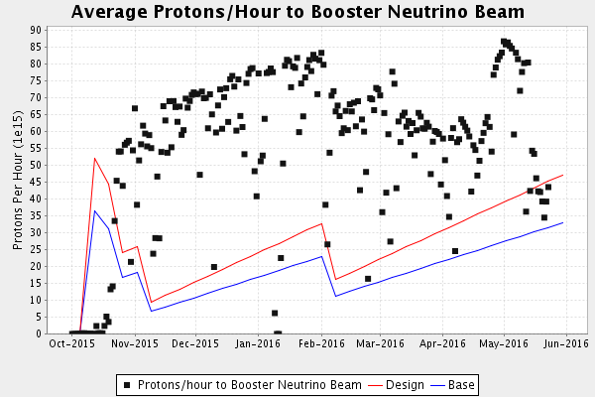
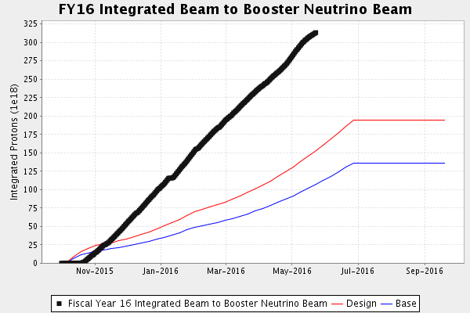
Performance measures: BNB

Slide 4
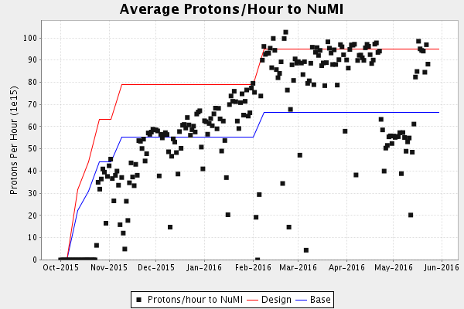
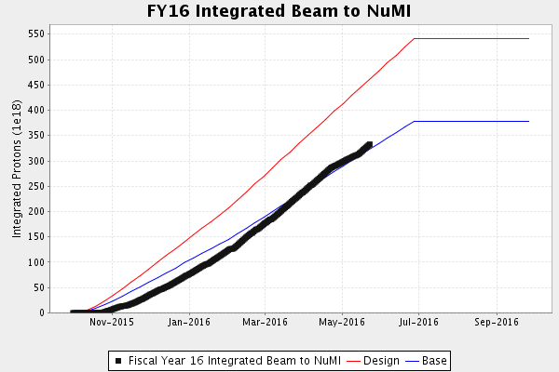
Performance measures: NuMI

Slide 5
Complex Status
LINAC
  Running well
  LRF1 Marx Modulator
Booster
  Booster rate: ~10 Hz
  Tuning up / studies
    Beam to BNB
    Beam to Main Injector
MI/RR
  Delivering beam to NuMI & Switchyard
  Standard operation: $2As (1.33 Sec MI ramp rate) Slip Stacking
NuMI
  Took beam when available-
    Beam Power ~510-520kW
Booster Neutrino Beamline (BNB)
  Receiving Beam
Switchyard
  Meson beam
    MTest using beam
    MCenter off
  SeaQuest
    Using beam
General
  Wednesday, June 1st
    Tentative shutdown day
    Will probably move later
  Monday, August 1st
    New Start Date of Summer Shutdown
    Beam probably off on Friday

Slide 6
Controlled Accesses
Controlled Access Event (3/01/2016)
  Four people performed a controlled access into Booster
  One had the wrong key (Verification is important)
  Enclosure dropped as training requires
  Similar to incident in 2014
  Controlled accesses were not permitted
Controlled Access Modification (3/02/2016)
  No more group controlled accesses
  Controlled accesses can resume in pairs
  Each person must manipulate their key for entry
  Interim procedure until investigation has been completed, corrective actions identified/implemented

Slide 7
Schedules and Links
Schedule can be accessed from the Operations Home Page
  - Schedules -> Operations Schedule
Direct link to schedule
  - http://www-ad.fnal.gov/ops/schedule.html

