Slide 1
3.9 GHz Cryomodule Design
3.9 GHz Cryomodule Status Review
Tom Peterson, for the cryomodule design team
26 May 2016

Slide 2
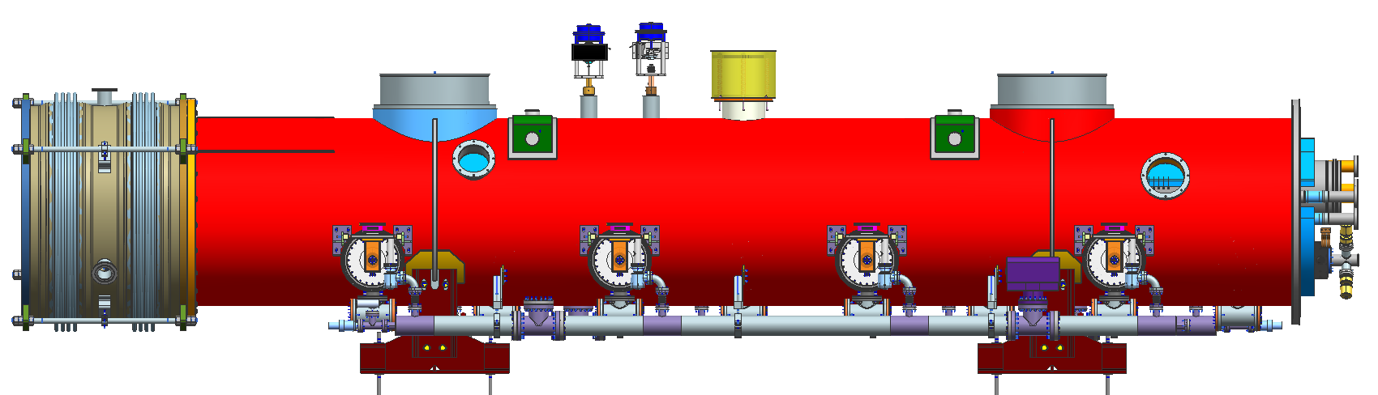
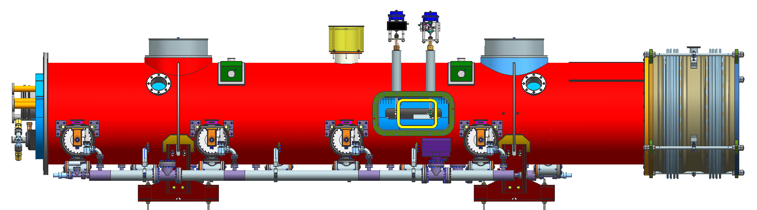
LCLS-II 3.9 GHz cryomodule

Slide 3
Outline
Introduction, major requirements
Design strategy and previous 3.9 GHz cryomodules
3.9 GHz cavity design
3.9 GHz cryomodule mechanical design
Analyses in support of safety and code compliance
Status and summary
Additional information

Slide 4
3.9 GHz cryomodule parameters from LCLSII-4.1-PR-0097-R2

Slide 5
ILC / XFEL CM Modifications for LCLS-II (components)
Component design – based on TESLA / ILC / XFEL designs
  Cavities – XFEL identical
    Transition to slightly smaller beam tube
  Helium vessel – XFEL-like
    1.3 GHz modified ILC with bellows at end for end lever tuner
    3.9 GHz modified for addition of piezos in blade tuner, larger chimney
  HOM coupler – XFEL-like
  Magnetic shielding – increased from XFEL to maintain high Q0
  Tuner – 3.9 GHz XFEL-like blade tuner style
  Magnet – provision for addition of future small magnet
  BPM – DESY button-style with modified feedthrough
  Coupler – XFEL-like modified for CW operation

Slide 6
3.9 GHz cryomodule design for LCLS-II
3rd generation design
  FLASH (Fermilab)
  EuXFEL (LASA/INFN)
Significant changes due to CW operation
  higher heat load (larger 2-phase chimney)
  modifications to FPC
Retain blade tuner
  add fine tuning by means of piezos
Modification to cavity ends
  reduce trapped modes

Slide 7
3.9 GHz cryomodule design strategy
Build on successful implementation now in operation at FLASH
  Many lessons learned and subsequently applied
XFEL experience
  LASA, Milano adapted the Fermilab FLASH design for XFEL and used Fermilab as a resource including test verification
  We, in turn, are taking back valuable design ideas and information from LASA, Milano – very good collaboration with LASA, Milano (as well as with XFEL, DESY)
Apply LCLS-II 1.3 GHz CM as much as possible
  lower risk, but sequential (series) design process
  will supplement plans for Design Verification
Common parts, e.g., instrumentation
Common transport fixture
CMTS can accommodate both types of CM’s
Primary design issues
  Tuner (modification to add piezos to existing blade tuner design)
  RF Power Input Coupler for CW operation
  Cavity dynamic heat – smaller cavity with more heat, larger diameter 2-phase chimney
  Very tight space limitations on the small helium vessel around the blade tuner and chimney opening (smaller not necessarily easier!)
  Reduce trapped modes – minor change to ends, but not cavity

Slide 8
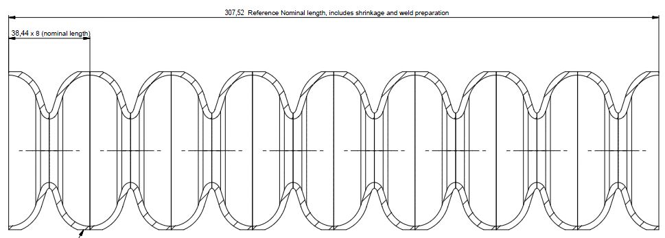
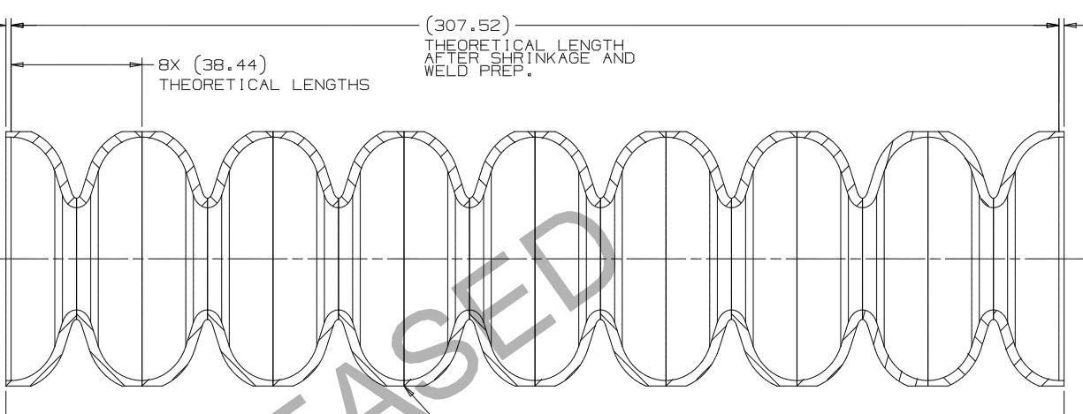
Bare Cavity Design (Chuck Grimm)
XFEL Cavity Dumbbell and LCLS-II Cavity Dumbbell Assemblies are Identical
  Mid-Cells and End Half-Cells are the Same Geometry (XFEL – Top / FNAL Bottom)

Slide 9
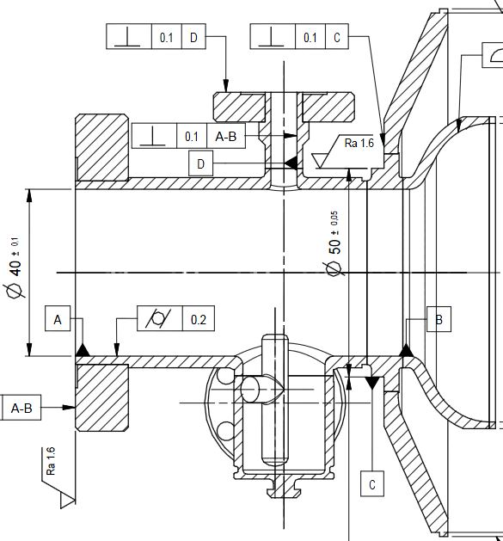
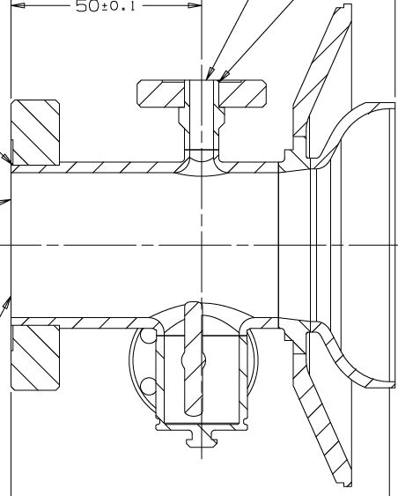
Bare Cavity Design
XFEL Bare Cavity FP Endgroup Design – Left – 40mm Beam Tube
LCLS-II Bare Cavity FP Endgroup Design – Right – 38mm Beam Tube
Dia = 38
Reducing
Spool

Slide 10
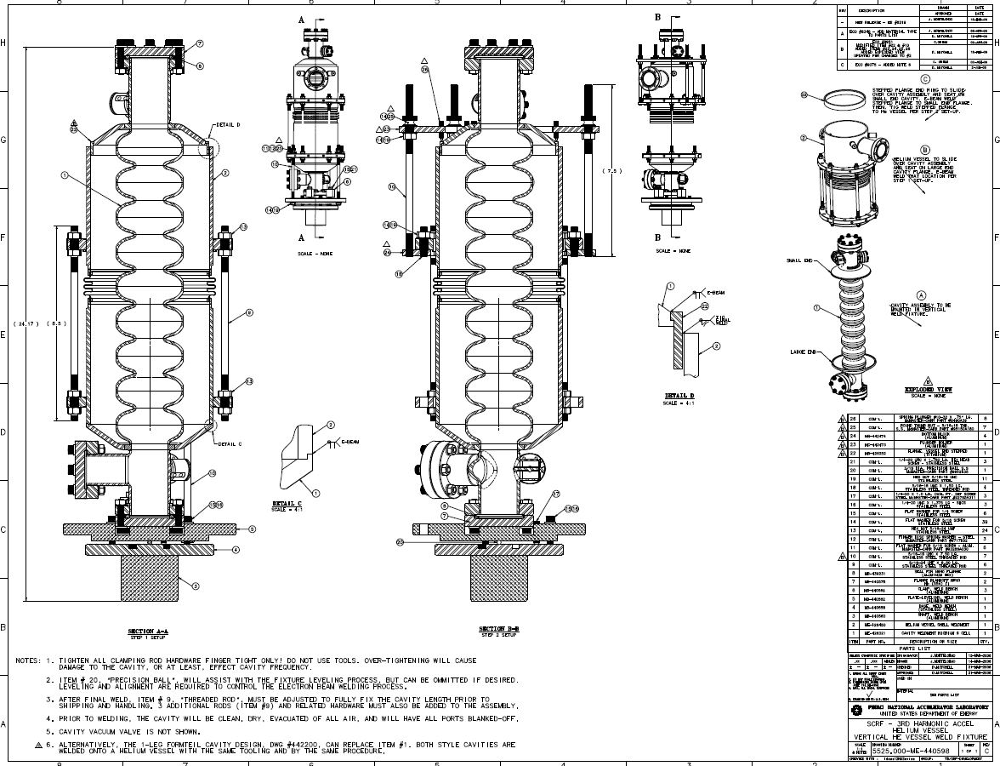
Dressed Cavity Design

Slide 11
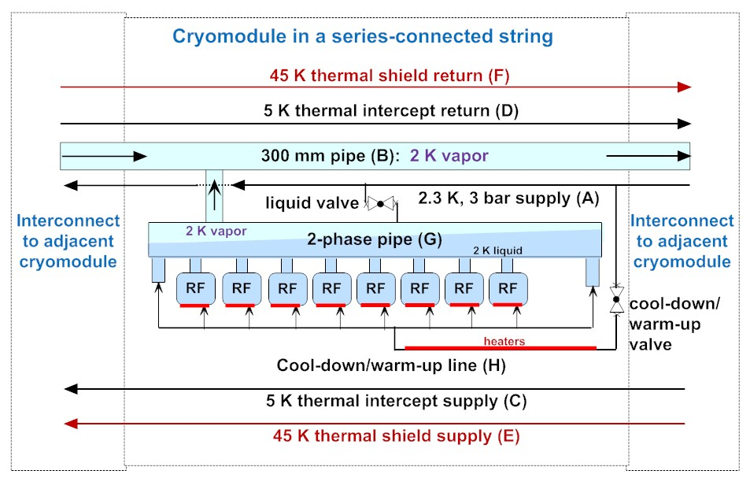
3.9 GHz Cryomodule Flow Scheme

Slide 12
2 K heat in first few cryomodules, including 3.9 GHz
Nominal values of Q0 = 2.0x10⁹, gradient = 13.4 MV/m, result in 14.3 Watts per cavity and 112 W per cryomodule, compared to about 10 W per cavity and 88 W per cryomodule for 1.3 GHz
From LCLScryoHeat-23Feb2016.xlsx

Slide 13
3.9 GHz cavity dynamic heating may be large
Minimum Q0 = 1.5x10⁹, maximum gradient = 14.9 MV/m (LCLSII-4.1-PR-0097-R2)

Slide 14
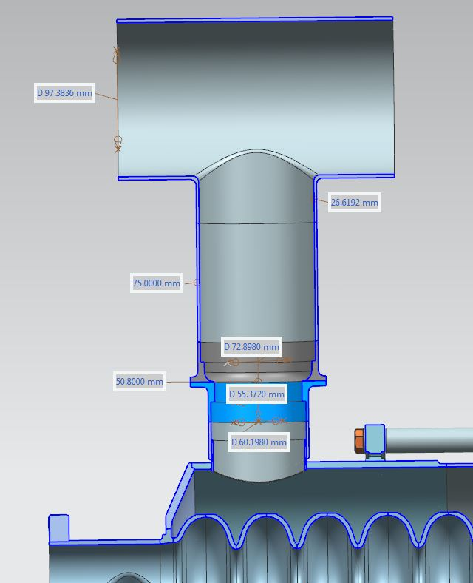
Chimney size, step up in diameter at Ti-SS transition
Maximum heat about 24 Watts.
Various constraints limit nozzle into
  helium vessel to 60.2 mm ID
Increased heat transport margin from
  25% to 50%

Slide 16
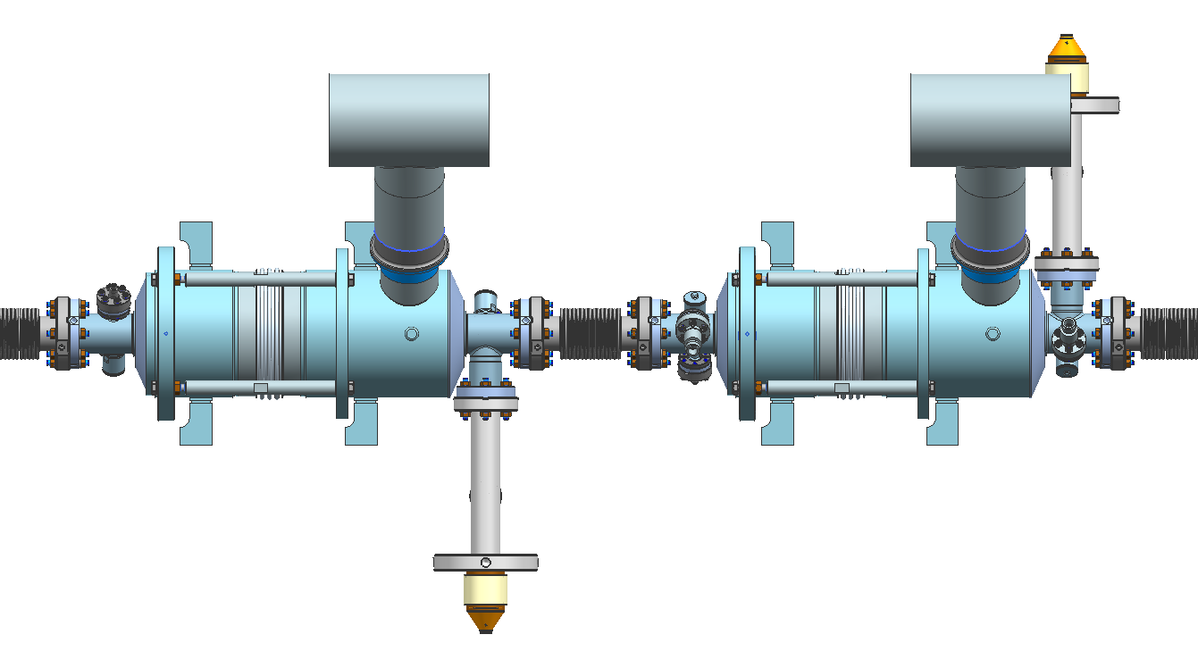
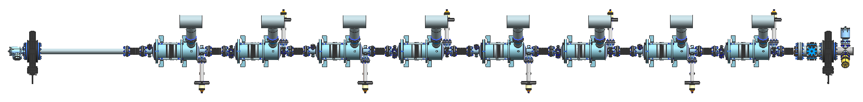
3.9 GHz cryomodule cavity string
(note alternating input coupler positions)
Cavity-even: F10048832
Cavity-odd: F10048834
Cold (operational) cavity
center to cavity center spacing of (8 + 0.25) x lambda
= (8+0.25)x76.87 = 634.2 mm
(slightly more than XFEL)
634.2 mm
cavity string
F10014812
-1671.5 at warm
-1668.1 at cold
CM fixed post
0
4581.5 at warm
4578.9 at cold

Slide 17
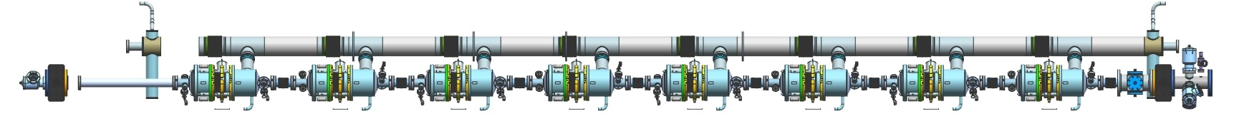
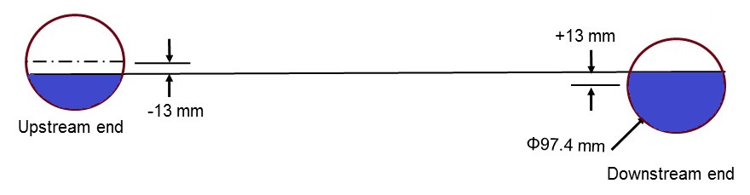
Liquid helium levels in the 2-phase pipe with LCLS-II tunnel slope ~0.5%
Upstream end
Beam
Downstream end
5250 mm
Shorter cryomodule results in less impact of slope
on liquid helium elevation issue in the 2-phase pipe.

Slide 18
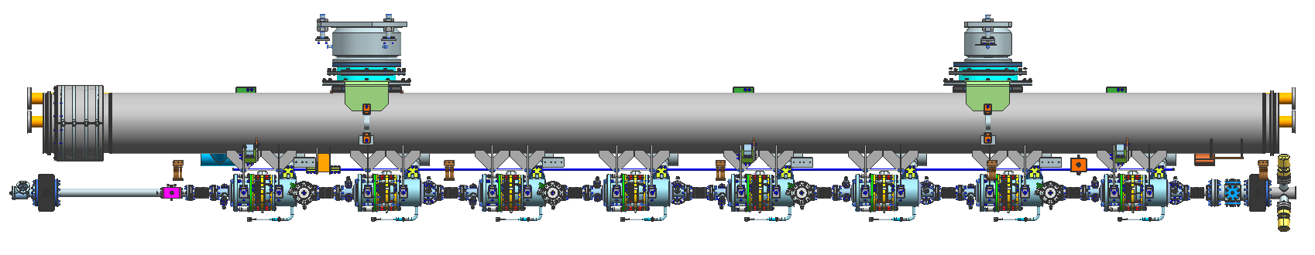
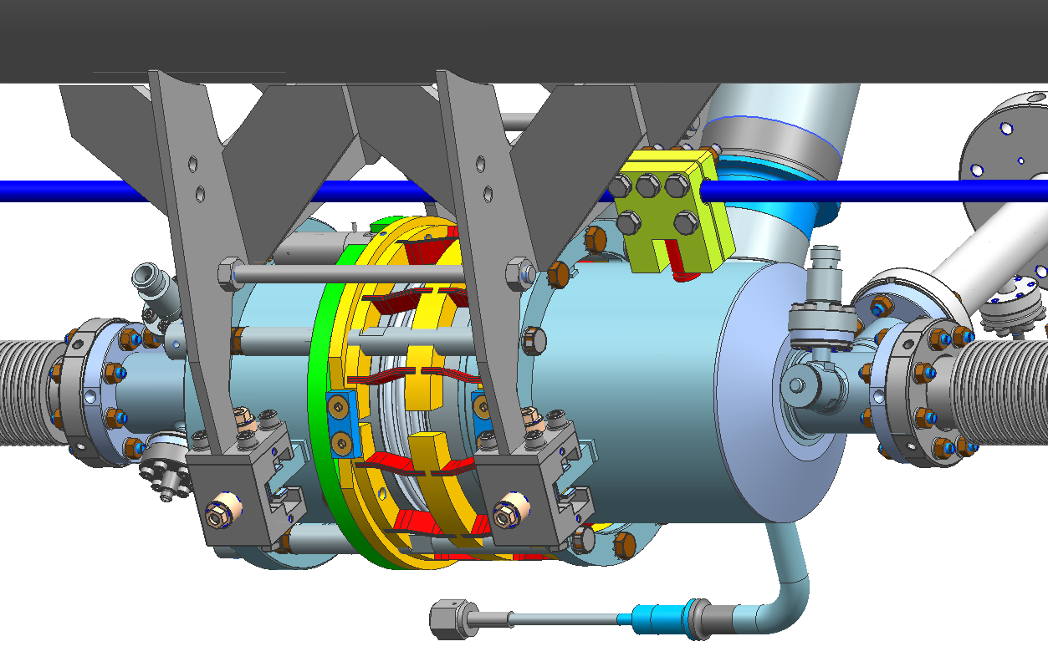
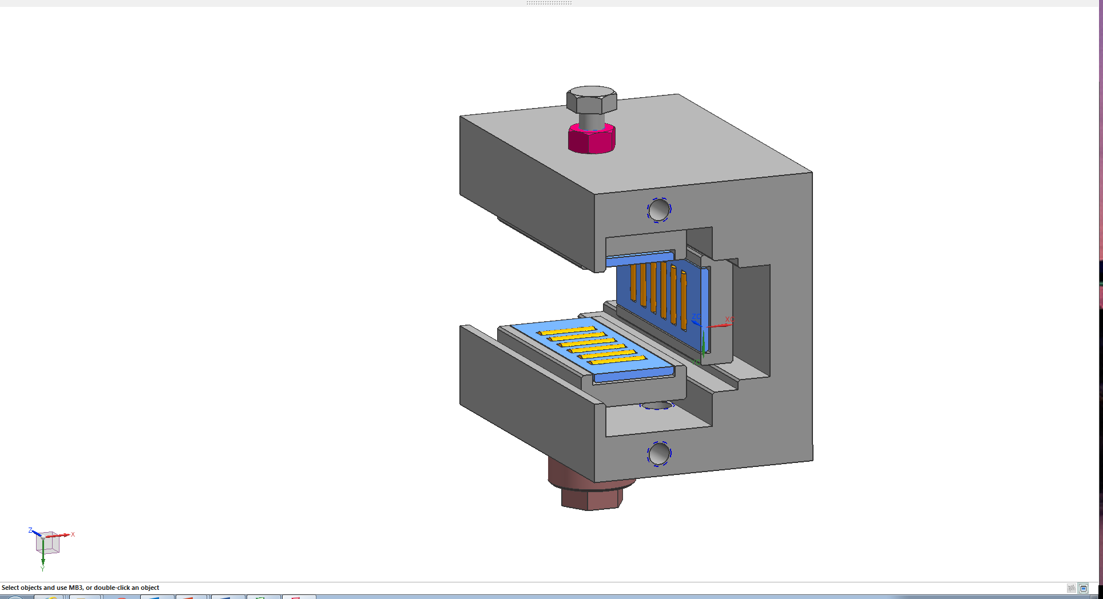
3.9 GHz cryomodule support system
Fixed support post “A”
Slide-able support post
Invar rod fixed to HGRP at “B”
220 mm upstream of “A”
Cavity suspended under HGRP
Invar rod
C-shaped needle clamps with bearing allow beamline frictionless movement with respect to the HGRP during thermal cycling
Invar rod post on the helium tank clamped to Invar rod at “C”

Slide 19
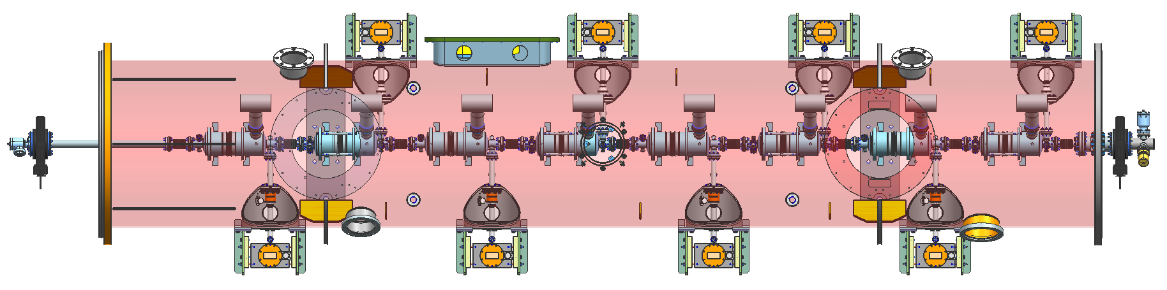
Cavity Z motion, warm to cold
Coupler port # | Offset to coupler at installation
Cavity 1 | 0.96
Fixed post | 0.00
Cavity 2 | 0.62
Cavity 3 | 0.28
Cavity 4 | -0.07
Cavity 5 | -0.41
Cavity 6 | -0.75
Cavity 7 | -1.09
Cavity 8 | -1.43
Coupler port aligned concentric to coupler at cold
0.0
-Z
+Z
#2 #4 #6 #8
BEAM
Upstream end
#1 #3 #5 #7
Downstream end

Slide 20
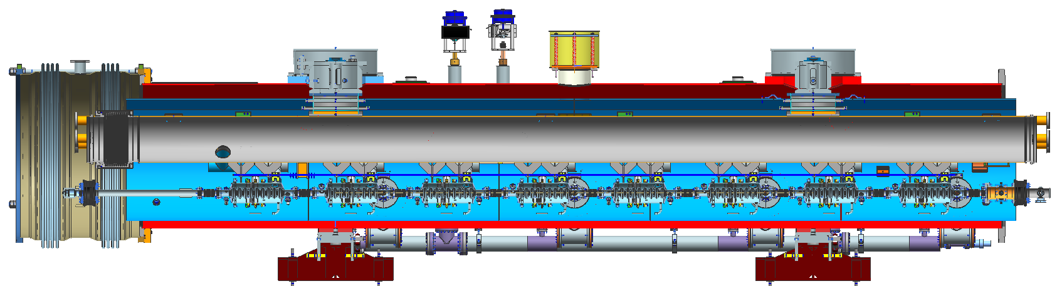
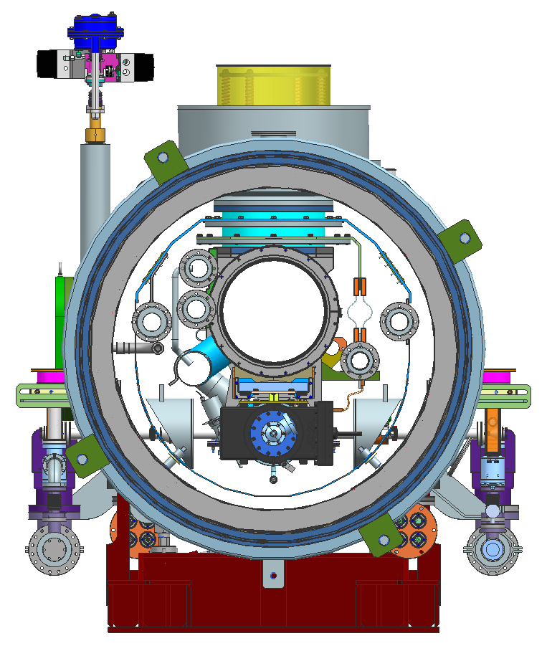
6554.5 mm (Cryomodule slot length)
Upstream end
Downstream end
BEAM
6253.0 mm (Gate Valve-to-Gate Valve faces)
Vacuum vessel
OD: 38” (965.2 mm)
Bellows interconnection
OD: 1160 mm
1820 mm
1656 mm
590 mm
3.75”
1500 mm

Slide 21
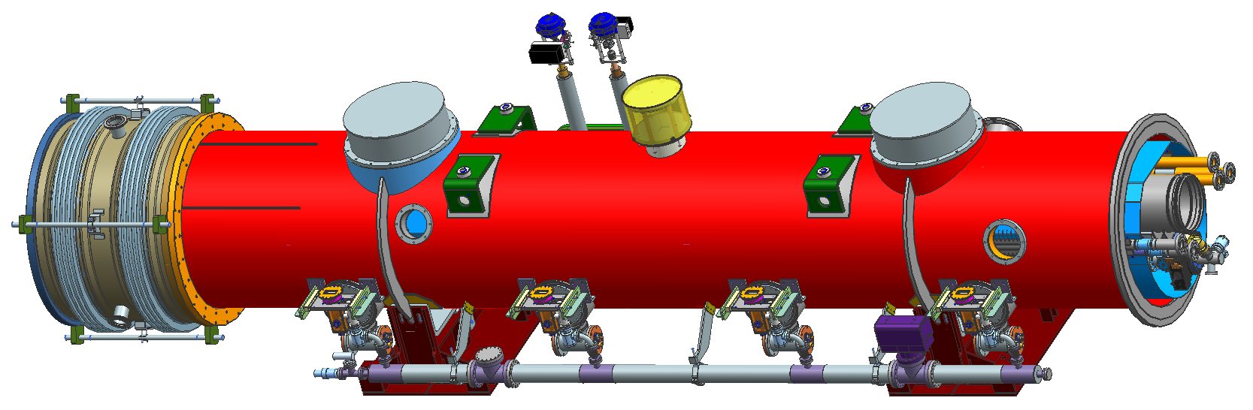
3.9 GHz cryomodule assembly
3.9 GHz cryomodule F10014857
Identical interconnect unit
Identical piping
Beams
6.5545 m

Slide 22
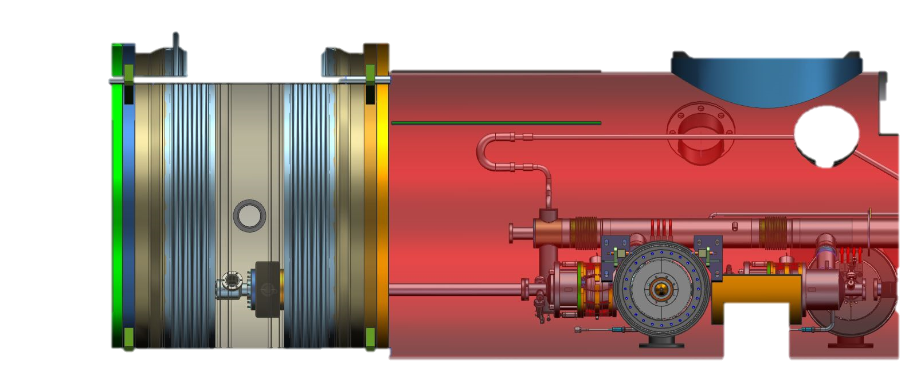
Upstream End
700
Bellows rail
(Same as 1.3GHz)
374.5223
Flange to valve face
(Same as 1.3GHz)
1st coupler port

Slide 23
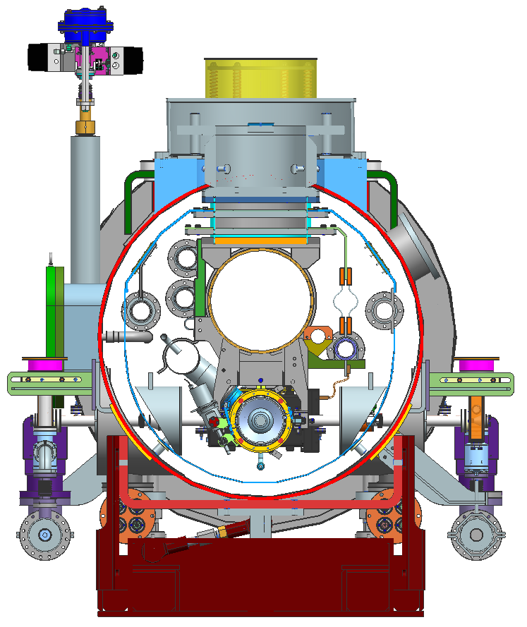
Cross section showing main features
Cold mass support bracket
Cryogenic valve
Support post
Cooling pipes
Vacuum vessel
HGRP
Thermal shield with MLI
2-Phase pipe
Cavity string
Main coupler vacuum manifold
Adjustment support

Slide 24
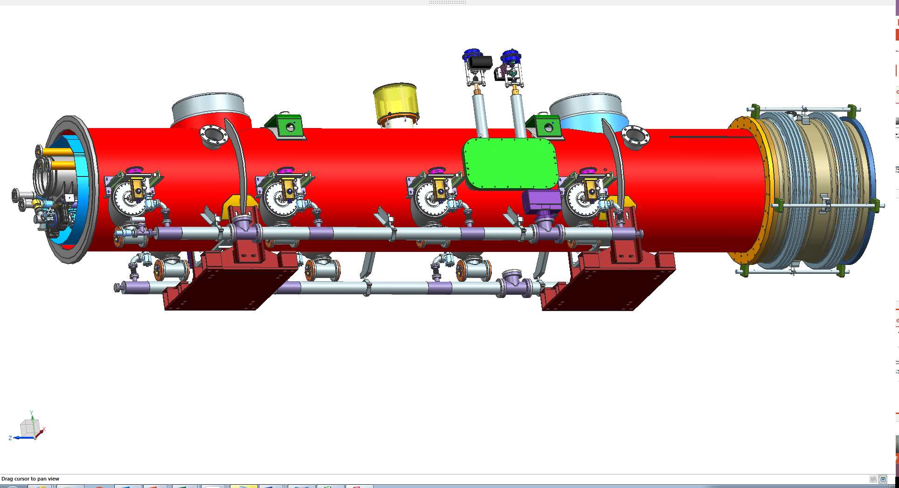
3.9 GHz cryomodule external features
Port for vac gauge
Fixed support post
Pressure relief
Sliding support post
Instrumentation ports
Insulating vac pump-out port
4 couplers on both sides of module
8 pairs of instrumentation ports
Warm coupler vacuum manifold
Survey fiducials
On both sides of 2 post ports
Module pickup bushing hoist rings
Pre-cool valve
JT Valve
2 LHe level instrumentation ports
2 support stands
Access to cryogenic valve welds to piping lines

Slide 25
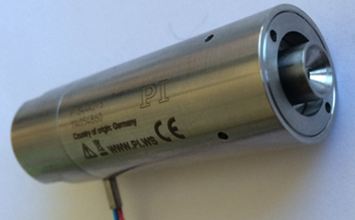
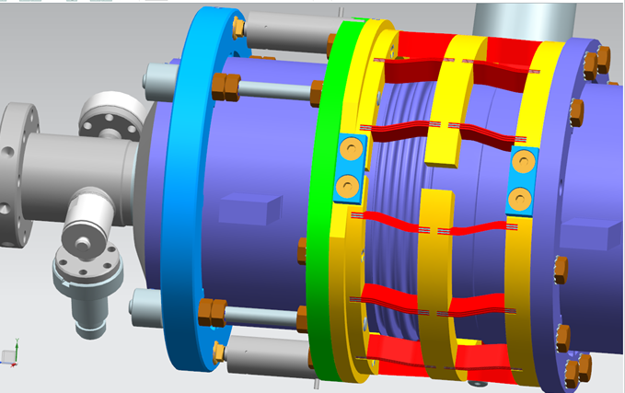
3.9 GHz blade tuner - design
‘Slim’ blade tuner design is preferred to minimize significant re-engineering of the dressed cavity/helium vessel while providing room for a larger 2-phase chimney
Designed and built by LASA/INFN, Milano for the 3.9 GHz cavities fabricated for the XFEL project
Modify to allow fast tuning by means of piezo tuners
Encapsulated piezo designed for the LCLS-II 1.3 GHz cavities will well fit for this task
Experienced LLRF & microphonics team at Fermilab
Encapsulated piezo stack for Fast tuner
Modification of the LASA/INFN tuner by adding 2 encapsulated piezo stacks

Slide 26
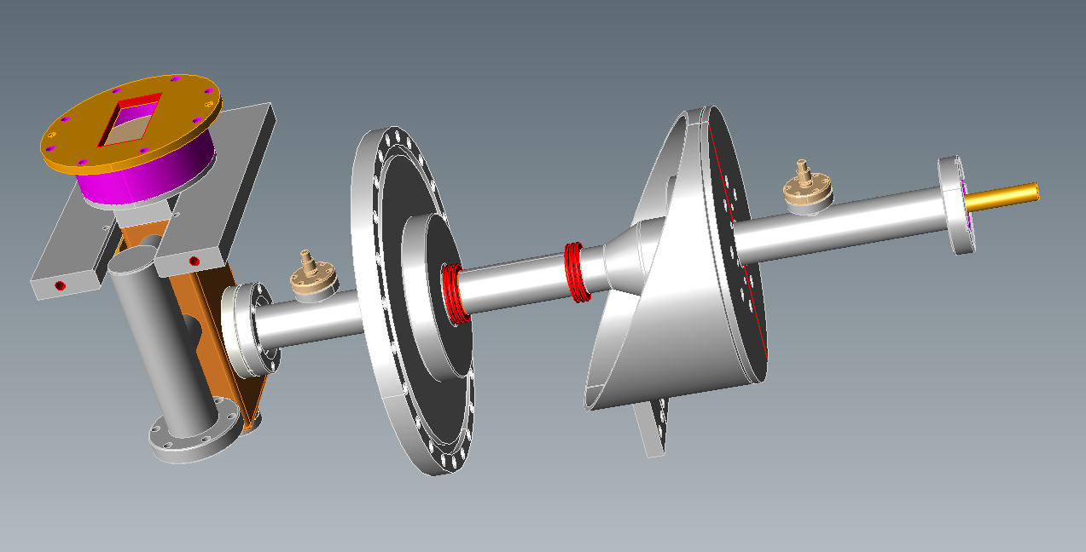
3rd harmonic cavity power coupler
For LCLS-II three modifications of existing design will provide safe margin for operation at 2kW cw power:
  Shortening antenna to provide Qext~2.5e7
  Decrease length of two SS bellows in inner conductor (warm part) from 20 convolutions to 15 convolutions
  120 microns Cu plating of inner conductor (instead of 30 microns in current design)

Slide 27
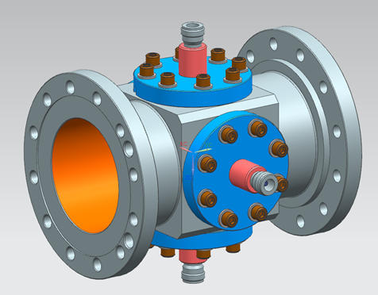
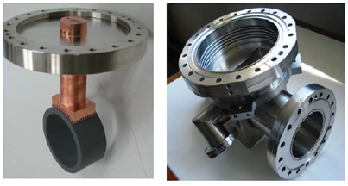
Use 1.3 GHz BPM and HOM absorber
Concept: Use 1.3GHz beam line components (ID=78mm) in transition between cavity strings:
Spool piece,
BPM,
Gate-valve,
Beamline HOM absorber
Optimize length of transition from ø38mm to ø78mm for minimum wakes
Short ~25mm in flange (XFEL)
Long >300mm in spool-piece
From Nikolay Solyak

Slide 28
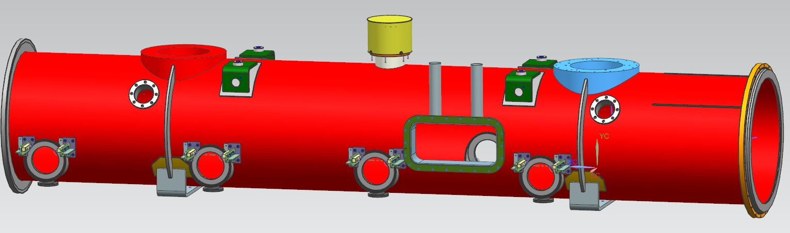
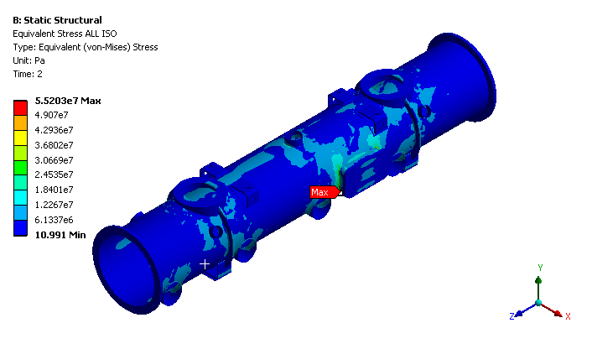
Vacuum vessel
Static structural analysis was performed to evaluate the vacuum vessel mechanical stresses and deformations under the cold mass weight of 3 Ton, for two scenarios: module in air, under vacuum.
A large safety factor
Engineering document ED0004908

Slide 29
3.9 GHz cryomodule tunnel transport clearance
Tight clearance for moves
through tunnel for 3.9 GHz.
Also true for 1.3 GHz.

Slide 30
3.9 GHz cryomodule instrumentation
The production
cryomodule
instrumentation list
has been edited
(Thomas Cummings,
Darryl Orris, et al.) to
create a draft 3.9 GHz
cryomodule
Instrumentation list.

Slide 31
Vacuum Vessel Instrumentation Flanges
Flange K
Flange D
QTY. 8 sets of
Flange A & B
Flange E
Flange L
Flange A
Flange B
Similar to 1.3 GHz module but less those for magnets

Slide 32
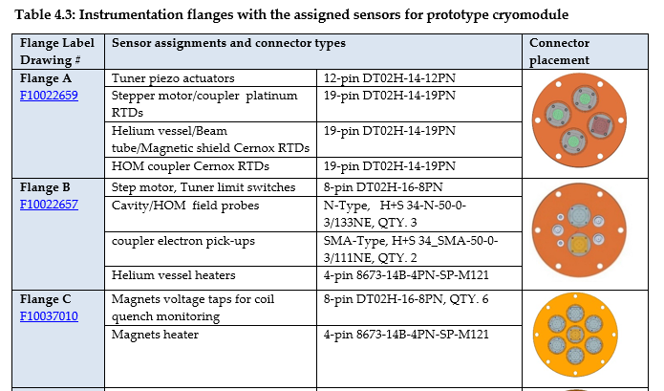
Cryomodule interfaces – instrumentation connectors
Fermilab ED0004361 Working Document, “1.3 GHz Cryomodule Mechanical Design ”

Slide 33
Comparison of 3.9 GHz with 1.3 GHz
3.9 GHz cryomodule | 1.3 GHz cryomodule
Two cryomodules | 35 cryomodules
6.55 meters slot length | 12.22 meters slot length
Two support posts, one end fixed | Three support posts, center fixed
634.2 mm coupler-to-coupler | 1383.6 mm coupler-to-coupler
Couplers alternate sides | Couplers all on aisle side
Two types of dressed cavities | All dressed cavities the same
BPM, but no magnet | BPM and magnet package
Blade tuner with piezos | End lever tuner with piezos
38 mm inner diameter beam tube end | 78 mm inner diameter beam tube end
One cool-down inlet port | Two cool-down inlet ports
14.3 dynamic W/cavity, 112 W/CM | 10.1 dynamic W/cavity, 88 W/CM

Slide 34
Analyses in support of safety and code compliance
System pressure drops for emergency venting
  Worst-case flow for each line is evaluated
  Loss of insulating vacuum to air or cavity vacuum to air provides the greatest heat flux and flow rates
  Process lines vent via the cryogenic distribution system
  3.9 GHz cryomodules are part of the system with 1.3 GHz, same line diameters
Vacuum relief valve sizing
  One insulating vacuum relief per cryomodule, on the interconnect sleeve assembly
  Worst-case internal process line ruptures have been evaluated
    Provide sizing for vacuum reliefs
    Provide flow rates and helium inventory release sizes for ODH analysis
  Documents
    ED0002339 -- LCLS-II 1.3 GHz Cryomodule Vacuum Vessel (FESHM conformance)
    ED0002337 -- LCLS-II 1.3 GHz Cryomodule Vacuum Vessel FEA Structural Analysis
    ED0002396 -- Cryomodule vacuum vessel venting calculation
  3.9 GHz vacuum system contiguous with L1 1.3 GHz
  Same vacuum reliefs as 1.3 GHz
Helium vessel (pressure vessel compliance) engineering notes
  3.9 GHz designed to the same standards as 1.3 GHz, similar documentation
Cryomodule piping (piping code compliance) engineering notes
  3.9 GHz designed to the same standards as 1.3 GHz, similar documentation

Slide 35
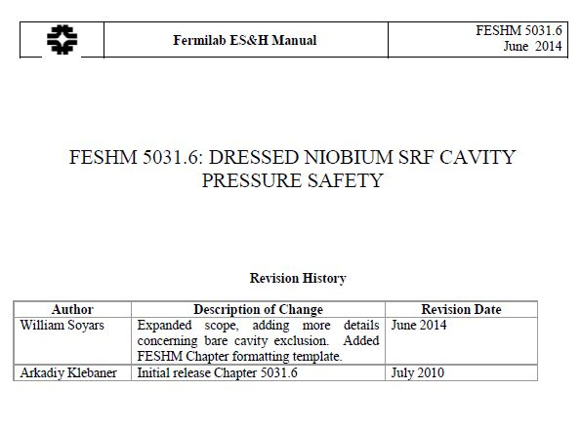
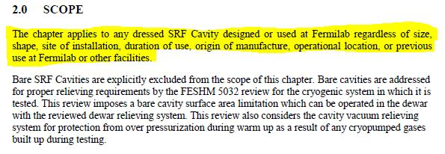
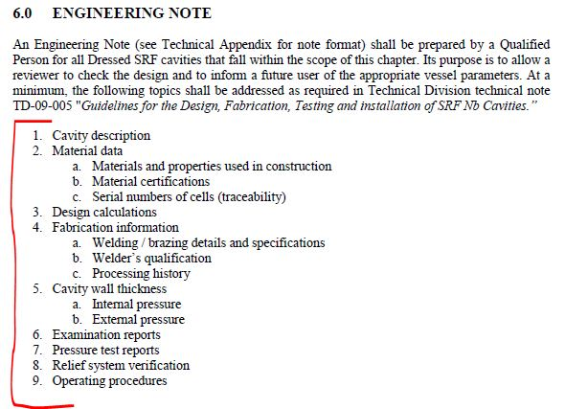
Dressed cavity pressure vessel compliance
Follow Pressure Vessel Guidelines as Specified in Fermilab’s ES&H Manual:
FESHM 5031.6: Dressed Niobium SRF Cavity Pressure Safety
TD-09-005: Guidelines for the Design, Fabrication, Testing and Installation of SRF Nb Cavities

Slide 36
3.9 GHz design status and summary
LCLS-II 3.9 GHz Harmonic Linearizer consists of two 8-cavity cryomodules
Parameter set determined
  Physics Requirements Document: “SCRF 3.9 GHz Cryomodule,” LCLSII-4.1-PR-0097-R2
  Design issues identified, design is advanced
  Taking advantage of 1.3 GHz design & commonalities
  Taking advantage of collaborations and other 3.9 GHz experience – XFEL, INFN
PDR was held on 20 Nov 2015
  Preliminary design review for the cryomodule
  Also served as a final design review for the RF cavity
Cavity design and drawings are complete
  Procurements are underway
A full CAD model and top-level drawing of the cryomodule are being developed F10014857
Some dates:
  31 Aug 2016 – Complete dressed cavity design
    Includes inner magnetic shield
  30 Sep 2016 – Complete 3.9 GHz cryomodule Engineering Specification Document (ESD)
  30 Jan 2017 – 3.9 GHz cryomodule Final Design Review (FDR) –

Slide 37
Acknowledgments
This presentation includes information from many people at Fermilab, Jlab, and SLAC involved in cryomodule design, cryogenic distribution design, and overall cryogenic system design.
Special thanks to Saravan Chandrasekaran, Camille Ginsburg, Chuck Grimm, Elvin Harms, Yun He, Joshua Kaluzny, Matt Kramp, Yuriy Orlov, and Nikolay Solyak who provided information and slides for this presentation.

Slide 38
Backup slides, additional information

Slide 39
LCLS-II Linac
Physics Requirements Document: “SCRF 3.9 GHz Cryomodule,”
LCLSII-4.1-PR-0097-R2.
Thirty-five 1.3 GHz 8-cavity cryomodules
Two 3.9 GHz 8-cavity cryomodules, connected directly to two 1.3 GHz cryomodules
Four cold segments (L0, L1, L2 and L3) which are separated by warm beamline sections.

Slide 40
LCLS-II cryomodules: top level parameters
Cryomodule (CM) Parameters | Symbol | nom.value | Units
Cavity operating temperature | T­_{cryo} | 2 | K
# 9-cell cavities per cryomodule (1.3 GHz) | N_{cav} | 8 | -
# installed cryomodules (1.3 GHz) | N_{CM} | 35 | -
# 3.9-GHz cavities per 3.9 GHz CM | - | 8 | -
# 3.9 installed GHz cryomodules | - | 2 | -
# installed 1.3 GHz cryomodules in L0 | N_{CM0} | 1 | -
# installed 1.3 GHz cryomodules in L1 | N_{CM1} | 2 | -
# installed 3.9-GHz cryomodules as linearizer | N_{CMLH} | 2 | -
# installed cryomodules in L2 | N_{CM2} | 12 | -
# installed cryomodules in L3 | N_{CM3} | 20 | -
Physics Requirements Document: “SCRF 1.3 GHz Cryomodule,”
LCLSII-4.1-PR-0146.
Notes:
Magnet:
Conductively-cooled, split magnet prototypes have been tested
LCLS-II will include a quad/corrector dipoles / BPM package
Detailed magnetic design(s) will be made specific for LCLS-II

Slide 41
Some major requirements in terms of driving design
These are the basic requirements including for 1.3 GHz
Series configuration, TESLA style
  Continuous insulating vacuum
  No external parallel transfer line
  300 mm OD helium gas return pipe (HGRP) is “backbone” support
  Modified tuner design
Thermal performance in CW operation
  High heat loads, heat transport, helium flow rates
  Input coupler for CW operation
0.5% longitudinal tunnel slope
  Liquid helium management
Retention of good cavity quality factor (Q0)
  Magnetic shielding
  No N2 doping, but rapid cool-down would be available if beneficial
Pressure safety
    A cryogenic system issue of which cryomodules play a major part

Slide 42
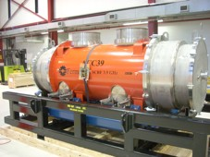
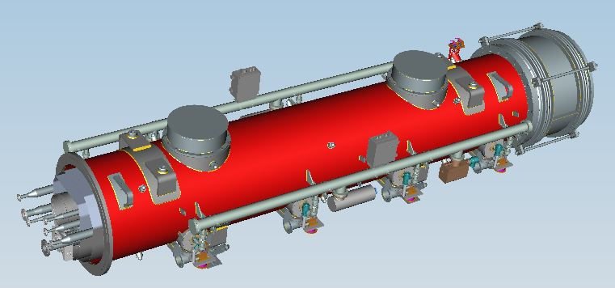
Previous 3.9 GHz cryomodules
4-cavity 3.9 GHz cryomodule designed and built
at Fermilab for FLASH at DESY, in operation.
Shown here on its shipping frame at Fermilab.
3.9 GHz cryomodule for XFEL design by INFN

Slide 43
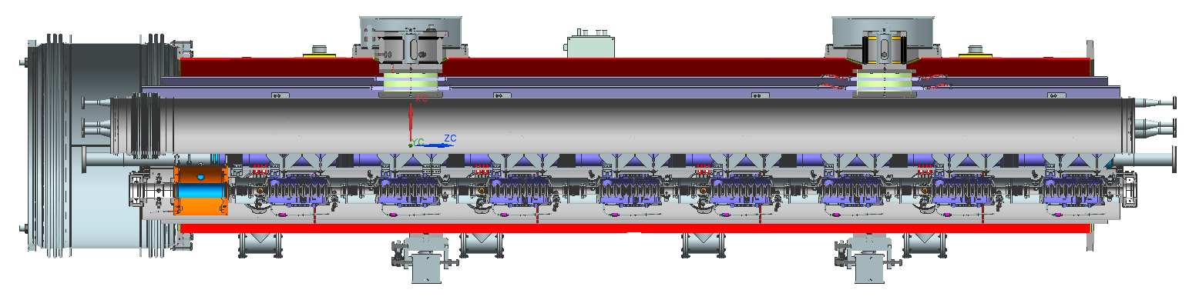
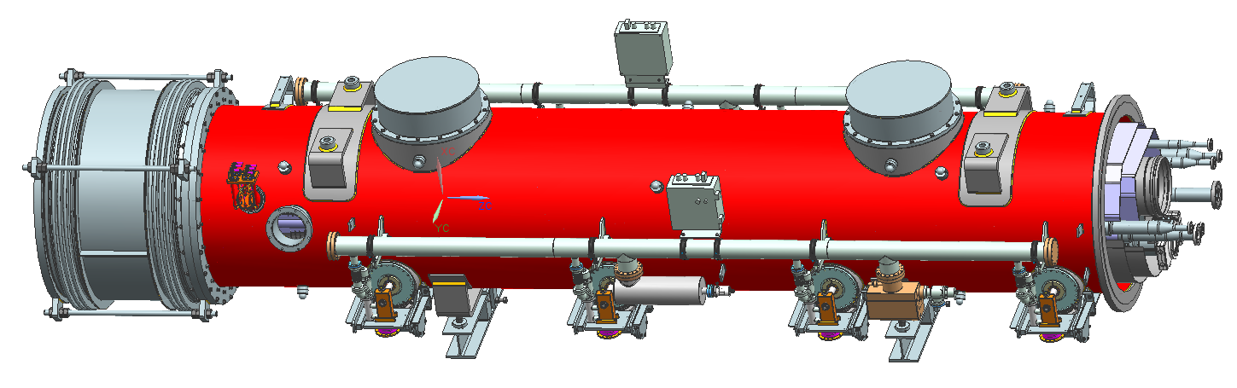
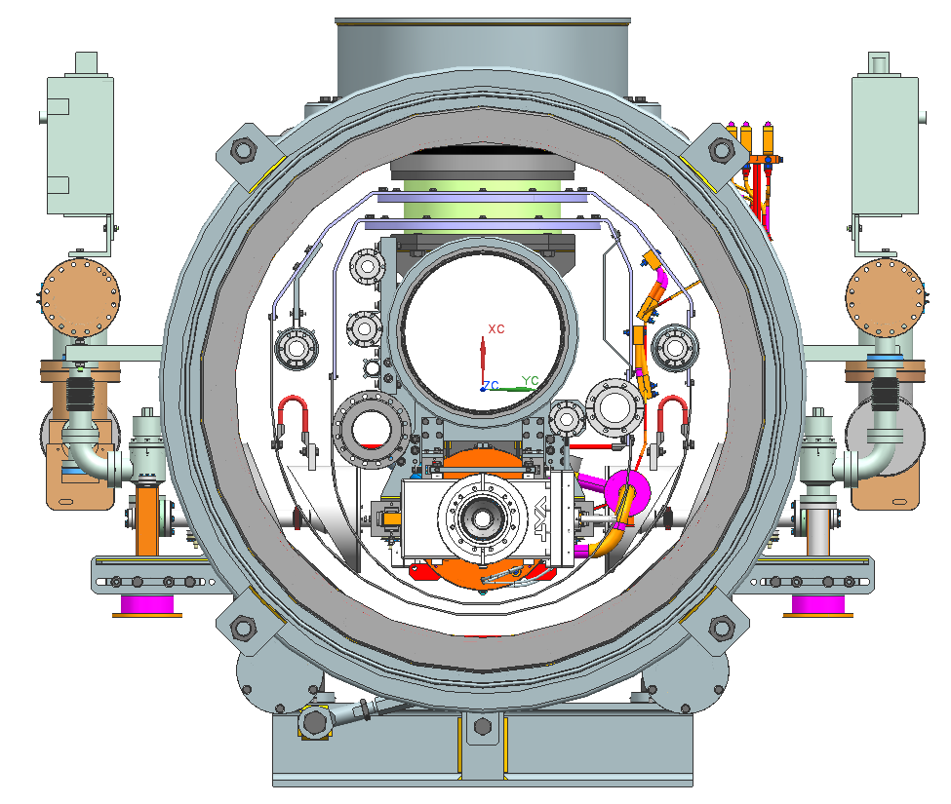
XFEL 3.9 GHz cryomodule
Magnets+BPMs
Interconnection Bellows
no space for sliding

Slide 44
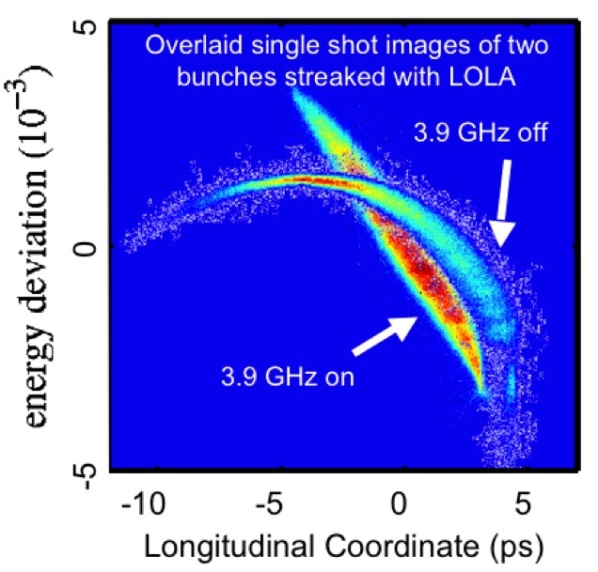
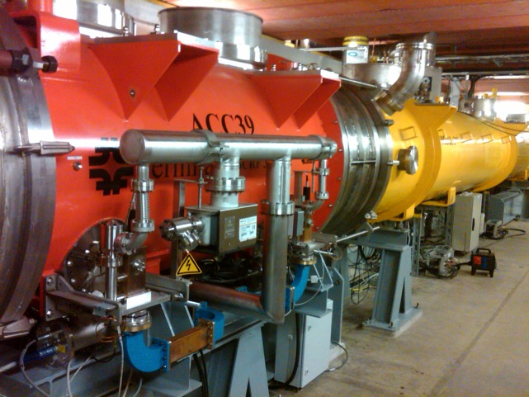
FLASH - ACC39 performance
ACC39 routinely operates at 18.9 to 19.7 MV/m
  Capable of operation at 22 MV/m
    Limitation set by thermal interlocks – concern about compromising HOM’s on cavities 3 & 5 (trimmed 2-post style)
Amplitude stability ≤ 2x10⁻⁵ pulse-to-pulse
Phase stability ≤ 0.003° pulse-to-pulse
44

Slide 45
High Q0 requirement drives some new design features
We assume Q0 = 2.7E10 in our design for 1.3 GHz
Magnetic shielding to keep < 5 mGauss
  New features necessary such as active external coils
High rate of cool-down looks necessary
  VTS results were best with much as 2 – 3 Kelvin/minute through 9.2 K transition temperature
  Key is high delta-T within Nb to “sweep out” magnetic flux
For fast cool-down, option to cool one cryomodule or a few cryomodules at a time
  Create a closed-ended warm-up/cool-down manifold (line H) for each cryomodule so as to provide a cool-down/warm-up valve on each cryomodule
  Design for 30 grams/sec of 5 Kelvin helium flow into cryomodule during cavity transition through 9.2 K
  Retain original plan for uniform cooling of bimetallic joints
  Note: closing line H has liquid helium management advantages, also

Slide 46
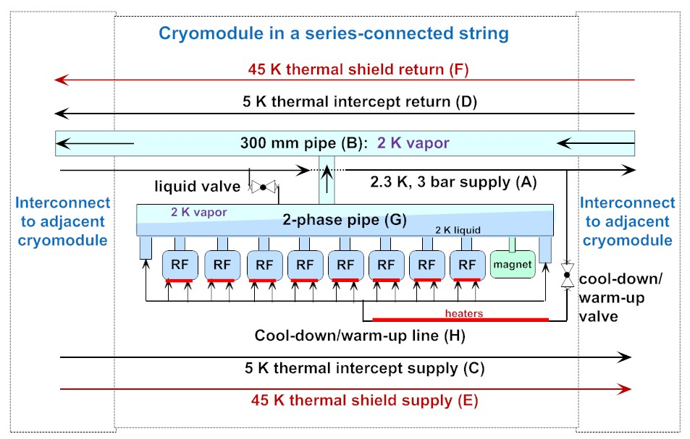
1.3 GHz cryomodule flow scheme
(3.9 GHz the same but without magnet and with single cool-down/warm-up input)

Slide 47
Liquid helium management
High heat loads (~80 Watts per cryomodule at 2.0 K)
0.5% tunnel slope downward in beam direction
We have followed careful design for liquid helium management
  The design keeps liquid helium out of the 300 mm HGRP
  Cavities are covered with liquid with plenty of allowance for liquid level control in the 2-phase pipe

Slide 49
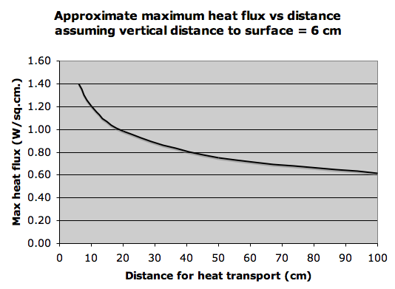
Helium II heat transport within the helium vessel

Slide 50
Cryomodule pipe pressures

Slide 51
Cryogenic plant capacity
(Cryo Plant Performance Sheet from Dana Arenius, August 5, 2014)
In liquefier mode (supplying 4.5 K, receiving back warm helium gas), 31 grams/sec is no problem.
  However, 4 cryomodules would require 4 x 31 = 124 gr/sec, about the limit of cryogenic plant production
  L3 has 20 cryomodules cooled in parallel
    31 grams/sec per cryomodule would not be available
  Need to focus cooling on a few cryomodules

Slide 52
Cool-down requirements
We must cool slowly from 300 K until most thermal contraction is complete (around 80 K). Cool-down rates (dT/dy and dT/dt) based on DESY measurements and analysis, in order to limit stresses on the support posts, must be limited in the Gas Return Pipe (HGRP)
  HGRP vertical gradient is < 15 K
  HGRP longitudinal gradient is < 50 K
  HGRP cool-down rate is 10 K/hr
  Cooling from room temperature to nominally 80 K takes about 2 days
May start fast cool-down at 80 K or colder
  “Fast” means 2 – 3 K/minute (“slow” < 0.5 K/minute) (reference: Anna Grassellino’s presentations)
  Since thermal shield is ~35 K – 55 K, we assume 40 K delta-T at 3 K/minute, which implies 13 minutes for transition from thermal shield temperature to below the niobium 9.2 K critical temperature

Slide 53
Conclusion for cool-down concept
Implementation . . .
  Isolate Line H (cool-down / warm-up line) for each cryomodule and provide each cryomodule with its own cool-down valve, supplied from Line A (helium supply)
  We are looking at other options for cooling more cryomodules, as much as an entire half-linac, at once using stored liquid and/or taking advantage of the relatively larger volumetric flow of cold vapor
Required cool-down rate can be provided with our design
  “Fast” cool-down comparable to single cavity tests can be provided in a cryomodule
  Cryogenic plant can provide the flow for a few cryomodules at a time
  Capillary tubes and other pipes can carry the flow
  Note that line H (cool-down / warm-up line) exists only in the cryomodules and is eliminated from the distribution system.

Slide 54
Support post (same as 1.3 GHz)

Slide 55
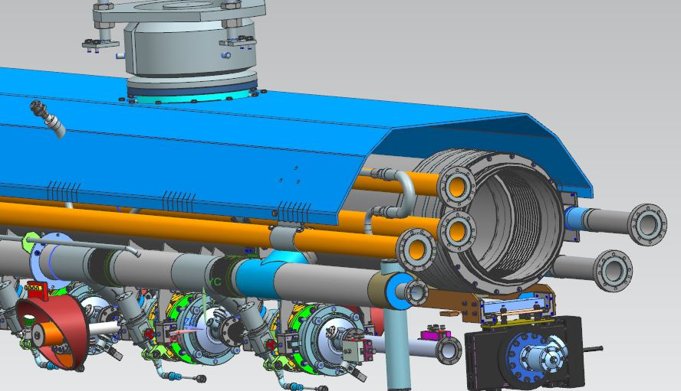
Upstream end piping and gate valve hanger assembly

Slide 56
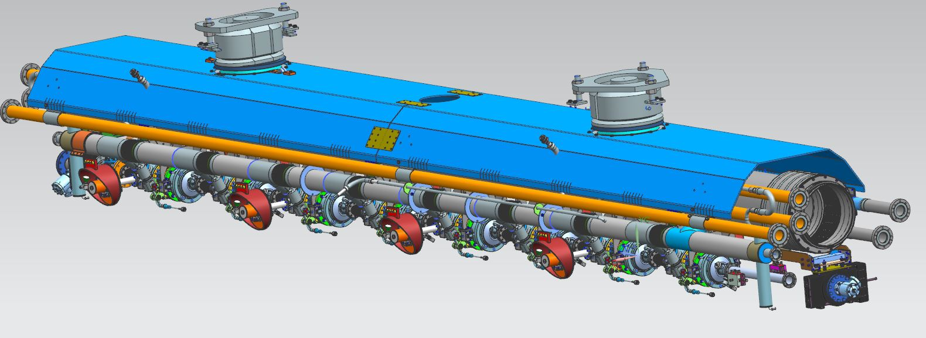
Cold mass assembly, lower thermal shield section removed

Slide 57
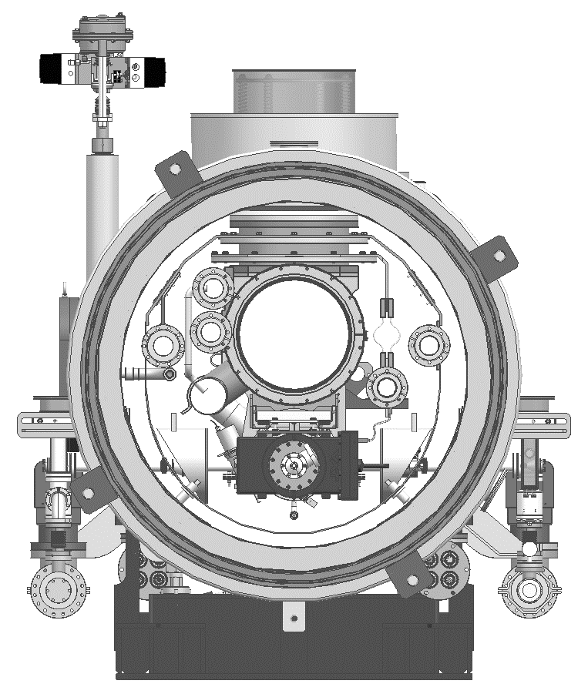
Three vacuum spaces
Insulating Vacuum
Beamline Vacuum
Warm coupler Vacuum

Slide 58
Alignment (identical to 1.3 GHz methods)
Alignment design and procedures based on
  TESLA Test Facility experience at DESY
  CM1, CM2, and FLASH 3.9 GHz cryomodule experience at Fermilab
  Jlab experience for CEBAF and SNS
  Recent XFEL procedures
An LCLS-II workshop on alignment with SLAC, Jlab and Fermilab participation was held in May, 2015
Alignment features include
  External fiducials referenced to cavity string
  Thermal contraction allowance
  2-phase pipe closure, compensation for pressure loads
  Post-shipment survey mark

Slide 59
LCLS-II cryomodule cryogenic circuits
Circuit lines, 1.3 GHz shown
2.4 K subcooled supply
Helium gas return pipe (HGRP)
Low temperature intercept supply
Low temperature intercept return
High temperature shield supply
High temperature shield return
2-phase pipe
Warm-up/cool-down line
Operating Parameters | A | B | C | D | E | F | G | H
Pressure, [bar] | 3 | 0.031 | 3.2 | 2.5 | 3.7 | 2.7 | 0.031 | 3
Temperature, K | 2.4 | 2.0 | 5.5 | 8.0* | 35 | 55 | 2.0 | 2.0
*Line D returns 1.3 bar, 7.5 K to cryogenic plant after expansion valve

Slide 60
Most recent estimate of heat loads
From LCLScryoHeat-23Feb2016.xlsx
Summary document is Cryogenic Heat Load, LCLSII-4.5-EN-0179

