Slide 1
3.9 GHz Cryomodule Schedule
Camille Ginsburg and Genfa Wu
2016-05-26

Slide 2
Outline
Work Flow and Schedule Outlook
Design Verification Status
Procurement Status
Risks and Learn Other’s Lessons
Summary

Slide 3
3.9 GHz CM Work Flow
Engineering Design
Final Design Review
Procurement
Design Verification
Fabrication and Testing

Slide 4
3.9 GHz Engineering Design – ESD and FDR
Engineering Specification Document will be released four months ahead of the FDR
  Mature engineering design leads to the release of ESD for high level RF, vacuum, infrastructure integration (Sep 2016)
  Continue the integration engineering, support the design verification and early procurement (Jan 2017)
  Complete the FDR and address review comments (Feb 2017)
  Release the drawing packages for remaining components in support of production procurement. (March 2017)

Slide 5
3.9 GHz CM Design Verification Goals
Verify dressed cavity performance exceeds the specification
  2.0e9@13.4 MV/m ( 1.5e9@14.9 MV/m )
Measure and insure the helium vessel heat load capacity meets the specification (36 W)
Coupler CW operation at 2 kW
HOM coupler CW operation
Cavity resonance control within 5 Hz, microphonics < 30 Hz.
Magnetic shield design to achieve cavity Q0.
  Integration with helium vessel
Two integrated horizontal tests are planned for design verification.
Notes:
24 W maximum from cavity

Slide 6
3.9 GHz CM Design Verification and Production Relationship
Most components are drawn from production stock
Cavity prototypes take an earlier delivery of the first two production lots
Magnetic shield prototypes are separate from the production
 | Design Verification | Remain in Production | Notes
Bare Cavity | 4 | 16 | 2 spare cavities
Dressed Cavity | 2 | 16
Tuner | 1 | 15
Power coupler | 3 | 15
HOM Feedthrough | 5 | 51 | Includes unit of spare cryomodule
Field probe | 6 | 22 | Includes unit of spare cryomodule
Magnetic shield | 2 | 16

Slide 7
3.9 GHz CM Schedule Overview
The first horizontal integrated test leads to the Final Design Review
Engineering Specification Document has interface information before FDR

Slide 8
3.9 GHz CM Schedule Overview

Slide 9
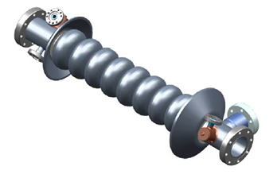
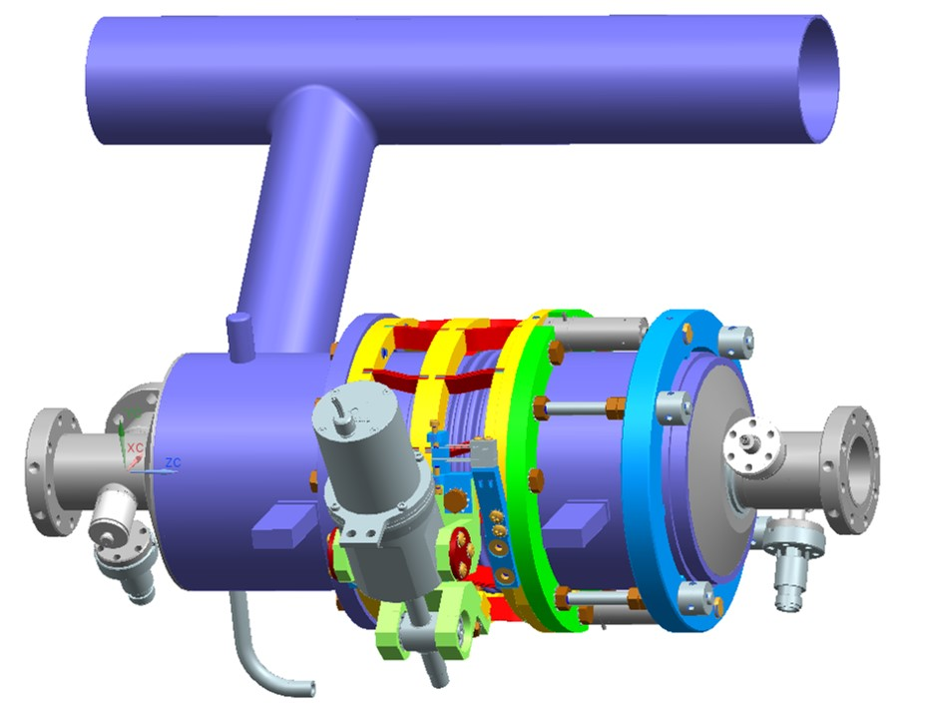
3.9 GHz CM Design Verification Status - Cavities
Four Bare Cavities ordered.
  Delivery is expected in September
Early cavity development to minimize the technical risk
  Bare cavity processing development is supported by Fermilab R&D
  Cavity loan from INFN-Lasa
Dressed cavity will be procured in November

Slide 10
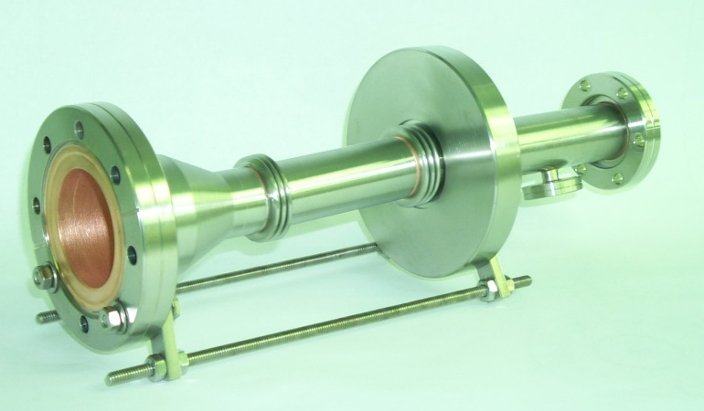
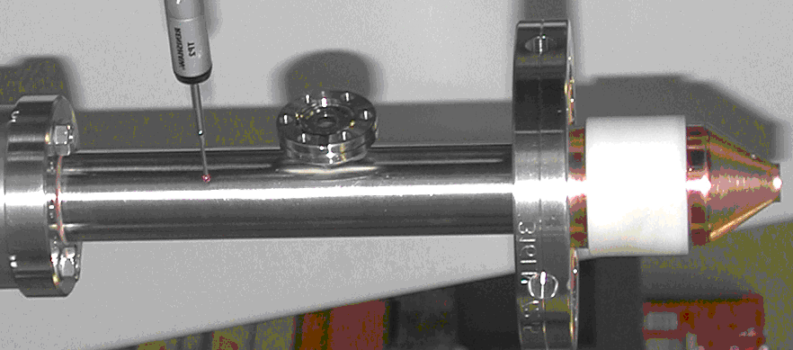
3.9 GHz CM Design Verification Status - Couplers
Three existing couplers were transferred from Fermilab stock to LCLS-2 with antenna modification
  Modified coupler delivery is expected in September

Slide 11
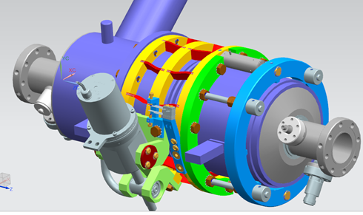
3.9 GHz CM Design Verification Status – Tuner/Piezo
One blade tuner was ordered
  Delivery is expected in June
  Mockup dressed cavity received
  Using piezo and stepper motor from 1.3 GHz stock

Slide 12
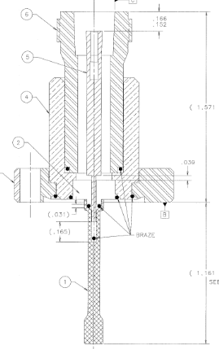
3.9 GHz CM Design Verification Status – HOM/FP
Production units are all ordered
  Delivery is expected in August

Slide 13
3.9 GHz CM Procurements
Tuner stepper motor awarded
Tuner piezo stacks awarded
HOM/FP awarded
Instrumentation will start procurement in July
Cold mass upper assembly will start procurement in October due to long lead time
All other components will start procurement after FDR is completed
  Dressed cavity procurement follows the 1.3 GHz cavity strategy

Slide 14
3.9 GHz Infrastructure
VTS bare cavity test RF system is in place.
VTS dressed cavity tooling will be designed
HTS
  tooling/fixtures are in storage
  3.9 GHz CW klystron work is in progress

Slide 15
3.9 GHz Cryomodule Risks
Technical risks – resolve during design verification
  Coupler
  Tuner
  Helium vessel
Schedule risks
  Bare cavity delivery
  Cavity prep and test in parallel with other activities (1.3 GHz LCLS-2, PIP-2, SRF R&D)
  HTS tests in parallel with other activities (PIP-2, 1.3 GHz HTS)
Using loaned cavities
Request early partial delivery of cavities
Dress a cavity as soon as it meets specification

Slide 16
Lessons Learned
Incorporate the vast knowledge from 1.3 GHz cryomodule design
Follow the better procurement strategy
Better alignment of engineering design and design verification work flow
Collaborate with DESY and INFN-LASA staff to incorporate the lessons learned from XFEL

Slide 17
Summary
3.9 GHz engineering design is in good progress.
3.9 GHz design verification started.
  Bare cavity delivery is driving the schedule.
3.9 GHz procurement has started.
  Low risk components are awarded or planned ahead of the final design review
  Remaining components are planned after final design review

