Slide 1
3.9 GHz components design
Speaker:
Nikolay Solyak (from behalf of LCLS-II design team)
3.9GHz Review, FNAL, May. 26, 2016

Slide 2
Outline
3.9 GHz system functionality
Requirements
Cavity design modification
HOM design
Coupler design
Heating issues
Frequency Tuner
BPM; Gate-valve; HOM absorber.
Conclusion

Slide 3
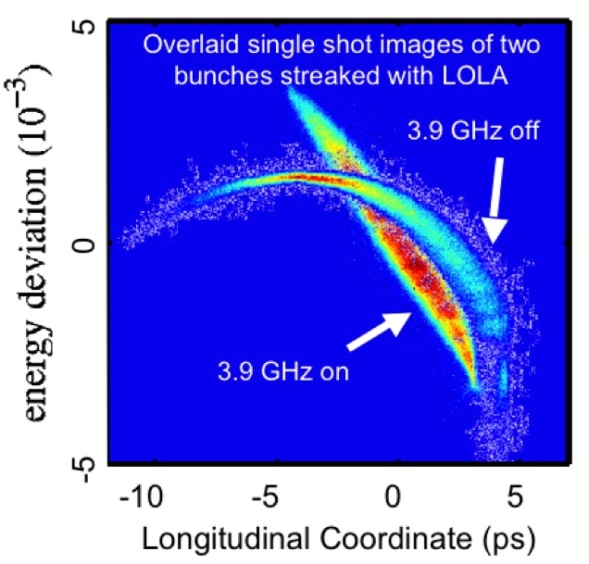
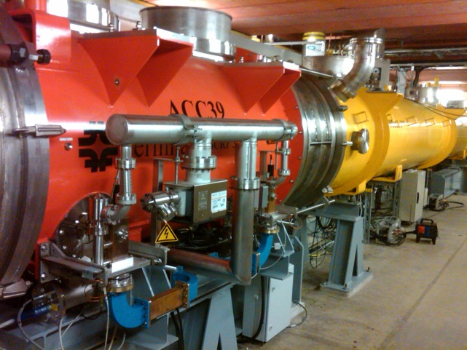
FLASH and XFEL - ACC39 performance
ACC39 routinely operates at 18.9 to 19.7 MV/m
  Capable of operation at 22 MV/m
    - Limitation set by thermal interlocks – concern about compromising HOM’s on cavities 3 & 5 (trimmed 2-post style)
Amplitude stability ≤ 2x10⁻⁵ pulse-to-pulse
Phase stability ≤ 0.003° pulse-to-pulse
3

Slide 4
LCLS-II
36MV/CM

Slide 5
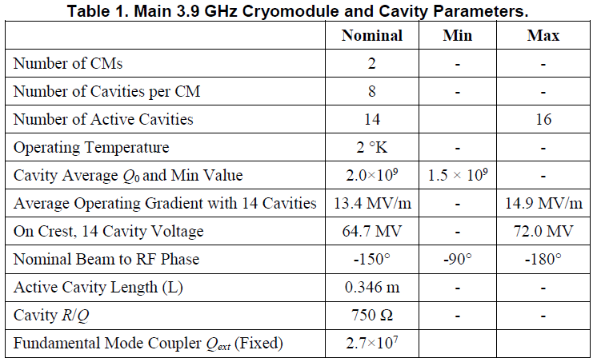
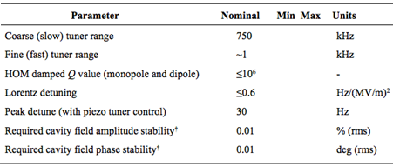
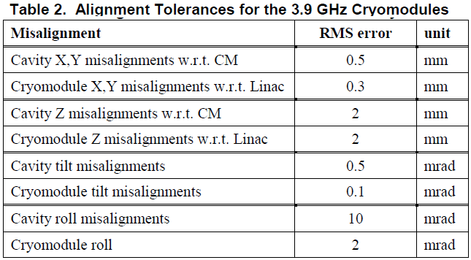
LCLS-II reqs.(PRD and FRD)
LCLSII-4.1-PR-0097-R2
Table 3. Tuning/stability requirements
Two CMs; 8 cavity / each
9 Cu plated bellows
Coupler orientation as per XFEL
~150 W heat load/cryomodule (2K)
BPM at downstream end (1.3GHz type)
No magnet

Slide 6
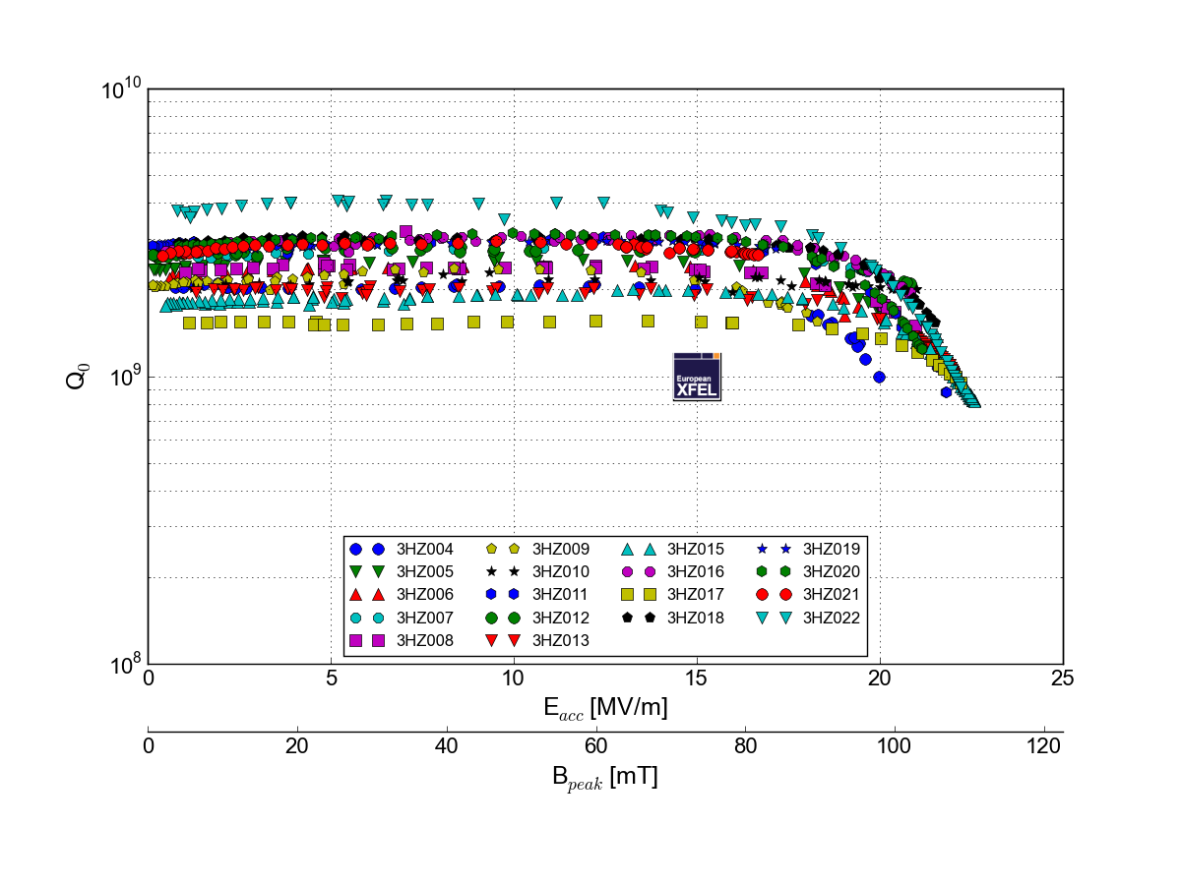
Cavity gradient and Q0 requirements
(recent data from XFEL cavity production)
P.Perini, INFN
Recent XFEL production cavities (INFN-Zenon);
At 2K the all cavities have Qo in range ~(2-3)·10⁹ (except 2)
No field slope up-to ~17 MV/m; Quench at 20-23 MV/m, VTS
No Q degradation after welding to HV
Risk: LCLS-II cavity (cw) requirements more stringent than XFEL (pulse) !!!
➔ Require Prototyping and Testing

Slide 7
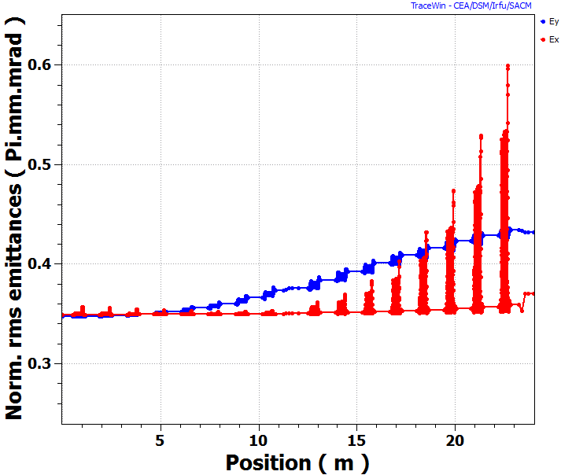
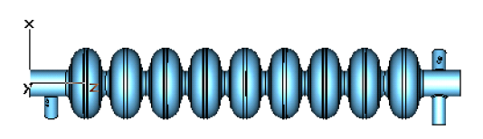
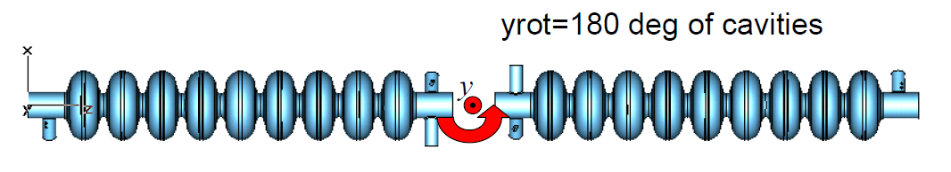
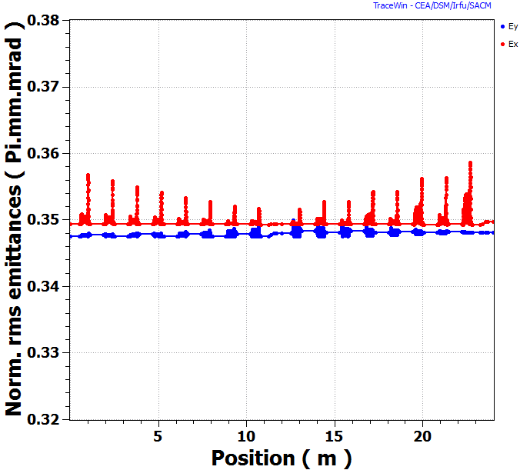
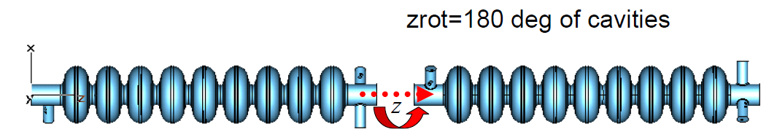
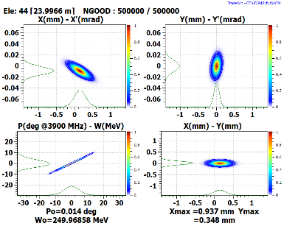
Effect of large field asymmetry and cavity orientation
Δε_{x} (%) ~ 6.0 %
ε_{y}
3.9 GHz Cryomodule Options
Δε_{y} (%) ~ 24.0 %
ε_{x}
1.3GHz like Cryomodule Layout:
FLASH-like Cryomodule Layout:
XFEL/LCLS2 Cryomodule Layout
 | 1.3GHz-like | XFEL
Δε_{x} (%) | 6 .0 | 0.09
Δε_{y} (%) | 24.4 | 0.15
Emittance growth in 3.9 GHz system

Slide 8
Cavity/coupler design issues and proposed modifications for LCLS-II CW operation
Cavity, bellows and Helium vessel
HOM coupler
Power Coupler
Blade-Tuner with piezo

Slide 9
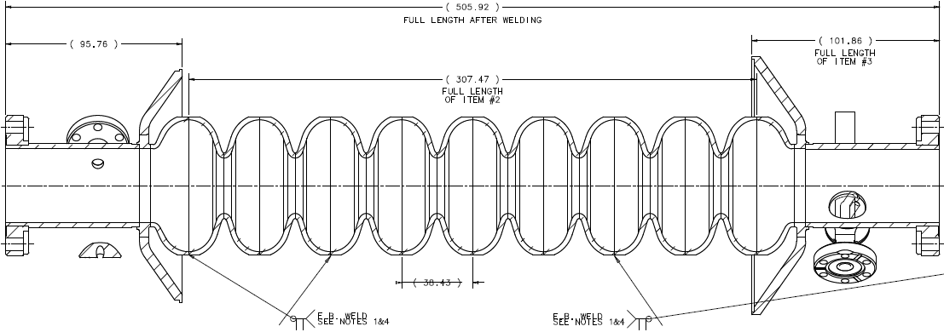
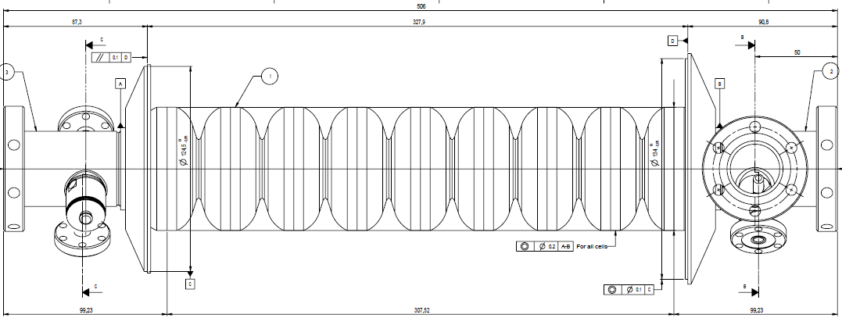
Cavity drawings: FLASH → XFEL → LCLS-II
FNAL/FLASH design
INFN/Zenon
modification
(starting point for LCLS2)
LCLS-II:
Additional modifications to meet requirements.

Slide 10
LCLS-II 3.9 GHz cavity design
INFN = modified FNAL design of the cavity for XFEL project. Modifications are done to simplify/improve production (Zenon) and tuning. Drawings and 3D models are available (thanks INFN team)
CW operation in LCLS-II is more severe regime for the cavity. Some minor modifications are needed to reduce risks and eliminate tuning and heating problems.
Proposed modifications in cavity RF design.
Issue #1: Frequency of lowest dipole mode trapped in coupler end of the cavity is too close to operating mode frequency, 3.9 GHz. As a result the tuning of notch frequency is difficult and 3.9 GHz frequency power leak is significant.
    Solution: Move away frequency of this mode
    Modification: Reduce beam pipe and bellow diameter from 40 to 38mm.
Issue #2 : Overheating of the HOM antenna (quench ~20MV/m at cw/VTS)
  Modification: Increase length of bump
Issue: Heating of bellow between cavities
  Modification: reduce bellow ID from 42 to 38mm

Slide 11
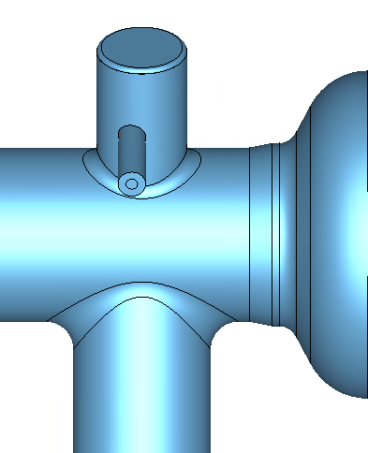
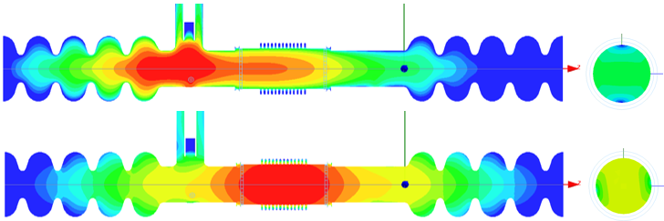
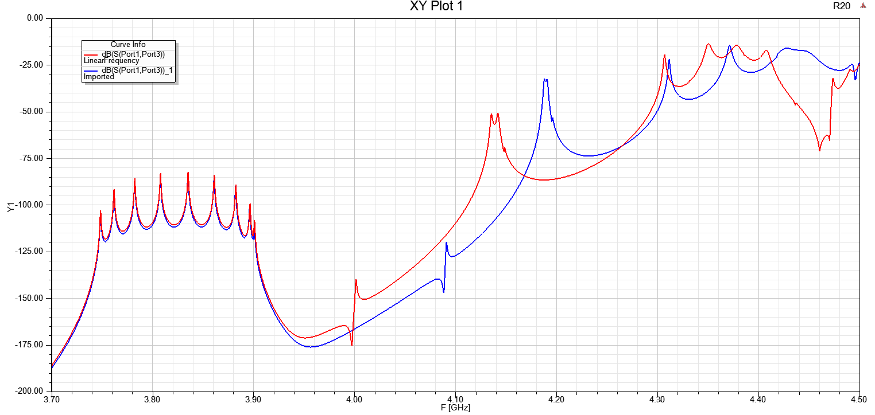
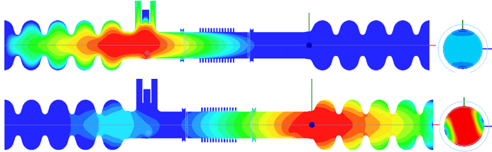
Reduce beam pipe diameter from 40mm to 38mm.
No modification of cavity cells.
Add small conical transition between beam pipe and end cell.
8.35mm
FLASH: Lowest Dipole HOMs. Beam Pipe Ø 40 mm and Bellows Ø 42 mm.
F = 3.992 GHz, Q_{E} = 3.6e4
Ø38 mm
F = 4.047 GHz, Q_{E} = 8.0e4
  A. Lunin/T.Khabiboulline
LCLS2: Lowest Dipole HOMs. Beam Pipe Ø 38 mm and Bellows Ø 38 mm.
F = 4.092 GHz, Q_{E} = 2.7e4
F = 4.188 GHz, Q_{E} = 7.4e3
In current design lowest mode is closer (min ~10-20 MHz vs. 100MHz in simul.) to operat. mode
Lowest dipole mode frequency shifted by 100 MHz up away from operating mode frequency.

Slide 12
Modification of HOM coupler
Reduce penetration of antenna inside HOM to reduce heating → F-part modification
Increase wall thickness on the top of HOM can to prevent cracks and vacuum leak
To modify length of HOM feedthrough
(choice of feedthrough design: Fermilab vs. XFEL)

Slide 13
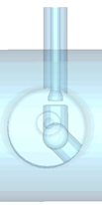
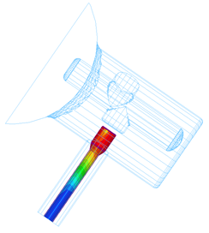
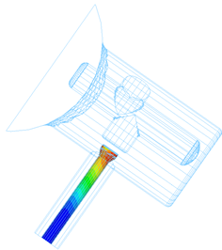
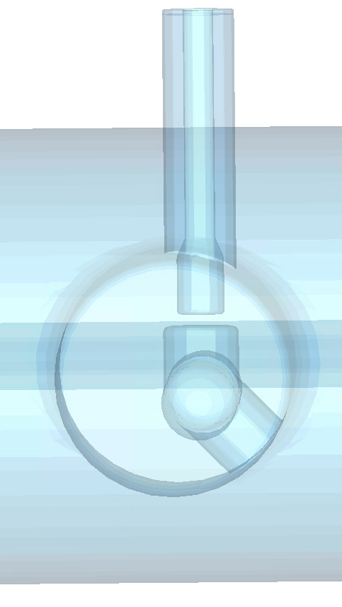
HOM F-part modification to reduce antenna heating
Reduce penetration to beam pipe. Increase length of bump in F-part
Current design
Modified design
7.8mm
5.8mm
G = 3.2e8 Ω
G = 1.74e9 Ω
  A. Lunin/khabiboulline
  Current design HOM antenna quenches at ~20 MV/m in VTS. Expected that quench limit will even lower in CW regime at HTS and CM.
RF power dissipation on HOM antenna reduced by factor of 5.4 after modification

Slide 14
HOMs Resonant Losses in the 3.9GHz LCLS-II cavity (run #1)

Slide 15
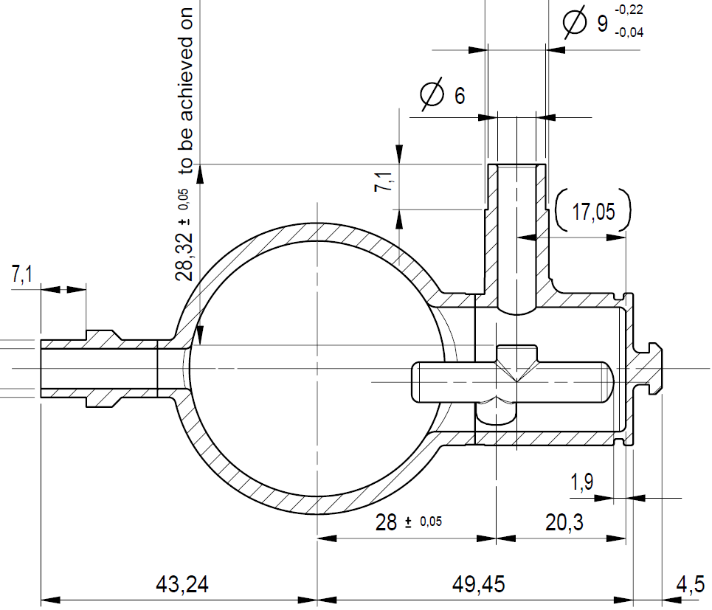
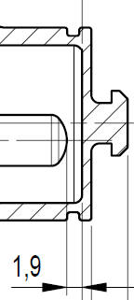
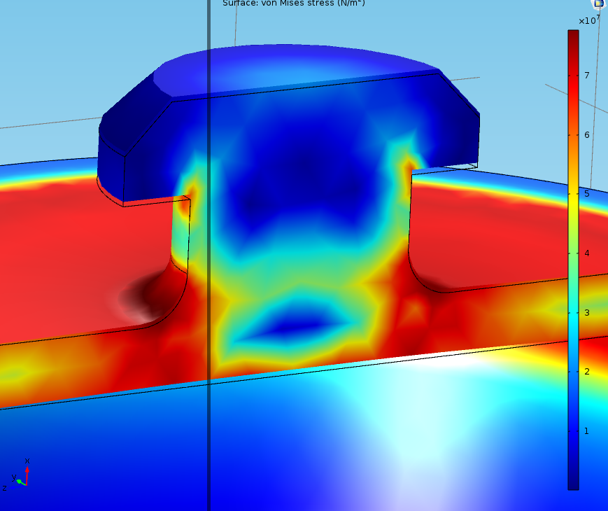
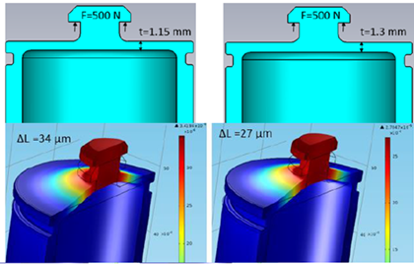
HOM can thickness increase from 1.0 mm to 1.3 mm.
  Thickness of hat is a concern:
  Was broken when h=1mm (FLASH).
  XFEL design has thickness of 1.15 mm → one prototype cavity has a leak.
  Proposal to have 1.3mm.
Knob pulled up by 0.1 mm
1.3mm
Wall=1.3 mm
Conclusion: 1.3mm is acceptable thickness of can wall

Slide 16
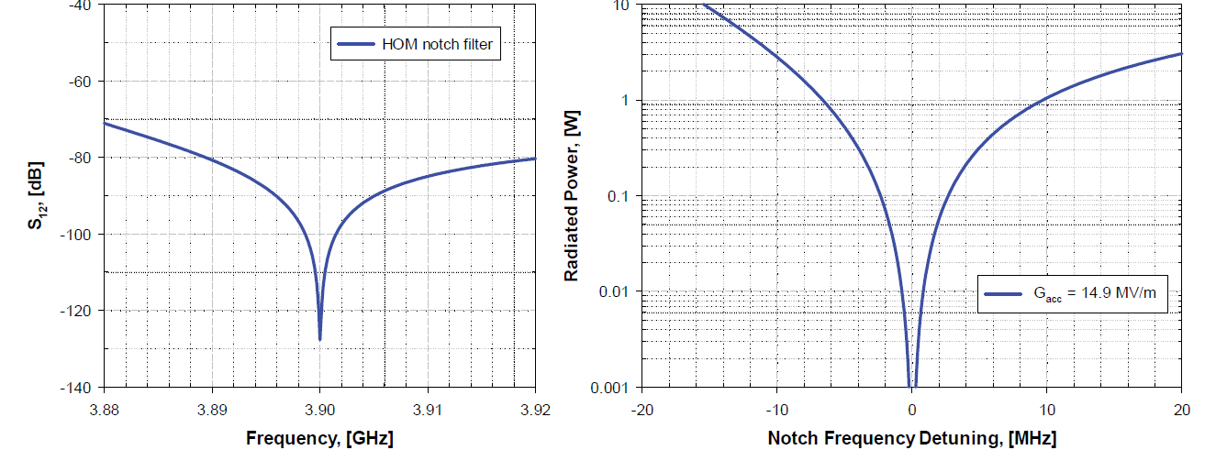
Notch filter tuning requirements
Tuning accuracy ±2MHz ➔ P < 0.1 W
Passband of the 3.9 GHz notch filter (left) and corresponding power radiated through HOM coupler at nominal accelerating gradient (right)
For 1.3 GHz HOM accuracy for notch filter frequency ~0.5MHz

Slide 17
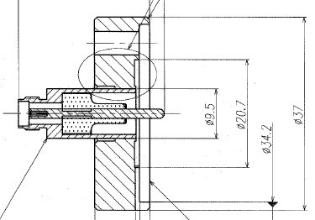
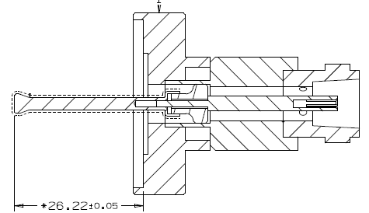
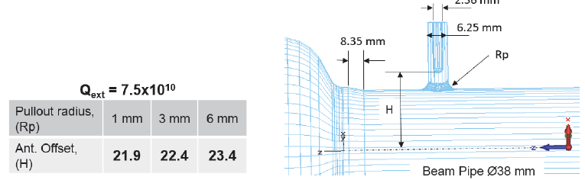
HOM and pick-up feedthrough:
XFEL design (used for 1.3GHz and 3.9 GHz)
Field probe for 3.9 GHz (modified 1.3GHz design)
Antennaa are modified for 3.9 GHz
All feedthroughs are ordered in Kyocera for 24 cavities

Slide 18
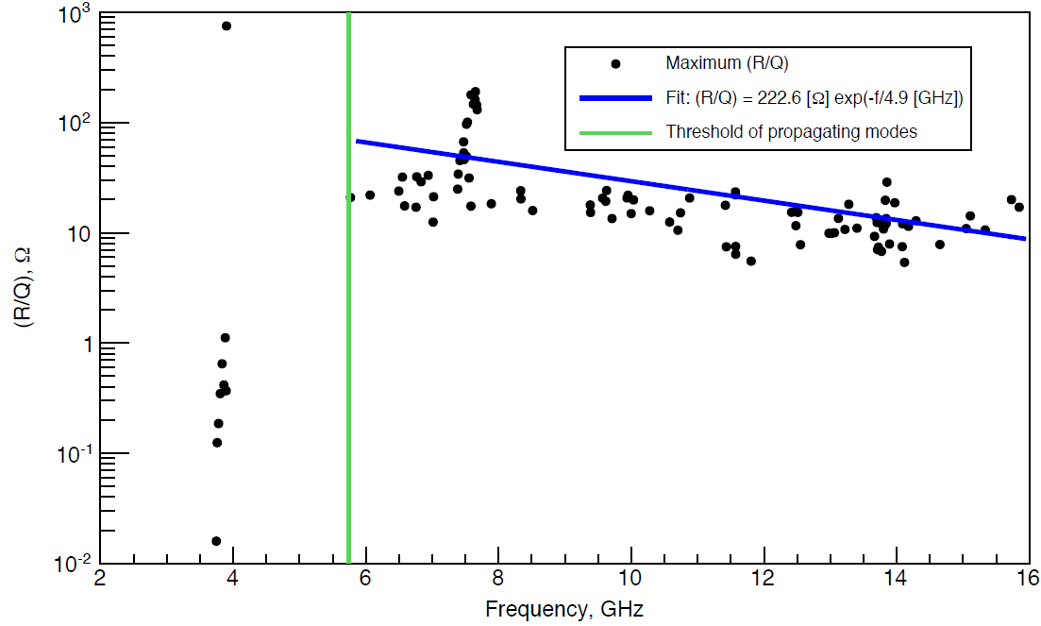
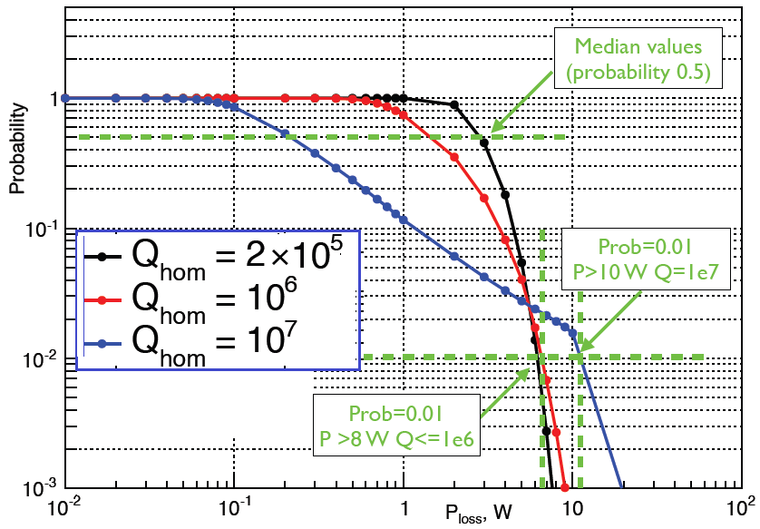
3.9 GHz: Power removed by HOM coupler
A. Sukhanov
R/Q of monopole modes in cavity chain
Simulation model includes copper plated bellows between cavities
HOM frequencies have random distribution ~ 1MHz rms
Max values of R/Q for each mode is used (vs. cavity to cavity distance) – overest.
Q_{HOM} < 10⁶ for most dangerous modes (Pmax < 7W, prob. 10⁻² per 2 HOMs)

Slide 19
HOM antenna heating issues
Maximum power flux to HOM coupler up to 4W:
< 0.5 W – leakage from operating mode
Max power flux to 2K is 0.1W (from power dissipated in cable)
Part of this will be dissipated in cable (0.6dB/m) and will heat HOM antenna.
Heat removal from feedthrough (2K) and from the cable intercepts (5K and 50K) is essential part of design.
Choice of cable and specs is part of current activity. Use the same cables as in 1.3GHz CM, but ~1m shorter.

Slide 20
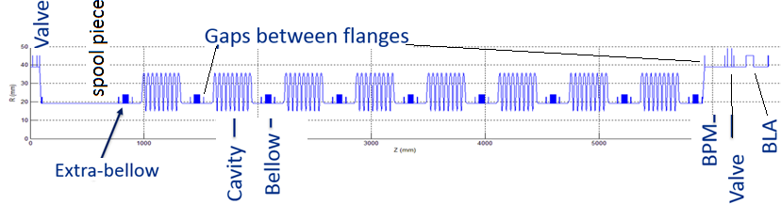
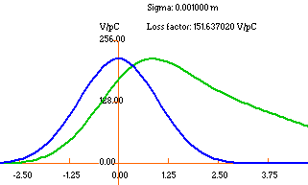
Beamline components heating: wakes
Bunch length (sigma) | 1mm
8x (Cavities + bellow) | 135.5 V/pC
CM (8cav/9bellow/gaps) | 151.64 V/pC
Components in 2 CM’s | Power Deposition, [W]
 | A (baseline) |  | B
 | No HOM, PC | HOM PC | HOM PC
BLA (1 or 2) | 16.2 | 13.5 | 10.5
SS tube 2.5m | 1.65 | 1.4 | 2.2
Bellows (17) | 0.36 | 0.3 | 0.4
Gate Valve (4) | 0.6 | 0.45 | 0.7
Spool (2) | 0.02 | 0.02 | 0.03
HOMC (32) | 0 | 0.5 | 0.75
FPC (16) | 0 | 2.7 | 4.1
Wake power (300µA; σ=1mm) is 13.65 W per CM, and only 9.5 W above beam pipe cut-off frequency
A
CM11
BLA
CM2
BLA
SS Beam Pipe (L=2.5m)
B
CM1
BLA
CM2
SS Beam Pipe (L=2.5m)
Total power in 2 CMs ~19 W

Slide 21
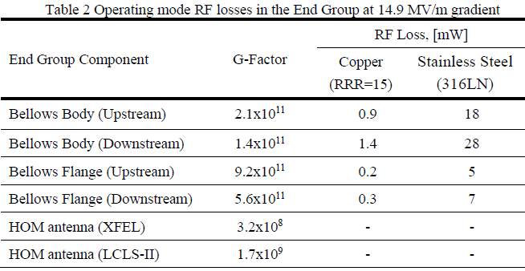
Heating of bellows from operating mode RF

Slide 22
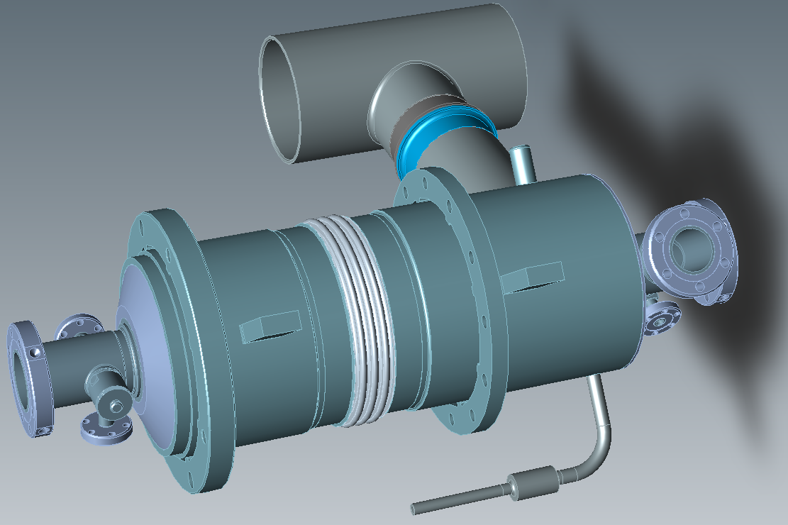
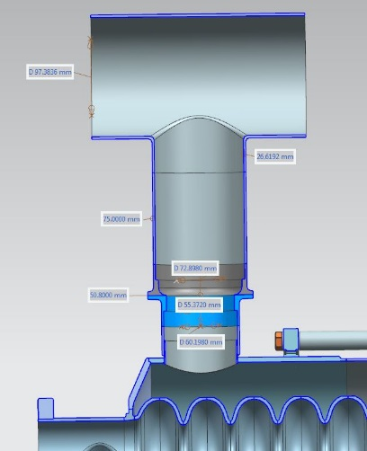
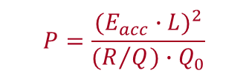
Chimney Power Limit
$$P=\frac{{(E_{acc}∙L)}^{2}}{(R/{Q)∙Q_{0}}}$$
- Cryoload at 2K
 | Nominal parameters | Max in CM | Max power (VTS/HTS)
E_{acc} (MV/m) | 13.4 | 14.9 | 16.4 (+10%)
Q0 | 2.e9 | 2.e9 | 1.5e9
P/cav (W) | 14.3 | 17.7 | 28.6
LCLS2-1.3 GHz
LCLS2-3.9 GHz
Avrg power per cavity in CM
Max power in individual cavity
Chimney the heat load limit is at least 30 W (ID= 60.2 mm (short) → 73mm (long part))

Slide 23
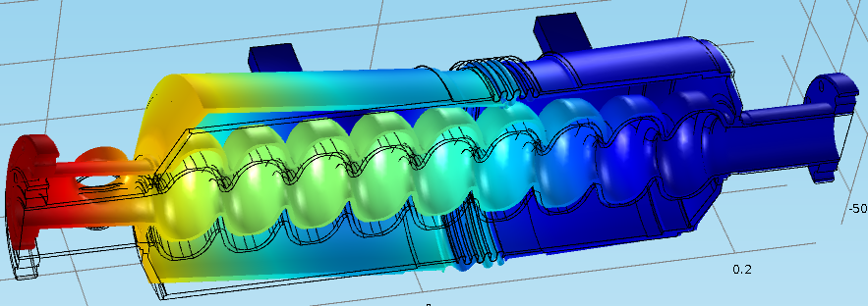
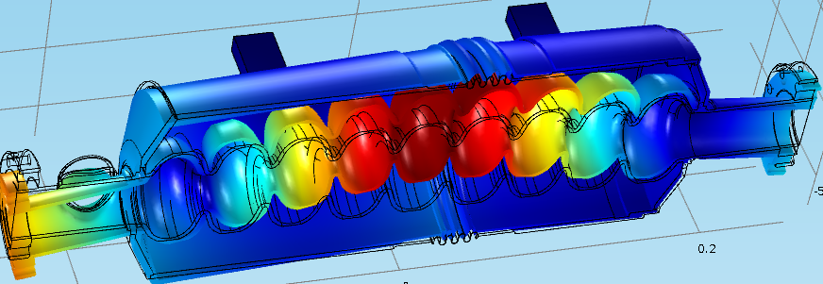
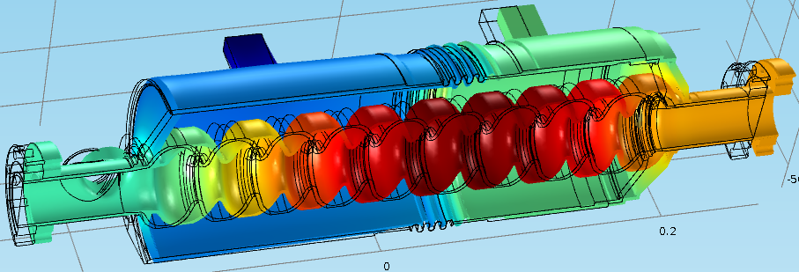
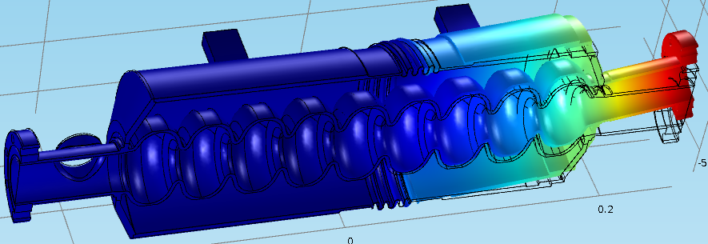
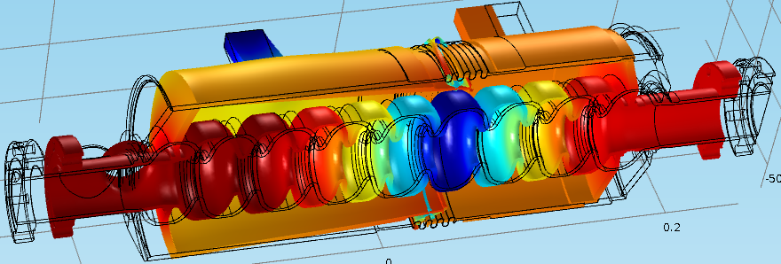
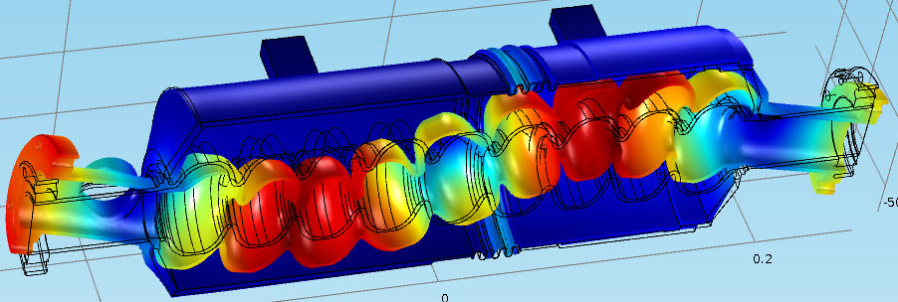
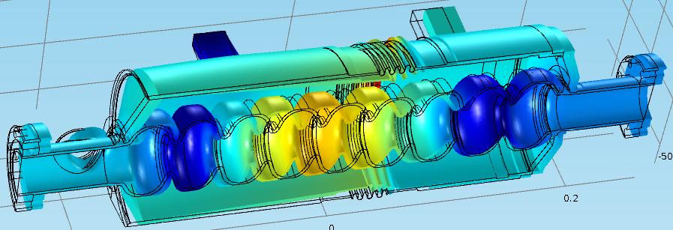
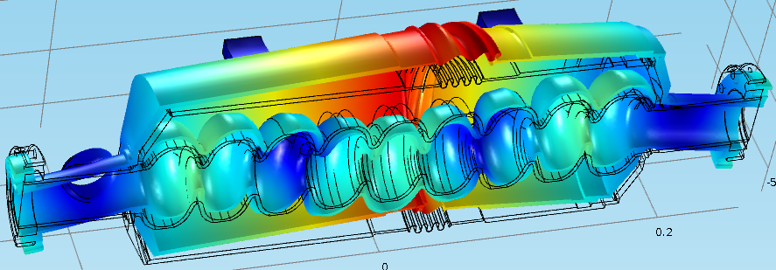
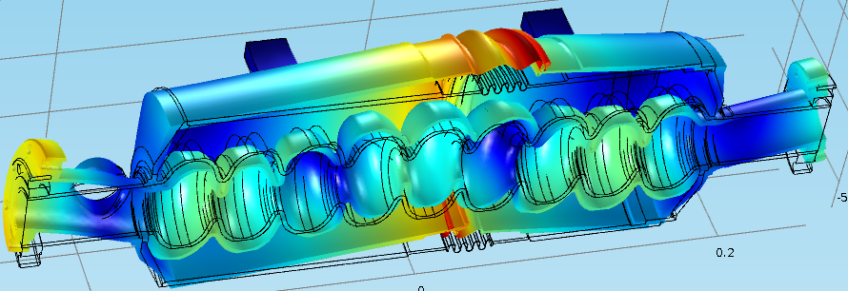
Cavity Mechanical Resonances
(Stiffness of the Tuner = 40 kN/mm)
Transverse modes
218.9 Hz
Longitudinal modes
Frequencies (Hz) of Longitudinal modes L#1-L#3 vs. Stiffness of the Tuner (kN/mm)
T#1
506.2 Hz
231.7 Hz
T#2
L#1
370.8 Hz
k=0.75 Hz/µm
785.1 Hz
T#3
526.1 Hz
L#2
k=4.75 Hz/µm
1076.4 Hz
T#4
719.7 Hz
L#3
k=0.75 Hz/µm
T#5
865.7 Hz
  I. Gonin
T#6

Slide 24
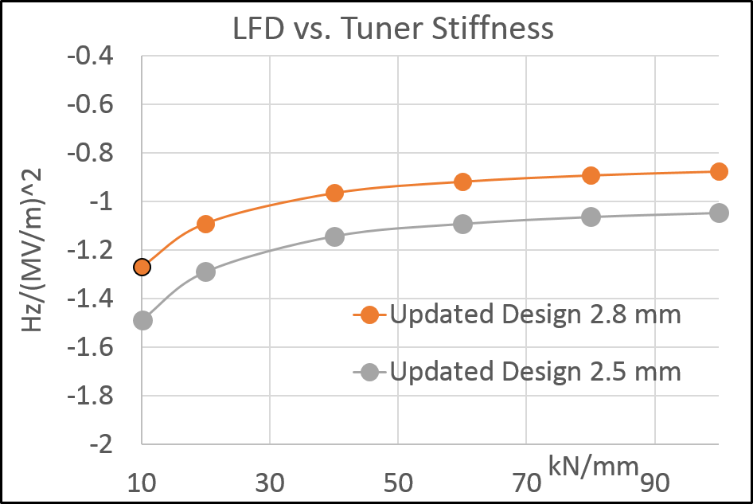
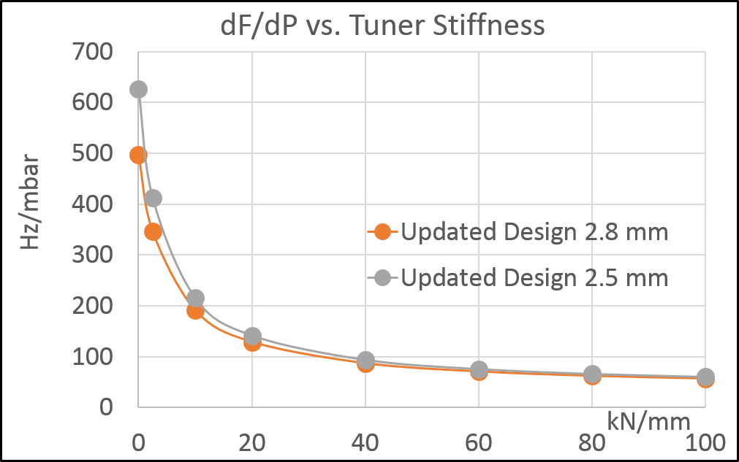
Dressed Cavity LFD and dF/dP
  I. Gonin

Slide 25
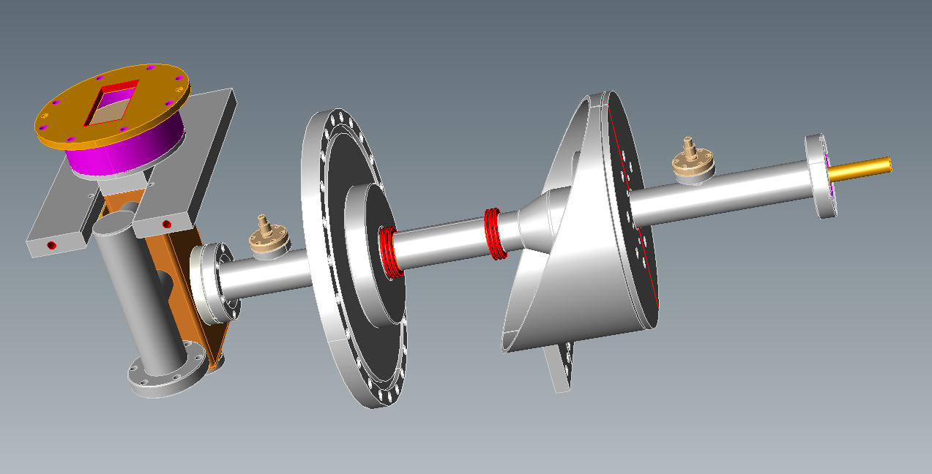



Modification of 3.9 GHz power coupler for LCLS-II CW operation
Original FNAL design (FLASH & EXFEL)
Cold part
Warm outer part
Warm inner part and WG
Coupler was designed for pulse operation (P=50kW, DF=2%).
LCLS-II requirements: P_{max}=2kW cw; quasi – TW regime:
    W/o modification inner conductor of warm part will be overheated up to 1000 K.
Proposed modifications:
    Shorter antenna (QL~2.7e7 vs. 1.5e6)
    Increase thickness of copper plating on inner conductor from 30 µm to 120 µm
    Reduce length of 2 inner bellows in inner conductor from 20 to 15 convolutions.
    Increase thickness of ceramics in cold window to move parasitic mode away.

Slide 26


Coupler THERMAL ANALYSIS
For solving the inner conductor overheating problem we propose to reduce the length of two inner bellows from 20 to 15 convolutions and to increase the thickness of a copper plating on the inner conductor from 30 to 120 microns.
Losses (W) at 5K and 50K
SS Inner Conductor | T_{max} K | Losses@50K | Losses@5K
30 µm plating | 1000 | 9.2 | 0.8
100 µm plating | 507 | 9.3 | 0.8
150 µm plating | 427 | 9.4 | 0.8
Temperature, K
Cu plating thickness, µm
Assumptions
Pin=2kW TW,
10μm on outer,
RRR=50; ASE,
10% roughness
ε=9.8, tan=3e-4,
T=320K
T=150K

Slide 27

Main coupler antenna configuration
Beam Pipe Ø40 mm
Beam PipeØ38 mm
  A. Lunin
Nominal power coupler antenna positions in the 3.9 GHz cavity for XFEL (left) and LCLS-II (right);
QL=2.5e7

Slide 28




Trapped modes in cold ceramic window
Trapped mode resonances measured in the 3rd harmonic power coupler (shift -20MHz). Transmission losses more than 3 dB, bandwidth ~ 0.5 MHz.
Two nearest trapped modes in the coupler ceramic window (simulations)
The inner and outer diameters of ceramic changed symmetrically by 0.25 mm each, which shifts down by 33 MHz the frequency of nearest parasitic mode and, thus, secures of ~50 MHz isolation from the operating mode. (sensitivity of parasitic mode frequencies vs. ceramic radius is ±65.6 MHz/mm)
Set-up for ceramic measurement.
ε=9.71; tanδ=3.6E-4 (averaged over 5 modes)

Slide 29



Coupler MECHANICAL DESIGN
COMSOL solid model and mechanical boundary conditions.
Solid model of 15 convolutions stainless steel bellows with 120 μm copper plating.
 | MPa/mm
Inner conductor, transverse, | 38
Outer conductor, transverse, | 45
Inner conductor, longitudinal | 253
Outer conductor, longitudinal | 98
Summary of stresses in 15 convolutions bellows
Typically copper bellow endurance limit for infinite cycles is from 83 to 166 MPa or 300 MPa for a low cycle fatigue strength CPI feed-back)
Von Misses stresses for 0.5 mm longitudinal deformations of each bellows.

Slide 30
Tuner SUMMARY/STATUS
Use XFEL 3.9GHz slim blade tuner (INFN) with minor modifications to meet LCLS-II requirements.
Modification introduced:
  #1 -adding fine/fast piezo tuner
  #2 replacement of the Sanyo/HD actuator on Phytron electromechanical actuator.
Note: Piezo-capsule and Phytron actuator selected for 1.3GHz tuner. Both active components passed several lifetime and rad. hardness tests
Yu.Pischalnikov, SRF Cavity Tuner

Slide 31





INFN slim blade tuner modifications – adding Fine/Fast (piezo) tuner
Moved second ring, welded to He Vessel. to accommodate 66mm piezo-stacks
INFN (EuXFEL) tuner
Evgueni Borissov
Two PI piezo-capsules (4 piezo-stacks). Will deliver more than 10kHz.
Even one piezo can deliver required fine tuning stroke >1kHz.
Yu.Pischalnikov, SRF Cavity Tuner

Slide 32


BPM and HOM absorber
Concept: Use 1.3GHz beam line components (ID=78mm) in transition between cavity string:
BPM,
Gate-valve,
Beamline HOM absorber (~10 W)

Slide 33
Conclusion
Design is completed and Technology of all components exist (based on FNAL/XFEL/INFN).
To meet LCLS-II requirements cavity, coupler, HV and tuner designs are modified to reduce risks and improve performance at cw operation.
Simulations and studies for the dressed cavity and beamline components are done to prove proposed modifications and predict performance in LCLS-II cryostat.
Prototypes of Cavity and Auxiliaries (Tuner, main coupler, magnetic shielding, feedthroughs,…) will be tested in HTS (DV) before major procurement starts.

Slide 34
Thanks:
T.Khabiboulline, I.Gonin, A.Lunin, S.Kazakov, R.Stanek, C.Ginzburg, E.Harms, H.Edwards, C.Grimm, M.Foley, Y.Pischalnikov, T.Arkan, A.Rowe, A.Grassellino, G.Wu, O.Prokofiev, J.Ozelis, A.Saini, J.Kaluzny, S.Yakovlev, M.Hasan, T.Peterson, Y.Orlov, Y.He, E. Borissov, …

Slide 35
Back-up slides

Slide 36


LCLS-II 3.9GHz Cryomodule, (F10014857 in Team Center)
8 - 3.9GHz cavities
Power couplers from both sides
2-coldmass supports
Interconnection sliding bellow
38” OD vacuum vessel pipe
One thermo shields:50K
5K intercept
XFEL cavity orientation (z-rotation:180 deg)

Slide 37



LCLS-II. 3.9GHz Cavity String (F10014812)
Blade tuner
Spool piece
Spool piece
and BPM
3.9 cavity Style-B
3.9 cavity Style-A
Gate Valve

Slide 38

4.8
FLASH
750
Iris Aperture: 30mm vs. 70mm (ratio 2.34)
E_{p}/E_{acc} ; 2.26 vs. 2.0 (13% higher)
H_{p}/E_{acc}(mT/MV/m) 4.86 vs. 4.26 (14% higher)
R/Q (Ohm) 750 vs. 1000
BCS resistance ratio (f²) (9 times higher)
Comparison
3.9 GHz vs. 1.3 GHz:

Slide 39
Vendor | Times Microwave |  |  | Huber+Suhner |  |  |  | Gore Type 42
Cable Type | TFlex-401 | TFlex-401t | SFT-304 | 32022 | 32039 | SF229 | 3288LM (SF329) | Gore Type 42
Inner Cond OD [in] | 0.0641 | 0.062 | 0.062 | 0.0359 | 0.06 | ? | ? | 0.089
Outer Cond ID [in] | 0.208 | 0.185 | 0.185 | 0.106 | 0.191 | ? | ? | 0.196
Outer Cond OD [in] | 0.249 | 0.227 | 0.227 | 0.109 | 0.20 | ? | ? | 0.225
Cable OD [in] | 0.27 | 0.250 | 0.250 | 0.144 | 0.250 | 0.20 | 0.20 | 0.29
Material of Conductor | CuAg | CuAg | CuAg | CuAg | CuAg | CuAg | AlCuAg | CuAg
Dielectric | PTFE (ε_{r}=2.04) | ePTFE | ePTFE | Microporous PTFE | Extruded TFE | Low density PTFE | Microporous PTFE | ePTFE (ε_{r}=1.4)
Velocity % | 69.5 | 69.5 | 76 | 76.3 | 70.3 | 82 | 82
Attenuation [dB/m] at 1 GHz | 0.26 | 0.22 | 0.22 | 17dB/100ft at 2GHz | 12dB/100ft at 2GHz | 0.18 | 0.18 | 0.3
Outer Braid | CuAg | CuAg | CuAg+ Polymide/Al+CuAg | CuAg+ Polymide/Al+SS | CuAg+ Polymide/Al+SS | Polymide/Al+CuAg | Polymide/Al+AlCuAg | CuAg+ Mechanical Shield
Jacket Material | FEP | TEFZEL 750 | FEP | FEP | FEP | FEP | ECTFE | TEFZEL
Temperature Rating [C] | -65 to +125 | -55 to +200 | -55 to +200 | -55 to +200 | -55 to +200 | -55 to +125 | -65 to +165 | -100 to 150
Shielding | >100 dB | >100 dB | >110 dB | >110 dB | >110 dB | >90 dB | >90 dB | >110 dB
Radiation Resistance [Rad] | 1e5 | 3e7 | 1e5 | 1e5 | 1e5 | 1e5 | 2e8 | 1e8
Material of Connectors | Brass | Brass | Brass | Brass | Brass | Brass | Brass | Be Cu
Price of 3m long assemblies(min is 250) | $147 | $175 | $157 | $146 | $192 | $266 | $341 | $756

Slide 40
Lead Intercepted Power (3.9 GHz)
Narrow Leads
Wide Leads
Power Flow [W] | 2K | 5K | 50K | 300K
0 | 6.30 | 189.88 | 287.86 | -484.04
1 | 18.06 | 217.86 | 358.44 | -394.68
2 | 29.84 | 246.19 | 435.51 | -298.46
3 | 41.63 | 274.95 | 520.27 | -194.23
4 | 53.49 | 304.20 | 614.21 | -80.58
5 | 65.44 | 334.01 | 719.21 | 44.26
6 | 77.43 | 364.58 | 837.66 | 182.56
7 | 89.46 | 396.08 | 972.68 | 337.22
8 | 101.50 | 428.79 | 1128.35 | 512.10
9 | 113.61 | 462.98 | 1310.21 | 712.38
10 | 125.80 | 499.07 | 1525.91 | 945.19
Power Flow[W] | 2K [mW] | 5K [mW] | 50K [mW] | 300K [mw]
0 | 9.27 | 164.76 | 242.83 | -416.87
1 | 21.91 | 193.01 | 313.60 | -326.02
2 | 34.61 | 221.87 | 393.03 | -226.41
3 | 47.43 | 251.44 | 483.14 | -116.22
4 | 60.39 | 281.94 | 586.51 | 6.86
5 | 73.47 | 313.74 | 706.51 | 145.86
6 | 86.67 | 347.22 | 847.86 | 304.90
7 | 100.05 | 383.02 | 1017.10 | 489.75
8 | 113.67 | 422.00 | 1223.63 | 708.57
9 | 127.78 | 465.89 | 1481.52 | 973.22
10 | 142.70 | 517.64 | 1812.94 | 1301.92

Slide 41






Thermal simulation for HOM cable (TFlex401)
P_{antenna}= 9uW (140mT with modified design, 63 mT with original design)
Narrow cooling leads
(45mm x 2.5x2.5 mm²)
Wide cooling leads
(45mm x 2.5x10 mm²)
M.Hasan/T.Khabiboulline
zoom
Cable is OK up to 9 W input power flow
(80°C cable limit).

Slide 42


TFlex 401 cable after 500 MRad γ-radiation in Sandia (7 days)
Modification: FEP→Tefzel for outer conductor
Conclusion
New antenna design has better thermal performance
Preliminary analysis shows that the TFlex-401t/Huber-SF329 cable used for the 1.3GHz cryo-module will work for up to 8W power flow out of the HOM ports for the 3.9GHz cryo-module
Wide Leads are critically needed
Y.Pischalnikov/T.Khabiboulline/M.Hasan

