Slide 1
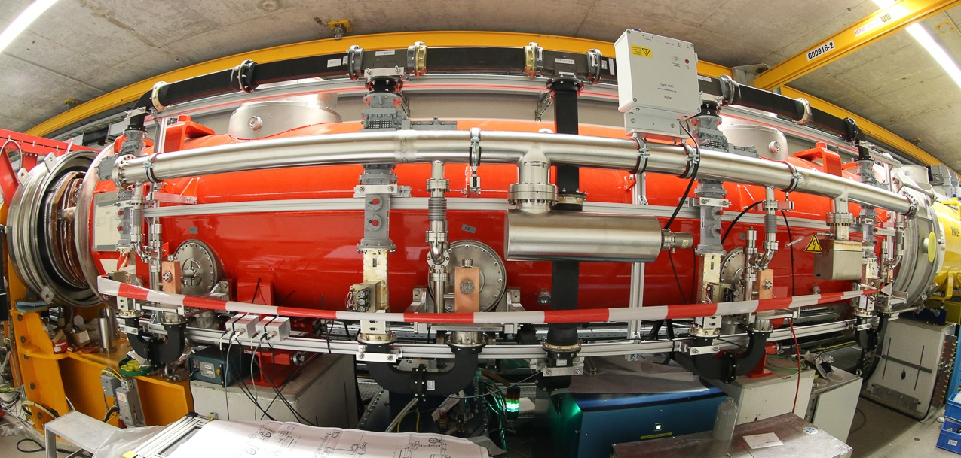
Status of AH1 and options for 3.9GHz R&D
Cecilia Maiano
Paolo Pierini, Elmar Vogel
Cavity Meeting
04 May 2016
PPT version 0 3/5/2016

Slide 2
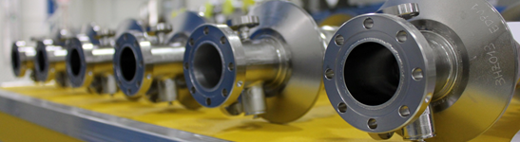
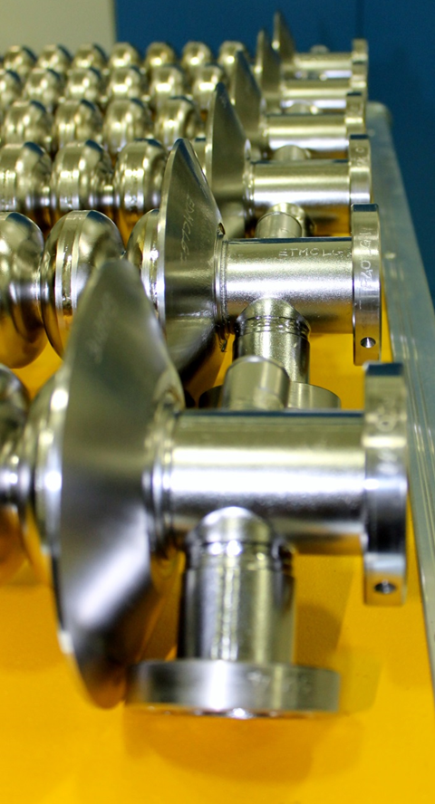
Outline
Performance of AH1 in Injector
Spare module preparation
Opportunities for CW R&D at 3.9 GHz

Slide 3
SUMMARY OF AH1 Perfomance IN INJECTOR

Slide 4

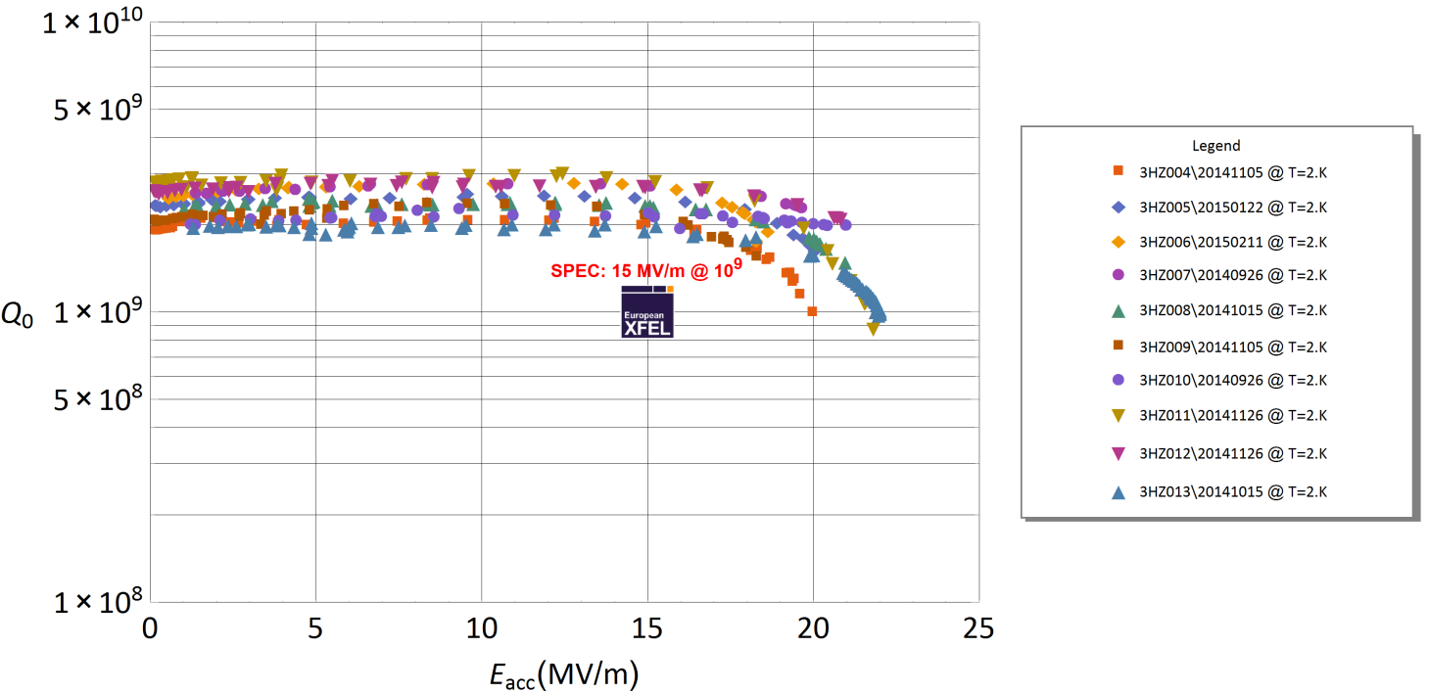
Cavity vertical tests at INFN/LASA
AH1 cavities: First vertical test 26-Sep-14 and last 11-Feb-2015
PERFORMANCE GOAL (SPEC): 15*0.346*8 ~ 42 MV
Beam Dynamic Requirements (worst case scenario ) < 30 MV

Slide 5
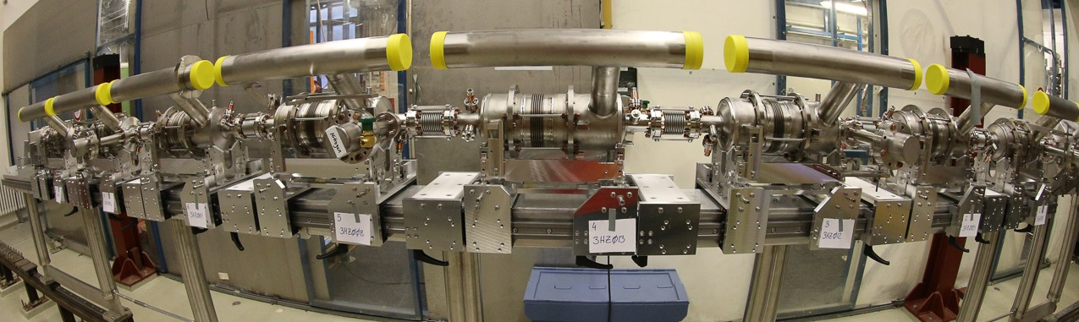
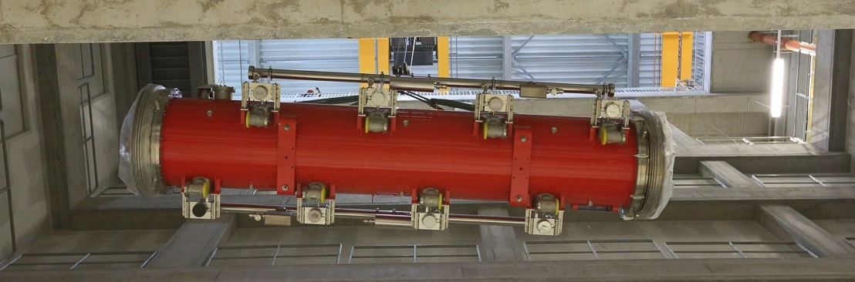
Major AH1 Assembly Milestones
July 3 2015
September 23 2015

Slide 6
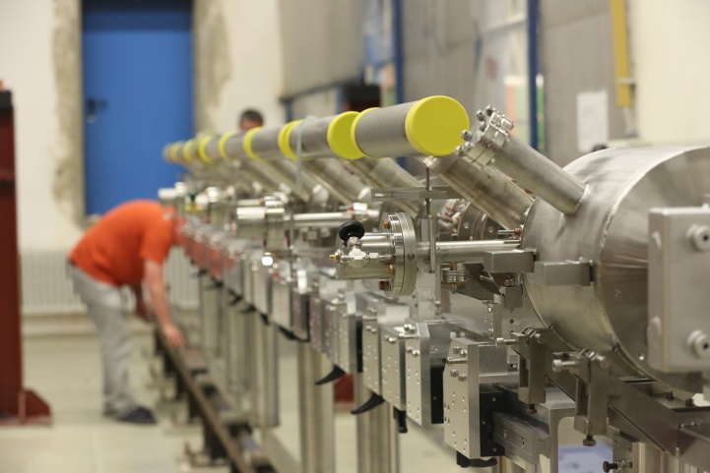
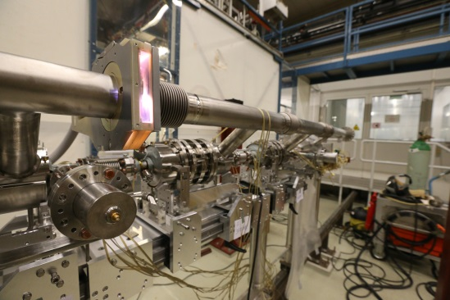
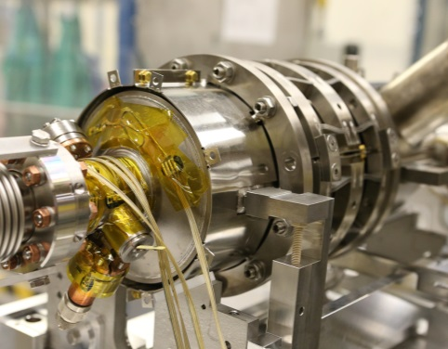
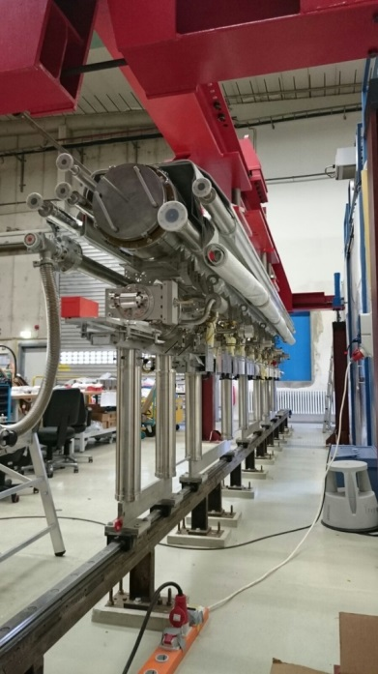
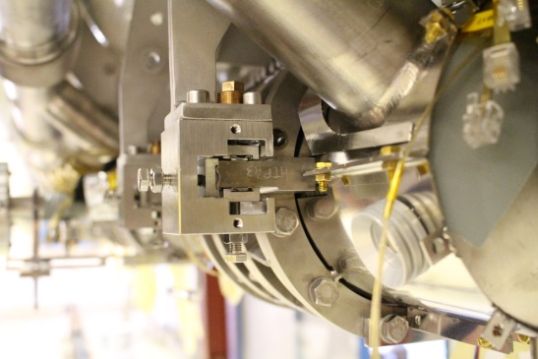
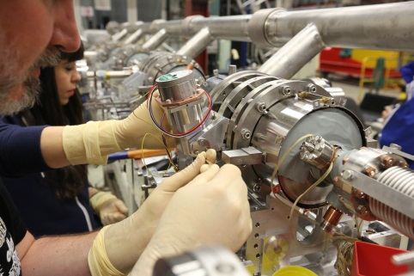
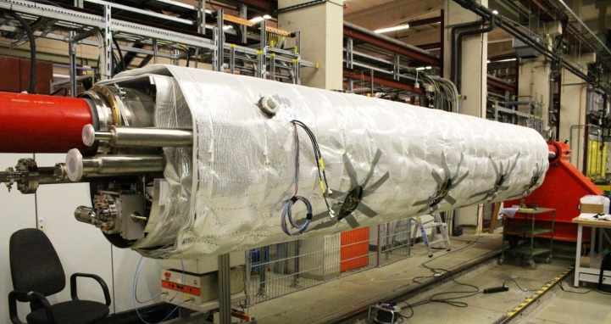
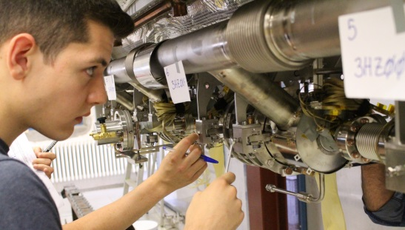
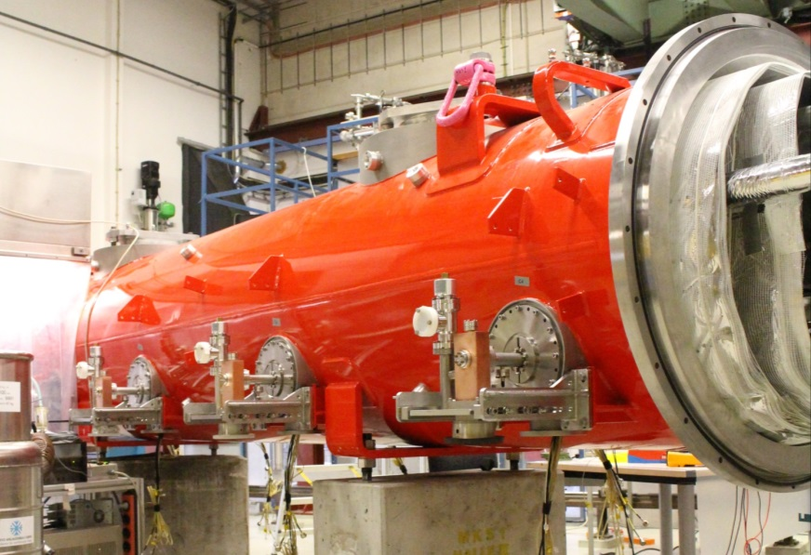
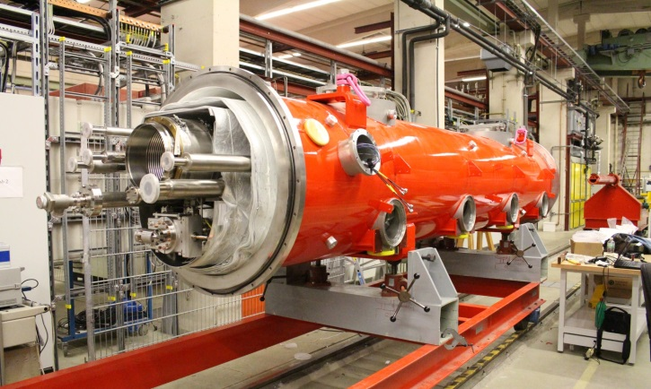
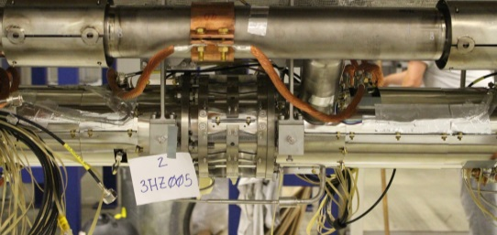
The assembly in Halle III (14 weeks)

Slide 7
Module assembly timeline
 | Where | When | Activity
14 weeks from cavities to tunnel | CLEAN ROOM (3 wks) | WK25 | Clean room preparation, last coupler installed on cavities
 |  | WK26 | String installation start. Cavity connections
 |  | WK27 | Finish installation. String Roll-out
 | ROLL-OUT AREA ON GIRDER (2 wks) | WK28 | Partial magnetic shield installation and tuner installation, T sensors
 |  | WK29 | 2 phase line welds, T sensor installation completion, tuner motor
 | ROLL-OUT AREA SUSPENDED (2 wks) | WK30 | Suspension from cold mass, completion of magnetic shield, alignment
 |  | WK31 | End of string alignment (2 pass and final survey), transfer to cantilever, preparation of 2K thermal sinking (HOM, motor), HOM notch filter tuning
 | CANTILEVER (4 wks) | WK32 | Weld of the magnet package current leads, weld of the warmup circuit
 |  | WK33 | RF cables, completion mag shield, HOM thermal sinks, installation of coupler cones, cable thermalization, start assembly of 4K shield parts
 |  | WK34 | Finalization of 4K/80K shields and MLI blankets
 |  | WK35 | Vessel roll-on, post bracket/suspension of the Cold Mass on the Vacuum Vessel, longitudinal pre-alignment of CM to VV, transfer to floor supports
 | FLOOR SUPPORT (3 wks) | WK36 | CM to VV alignment, start of coupler installation
 |  | WK37 | Finish coupler installation on one side, install coupler vacuum pump line
 |  | WK38 | Coupler side two, coupler vacuum, beam vacuum & leak check
 |  | WK39 | Transport to Tunnel

Slide 8
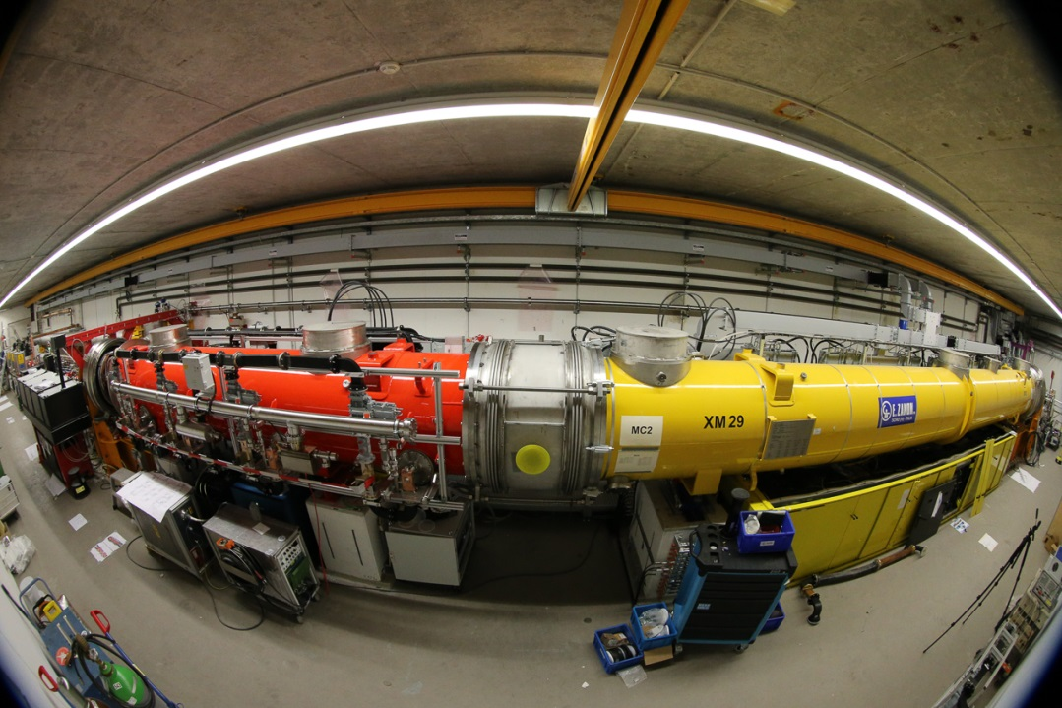
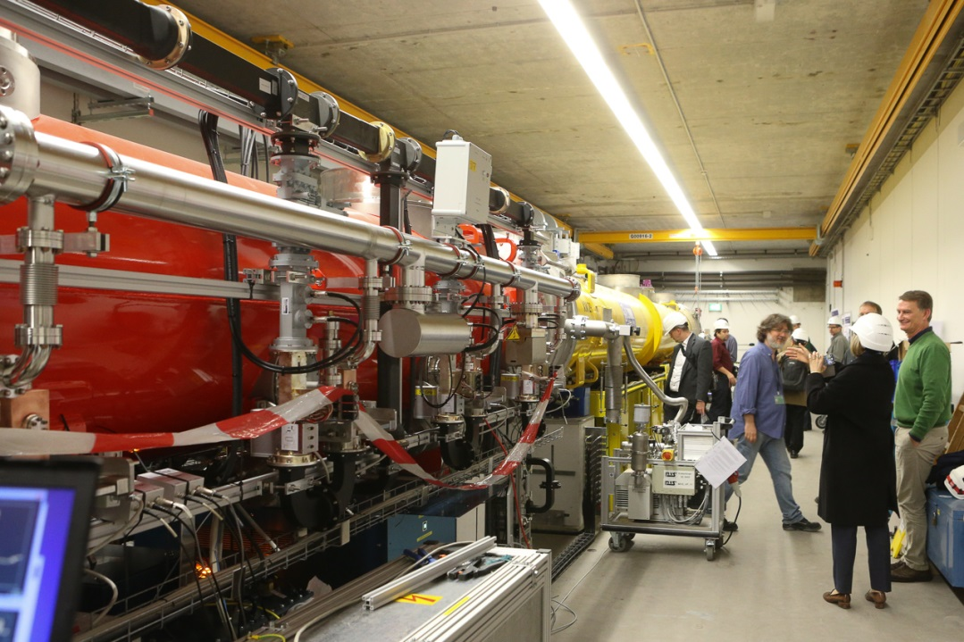
Final Preparation stages in tunnel
November 11 2015
Assembly WG distribution
Injector String Integration
Dec 10: Start cooldown
Dec 15, cavity pre-tuning
Dec 16, calibration: AH1 Ready

Slide 9
RF Commissioning in Tunnel
Infrastructure aspects, workload of AMTF and schedule delays (arrival of 3.9 components) made it impossible to test the module before tunnel installation
Tunnel installation without cryogenic and RF testing
Tunnel is not the most favorable environment for precise RF measurements activities
  Few RF power meters with respect to AMTF, though a few not initially foreseen were implemented by MHF-sl (e.g. HOM power readings, not present in the main linac)
  The positive aspect is that all subcomponents were in their final configuration and driven by the XFEL control system
    Smooth transition from characterization to operation

Slide 10
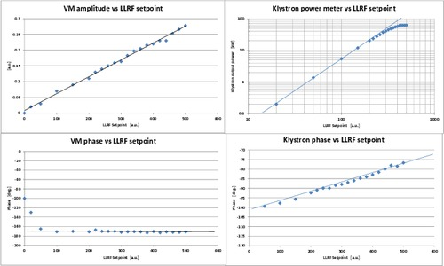
Klystron operated by LLRF on load
Operation on load, achieved 61 kW power at saturation

Slide 11
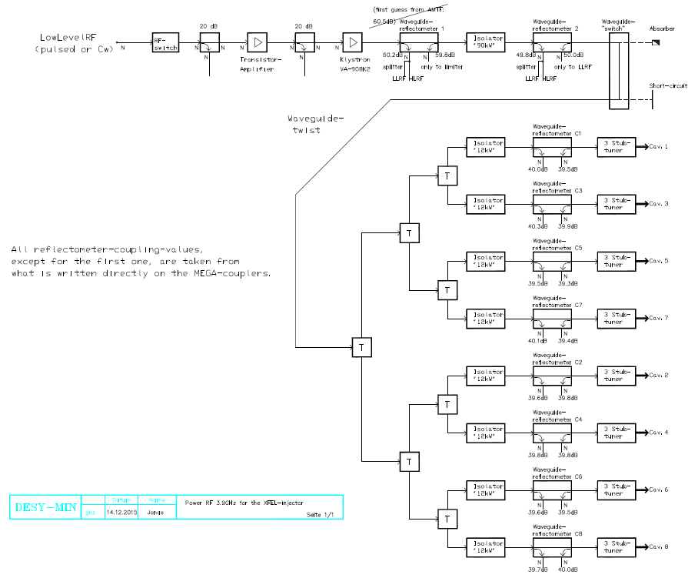
Present RF Distribution layout
PMeter (Cal)
Pre
Amp
KLY
Output of
LLRF VM
Cavity 1
Cavity 3
Cavity 5
Cavity 7
Check of the WG distribution flatness performed only at few W level after assembly
Cavity 2
Cavity 4
Cavity 6
Cavity 8
Courtesy of R. Jonas, MIN
Only to LLRF

Slide 12
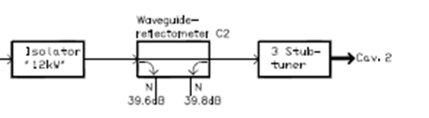
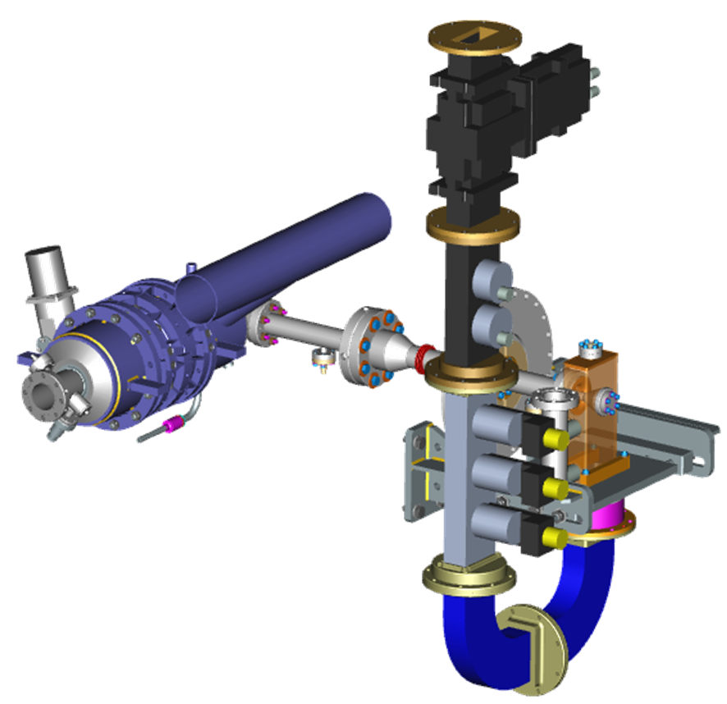
Cavity Phasing and QL adjustment
WG distribution uses 3dB splitters to provide RF power to cavities from a single Klystron
  No phase shifters
  Flexible waveguide sections
  Assembled in tunnel
    no measurements
    at relevant Kly power
Fixed coupler design
The systems relies on 3-stub tuners to achieve the desired QL adjustment and cavity phasing
Directional
Coupler
3-stub tuner

Slide 13
Main characterization checklist
Cavity performances, up to quench limit - done
Phase alignment and QL tuning - done
Beam-based calibrations - done
HOM thermal stability studies - done
Cryogenic performance assessment - done
Preserving (and improving) beam quality – ongoing
Characterization of the RF power distribution – skipped (for schedule reason)

Slide 14
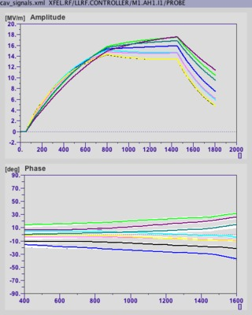
First operation at nominal gradient on Day 1
18 December 2015
  Operation with no beam
  First rough calibration (LLRF)
    Assume P_{cav}=P_{kly}/10
  Nominal pulse structure
    Fill: 750 us/FlatTop: 650 us
  Gradient well above nominal
    40 MV of VS voltage
    First quench > 45 MV
  Cavity phasing missing and QL values not yet tuned
  LLRF in FB mode
Arbitrary calibration/need beam

Slide 15
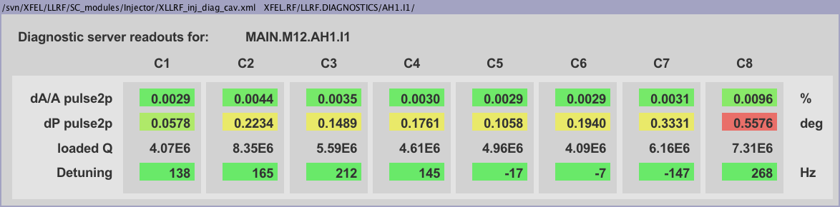
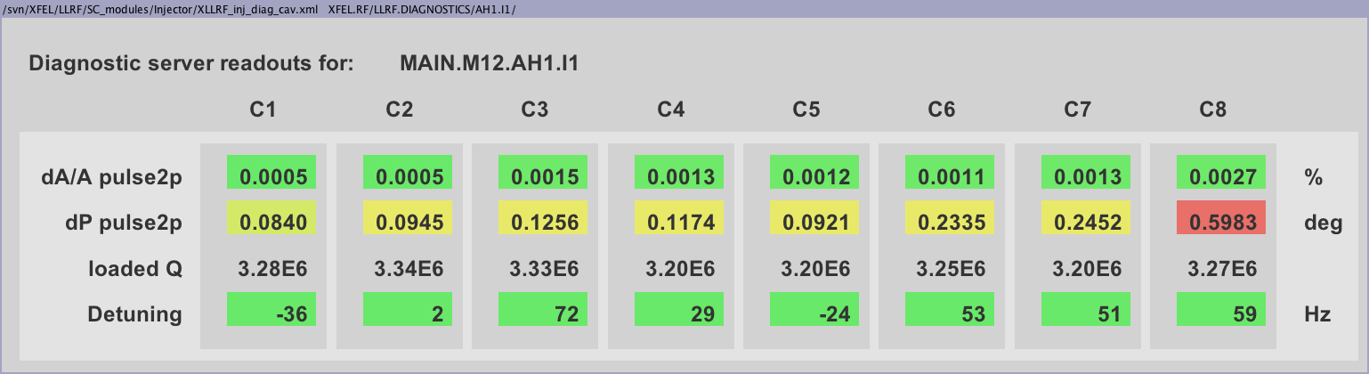
Initial QL values (nominal 3.2E6)
Cumulative effect of antenna / cavity tolerances
  Spread in the QL values (all stubs out), factor of 2
TUNING

Slide 16
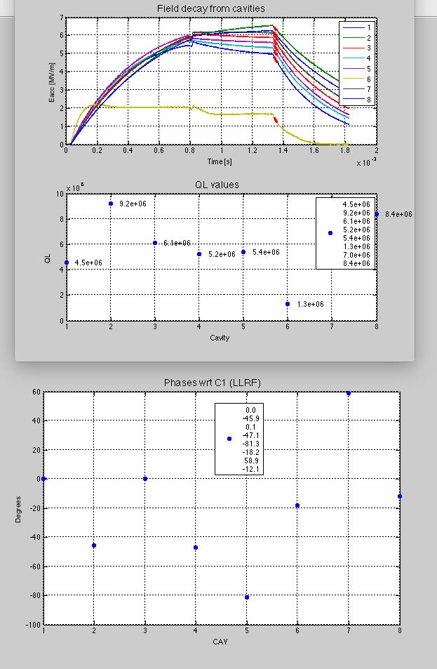
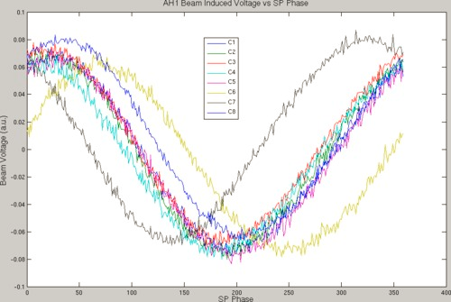
Beam Based calibration: Cavity Phases
January 2016, on beam
  Beam transients
  Phase Calibrations
Preliminary to :
  Phase Tuning
  QL tuning
Large initial cavity phase spread
  WG assembled in tunnel, no cal.
Cavity transient, QL determination and phase calibration
Beam induced cavity gradient changes
Tune with
  3-stub tuners
  WG Spacers
160°
After operation of a few stub tuners

Slide 17
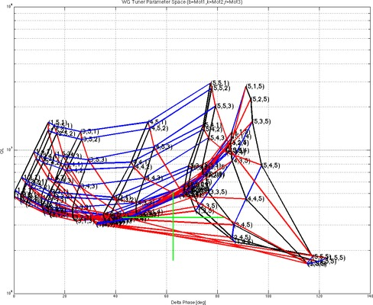
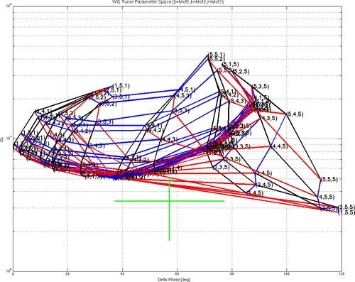
QL tuning & Phase alignment
1 February 2016, AH1 moved 1 ms after the beam
  Allow injector commissioning while aligning cavity phases
Individual maps of all 3-stub tuner positions
QL-Phase region
Case of design in range of tuner
QL-Phase region
Case of design outside range of tuner
WG spacers installed on 3 cavities

Slide 18
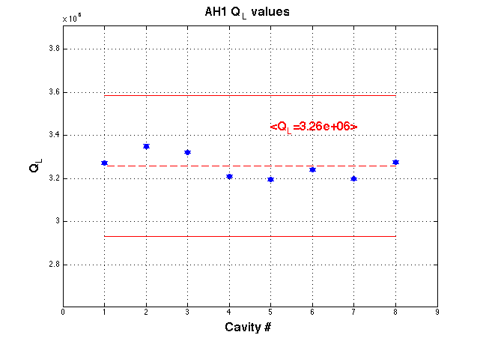
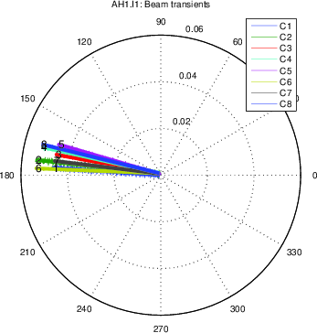
Started regular operation in injector
10 February 2016
  QL aligned well within the 10% requirement
  Phases within 15°
16 February 2016
  Back on beam
  Moved to -180°(wrt on-crest), calibration with beam energy

Slide 19
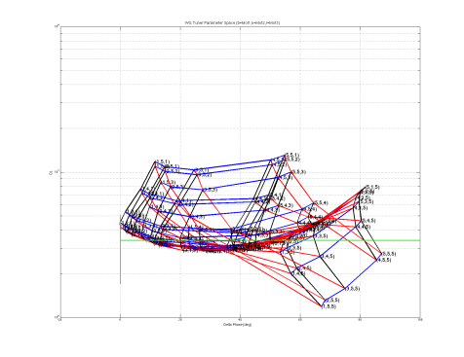
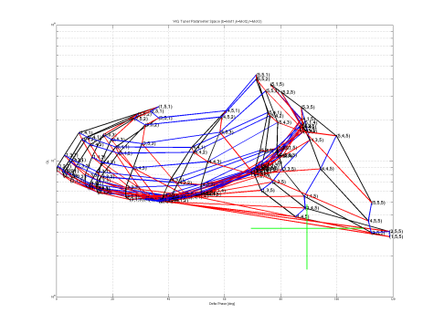
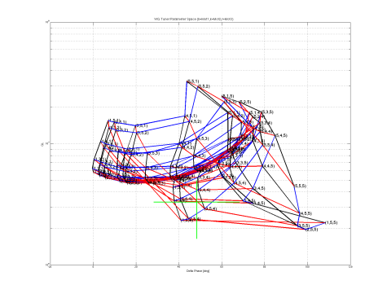
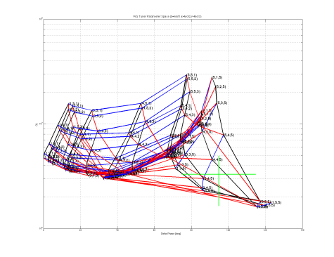
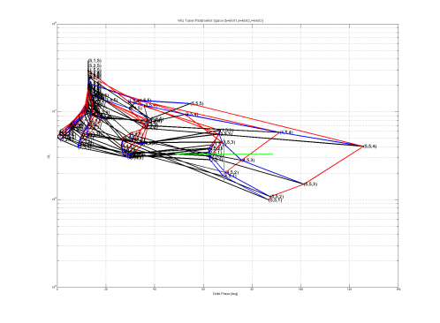
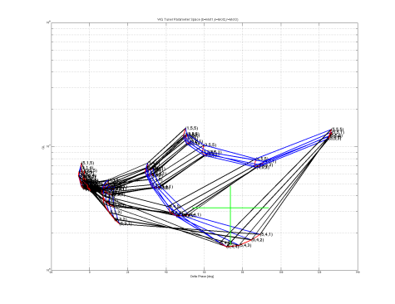
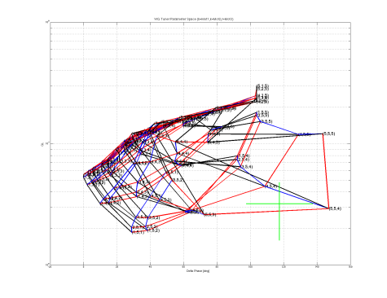
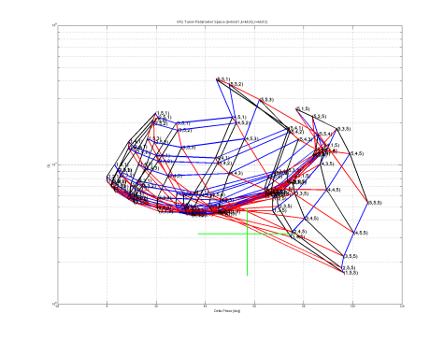
Max QL obtainable in present module
By mapping all tuners we were able to reach high QL values with the present antenna design
  Easy without phase constraints (single 1:1 powering)
Cav | 1 | 2 | 3 | 4 | 5 | 6 | 7 | 8
Max QL | ~ 1E7 | ~ 4E7 | ~ 3E7 | ~ 3E7 | ~ 4E7 | ~ 1E7 | ~ 3E7 | ~ 4E7
Already close to values for CW operation

Slide 20
Quench Gradients in tunnel
Cav | Tunnel |  | VT
 | Max Gradient | Limit | Gradient
C1 | 18.1 MV/m | Quench | 21.0 MV/m
C2 | 17.6 MV/m | Power | 20.0 MV/m
C3 | 18.7 MV/m | Quench | 20.8 MV/m
C4 | 17.1 Mv/m | Power | 22.0 MV/m
C5 | 18.2 Mv/m | Quench | 21.0 MV/m
C6 | 17.6 Mv/m | Power | 19.6 MV/m
C7 | 17.7 Mv/m | Quench | 20.0 MV/m
C8 | 17.3 Mv/m | Power | 21.8 MV/m
Error on the individual cavity gradient estimation not yet analyzed but probably as large as 30%
Tunnel measurement much less accurate
WG distribution assumed uniform (3x3dB+loss)

Slide 21
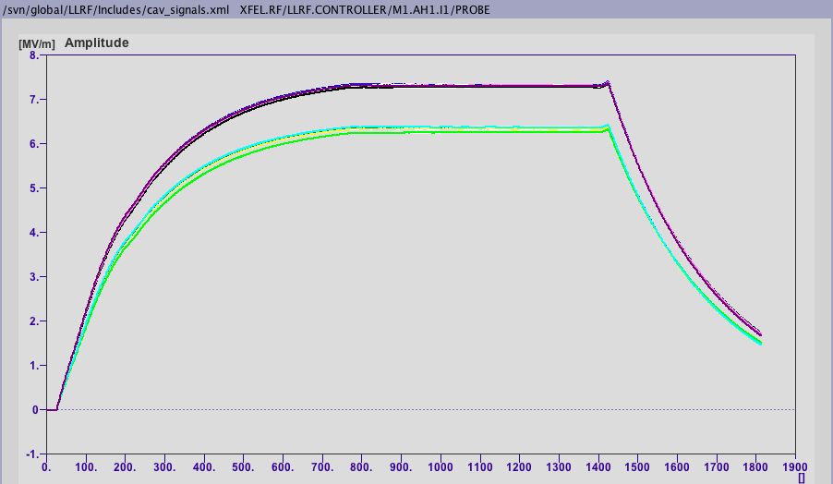
After final round of Beam Based Calibration
After LLRF final calibration with beam induced transients an asymmetry of the WG distribution is apparent (left/right arms of the distribution system
  Confirmation requires dedicated measurements of WG distribution at high power (@Cav Directional Couplers)
Odd-numbered
Requires RF cables disconnection to LLRF panel & several accessess with measurement equipment
Did not proceed as module performances are reached with margins!
Even-numbered
Regular closed loop operation, at 20 MV setpoint

Slide 22
Detuned HOMs
The installation of the power coupler detunes the notch filter in front of it
  Perturbation of the field pattern locally in the small structures at 3.9 GHz
  A retuning was needed
Cavity 1 was suboptimally tuned
  Could have done better, but did not yet have the operational experience to set better requirements during tuning (now we would not miss it)
Cavity 4 was already at its limit
  Large deformation of the can, to a point where capacity no longer changes and risk of cavity integrity was high!

Slide 23
HOM performance
Cavity Q0 is 2E9 (VT measure)
Qt is 1E10 (VT calib)
Cav | QH1 | QH2
C1 | 7.29E+09 | 5.64E+11
C2 | 1.14E+12 | 5.72E+10
C3 | 8.70E+10 | 1.33E+11
C4 | 1.91E+09 | 6.29E+11
C5 | 3.18E+11 | 2.68E+11
C6 | 8.32E+11 | 5.05E+11
C7 | 1.36E+11 | 6.28E+10
C8 | 4.50E+11 | 1.19E+15
C1 HOM1 suboptimal tuning
C4 HOM1 detuned (cavity Q0)
However, stable thermal behavior at 10 Hz operation up to SP in excess of 40 MV
What about CW?

Slide 24
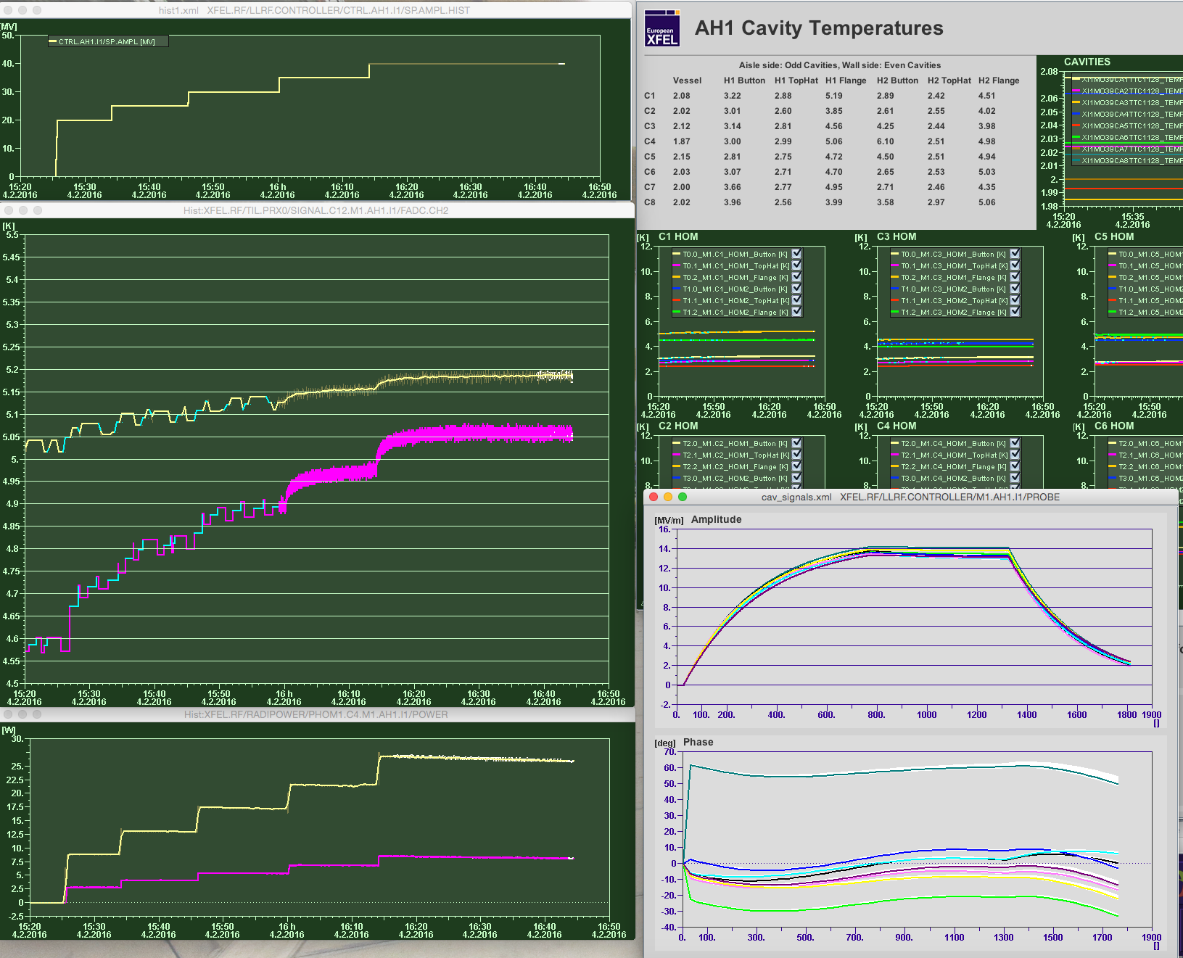
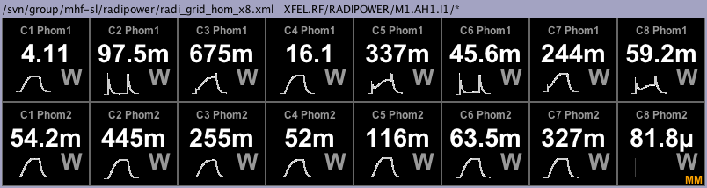
Temperature stability at highest SP
In spite of the large peak fundamental mode power leaking out of two HOM1 couplers temperatures are extremely stable
  10 Hz! 1% d.c.
Three CERNOX sensors are at each HOM can end (flange, top-hat and inner antenna base) and connected to technical interlock system
Never triggered!
V SP
Temperature increase
Levels at 20 MV
40 MV
Power C1H1 C4H1

Slide 25
Cryogenic aspects (only static so far)
Static loads of individual component in the injector circuit cannot be individually assessed, only global measurements can be done
  Including end and feed box and both modules
However, using data from components assessed in AMTF MKS estimates
  2 K: 4-7 W
  5/8 K: N/A problems with flowmeters
  40/80 K: approx 95 W
Overall, performance similar to 1.3 GHz modules
  Somewhat expected, same concept, same # penetrations
  Well within capabilities of cryocapabilities at injector

Slide 26
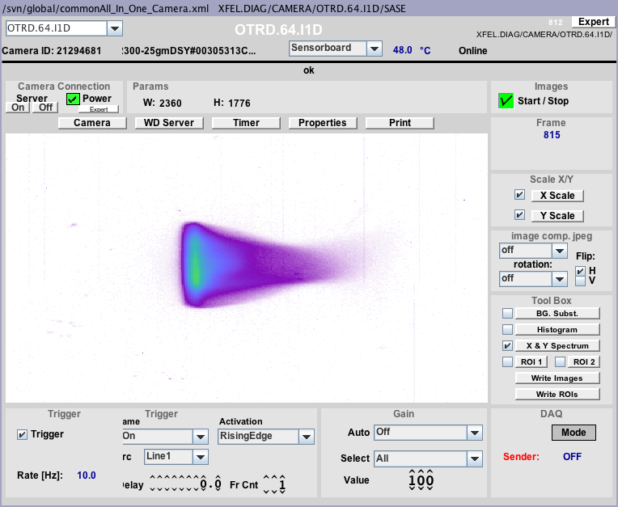
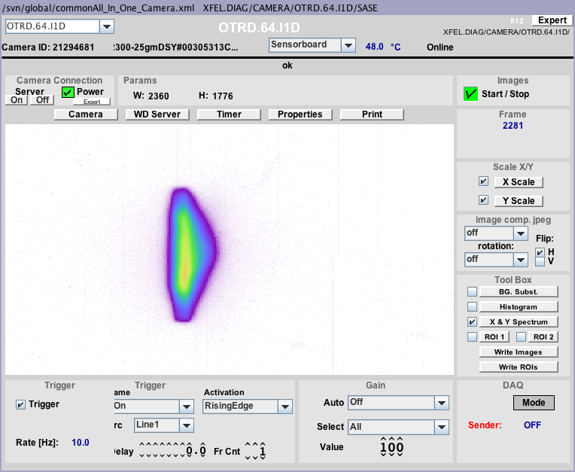
First confirmation of linearization effect
TDS diagnostic not yet available at injector
12 April 2015 transmission of full train with acceptable losses in the beamline after last dipole to dump not possible without AH1 to get rid of the energy tails with A1 on-crest
AH1=0 MV
AH1=10 MV

Slide 27
Spare MODULE

Slide 28
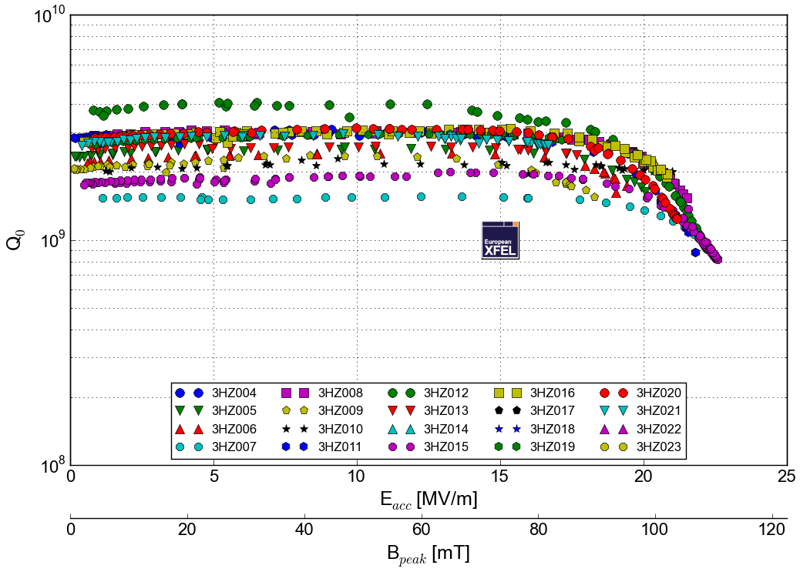
Now: All 20 cavities are tested (AH1 + spare)

Slide 29
Spares components
5 cavities for spare module presently at DESY
  2 from previous series production
  3 from the second series of 10 cavities
5 more cavities tested, expected before end May/mid June
Last 2 cavities of the second series delayed
  Vessel integration non-conformities: Repair
Module (CM and VV) at DESY
Several other components already have been procured in quantities for 2 modules and are already in stock either at DESY, INFN or FNAL
  Couplers, magnet, magnetic shields, PU and HOMs, beam line flange transitions, vacuum line, waveguides, etc.

Slide 30
Spare module activities
String assembly and module installation scheduled to start in September, after tunnel closure and DESY Clean Room maintenance
  Increased manpower availability for all operations with the end of tunnel assemblies
Adaptation of the module support rail for XATB1 in AMTF ongoing (BINP procurement)
  Ready before end of 2016
Testing in nominal XFEL pulsed conditions in early 2017
  XATB1 already equipped with RF (used for single cavity tests)
Can the test scope be extended to CW (similar to 1.3)?

Slide 31
CW testing of X3M2 in AMTF
Module will be here/needed as spare part of XFEL injector
XATB1 will host the pulsed tests, which are scheduled and funded by the spare part agreements
CW RF is missing, but all other ingredients are there and possible high duty cycle upgrades to XFEL will require to assess the feasibility of a 3.9 GHz CW system
Started inquiring options for RF system
  Two companies exploring 3.9 GHz SSA @ 1 kW
    1 proposal: 10 k€ feasibility + 1 kW units @ 70-80 k€
    1 other still in conceptual phase
Currently no budget, just the opportunity to discuss the idea!

Slide 32
Summary
RF commissioning of the 3.9 GHz module in the tunnel was a great success
  Achieved performances above nominal during the early injector commissioning stages in December 2015, with the AH1 pulse shifted in time from the beam
Module in regular operation with beam since January 2016
  Final verification will be achieved with TDS
The second spare module is well proceeding towards assembly & testing
  An extended test scope for CW testing with SSA can be conceived, in view of the possible future high duty cycle upgrades of the XFEL facility

Slide 33
Thanks!
WP46: 3.9 GHz System
Acknowledgements
INFN
M.Bertucci, M. Bonezzi, A.Bosotti, JF.Chen, M.Chiodini, M.Fusetti, P.Michelato, L.Monaco, M.Moretti, C.Pagani, R.Paparella, D. Sertore
DESY
Too many people from MIN, MKS 1, MKS 3, MHF-SL, MPL, MSK, etc.
And especially the whole BKR team
FNAL
Elvin Harms and the ACC39 team
Most photos courtesy of D. Nölle/Ettore Zanon S.p.A.

