Slide 1

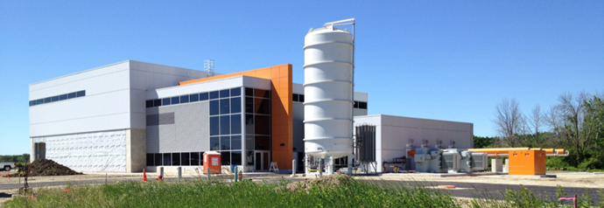
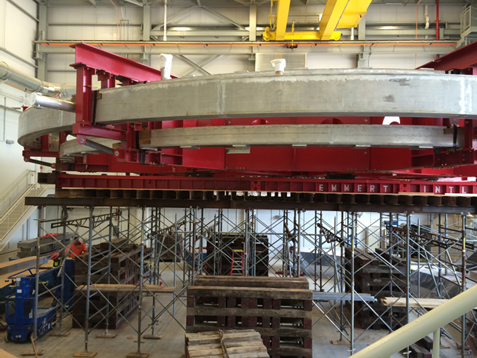
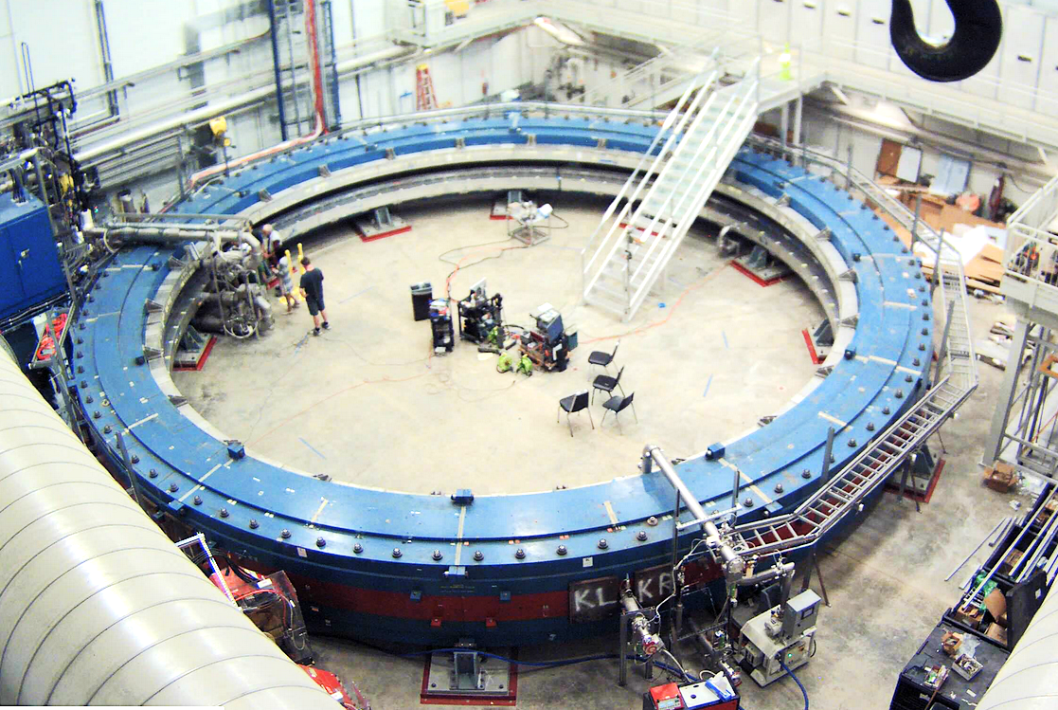
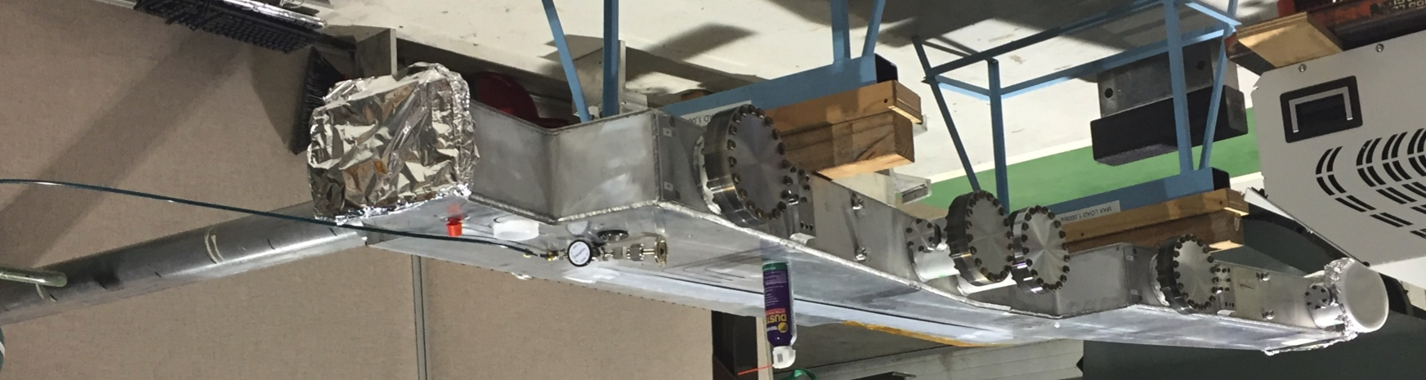
The Fermilab Muon (g - 2) Experiment:
The Inflector Magnet
David Hertzog UW – Lee Roberts BU

Slide 2
Our Request
We request that the PAC strongly endorse our continued development of a new open-ended inflector, using the contingency that has been liberated by the continued retirement of risk.
This will contribute significantly to reaching our goal of an overall total error of 140 ppb
  Statistics: 100 ppb 2 × 10¹¹ analyzed events
  Muon frequency: 70 ppb
  Magnetic field: 70 ppb

Slide 3








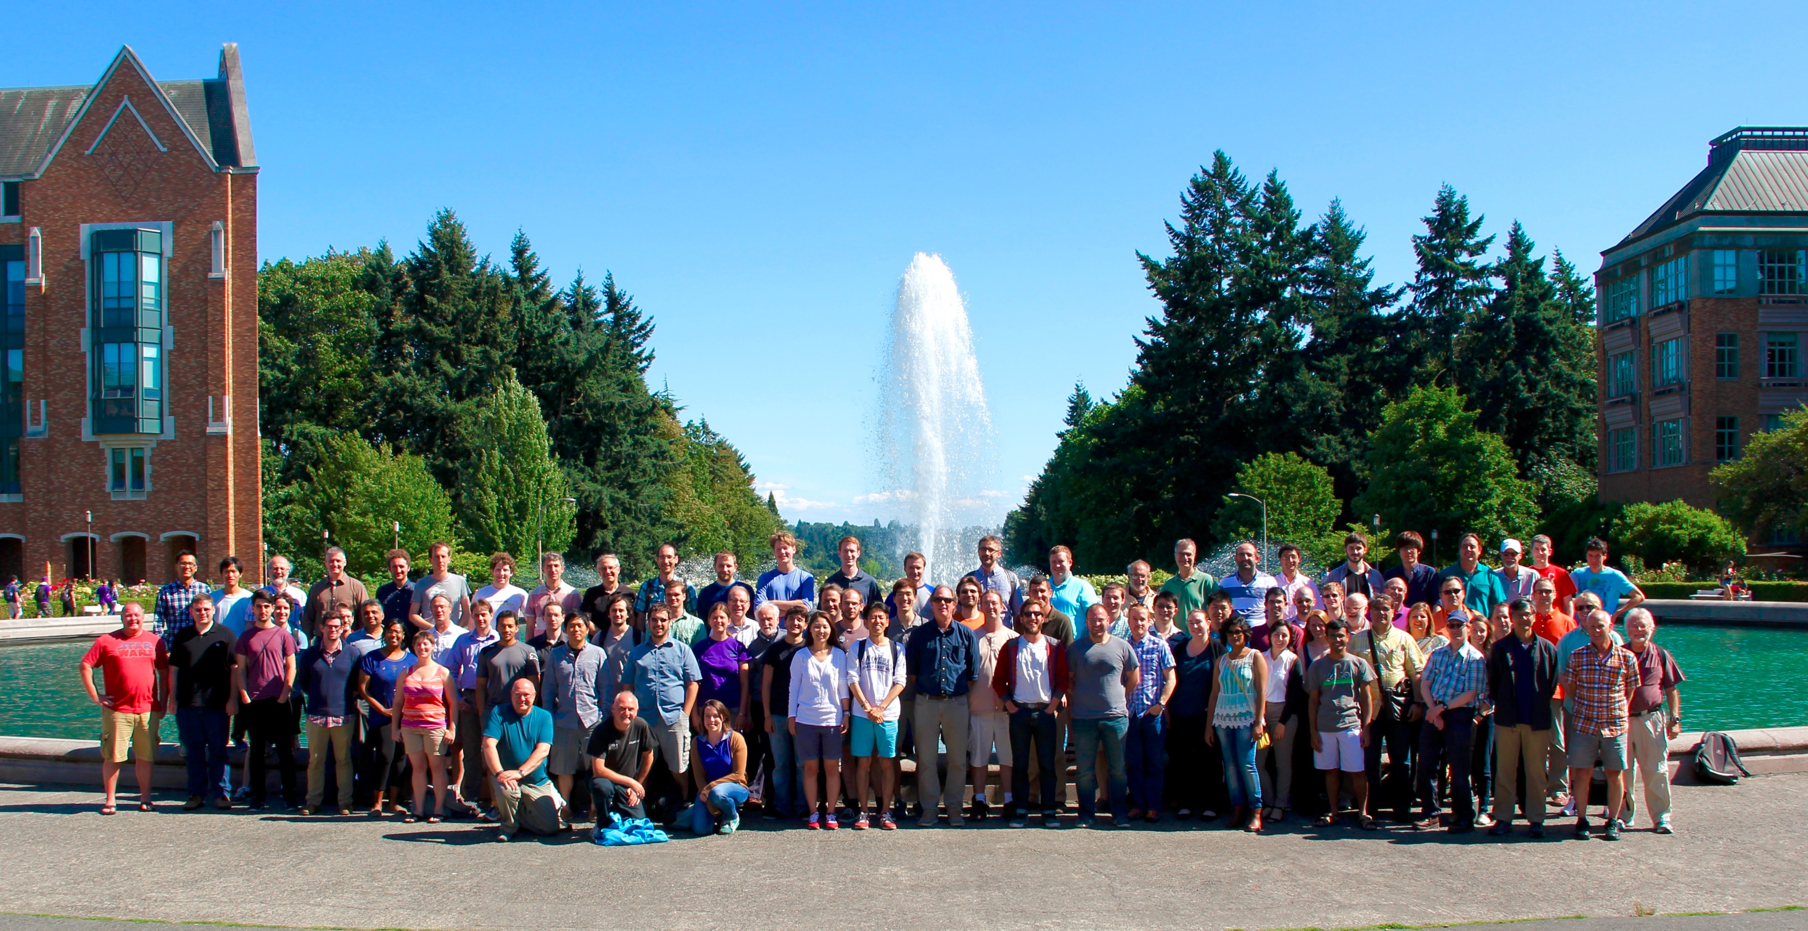
Fermilab E989: 34 Institutes; >150 Members
Domestic Universities
  Boston
  Cornell
  Illinois
  James Madison
  Kentucky
  Massachusetts
  Michigan
  Michigan State
  Mississippi
  Northern Illinois
  Northwestern (thy)
  Regis
  Texas
  Virginia
  Washington
  York College
National Labs
  Argonne
  Brookhaven
  Fermilab
Italy
  Frascati,
  Roma 2,
  Udine
  Pisa
  Naples
  Trieste
China:
  Shanghai
The Netherlands:
  Groningen
Germany:
  Dresden (thy)
England
  University College London
  Liverpool
  Oxford
Korea
  KAIST/IBS
Russia:
  Dubna
  Novosibirsk
g-2 Physics Week 2015
Seattle
D.W. Hertzog, Co-Spokesperson
B.L. Roberts, Co-Spokesperson
C. Polly, Project Manager

Slide 4
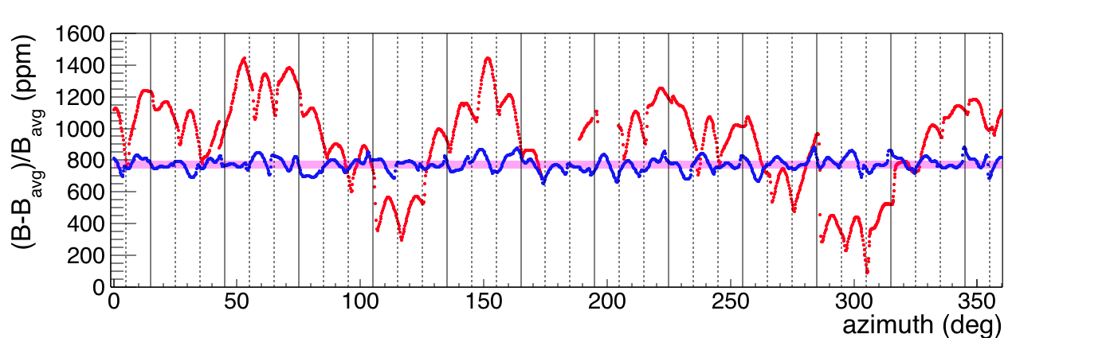
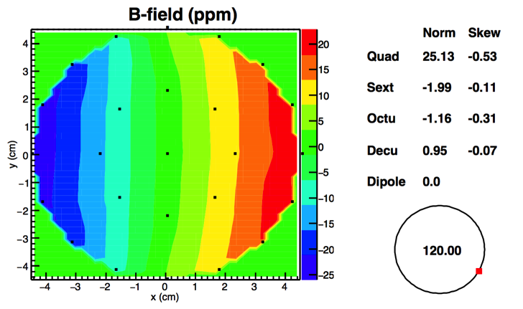
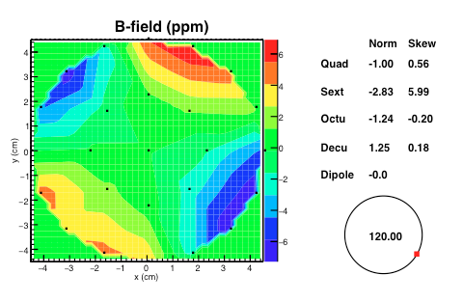
Magnetic field uniformity
Oct 2015
→ June 2016
→Goal
~200
ppm
~1400
ppm
Azimuthally Averaged Map
Vertical (cm)
Vertical (cm)
R-R₀(cm)
R-R₀(cm)
October 2015
Today
Notes:
RMS is currently 40 ppm, BNL was about 35 ppm Goal is about 15 ppm

Slide 5
Outline
Introduction
Quick overview of the motivation and theory
Quick overview of the experiment
Introduction to the inflector
Limitations of the old inflector
  Why we want to build a new one
Schedule and cost for the new inflector
Summary

Slide 6
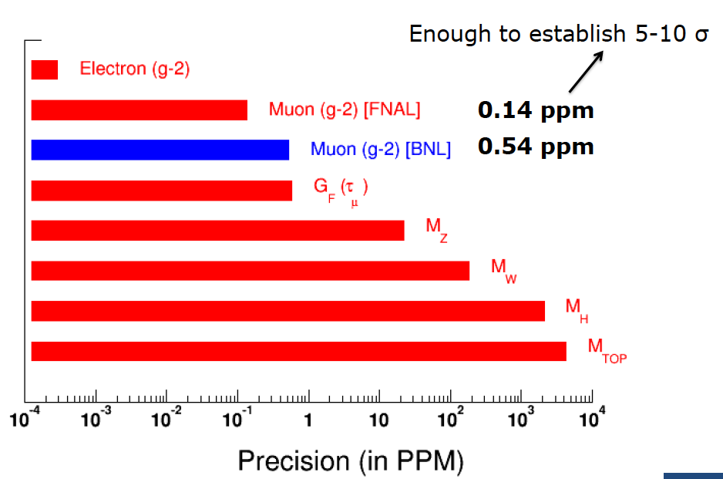
Sensitivity Requires Precision (systematics + statistics)
Systematic Errors are critical and require significant running time
0.014 ppm
(0.54 ppm)
MuLan at PSI (Hertzog co-spokes)
(23 ppm)

Slide 7
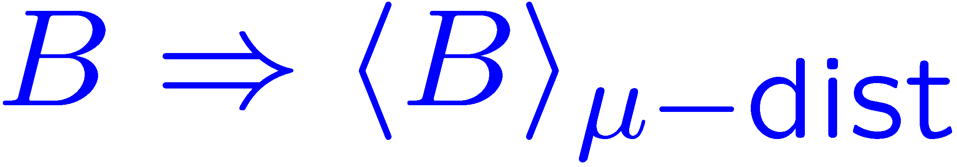
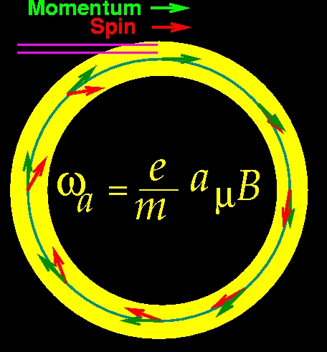
Rate that spin turns relative to the momentum
With an electric quadrupole field for vertical focusing and the magic γ_{magic} = 29.3; p_{magic} = 3.09 GeV/c
0
Measure two quantities
where B is expressed in terms of the Larmor frequency of a free proton, averaged over the muon distribution.

Slide 8
Experimental Technique
narrow bunch of protons
x_{c} ≈ 77 mm
β ≈ 10 mrad
B·dl ≈ 0.1 Tm
Pions
Inflector
p=3.1GeV/c
Target
(1.45T)
Muon storage ring – weak focusing betatron
Muon polarization
Injection & kicking
Focus with electric quads
24 electron calorimeters (E, t)
Injection orbit
Central orbit
Storage
ring
Kicker
Modules
R=711.2cm
d=9cm
R
R
β
Electric Quadrupoles
x_{c}
B. L. Roberts, Fermilab , 3 September 2008
- p. 8/68
Notes:
8

Slide 9
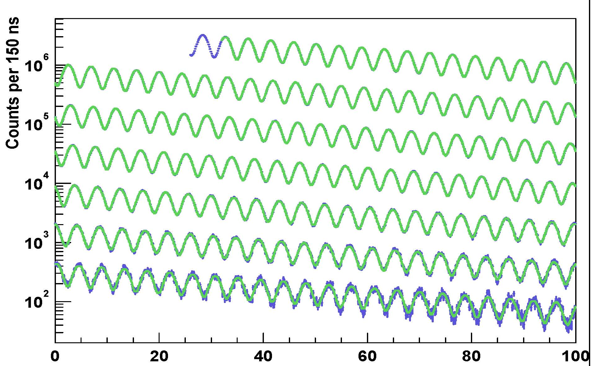
E821 arrival-time spectrum
γτ
0 – 100 μs
100 – 200 μs
200 – 300 μs
300 – 400 μs
400 – 500 μs
500 – 600 μs
600 – 700 μs
Time modulo 100 μs

Slide 10
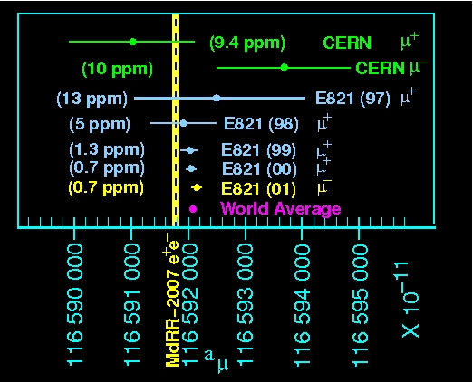
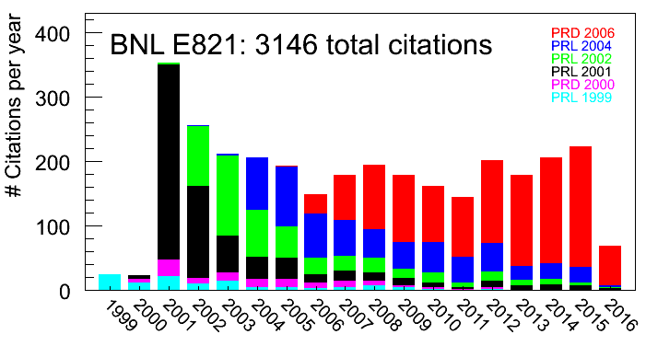
Comparison with Experiment
This greater than 3 σ difference could be caused by new, as yet undiscovered, particles in nature.
⁻ theory
(statistics limited result)
The value of the muon anomalous magnetic moment constrains almost all models of physics beyond the Standard Model
as of 6/6/2016

Slide 11
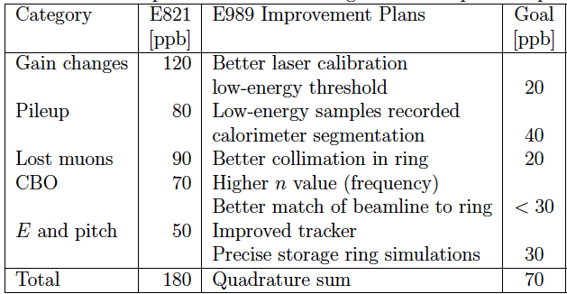
Systematic Errors on ω_{a} (ppb)
Determination of these errors requires beam.

Slide 12
What does the inflector do? How does it do it?
The inflector magnet cancels the field in the magnet gap and permits the muon beam to enter the storage ring undeflected.
The inflector field is not permitted to leak flux into the storage ring and spoil the precision uniform magnetic field.

Slide 13
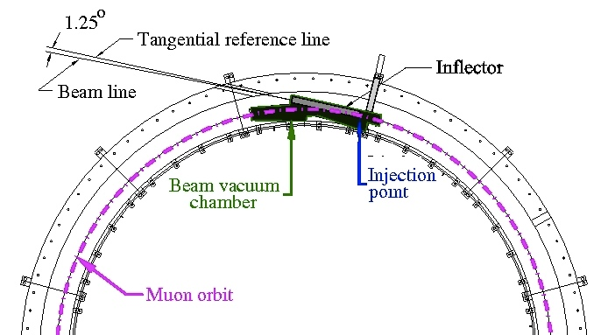
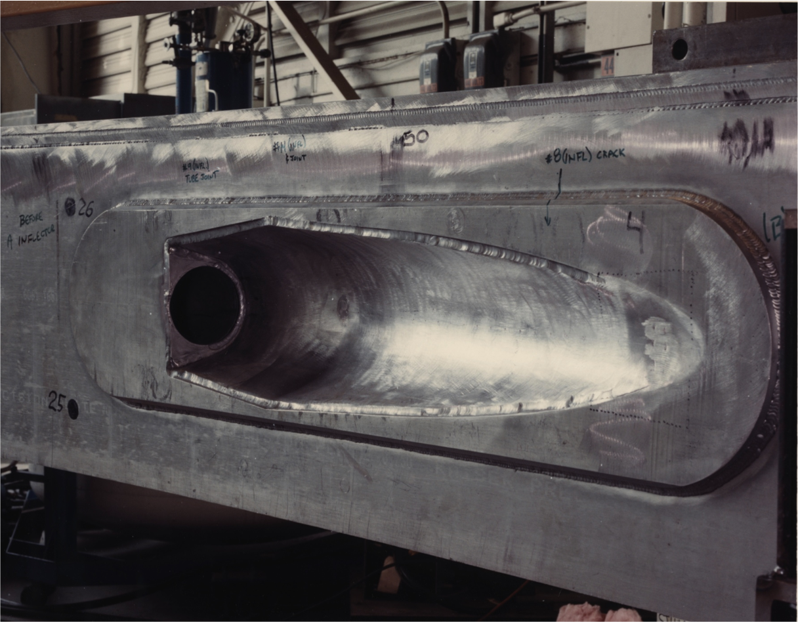
Inflector Geometry
yoke
Inflector Services
coil
Inflector
beam hole through outer coil cryostat

Slide 14
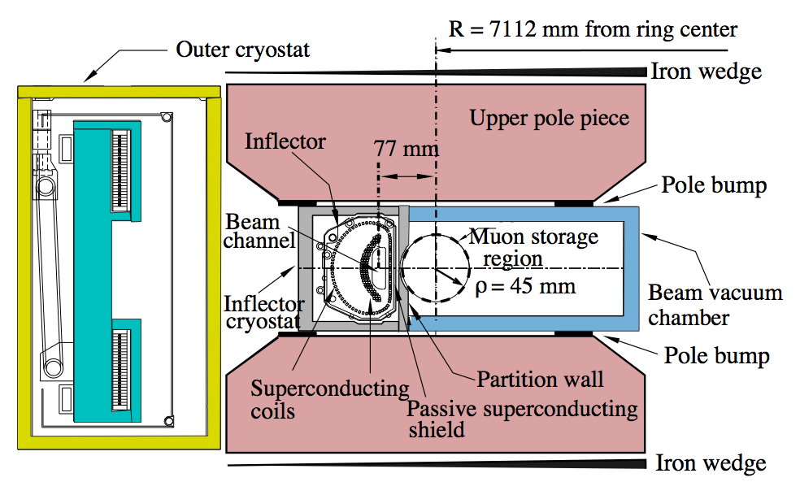
What’s an inflector?
Highly constrained
  Limited space
  Nulls 1.5T field
  Part-per-million level impact in storage region
  DC to not induce eddy currents
  High J_{c} superconductor
  Maximize injection efficiency
Has to cancel
1.45T field here!
μ
Can’t disturb field here
by more than a few ppm!

Slide 15
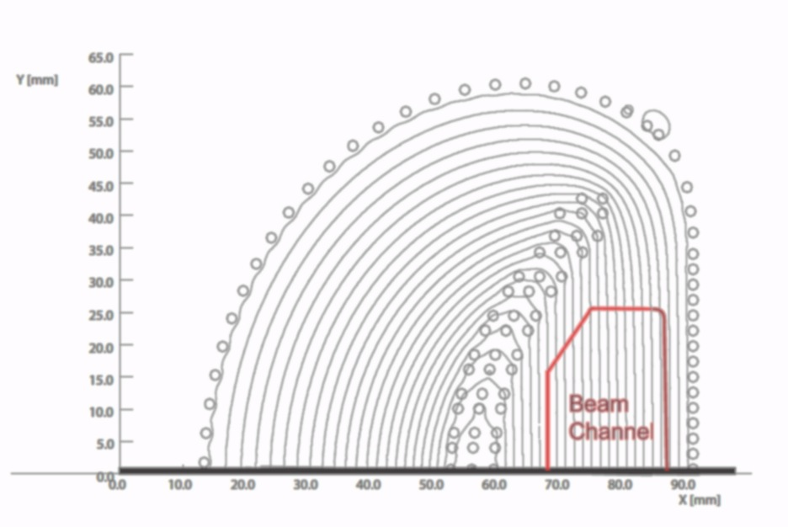
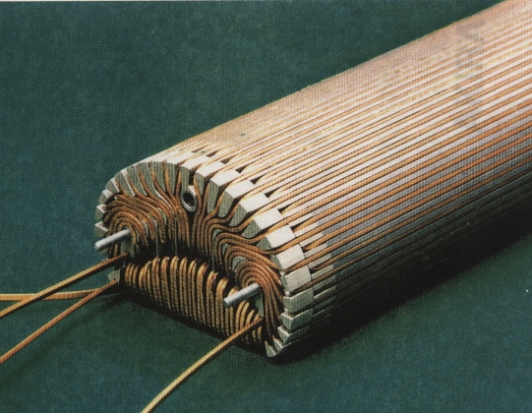
How does it work?
Truncated double cosine θ design
B_{inf} =0
out-side
18mm
56mm
E821 Inflector: both ends closed
two coils in series with currents in the opposite direction
μ beam

Slide 16
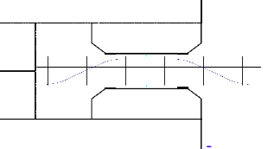
Radial beam motion
Beam exits yoke
Beam through outer coil
Beam through Inflector
Beam kicked onto orbit
B

Slide 17
A tale of five inflectors:
There are five inflectors mentioned in this talk, 3 from E821
  The short prototype with one open, one closed end.
  First inflector that was damaged in commissioning, repaired and initially used in E821
    it leaked flux, producing a 0.2 ppm systematic error, and was replaced after the 1999 run.
    destructively dismantled in TD to reverse engineer and salvage parts
  Current inflector – replaced the damaged one; was installed into E821 in late 1989. We are reusing it as our baseline plan.
  Full-scale technical model – a full-scale prototype that we are proposing to build largely out of recycled parts from V2.
    we hope that we can use it in the experiment
  All New inflector – made entirely from new parts, only if needed

Slide 18
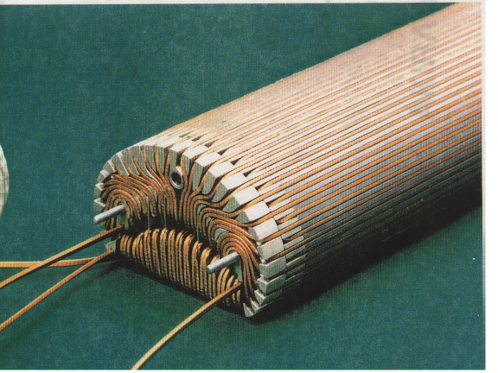
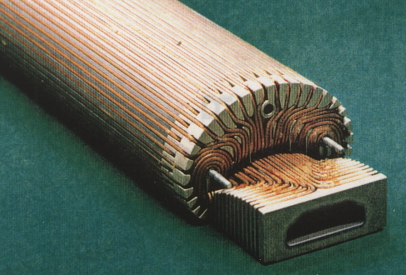
The E821 prototype inflector
One open end, one closed
What we used
Remember this open end, to compare with Vladimir’s new design

Slide 19
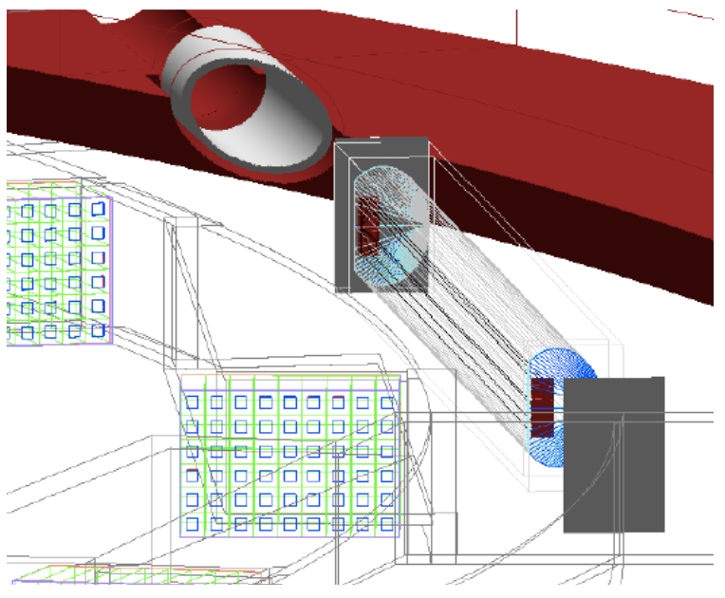
Effect of closed ends on injection efficiency:
Full Geant tracking model
Results demonstrates opening windings leads to 60% higher injection efficiency
Confirmed with transport codes
Relative Storage Fraction
 | Closed ends | Open Ends
E989 | 1.0 | 1.6

Slide 20
Three reasons why we need a new inflector:
It minimizes risk of single point failure, which would delay the experiment by 1-2 years if the remaining E821 inflector fails.
The 60% increase in injection efficiency is huge, because:
  It protects us should one of the projected flux increases not be realized.
  It reduces run time and permits additional systematic studies.
  It will enable us to push the experiment to the systematic limit.
If we do get the flux we are expecting, then the 60% is a big boost towards being able to run μ⁻ , since DOE will have invested ~$100M in the capability to measure .

Slide 21
Why was the new inflector not in the baseline?
We were given a total project cost for the experiment of $46.4 M, and a new inflector did not fit into that guidance.
Nevertheless, from the beginning we told DOE, and each of the review panels, that we wanted to add this scope should contingency become available.
The experts on every review panel agreed with this priority, and recommended that we do everything to keep the new inflector on track.

Slide 22
CD Review inflector recommendations
July 2014 CD-2/3 Review
June 2015 CD-2/3 Follow-up Review
April 2016 DOE Progress Review
  Management should work hard to develop the new inflector
  Recommendation 2: Continue to develop the new inflector design and the associated beam optics/detectors to maximize muon delivery to the ring….
  Recommendation 7: Continue to work on improved inflector design until a decision can be made. To that end, formulate a schedule and plan whereby an inflector decision can be revisited on the basis of cost experience in a timely fashion.
  Response: Invested ~$500k to develop the final design for an open-ended inflector allowing 60% higher injection efficiency.
  The project, in conjunction with the laboratory, should develop a path forward for an improved inflector in the context of the overall proton economics plan for the laboratory.
  Recommendation 2: The Committee supported proceeding forthwith with “Stage 1” of the new-design inflector prototype and getting DOE guidance regarding implementation paths for any potential “Stage 2” inflector implementation, as appropriate.
Notes:
Every committee recommendation

Slide 23
Operational Risks?
“Don’t we have a number of unique single points of failure?”
There are a number of unique pieces, but only the inflector failure would shut us down for 1 to 2 years.
  The Storage Ring is quite robust. We have some He leak issues that will be repaired during the installation time for the vacuum chambers and detectors.
  The Electrostatic Quads are easily repaired if there is a failure, and one would only loose a month or so for a repair.
  The NMR Trolley has new digital electronics, with spares, but uses a few analog parts from E821. If necessary, these parts could be replicated rather quickly (weeks).
  Fast Muon Kickers: If one of them fails, we have spare components and it would take on the order of a month to repair and get back to running.
  The Inflector: We would lose one to two years.

Slide 24
New inflector design requirements
Both ends of the beam channel open.
Minimize flux leakage into the storage region
Must have passive SC shield, with less than 1 ppm leakage into the storage ring.
  Akira Yamamoto helped us to find the material that was left over from the E821 construction, which is adequate to shield 1.5 new inflectors.
Must fit into the existing cryostat and vacuum chamber
Same indirect cooling method

Slide 25
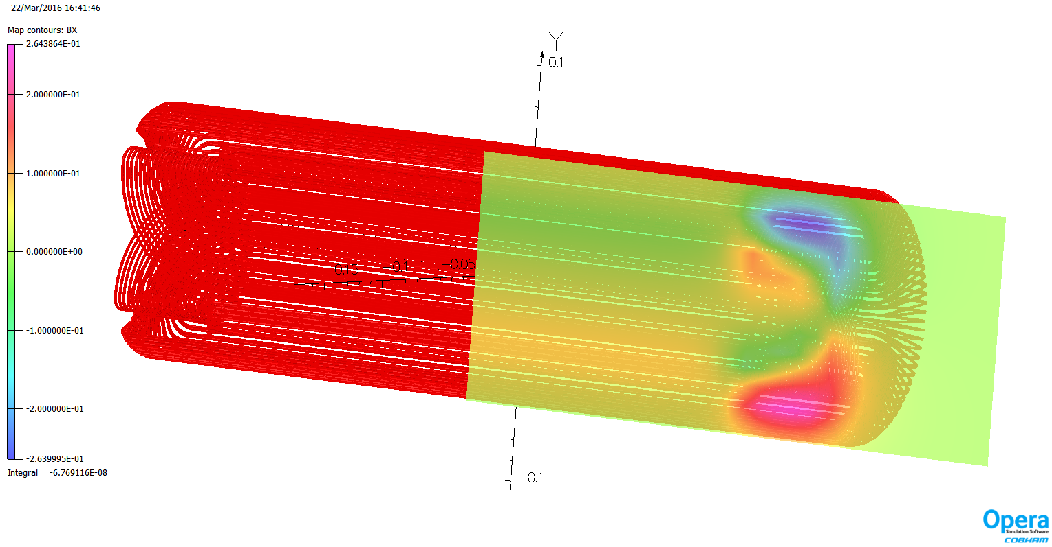
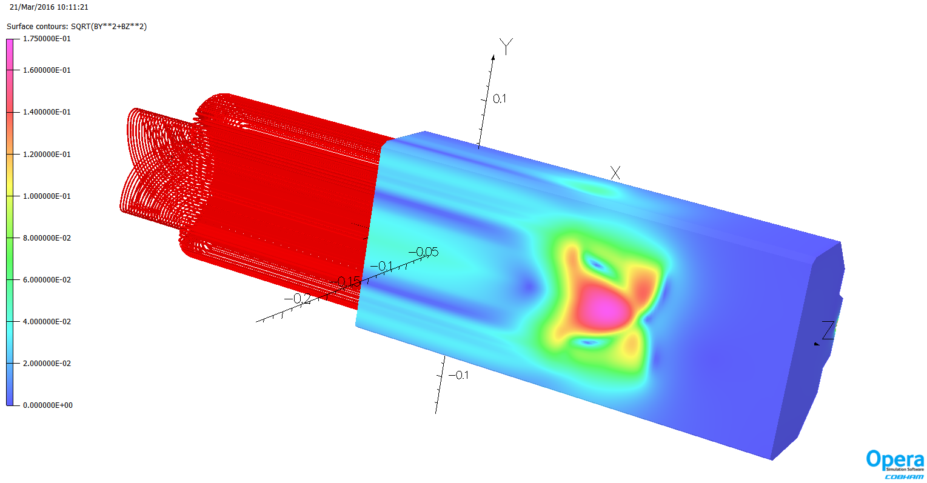
The new inflector design work (V. Kashikhin)
The ends consist of upper and lower coils with current in the opposite direction
with shield

Slide 26
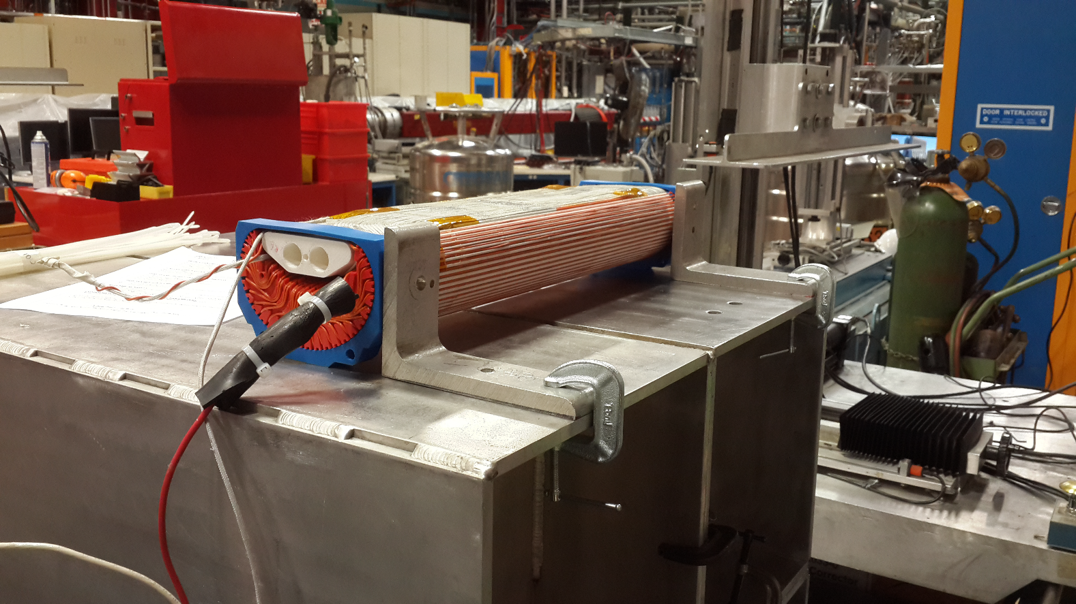
Prototype room temperature model in Fermilab TD
Inner Coil
Aperture
Outer Coil
Enabled measurement of the fringe field to compare with Opera

Slide 27
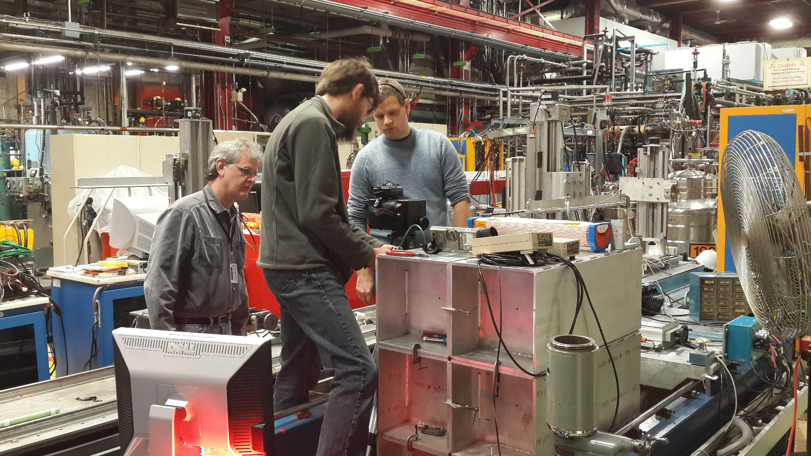
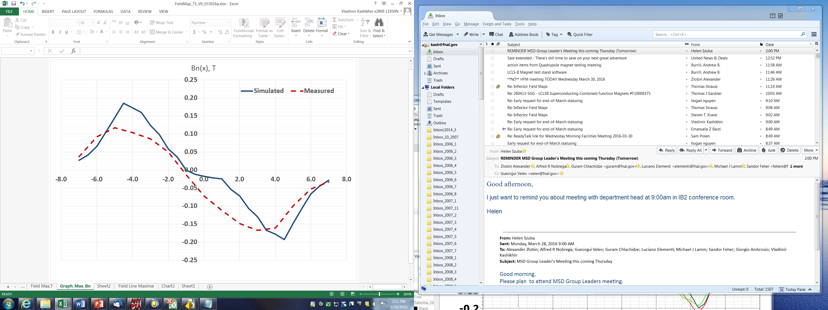
Magnetic Measurement Results
The model field was measured at 4 A current, and simulated at 1398 A. The distance from the inner coil surface was 8 mm.
The measured magnet aperture field transfer function is 10.39 G/A, simulated value 10.65 G/A.
Model measurements confirmed magnetic parameters.

Slide 28
Two-stage strategy
Stage 1: Build and test full-scale technical model using recycled parts ($400k loaded including 40% contingency, ~1 yr)
  Reuse mandrel and superconducting shield
  Shield is less than ideal
    Was cut and repair failed for E821
    Material is ½ the thickness of the current inflector we are using and the J_{c} is borderline
    If shield is only deficiency, can consider using Japanese shield
  If the technical model works, then it could be installed in the FY17 summer shutdown and used – not guaranteed
    If shield is only deficiency, can consider using the new Japanese shield
  Includes testing
Stage 2: Build a new inflector from all new parts (~$620k loaded including 30% contingency, ~1.5yr)
We propose to proceed with Stage 1 ASAP
Full Design Review on Friday, 24 June with Akira Yamamoto as one of the reviewers.

Slide 29
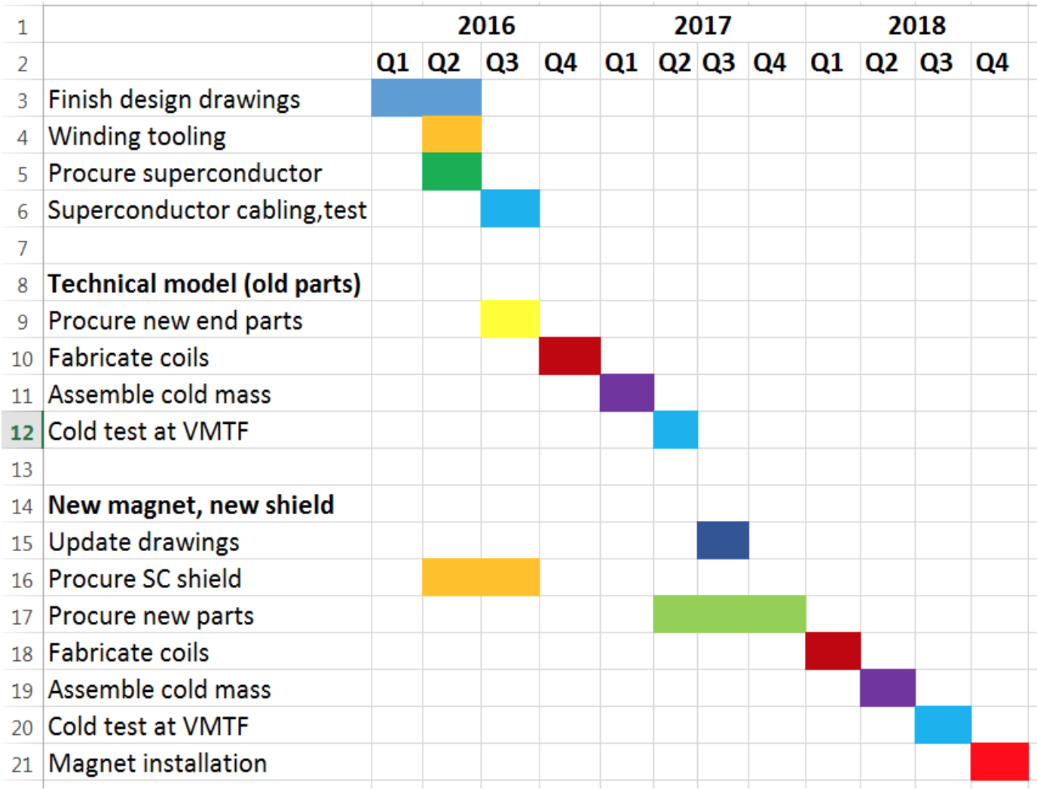
Schedule (CY)
Stage 1 - Ends in time to install in FY17 shutdown if the prototype works
Stage 2 - Need to wait and see on best strategy
Other project
scope ends
Stage 1
ops
Stage 2

Slide 30
Cost and Contingency: Recent history
We have spent $450 k on the design, with another $50 k expected to finish.
Invest $400 k for the “technical model”
If necessary $600 k for the new inflector.
The project has $5.3 M in contingency left, with $9M of work remaining. We have $1,000 k excess contingency.

Slide 31
Summary
The new inflector still remains the most important optional scope item considered by the project
  Reduces risk and increase injection efficiency by 60%
Design is complete
  Largest initial risk will soon retired, with new shield material in hand.
Propose funding Stage 1 to construct and test full-scale technical model
  $400k, made largely from recycled parts. Project shows ~ $1,000 k in the May analysis of excess contingency.
  Construction and testing completed on same timescale as rest of project scope
Options for stage 2 deferred for later strategy discussion
  Depends on outcome of technical model, how much contingency remains toward end of project

Slide 32
Our Request
We request that the PAC strongly endorse our continued development of a new open-ended inflector, using the contingency that has been liberated by the continued retirement of risk.

Slide 33
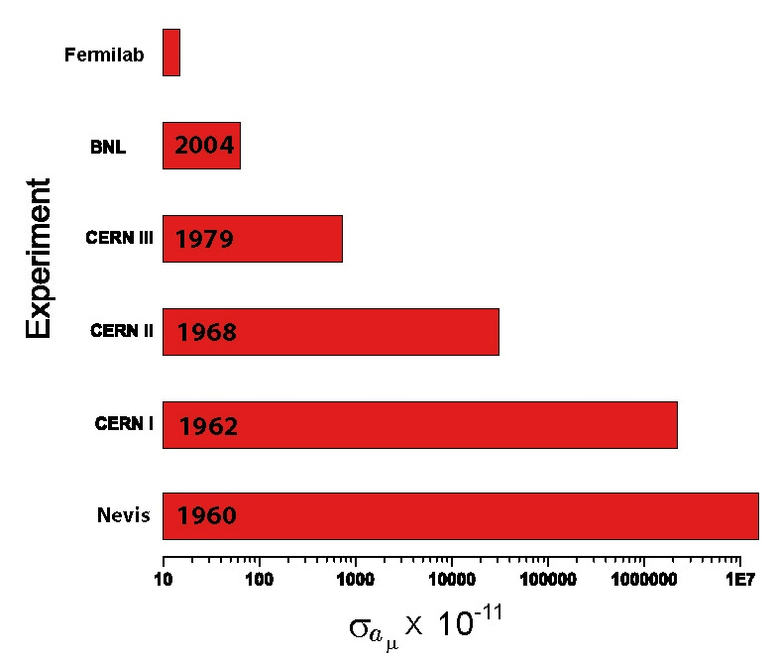
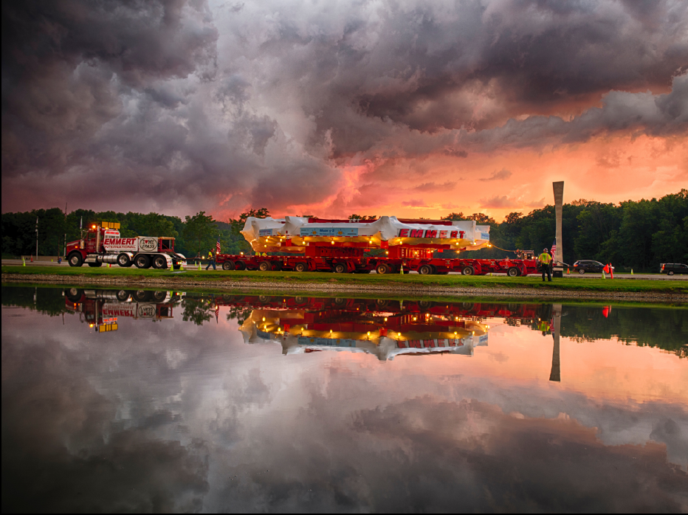
g = 2( … + C₃(α/π)³ + C₄(α/π)⁴+ Had + Weak + ? )
g = 2( … + C₃(α/π)³ + Had)
g = 2( … + C₃(α/π)³ + Had)
g = 2(1 + α/2π + C₃(α/π)³ )
g = 2(1 + α/2π)

Slide 35
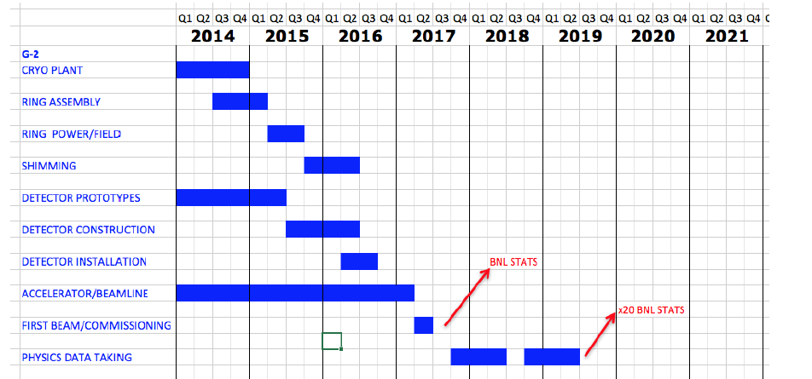
The Fermilab g-2 timeline (Calendar Year)
Physics results:
  a_{μ} a BNL level result soon, σ_{BNL}÷ 2, σ_{BNL}÷ 4
  muon EDM
  search for CPT/Lorentz violation
  muon lifetime in flight (special relativity test)

Slide 36
Block schedule from CD-2/3 Progress Review
2015
2016
2017
Sep
Oct
Nov
Dec
Jan
Feb
Mar
Apr
May
Jun
Jul
Aug
Sep
Oct
Nov
Dec
Jan
Feb
Mar
Prepare vacuum chambers
Install/test old inflector
Prepare old inflector/install infrastructure
Prepare quads
Final test quads
Field Shimming
Install Chambers
Prepare kickers
Prepare field equipment
Prepare detectors/electronics/DAQ
Install kickers, field monitoring equipment, det/elec/DAQ
He leak repair (off project)
Beamline construction
Accelerator construction is critical path
Ring critical path revolves around shimming the magnet to high uniformity → installing the vacuum chambers → installing all the subsystems that require the chambers to be in place
Conducting He repair scheduled after shimming and inflector/quad testing complete

Slide 37
2015
2016
2017
Sep
Oct
Nov
Dec
Jan
Feb
Mar
Apr
May
Jun
Jul
Aug
Sep
Oct
Nov
Dec
Jan
Feb
Mar
Prepare vacuum chambers/align cages w/ rails, quad, kicker plates
Field Shimming
Install Chambers
Prepare old inflector/install infrastructure
Install/test old inflector
He leak repair (magnet warm)
Construct & install quad pulsed power supplies, feedthroughs, connections
Final test quads
Assemble kicker plates, cages, pulsers
Install Blumleins, PS, & kickers
Test kickers
Construct and test upgraded NMR trolley & absolute calibration
Install trolley & calibration
Test NMR systems
Receive calo crystals/SiPMs
SLAC test beam
Construct 1st full calorimeter
Electronics & DAQ development
WFD production & QC
Electronics install
Dry runs & mock data challenge
Calo production & installation
DAQ installation & testing
1st tracker assembly & installation
2nd tracker assembly & installation
Install final focus on AP0 target
Commission primary proton beam to AP0
Construct M2/M3 beamlines from AP0 to Delivery Ring
Modify AP0 Li lens and PMAG PS for g-2 rep rate, replace beam dump
Install Delivery Ring injection, transport, and extraction
Construct M4/M5 beamlines from DR into g-2 ring

Slide 38
Shielding material - largest risk nearly retired
put at backjup
Shielding material that prevents flux from leaking out of inflector is absolutely crucial…had no solution in 2014
Explored two options
  MgB2 – could make this work but ceramic has complications
  Remanufacturing original NbTi/Cu shield
With help from Akira Yamamoto we located the last remnants of the original inflector shield material made in the R&D division of Nippon Steel!
  Nippon selling material for ~$50k, needs final processing by 2nd vendor for ~$30k
  Enough to make 1.5 new shields
  Procurement in progress on operations budget (to be purchased back by project if new inflector scope approved)

Slide 39
Contingency Spend Plan
Decision points based on when other significant milestones had been met to reduce risk
  Preliminary design of new inflector complete – added $345k of budget for next design phase was added in August 2014
  Completion of ring reassembly and powering of storage ring magnet – completed Sep 2015, no new scope added due to $1.8M in contingency used
  POs placed for quad pulsers and inflector valve box – retiring risk for final complex procurements
  Accelerator implementation is 50% complete – hit that mark Feb 2016
A new inflector has always been the highest priority in the contingency spend plan
Have completed bottom-up contingency analysis showing $1,000k in excess contingency
✔
✔
✔
✔

Slide 40
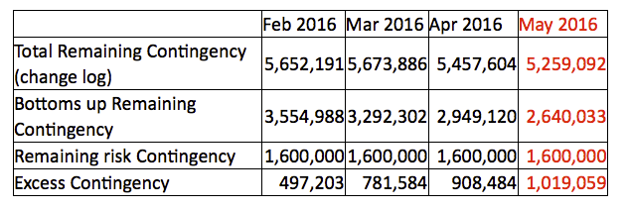
Cost and Contingency: Recent history
We have spent $450 k on the design, with another $50 k expected to finish.
The estimate is $400 k for the “technical model” and
$600 k for the new inflector.
Contingency history:
At every DOE review that we’ve had, the reviewers have recognized the importance of the benefits that a new inflector would have.

Slide 41
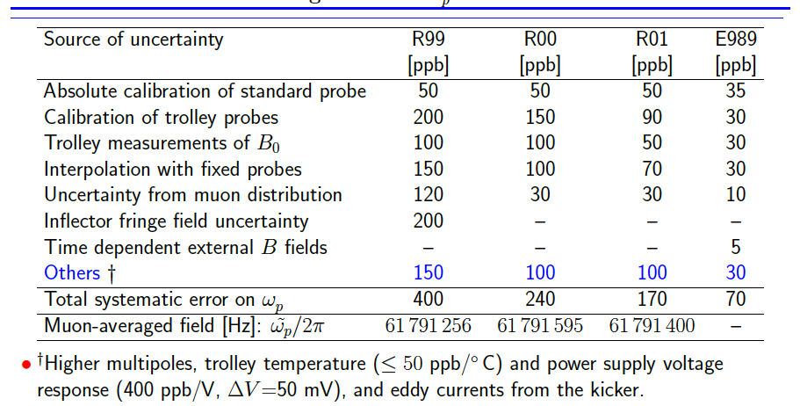
Errors from BNL and projected at Fermilab
These can be determined without beam with the storage ring magnet, and using the MRI solenoid facility at Argonne Lab

Slide 42
July 2014 CD-2/3 Review
Final committee report 6 Oct 2014
  The Committee noted that a new inflector design has the potential to have significant impact on the project. In particular, it would serve to
    Mitigate project performance risk – by providing increased muon intensity the new design provides contingency in case the project were to have issues achieving its intensity design goal
    Mitigate project hardware risk – the existing inflector would be available as a spare in case of inflector hardware failure
    Provide enhanced physics reach – the increase in muon acceptance would allow m- as well as m+ experiments: in the case of a potential physics discovery, this capability would aid in ruling out systematics as a source
  Management should work hard to develop the new inflector
  Recommendation 2: Continue to develop the new inflector design and the associated beam optics/detectors to maximize muon delivery to the ring….
  Recommendation 7: Continue to work on improved inflector design until a decision can be made. To that end, formulate a schedule and plan whereby an inflector decision can be revisited on the basis of cost experience in a timely fashion.
  Response: Invested ~$500k to develop the final design for an open-ended inflector allowing 60% higher injection efficiency.

Slide 43
June 2015 CD-2/3 Follow-up Review
Final committee report
  The Committee judged that a new, upgraded inflector may be a significant improvement as it could reduce the number of Protons on Target (POT) needed for Muon g-2. There is about $300k allocated to continue the study. Additional engineering design and planning of the new inflector is required to inform a decision to proceed based on a solid schedule and cost estimate. Even if this is done as an upgrade, the sooner the new device can be installed the greater the benefit will be.
  The project, in conjunction with the laboratory, should develop a path forward for an improved inflector in the context of the overall proton economics plan for the laboratory.

Slide 44
April 2016 DOE Progress Review
Final report
  A new-design/improved inflector to enable additional physics capability, with a 60% higher transmission is an alternative future option. It incorporates modified (open) ends that also reduce field at the shield location and newly available enhanced shield material. The next step for this option is to fabricate and test a “Stage 1” prototype inflector cold mass (in-project cost $400K +40% contingency over one year); this is beyond the KPP. If successful, the prototype could become an early upgrade option. Alternatively, with DOE guidance/approval, out-of-project (or contingency) dollars could be used to fabricate a “Stage 2” completely new production inflector (cost $620K +30% contingency over 1.5 years) of the new design for subsequent implementation in the SR.
  Recommendation 2: The Committee supported proceeding forthwith with “Stage 1” of the new-design inflector prototype and getting DOE guidance regarding implementation paths for any potential “Stage 2” inflector implementation, as appropriate.

Slide 45
The Fermilab error budget for a new experiment represents a continuation of improvements already made during E821
Systematic uncertainty (ppm) | 1998 | 1999 | 2000 | 2001 | E821 final | E989 Goal
Magnetic field – w_{p} | 0.5 | 0.4 | 0.24 | 0.17 | 0.17 | 0.07
Anomalous precession – w_{a} | 0.8 | 0.3 | 0.31 | 0.21 | 0.21 | 0.07
Statistical uncertainty (ppm) | 4.9 | 1.3 | 0.62 | 0.66 | 0.46 | 0.1
Systematic uncertainty (ppm) | 0.9 | 0.5 | 0.39 | 0.28 | 0.28 | 0.1
Total Uncertainty (ppm) | 5.0 | 1.3 | 0.73 | 0.72 | 0.54 | 0.14

Slide 46
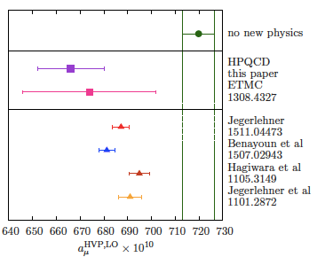
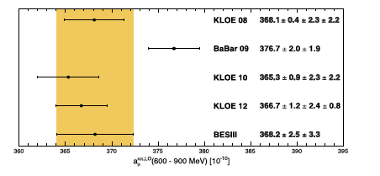
Recent news on the hadronic contribution to a_{μ}
The Lattice
  Chakraborty, Davies, de Olivera, Koponen , Lepage arXiv:1601.0307v1 [hep-lat] Lowest order hadronic
  Blum, Christ, Hayakawa, Izubuchi, Jin, Lehner, PRD 93 014503 (2016). Hadronic Light by Light
New e⁺e⁻ data
  BESIII PLB 753 (2016) 629
3 σ difference using the lattice alone
A complete re-evaluation including the new data is underway by Teubner (Hagiwara et al.,)

Slide 47
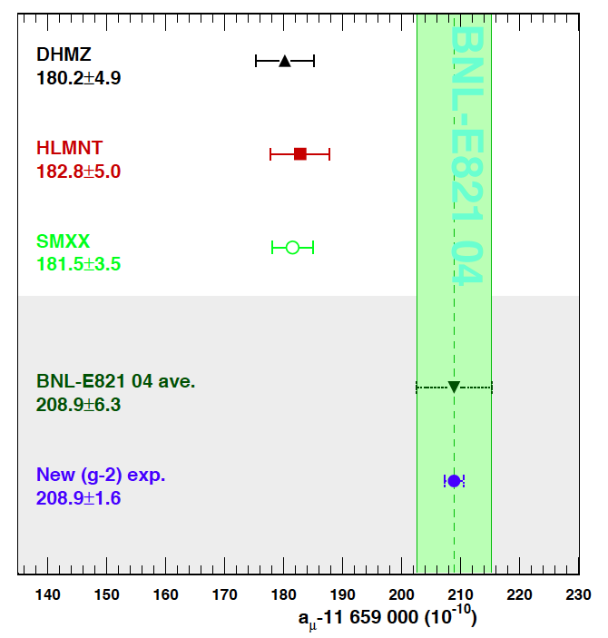
Where could a _{μ} be at the end of E989?
With 2 × 10¹¹ analyzed events above 1.8 GeV
  total data “several petabytes”
Experiment ± 140 ppb (±16 × 10⁻¹¹) or better
Theory ± 306 ppb (±35 × 10⁻¹¹) or better
Δ = (274 ± 38) × 10⁻¹¹
> 7 σ
Blum et al.
arXiv:1311.2198v1 [hep-ph] 9 Nov 2013

Slide 48
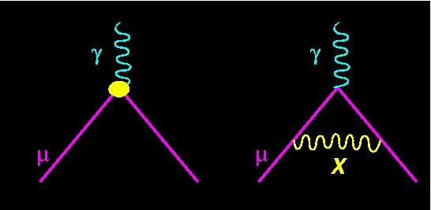
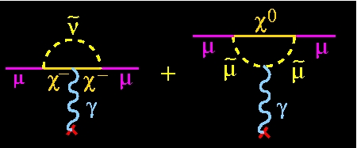
g is modified by virtual particles. Is SM complete?
The questions are:
  what’s the mass?
  what’s the coupling?
Substructure can also change g
The game plan:
  calculate the effect on g of all the known known particles
  compare with experiment
  see if they agree
  if they disagree, the Standard Model is incomplete
The bottom line: Nature knows about all particles
but we have to search for them
Y

Slide 49
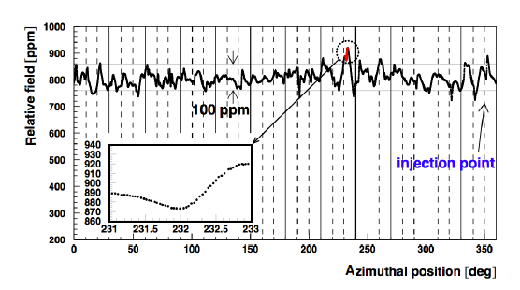
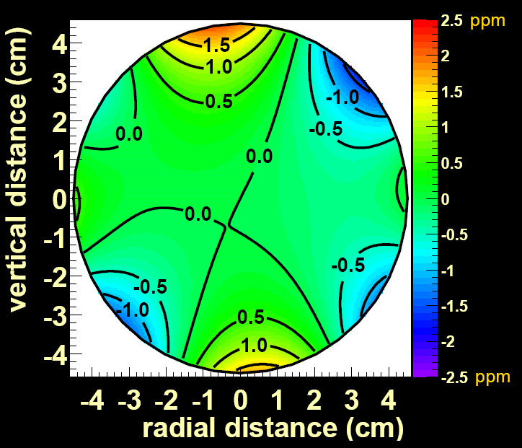
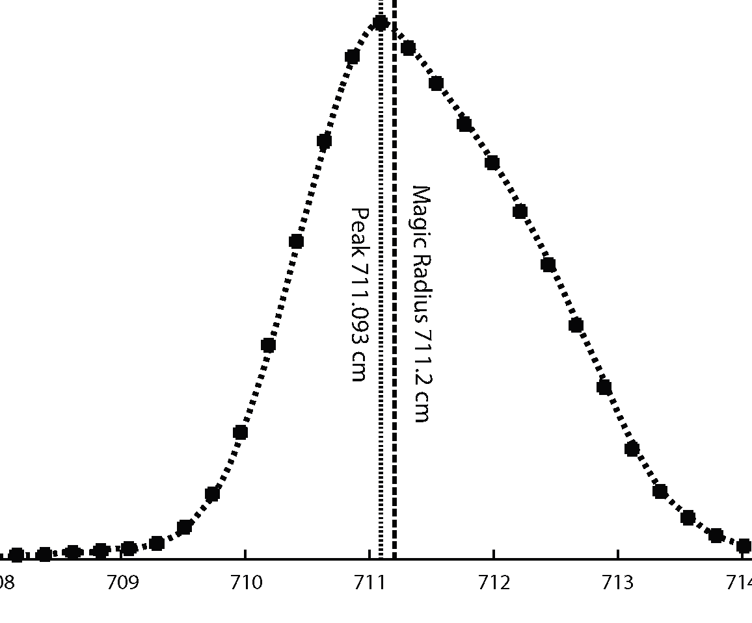
E821 field after shimming
0.5 ppm contours
Central trolley probe vs. azimuth
;
For one value of azimuth, φ
field volume 1.13 m³ or 40 ft³
Fermilab goals:
  point to point uniformity ±25 ppm
  average over azimuth even flatter than BNL
  total field error budget 70 ppb

Slide 50
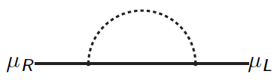
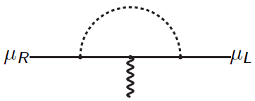
Why is a_{μ} special? Beyond the SM:
m_{μ} in loops
a_{μ} in loops
Any new physics that contributes to the muon mass can contribute to a_{μ}

Slide 51
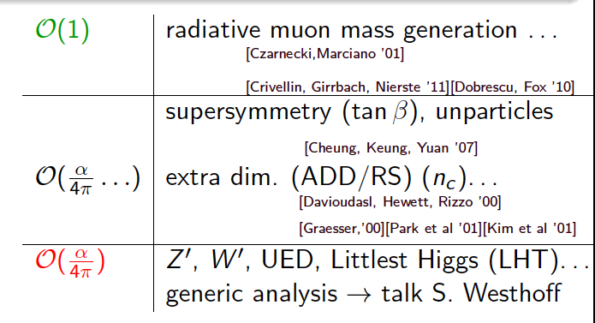
Classify new physics; C very model dependent
Freitas, Lykken, Kell, Westhoff
dark photon

Slide 52
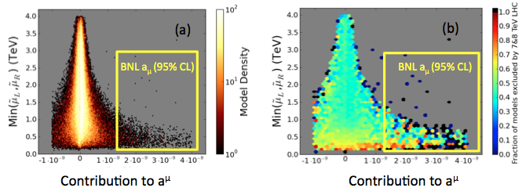
SUSY Parameter Space still allowed by LHC and a_{μ}
Density of Models
Fraction of Models Excluded
Courtesy – Tom Rizzo 2014
Cahill-Rowley, Hewett, Hoeche, Ismall, Rizzo Eur. Phys. J. C (2012) 72:2156
http://arxiv.org/abs/1206.4321
Cahill-Rowley, Hewett, Ismall, Rizzo PRD 88, 035002 (2013)
1211.1981

Slide 53
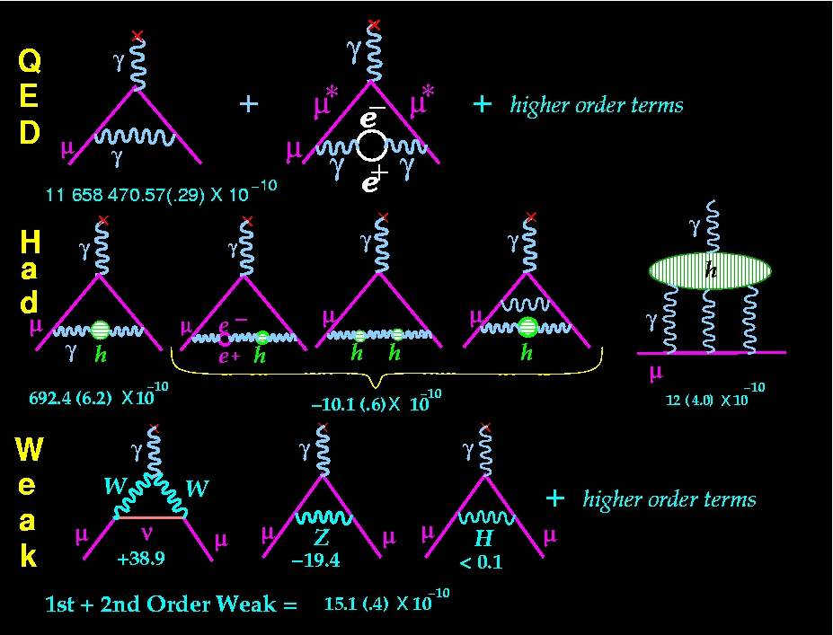
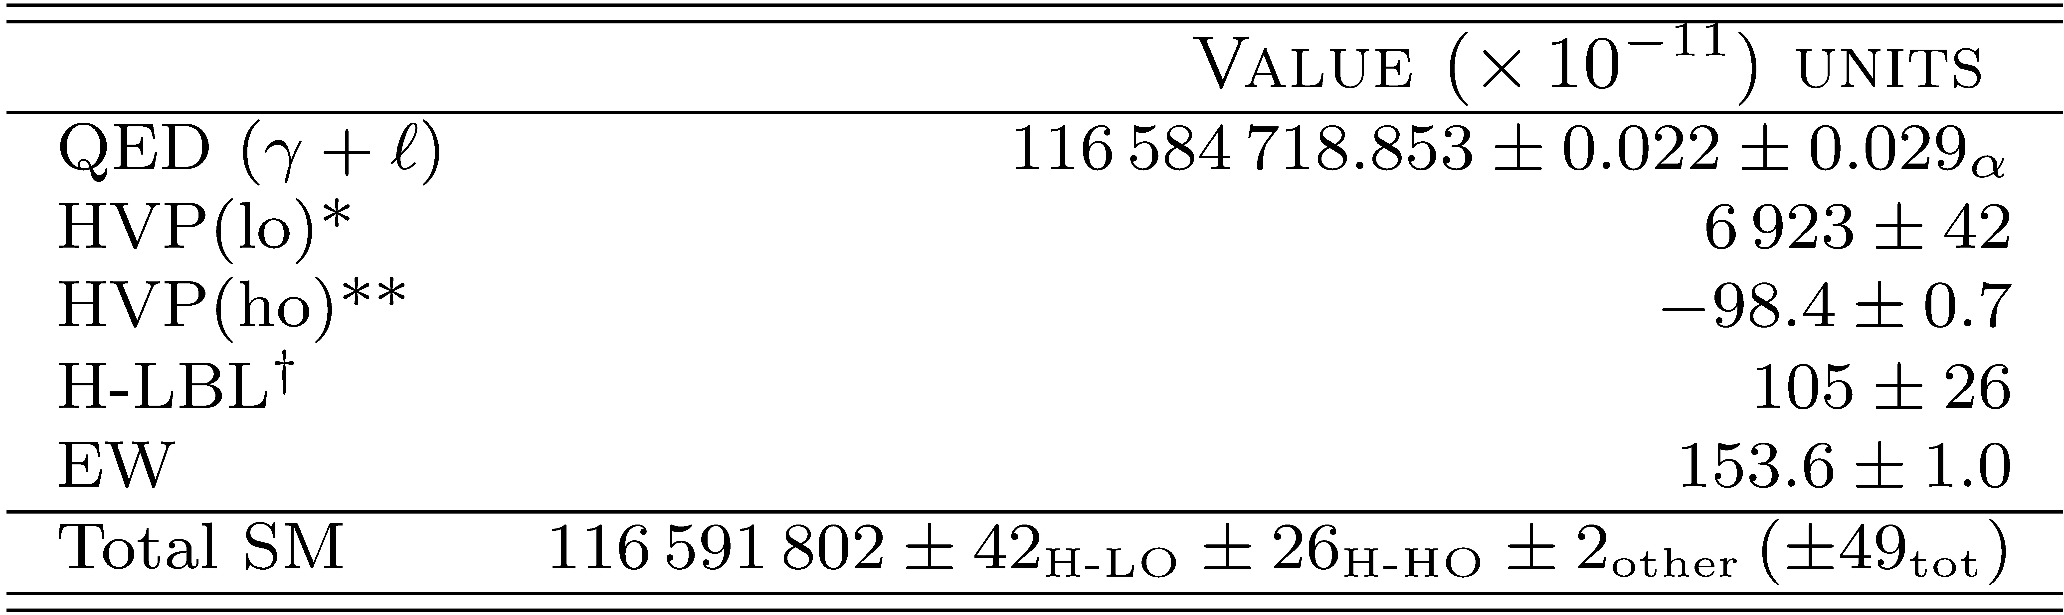
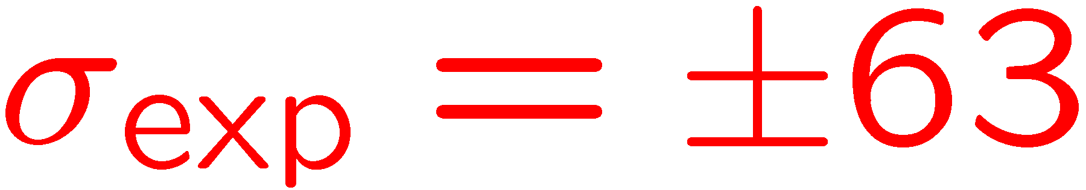
The SM Value for a_{μ}
well known
significant work ongoing
*Davier et al, Eur. Phys. J. C (2011) 71:1515 **Hagiwara et al, J. Phys. G38, 085003 (2011).
Prades et al Lepton Moments

Slide 54
Recent news on the hadronic contribution to a_{μ}
The Lattice
  Chakraborty, Davies, de Olivera, Koponen , Lepage arXiv:1601.0307v1 [hep-lat] Lowest order hadronic
  Blum, Christ, Hayakawa, Izubuchi, Jin, Lehner, PRD 93 014503 (2016). Hadronic Light by Light
New e⁺e⁻ data
  BESIII PLB 753 (2016) 629
3 σ difference using the lattice alone
A complete re-evaluation including the new data is underway by Teubner (Hagiwara et al.,)

Slide 55


Measuring the magnetic field (E821, E989)
Map the field often at 6000 locations in azimuth with an arrangement of 17 probes
Monitor the field during data collection with 366 fixed probes
The NMR trolley in a vacuum chamber

