Slide 1
Accelerator Expectations for FY17
Mary Convery
PAC meeting
20 June 2016

Slide 2
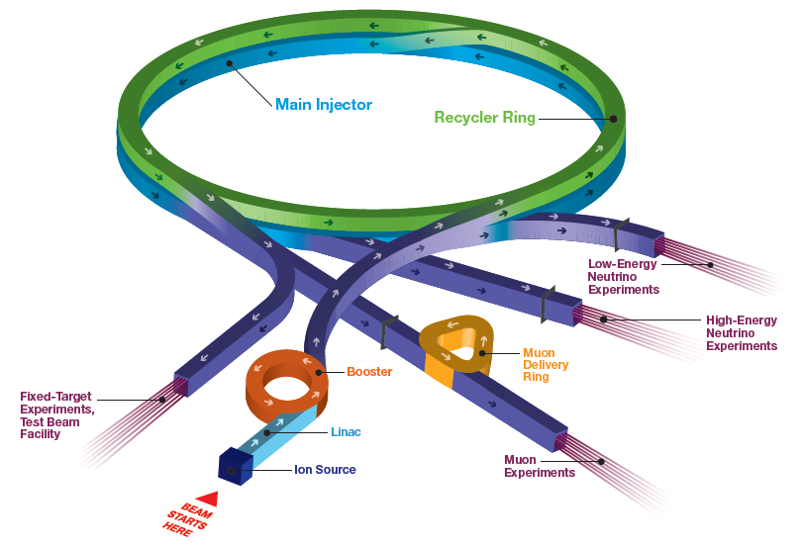
Fermilab Accelerator Complex
BNB: MicroBooNE
NuMI: MINOS+, MINERvA, NOvA
Fixed Target: SeaQuest, LArIAT, Test Beam Facility
Muon: g-2, Mu2e (future)

Slide 3
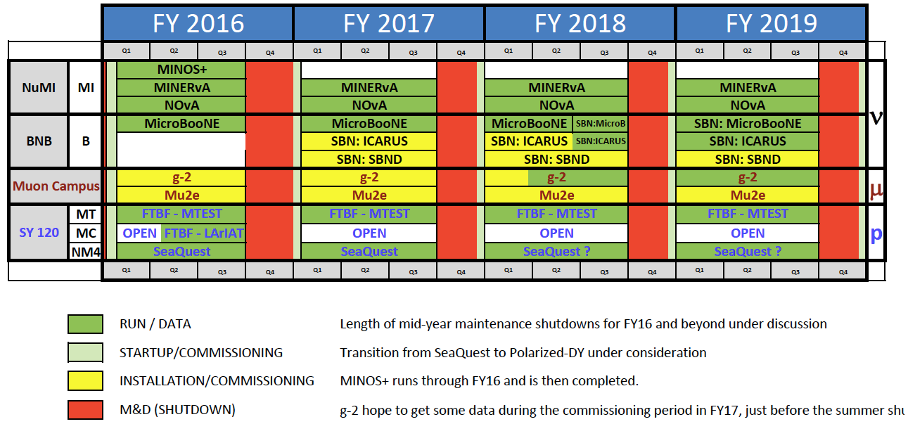
Fermilab Experiments’ Run Schedule

Slide 4
Accelerator Operations Priorities for FY16-18
Ramp up beam power to 700 kW for NOvA, achieve performance metrics, and support full experimental program
Continue carrying out the Proton Improvement Plan to reach >2x10¹⁷ protons/hour in the Booster and ensure a useful operating life of the proton source through at least 2030
Complete the Muon Campus construction in FY17, on budget and on schedule
Commission and operate beam to the g-2 experiment starting in FY17
Build an upgraded horn and power supply in the Booster Neutrino Beam target station for Short Baseline Neutrino

Slide 5
FY16 performance:
Ramp up beam power to 700 kW for NOvA, achieve performance metrics, and support full experimental program

Slide 6
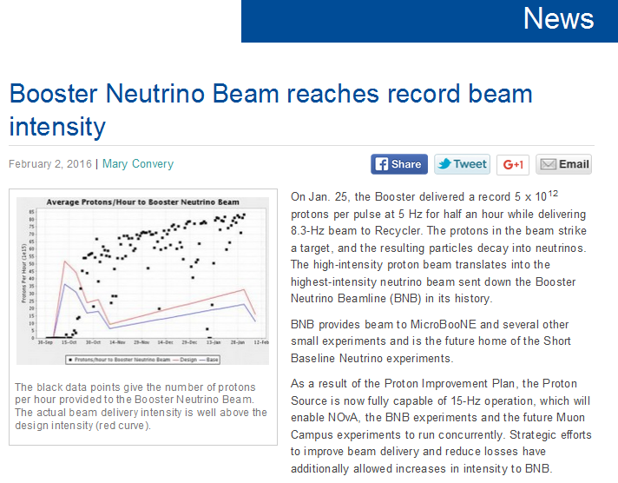
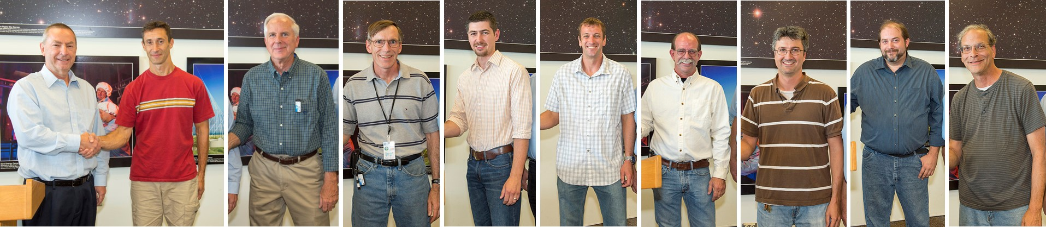
Booster 15 Hz Running
Capable of 15 Hz Booster beam since June 2015
Delivering record proton flux!
Enables us to supply beam to NuMI (at 700 kW), BNB, and the future Muon Campus
2015 Employee Performance Recognition Awards for 15 Hz in Booster

Slide 7
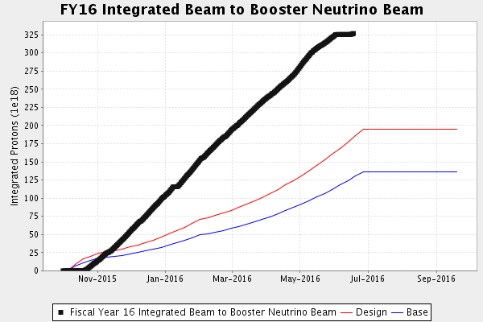
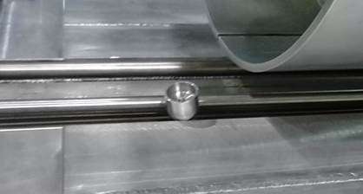
FY16 Goals for Beam to BNB
ground fault due to displaced cap on horn bolt to prevent corona discharge
(mock-up)
Booster ramp-up in flux (15 Hz and intensity) much faster than assumed
Had extended running at 5-Hz repetition rate (target station design limit)
Increasing NuMI power has not significantly impacted beam to BNB

Slide 8
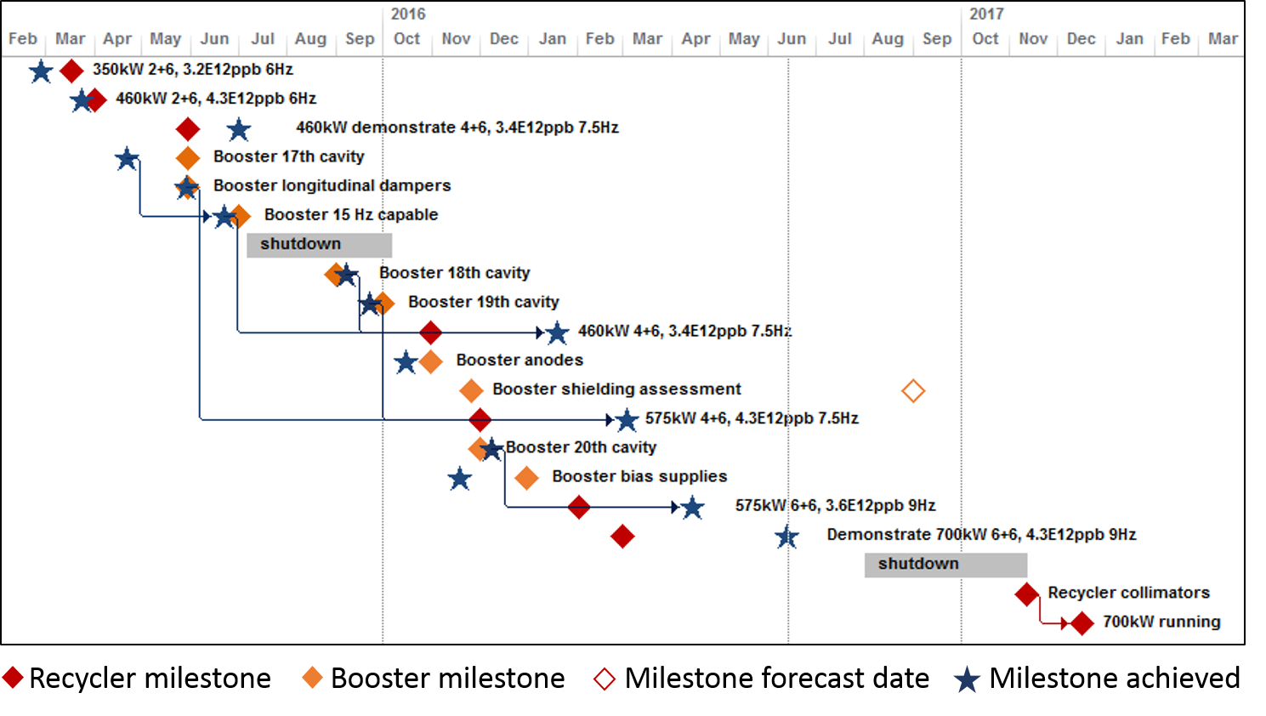
Achieving Milestones for 700 kW Beam Power from MI
Routinely running 6+6 slipstacking with beam power close to 600 kW
Have demonstrated 700 kW, 1-hour record 615 kW
Need Recycler collimators for full-time 700 kW operation

Slide 9
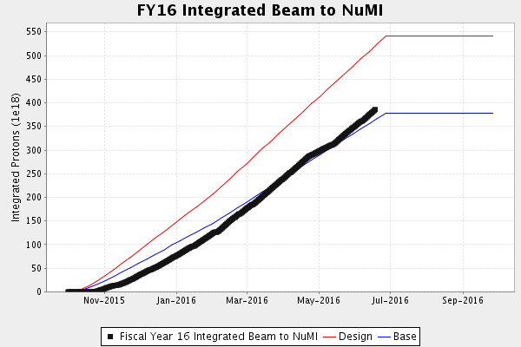
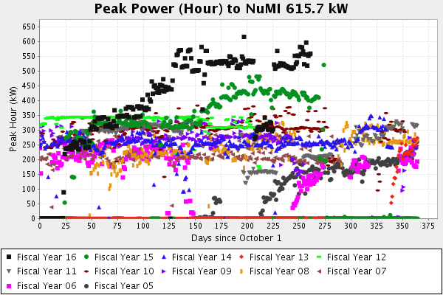
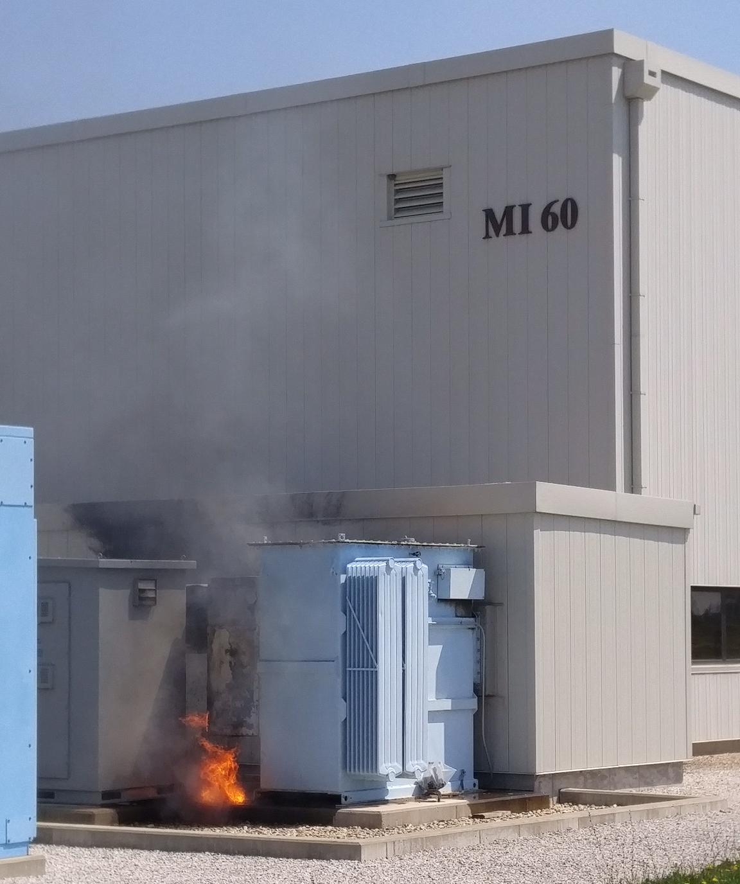
FY16 Goals for Beam to NuMI
Projection takes into account likelihood of turning off when cooling pond temps too high
Recycler RF anode power supply transformer failure
Based on milestones for achieving 700 kW beam power
Beam startup delayed to allow upgrade of Booster anode supplies
Recycler startup slowed by aperture restrictions which were fixed
Now running consistently at highest power to date

Slide 10
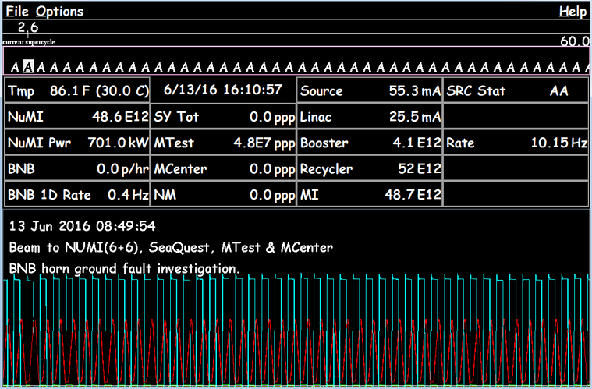
700 kW Beam to NuMI
Have also met our internal goals
  Run above 500 kW for 100 hours during one week with 10% of the timeline dedicated to slow extraction as usual (equivalent to beam power of 550 kW without slow extraction)
  Run for 1h at 600 kW with 6+6 slip stacking without slow extraction

Slide 11
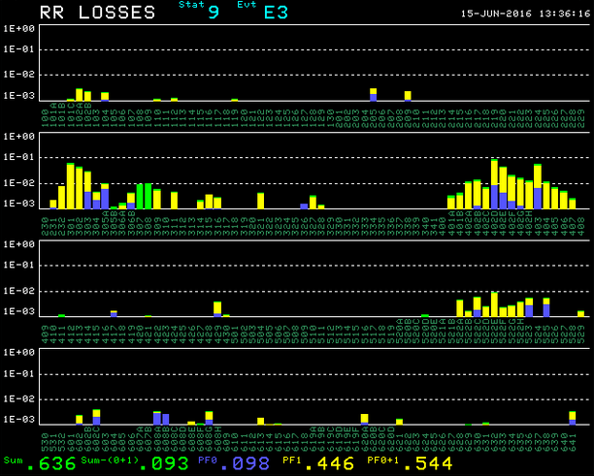
Recycler Collimators
Installing collimators in Recycler in order to run 700 kW continuous without significant irradiation of tunnel components

Slide 12
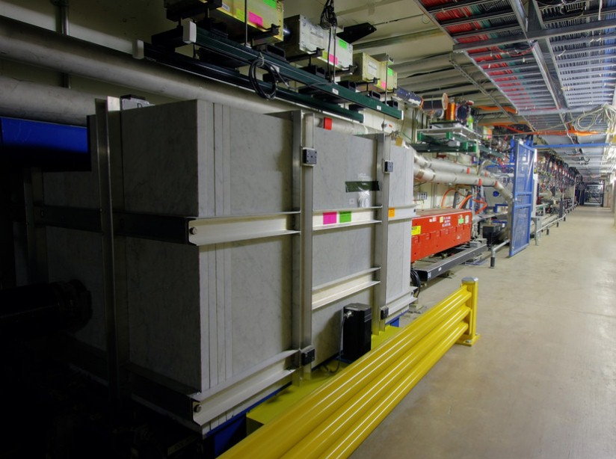
Recycler Upgrades for NOvA Operations
Conversion of vacuum system from titanium sublimation pumps to ion pumps, better suited for current Recycler operations
  1st phase complete, 2nd phase FY16 shutdown, final phase FY17
Collimators in Recycler
  Needed to run 700 kW continuous without significant irradiation of tunnel components
  Design based on Main-Injector collimators
  Primary and two secondaries in FY16
  Two additional secondary collimators in FY17
Main Injector secondary collimator

Slide 13
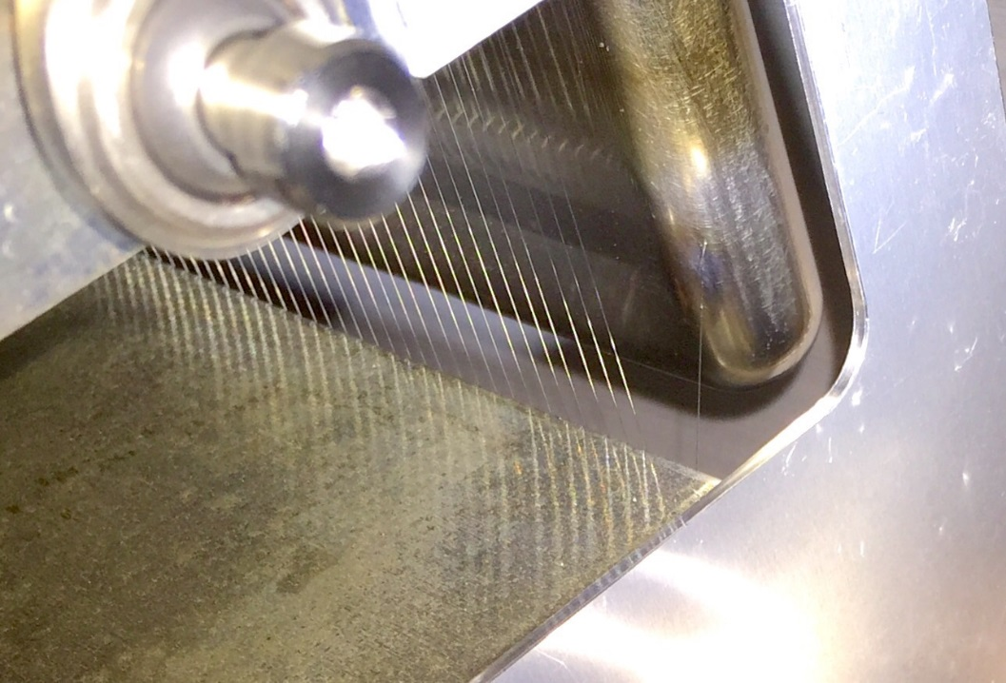
SY120 (120 GeV fixed target program)
Delivering beam to Fixed Target Test Beam Facility as needed (the facility is fully subscribed)
Supporting a second test beam for LArIAT liquid argon TPC
Providing requested intensity to SeaQuest
Extraction septum 2 broken wires
  Have two 2-mil spares
  Plan to rebuild a 4-mil spare
Improved beam-inhibit system with quadrupole input
Worked with Test Beam Facility to improve particle identification

Slide 14
Proton Improvement Plan:
Continue carrying out the PIP to reach >2x10¹⁷ protons/hour in the Booster and ensure a useful operating life of the proton source through at least 2030

Slide 15
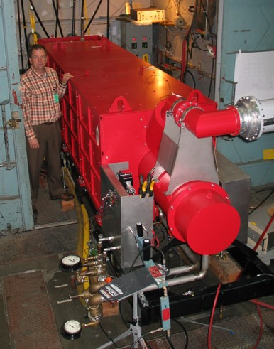
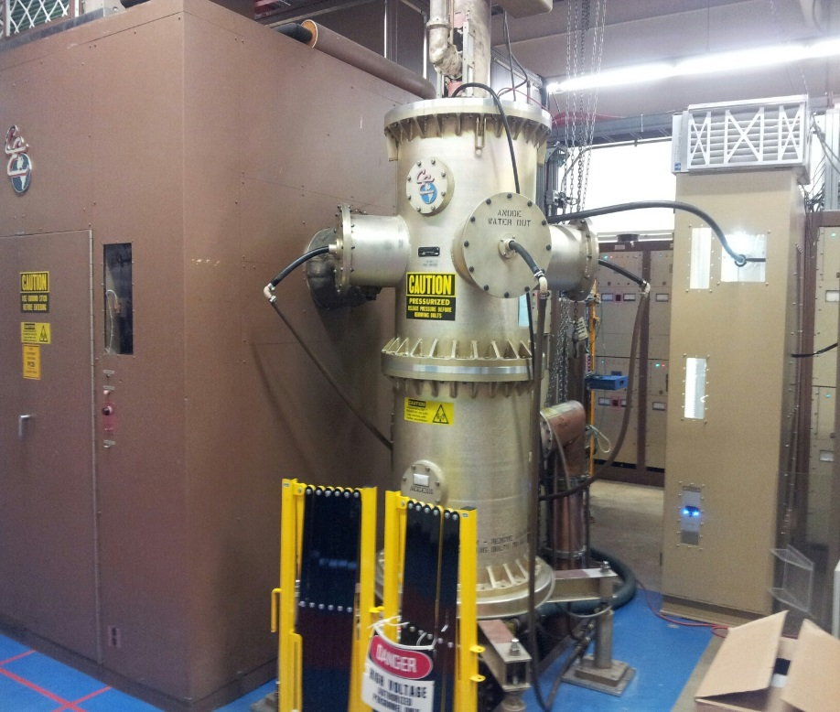
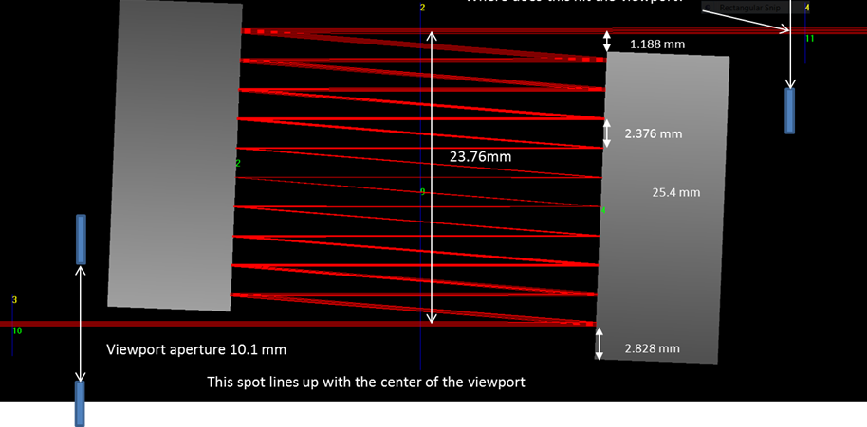
PIP – Linac Upgrades
200 MHz Klystron – power-tested and delivered
  First 200 MHz Klystron ever made
  This device is capable of replacing our tetrode 7835
  Developed replacement plan should it be needed
7835 Modulator – 28-cell unit operating in station 1, building 54-cell to install during shutdown
Laser Notcher testing in progress
  Greatly improved gradient stability
7835
Socket
Old
New

Slide 16
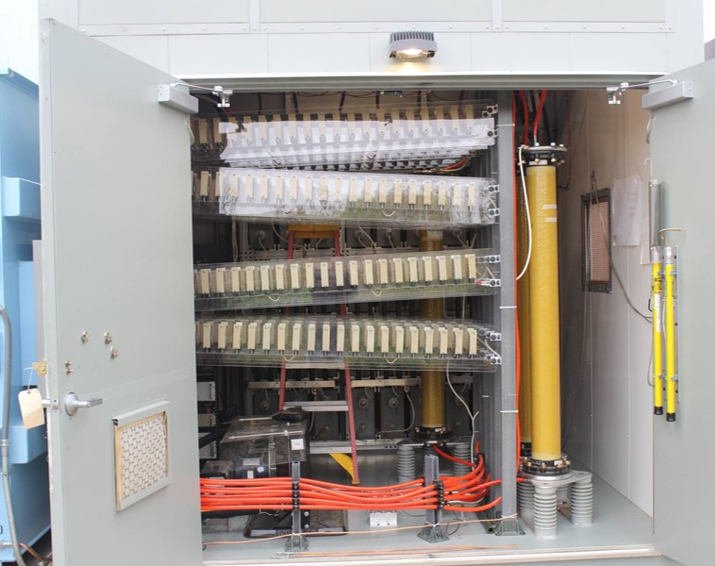
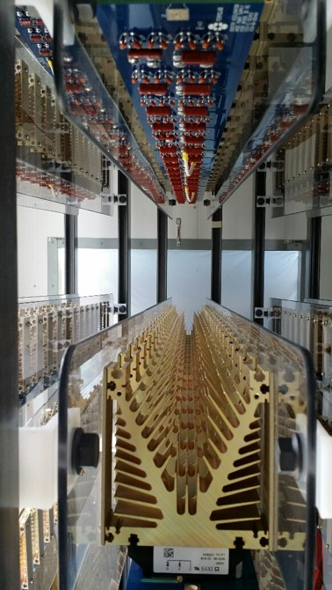
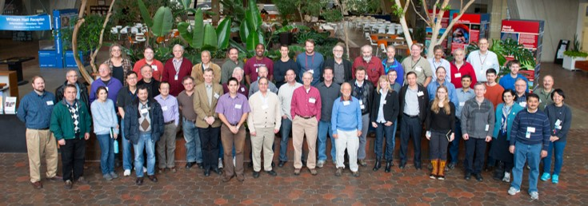
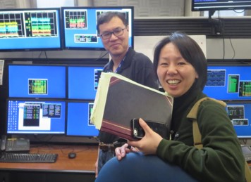
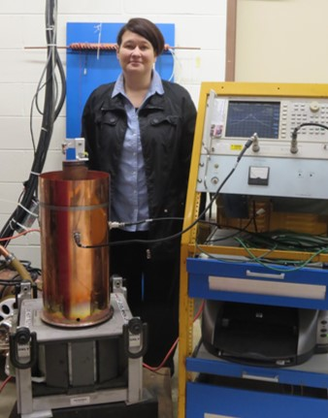
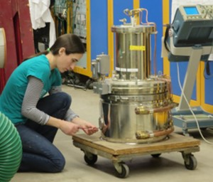
PIP – Booster Upgrades
RF cavity refurbishment complete, 20 stations installed, can run 15 Hz
Additional new RF cavity tuners being produced by Technical Division
Anode power supplies needed to run 20+ stations installed during shutdown
Additional cavities 21 & 22 – retrofitting large-bore cavities
Beam physics improvements and new instrumentation in progress
Prototyping second-harmonic (perpendicular bias) cavity
Designing replacement cavities compatible with PIP-II requirements
  Workshop on Booster Performance and Enhancements Nov ‘15

Slide 17
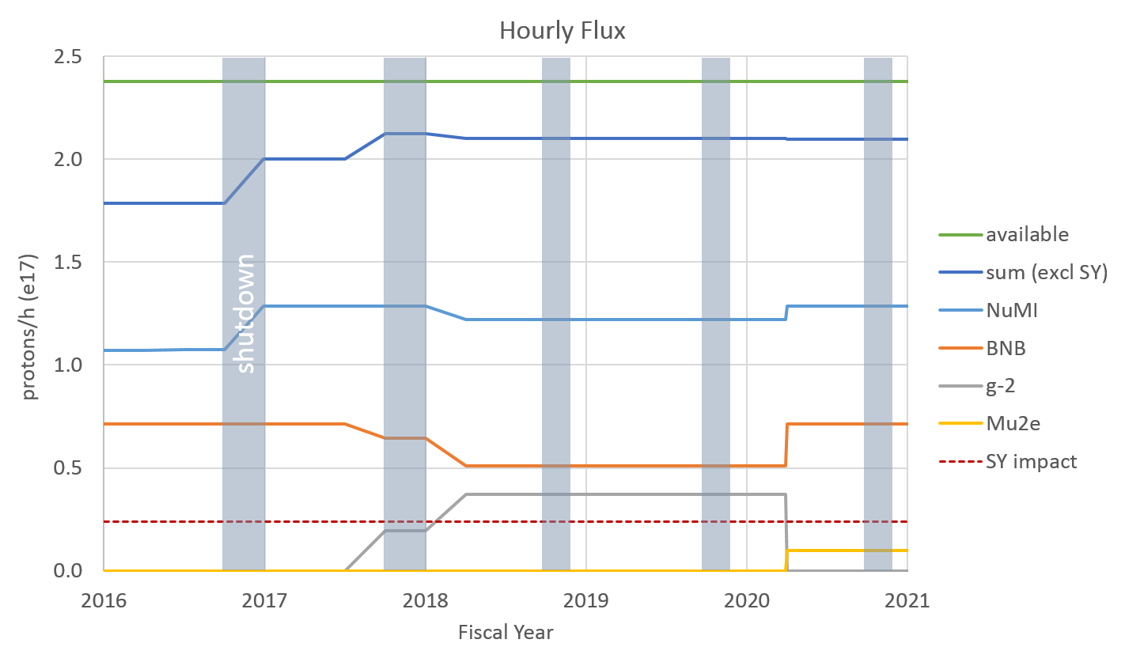
Proton flux to users
Presently limited to 1.8x10¹⁷ proton/h by Booster shielding assessment
  New assessment taking into account use of Total Loss Monitors being reviewed
Switch from 1.33s to 1.4s cycle time starting in FY18 to accommodate g-2
  NOvA and g-2 each get 95% of what they consider nominal

Slide 18
Accelerator Improvement Projects:
Complete the Muon Campus construction in FY17, on budget and on schedule

Slide 19
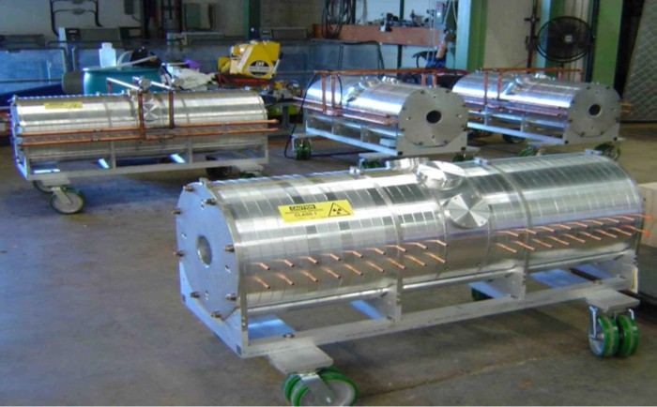
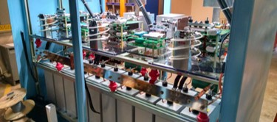
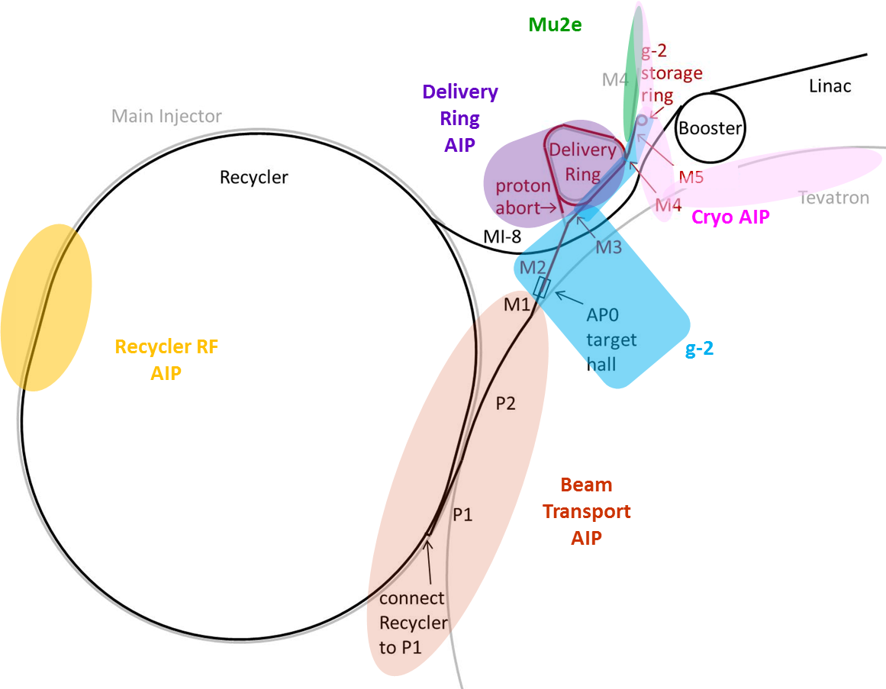
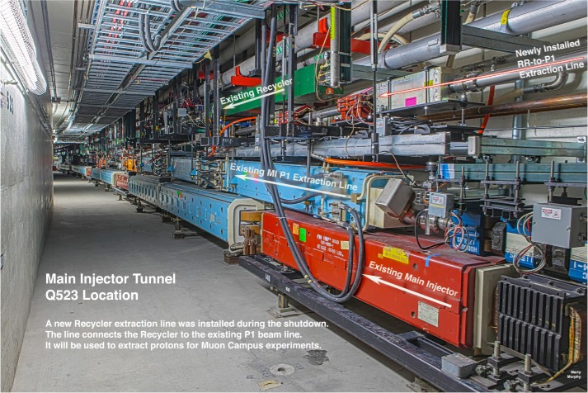
Muon Campus Accelerator Improvement Projects
AIPs under budget and on schedule to be ready in time for g-2
AIP | Total Project Cost | % complete
Delivery Ring AIP | $9.7M | 58
Recycler RF AIP | $7.9M | 81
Beam Transport AIP | $6.5M | 99
Cryo AIP | $9.5M | 68*
Pulsed septum power supply under construction
New RF cavities ready to install in FY16 shutdown
* cryo work needed for g-2 is 100% complete
New connection from Recycler to P1 line installed during FY15 shutdown

Slide 20
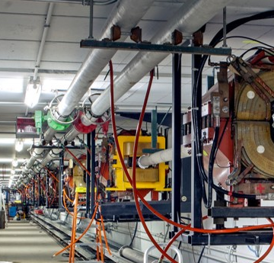
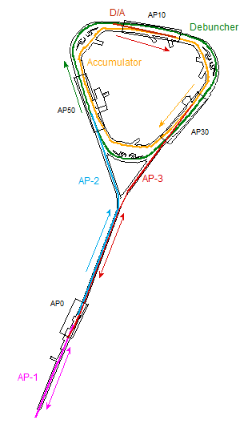
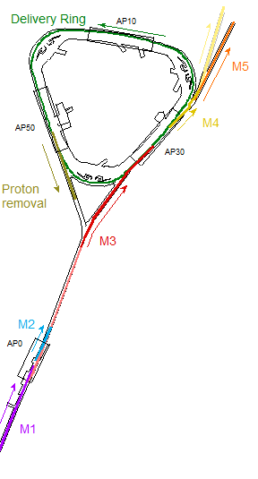
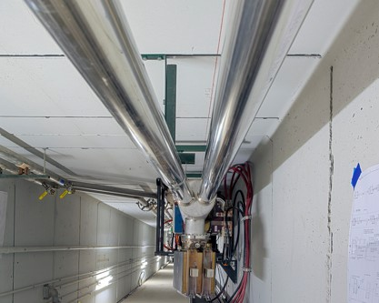
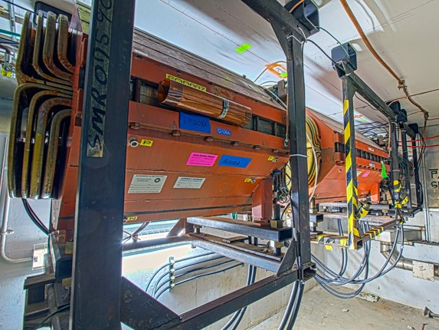
Muon Campus Beamline Construction
Pbar
Muon
beamline from target station to Delivery Ring installed and ready for commissioning
beamlines to target installed and ready for commissioning

Slide 21
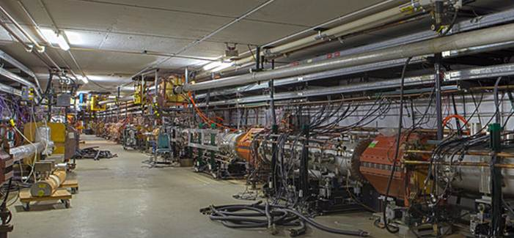
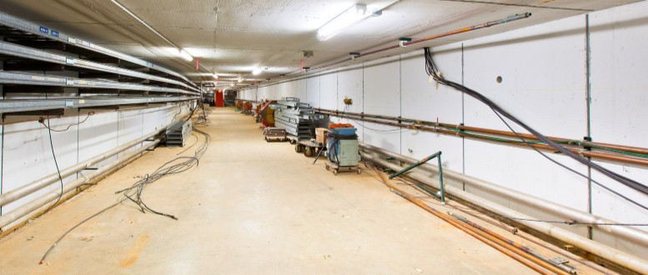
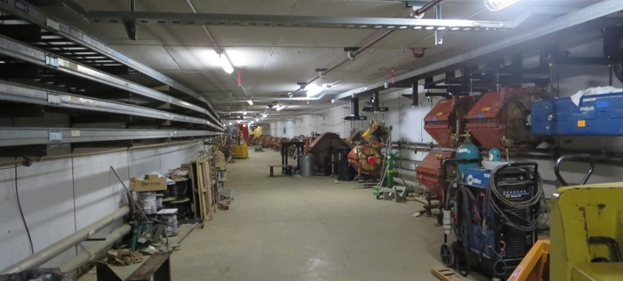
Muon Campus Beamline Construction
Pbar
Muon
5/8/14 start of decommissioning
new injection / extraction region reconfigured and installing magnets
3/23/15
beamline from target station to Delivery Ring installed and ready for commissioning
beamlines to target installed and ready for commissioning
2/26/16

Slide 22
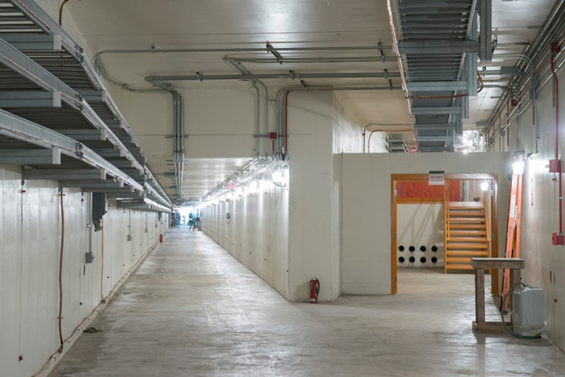
Muon Campus Beamline Construction
new tunnel construction complete
Pbar
Muon
new injection / extraction region reconfigured and installing magnets
beamline from target station to Delivery Ring installed and ready for commissioning
beamlines to target installed and ready for commissioning
Installation for g-2 complete end of March 2017

Slide 23
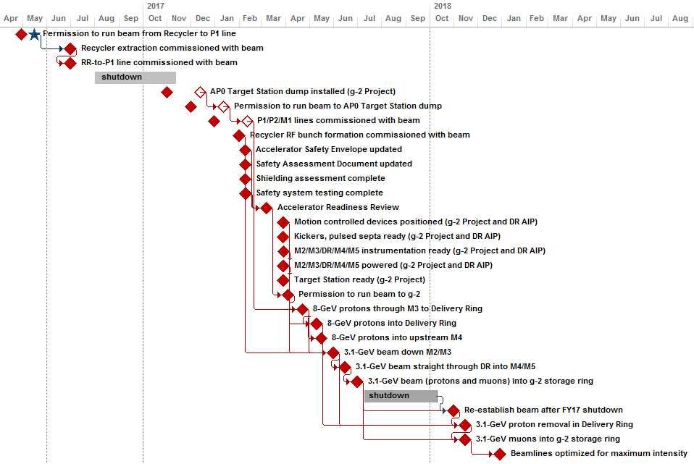
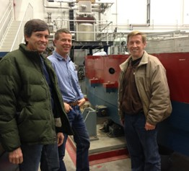
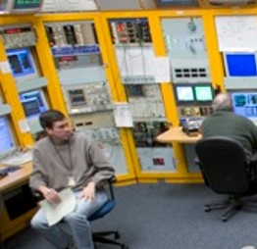
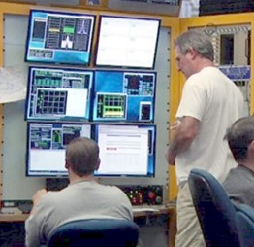
Muon Campus Commissioning and Operations
Commissioning beam to g-2 will be a priority in FY17

Slide 24
Target Systems

Slide 25
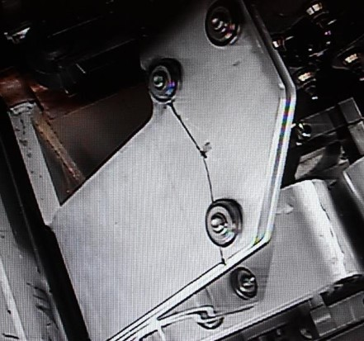
Target Systems Operations
Assembling and preparing to test BNB-4 horn during FY16 shutdown
NuMI horn 1 PH-104 (700 kW design) failed in FY15 with stripline fracture from fatigue due to vibrations
  Current horn PH-103 designed for 400 kW but air diverters increase cooling to allow 700 kW
  Retrofitting PH-105 with new design (more rigid, larger radii turns, air diverter), ready in FY17
  PH-106 with new design ready in FY17
Will replace NuMI target during FY16 shutdown
  Outlived design lifetime but not at design power (700 kW)
NuMI dehumidification
  Needed to prevent tritium
  Equipment affected by high radiation exposure
Working to replace AP-0 (former Pbar) target station beam dump for g-2
  Water leaks in both cooling lines of existing dump
  Difficulty removing since bolt on one end no longer attached

Slide 26
Target Systems Consumables
Device | Installed | Future
NuMI target | TA-01 | TA-02 ready TA-03 complete FY16 TA-04 complete FY17 TA-05 complete FY17 TA-06,07 procuring parts TA-08,09 beginning procurements
NuMI horn 1 | PH1-03 | PH1-05 retrofit based on PH1-04 failure, complete FY17 PH1-06 complete FY17 PH1-07 procuring parts
NuMI horn 2 | PH2-02 | PH2-03 ready PH2-04 complete FY16 PH2-05 complete FY17
BNB horn | BNB-3 | BNB-4 complete FY16
AP-0 target | 18 | 1 spare + spares of old design
AP-0 lithium lens | 10mm-4 | 3 spares, parts for 4 more
AP-0 pulsed magnet | PMAG-12 | 2 spares

Slide 27
BNB Upgrade - SBN
Optimized horn design can increase neutrino yield by up to 70%
  Inner conductor shape optimized for given length and current for efficient focusing
  Longer horn
Upgrade power supply to allow running at higher current and/or repetition rate
Propose to manage this as two AIPs within the SBN Program (FY18-FY20)
longer horn + higher current
longer horn
existing horn

Slide 28
Projections for FY17

Slide 29
Shutdowns
FY16 summer shutdown (Aug 1 – Nov 11)
  Delayed due to Recycler collimator readiness
  Lengthened due to lack of labor availability (13→15 weeks)
  Major jobs:
    Second phase of Recycler TSP2IP upgrade
    Installation of Recycler collimators
    Installation of 2.5 MHz RF in Recycler for Muon Campus
    Replacement of NuMI target and dehumidifiers
Switch back to running on Master Substation (~2 days in Jan)
FY17 summer shutdown (July-Sept)
  Expect 12-13 weeks driven by final phase of TSP2IP upgrade and second phase of Recycler collimator installation

Slide 30
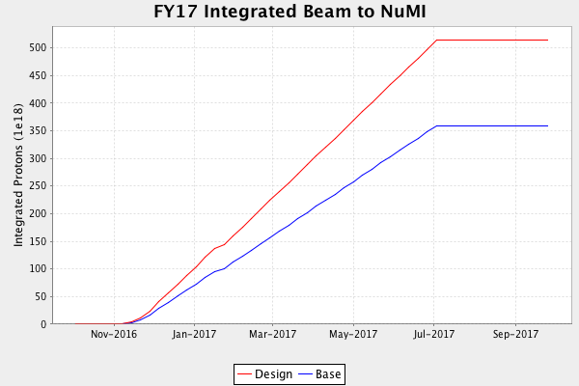
FY17 Goals for Beam to NuMI

Slide 31
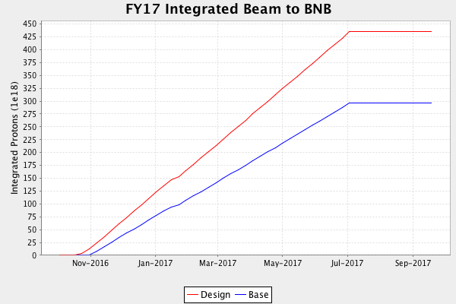
FY17 Goals for Beam to BNB
New gates will allow beam to BNB while accessing ~2/3 of MI tunnel

Slide 32
FY17 Goals for Beam to g-2
Establish muons to the g-2 storage ring
  Proton removal likely not commissioned before July (100x more p than μ)

Slide 33
Conclusions
We are making good progress towards 700 kW beam power for NOvA
Many of the PIP improvements in beam delivery have been realized already; work to ensure reliability remains
Muon Campus construction is on track and we will be ready to commission and operate beam to g-2 starting in FY17
  This will be a primary focus of our efforts in FY17 and FY18
Optimizations for the SBN program of building an upgraded horn and power supply could increase neutrino yield by up to 70%
  We are planning to start this 3-year project in FY18

