Slide 1
LBNF Update to the FNAL Physics Advisory Committee
C. J. Mossey, Deputy Director for LBNF
21 June 2016

Slide 2
Topics in this update
From January PAC Report:
  “The PAC endorses the focus areas laid out by the LBNC for FY2016 and looks forward to progress reports in the identified areas:
    LBNF: Execution against final design plan for CD-3a scope”
Also, updates on:
  CM/GC contract
  Test blast vibration study
  Excavated Rock Disposal plan
  Reliability Projects (Ross Shaft)
  Lease and easements
  Fiscal update
  Summary

Slide 3
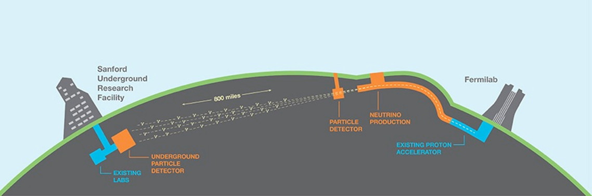
Quick Project Overview: LBNF/DUNE
  LBNF and DUNE: two sub-projects
This facilitates CERN as a facility partner
Share common project office resources
  LBNF: DOE project with support from non-DOE partners. Provides facility infrastructure at two locations to support the experiment:
Near site: Fermilab, Batavia, IL – facilities to create neutrino beam
Far site: Sanford Underground Research Facility, Lead, SD – facilities to support DUNE detectors
  DUNE: Deep Underground Neutrino Experiment
Near and far site detectors: U.S. as partner in international project

Slide 4
Quick Project Overview: LBNF/DUNE
  LBNF and DUNE: two sub-projects
This facilitates CERN as a facility partner
Share common project office resources
  LBNF: DOE project with support from non-DOE partners. Provides facility infrastructure at two locations to support the experiment:
Near site: Fermilab, Batavia, IL – facilities to create neutrino beam
Far site: Sanford Underground Research Facility, Lead, SD – facilities to support DUNE detectors
  DUNE: Deep Underground Neutrino Experiment
Near and far site detectors: U.S. as partner in international project
Present focus

Slide 5
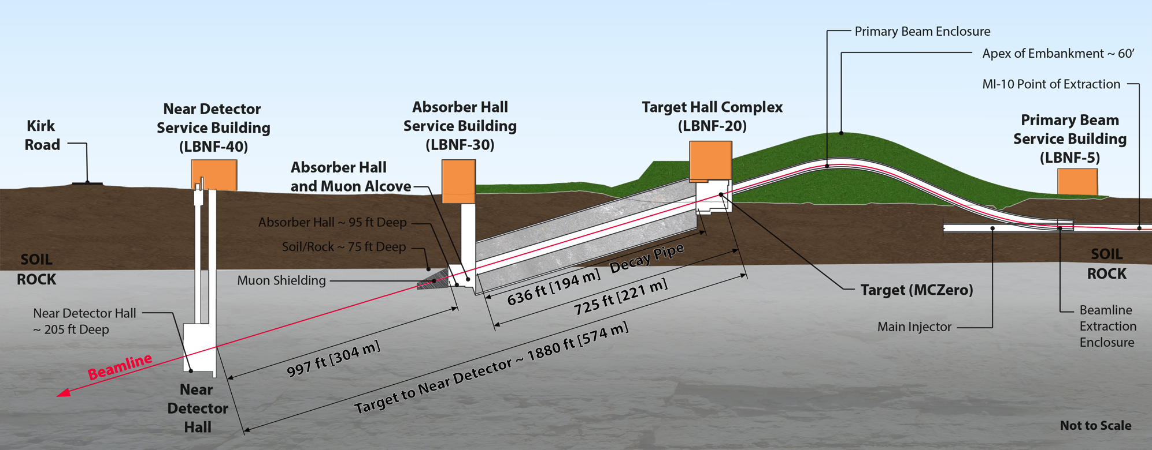
Overview - “Near Site” – LBNF/DUNE at Fermilab, Batavia, IL
Primary proton beam @ 60-120GeV extracted from Main Injector
Initial 1.2 MW beam power, upgradable to 2.4 MW
Embankment allows target complex to be at grade and
neutrino beam to be aimed to Lead, SD
Decay region followed by absorber
Four surface support buildings
Near Detector facility
DUNE Near Detectors (fine grained straw tube with gas targets)
Beamline design based on Fermilab’s NOvA beam, currently the most powerful neutrino beam in the world

Slide 6
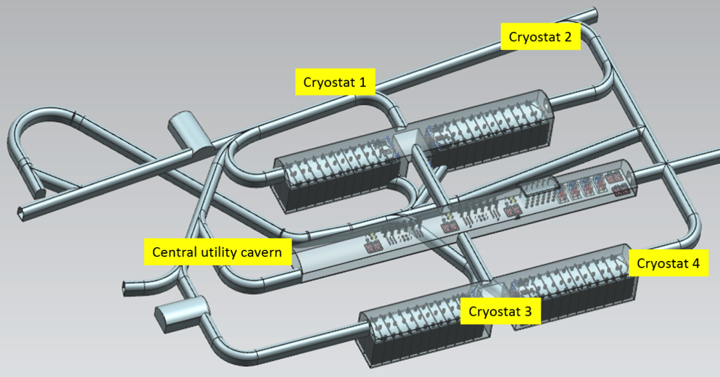
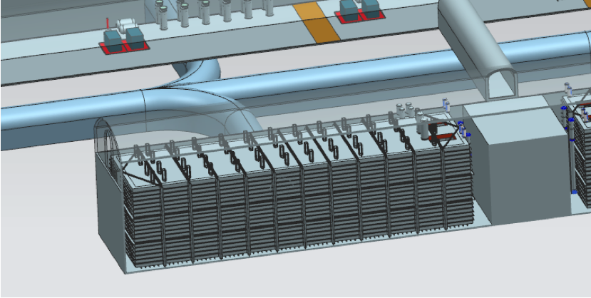
Quick Overview – “Far Site” – LBNF/DUNE at Sanford Lab
Conventional Facilities:
  Surface and shaft Infrastructure including utilities
  Drifts and two caverns for detectors
  Central utility cavern for conventional and cryogenic equipment
Cryostats:
  Four membrane cryostats supported
  by external steel frames
Cryogenic Systems:
  LN2 refrigeration system for cooling
  and re-condensing gaseous Argon
  Systems for purification and
  recirculation of LAr
Argon: 70kt LAr (~40kt “fiducial” mass)
DUNE LAr-TPC Detectors
4850L cavern and drift layout
Extensive prototyping program in progress to scale LAr TPC detector technology to 10kt fiducial volume
Single cryostat

Slide 7
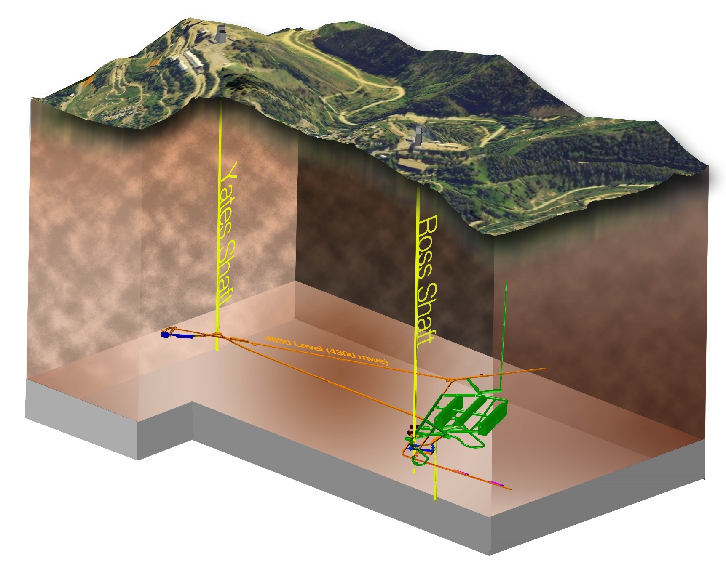
Far Site Scope – Overview of Phases of Work
Sanford Lab Reliability
Projects
FY16 – 18
  Ross shaft rehab
  Hoist motor
  rebuilds, more…
Pre-Excavation
FY17 - 20
  Rock disposal
  systems
  Utilities support,
  more…
Excavation/
Construction
FY18 – 22
  Caverns/Drifts/Utilities/Surface building
Cryostats/Cryogenic Systems FY20 – 25

Slide 8
Final Design Plan
Far Site Conventional Facilities

Slide 9
Far Site Conventional Facilities Final Design - Plan
Final design includes pre-excavation, excavation, and buildings and site infrastructure scopes
  Deliverables planned at 30%, 60%, 90%, and 100% of final design
  Provides defined points for stakeholder review
  CM/GC involvement through independent cost / schedule estimate generation and estimate reconciliations and constructability reviews
In addition to construction contract document production (drawings and technical specifications), cost estimates & schedules, calculations, final design scope includes:
  Basis of Design report
  Geotechnical Baseline Report and 3D geotechnical modeling
  An instrumentation and ground monitoring program
  Concept of Operations report
  Fully integrated 3D Revit model

Slide 10
Far Site Conventional Facilities Final Design – Current Status
Final design for Pre-excavation underway:
  30% pre-ex final design was received and reviewed.
  60% pre-ex design technical submittal expected on July 14. Cost and schedule submittal will arrive 3 weeks later.
Final design for Excavation and Buildings & Site Infrastructure to start in December 2016
Other design status updates:
  Recent focus has been on rock handling systems and shaft infrastructure including fiber optic and power cables, water, and gas piping.
  At CD-3a review, the Project was tracking 17 open design items; have since resolved all but 3 items:
    Drift size optimization. Expect to closeout in June.
    Sizing the number of fiber optic connections between 4850L and surface to support DUNE detectors. Expect to closeout in June.
    DUNE detector rack cooling approach - Discussions in process.

Slide 11
Far Site Conventional Facilities Final Design - Schedule
 |  |  |  | FY16 |  |  |  |  |  |  |  |  | F Y17 |  |  |  |  |  |  |  |  |  |  |  | F Y 1 8
Activity Name | Dur | Start | Finish | J | F | M | A | M | J | J | A | S | O | N | D | J | F | M | A | M | J | J | A | S | O | N | D
Pre-Excavation Design
Pre-EXC - 30% Final Design | 56 | 04-Jan-16 | 22-Mar-16
Pre-EXC - 60% Final Design | 69 | 11-Apr-16 | 14-Jul-16
Pre-EXC - 90% Final Design | 64 | 15-Jul-16 | 13-Oct-16
Pre-EXC - 100% Final Design | 33 | 14-Oct-16 | 30-Nov-16
Main Scope Design Excavation and B&SI
30% Final Design | 74 | 07-Dec-16 | 24-Mar-17
60% Final Design | 74 | 27-Mar-17 | 10-Jul-17
90% Final Design | 75 | 11-Jul-17 | 23-Oct-17
100% Final Design | 28 | 24-Oct-17 | 05-Dec-17

Slide 12
CM/GC Contract
(Construction Manager/General Contractor)

Slide 13
Many Procurements in Support of LBNF – not just CM/GC
Far Site Facilities CM/GC (detailed status on next slide)
2017 Ross Shaft rehab work:
  Since Jan 2016, working under LBNL-SDSTA cost-reimbursable construction contract
  Putting similar Fermilab-SDSTA contract in place – working through sole source, authority for work on non-federal property, and other contractual/legal issues with DOE
  Working to have contract in place late 2016
Plan for other SURF Reliability Project activities
  Believe this should be done by SDSTA
  Developing best acquisition approach in conjunction with Fermilab’s SURF Services (Operations) contract for FY17
Evaluating LN2 Systems design-fab-install strategy

Slide 14
CM/GC Contract Status
CM/GC Acquisition Plan Amendment and Request for Proposal have completed DOE Independent Review Board (IRB) process.
  IRB recommended approval
Package forwarded to DOE Office of Science senior contracting officer for final approval on 8 June. Assuming no unexpected issues, expect final approval in approximately two weeks.
Schedule considerations:
  Project desires award of CM/GC contract by 6 Dec 2016 to align with final excavation and BSI design effort. Schedule to support this shown on next slide.
  After CM/GC approval, next critical milestone is pre-proposal conference, tentatively scheduled for 19 July at Sanford Lab.
  To allow the construction industry time to plan, the complete draft RFP has been released on FedBizOps website that ties to the public docdb link for the RFP.

Slide 15
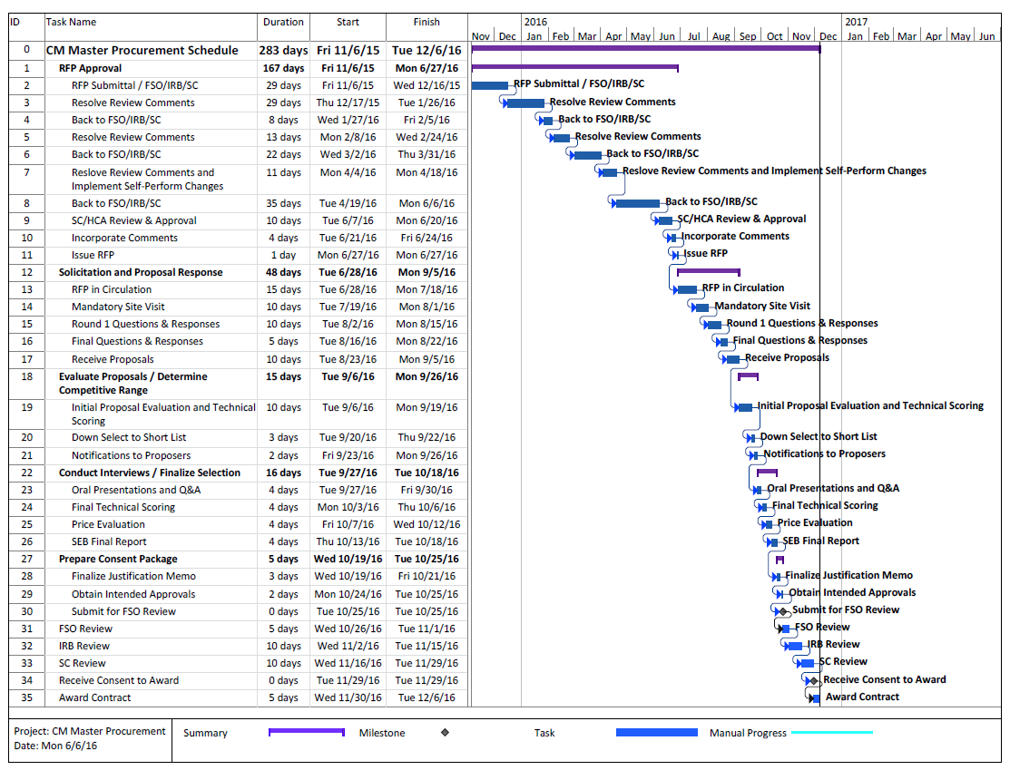
CMGC Procurement Schedule

Slide 16
Test Blast Vibration Study

Slide 17
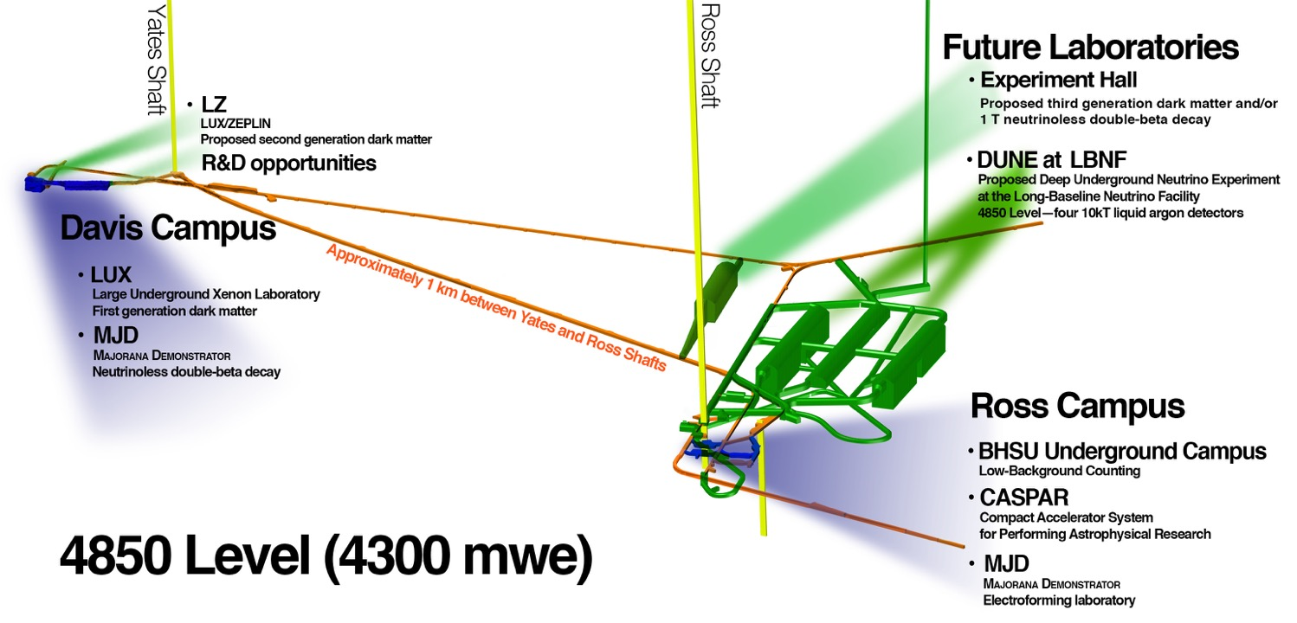
Blast Vibration Study – LBNF in context of Underground Laboratory

Slide 18
Blast Vibration Study - Background
Excavation design includes a model for blast vibration & air overpressure
  Initial model based on industry experience and geotechnical site investigation
  Potential risks to other 4850L experiments discussed during Logistics Workshop held August 2015 at SURF
  Blast Vibration Study was proposed to validate model
Two Phase Blast Vibration Study was completed March 11th
  18 monitoring instruments were deployed on 4850L
  Experiment specific data was collected by LBCs, LUX, MJD
  Lessons learned from the December blasts were incorporated into March efforts
      Adjusted blast pattern and utilized non-electronic detonators
  Seismic data collected by DUGL, Transparent Earth, GEOXTM evaluated
  Results have confirmed the blast vibration & air overpressure model to inform excavation final design

Slide 19
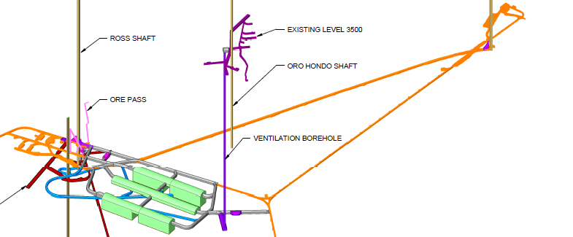
Blast Vibration Study Location
Two “trim” blasts and two “production” blasts executed

Slide 20
Blast Vibration Study - Conclusions
Excavation within 300 feet of the Ross Campus may exceed the current 0.5 in/sec threshold for peak particle velocity (PPV) for science spaces.
The 133 dB limit for air blast overpressures at the Ross Campus can be managed with properly designed and operated air lock style bulkheads.
During excavation, there may be periods when access to the Ross Campus facilities may be limited / modified.
Activities during final design:
  Continue evaluation of the upper allowable limits for peak particle velocity near the Ross Campus. Experience at other labs suggests a higher limit may be acceptable.
  Evaluate the pros / cons of removing the blast resistant bulkhead currently planned between LBNF detector chambers 1 and 2
  Assess whether excavation of chambers 3 and 4 impacts installation of cryostat #1. Determine if blasting plans need adjustment or if detailed coordination is sufficient.

Slide 21
Excavated Rock Disposal

Slide 22
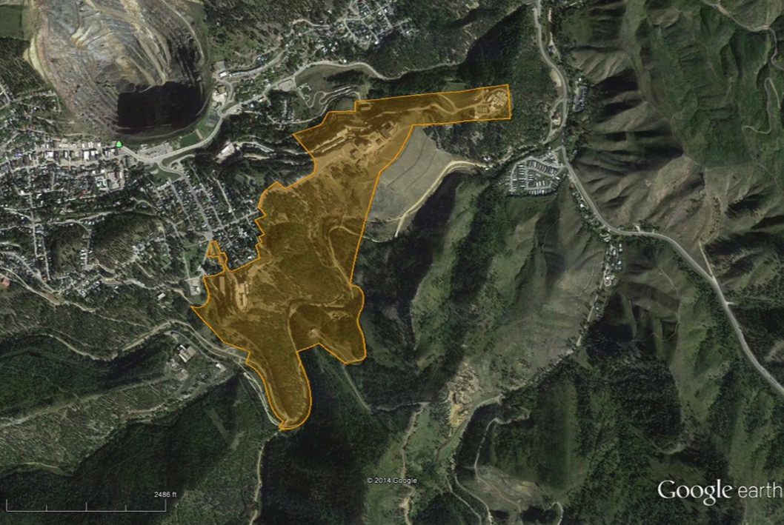
Far Site Location – Sanford Lab in Lead, SD
Lead, SD
Yates Complex
Ross Complex
Property Summary
186 acres (surface)
7700 acres (underground)

Slide 23
Conveyor Path from SURF to the Open Cut

Slide 24
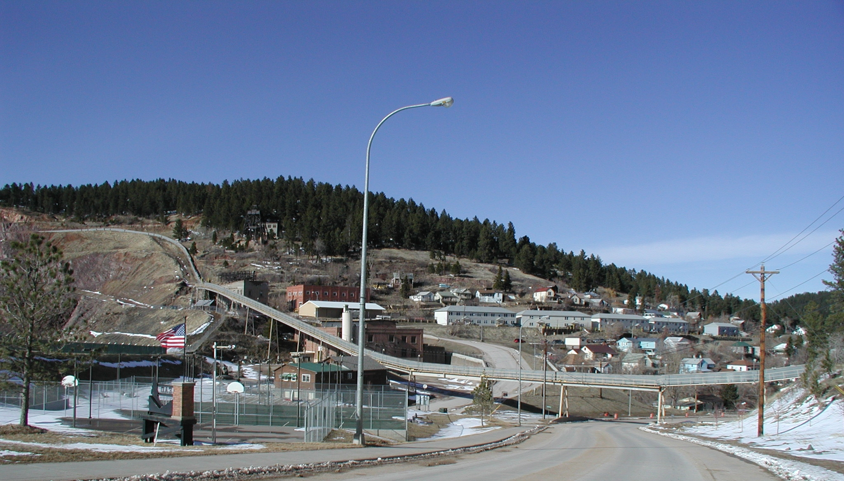
Previous Homestake Surface Conveyor System

Slide 25
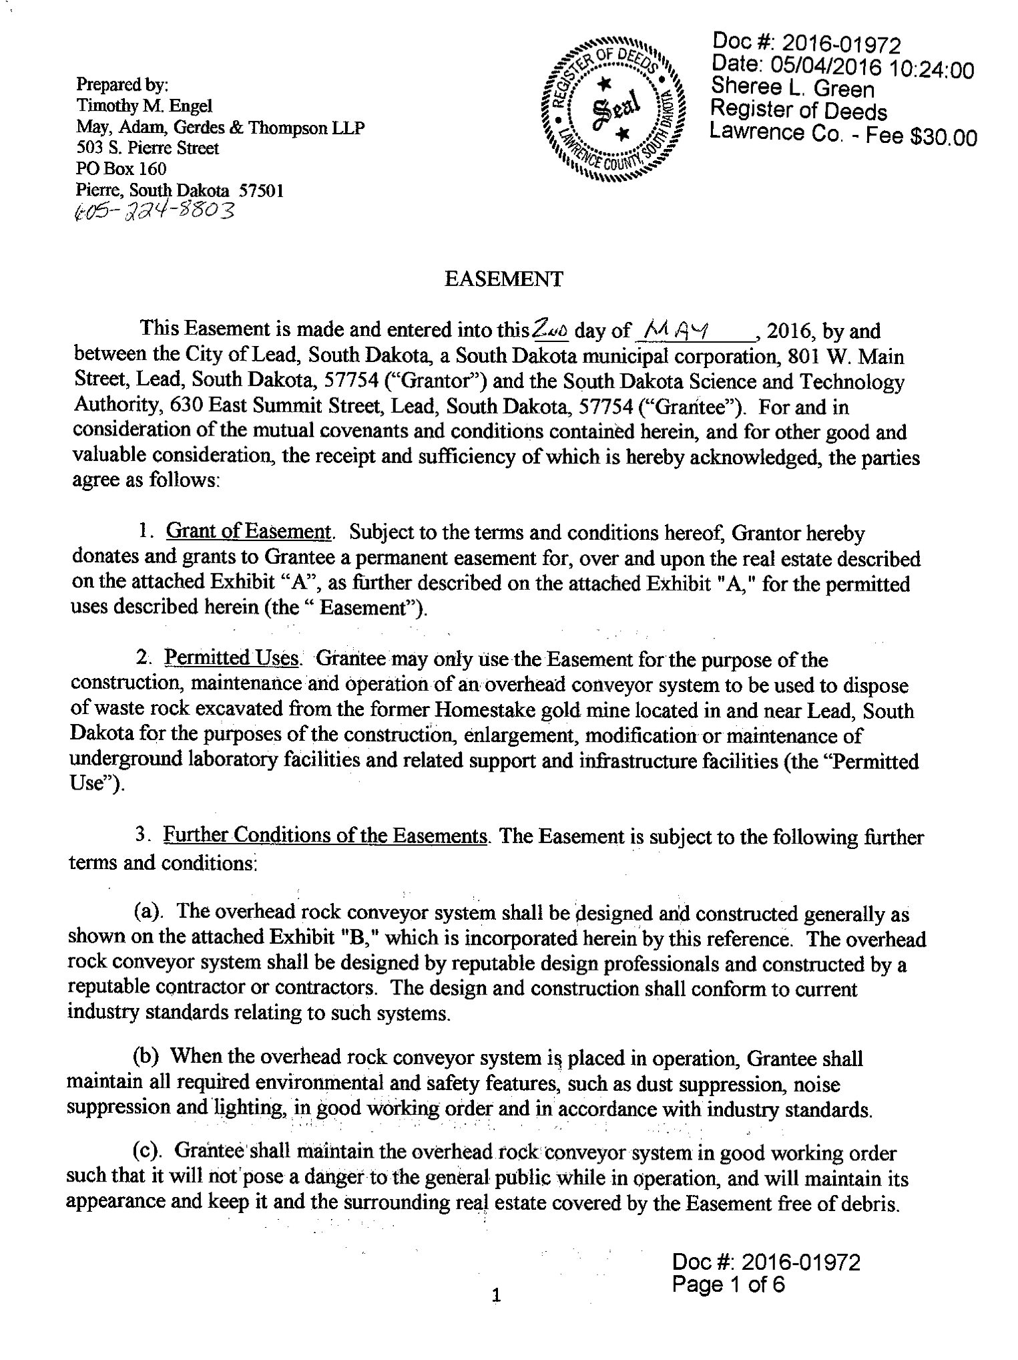
Excavated Rock Handling Update
Rock placement location secured. Land easements in place.
LBNF will place excavated rock in the Open Cut. The EA considered 2 options.
SDSTA has now secured required agreements to make this plan a reality
  October 2015, SDSTA secured easement with Barrick / Homestake allowing placement of up to 5M tons of rock in the Open Cut
  May 2nd 2016, SDSTA secured an easement with the City of Lead for a conveyor system from SURF’s property to the Open Cut
These agreements represent a major step forward to facilitate LBNF excavation
Currently working with SD DENR on a revision to Homestake’s mining permit for the Open Cut. ECD is Jan 2017.

Slide 26
Reliability Projects
Ross Shaft Renovation

Slide 27
Ross Shaft Refurbishment Update
3,765 feet down from surface (75% completed overall)
Surface
Tramway
300 L
800 L
1250 L
1400 L
1550 L
1700 L
1850 L
2000 L
2150 L
2300 L
2450 L
2600 L
2750 L
2900 L
3050 L
3200 L
3350 L
3500 L
3650 L
3800 L
3950 L
4100 L
4250 L
4400 L
4550 L
4700 L
4850 L
5000 L
Schedule
Ross Shaft refurbishment needed to support hoisting of the ~800,000 tons of excavated rock and transport of personnel and materials for LBNF construction
Rehabilitation started in August 2012. SDSTA (state and private funds) provided first $20M. SDSTA purchased the structural steel for entire project.
New contract established in January 2016 between LBNL and SDSTA. Provides DOE funds to complete remainder of the refurbishment to the 5000 foot level.
Have reached the 3765L . On track for Aug 2017 finish.
Working to transfer contracting responsibility for Ross Shaft to FNAL effective 1 Jan 2017.
Q1 CY2014
Completed
Q1 CY2015
Q1 CY2016
Q1 CY2017
Mid CY2017

Slide 28
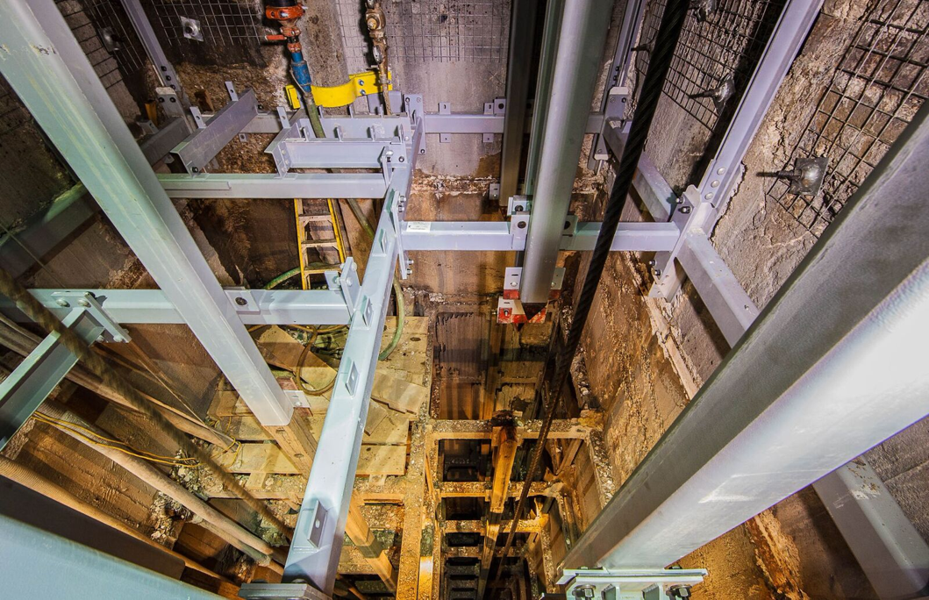
Ross Refurbishment - Recent New Steel Installation

Slide 29
Lease & Easements

Slide 30
Leases and Easements at Sanford Lab
  Generally, government funds cannot be used to make improvements in property not owned by the U.S. government.
  Investment of U.S. federal funds at Sanford lab require proper authorities in accordance with Comptroller General (GAO) policy:
    Working to finalize
    easement requirements
    for shaft, drifts, other
    “common access” areas
    at Sanford Lab
    Lease for LBNF site has
    been signed; “pre-
    acceptance” inspection
    completed; lease went
    into effect on 1 May 2016 for 20 years.
    First year of lease has
    been paid for.
EASEMENT AREAS
LEASED AREA

Slide 31
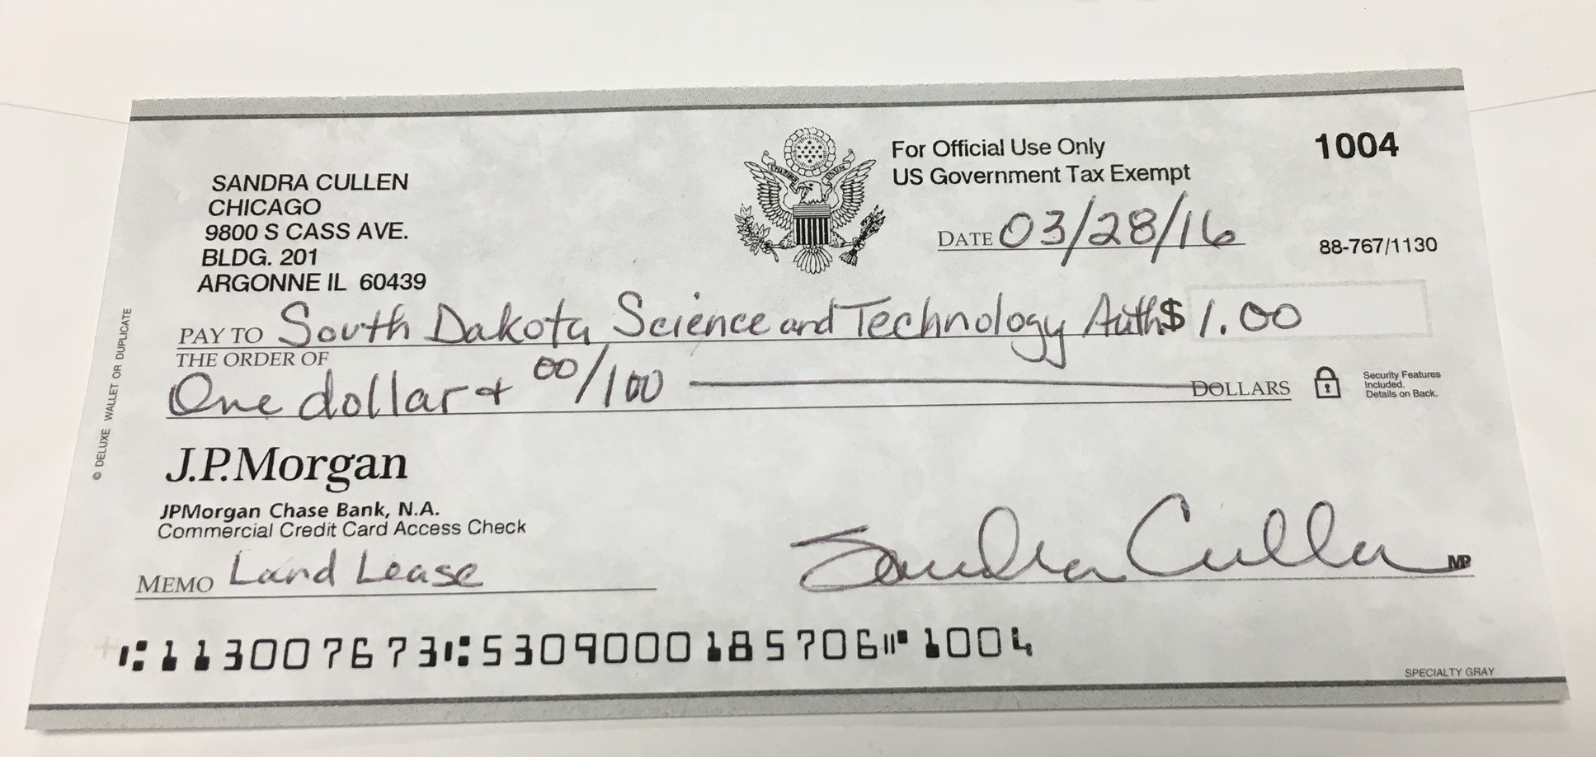
Leases and Easements at Sanford Lab
Check for 1st year’s lease

Slide 32
Fiscal Update

Slide 33
Congressional Appropriations Status
FY17 Funding Status:
  President’s budget submit requested $45M for LBNF/DUNE
  House and Senate both propose to increase LBNF funding in FY2017 above the President’s budget request:
    House: +$5M
    Senate: +$10M
  both House and Senate versions of appropriations bill authorize start of construction at Sanford Lab in FY2017.
  Continuing resolution risk (next slide)

Slide 34
Continuing Resolution Planning
Continuing resolutions have potential to significantly impact project execution at this stage of maturity:
  Year-to-year funding is significantly ramping up
  Require authorization to begin construction operations at Far Site in FY17
Have developed multiple funding scenarios to anticipate potential FY17 appropriations timeline, including:
  3 month continuing resolution
  Full year continuing resolution
Mitigation measures include:
  Month-to-month funding of Ross Shaft renovation and university POs
  In longer CR scenarios, will negatively affect project schedule

Slide 35
Road to CD-3A Milestone

Slide 36
Road to CD-3A Milestone: Funding Profile Update
Because of size of CD-3a funding request in advance of baselining, DOE Under Secretary for Science and Energy desires to have supportable funding profile for entire project understood concurrent with approval of CD-3a milestone
LBNF Project team has been working closely with DOE Program manager to develop funding profiles that support “stake in the ground” milestones for DUNE collaboration:
  2021 - Start of detector installation
  2024 – Start of detector commissioning
  2026 – Deliver first neutrino beam
The LBNF/DUNE project leadership, in consultation with DOE leadership, has agreed that the optimum time to request ESAAB approval of the CD-3A milestone is the August-October 2016 timeframe.
  This aligns the timing of the ESAAB review with the DOE's internal FY18 budget development process
This timing does not impact the existing project schedule.
Status: Profile under review by SC-2
  Currently responding to request for information on final CD-3A funding requirement as element of each year’s funding profile.

Slide 37
The Road to CD-3A Milestone - Summary
Status of actions required to achieve “early construction start” milestone:
Recommendations from December DOE IPR necessary for
CD-3a milestone have been addressed.
Independent Cost Estimate (ICE) completed
  DOE PM office conducted review of LBNF cost estimate for CD-3a scope from Dec 2015 to Jan 2016
  Conclusions of review include:
    ICE base estimate $12M less then project estimate
    ICE estimated contingency $20M less then project estimate
    ICE estimate for Total CD-3a Request 10% below project estimate
DOE project funding profile approval by Under Secretary Orr (anticipated late July to August timeframe)
PMRC and ESAAB review/approval August/September timeframe

Slide 38
Summary
LBNF Activities Recently Completed, Underway and Planned
Began execution by DOE/FNAL of Sanford Lab “Reliability Projects” such as Ross Shaft refurbishment, to reduce risk during main excavation operations
Began final design for Far Site conventional facilities
Executed Lease for LBNF exclusive use areas at Sanford Lab
Achieve DOE CD-3a milestone
Award CM/GC contract
Start construction activities at Sanford Lab in 2017
Initiate major cavern excavation construction work in 2018
Complete first cryostat and cryo systems construction to enable detector install to begin in 2021, with commissioning in 2024
Produce neutrino beam in 2026!

Slide 39
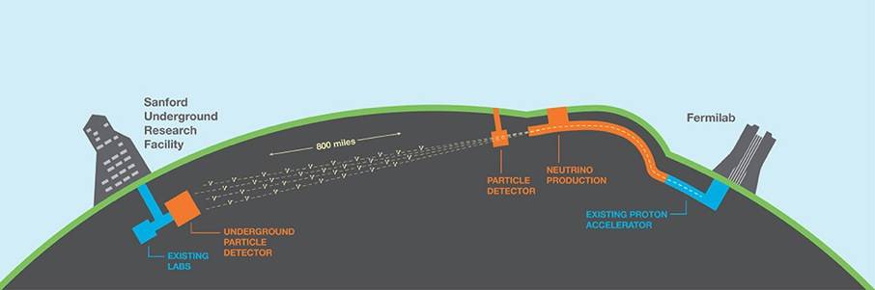
Questions?
Animation Links:
LBNF/DUNE animation (YouTube)
Video page (FNAL website)
Social Media Links:
LBNF Facebook
DUNE Facebook
LBNF Twitter
DUNE Twitter

Slide 40
Backup Slides

Slide 41
Why we care about vibration (peak particle velocity)
When the “receptor” is close to the blast location, the round length must be shortened to meet the PPV threshold
Shorter rounds equals more drill and blast cycles and increased time and cost

Slide 42
International Codes and Standards
As an international project with major in-kind contributions, LBNF/DUNE needs the ability to accept non-U.S. design standards within DOE 10CFR851 construct.
Fermilab has finalized and implemented new FESHM Chapter 2110 – Establishing Code Equivalency with International Codes and Standards.
Working with SBN project team, have developed priority sequence to review non-U.S. mechanical and electrical design standards proposed for equipment coming from CERN. Task forces being formed to complete focused reviews.
Code equivalency review status:
  EN 13455 – Unfired Pressure Vessels – complete
  EN 13480 – Metallic Industrial Piping – underway
  EN 12434 Cryogenic Flexible Hoses, EN 13458 Cryogenic Vessels, EN 13648 Cryogenic Vessels-Safety Devices for Overpressure protection, and ISO 4126 Safety Devices for Overpressure protection – planned
  Similar strategy for Electrical device standards in development

Slide 43
LBNF/DUNE Risk Status
Status as of end of May for on-project risks
  55 high and medium ranked open threats
  Expect to retire some risks during workshop and may change some probabilities & impacts

Slide 44
Beamline Optimization Status
In coordination with DUNE and at the collaboration’s request, investigating alternate configurations through FY17 to provide better physics.
Recently optimized beamline design requires conceptual engineering and costing analyses on targets, horns (3 vs. 2), and target chase atmosphere (He or N vs. air).
  Plan is to work at Fermilab and RAL over next 15 months on conceptual engineering and costing before deciding whether these are viable options to existing design.
  In discussion with Fermilab AD regarding engineering resources
Radically different beam idea presented at May DUNE collaboration meeting. Physics analyses being done first by DUNE to validate consideration of this approach, presently thought to be cost-neutral.
  Collaboration evaluating tune-ability of the idea
  EFIG will hear collaboration evaluation at 13 July meeting
  Then will decide if further development is worthwhile, balancing available resources and cost/benefit/risk
Need beamline preliminary design to start in fall 2017 for 2019 baselining.

Slide 45
Project Risk Management
Update since January: Added 4 new risks related to existing SURF infrastructure needed for LBNF/DUNE:
    PM-150 Ross Hoists break down – multiple components
    PM-151 Ross cage hoist brakes failure
    Ross skip hoist brakes failure
    Ross skip drum cracks require repair
Risk workshop held last week at Fermilab:
  reviewed and updated all current medium and high ranked risks
  added brainstorm & discuss any new or proposed risks
  prepare for updated monte carlo analysis to inform risk cost (for DOE-only) and schedule contingency calculations
Mitigated by including motor repairs & new brakes/clutches in base plan
Retained as risks with low probabilities/impacts

Slide 46
Project Staffing
Project Office hires:
  LBNF/DUNE QA manager – interviews complete, pursuing one candidate
  LBNF/DUNE Financial Manager – replacement hired, will start August 1st
  Senior Procurement Administrator fully matrixed to LBNF - interviewing
Have developed plan with Directorate approval to ensure sufficient on-site management and oversight for SURF activities

Slide 47
Cryogenic Infrastructure Design Status
Cryostat: No progress since CD3a because focus is on ProtoDUNEs, from which much will be learned.
  Working through question of side penetrations with LBNF Cryogenic Safety Review Panel.
  Expect to restart this design in 2017; working on understanding what inputs are needed to achieve GTT final design and early procurement schedule at CERN
N2 and LAr Systems:
  Recently resources have been working on designing ProtoDUNEs cryogenic systems
  As reported in ProtoDUNE mini-review, cryo systems is out for bid by CERN
  Procurement of the LAr pumps for ProtoDUNEs is underway at Fermilab.
  Working on furthering LAr cryo systems requirements, which will be vetted by DUNE Cryo Task Force
Discussing idea of a design-build-install approach to the LN2 system.
  RFI to industry regarding this vs. separate design, fab, and install contracts is under evaluation
Internal cryogenics and the interface with the detector being discussed with DUNE

Slide 48
Review Recommendations – LBNF and DUNE
DATE | REVIEW | TOTAL # REC | # CLOSED | # IN-PROGRESS | # TO BE CLOSED 2016
Jun 2015 | Dir CD-1R | 30 | 27 | 3 | -
Jul 2015 | DOE CD-1R | 31 | 19 | 12 | 3
Sep 2015 | LBNC-LBNF | 7 | 5 | 2 | -
Oct 2015 | Dir CD-3a | 9 | 8 | 1 | 1
Dec 2015 | DOE CD-3a | 19 | 10 | 9 | 7

Slide 49
LBNF Far Site Conventional Facilities Acquisition Strategy
Conventional Facilities Final Design
CM Services
Pre-Excavation Construction
CM Services
Construction sub-contracts
Excavation, Surface, and BSI Construction
CM Services
CM Services
Construction sub-contracts through Ch 2
Thru Ch 3&4
Cryo and DUNE Install
Continues through
July 2026
CM Services
FY16
FY17
FY18
FY19
FY20
FY21
FY22

Slide 50
LBNF Far Site Conventional Facilities Acquisition Strategy
Conventional Facilities Final Design
CM Services
Pre-Excavation Construction
CD-3A Scope
CM Services
Construction sub-contracts
Excavation, Surface, and BSI Construction
CM Services
CM Services
Construction sub-contracts through Ch 2
Thru Ch 3&4
Cryo and DUNE Install
Continues through
July 2026
CM Services
FY16
FY17
FY18
FY19
FY20
FY21
FY22

Slide 51
LBNF/DUNE Key Milestones/Target Dates
Schedule based on CD-1R milestone profile

Slide 52
International Partnership - LBNF
CERN is a major partner in facility infrastructure at Sanford Lab and is also key to facilitate European engagement.
  Signed four partnership protocols on 18 Dec 2015 including neutrinos
  Have already committed to provide first cryostat (valued at $90M U.S. TPC)
  Facilitating engagement with member countries and European HEP community – may facilitate other LBNF partners
  Supporting prototyping effort with short baseline and protoDUNEs with CERN “neutrino platform”
IHEP-China providing prototyping of corrector magnets
UK proposing to do essential Target R&D
South Dakota, where more than $146M has been invested in the Sanford Underground Research Laboratory to date.
India providing major contribution to PIP-II which supports LBNF

Slide 53
Far Site Construction/Installation Logistics Planning
Material movement through facility:
  Iterating with Cryo and Detector teams to understand logistical requirements through shaft and drifts
  Modeling to inform headframe and shaft bottom modifications is underway
Blast Vibration Study
  Completed test program in March
  Validating excavation rate assumptions
  Verifying that impacts are minimal or manageable
Studying number of personnel underground
  Have determined that Ross Shaft could support all LBNF/DUNE access
Recent Request for Information to local South Dakota companies and leaders for available housing, warehousing, and office space
  Housing is the biggest challenge

Slide 54
Planning Outputs: Personnel Underground & Ross Shaft Utilization
Key Sanford Lab infrastructure will handle all planned activities
At peak, 100 on days
85 on nights
PERSONNEL
76% utilization at peak including planned maintenance
Yates provides margin
HOURS PER DAY

