Slide 1
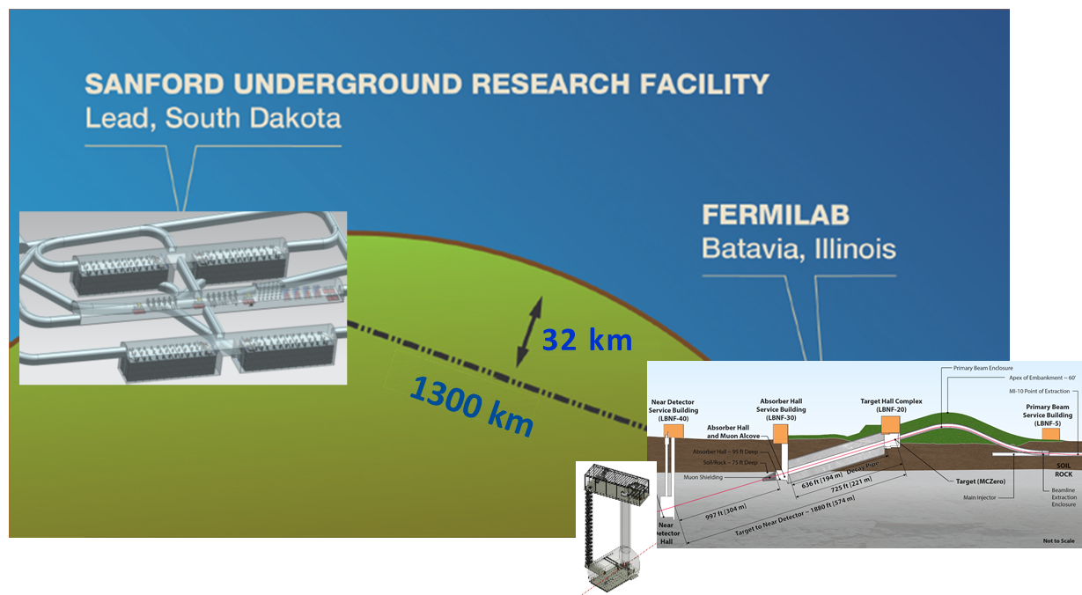
LBNC report on LBNF and DUNE
David MacFarlane,
LBNC Chair
Report to PAC
June 21, 2016

Slide 2
Genesis, scope and membership
Recommended by Fermilab PAC in January, 2015 as a new advisory committee focused specifically on LBNF/DUNE
  Modeled after the successful LHCC at CERN
Scope includes scientific, technical and managerial decisions/preparations of the experiment & facility
Provides continuous oversight, reports to Fermilab Director
Membership:
Chair, David MacFarlane (SLAC)
[Ursula Bassler (IN2P3)]
Sampa Bhadra (York)
Francesca Di Lodovico (Queen Mary)
Patrick Huber (Virginia Tech)
Mike Lindgren (FNAL)
Naba Mondal (TIFR)
Tsuyoshi Nakaya (Kyoto)
David Nygren (UT Arlington)
Marco Pallavicini (Genova)
Stephen Pordes (FNAL)
Kem Robinson (LBNL)
Nigel Smith (SNOLAB)
David Wark (Oxford)

Slide 3
How has the LBNC provided oversight to date?
Feb-July 2015:
  LBNF & DUNE: Development & preparation for CD-1R
  Overall strategy for achieving the physics goals laid out by P5 and credibility of projected physics performance
  Realistic implementation plan and timeline for LBNF and DUNE, with international participation from the beginning
July-Dec 2015:
  LBNF: CD-3a review preparation
  DUNE: Initial TF, WG organization
Jan-May 2016:
  LBNF: Pre-excavation planning, CM/GC & CD-3a approvals
  DUNE: protoDUNE ramp-up, TF studies, CD-2 strategy development

Slide 4
Overview of the CY2015 for LBNF and DUNE
CD-1R preparation
CD-3a preparation
LBNF
CD-1R Director’s Review June 2-4
CD-1R DOE Review July 14-16
CD-3a Director’s Review Oct 27-29
CD-3a DOE Review
Dec 2-4
Science strategy & CD-1R preparation
WG, TF, WA105 & protoDUNE
DUNE
Collab Spokespersons elected March 9
DUNE Collab meeting Apr 15-18
CD-1R Director’s Review June 2-4
CD-1R DOE Review July 14-16
DUNE Collab meeting Sep 3-5
LAr workshops Oct 19-20
LBNC
PAC
Feb 5
Apr 2
Apr 9
Jul 30
Sep 3
May 14
Jun 11
Aug 6
Oct 23
Nov 24
Dec 14
Apr 18-19
May 21
Jun 22-25
Sep 5-6
Face-to-face
Not shown: weekly Saturday morning calls with LBNC Chair, Fermilab, LBNF, & DUNE management

Slide 5
Overview of CY2016 for LBNF and DUNE
Pre-excavation planning, CM/GC & CD-3a approval support
LBNF
DOE Status Review Aug 11-12
protoDUNE ramp-up, TF studies, CD-2 strategy development
DUNE
DUNE Collab meeting Jan 12-15
SPSC
Apr 19-20
DUNE Collab meeting May 19-22
DOE Status Review Aug 11-12
LBNC
PAC
PAC
Apr 4
May 6
Jun 12
Jan 11-12
Apr 29
Jan 19-21
Jun 13-14
Jun 19-21
Face-to-face
Not shown: weekly Saturday morning calls with LBNC Chair, Fermilab, LBNF, & DUNE management

Slide 6
Overview of CY2016 for LBNF and DUNE
Pre-excavation planning, CM/GC & CD-3a approval support
LBNF
DOE Status Review Aug 11-12
protoDUNE ramp-up, TF studies, CD-2 strategy development
Two-hour agenda
Update on Roadmap to CD-2
protoDUNE organization, schedule and TDR development
35 T update and lessons learned
DUNE
DUNE Collab meeting Jan 12-15
SPSC
Apr 19-20
DUNE Collab meeting May 19-22
DOE Status Review Aug 11-12
LBNC
PAC
PAC
Apr 4
May 6
Jun 12
Jan 11-12
Apr 29
Jan 19-21
Jun 13-14
Jun 19-21
Face-to-face
Not shown: weekly Saturday morning calls with LBNC Chair, Fermilab, LBNF, & DUNE management

Slide 7
Overview of CY2016 for LBNF and DUNE
Pre-excavation planning, CM/GC & CD-3a approval support
LBNF
DOE Status Review Aug 11-12
protoDUNE ramp-up, TF studies, CD-2 strategy development
Two-hour agenda
Update on LBNF
protoDUNE-SP planning at CERN
protoDUNE-DP planning at CERN
DUNE
DUNE Collab meeting Jan 12-15
SPSC
Apr 19-20
DUNE Collab meeting May 19-22
DOE Status Review Aug 11-12
LBNC
PAC
PAC
Apr 4
May 6
Jun 12
Jan 11-12
Apr 29
Jan 19-21
Jun 13-14
Jun 19-21
Face-to-face
Not shown: weekly Saturday morning calls with LBNC Chair, Fermilab, LBNF, & DUNE management

Slide 8
Overview of CY2016 for LBNF and DUNE
Pre-excavation planning, CM/GC & CD-3a approval support
LBNF
DOE Status Review Aug 11-12
protoDUNE ramp-up, TF studies, CD-2 strategy development
Two-hour LBNC follow-up discussion
Planning for mini-review and LBNC June meeting
Discussion of protoDUNE resources, planning, physics
DUNE
DUNE Collab meeting Jan 12-15
SPSC
Apr 19-20
DUNE Collab meeting May 19-22
DOE Status Review Aug 11-12
LBNC
PAC
PAC
Apr 4
May 6
Jun 12
Jan 11-12
Apr 29
Jan 19-21
Jun 13-14
Jun 19-21
Face-to-face
Not shown: weekly Saturday morning calls with LBNC Chair, Fermilab, LBNF, & DUNE management

Slide 9
Overview of CY2016 for LBNF and DUNE
Pre-excavation planning, CM/GC & CD-3a approval support
LBNF
DOE Status Review Aug 11-12
protoDUNE ramp-up, TF studies, CD-2 strategy development
DUNE
DUNE Collab meeting Jan 12-15
SPSC
Apr 19-20
DUNE Collab meeting May 19-22
DOE Status Review Aug 11-12
LBNC
PAC
PAC
Apr 4
May 6
Jun 12
Jan 11-12
Apr 29
Jan 19-21
Jun 13-14
Jun 19-21
Face-to-face
Not shown: weekly Saturday morning calls with LBNC Chair, Fermilab, LBNF, & DUNE management

Slide 10
LBNC agenda for LBNF/DUNE on Jun 13-14
Standalone LBNC meeting: model for the future

Slide 11
LBNF: Comments
LBNC very pleased to hear positive recommendations from CD-3a review and looks forward to completion of qualifications required prior to ESAAB
Near term tasks for LBNF are appropriately prioritized leading to conclusion of the CD-3a process.
LBNF FSCF has a clear and well documented path forward to final design, including interfaces and a blasting test program.
Previous recommendations from LBNC reviews of LBNF have been mainly closed, or noted as required actions in the future. Two recommendations require comment.
The LBNF Project Team appears to be well prepared for potential re-planning efforts that may follow the Presidential Budget Request in February

Slide 12
LBNF: Comments (continued)
The process of completing responses to comments on the CMGC RFP is taking somewhat longer than originally planned and the execution schedule for bringing a contractor on board is very tight

Slide 13
LBNF: Recommendations
Provide a written commentary to close out all previous LBNC recommendations
Confirm assumptions used for the Ross shaft utilization and optimization (shift schedule, restrictions during blasts)

Slide 14
DUNE: A lot of progress in 14 months
Hit many milestones in the last 14 months
  April First DUNE Collaboration Meeting ✔
  April Institute Board Rules approved ✔
  May First DUNE Executive Committee meeting ✔
  July DOE CD-1-R Review ✔
  July Scientific/Detector Coordinators appointed ✔
  August Technical Board Formed ✔
  Sept 2nd Collab. Mtg. and move to regular WG mtg. schedule ✔
  Dec DOE CD-3a Review ✔
  Dec Full integration of dual-phase (WA105) into DUNE ✔
  Dec ProtoDUNE-SP approved at CERN ✔
  Jan ProtoDUNE-SP leadership team in place ✔
  Jan 3rd Collab. Mtg. & ProtoDUNE “Expressions of Interest” ✔
  Feb Draft strategy for 2016-2019 circulated to collaboration ✔
  Apr European and Latin Americas meetings ✔
  May ProtoDUNE organization defined ✔
P5 + 1
2015
2016
P5 + 2

Slide 15
State of DUNE [Rubbia]
Comments
  DUNE management needs to be actively identifying and resolving critical technical and performance issues, e.g., with protoDUNE-SP cold electronics
  Presentations would be more useful if they include a identification of current problems, risks, and mitigating strategies or actions taken to solve problems, e.g., the protoDUNE-SP cold electronics
Recommendations:
  Develop a full assessment of risks and corresponding mitigation strategies for protoDUNE-SP and -DP
  Keep the LBNC informed of progress in dealing with critical issues
  Use the engagement of the Fermilab Director and Fermilab as host lab to maximum advantage in resolving critical issues

Slide 16
Timeline and major milestones to CD-2
ProtoDUNE EoIs
Q1
Q1
Q2
Q2
Q3
2016
Q3
ProtoDUNE-SP Design Reviews
WA105 1x1x3 m³ Operation
Q4
Q4
DUNE EoIs
Q1
Q1
DUNE Far Detector Consortia
Q2
Q2
Task force reports
2017
Decision on
ND Conceptual design
WGs ➝ Consortia
Q3
Q3
ND EoIs
ProtoDUNE-SP “parts” at CERN
Q4
Q4
ND Consortia
Q1
Q1
Decision on FD
1 & 2 in 2018
ProtoDUNE commissioning
Q2
Q2
TDR Planning/Writing teams
ProtoDUNE beam operation
Q3
2018
Q3
Initial PD-SP/DP reports
Q4
Q4
International commitments
Q1
Q1
ND International commitments
Internal review of FD TDRs
Q2
Q2
Internal review of FD TDR
Q3
2019
Q3
TDR Finalized
Q4
Q4
CD-2/3 and LBNC Reviews
ProtoDUNEs & FD
ND, TF and TDR

Slide 17
DUNE Strategy for CD-2 [Thomson]
Comments
  The strategy appears to capture the main goals and lays out a plausible pathway to a TDR and IPR in Q4/2019
  The call for DUNE FD construction EOIs in Q2/2017 overlaps the construction of protoDUNE-SP and -DP which may be a challenge
  The Collaboration currently sees a variety of factors in the technology choice for the second FD module, and does not want to lay out definitive criteria and a process at this time
  Development of the strategy document is responsive to the LBNC recommendation from Jan 2016 and will serve as an effective communication vehicle for the collaboration as a whole
  One of the more challenging elements of the plan is the development of a full funding matrix on the timescale of the TDR

Slide 18
DUNE Strategy for CD-2 [Thomson]
Recommendations
  Expand on this excellent start to incorporate alternatives planning, e.g., if protoDUNE-SP does not demonstrate the required engineering performance

Slide 19
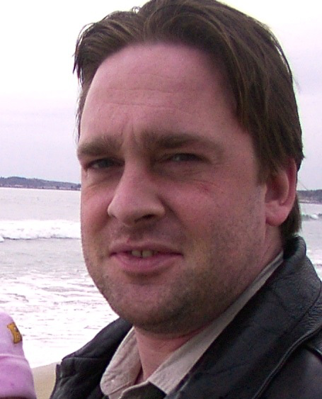

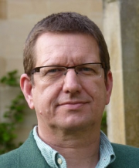
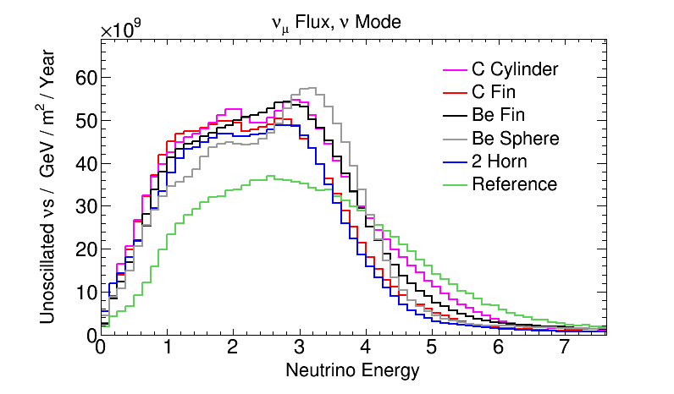
Progress with Task Force groups

Slide 20
Far Detector Task Force Update [Whitehead]
Comments
  While there is good overall progress being made by the TF, many important milestones have shifted from spring to summer
  Implementation of DP simulation and reconstruction is going well but not too surprisingly is delayed until fall
  It is not clear how effective the feedback loop is between reconstruction development and higher-level analysis efforts
  Ultimately detector design optimization will also need to weigh factors such as relative cost and technical risk vs TF physics performance results

Slide 21
Far Detector Task Force Update [Whitehead]
Recommendations
  Define a plan to address reconstruction below 50 MeV
  Review whether there is sufficient manpower to conduct the full range of physics studies laid out in the TF charge
  Review whether feedback from physics studies to reconstruction algorithm development is working effectively
  Update the LBNC with the status of actual versus planned manpower across the TF at the fall meeting

Slide 22
ND Task Force [Brice]
Comments
  Neutral particles are not accounted for in detail, i.e., no specific detector treatment with resulting uncertainties in energy response, is implemented
    Recent literature indicates that this can be a serious problem
  Instead of just a comparison of ND technologies, a valuable outcome from the TF would be a set of overall ND requirements independent of technology
  “Cheating” appears to be a response to the lack of manpower to develop suitable event reconstruction and the details of the assumptions made here may have significant impact on the reliability of the final result

Slide 23
ND Task Force [Brice]
Comments (continued)
  The attempt at including model-independent cross section errors is very valuable and can be easily extended to include uncertainties associated with neutral particles (see recent literature)
  Lessons learned from existing software solutions should be used to address current or future related technical problems VALOR may be trying to resolve

Slide 24
ND Task Force [Brice]
Recommendations
  Clearly document “cheating” strategies and investigate sensitivity of results on those assumptions
  Properly include energy response uncertainties from neutral particles (“missing energy”)
  Investigate alternatives to the current framework if technical difficulties were to persist
  Consider extending the TF scope to deliver requirements for a near detector independent of any specific design
  Update the LBNC with the status of actual versus planned manpower across the TF at the fall meeting

Slide 25
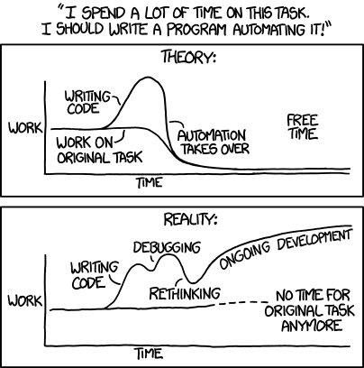
Software and Computing

Slide 26
Software & Computing Working Group [Junk]
Comments
  MC Challenge 6.0 demonstrated the capability for producing large simulation samples with available resources
  No analysis of whether identified manpower is adequate to address high-priority S&C tasks was presented
  It is unclear how well experience from analysis of MC samples are fed back to the S&C group
  It is not clear how well ProtoDUNE-DP is integrated in the C&S WG

Slide 27
Software & Computing Working Group [Junk]
Recommendations
  Provide an overview of high level computing infrastructure including how requests are made to the group and how feedback from the working groups is incorporated into software development planning
  Engage physics WGs in analysis of simulation samples and in providing feedback to the S&C WG
  Ensuring adequate support for protoDUNE(s) at CERN is high priority, including defining the Fermilab role
  Provide an update on ProtoDUNE-DP software integration and MCC production
  Provide an overview of strategy for addressing the different software release timelines and goals (e.g., when the next software release is due and when the next MCC7 is planned)

Slide 28
Physics Working Group [Urheim]
Comments
  The BSM working group has gotten off to a very good start and impressive progress is being made
  The SN workshops are a model for other areas
  Commendable participation by theorists
  Despite good success in attracting more collaborators, manpower remains an issue in several areas and needs continued attention, especially in view of the planned TDR
Recommendations
  Close interaction with reconstruction efforts should continue to be encouraged and maintained
  The low-energy reconstruction efforts should continue to be a priority given their importance for informing the detector design

Slide 29
LBNC mini-review agenda for protoDUNE on Jun 12-13

Slide 30
LBNC mini-review of protoDUNE on Jun 12-13
Experts conducted a one-day assessment of planning, resources, and organization for protoDUNE
  Goals: Technical risks identified, resource limitations identified, baseline established for schedule monitoring
Mini-review committee
  Rick van Berg, Penn (Electronics)
  Arkadiy Klebaner, Fermilab (Cyrogenics)
  Aseet Mukherjee, Fermilab (TPC)
  Michael Lindgren, LBNC
  Stephen Pordes, LBNC
  David MacFarlane, LBNC

Slide 31
Mini-review charge
Provide an in depth review of the following areas of planning for execution of protoDUNE-SP and -DP projects:
  Organization, including common areas between the two projects, & project management, including design review planning, QA planning, change control, schedule & milestone planning;
  Adequacy of resource planning, status of filling key positions and plans for ramping up presence at CERN;
  Identification of major areas of technical risk and assessment of mitigation plans, R&D strategies, as well as the range of potential impacts on schedule or resources; and
  State of engineering design development for major systems, including the TPC hardware systems and the electronics system;

Slide 32
Mini-review charge
  State and plans for overall integrated system design and testing; and
  Feasibility of planned schedule and range of uncertainties, including basis of estimate, identification of key milestones, options for schedule improvements through additional resources, options for mitigation based on major risks.
The mini-review should be prepared to discuss initial findings, comments, and recommendations with the LBNC on Monday evening, June 13.

Slide 33
protoDUNE-SP

Slide 34
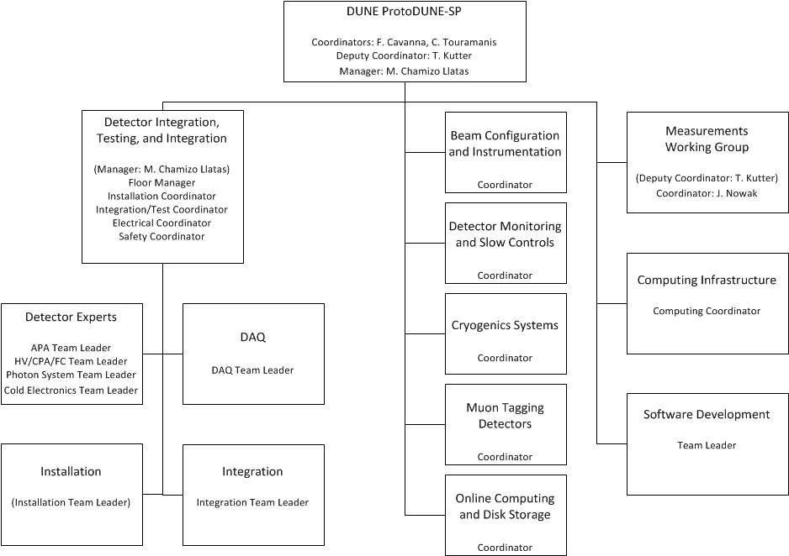
protoDUNE-SP organization
FD WG
PD-SP WG
Detector
component
fabrication

Slide 35
protoDUNE-SP mini-review: management
Comments
  The management for protoDUNE-SP has not responded in a decisive fashion or elevated the response appropriately in the case of serious risks from the cold electronics system
  There does not appear to be a single individual who is responsible for delivery of the cold electronics as a working system
  Some basic design decisions are still subject to R&D, such as the field cage design
  It is important to maintain engineering rigor in the design and production of components as planned
  It does not appear that the process of forming consortia will converge before end of summer, and there will still be funding support questions at that point

Slide 36
protoDUNE-SP mini-review: management
Comments (continued)
  protoDUNE-SP is a critical part of the CD-2 preparation plan and a very visible first major project undertaken by DUNE

Slide 37
protoDUNE-SP mini-review: management
Recommendations
  Put in place a single individual with appropriate expertise who is responsible for cold electronics (from wire signal to delivery of digital signals to DAQ) as a working system
  Clarify roles and responsibilities of the major participants in the cold electronics system and potentially revisit roles in the process
  Form a task force to devise a robust strategy for delivery of a cold electronics system for protoDUNE-SP
  Complete the development of a risk matrix and corresponding mitigation strategies, particularly for the cold electronics
  Take design decisions as early as possible, particularly in cases where choices will not impact significantly the overall goals of the protoDUNE effort

Slide 38
protoDUNE-SP mini-review: management
Recommendations (continued)
  Work with the funding agencies, including DOE, to make sure support for operations and the hiring of key personnel is realized in a timely fashion
  Develop and monitor an agreed upon set of key milestones associated with the protoDUNE-SP project by September 1

Slide 39
protoDUNE-SP mini-review: TPC
Comments
  The TPC team has presented an excellent summary of the construction plans.
  The schedule is very tight, with no hidden contingency.
  Potential human resources required to meet this schedule have in many places been identified, but many are not yet committed.
  Given the tight schedule and personnel constraints, the focus needs to shift from R&D and optimization to production. The team continues to explore manufacturing options on items which, though valuable for DUNE, are not required for protoDune success.
  The design of the CPA is relatively mature, and the team should decide on a lamination process soon

Slide 40
protoDUNE-SP mini-review: TPC
Comments (continued)
  The team should develop a quantified failure mode analysis, including probability and impact of a broken wire in an APA.

Slide 41
protoDUNE-SP mini-review: TPC
Recommendations
  Clearly identify the goals for the protoDune SP TPC and focus resources where needed to achieve them
    Understand and communicate the relative priorities of manufacturing process development, preproduction engineering for Dune, and construction, installation, and commissioning of a TPC in time to validate operation and test calibration before the CERN long shutdown.
    If the principle goal is for protoDUNE to be ready for beam in mid‑2018
      Refocus resources on R&D of direct relevance to protoDUNE.
      Have a clear de-scoping plan
  Develop a more quantitative failure mode analysis
  Develop and monitor an agreed upon set of key milestones associated with the TPC system by September 1

Slide 42
protoDUNE mini-review: electronics
Comments
  Communication between the CE designers and the rest of the DUNE collaboration needs improvement
  The recent involvement of MSU and Boston University is evidence of a new openness in collaboration
  It is not clear that all of the interactions / connections between the APA structure and the CE system are well defined or well understood
  Understanding of the “noise” problems observed in the 35Ton detector is only beginning and may never fully converge on the technical changes necessary to achieve acceptable performance in protoDUNE

Slide 43
protoDUNE mini-review: electronics
Recommendations
  Develop a method to improve the communications between the CE team and the rest of the collaboration
  Consider developing multiple mitigating strategies to ensure a working protoDUNE-SP electronics system:
    Investigate the options (including the identification of possible design teams) for implementing the design of a cryogenic capable true 12 bit ADC using the same interface as the present CE ADC but based on a more traditional and well-understood ADC architecture
    Investigate the options (including the identification of possible design teams) for implementing a cryogenic front-end design as a fully differential device (to improve the power supply rejection ratio) using the same interface as the present CE front-end chip

Slide 44
protoDUNE mini-review: electronics
Recommendations (continued)
    Investigate the options (including the identification of possible design teams) for implementing a variant of the FEMB design
  Fully document and understand the planned electrical connections (DC and AC) between the detecting elements and the CE system and the cryostat shell and verify that the design is as robust as possible
  Develop and monitor an agreed upon set of key milestones associated with the CE and DAQ systems by September 1 and update if necessary

Slide 45
protoDUNE-DP

Slide 46
protoDUNE-DP
Comments
  protoDUNE-DP has been developing an engineering design, with corresponding R&D, for many years and as a result the design is relatively mature
  All aspects of the design appear to be well thought through, including details such as internal sensors
  There are still aspects of the design in R&D: e.g., cathode plates and field cage (in common with protoDUNE-SP)
  The successful operation of the 3x1x1m prototype, as a large-scale demonstration of the dual phase technology, is crucial
  There may not be enough schedule time for commissioning and initial operation of the 3x1x1m prototype before the start of procurements for the 6x6x6m TPC components

Slide 47
protoDUNE-DP
Comments (continued)
  The assembly schedule appears plausible, based on previous experience with commercial vendors and assembly of the 3x1x1m prototype
  There are critical dependences on NP construction activities, starting with the availability of the Building 185 clean room in January 2017
Recommendations
  Complete the development of a risk matrix and corresponding mitigation strategies
  Take design decisions as early as possible, particularly in cases where choices will not impact significantly the overall goals of the protoDUNE-DP effort
  Develop and monitor an agreed upon set of key milestones associated with the protoDUNE-DP project by September 1

Slide 48
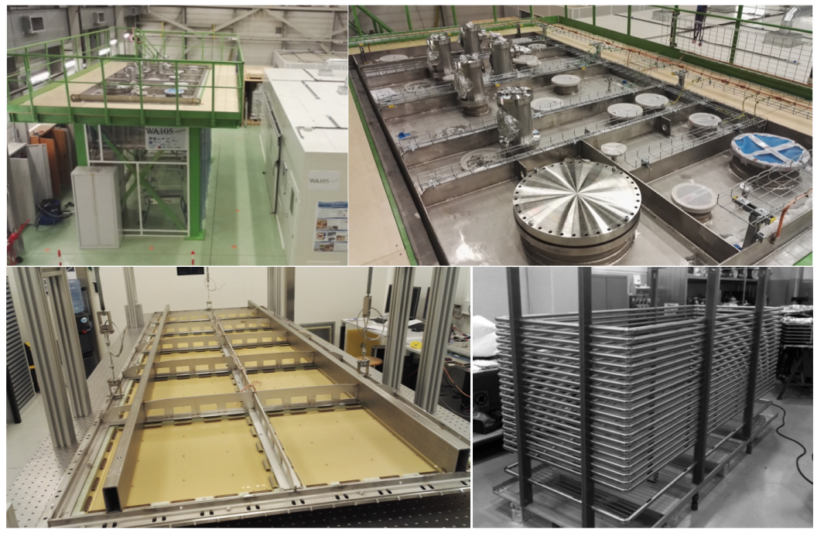
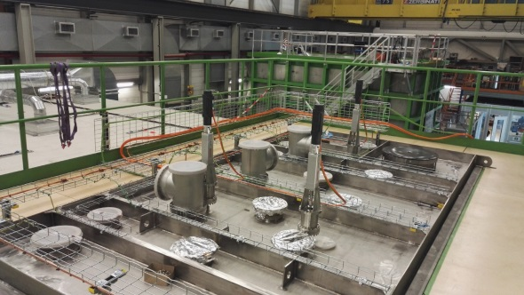
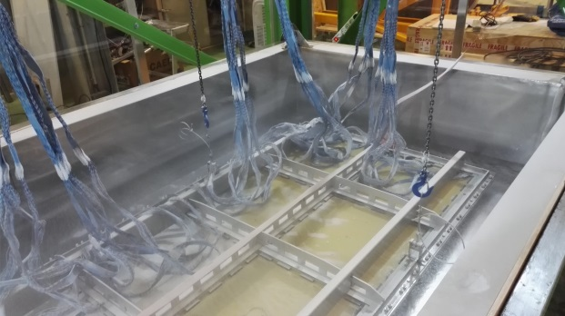
Neutrino Platform: very impressive effort at CERN

Slide 49
Tight schedule
Start of cryostat construction
Clean room for CRP assembly Bld 185
Cryostat ready for detector installation
EHN1 infrastructure milestones
Cryogenics ready
Jul 2016
…
Sep 2016
…
Jan 2017
…
Mar 2017
Apr
2017
…
Aug
2017
…
Dec
2017
Jan 2018
Feb
2018
Mar
2018
Apr
2018
➔ Beam data
Start CRP assembly
First cosmics
All CRPs assembled
Ready for installation
CRPs installed & cabled
TCO & cryostat sealed
Start cryogenic operation
& detector commissioning
Ready to start beam data taking
Final design of detector elements
Detector fully installed and cabled

Slide 50
Summary
Initial focus was CD-1R, then CD-3a for LBNF and now TF, protoDUNE, & developing international partners for DUNE
  Enormous progress (Snowmass, P5, LBNF/DUNE) in setting the stage with DOE & the international community for a US hosted global neutrino facility
  Outstanding performance at CD-1R was a first big test for the new paradigm followed quickly by crucial CD-3a in December
Longer-term evolution to more in-depth review and advice on physics, technical, project execution & management
  Focusing on protoDUNE resources, risks, planning, schedule and, manpower; & overall DUNE strategy for CD-2 by Q4/2019
  LBNF pre-excavation design, CMGC contracting, final design for excavation phase, and overall project planning

Slide 51
LBNC membership
Intend to rotate a fraction of initial LBNC members at the end of 2016
  Opportunity as well to strengthen expertise as committee transitions to focus more on implementation and monitoring of design & construction of protoDUNE, preparation of TDR
  Will overlap new members at fall face-to-face meeting
  Intend to continue with 3 face-to-face meetings per year, along with intermediate phone calls as follow-up to key aspects of the projects

