Slide 1
Theory Strategic Plan Update
Marcela Carena
Fermilab PAC meeting
6/21/2016

Slide 2
Theory Strategic Goals
Conduct world-leading theoretical particle physics and theoretical
astrophysics research.
Focus effort and core strength in key research areas directly related to the U.S. and worldwide experimental programs.
Influence and motivate the design of experiments, data analyses, and their interpretation.
Train next generation of theorists in data-rich environment and contribute to educating junior experimentalists.
Provide a national resource for university physicists.
Foster an intellectually vibrant atmosphere at the lab.
Theory Strategic Plan Presentation: PAC- 01/20/2016
https://indico.fnal.gov/getFile.py/access?contribId=8&resId=0&materialId=slides&confId=11253

Slide 3
Theoretical Physics
Theoretical Astrophysics
Key research areas:
collider phenomenology, Higgs physics, flavor physics, neutrino physics, BSM model building, perturbative and lattice QCD, dark matter, baryogenesis.
Key research areas: dark matter, dark energy, inflation, CMB, cosmic neutrinos, large scale structure.
see also Scott Dodelson’s talk
Frequent interaction and collaboration between the two groups
Synergies with Fermilab Programs on
LHC, Cosmic, Neutrinos, Muons, Scientific Computing
Discussed in detail at the Theory Strategic Plan Presentation: PAC- 01/20/2016

Slide 4
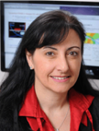
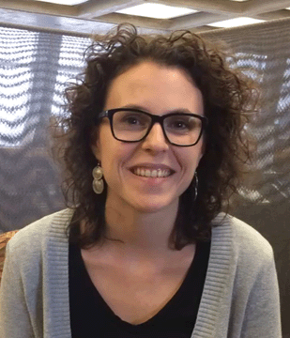
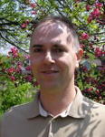
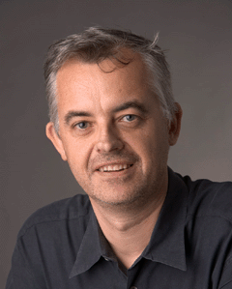
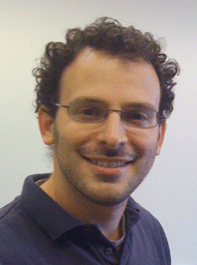
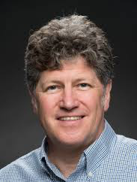
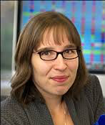
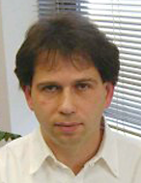
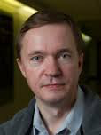
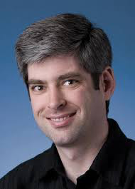
Fermilab Theorists: Particle Physics and Astrophysics
J. Campbell SII
M. Carena SIII
PP Dept. Head
P. Coloma AS
B. Dobrescu SII
LPC
E. Eichten SIII
P. Fox SI
LPC
W. Giele SII
R. Harnik SI
LPC
C. Hill SIII
Kronfeld SII
SG ν-Nucleus Int.
P. Mackenzie SIII
Chair USQCD
S. Parke SIII
NPC Coordinator
C. Quigg SIII
R. Van de Water SI
Plus
11 RA’S
6 Students
S. Dodelson SIII
J. Frieman SIII
DES Director
N. Gnedin SII
D. Hooper SII
A. Stebbins SII
Astrophysics Dept. Head

Slide 5
Plan for Theoretical Physics (slide from January PAC)
Maintain a broad theory effort aligned to the lab program
Maintain, and to the extent possible grow, the postdoc cohort
Strengthen the visitor programs
Strengthen the theory effort in neutrinos, as recommended by both the comparative and institutional reviews
=>This will require recruiting at least two new neutrino theorists, supplemented by longer-term visitors, including Scholars, and through the theory connection to the Neutrino Physics Center
Maintain strength in BSM, pQCD, and lattice QCD, and crosscutting cosmic research
=> this will require a new hire in pQCD
Maintain the Graduate Student research program
Notes:
And this PAC in January

Slide 6
Plan for Theoretical Physics (updates)
Maintain a broad theory effort aligned to the lab program
Maintain, and to the extent possible grow, the postdoc cohort
Strengthen the visitor programs
Strengthen the theory effort in neutrinos, as recommended by both the comparative and institutional reviews
=>This will require recruiting at least two new neutrino theorists, supplemented by longer-term visitors, including Scholars, and through the theory connection to the Neutrino Physics Center
Maintain strength in BSM, pQCD, and lattice QCD, and crosscutting cosmic research
=> this will require a new hire in pQCD
Maintain the Graduate Student research program

Slide 7
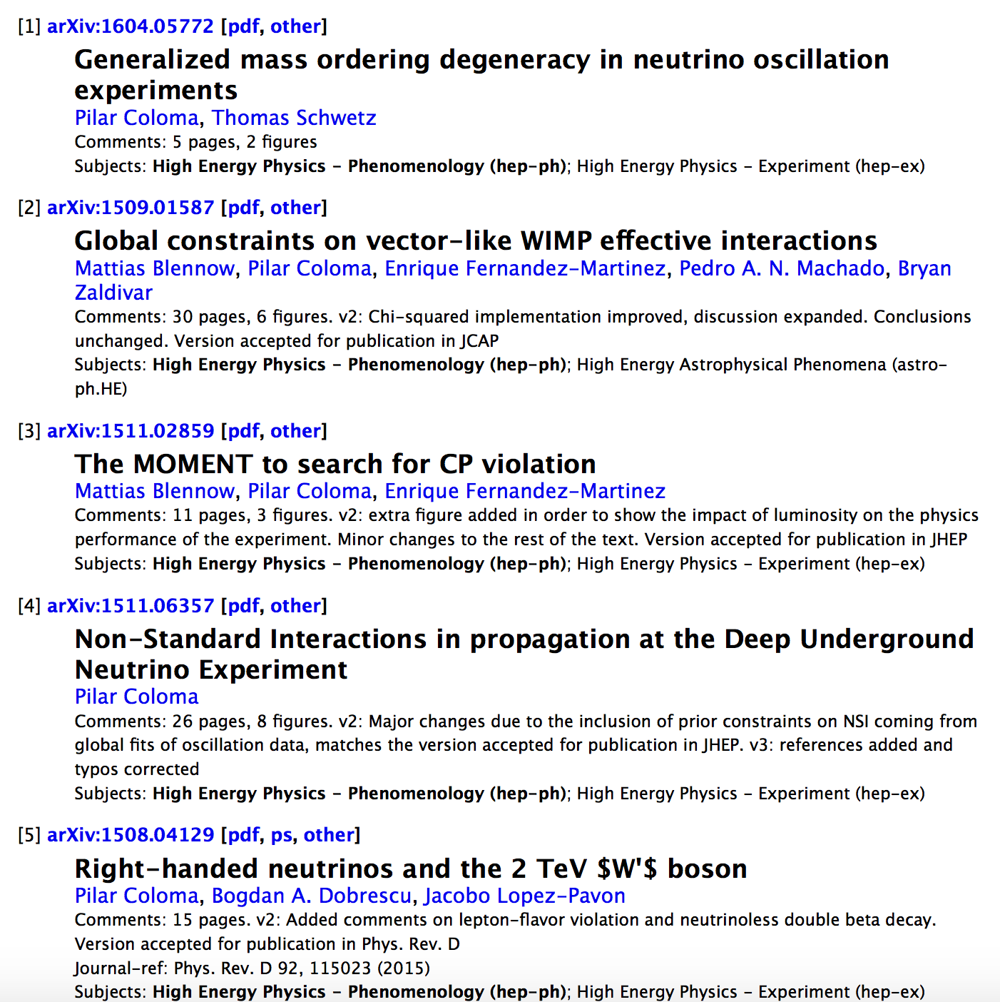
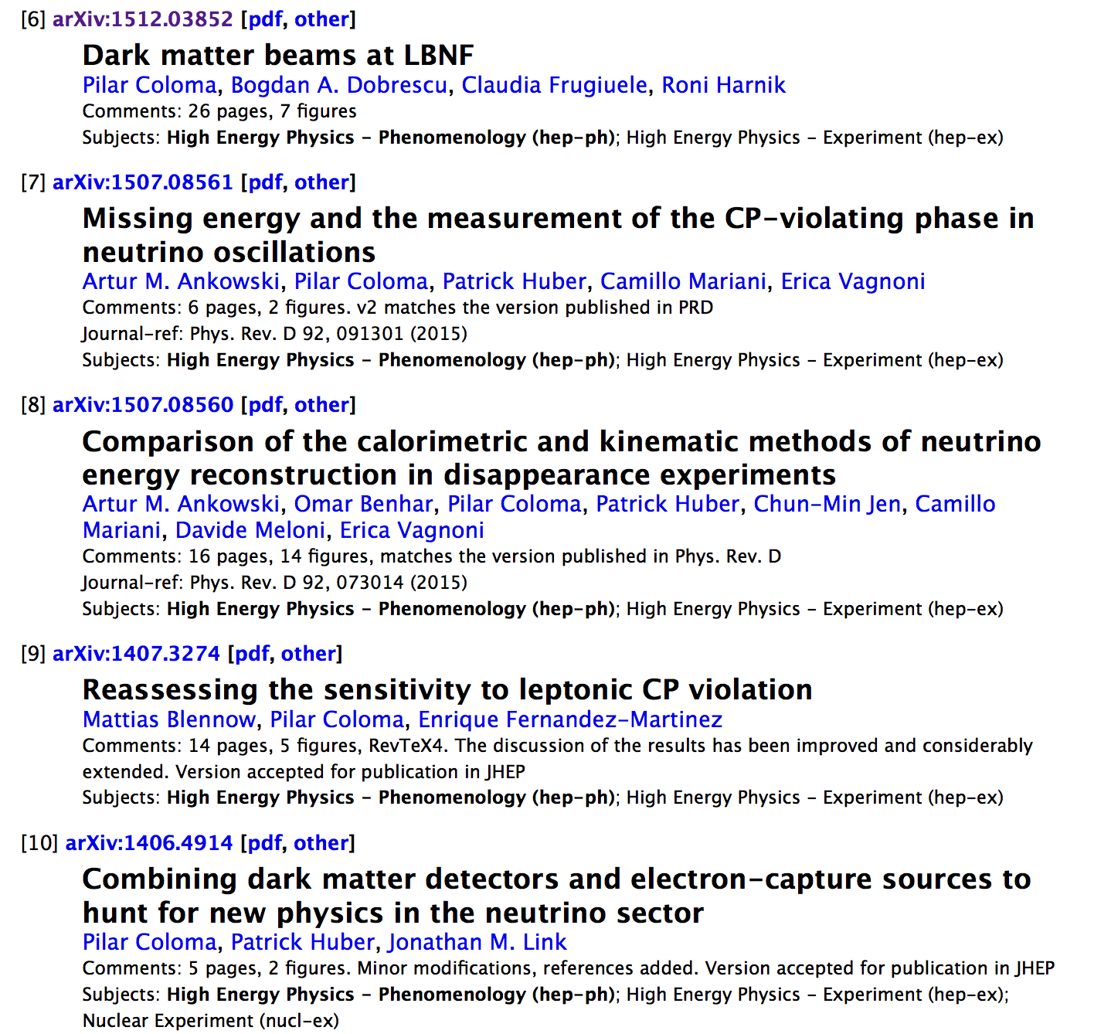
New Neutrino Associate Scientist Hire
Pilar Coloma (as of 07/01/2016)
World expert in phenomenology of neutrino oscillations
Engaged with Neutrino experimental community

Slide 8
Neutrino Nuclear Theory Effort
Core theory community in this area is very small
Need to optimize how neutrino theory effort interacts with neutrino experiments
special concern: theory developments in Neutrino Nucleus Scattering
Formed WG in April to assess uncertainties on neutrino-nucleus interactions
Steering Group: Andreas Kronfeld, Sam Zeller (co-chairs),
J. Carlson, R. Hill, G. Perdue, R. Schiavilla
Short-term: work with NuSTEC (Spokepersons Jorge Morfin & Luis Alvarez Ruso)
on a white paper covering the full range of issues in neutrino-nucleus scattering.
Add HEP theorists to NuSTEC Collaboration
Participation in 2016 workshop on neutrino-nucleus interaction at the Institute for Nuclear Theory, U Washington: http://www.int.washington.edu/PROGRAMS/16-63w/
Long-term : structured description of the sources of uncertainty, and how they can be improved, focusing on the impact on oscillation parameters

Slide 9
The Neutrino Physics Center (npc.fnal.gov)
NPC Coordinators: Bonnie Fleming, Deborah Harris, Stephen Parke
Born Dec. 2015
• Field Work Proposal funded by DOE
Formed International Advisory Committee (for members see webpage)
• In March 2016 had first call for Neutrino Fellowship proposals:
(funded 32 including 5 in nucl-th and hep-th for summer of 2016)
• In 2017 and beyond, will oversee the International Neutrino School and
host it at Fermilab in the odd years.
• Fermilab Neutrino Seminar, Fermilab Neutrino University, more to come …..

Slide 10
Plan for Theoretical Physics (updates)
Maintain a broad theory effort aligned to the lab program
Maintain, and to the extent possible grow, the postdoc cohort
Strengthen the visitor programs ➔Fermilab Distinguished Scholars
Strengthen the theory effort in neutrinos, as recommended by both the comparative and institutional reviews
=>This will require recruiting at least two new neutrino theorists, supplemented by longer-term visitors, including Scholars, and through the theory connection to the Neutrino Physics Center
Maintain strength in BSM, pQCD, and lattice QCD, and crosscutting cosmic research
=> this will require a new hire in pQCD
Maintain the Graduate Student research program

Slide 11
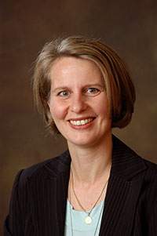
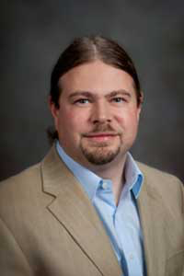
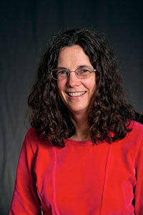
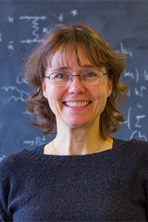
Fermilab Distinguished Scholar Program launched:
New initiative to appoint U.S. particle theorists to rotating terms as FDS, to spend at least one month total per year for 2 years (+1 year ext.) in residence at Fermilab. FDS may be accompanied by student and/or postdoc
Candidates are recommended by an external advisory committee
Main Goals: Strengthen connection between the Fermilab theory departments and the wider U.S. particle theory community, and increase resident Fermilab theoretical expertise in targeted physics areas to support the Fermilab experimental program.
Aida El-Khadra,
UIUC (Lattice QCD)
Patrick Huber,
Virginia Tech. (ν’s)
Ann Nelson,
U. Washington (BSM, ν’s)
Doreen Wackeroth,
SUNY@Buffalo (pQCD)

Slide 12
Plan for Theoretical Physics (updates)
Maintain a broad theory effort aligned to the lab program
Maintain, and to the extent possible grow, the postdoc cohort
Strengthen the visitor programs
Strengthen the theory effort in neutrinos, as recommended by both the comparative and institutional reviews
=>This will require recruiting at least two new neutrino theorists, supplemented by longer-term visitors, including Scholars, and through the theory connection to the Neutrino Physics Center
Maintain strength in BSM, pQCD, and lattice QCD, and crosscutting cosmic research
=> this will require a new hire in pQCD:
Maintain the Graduate Student research program

Slide 13
Plan for Theoretical Physics (updates)
Maintain a broad theory effort aligned to the lab program
Maintain, and to the extent possible grow, the postdoc cohort
Strengthen the visitor programs
Strengthen the theory effort in neutrinos, as recommended by both the comparative and institutional reviews
=>This will require recruiting at least two new neutrino theorists, supplemented by longer-term visitors, including Scholars, and through the theory connection to the Neutrino Physics Center
Maintain strength in BSM, pQCD, and lattice QCD, and crosscutting cosmic research
=> this will require a new hire in pQCD:
Maintain the Graduate Student research program
Associate Scientist Search Underway

Slide 14
Plan for Theoretical Physics (updates)
Maintain a broad theory effort aligned to the lab program
Maintain, and to the extent possible grow, the postdoc cohort
Strengthen the visitor programs
Strengthen the theory effort in neutrinos, as recommended by both the comparative and institutional reviews
=>This will require recruiting at least two new neutrino theorists, supplemented by longer-term visitors, including Scholars, and through the theory connection to the Neutrino Physics Center
Maintain strength in BSM, pQCD, and lattice QCD, and crosscutting cosmic research
=> this will require a new hire in pQCD:
Maintain the Graduate Student research program

Slide 15
Plan for Theoretical Physics (updates)
Maintain a broad theory effort aligned to the lab program
Maintain, and to the extent possible grow, the postdoc cohort
Strengthen the visitor programs
Strengthen the theory effort in neutrinos, as recommended by both the comparative and institutional reviews
=>This will require recruiting at least two new neutrino theorists, supplemented by longer-term visitors, including Scholars, and through the theory connection to the Neutrino Physics Center
Maintain strength in BSM, pQCD, and lattice QCD, and crosscutting cosmic research
=> this will require a new hire in pQCD:
Maintain the Graduate Student research program ➔ ended *

Slide 16
Plan for Theoretical Astrophysics (slide from January PAC)
Maintain a broad theory effort to study fundamental physics related to astronomy: i.e. dark matter, dark energy, cosmic and astrophysical neutrinos, early universe.
Help train next generation of cosmic scientists by maintaining a strong postdoc recruitment program exposing them to the broad spectrum of current cosmic research.
Continued active support of current DOE cosmic program (DES, DESI, LSST, SPT) including development of methods and extraction of scientific results
Continued work to develop future cosmic research beyond cosmic program (e.g. 21cm surveys)
Continued participation in Graduate Student research program

Slide 17
Plan for Theoretical Astrophysics (update)
Maintain a broad theory effort to study fundamental physics related to astronomy: i.e. dark matter, dark energy, cosmic and astrophysical neutrinos, early universe.
Help train next generation of cosmic scientists by maintaining a strong postdoc recruitment program exposing them to the broad spectrum of current cosmic research.
Continued active support of current DOE cosmic program (DES, DESI, LSST, SPT-3G, CMB-S4) including development of methods and extraction of scientific results (Dodelson’s talk yesterday)
Continued work to develop future cosmic research beyond cosmic program (e.g. 21cm surveys)
Continued participation in Graduate Student research program

Slide 18
Plan for Theoretical Astrophysics (update)
Maintain a broad theory effort to study fundamental physics related to astronomy: i.e. dark matter, dark energy, cosmic and astrophysical neutrinos, early universe.
Help train next generation of cosmic scientists by maintaining a strong postdoc recruitment program exposing them to the broad spectrum of current cosmic research.
Continued active support of current DOE cosmic program (DES, DESI, LSST, SPT) including development of methods and extraction of scientific results
Continued work to develop future cosmic research beyond cosmic program (e.g. spectroscopic and 21cm surveys)
Frieman member of National Academies Committee on Facilities in LSST Era;
Dodelson chaired DOE Cosmic Visions Group, http://arxiv.org/abs/1604.07626;
Workshop on Future surveys: https://kicp-workshops.uchicago.edu/FutureSurveys/

Slide 19
Plan for Theoretical Astrophysics (update)
Maintain a broad theory effort to study fundamental physics related to astronomy: i.e. dark matter, dark energy, cosmic and astrophysical neutrinos, early universe.
Help train next generation of cosmic scientists by maintaining a strong postdoc recruitment program exposing them to the broad spectrum of current cosmic research.
Continued active support of current DOE cosmic program (DES, DESI, LSST, SPT) including development of methods and extraction of scientific results
Continued work to develop future cosmic research beyond cosmic program (e.g. 21cm surveys)
Continued participation in Graduate Student research program: ended *
Mentored ~20 PhD students over past 3 years, mostly NSF support from UChicago

Slide 20
“Essential contributions in support of the U.S. particle physics community”
Strong postdoc training with exceptional outcomes*
Leadership in topics essential to the experimental program but thinly covered at US universities such as Perturbative and Lattice QCD* as well as Neutrino-Nucleus interaction Th-Exp. Effort.
Develop ideas that shape experimental design and analysis*
Theoretical resources to the largest experimental community in the US*
Community Leadership and Lab service*

Slide 21
Strengthening Neutrino Theory at US Universities
“Strategic relationships with other U.S. theory groups
that should be explored or strengthened”
U.S neutrino theory community is tiny compared to Europe and
given the US investment in Neutrinos, the theory investment is subcritical
Train neutrino theory postdocs who will become next generation of professors
Distinguished Scholars and Neutrino Physics Center will help to strengthen effort by providing a visible hub
Fermilab can help to seed new junior faculty positions at U.S. universities
– explore possible mechanisms to do this with maximal effect -

Slide 22
Backup Slides

Slide 23
Exceptional postdoc outcomes
Both groups attract first-rate talent, mentor them in a broad and data-rich environment
Theory postdocs move on to faculty or lab staff positions at a high rate (~ 80%)
Famous Fermilab Theory Postdoc Alumni:
Head of CERN Theory Division (Giudice)
Vice-President CERN Council (Rabinovici)
Director Tata Institute, Mumbai (Trivedi, AS)
Director JINR, Dubna (Matveev)
National Medal of Science awardee & PCAST Member (Shirley Jackson)
Director IAS Hong Kong (Tye)
Director IPPP, Durham (Glover)
Head of BNL Physics Dept. (Dawson)
Director of PITT PACC (Han)
Max Planck Director (Lindner)
Director of Perimeter Institute (Turok, AS)
Director of FTPI, U. Minnesota (Olive)
Director Inst. Data Intensive Science (Szalay, AS)
DESY Theory Head (Buchmuller)
Heineman Prize (Ramond)
Dirac Medal and Milner Prize (Sen)
Sakurai Prize (Kosower)
CERN LPCC (Mangano)
Oxford Prof. & Bessel Award (Zanderighi)
IUPAP Young Scientist Prize (Santiago)
U Wash Dept Chair (S. Ellis)
CCAPP at OSU Chair (Beacom)
Chair U Sussex Phys. Dept. (Copeland)
Chair UC Davis Phys. Dept. (Albrecht, AS)
Chair A&A Dept. UChicago (Olinto)
Head Fermilab Astrophysics, (Stebbins)
Etc.
23

Slide 24
Leadership in perturbative QCD
Strong research efforts crucial to support experimental program
Successful training of young QCD theorists
Frequent interaction with and resource to experimental community
Contributions to the community:
Develop, maintain, and provide support for the parton-level Monte-Carlo program MCFM
First public MC generator with fully differential NNLO corrections for multiple processes
Cited by 20% of all ATLAS and CMS papers and widely-used by theoretical community
Scientific achievements of Fermilab theorists:
State-of-the-art calculations of Z+jet and H+jet at NNLO, two-loop corrections to gg→ZZ
Enabled numerous high-impact LHC analyses such as the constraint on the Higgs Boson
width via off-shell 4-lepton production
6/21/16
Marcela Carena | Theory Strategic Plan Update

Slide 25
Leadership in Lattice QCD
Strong research efforts crucial to support experimental program
Successful training of young QCD theorists
Frequent interaction with and resource to experimental community
Contributions to the national program:
Leaders in USQCD, including Executive Committee chair, past Scientific Program Committee chair/members, PI of LQCD (hardware) & SciDAC (software) grants
Develop and deploy (with Fermilab Scientific Computing) large computing clusters and software frameworks for use by U.S. lattice-QCD community
Scientific achievements of Fermilab theorists:
World-leading calculations in quark-flavor physics, including best results for D-meson decay constants, B-mixing matrix elements, and kaon & several B-meson form factors
Enabled most precise determinations of 7 out of 9 elements of CKM quark-mixing matrix
6/21/16
Marcela Carena | Theory Strategic Plan Update

Slide 26
BSM theory: developing ideas to drive experiments
Fermilab BSM theorists do world-class original research
BSM Higgs phenomenology and benchmarks
Dark matter at colliders
Dark matter at neutrino beams
Dark matter direct detection
Axion detection
New Interactions in Neutrino experiments
LHC searches for LFV Higgs decays
LHC searches for Neutral Naturalness
Responses to collider anomalies (e.g. WZ, 750 GeV di-photon,...)
Matrix element methods for Higgs golden channel (4l)
Proposals for new LHC searches
…
Continuous face-to-face interactions with largest U.S. experimental community

Slide 27
Community Leadership (select list)
APS Council, current DPF chair-elect, three past DPF chairs, officers of DAP, many other APS committees
Snowmass conveners and co-authors of 18 Snowmass reports
HEPAP, P5, NAS BPA, PASAG, AAAC, CAA, DOE COV, NSF COV etc
CERN SPC, DESY PRC, ILC PAC, other international panels
Chair of International Neutrino Commission
Fermilab physics studies
Laboratory Services (select list)
Fermilab Academic Lectures
Fermilab SAC, LPC, Wilson Fellow Cmte, Lederman Fellow Cmte,
Joint Experimental-Theory seminar, Fermilab Colloquium Cmte.
Public lectures, books, Saturday Morning Physics
Organize and lecture at workforce training events (schools)
Organize workshops and conferences

Slide 28
Graduate Student Research Program in Theoretical Physics 2010–2016
One year research opportunity for US university PhD students with staff of Theoretical Physics & Theoretical Astrophysics Departments:
outstanding opportunity for students;
brought more youthful enthusiasm to the theory dep’ts;
excellent placement for students.
Now encouraged not to use the overall budget to bring students to Fermilab, but to use the DOE SCGSR program instead—
three students via this program so far (just finished, in progress, coming soon).

