Slide 1
WA 105 3*1*1 PROJECT STATUS

Slide 2
The SVB is already quite visible, with valves installed and currently they are wrapping MLI.
The PSVB is only yet available in parts.
The CVB is in the final stages of design and preparation/purchase of parts,
The PVB is in the final stage of detailed design.
TLA9 is in detailed design
Ports 3,4,5,8 under fabrication

Slide 3
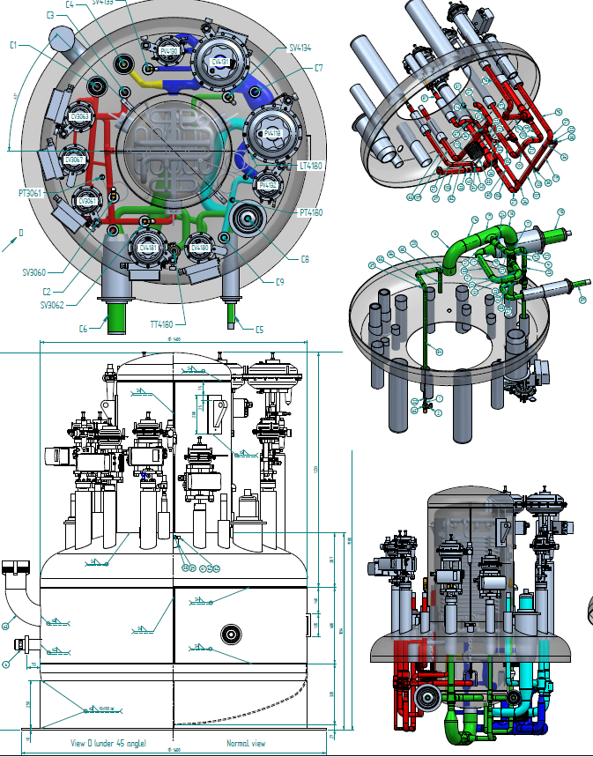
CVB Detailed Design

Slide 4
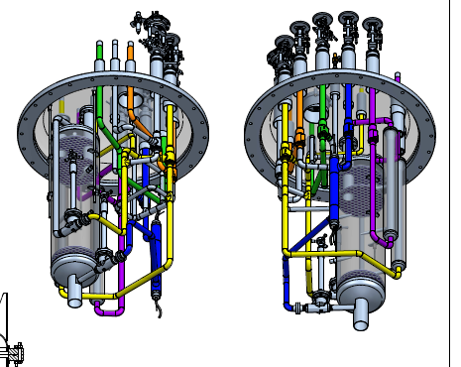
PVB Detailed Design

Slide 5
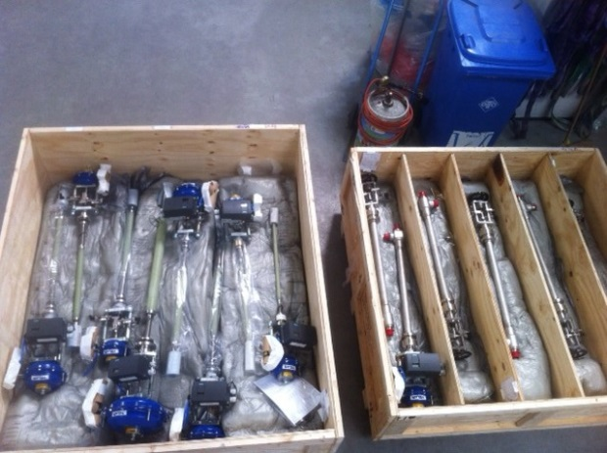
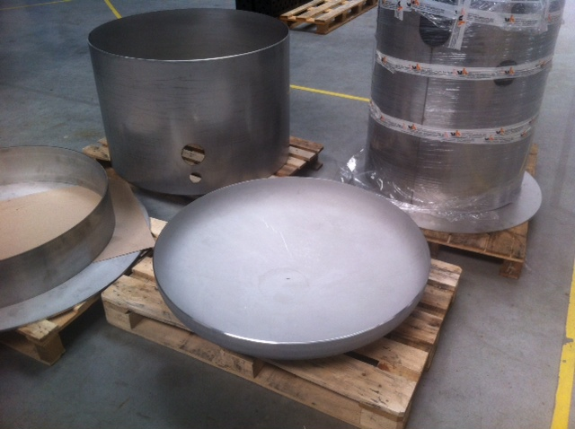
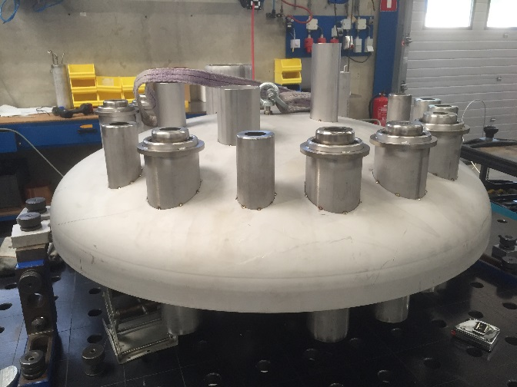
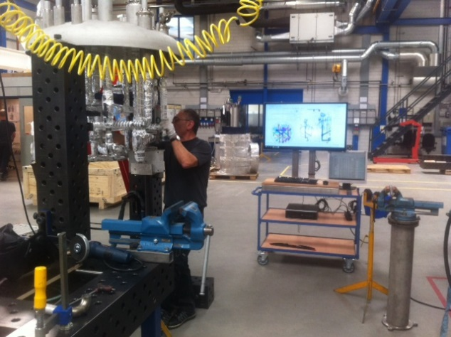
STATUS of the MANUFACTURING
Cryo valves
PSVB parts
SVB

Slide 6
Schedule
Manufacturing has started w20 and will end w34,
Critical path is on PVB due to delay on filter design,
Activities during August at DeMaco will be limited,
FAT at DeMaco end of August and delivery at CERN first week of September,
2 weeks of installation,
WAT and CAT mid September (w37-38).

