Slide 1

Coil Fabrication and Shipment Processes
Fred Nobrega
FNAL QA/QC for HL-LHC-AUP Coil Fabrication Review – May 31, 2016

Slide 2

Outline of Talk
Coil requirements & specification
Manufacturing plan of LARP and HL-LHC-AUP
Overview of coil fabrication process
Coil shipping

Slide 3
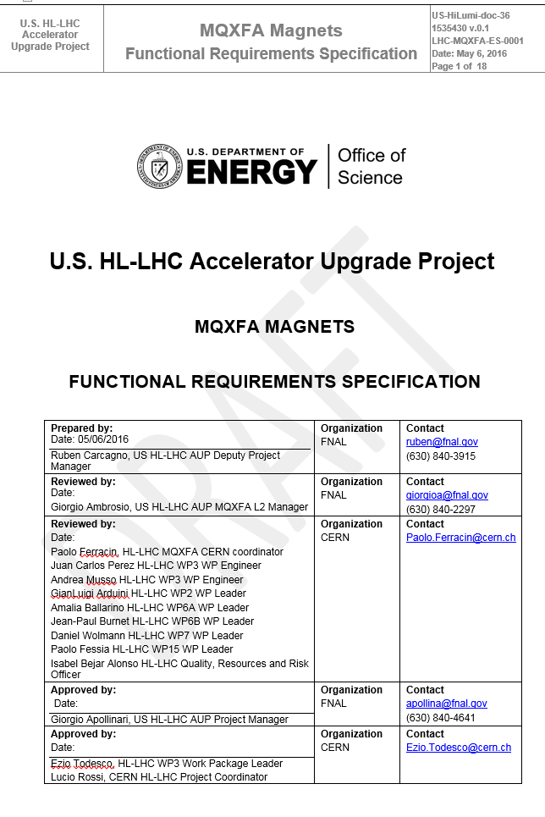
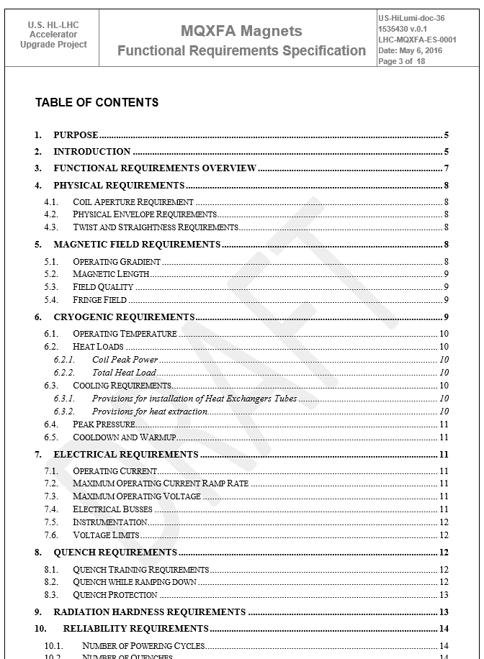
MQXFA FUNCTIONAL REQUIREMENTS SPECIFICATION

Slide 4
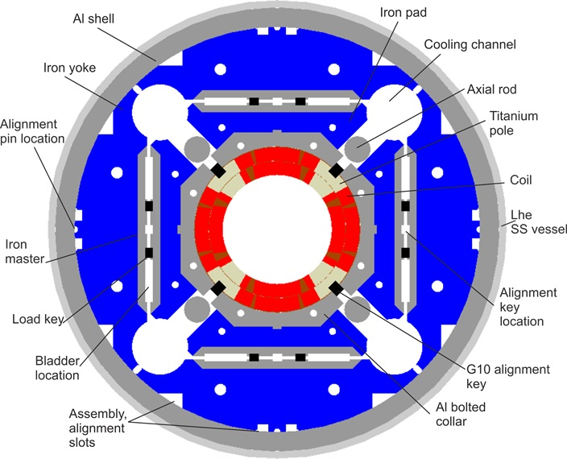
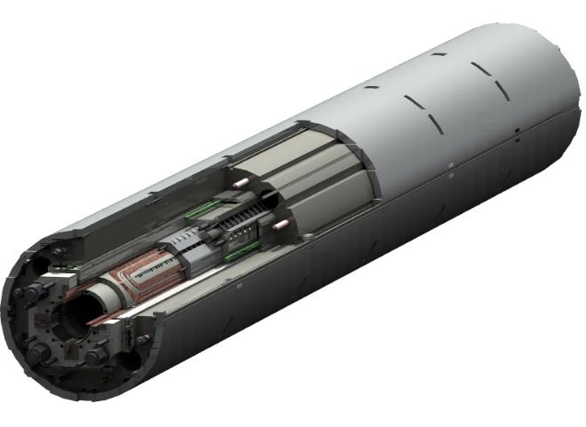
MQXFA FUNCTIONAL REQUIREMENTS SPECIFICATION
4. Physical Requirements
  4.1. Coil Aperture Requirement
R-T-01: The MQXFA coil aperture requirement is 150 mm. This aperture is the coil inner diameter at room temperature, excluding ground insulation, cold bore and beam screens.
This aperture represents an increase of 80 mm over the present LHC inner triplet coil aperture of 70 mm. The larger aperture is a key MQXFA requirement for HL-LHC, because it allows a smaller β* and higher luminosity. Advances in Nb₃Sn technology for superconducting magnets allow this increase in aperture while keeping the magnet length at acceptable values.

Slide 5
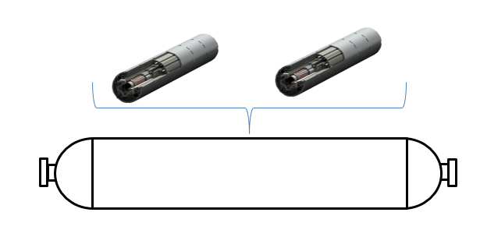
Project Manufacturing Plan Overview
Coil fab at both FNAL and BNL→ ship to LBNL
Magnet assembly at LBNL, ship to BNL for cold test then shipped to FNAL.
FNAL assembles and tests cold mass then ships to CERN to cryostat.
Magnets
Cold Mass Assembly
Liquid Helium Containment Vessel

Slide 6
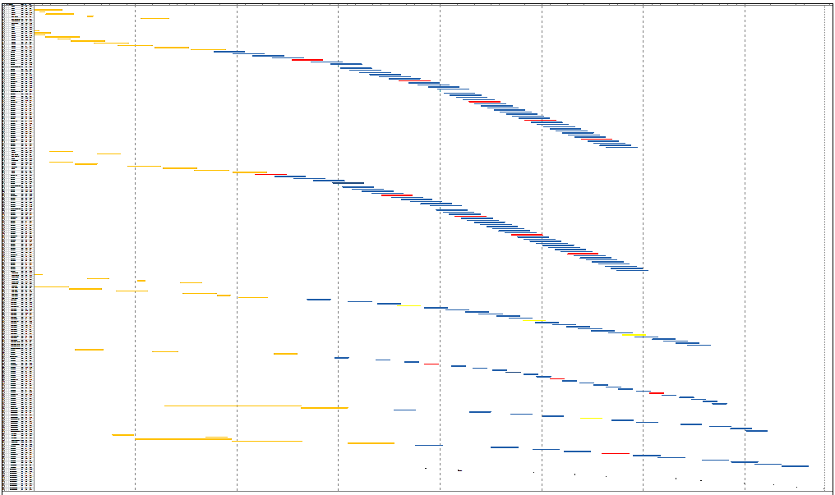
Manufacturing Plan
OCT 2016
Today
FY17
FY18
FY19
FY20
FY21
FY22
FY23
FY24
LARP
FNAL Coils
Project
BNL Coils
LBNL Structure Assembly
BNL Vertical Test
FNAL Cold Mass Assembly
FNAL Cold Mass Test
Delivery to CERN

Slide 7
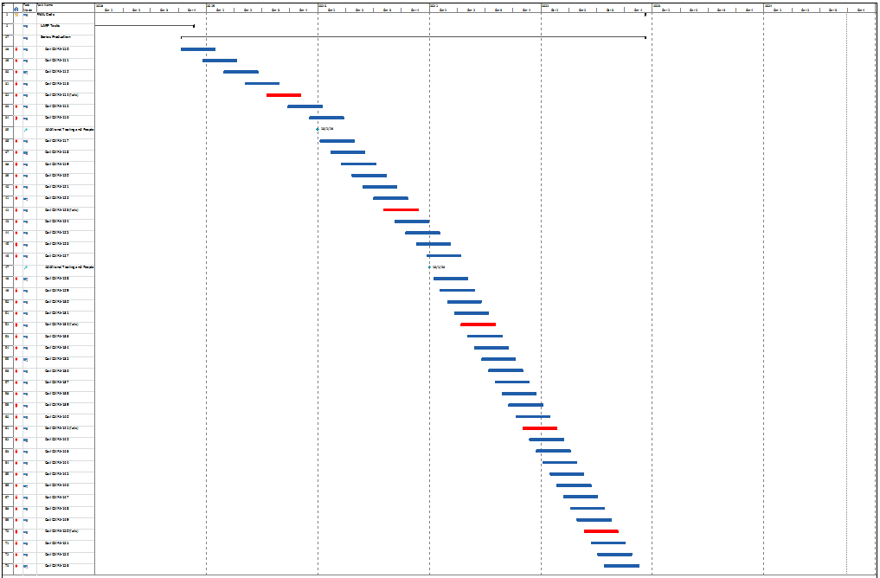
FNAL Production Coils
FY18
FY19
FY20
FY21
FY22
LARP Rate (1 coil every 50 days)
Add Tooling + Techs
Intermediate Rate (1 coil every 25 days)
Add Tooling + Techs
Peak Rate (1 coil every 16 days)

Slide 8
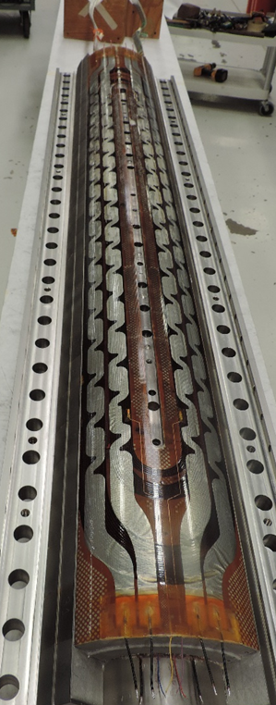
Coil Fabrication Steps and Tooling Usage
Series Production Estimate:
  It takes an average of 2 technicians working 80 days to fabricate a coil (~0.7 FTE-years)

Slide 9
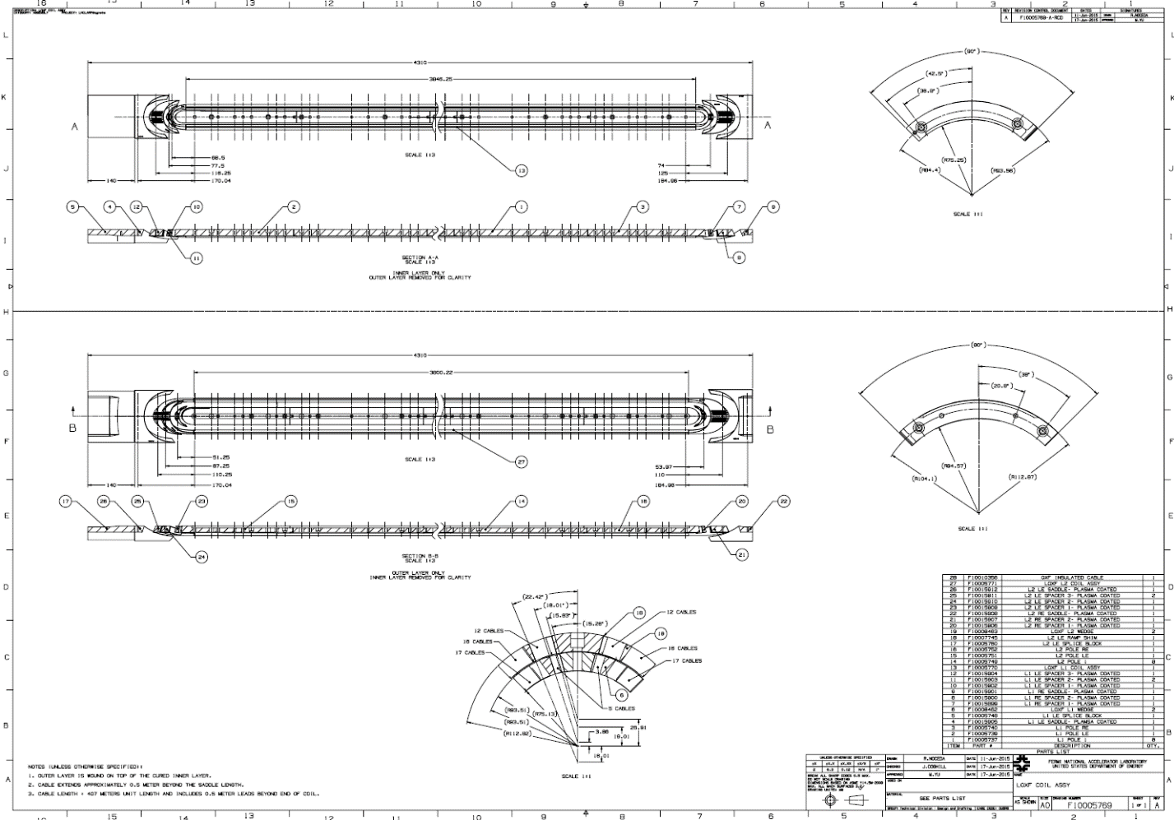
Coil Winding Assembly Drawing

Slide 10
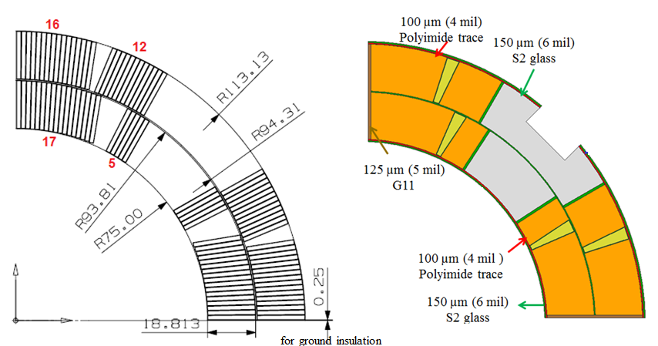
Coil Parameters
2 layer cot-theta coil with inner/outer radius of 75/113.13 mm, with cable using 40 x 0.85 mm strand and is 18.15 mm wide.
QXFA magnetic length is 4.2 m @ 1.9 K. (LARP 4.0 m)

Slide 11
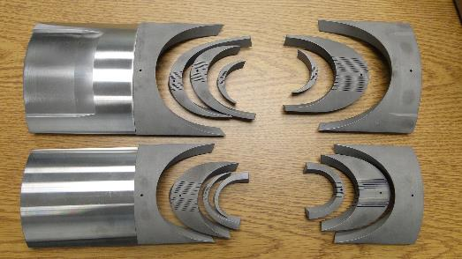
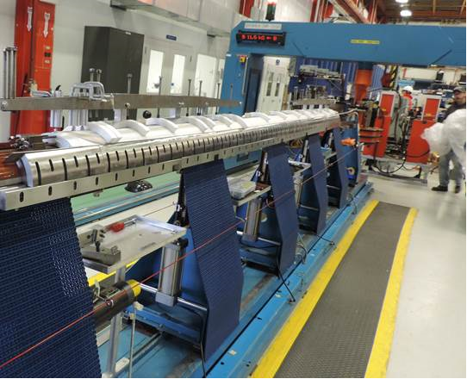
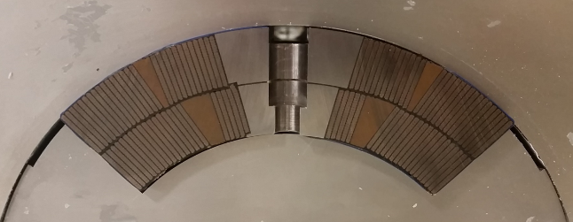
Coil Winding and Curing
Cable tension 15-25 kg depending on turn.
Curing cycle 150° C for 90 minutes in closed cavity with CTD-1202X ceramic binder.

Slide 12
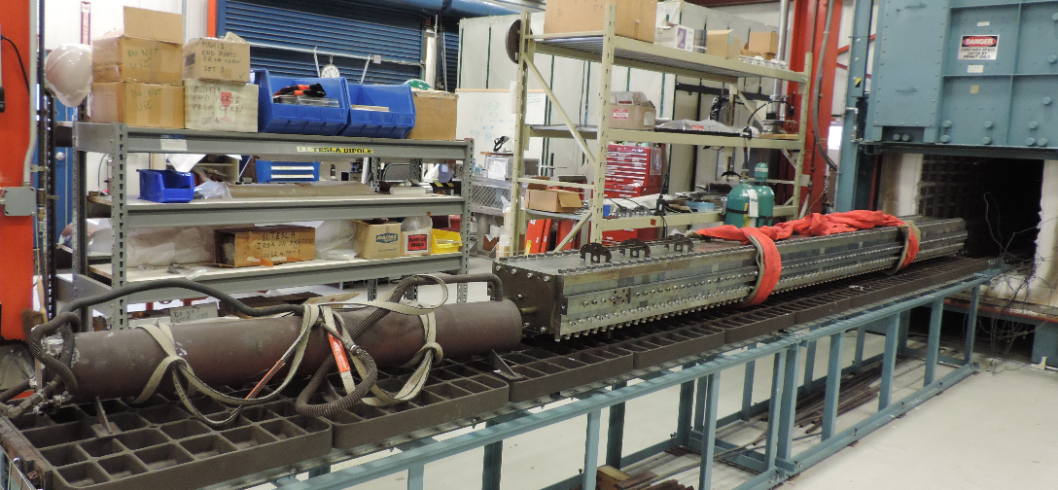
Coil Reaction
Reaction cycle is in an argon atmosphere and at 210° C for 72 hours, 400° C for 48 hours and 650° C for 48 hours. The heat treatment lasts about 9 days including ramp up and cool down. The heat treatment recipe varies with strand type during LARP only.

Slide 13
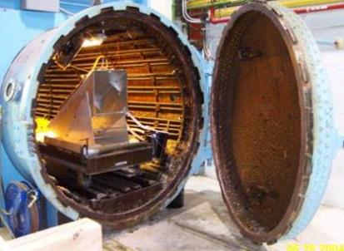
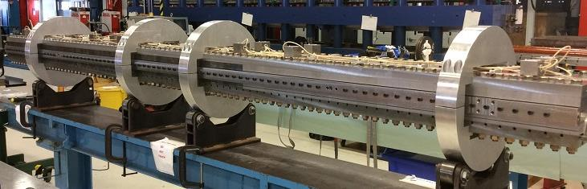
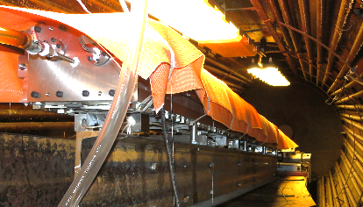
Coil Impregnation
Impregnation is with CTD101K and is done in the IB2 vacuum oven at 30-50 μm Hg with epoxy temperature of 60° C.
Curing is the same oven at 125° C for 21 hours using external heaters mounted on the tooling.

Slide 14
Coil QXFP01A CMM
Each box is 100 microns (4 mils)
Inspected cross sections include strain gauge locations and end regions.

Slide 15
Sample CMM Wedge Inspection
FURFACE PROFILE 533 MM FROM END EXAGGERATION X 100 EACH SQUARE= .01

Slide 16
Sample CMM End Part Inspection

Slide 17
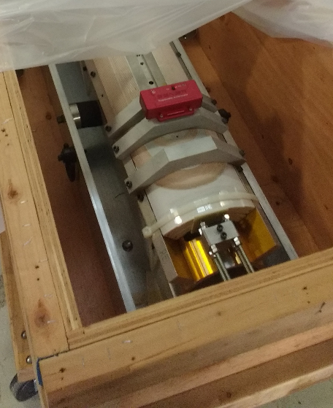
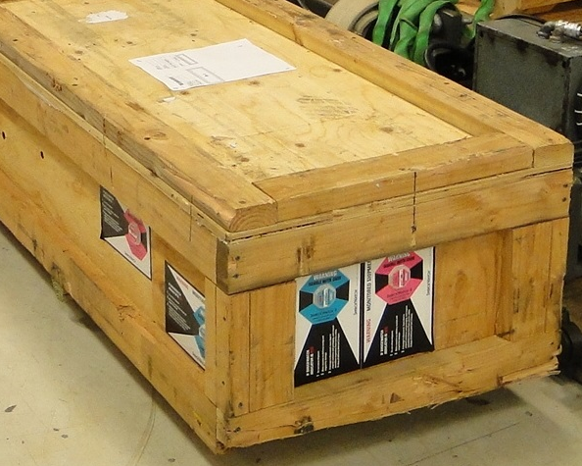
Coil Shipping
Coil shipping with accelerometers mounted on the coil and ShockWatch Indicators on the crate.

Slide 18
QXFP01 Coil Shipping

Slide 19
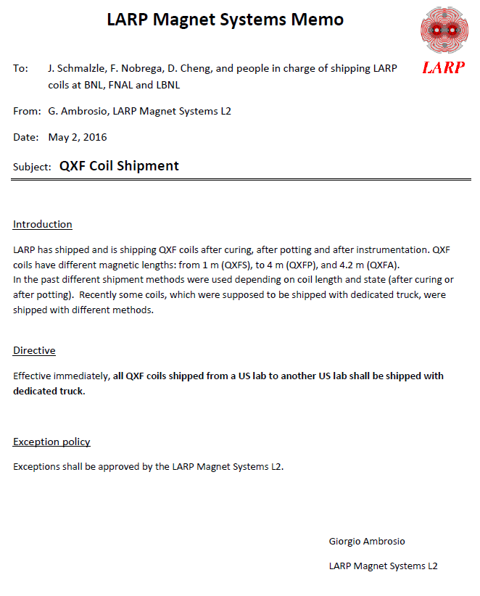
Coil Shipping
Dedicated truck point to point.
Soon to be revised from an exclusive dedicated truck to a dedicated truck that shares trailer space. Lower cost with longer delivery time depending on number of stops.

Slide 20
Traveler’s & Discrepancy Repots
All major fabrication steps are in electronic travelers called VECTOR. The level of detail varies with the operation complexity.
Discrepancy reports (DR) are typically generated whenever a step within traveler is not met, a parameter is out of range, or if damage is observed to coil or tooling.
DR’s are used to help prevent future occurrences of the event and to document lessons learned.
More details in next talk.

