Slide 1
Cherenkov (and tof?)
My current understanding

Slide 2
Freon
Present assumption; use Freon at 10 atm.. But if I understand correctly, Freon will liquefy above 5atm at ambient temperature
The same (or worse..) for similar heavy gases that could replace Freon
➔ stay with standard 3-bar Cerenkov, no need to build 10-bar ones.
From NIST:
Isothermal density vs pressure
For Freon at 20⁰Celsius
Red is gas
Blue is liquid

Slide 3
PID
Two handles: Cerenkov and ToF
From Yannis: Cerenkov, used as threshold counter, Freon:.
With 3bar gas pressure, can identify π > 2 GeV, K > 7 GeV
With 10 bar π > 1 GeV, K > 4 GeV
Therefore:
Pions can be identified with a single Cerenkov down to 2 GeV. Use 3 bar to minimize material budget at low p
Kaons will need additional Cerenkov, starting from 7 GeV
TOF is needed for :
  pion/kaon below 2 GeV
  Proton/kaon below 7

Slide 4
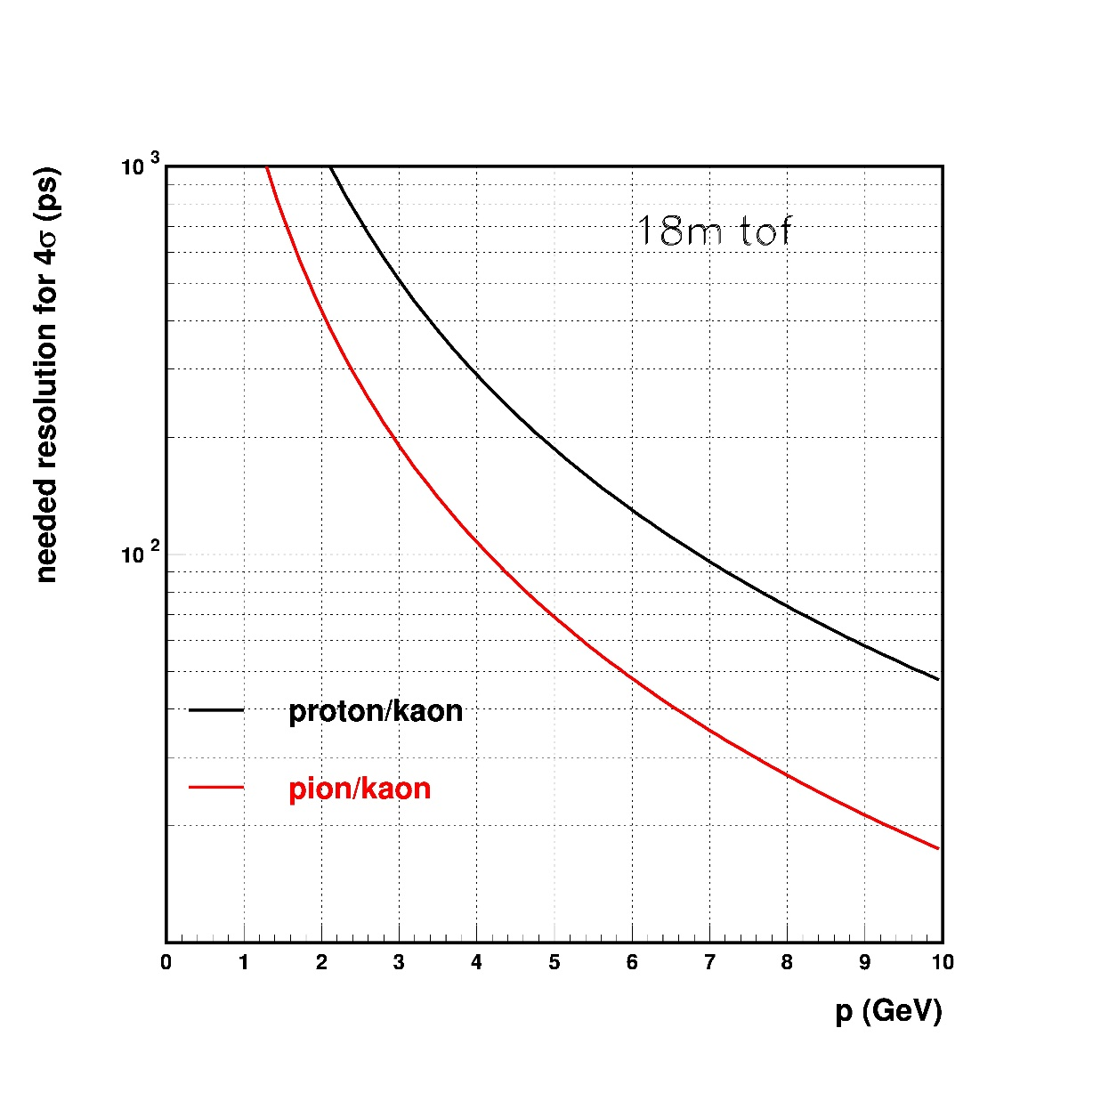
TOF -2
Needed Tof resolution to get 4 σ discrimination, assuming 18m path
TOF is needed for :
  pion/kaon below 2 GeV
  Proton/kaon below 7 GeV
  pion/kaon below 2 GeV : need 400 ps resolution
  Proton/kaon below 4 GeV : 300 ps
    7GeV : 100 ps

Slide 5
Summary
For electron beam: NO Cerenkov. Possibly also no TOF
For p< 2 GeV: NO Cerenkov. TOF needed.
For 2< p < 7 GeV : Only ONE Cerenkov, pressure <= 3bar + TOF needed
For p> 7 GeV: two cerenkovs, one at low pressure (< 1 bar), the other <=3 bars, no TOF, not needed
ToF resolution better than 100 ps if path is at least 18 m → ok for the FNAL devices
Would be interesting to have fully plug-and-play devices.

Slide 6
backup

Slide 7
