Slide 1
Cosmic eLab API
Thomas Hein

Slide 2
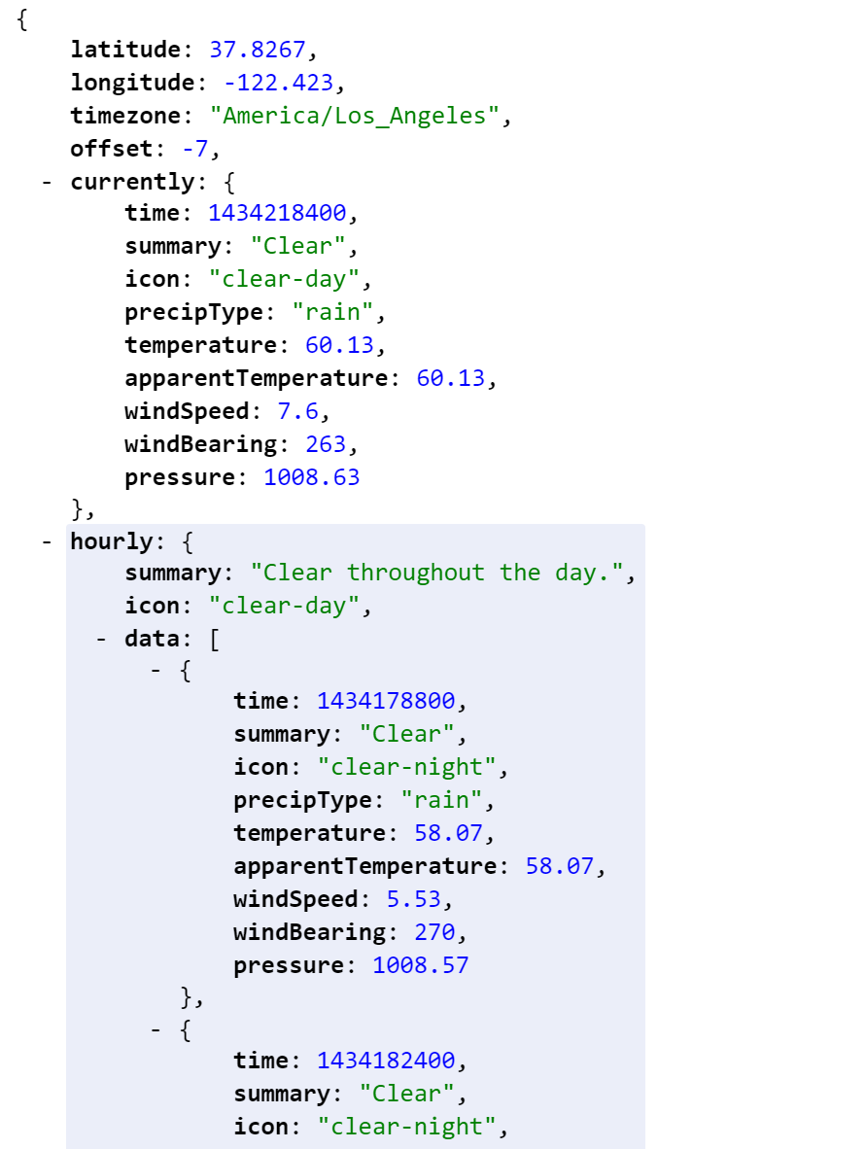
What is an API?
Application program interface (API) is a set of routines, protocols, and tools for building software applications. An API specifies how software components should interact and APIs are used when programming graphical user interface (GUI) components.*
*Source: http://www.webopedia.com/TERM/A/API.html

Slide 3
Why an API for Cosmic eLab
Website is useless for fetching large amounts of data
About 5 steps to get a single data file
Not machine friendly
Tedious process
Web Scrapping?
Slow
If website layout changes, have to completely rewrite scrapping script

Slide 4
Cosmic eLab API Goal
Allow another way of retrieving data easily by bypassing the website completely
Allow any language to be able to access the API and use a Standard format of presenting the data
Allow the lookups of files, detectors, schools, research groups, etc. from one central location
Allow more people to interact with this huge repository of data files of cosmic rays from all around the world (7TB)

Slide 5
13 Endpoints
An Endpoint is a part of the API that performs a certain task.
Some Endpoints include:
SearchDetectors
Input: State, City, School, Research Group, Teacher
Output: Detectors
GetFile
Input: FileID OR Detector, Year, MonthDay, Index, & File Type
Output: Outputs the file contents
SchoolInfo
Input: School Name or ID
Output: List of Detectors, Teachers, School, City, State, and Research Groups

Slide 6
Example Output of SchoolInfo Endpoint
http://localhost/v1/schoolinfo/?schoolid=2
This API uses the JSON format for presenting information. It’s the standard format used across most programming languages due to readability in both programs and with humans. Here is what the output actually looks like:
{"request":{"pass":"true"},"main":{"school":"found","schoolinfo":{"id":"4","name":"EEG High"},"city":{"id":"4","name":"Birmingham"},"stateinfo":{"id":"1","name":"ALABAMA","abbreviation":"AL"},"research_groups":["CRnew","lizteacher","CRrsp","teacherguy","gourd","newteacher"],"teacher_ids":["41","49","1414","7","32"],"detectors":false}}

