Slide 1
Target 2016: My Experience
Nathan Knauf

Slide 2
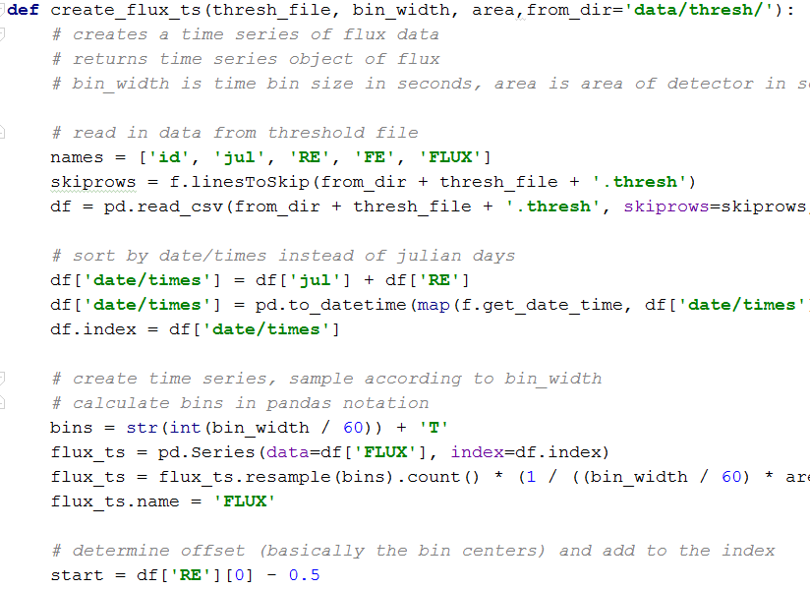
From June to Now
MyFirstProgram.py
Open Cosmics

Slide 3
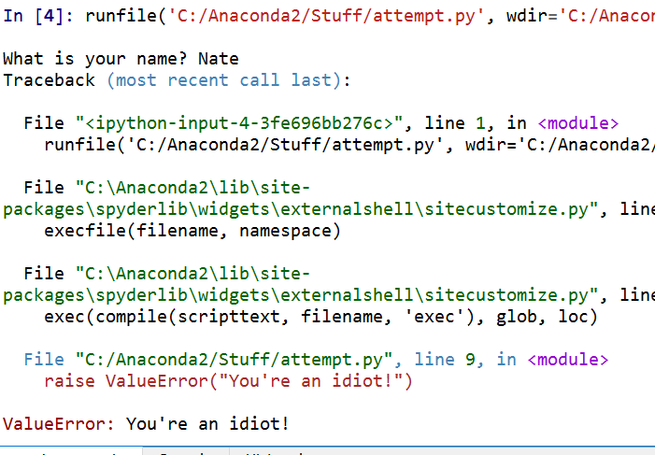
What I learned:
Python is easy! But also...
Python is challenging!
Computing is about 90% of the effort in today’s experiments
Coding can actually be very fun/rewarding
So many errors…

Slide 4
What I enjoyed:
Building a new skill
Helping out the Target students
Working with the folks at Fermilab
Being around one of the world’s premier physics research facilities
Image URL: https://wdrs.fnal.gov/employ/

Slide 5
Enjoy the rest of your summer!

