Slide 1
Technical Board Meeting, 15/6/2016

Slide 2
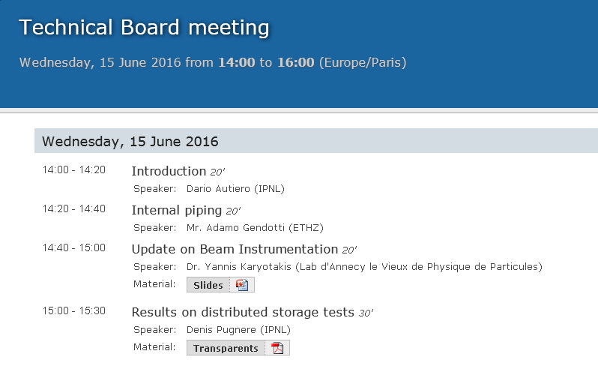
Update by Adamo on the internal piping of the cryostat and on the field cage (discussion already at the last TB meeting)
Update by Yannis on the beam instrumentation, news on the spectrometer design

Slide 3
Results on distributed storage tests:
Longest presentation today, by Denis Pugnere, one of our IPNL software engineers who has been working already for many months on the configuration of the online storage system also performing direct measurement on a test bench with material taken for loan at IPNL
Denis has been performing a systematic comparison of different configurations in order to choose the software for the distributed filesystem of the storage/online processing facility and he has identified possible bottlenecks at the level of the configuration of the DAQ clients, network, storage servers, file sizes and other parameters of the setup.
This provides useful information for the configuration and software of the online storage/data processing system

