Slide 1
Preliminary spectrometer calculations
N. Charitonidis, Y. Karyotakis, I. Efthymiopoulos
09/06/2016

Slide 2
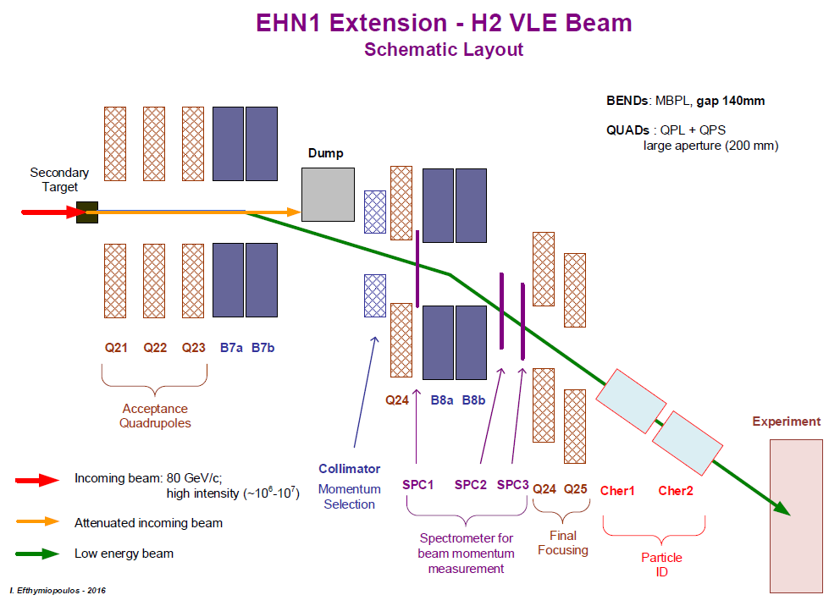
H2 beam line – spectrometer positions
Spectrometer positions from the B8b center :
BPROF1: 2.004 m
BPROF2: 1.718 m
BPROF3: 2.782 m
Assumed nominal energy: 12 GeV, more energies to follow

Slide 3
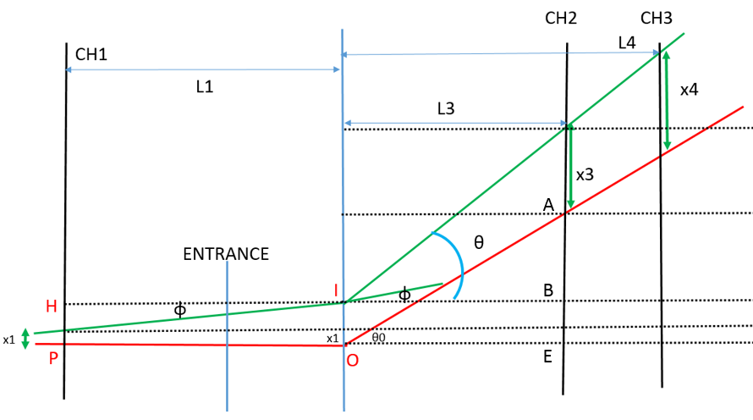
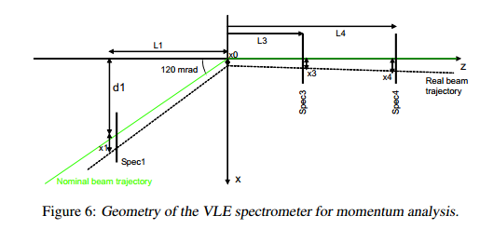
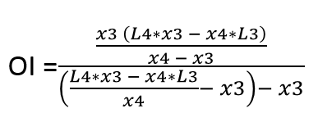
Two equivalent geometrical approaches – same results. x1, x3, x4 the position measurements.
1. I. Efthymiopoulos, A. Fabich (2005) - 2. N. Charitonidis, Y. Karyotakis (2016)

Slide 4
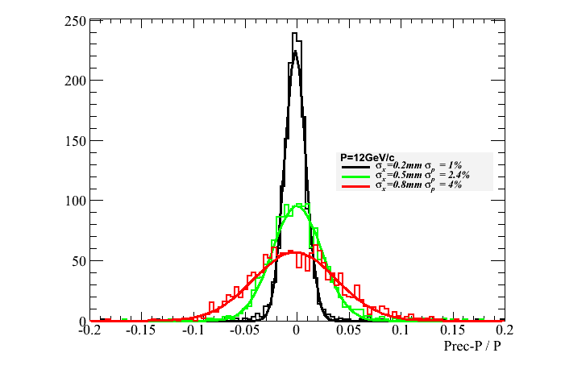
Results for 12 GeV, smearing the reconstructed angles with the detector’s resolution.
Full Simulation from GEANT4. Extracted x1, x3 and x4 used in the reconstruction.

