Slide 1
Long Magnet Fabrication at LBNL
D. Cheng
For the MQXFA team at LBNL
DOE Review
FNAL, July 13-15, 2016

Slide 2
Outline
LARP Shell-based magnet structure development at LBNL
Magnet Assembly Breakdown Structure and status
Assembly tooling and infrastructure status
Objectives for the MQXFA long prototypes
Summary

Slide 3
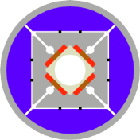
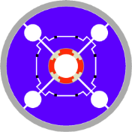
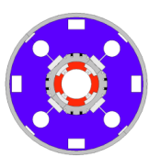
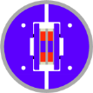
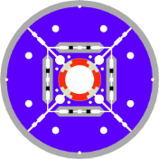
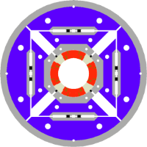
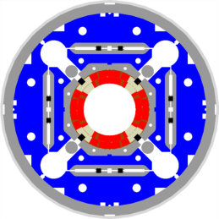
LARP Magnet Development History
Length
2004
1 m
0.3 m
1.5 m
3.6-3.7 m
2005
4.5 m
SQ
Subscale quad
Concept
2006
2007
LR
Long Racetrack
LRS01-02
Length demonstration
TQ
Technology Quadrupole
TQS01/02a-b-c/03a-b-c-d
Concept on cos2θ
Technology selection
Ultimate stress exploration
2008
2009
Scale-up & design optimization
Time
LQ
Long
Quadrupole
LQS01a-b/02/03
Some accelerator quality features
Length with cos2θ
Accommodating variability in coil dimension
2010
HQ
High-field
Quadrupole
HQ01a-b-c-d-e
HQ02a-b / HQ03a
Accelerator quality features
Mechanical alignment
High stress regime
2011
2012
2013
2014
2015
MQXFS
MQXFS1/D1
2016
MQXFA
Length scale up

Slide 4
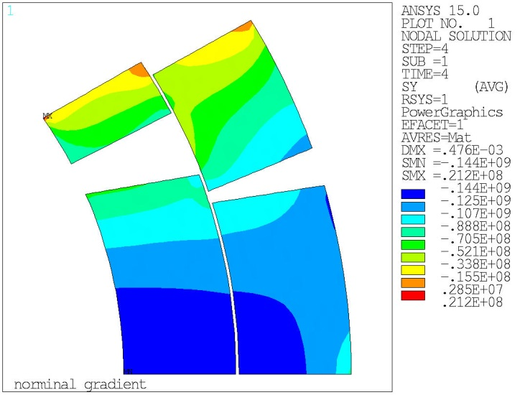
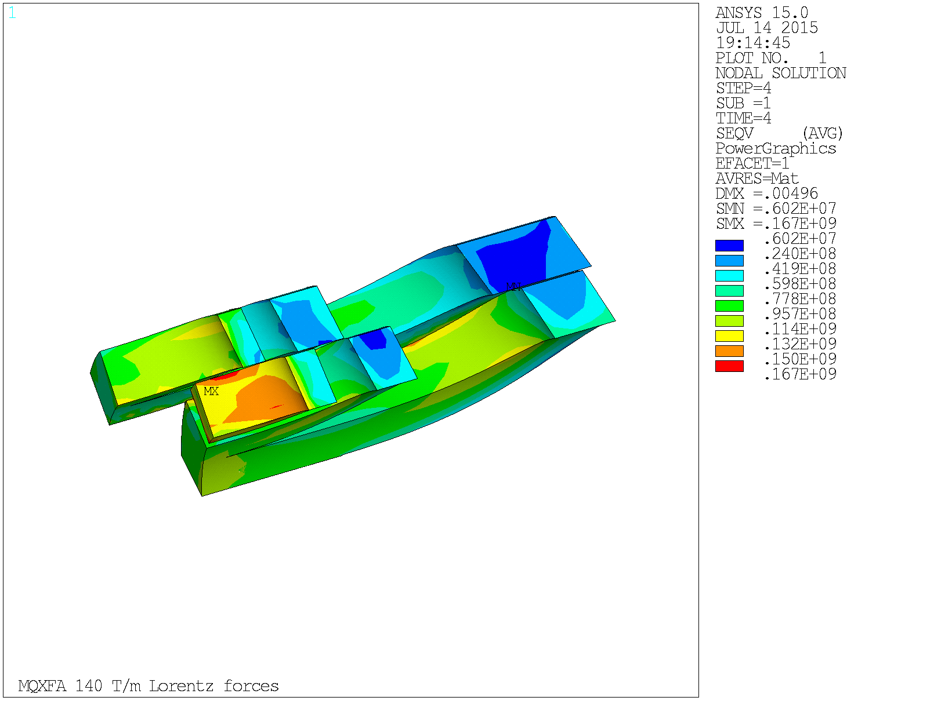
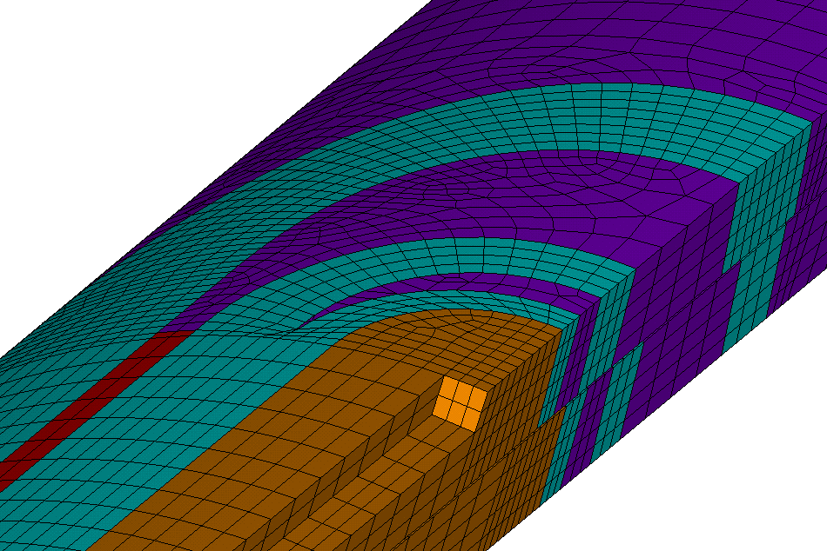
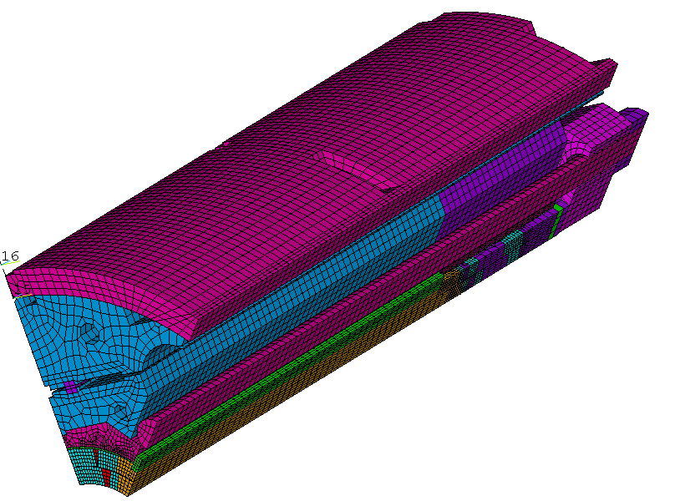
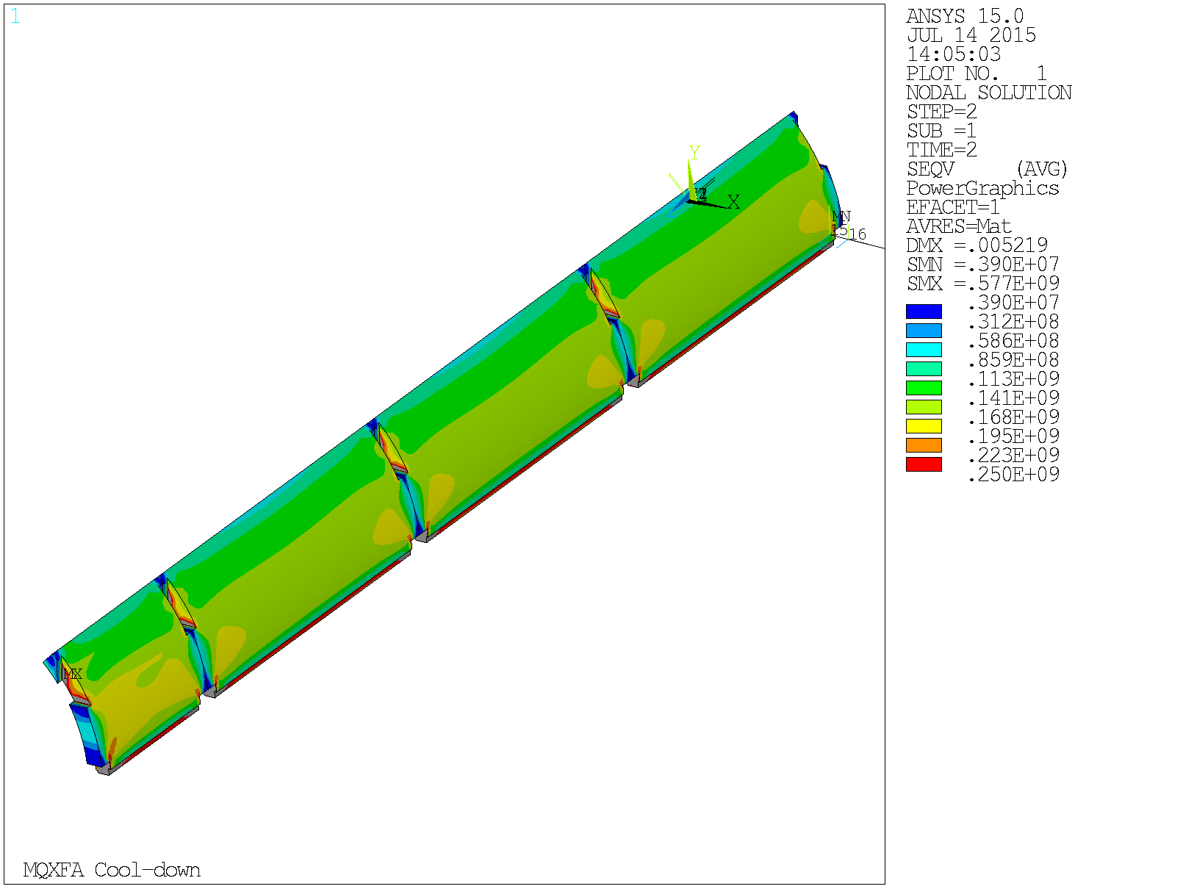
Analytical Structures Development for MQXFA
Developed 2D and 3D models based on prior experience, models, and test data
At 140 T/m
MQXFS short prototype already incorporates the segmented shell design that will be used in MQXFA
MQXFA Shell σ_{VM} in Pa at 4.2 K

Slide 5
MQXFA Structure
Shell-Yoke Structure
  Half-length subassemblies
  Joined shell-yoke subassembly, full-length
Coil pack subassembly
  Load pad stacks
  Collar stacks
  Instrumented and dressed coils
Master Key packages
  Load keys, alignment keys, shims
Axial load
  Axial rods (End plates, wire guides not shown)
Splice Connection box (Not shown)
Instrumentation connectors (not shown)

Slide 6
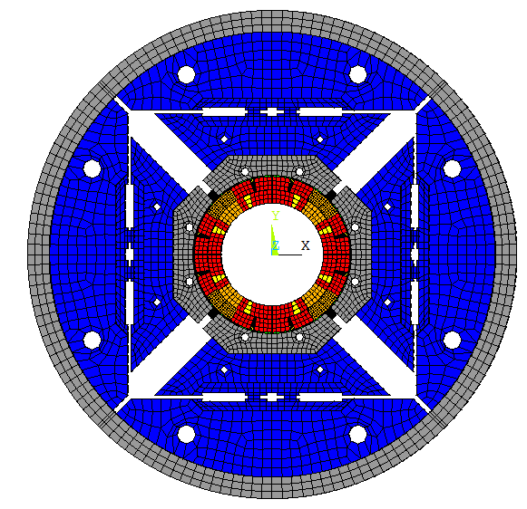
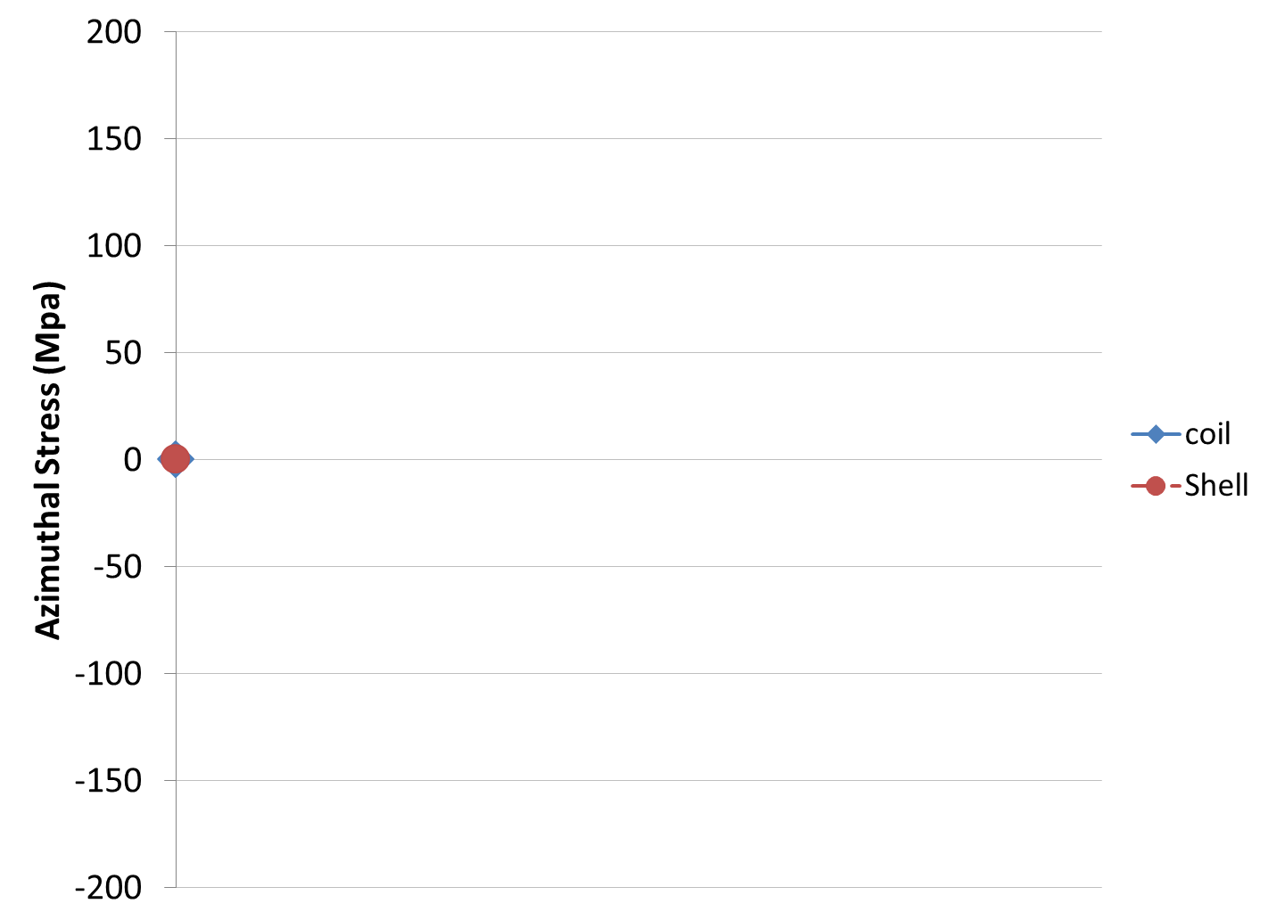
Shell-based support structure
Shell-based support structure often referred as “bladder and keys” structure developed at LBNL for strain sensitive material
  Low pre-stress at RT
  Achieves full pre-load at cold
Shell strain gauges on each quadrant
Each coil strain gauges on pole segments
Depictions of the HQ loading case shown

Slide 7
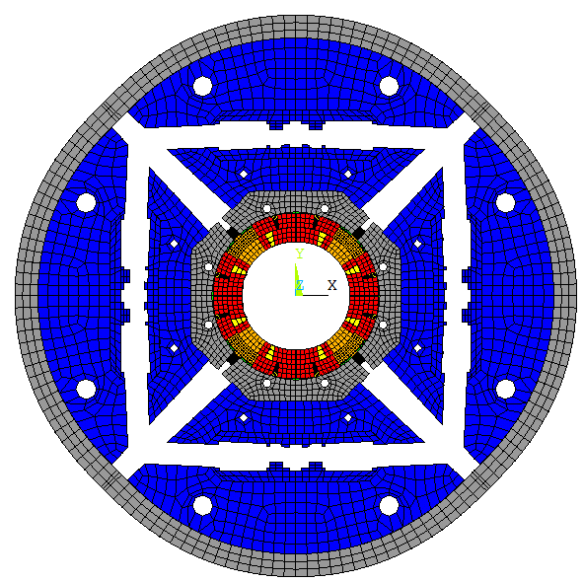
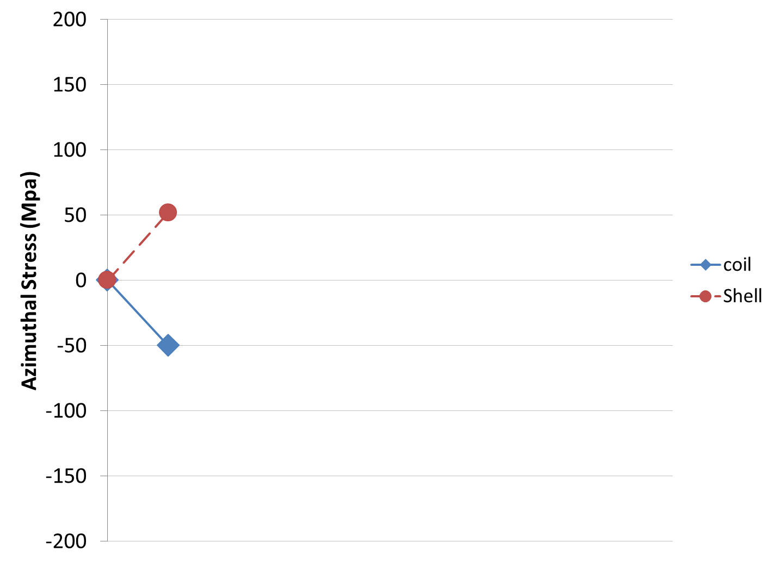
Shell-based support structure
Inflated Bladders
Shell-based support structure often referred as “bladder and keys” structure developed at LBNL for strain sensitive material
  Low pre-stress at RT
  Achieves full pre-load at cold
Bladder
Depictions of the HQ loading case shown
Displacement scaling 30

Slide 8
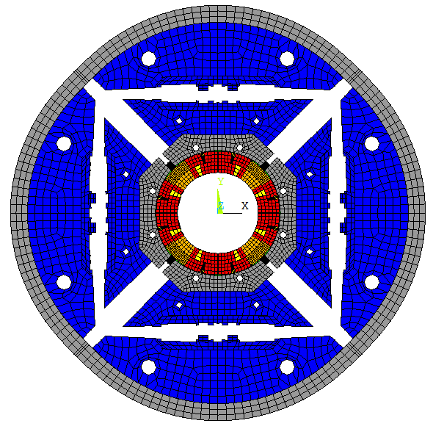
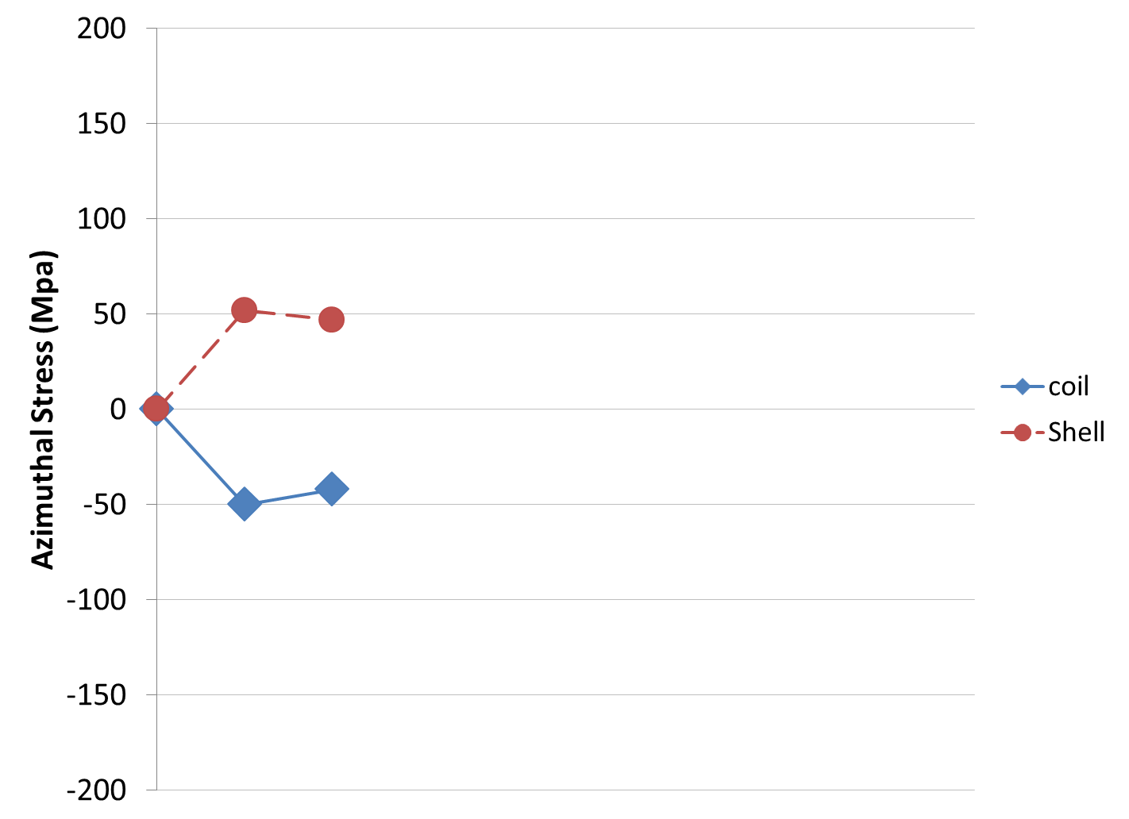
Shell-based support structure
Shimming of the load leys
Shell-based support structure often referred as “bladder and keys” structure developed at LBNL for strain sensitive material
  Low pre-stress at RT
  Achieves full pre-load at cold
Bladder
Keys
Depictions of the HQ loading case shown
Displacement scaling 30

Slide 9
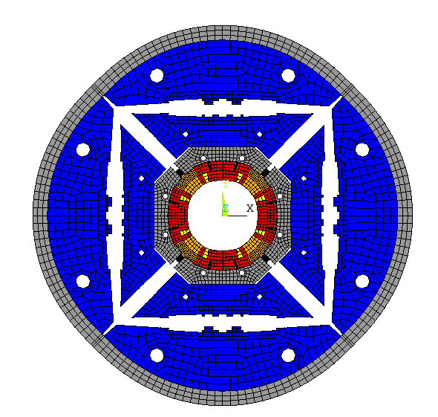
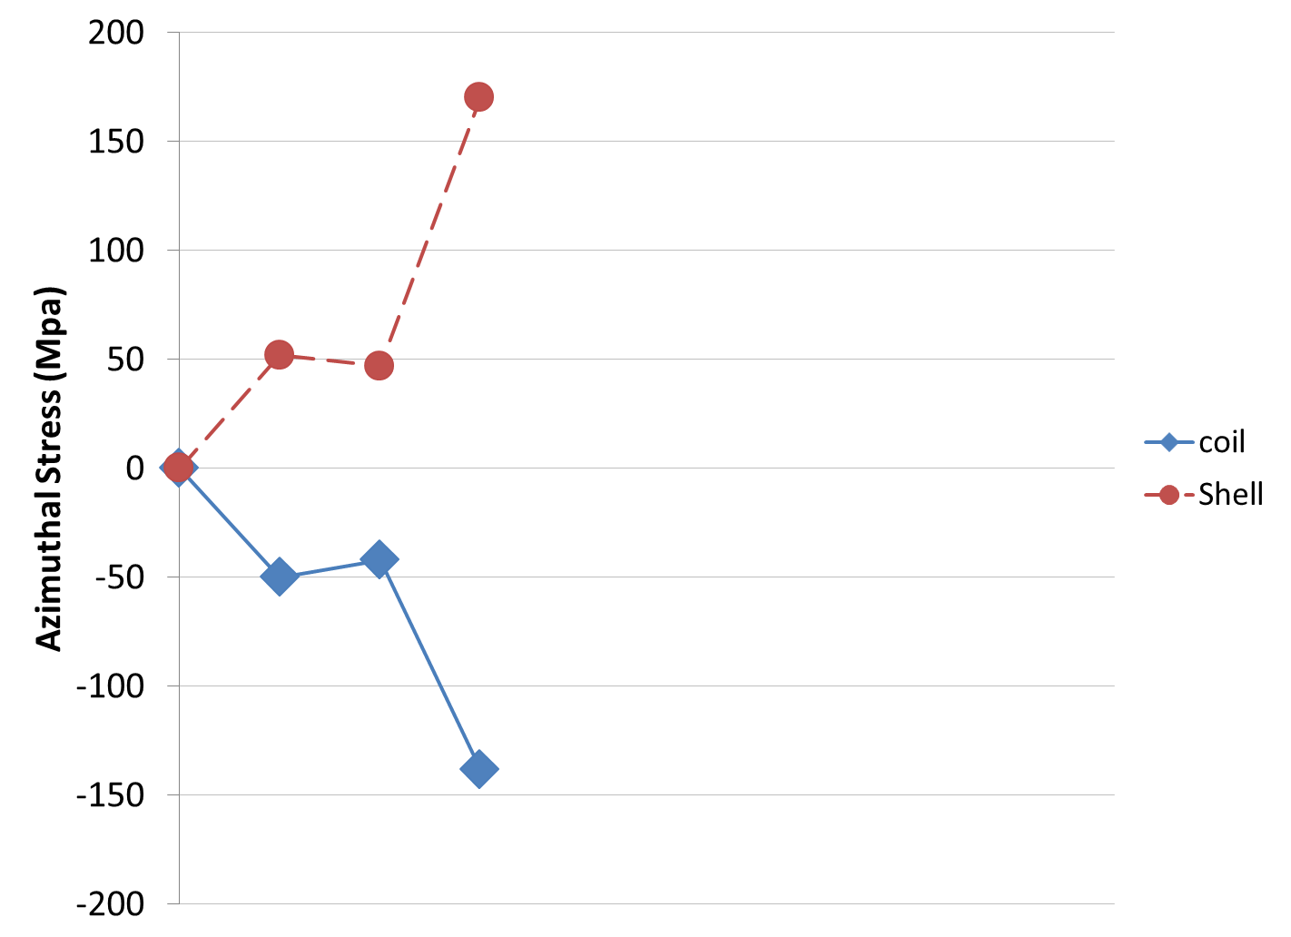
Shell-based support structure
Cool-down
Shell-based support structure often referred as “bladder and keys” structure developed at LBNL for strain sensitive material
  Low pre-stress at RT
  Achieves full pre-load at cold
Cool-down
Bladder
Keys
Depictions of the HQ loading case shown
Displacement scaling 30

Slide 10
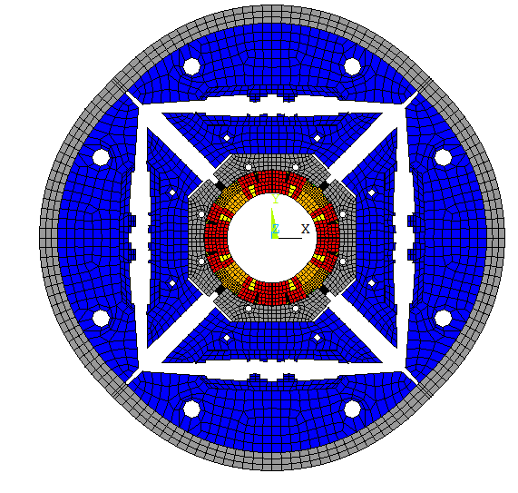
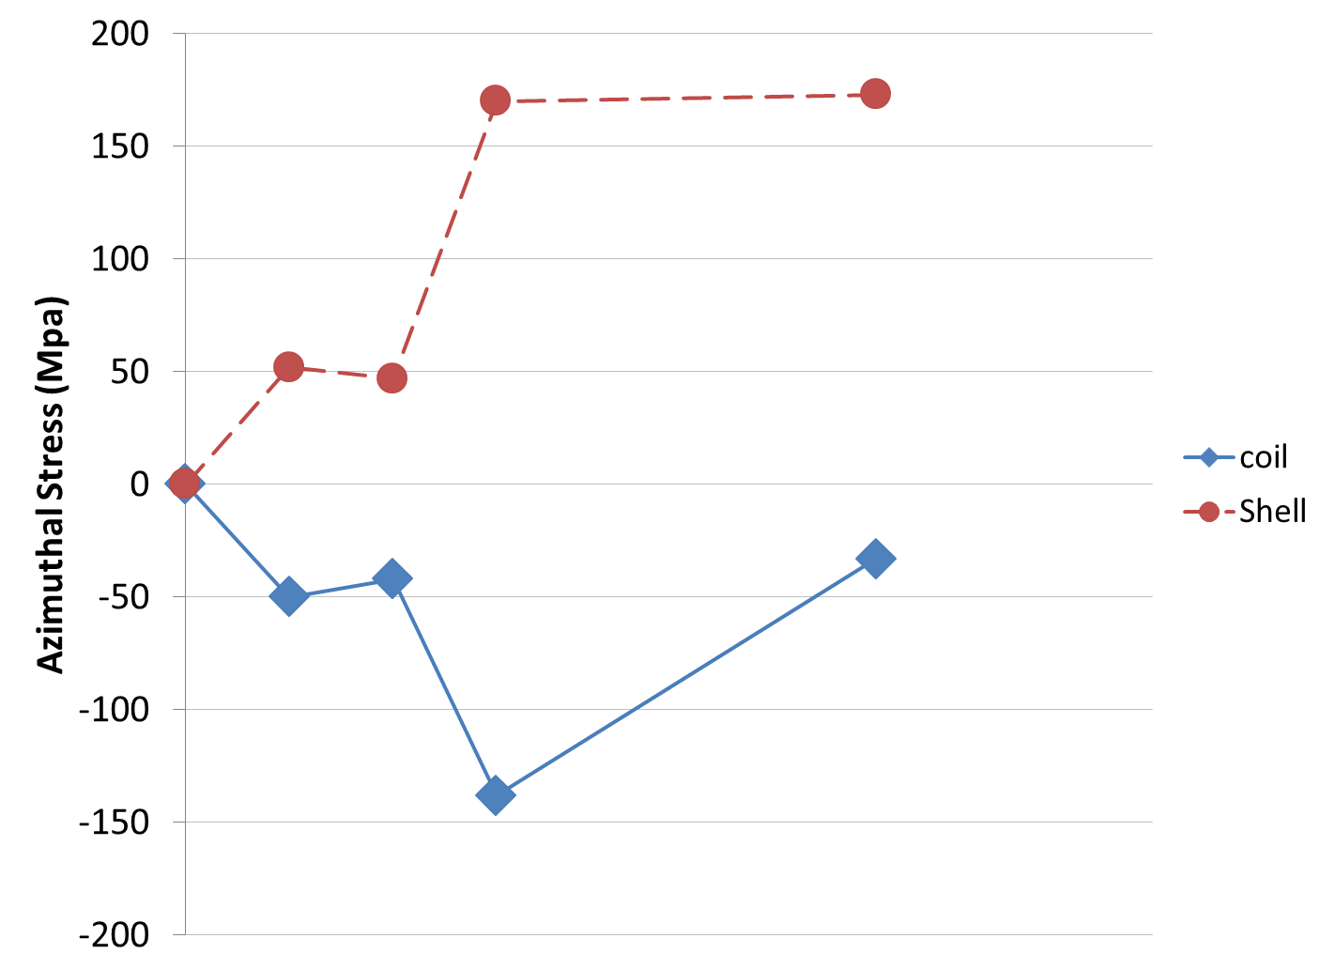
Shell-based support structure
Energized
Shell-based support structure often referred as “bladder and keys” structure developed at LBNL for strain sensitive material
  Low pre-stress at RT
  Achieves full pre-load at cold
This support structure allows for:
Gradual application of the preload:
  Axially and Azimuthally
Tunable preload
  During assembly
  In between tests
Reversible assembly process
  Allowing fast replacement of a defective coil if needed
Development history shows good correlation between models and strain gauge measurements
With shell structure
Cool-down
Lorentz forces
Bladder
Keys
Depictions of the HQ loading case shown
Displacement scaling 30

Slide 11
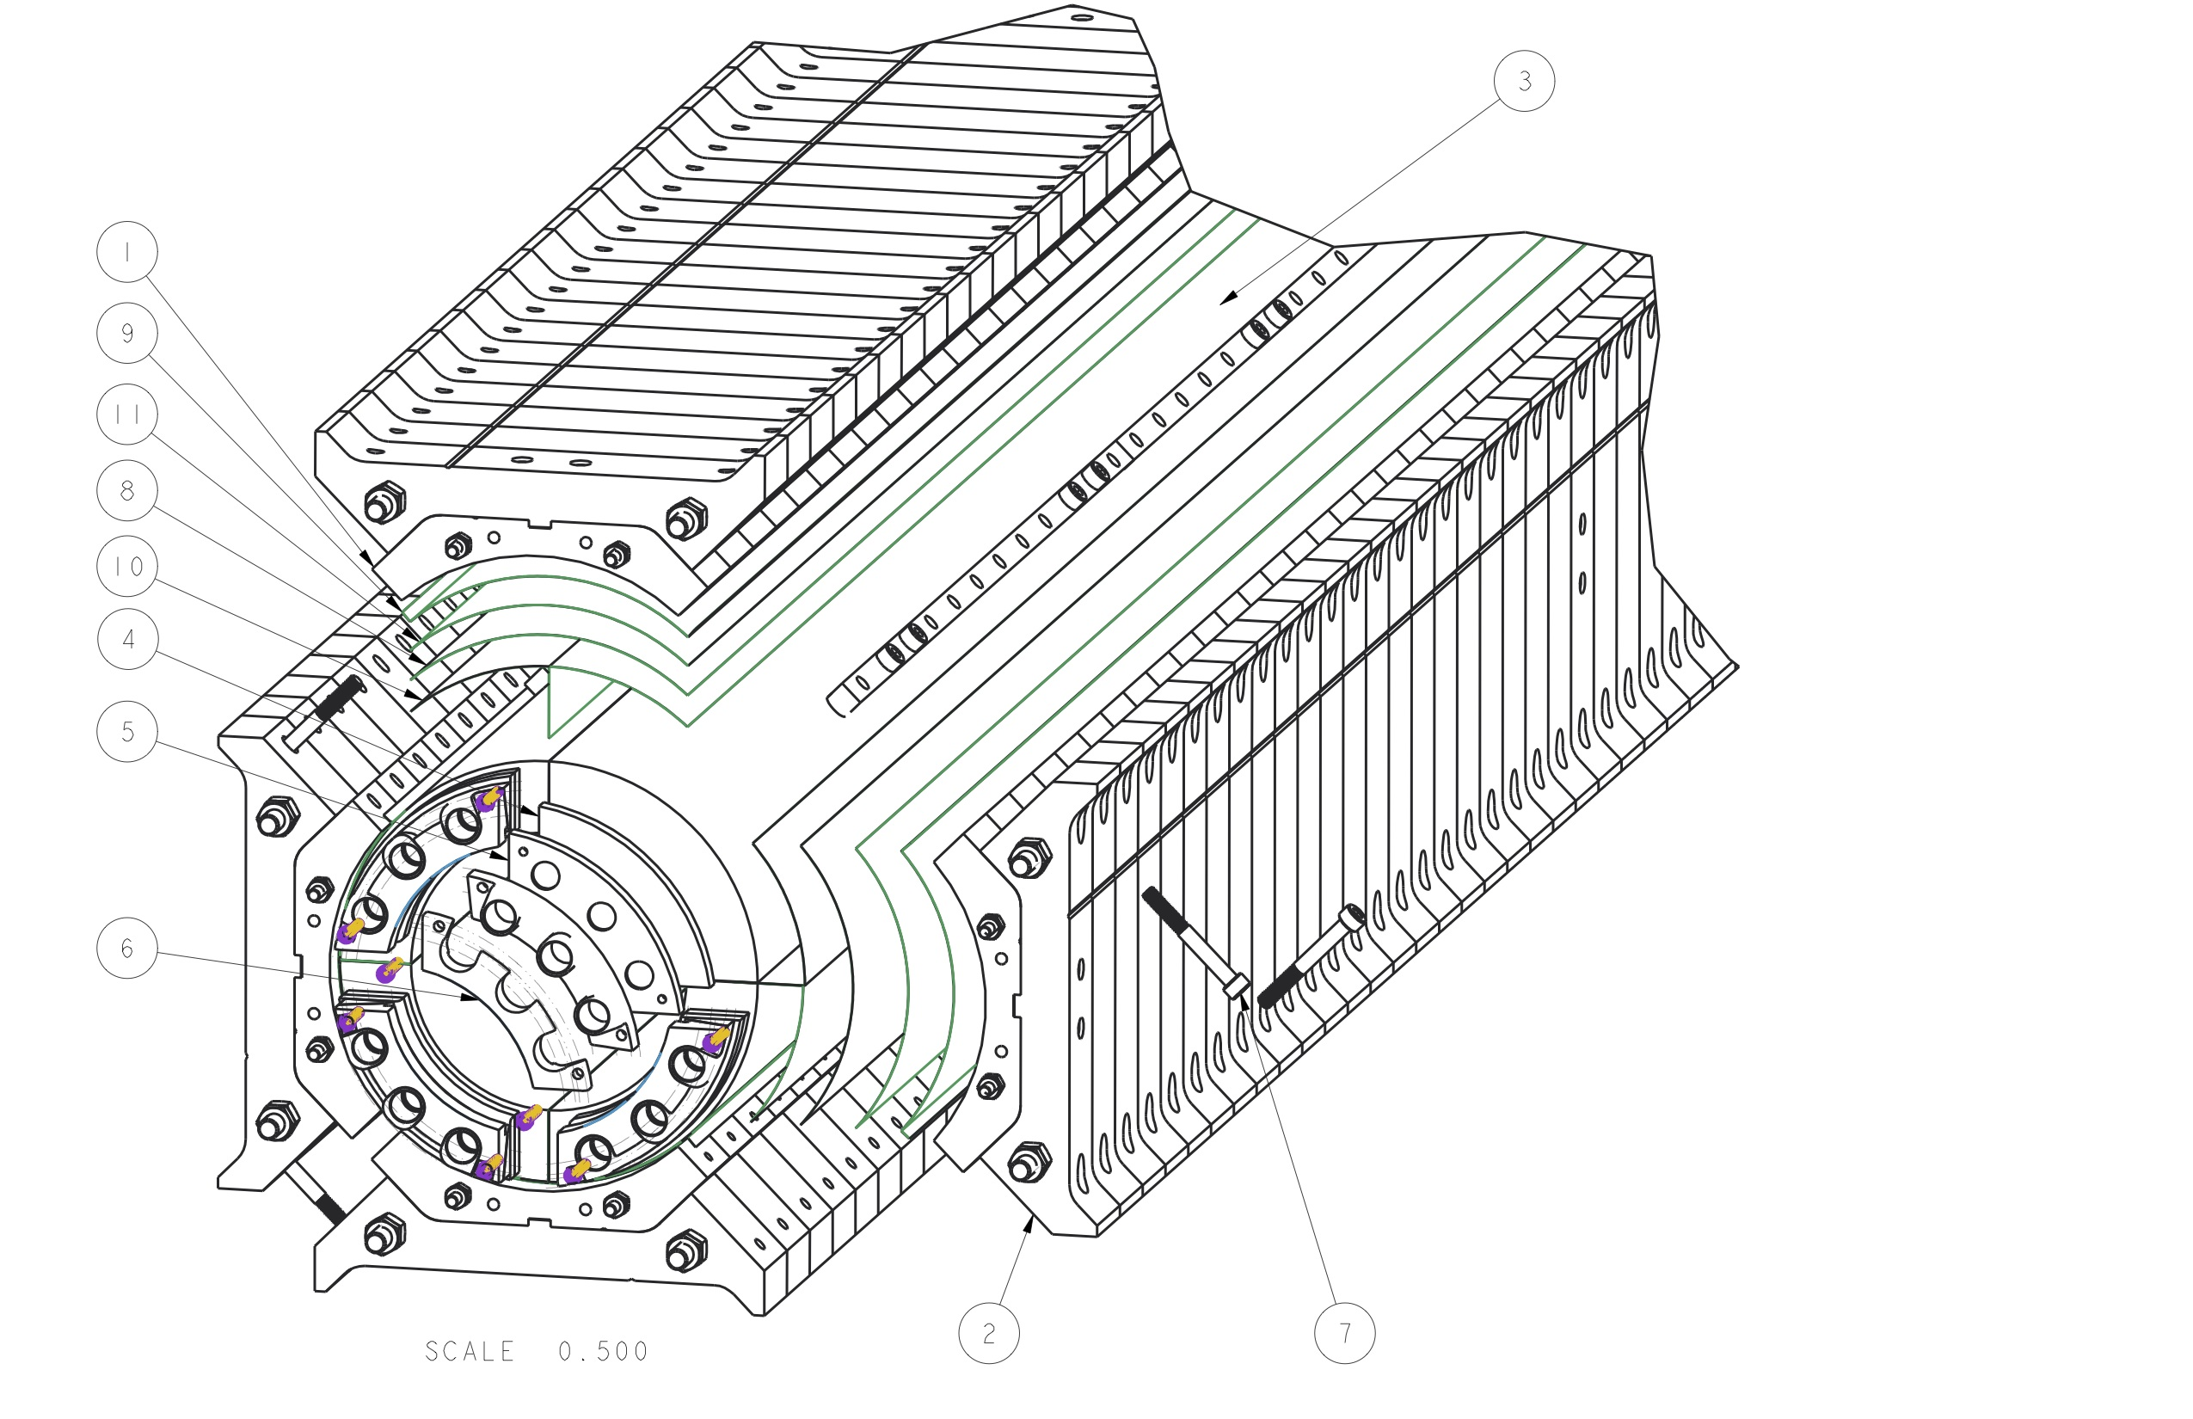
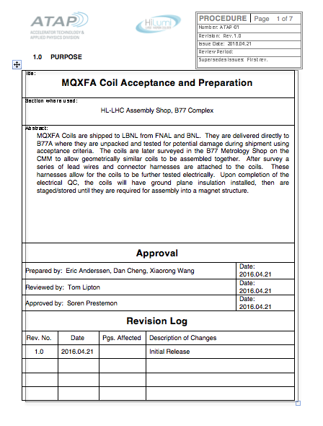
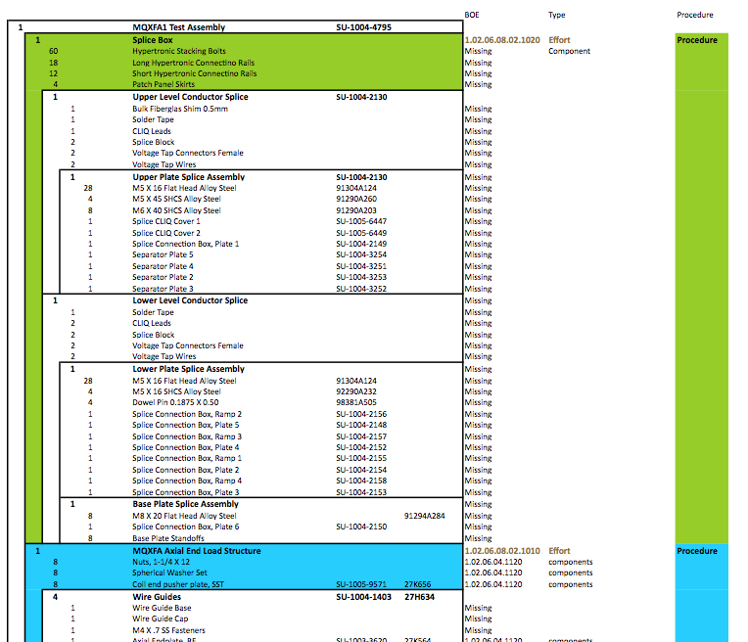
ABS and Documentation
Assembly Breakdown Structure document
  Identifies “Independent” tasks/subassemblies
    Dedicated procedures
    Dedicated QA elements
    CAD drawings, BOM
  Captures what information will be required for travelers / documentation that will be entered directly to CERN MTF system

Slide 12
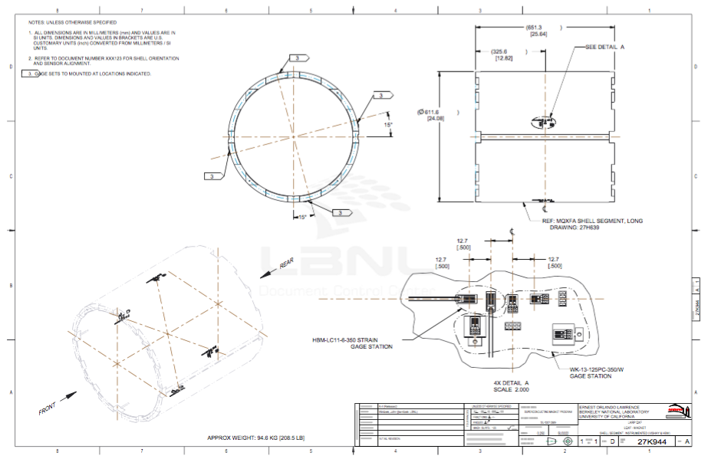
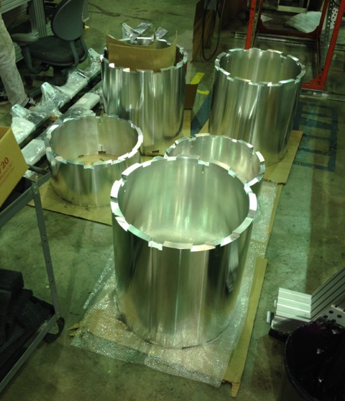
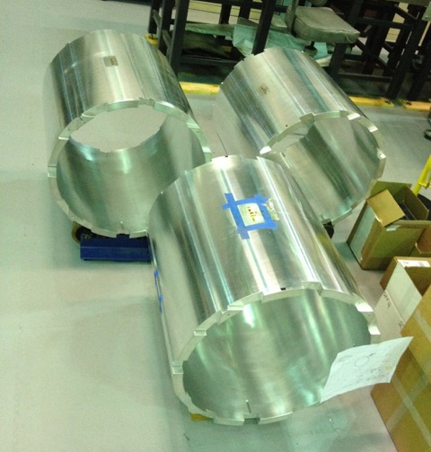
MQXFA1 Shells

Slide 13
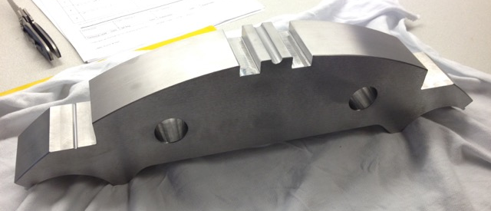
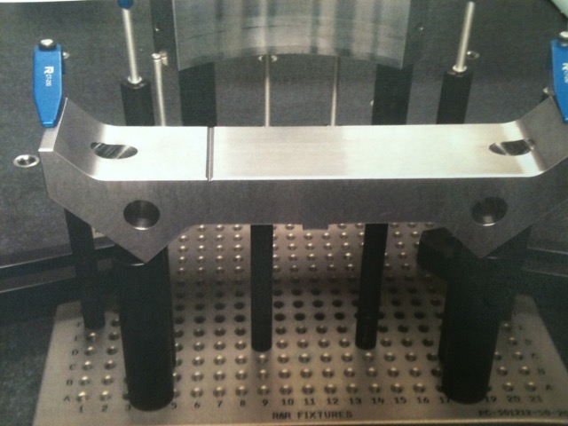
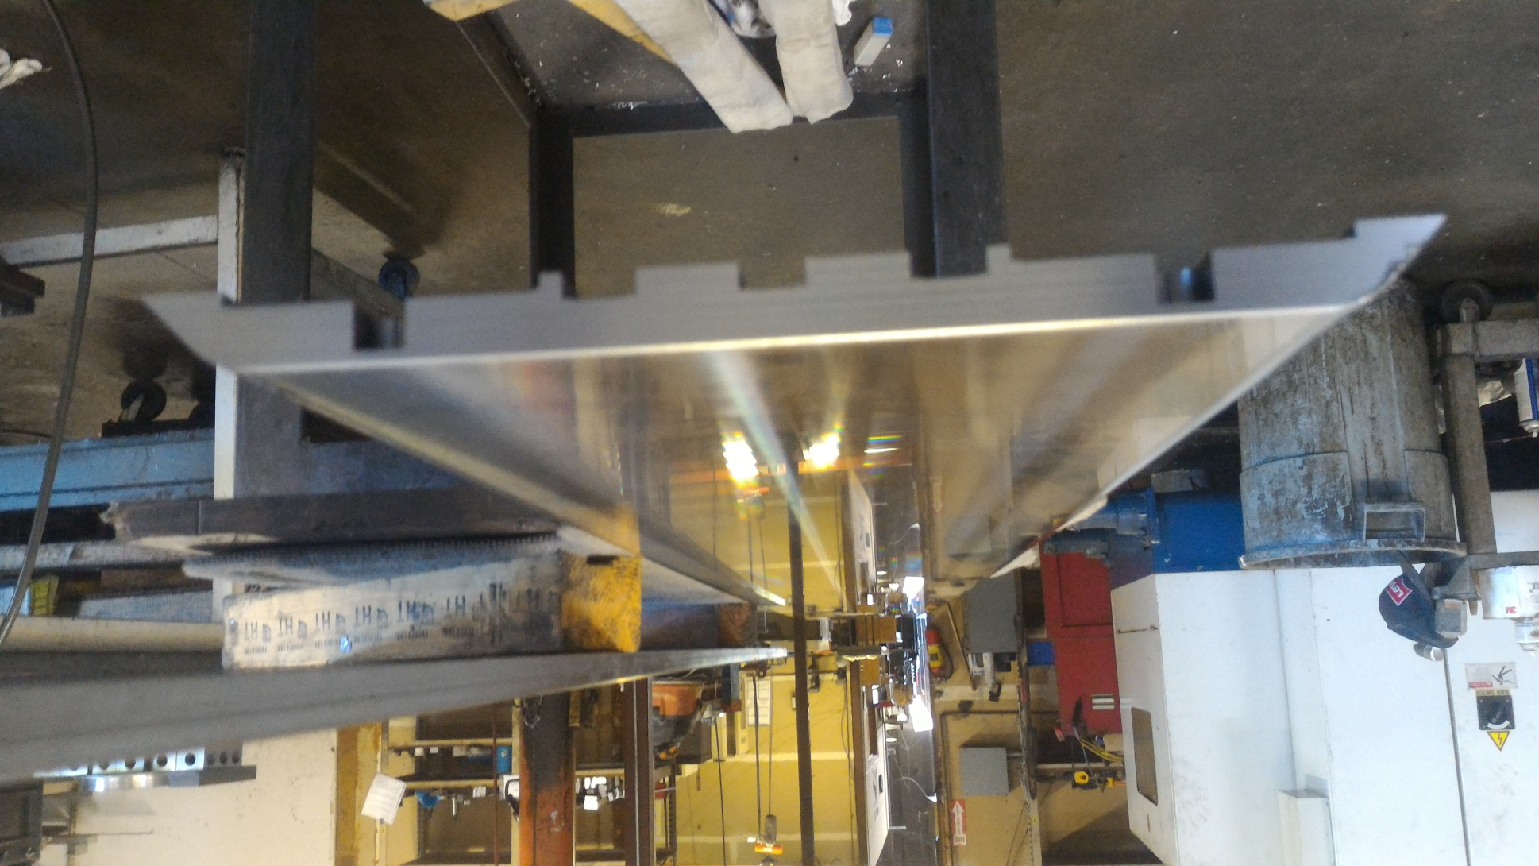
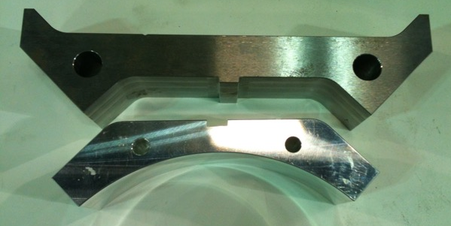
First Article parts
Yoke lamination
Load pad lamination
Load pad & collar
Master Key half

Slide 14
MQXFA1 Structures Status
One outcome of the July 2015 Internal MQXFA Structure Review allowed us to proceed with procurements of the structural parts for the first prototype
Many structural parts have been received
  Shells
    Instrumentation almost complete
  Nitronic 50 endplates
  Bladders
We experienced significant delays on laminated structural parts (yokes, load pads, collars)
  Tight tolerances and inspection of these features proved difficult with these particular vendors
  Initiated order with backup vendor for yokes
First sets of laminations (load pads, collars) are moving forward with production
We expect the MQXFA-M (mechanical model) to be assembled later this summer, but may have a slight delay in the start the assembly of the MQXFA1 prototype wrt to the initial schedule
For MQXFA2 (second prototype)
  We are evaluating the ramifications of producing the 2nd structure using thin laminations
  Some structural parts will also be redesigned to address stress concentrations observed in FEA results
Lessons learned: Low-bids are not always the best choice. Experience with the other vendors suggests that their capabilities are better suited to meet requirements and schedule.

Slide 15
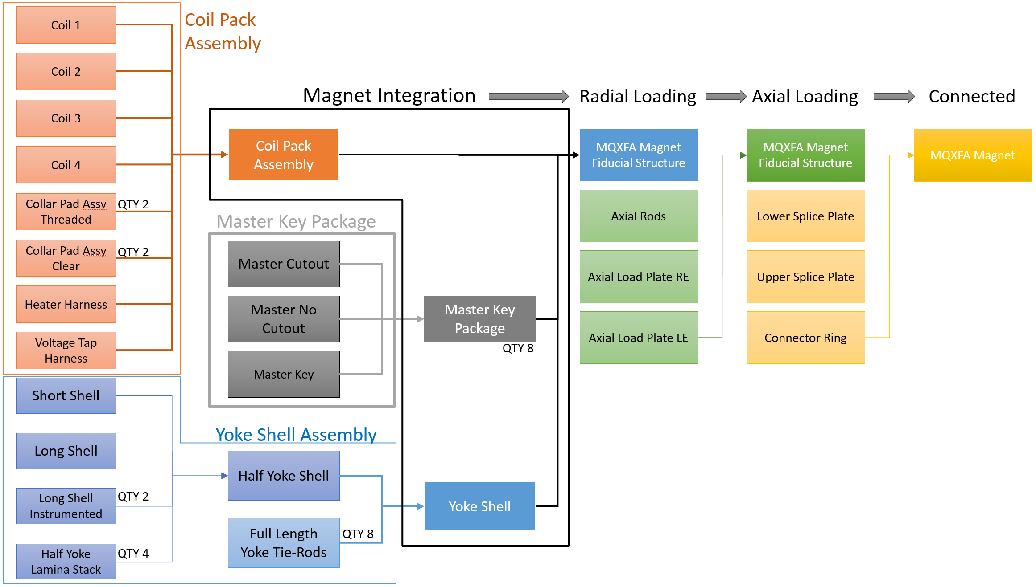
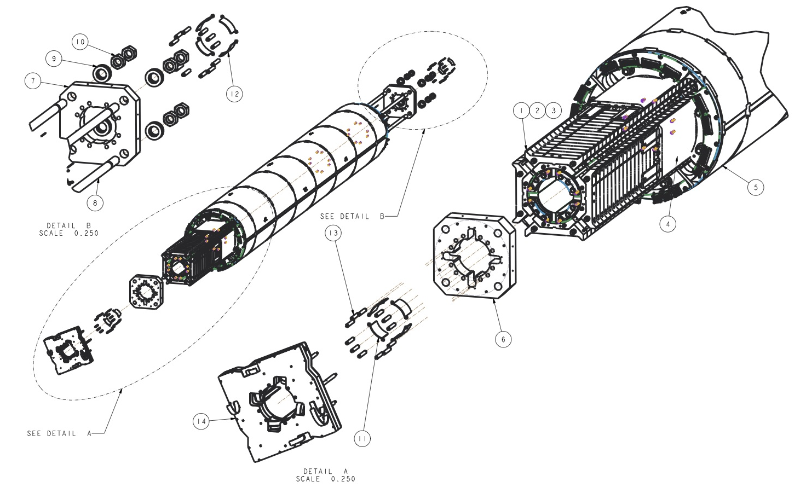
Magnet Assembly Process Flow

Slide 16
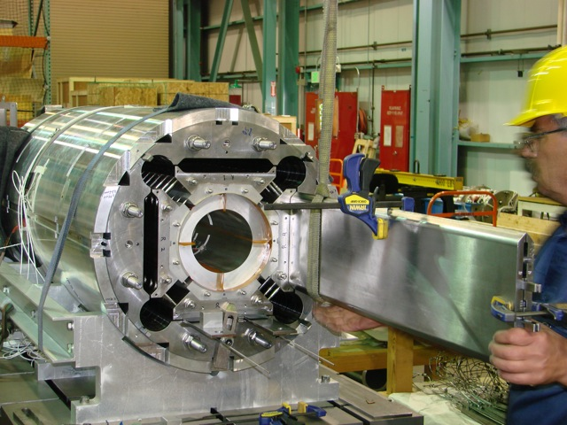
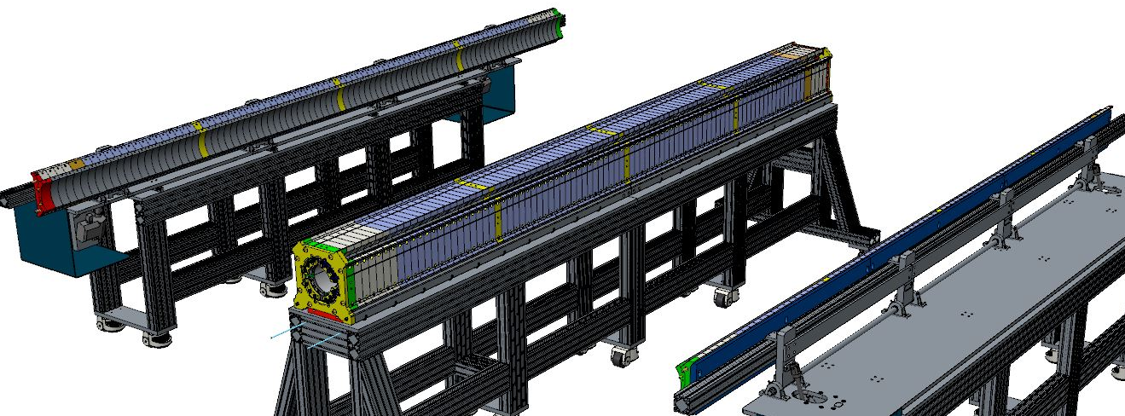
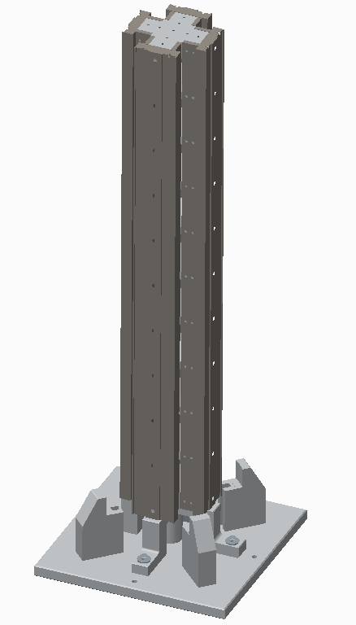
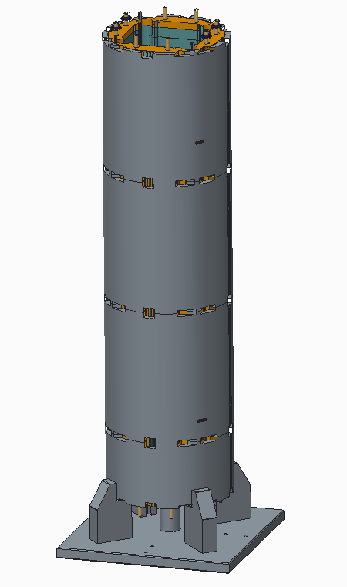
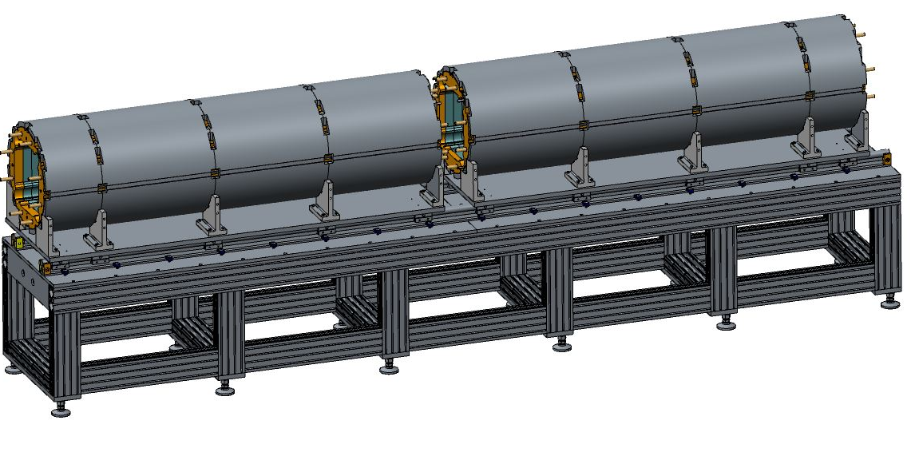
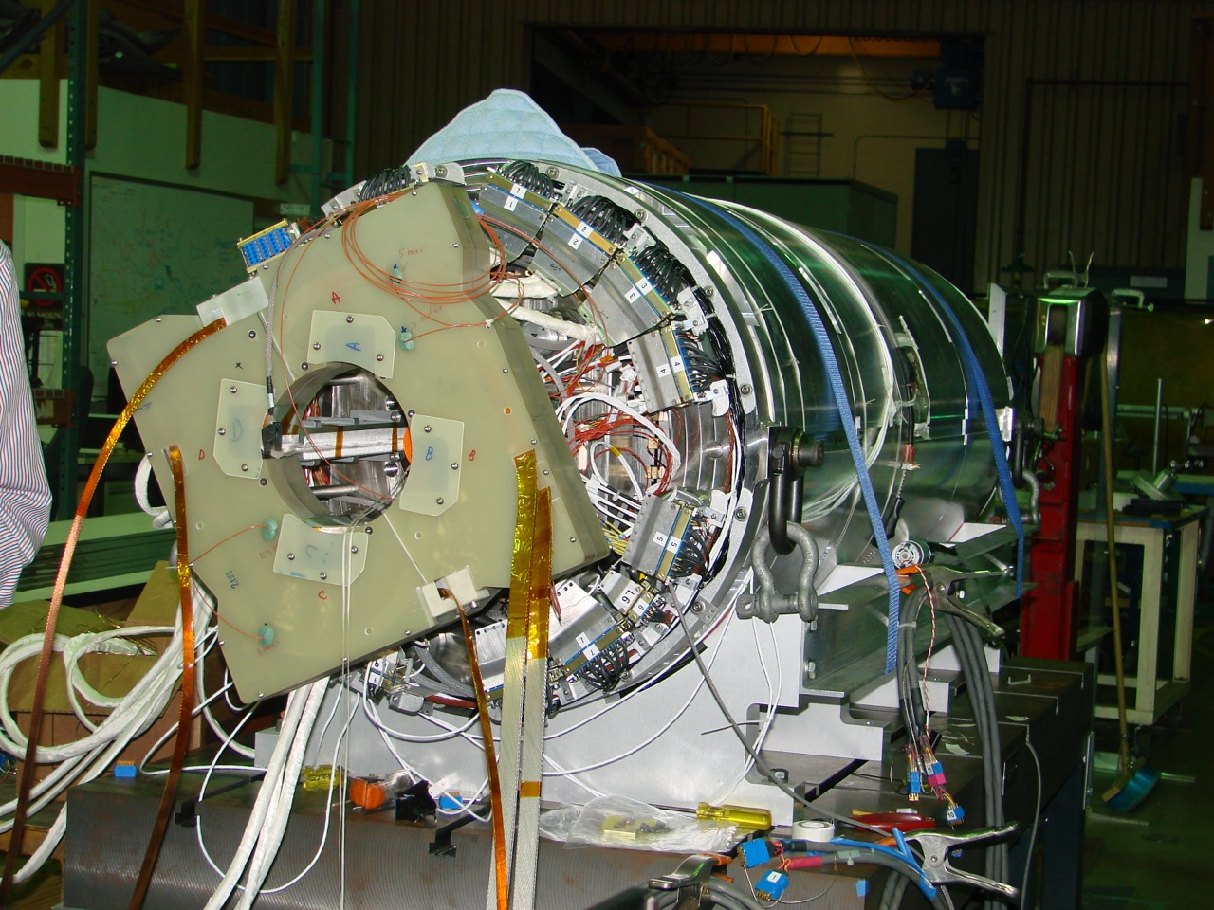
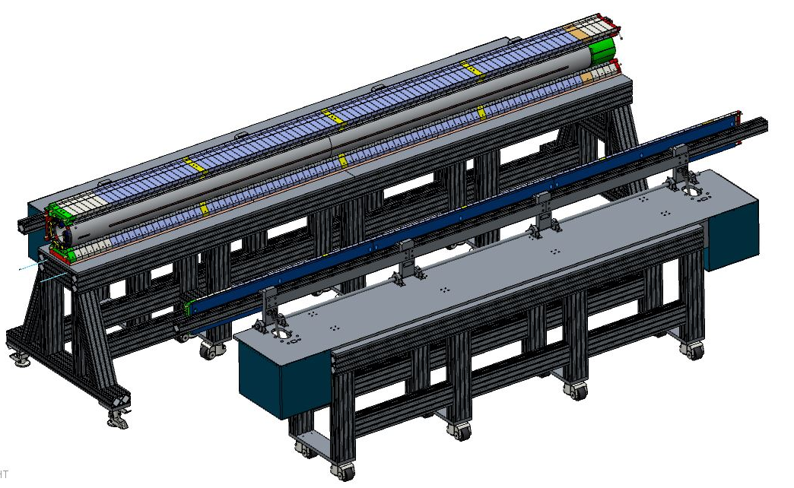
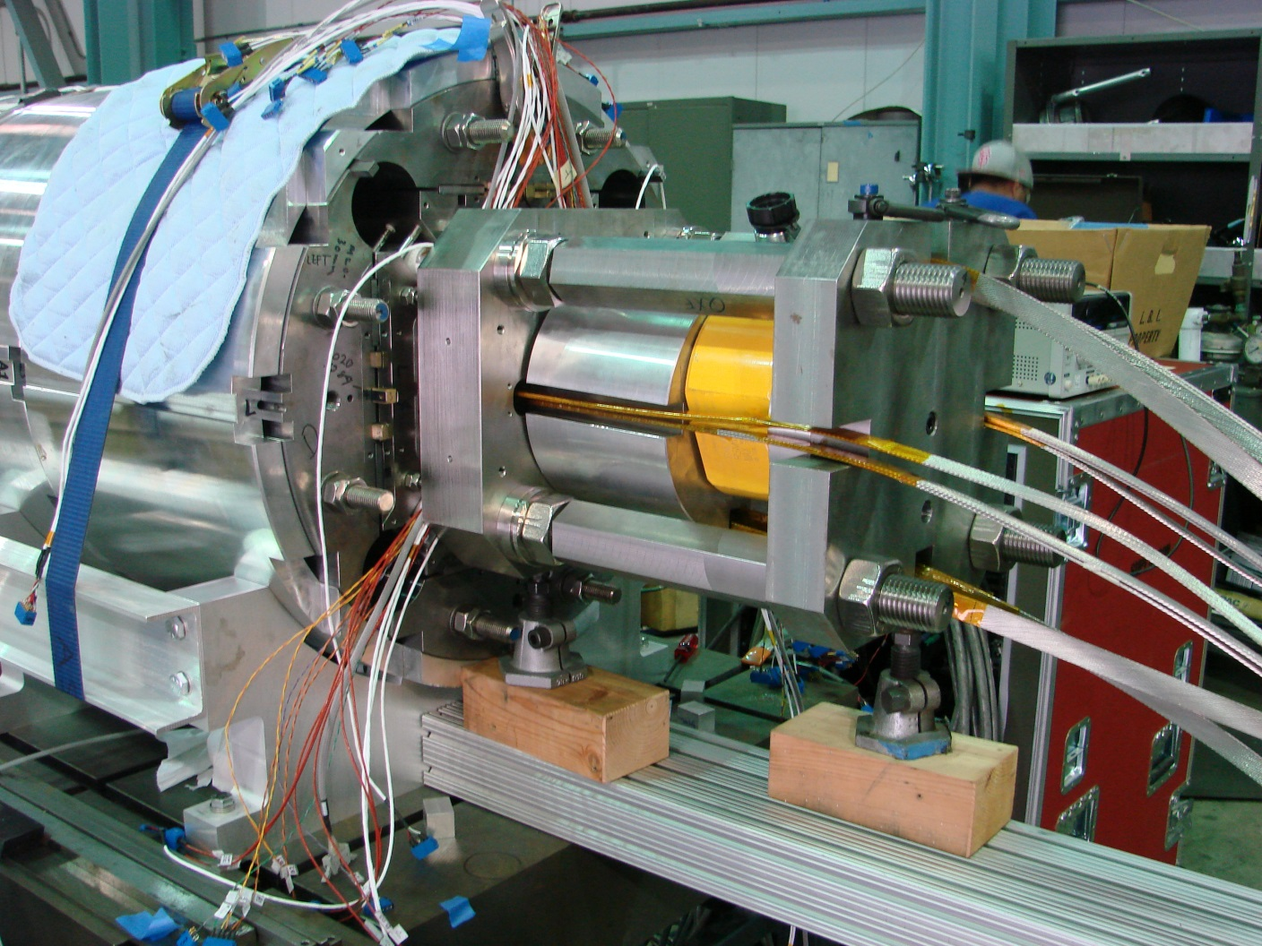
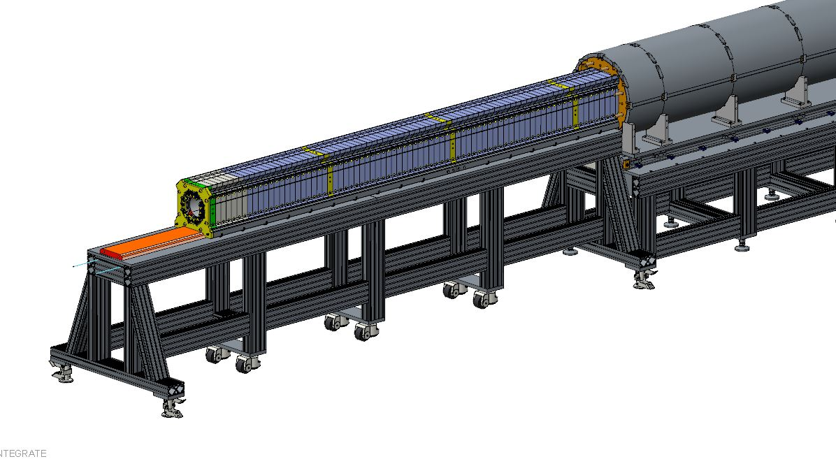
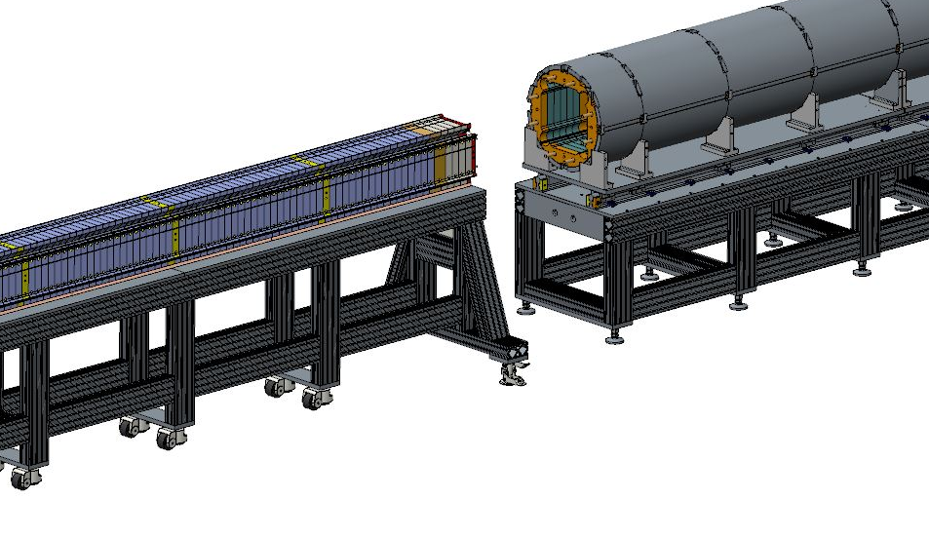
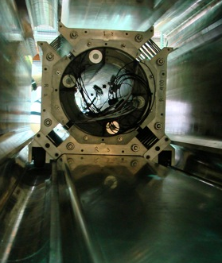
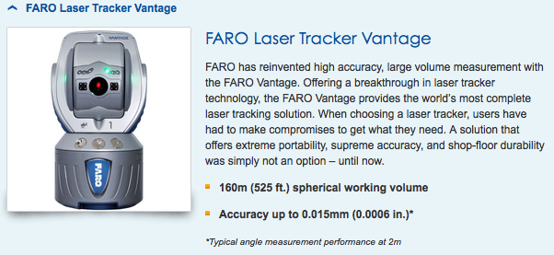
Magnet Assembly Tooling
Magnet assembly tooling has been developed from experience from the LARP LQ, HQ magnets, and scaled up from the MQXFS short prototype

Slide 17
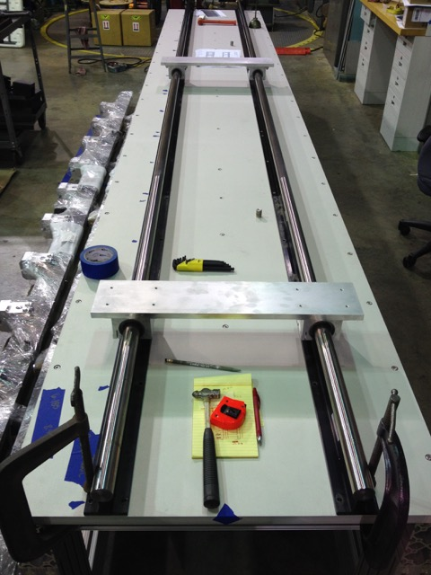
Assembly Tooling Status
Tooling is arriving and being staged
  Lifting fixtures are in the process of being qualified
  Integration table frame & coil pack assembly tables are being assembled
  Seismic restraints have been analyzed
Procurements have been initiated with almost all tooling
Assembly procedures and QC parameters are being developed from the scaled-up short model procedures, incorporating lessons learned
All tooling will be in place and commissioned this summer prior to the MQXFA-M model assembly
This tooling will also be used in the HL-LHC AUP assembly activities
Magnet Integration table setup

Slide 18
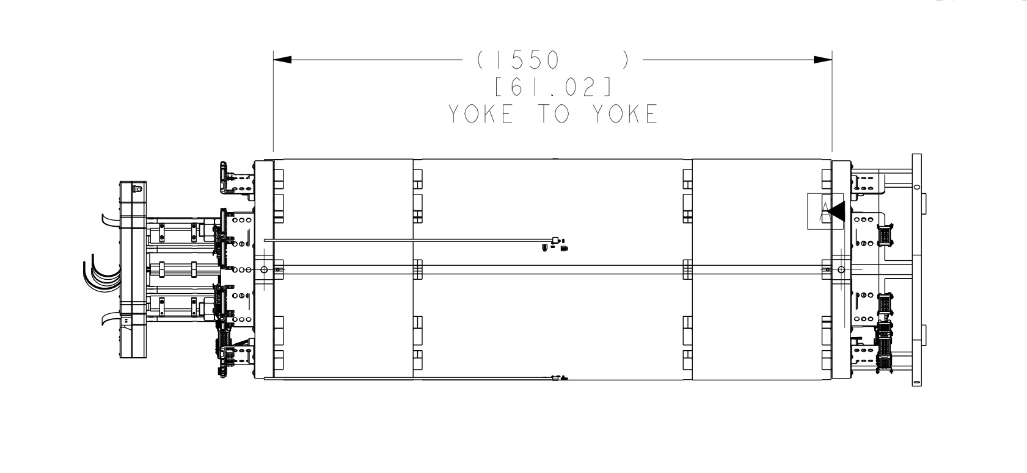
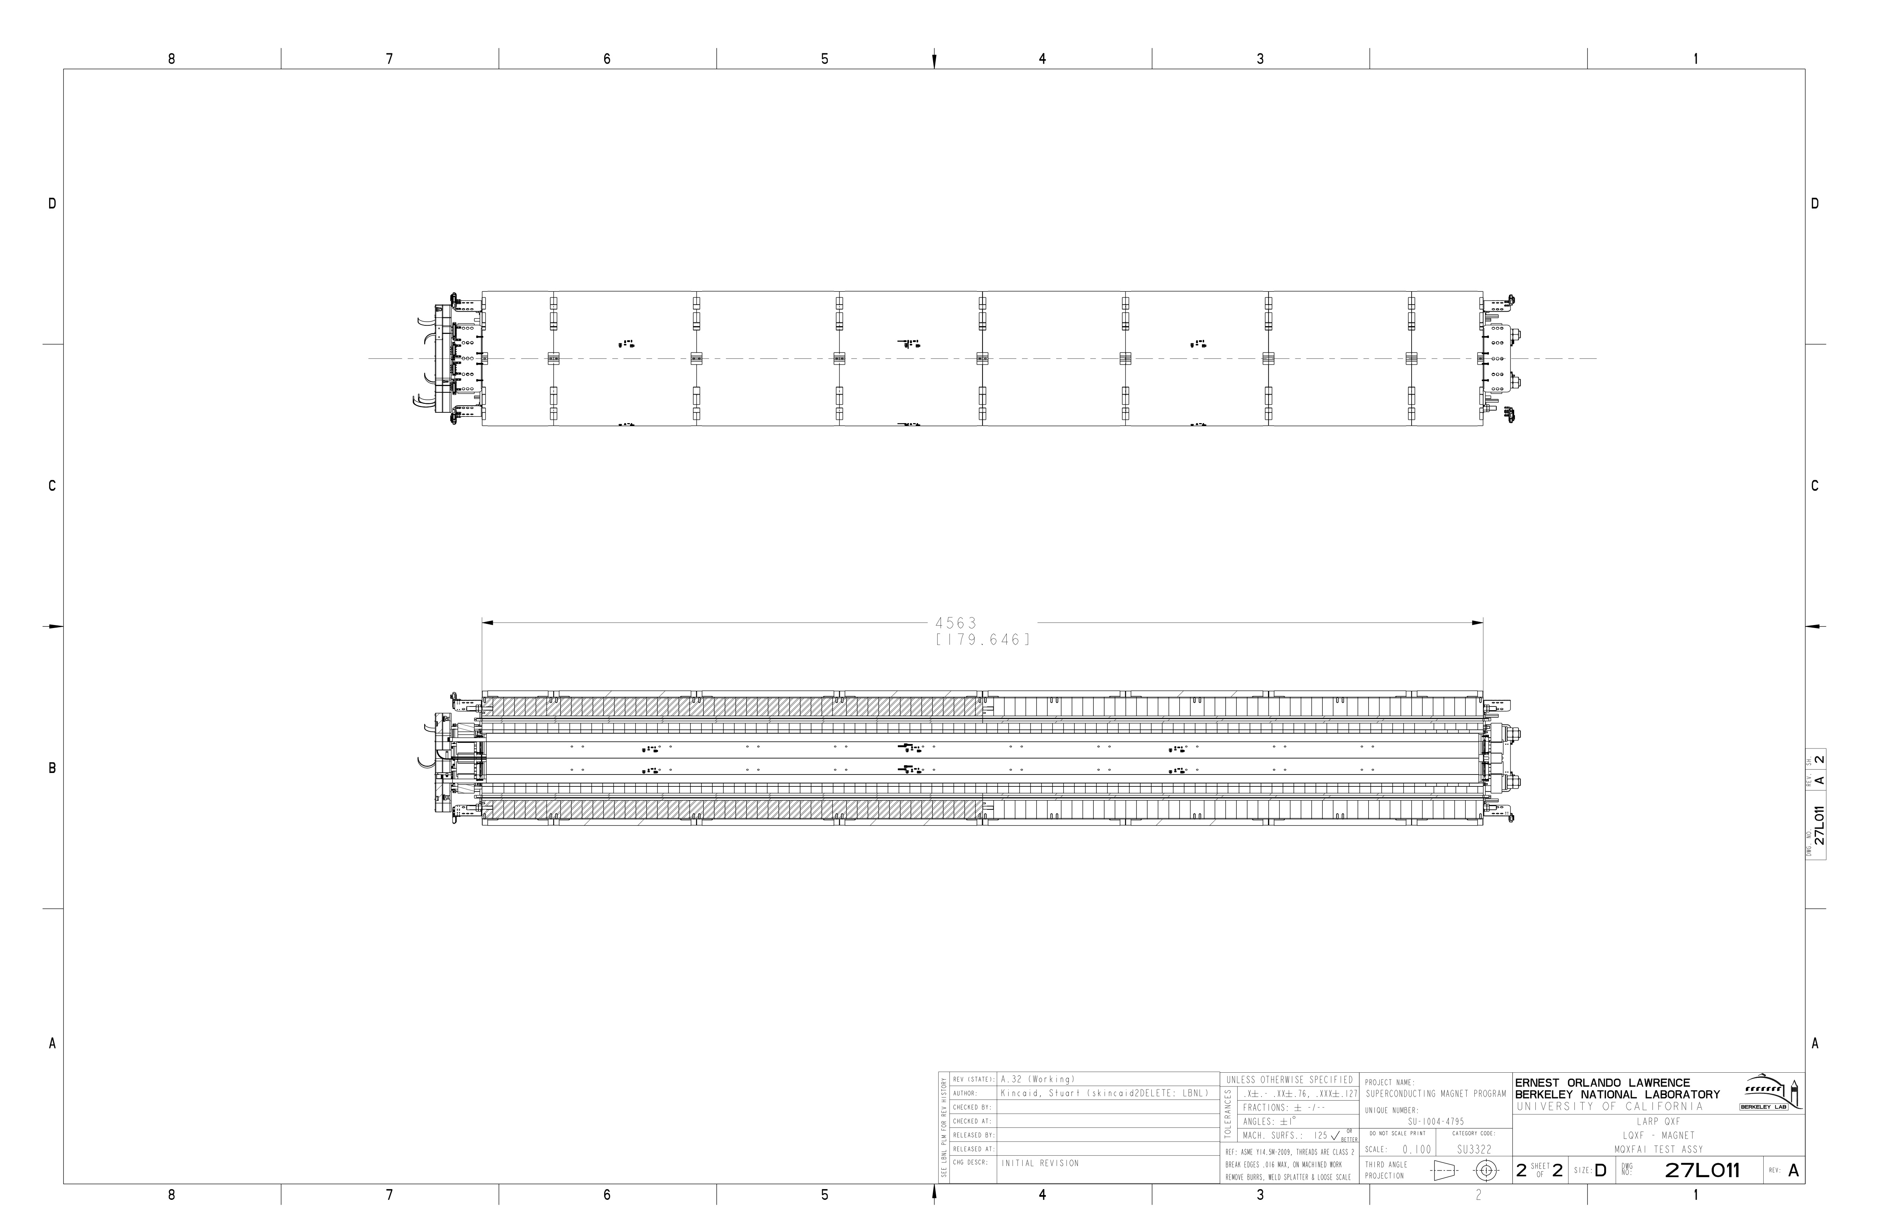
LARP MQXF Prototype Scale-up Plan
1.55 m
MQXFS
1.2 m magnetic length
2016
Dec. 2014 CERN design review recommended increasing margin by lengthening magnet and decreasing operating current; coil tooling required time to iterate, but shell/yoke was made to “new” length.
MQXFA-M
Mechanical model
4.52 m dummy coils
4.56 m yoke length
MQXFA1
1st Prototype
Thick laminations
4.0 m mag. length QXFP
4.56 m yoke length
4.56 m
2017
*June 2016 CERN International Review recommended the use of thin laminations in the 2nd Structure. Still under discussion.
4.56 m
MQXFA2
2nd Prototype
Thick laminations*
4.2 m mag. length QXFA
4.56 m Yoke length
MQXFA3
3rd Prototype
Thin laminations
4.2 m mag. Length QXFA
4.56 m Yoke length
2018

Slide 19
Objectives of the MQXFA Prototypes
Verify tooling scale up and operations from MQXFS to MQXFA
Refine CERN MTF documentation templates and processes for assembly and manufacturing data
Evaluate the magnet fiducialization process
  Determining mechanical and magnetic centers
  Evaluating feasibility of achieving alignment requirements set by CERN
Assess the thin lamination structure fabrication
  To be implemented first with short structures (with CERN-supplied thin laminations)
  Implemented with the long prototypes

Slide 20
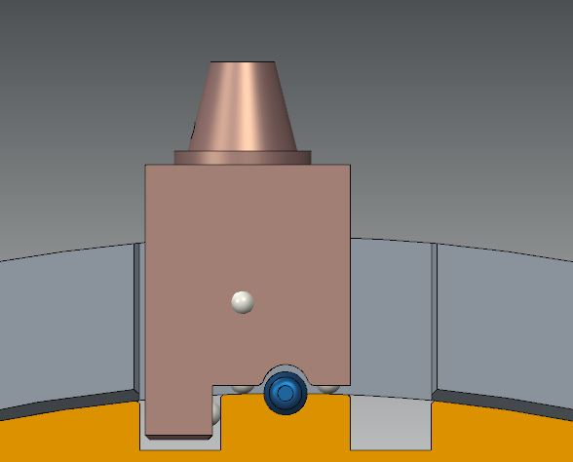



Fiducializing the Magnet Structure
Yoke/magnet fiducial features must be accessible after magnet has been assembled, as depicted here
1-2-3 survey
block
Planning to measure MQXFA1 alignment with respect to draft CERN requirements
Coil targets defined to their mechanical center
Yoke features
remain accessible after axial
endplates are installed
Yoke survey block will be
defined to coil targets

Slide 21


Proposed Fiducial Plan
Yoke Fiducials, 3x-4x per axial location
(bottom may not be readily accessible)
Coil Fiducials,
Impregnated (4x),
Both ends
Measured (mechanical, magnetic)
Centers

Slide 22


Warm Magnetic Measurements
May use the existing warm measurement probe with a different arrangement of two pickup coils; we can measure:
  The field angle from the first coil relative to that from the second coil as we scan along the magnet (We will check the possible resolution of this method)
  Waviness of transverse center as function of z-position
  Variation of main field angle as function of z-position
Survey targets can be attached to the measurement probe to track position and location of probe during measurements
Stretched wire measurements may also be performed
This information will be combined with the mechanical fiducialization data

Slide 23


Magnet Assembly Tooling Layout
Magnet integration table will be surveyed and fixed into place
Network of semi-permenent survey monuments for aligning the tables and defining coordinate system when surveying magnet structure

Slide 24
Summary
Structure has been well developed through many years of LARP model magnet development, exhibiting good correlation of FEA and real structures
Assembly tooling and procedures are based on the experiences and lessons learned from both short and long models
  Tooling will be ready this summer for the MQXFA-Mechanical model assembly
  Tooling will also be used for HL-LHC AUP Project
The prototypes that are being fabricated now are being used to evaluate and confirm
  Assembly processes for the long prototypes
  Survey and fiducialization measurements
  QA steps (hipot, alignment, etc.) and Documentation
First long magnet test expected in spring 2017
Second prototype structure assembled late 2017

Slide 25
Acknowledgements
LBNL
  H. Felice, H. Pan, E.C. Anderssen, L. Brouwer, D.R. Dietderich, R. Hafalia, M. Marchevsky, S. Myers, S. O. Prestemon, G.L. Sabbi, X. Wang, J. Wirdzek
CERN
  N. Bourcey, P. Ferracin, M. Juchno, J. C. Perez, H. Prin, G. Vallone
BNL
  M. Anerella, A. Ghosh, J. Schmalzle, P. Wanderer
FNAL
  G. Ambrosio, R. Bossert, E. Holik, S. Krave, F. Nobrega, M. Yu

Slide 26
Backup Slides

Slide 27

MQXFA Requirements
Draft requirements already agreed upon:
  Aperture (T) = 150 mm
  Gradient (T) = 143 T/m
  Magnetic Length (T) = 4.2 m
  O.D. (T) = 614 mm
  Fringe Field (O) < 50 mT at 0.5 m
  Operating Temp. (T) = 1.9 K
  Yoke Channel Diameter (T) = 77 mm (for HX tubes)
  Cooling Provisions (T):
    Polyimide-free area: 40% inner coil surface
    Free passage through the coil pole and G-10 alignment key, equivalent of 8 mm diameter holes repeated every 50 mm
    Free Helium paths interconnecting the yoke cooling channel holes
    Free cross sectional area of at least 150 cm²
  Maximum ΔT at cool down: 100 K
  Ramp rate (T): 14 A/s
  Instrumentation (T): Voltage taps
R. Carcagno, et al.:https://us-hilumi-docdb.fnal.gov:440/cgi-bin/ShowDocument?docid=36
Threshold Requirements (T): Project must meet
Objective Requirements (O): Project should meet and will strive to achieve

Slide 28
MQXFA Requirements
Draft requirements already agreed upon (cont.):
  Quench memory (O): reach operating current after thermal cycle with no more than 1 quench
  Ramp Down (T): Not quench while ramping down at 300 A/s
  Radiation dose (O) < 30 MGy
  Powering cycles (O) < 3,000
  Quenches (O) < 50
  Interfaces (T):
    Cold Mass, CERN cryo system, CERN power system, CERN quench protection system, CERN instrumentation system
      Details defined in interface document (to be written)
  Safety (T): complies with CERN’s “Launch Safety Agreement” (LSA) for IR Magnets (WP3)

Slide 29








Example of feedback from analytical models and test results (LQS01)
Coupled analysis and SG measurements fed back into assembly improved the performance
shell Strain Gauge
measured
Expected
coil Strain Gauge
92 % at 4.5 K
LQS01b
LQS01a
LQS01a
Pole Strain
Gauge
Pole Strain
Gauge
pad
pad
Nominal
Nominal
Oversized

Slide 30




Segmented shell development with LR
LRS02 reached 96 % of Iss
Shell segmentation demonstrated in LR to ensure reliable azimuthal preload

Slide 31

Model and components description
Half-length model: 2.281 m
45 degree model
View of the meshed model
Solid 186 elements
All components are in contact using contact elements
  Contact174
  Target170
  Baseline Friction coefficient is 0.2
Long model built using the short model as starting point.

Slide 32

Model and components description
Half-length model: 2.281 m
45 degree model
View of the volumes

Slide 33


Model and components description
All components of the coils are modeled and bonded to simulate impregnation
The coil is the only component imported from CAD

Slide 34


Model and components description
During assembly, key are assembled in pole groove: tight fit
In the model the key is bonded to the bottom of the pole groove to ensure convergence of the model
G10 Alignment key

Slide 35

Model and components description
Aluminum collars in contact with the alignment key
In the model, contact allowing sliding and separation
Aluminum collar
G10 coil to collar ground plane

Slide 36

Model and components description
Load pads:
Magnetic steel in the center
Stainless steel at the extremity
Load pads

Slide 37

Model and components description
Yoke and shell are pre-assembled
Tensile azimuthal strain in the shell
In the model
Shell stress is zero for the first step
Aluminum shell

Slide 38

Model and components description
During assembly master allow
Insertion of the bladders and keys
Masters

Slide 39


Model and components description
Pushers are present in the assembly
to ensure GPI and contact between the endplate and bullets screws
In the model, pusher are bonded to the coil endshoes
G10 and stainless steel pushers

Slide 40


Model and components description
Pushers are present in the assembly
to ensure contact between the endplate and bullets screws
In the model, the endplate is in direct contact with the pushers: sliding contact with μ=0.2

Slide 41
Applying Lessons Learned in Tooling
Key takeaways from our magnet development
LQ
  We learned manufacturing and assembly techniques for long magnets and their related structures
  Tooling related to the length scale up from short models was functional, but for would require design additions for efficiency
HQ
  The addition of the alignment key feature also required better manipulation of coil CMM data and overall shim package control
  We refined the process of calculating radial shim packaging due to large variances of coil sizes that were observed
MQXFS(D/1)
  Beginning to apply efficiency and throughput improvements (with the use of custom-sized radial shims, for example, etc.)
  Our tooling for manipulating the coils during preparation and assembly are designed to be scaled up for production
  Adjusting dimensions of parts (collar radius, adding tooling process keys) will simplify the assembly process by reducing number of parts that have to be handled during operations
Parallel short magnet development with CERN provides feedback for similar tools & tooling designs

Slide 42
Summary of LQ Experience
What we learned:
  Master keys were integral to the design and assembly of the long structure assembly process
  Joining shell-yoke subassemblies is a viable option to making long magnets
  Half-length master key assemblies were effective in the preload operations
  Collar shimming and coil radial contact was important for the preload of the magnet coils
What we wanted to do better:
  Long shell machining started with one piece, but limited fabrication options, and added time and cost
  Long coil handling tooling was functional, but not efficient
  Load pad handling was also functional, but not necessarily scalable
  Coil pack insertion method is not necessarily scalable
  Instrumentation wire routing at magnet level needed improvement
✔
✔
✔
✔
✔

Slide 43
Summary of HQ Experience
What we learned
  We refined the process of calculating what shims were required to ensure the contact between collars, coils, and alignment keys
  Collars required ground plane protection in addition to better control of radial shimming
  Full length (G10) alignment keys only needed to be shimmed to size at pole island region
  Strain gauge installation process was refined, which improved reliability

Slide 44
Summary of MQXFS/D Experience
What we learned
  We were able to preload several shells in one shell-yoke preload assembly step
  Yoke/Shell alignment may only require 1 quadrant pin for clocking, which will not over-constrain system
  Custom width GPI coil layers facilitated ease of preparation
  Strain gauge measurement systems are showing comparable results
What we’d like to do better
  Seismic support of the shell-yoke subassembly needs improvement
  Bladder support cross requires double slots for lower pressure operation => more reliability
  GPI creasing technique/tooling to be improved
  Collar radius will be adjusted to reduce amount of radial shims required
    Collar shims will be custom width sheets of Kapton rolls, also for ease of prep
  Pressure paper sensitivity was not high enough
  Coil pack installation support needs to positively engage coils during assembly
  Alignment and load keys will be adjusted in thickness to reduce the amount of shim stock required, and also be made out of bronze instead of steel
✔
✔
✔
✔
✔
✔
✔

Slide 45

Present Tooling Infrastructure Footprint
Layout for MQXFA (early 2016)
Accommodates the short magnet program that is continuing in parallel with the prototype development
Long prototype layout presently being built up
Entire long operation serial, no parallelization

Slide 46
Alignment: What is Achievable?
This is more of a fiducialization process
Magnet alignment: No real “knobs to turn”
  Assembly tooling will be aligned, though
  Will likely use a laser tracker (FARO Vantage system)
  Our survey crew will need to perform some tests
http://www.faro.com/products/metrology/faro-laser-tracker/overview

