Slide 1
BNL LHC Hi-Lumi
QXF Vertical Test Facility Status
M. Anerella
On behalf of H. Hocker, P. Joshi, P. Kovach, A. Marone & J. Muratore
July 14, 2016

Slide 2
Outline
Scope - Introduction
Cryogenic Infrastructure
Power Supply
Data Acquisition
Test Dewar
First Long MQXF (Mirror) Test Plan
Summary

Slide 3
Scope, Introduction
“the Challenges for HiLumi”
Scope: cold test (4) prototype units, (20) production magnets
Challenges:
Cryogenic Test Facility:
1.9K in magnet testing (previously 4.5K for magnets, but 1.9K has been achieved for cable sample tests)
Electrical Systems:
24KA (21KA max. required, Mirror) in magnet testing (previously 10KA for magnets; are now modifying a 30KA power supply previously utilized for cable sample tests)
Intensive data acquisition
5 MJ energy extraction
Vertical Dewar:
Existing available dewar operates at 4.5K; no capability for 1.9K heat exchanger
Existing available dewar contains Ø 610 mm helium vessel (HiLumi = Ø 630 mm)

Slide 4
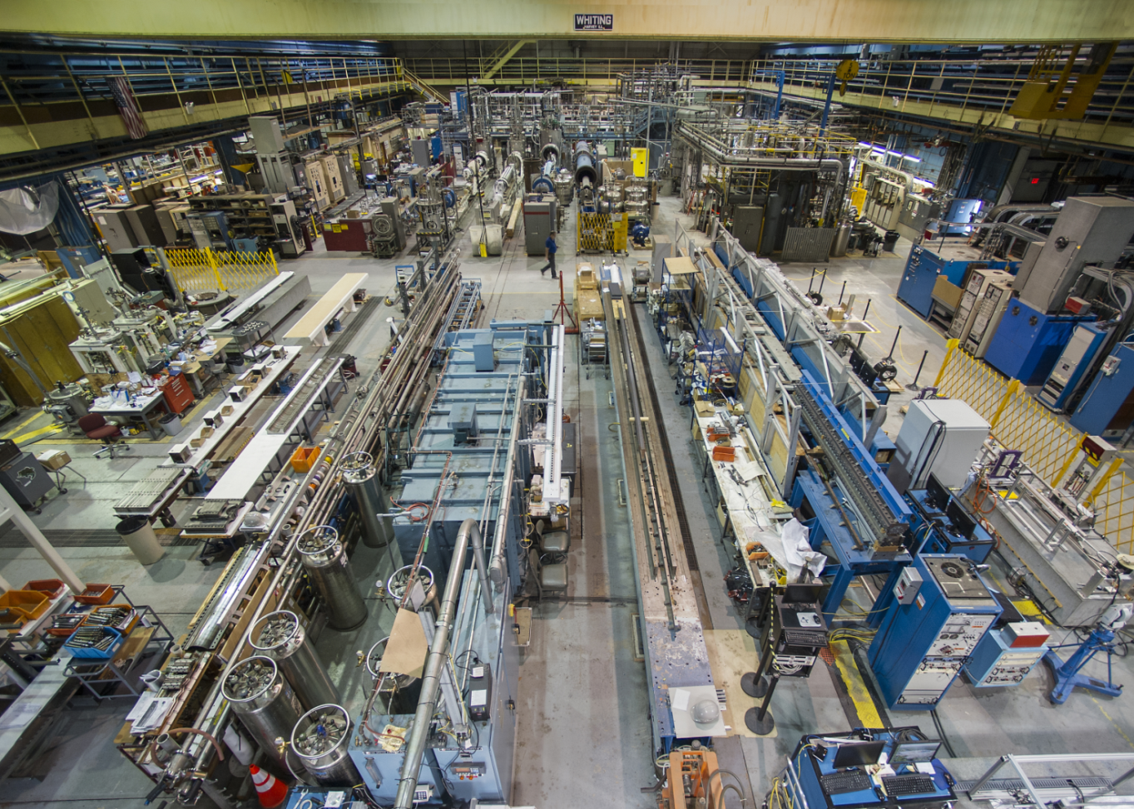
BNL Facility North (High) Bay Area
Test Facility in Background
Capacity:
30 ton / 5 ton crane
Total hook height above dewar flange ~ 6.7 m
Ø 810 mm vacuum vessel
Total helium dewar length = 6.1 m

Slide 5
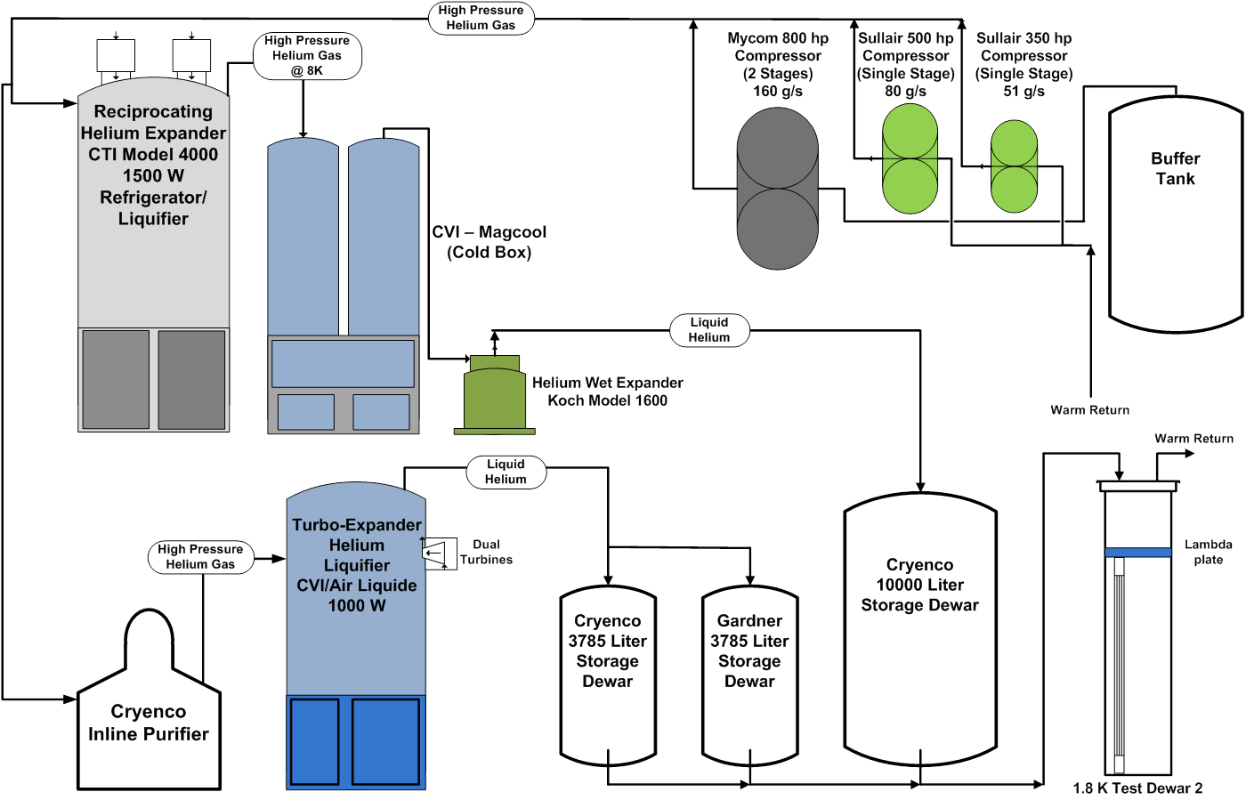
Cryogenic Facility Schematic

Slide 6
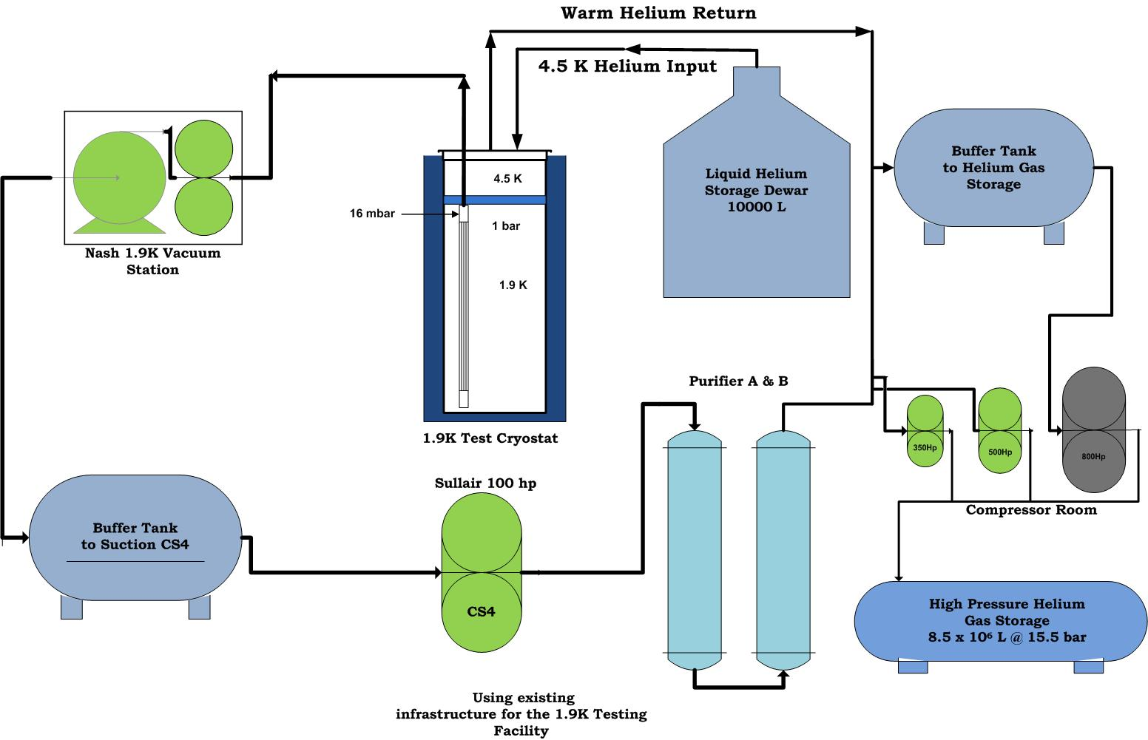
1.9K Cooling Schematic

Slide 7
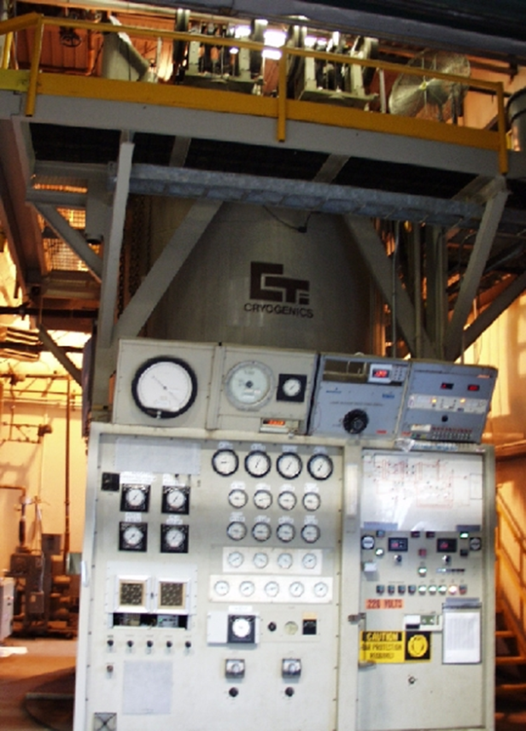
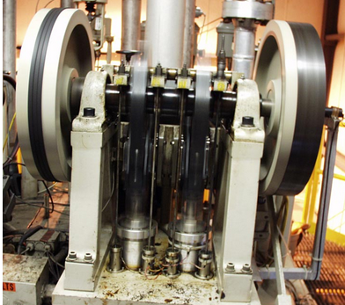
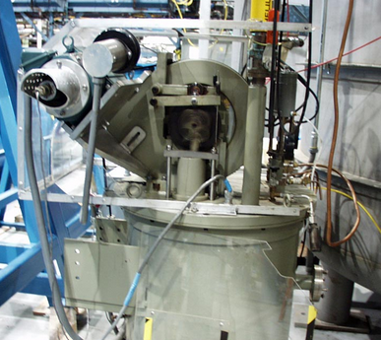
Cryogenic Facility p.1
Main Refrigeration Units
CTI Model 4000 Refrigerator/Liquifier - (primary unit, 320 L/hr. uses (2) reciprocating engine expanders @ 250 RPM)
Rebuilt expander in 2013
Unit in good working condition
Recently upgraded with a new LN₂ heat exchanger, doubling the number of inline purifiers to four, rebuilt expansion engines, and new diagnostic and control software (LabVIEW).
Koch Model 1600 Wet Expander; 60 RPM, Ø76 mm bore, 51 mm stroke
Unit in good working condition
Seals, O-rings, other parts replaced / maintained
This work was funded by BNL.
7

Slide 8
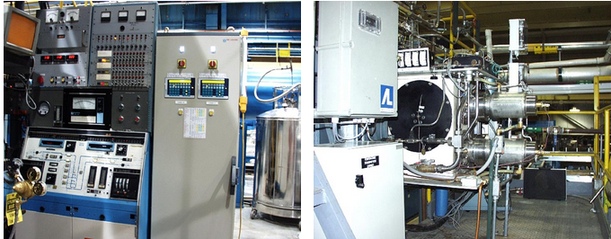
Cryogenic Facility p.2
Secondary Refrigerator/Liquifier
CVI Refrigerator * (2 turbines @ 130,000 RPM, 160 L/hr. – 1000W @ 4.5K)
Replaced (1st stage nitrogen-helium) heat exchanger
Replaced turbine chilled water heat exchanger
Installed upgraded relief & isolation valves
Installed new piping to increase efficiency
Replaced temperature sensors & updated PLC controls for improved turbine protection
* backup unit, risk mitigation against CTI Refrigerator failure
Note: all this work is BNL funded

Slide 9
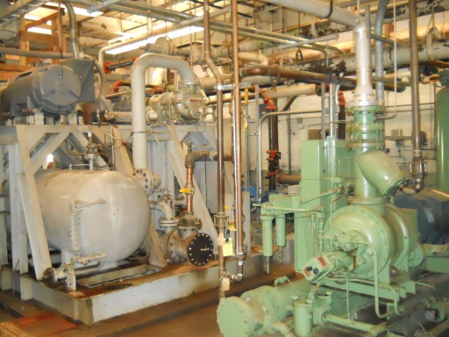
Cryogenic Facility p.3
Compressors
Mycom Compressor (primary unit, 2 stage, 800 hp, 597 KW, 160 g/s)
Purchased & received critical spares:
new 2nd stage compressor head
new 400 hp motor
new oil heat exchanger
new helium heat exchanger
Maintenance items completed:
Installed new oil filter & seals
Repaired oil leaks
Replaced oil line clamps
Refurbished & resealed heat exchanger
Sullair 350 Compressor (single stage, 350 hp, 261 KW, 51 g/s)
Purchased & received critical spares:
new compressor screw
new oil pump
Mycom and Sullair 350 compressors
Note: all this work is BNL funded

Slide 10
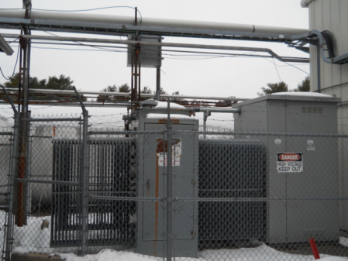
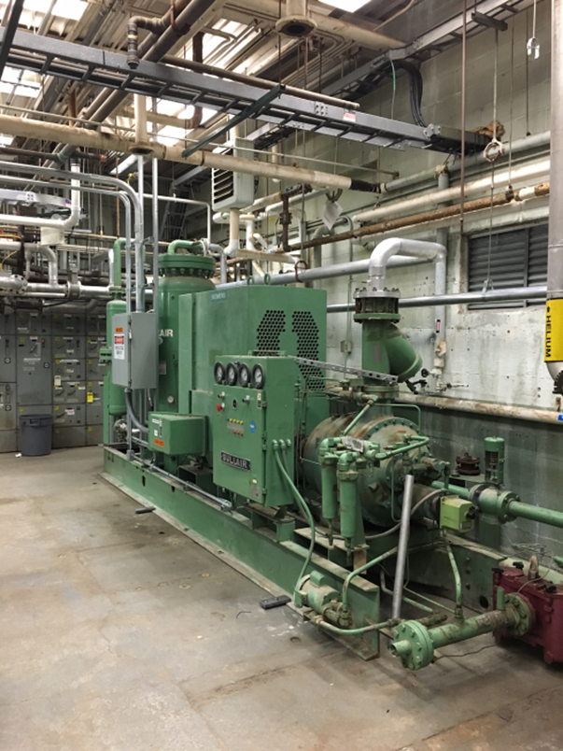
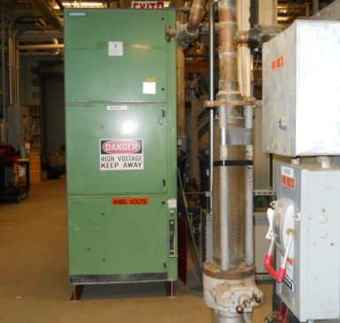
Cryogenic Facility p.4
Sullair 500* (500 hp, 94 g/s) Installation
* backup unit, risk mitigation against Mycom compressor failure
4160V transformer relocated into place – conduit/wiring installation complete
Sullair skid modified for new location
Electrical panel removed
Frame cut/shortened/re-welded
All electrical & plumbing installations are complete
Waiting for turn-on
Cost underrun! Surplus funds approved for use in commissioning helium dirty gas purifier system (Linde contract)
Note: all this work is BNL funded

Slide 11
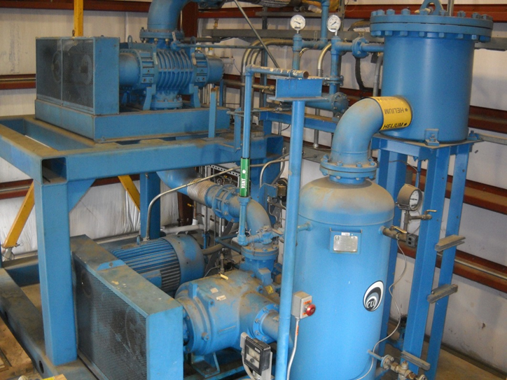
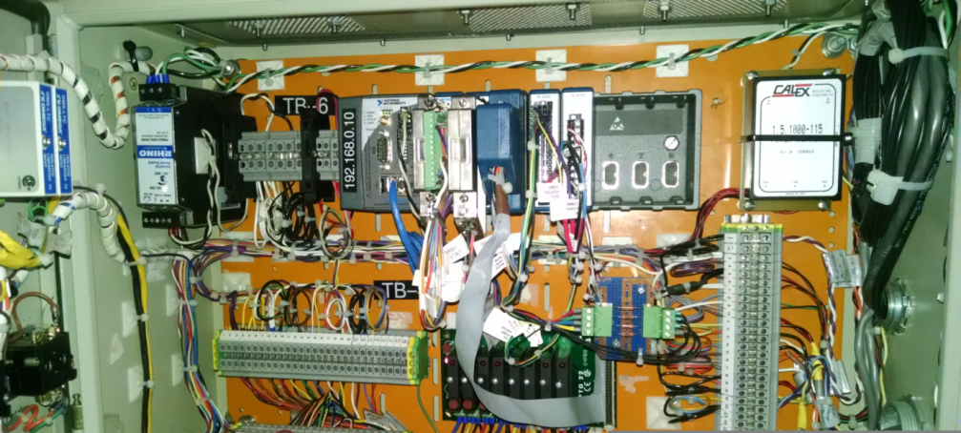
Cryogenic Facility p.5
Nash Helium Vacuum Pump
Nash-Kinema Vacuum Pump
Power = Two stages at 74.6 kW each
Suction pressure = 0.0837 bar @ 4.5 K
Discharge pressure = 1.2 bar
Delivers 2.7 g/s @ 1.8 K
Cooling capacity = 40 W @ 1.8 K
Pumps on LHe in heat exchanger - down to 16 mbar for 1.8 K operation.
Purchased (BNL funded) new 100 hp Sullair compressor
Connected helium exhaust gas line to new 100 hp compressor and inline purifier, to reclaim helium gas (was previously routed to dirty gas facility)
Replaced legacy soldered copper water lines with welded stainless steel
Purchased new booster and liquid ring vacuum pumps
Refurbished existing / purchased new (BNL funded) spare chilled water heat exchangers
Replaced drive belts
Repaired service air supply line
Updated control system
Installed new vacuum jacketed transfer line, valve to test dewar

Slide 12
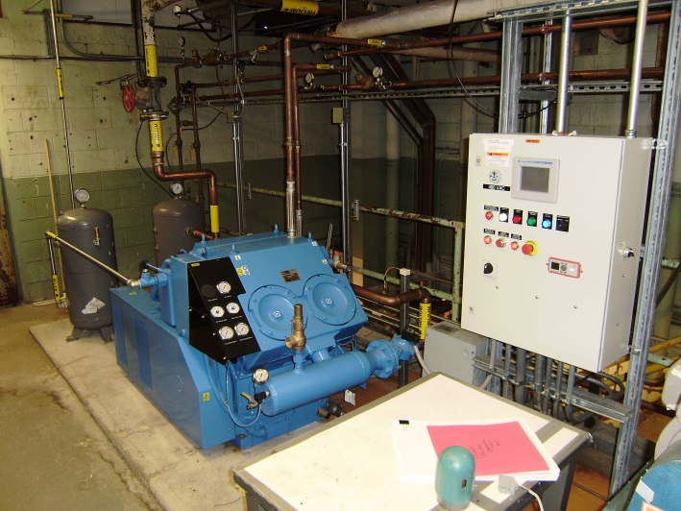
Cryogenic Facility p.6
Utility Compressors
Gardner Denver 60
Power = 44.7 kW
Discharge pressure = 17 bar
Delivers 213 m³/hr → 9.65 g/s
New Gardner Denver compressor
purchased with BNL funding.
Sullair 100 (3 units: CS4, CS5, CS6)
Power = 74.6 kW
Discharge pressure = 12 bar = 1.2 MPa
Delivers 20 g/s (80 g/s @ 8 bar input)
New Sullair 100 compressor
purchased with BNL funding.
Linde Model 500A He Gas Purifier
with dedicated compressor
All new system and commissioning contract purchased with BNL funding.
Pumps ‘dirty’ He gas to dirty gas bag and gas recovery tank.
Presently, only CS4 (new unit) being used, for pumping Nash 1.9 K station outlet to high pressure gas storage tanks.
Cleans and recovers ‘dirty’ gas.

Slide 13
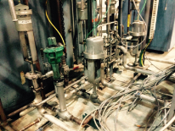
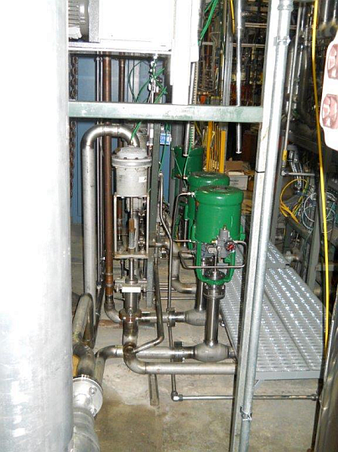
Cryogenic Facility p.7
“before” legacy copper lines & valves
Inline Purifiers
Replaced Polyflow lines
Valve Boxes
Replaced Polyflow lines
Quench Tank
Replaced valve & legacy soldered copper lines with stainless steel welded pipe; rerouted quench recovery line to improve flow
Replaced legacy soldered copper small diameter return manifold piping with large diameter welded stainless steel
Purchased & installed new return manifold valves
“now”
Note: all this work is BNL funded

Slide 14
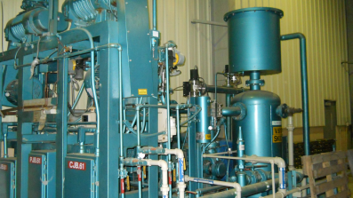
Cryogenic Facility p.8
(FY17)*
Re-commission Kinney Vacuum Pump (backup to Nash Pump, 2.0 g/s He @ 1.8K)
* Pending final BNL budget authorization

Slide 15
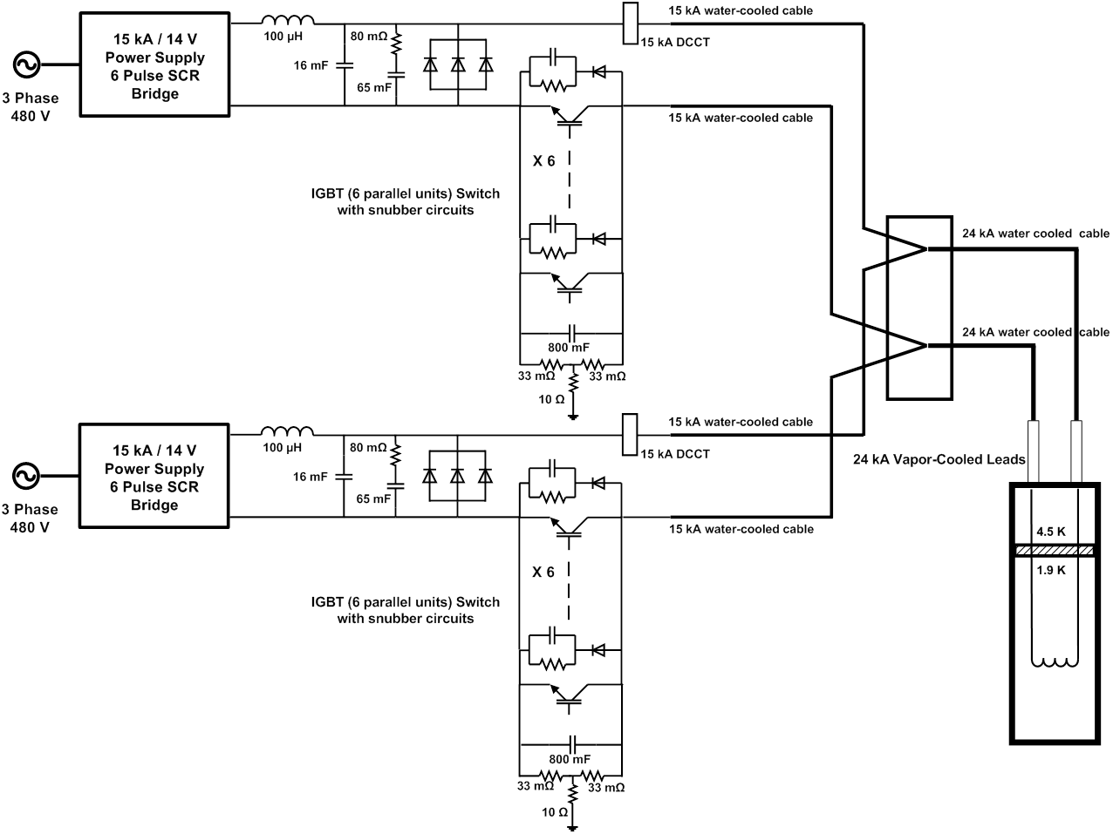
30 kA POWER SUPPLY UPGRADE

Slide 16
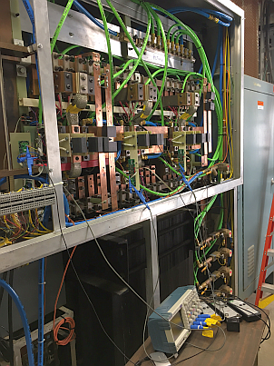
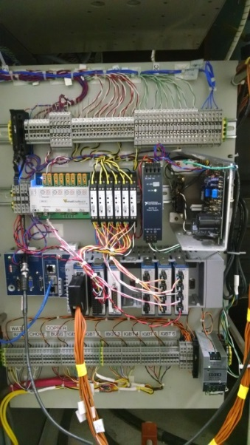
Power Supply Energy Extraction Switch
24KA IGBT Based Energy Extraction Switch:
Switch consist of 2 modules each with six high power IGBTs in parallel
First module - Design and tuning of snubber circuit components to absorb high voltage switching transients is complete in one module. Tested so far up to 9KA.
Tuning and testing of second module in progress. Tested up to 5.4KA
Stray and mutual inductances in the power supply circuit generated much higher switching transients than expected.
Reconfiguration of snubbers caused some delays.
40 channel IGBT Switch data monitoring and logging system for each module: Lab View program debugged and tested.
IGBT
Max operating current = 2000 A (Rated = 3600 A
Max voltage per IGBT = 840 V (Rated = 1200V)
(These values are with 66 mΩ dump resistor.)
Energy Extraction
66 mΩ center tapped to ground
Stainless Steel 1 MJ energy absorption rating
(will be replaced by new high power ceramic 66 mΩ 10 MJ resistors for MQXF)
IGBT data acquisition and instrumentation panel
15 kA power supply switch cabinet with IGBT and snubber circuits. Each power supply is configured for 12 kA with 6 water-cooled IGBT and snubber circuits, allowing 24 kA magnet operation.

Slide 17
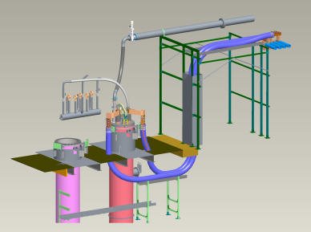
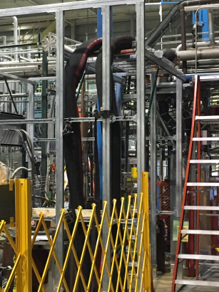
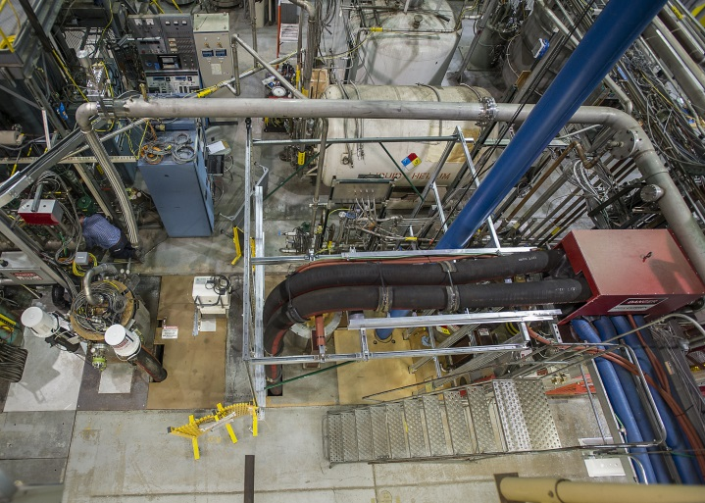
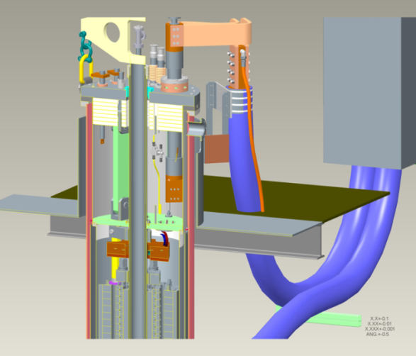
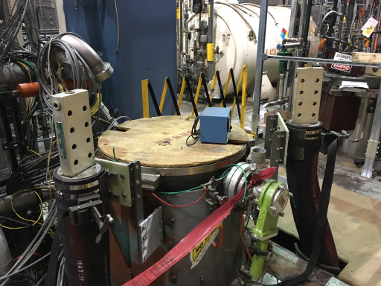
Power Supply Status, continued
Water cooled cable (from 24KA IGBT cabinet terminal to dewar) installation is complete
(Note also helium vacuum line)
Overhead view
Cables from junction box
24 kA water-cooled cables : Finished DI water cooling circuit, installed drain outlet, and verified flow (>68 L/min) and pressure drop. 15 kA water-cooled cables flow is 30 L/min.
Cables from trench at dewar

Slide 18
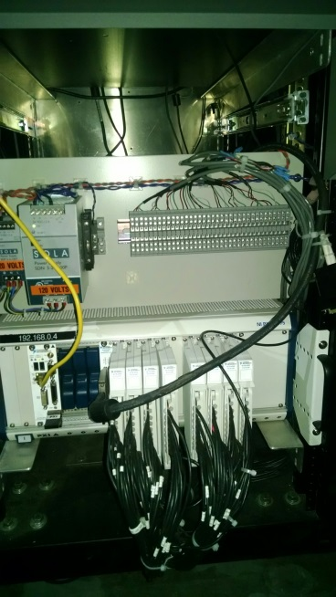
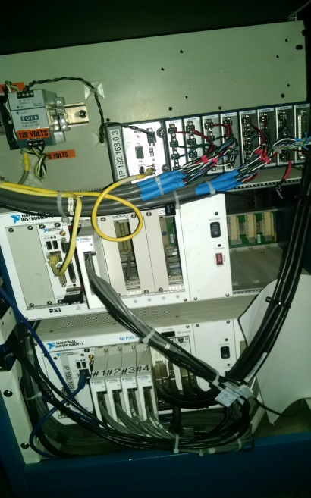
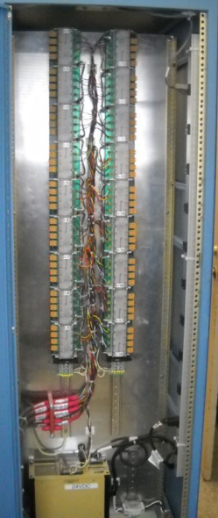
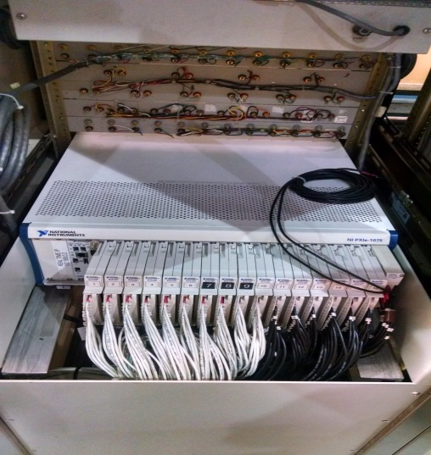
Data Acquisition and Controls
(details in spare slides)
64 Ch Slow Logger
Quench Detector
Voltage Taps monitoring system:
128 Channels Fast logger: Assembled and tested
64 Channels Slow logger: Assembled and tested
64 Channel Strain gage logger: 32 Channels tested, remaining channels to be assembled
8 Channel Quench Detector: Assembled & tested.
Cable end connector assembly complete on dewar end.
Acquisition software written/debugged/tested.
All isolators / pre-amplifiers assembled, calibrated & tested.
(FY17) - Spike Detector & Quench Antenna Data Acquisition System to be designed & built
128 Ch
Fast Logger

Slide 19
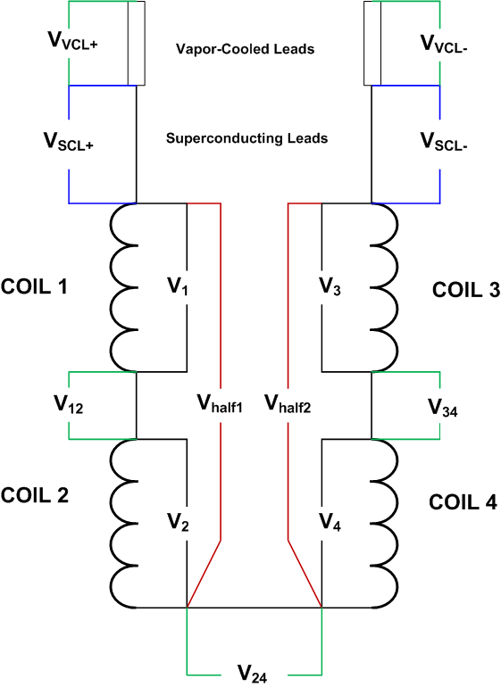
QUENCH PROTECTION p.1
QUENCH DETECTION
The quench detection system is based on a redundant scheme which relies on a number of voltage signals. When any one of the following signals reaches its specified threshold voltage after a specified validation time, a fast discharge is instigated (current decays through dump resistor). Typical threshold voltages and validation times are listed here.
Half coil voltage V_{half1} - V_{half2} 50-100 mV 10 ms
Quarter coil voltage V₁ – V₂ 50-100 mV 10 ms
Quarter coil voltage V₃ – V₄ 50-100 mV 10 ms
Total coil voltage V_{total} 50-100 mV 10 ms
SC lead voltages V_{SCL+} and V_{SCL-} 10-50 mV 5 ms
Splice voltages V₁₂, V₃₄, V₂₄ 8-10 mV 5 ms
Current Derivative V_{total} – L dI/dt 0.1-5 V 10 ms
Note: In Nb₃Sn magnets, current-dependent thresholds as high as several volts at low currents are necessary and are set in the software. This is to avoid false QD trips due to flux jump spikes.
There are also designed into the system a number of interlocks which also rely on various signals which, if they do not meet specified conditions such as voltage threshold or on-off state, will instigate a slow discharge, with the dump resistor out of the circuit. These include:
Vapor-cooled lead voltages 80-100 mV 500-1000 ms
Strip heater capacitor bank not charged
IGBT switch temperature or voltage too high
Others

Slide 20
QUENCH PROTECTION p.2
Quench Protection Heater Firing Units (HFU)
PRESENT HFU SYSTEM
Number of capacitor banks 4
Number of capacitors per bank 15 units
Capacitor voltage rating 450 V
Capacitance per unit 3100 μF
Total capacitance per bank 46500 μF
Maximum energy density that can be delivered vs capacitance with present system
 |  |  |  |  |  | outer |  |  |  |  |  |  |  |  |  | inner
 |  |  |  |  |  | energy |  |  |  |  |  |  |  |  |  | energy
Number |  |  |  |  |  | density |  |  |  | Number |  |  |  |  |  | density
Capacitors | C (μF) | R (Ω) | RC (ms) | time (ms) | E (J) | (J/cm²) |  |  |  | Capacitors | C (μF) | R (Ω) | RC (ms) | time (ms) | E (J) | (J/cm²)
1 | 3100 | 2 | 6.2 | 28.6 | 313.9 | 0.8 |  |  |  | 1 | 3100 | 4 | 12.4 | 57.104 | 313.9 | 0.5
2 | 6200 | 2 | 12.4 | 57.1 | 627.8 | 1.5 |  |  |  | 2 | 6200 | 4 | 24.8 | 114.208 | 627.8 | 1.0
3 | 9300 | 2 | 18.6 | 85.7 | 941.6 | 2.3 |  |  |  | 3 | 9300 | 4 | 37.2 | 171.312 | 941.6 | 1.5
4 | 12400 | 2 | 24.8 | 114.2 | 1255.5 | 3.1 |  |  |  | 4 | 12400 | 4 | 49.6 | 228.416 | 1255.5 | 2.0
5 | 15500 | 2 | 31.0 | 142.8 | 1569.4 | 3.8 |  |  |  | 5 | 15500 | 4 | 62.0 | 285.521 | 1569.4 | 2.5
6 | 18600 | 2 | 37.2 | 171.3 | 1883.3 | 4.6 |  |  |  | 6 | 18600 | 4 | 74.4 | 342.625 | 1883.3 | 3.0
7 | 21700 | 2 | 43.4 | 199.9 | 2197.1 | 5.4 |  |  |  | 7 | 21700 | 4 | 86.8 | 399.729 | 2197.1 | 3.5
8 | 24800 | 2 | 49.6 | 228.4 | 2511.0 | 6.2 |  |  |  | 8 | 24800 | 4 | 99.2 | 456.833 | 2511.0 | 4.1
9 | 27900 | 2 | 55.8 | 257.0 | 2824.9 | 6.9 |  |  |  | 9 | 27900 | 4 | 111.6 | 513.937 | 2824.9 | 4.6
10 | 31000 | 2 | 62.0 | 285.5 | 3138.8 | 7.7 |  |  |  | 10 | 31000 | 4 | 124.0 | 571.041 | 3138.8 | 5.1
11 | 34100 | 2 | 68.2 | 314.1 | 3452.6 | 8.5 |  |  |  | 11 | 34100 | 4 | 136.4 | 628.145 | 3452.6 | 5.6
12 | 37200 | 2 | 74.4 | 342.6 | 3766.5 | 9.2 |  |  |  | 12 | 37200 | 4 | 148.8 | 685.249 | 3766.5 | 6.1
13 | 40300 | 2 | 80.6 | 371.2 | 4080.4 | 10.0 |  |  |  | 13 | 40300 | 4 | 161.2 | 742.353 | 4080.4 | 6.6
14 | 43400 | 2 | 86.8 | 399.7 | 4394.3 | 10.8 |  |  |  | 14 | 43400 | 4 | 173.6 | 799.458 | 4394.3 | 7.1
15 | 46500 | 2 | 93.0 | 428.3 | 4708.1 | 11.5 |  |  |  | 15 | 46500 | 4 | 186.0 | 856.562 | 4708.1 | 7.6
QXF
target

Slide 21
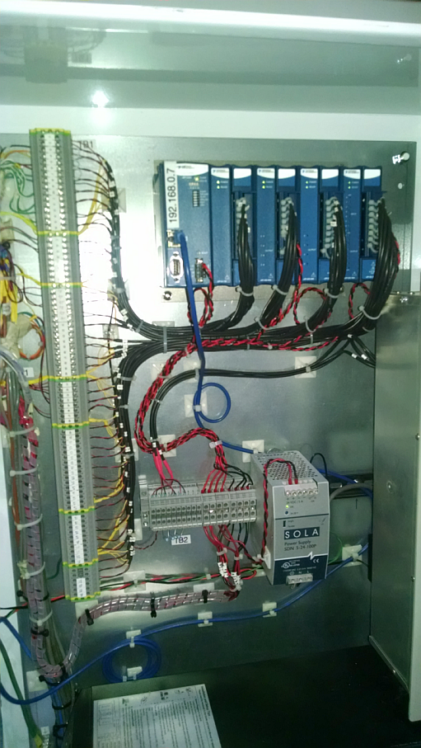
Cryogenic Controls
Nash Vacuum Pump Controls : New lab View based controls tested for remote and local operation
Finished hardware and software debugging of the new Lab View based Inline Helium purifier and its associated valve system.
Helium Recovery compressor: Retrieved vendor programmed ladder logic code for modification and addition of remote control logic. initial testing revealed damaged pressure sensor (as received). Replacement ordered.
New Lab View based controls for Quench recovery valve system being tested.
Monitoring system and controls for various level sensors, temperature sensors, heaters, vacuum sensors etc. are in process of being calibration and testing.

Slide 22
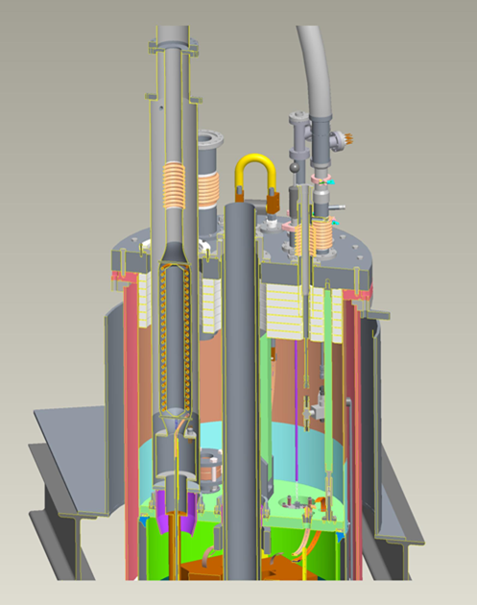
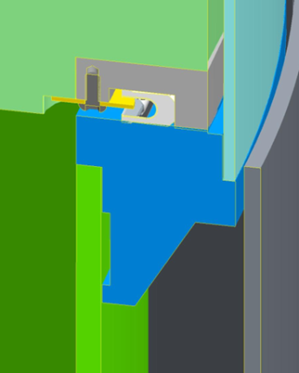
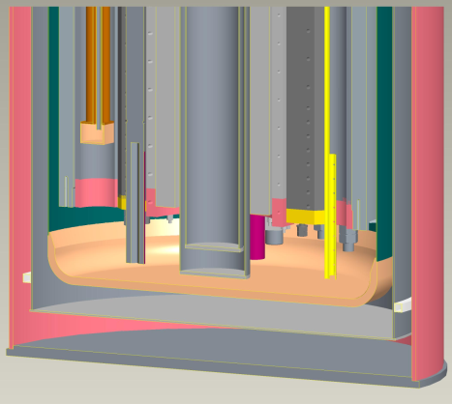
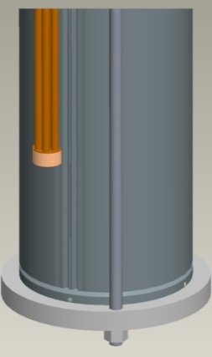
Test Dewar
Overall Design
G-10/SST Lambda plate
Upper He vessel
He vessel flange
Lower He vessel
Outer 4K heat shield
Lambda plate sealing detail
1.9K pre-cool Heat exchanger in magnet helium passage (left) and outside Mirror O.D. (right)
Upper dewar assembly:
Vent and burst disc in lambda plate (for Safety Approval)
Gravity seal at lambda plate
4K Al heat shield
2K-300K warm bore
Overall hanging assembly (mirror shown)
+200 mm extended helium dewar bottom

Slide 23
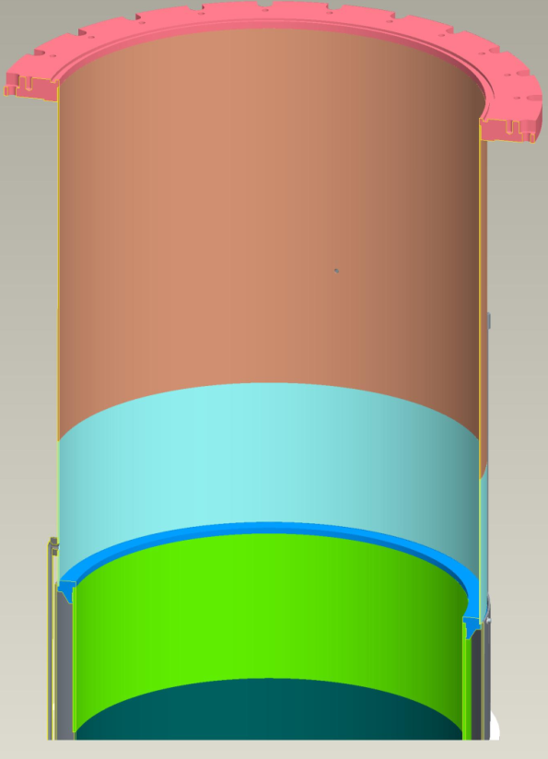
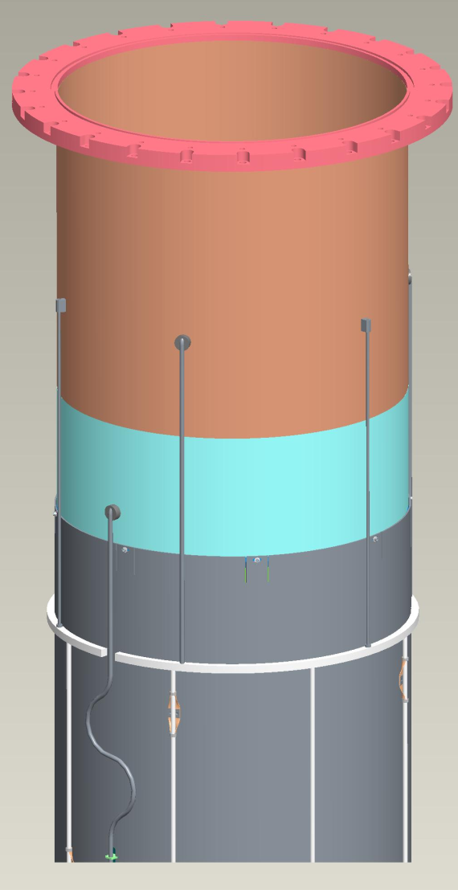
Helium Dewar & Outer 4K Heat Shield
Design Details
“blue/green” sections of helium vessel and lambda plate flange welded as a subassembly to permit precise, flat machined surface of lambda plate flange after welding (also locally thicker sections to accommodate bending stresses)
Flexible cu connections to Aluminum
Helium return in gas above 4K liquid
Helium supply from 4K liquid
Heat shield is bolted to outside of lambda plate flange (supports weight, provides conductive cooling)
SST manifolds, pipes

Slide 24
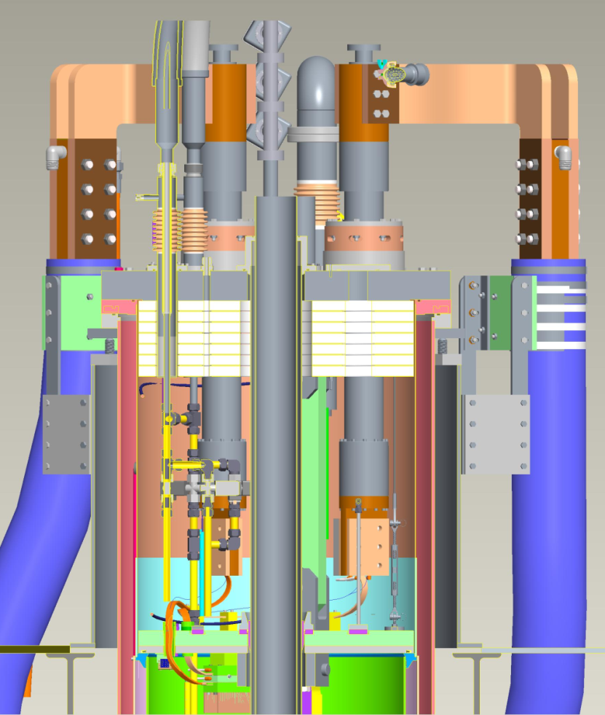
Test Dewar Thermal Performance
“The committee members thought that, because of the limited length of the dewar, the lambda plate was too close to the bottom of the VCL’s leaving only a very short length for 4.2 K LHe in the upper chamber. The problem could be either very high heat leak and helium consumption, or inability to establish a superfluid volume below the lambda plate.”
Helium supply capacity, using (2) Ø¾” fill lines, is 380 l/hr. – when powered, leads are submerged in liquid*
* as is done at FNAL
Boil-off based on total heat load, including leads:
200 l/hr. = magnet powered, 1.9K steady state (0.4 inches/min, liquid level above lambda plate)
170 l/hr. = magnet unpowered, 1.9K steady state (0.35 inches/min)
283 l/hr. = magnet unpowered, cooldown from 4.5K to 1.9K (0.5 inches/min)
33.34”
top plate to lambda plate (33.25” at FNAL)
4.5K helium
~6”-7” nominal helium liquid level
5.5” Bottom of 24KA vapor cooled leads to top of lambda plate
(6.5” at FNAL)
1.9K helium
4.5K heat shield

Slide 25
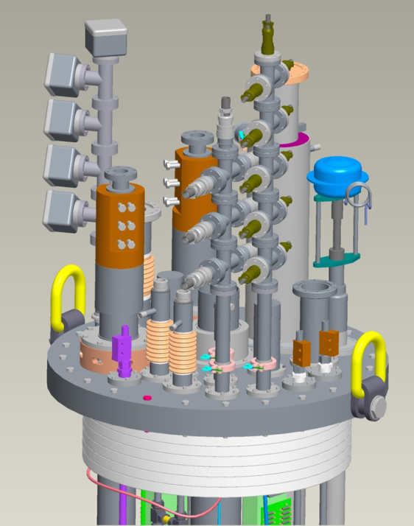
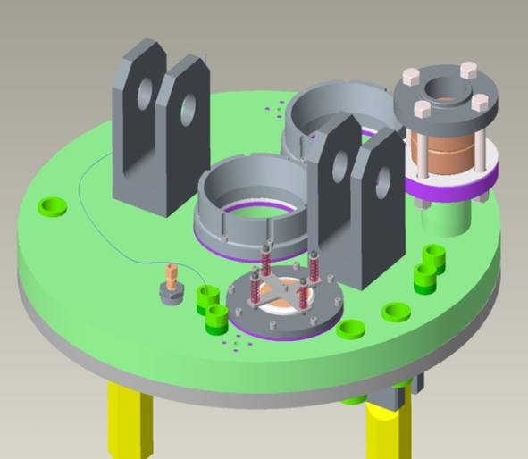
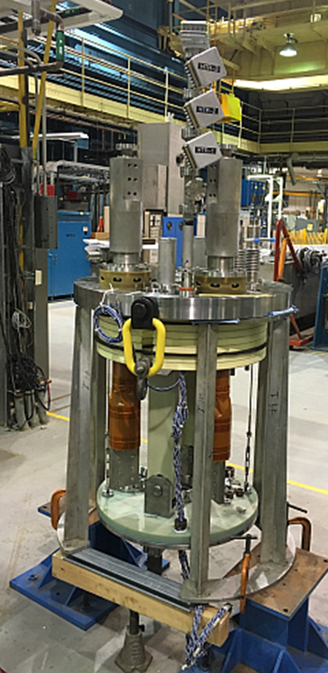
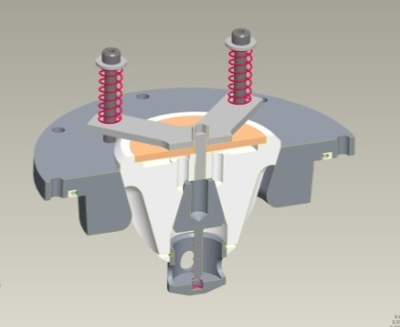
Top Hat, Lambda Plate Design Details
Lambda plate:
Top Hat:
(2) 24KA main coil vapor cooled leads
(2) 1KA CLIQ vapor cooled leads; port for 3rd lead provided
(3) instrumentation wiring ports
(2) helium fill lines, solenoid valves
1.9K precool Heat exchanger
Warm bore port
Helium vent port
Top Hat
2” Fike burst disc designed for subcritical flow (API 520). Venting 4150 g/s helium at 5.86 bar to 3.45 bar backpressure.
Pressure Relief (Quench) Valve
Designed for 750 g/s with a pressure rise of under 0.34 bar @ operating conditions (approx. 1.2 bar).
Contains internal 1.9 K make up valve, to eliminate low pressure vapor under lambda plate.
Top Hat and Lambda Plate assembled together

Slide 26
Test Dewar Status
Dewar & Heat Shield assembled, installed in vertical cryostat, pressure & leak checked – ready for operation
Top Hat & Lambda Plate assembly complete – ready for operation
1.9K Precool Heat Exchanger assembly complete – ready for operation
Mirror Magnet – received, assembled onto top Hat, installed into dewar (by 7/8)
Power Supply – IGBT testing complete to 21 KA total power (by 7/13)
Waiting for cryogenic facility turn-on

Slide 27
MQXFPM1 DRAFT TEST PLAN SUMMARY (more detail in back-up slides)
Electrical checkout at room temperature
Electrical checkout at 4.5 K
Testing at 1.9 K
Quench training at 1.9K
Operate magnet at I_{nom} = 0.95 I_{max} for at least 2 hrs.
Quench ramp rate dependence study – 10, 20, 50, 100, 200, 300 A/s
Magnet inductance measurements at 50, 200, 300 A/s
Quench temperature dependence study (20 A/s ramp rate)
Testing at 4.5 K
Establish quench plateau at 4.5 K
Operate magnet at 0.95 I_{max} (4.5 K) for at least 2 hrs
Magnet inductance measurement at 200 A/s
Magnet splice resistance measurements – splice voltage vs current
Testing at 1.9 K
Demonstrate quench plateau at 1.9K
Quench Protection Heater Studies
Warmup

Slide 28
SUMMARY
The cryogenics facility refrigerators, compressors, and other peripheral devices have been refurbished to test MQXF quadrupoles at 1.9 K and 1 bar (nom). BNL management supported funding (~$1.4M) the purchase of critical spares, preventive maintenance of critical components, and installation of backup systems to improve reliability and reduce risk for the Hi-Lumi production magnet testing program
The Magnet Division 30 kA power supply (formerly used for cable testing) and peripheral systems such as energy extraction and quench heater firing units have been converted to test magnets to 24 kA and at 1.9 K, and have added 24 kA water-cooled cables to test dewar.
A new and redesigned vertical test dewar has been built for 1.9 K testing of 4.2 m MQXF magnets, with new inner helium vessel, 4 K heat shield, 1.9 K heat exchanger, lambda plate, and new top plate with 24 kA vapor cooled copper leads.
The old data acquisition systems have been replaced by completely modernized and improved NI hardware and LabVIEW-based software.
The vertical test facility will be commissioned with a short sample of superconducting cable instrumented with taps and a spot heater. The mirror magnet will be on the hanging fixture but will not be connected to the power leads until the cable test has been successfully completed.

Slide 29
Thank you for your attention

Slide 30
Backup slides

Slide 31
MQXFPM1 DRAFT TEST PLAN SUMMARY
Electrical checkout at room temperature
Series resistances, grounds, hipots, level shift tests,
instrumentation checks
Electrical checkout at 4.5 K
Grounds, hipots, level shift tests, instrumentation checks
Power supply shutoff (manual trip) at 1000 A
Quench protection heater quenches I ≤ 5 kA
Testing at 1.9 K
Quench training at 1.9K @ 20 A/s, establish plateau (I_{max}).
Operate magnet at I_{nom} = 0.95 I_{max} for at least 2 hrs.
Quench ramp rate dependence study – 10, 20, 50, 100, 200, 300 A/s
Magnet inductance measurements at 50, 200, 300 A/s
Quench temperature dependence study (20 A/s ramp rate)

Slide 32
MQXFPM1 DRAFT TEST PLAN SUMMARY
Testing at 4.5 K
Establish quench plateau at 4.5 K
Operate magnet at 0.95 I_{max} (4.5 K) for at least 2 hrs
Magnet inductance measurement at 200 A/s
Magnet splice resistance measurements – splice voltage vs current
Testing at 1.9 K
Quench Protection Heater Studies – Tests to be done:
Minimum power density to quench at various currents 0.2I_{nom} – I_{nom}; one heater (IL or OL) to initiate quench, the rest to protect the magnet; HFU voltage increase in steps for each current.
Quench delay vs current, with comparison of IL and OL heaters
Quench delay vs peak power density at currents 0.4I_{SSL},0.8I_{SSL}
Quench delay vs HFU time constant at currents 0.4I_{SSL},0.8I_{SSL}

Slide 33
MQXFPM1 DRAFT TEST PLAN SUMMARY
Testing at 1.9 K
Quench Protection Heater Studies – Tests to be done (continued):
Heater delay repeatability tests at fixed nominal conditions of current, power density, etc.
Quench Integral (MIITs) measurements vs current with no energy extraction
Quench Integral (MIITs) measurements vs current with energy extraction
Fast Extraction Study
Warmup
RRR measurements

Slide 34
DATA ACQUISITION SYSTEMS
FAST DATA LOGGER DAQ
National Instruments PXIe-4300 (16 Units)
Number of channels = 8 differential, simultaneous sampling
Analog input = ±10 V, ±5 V, ±2 V, ±1 V
ADC resolution = 16 bit
Sampling rate = 250 kHz max per channel
Time scale accuracy = 50 ppm sampling rate
Time scale resolution = 10 ns
TOTAL CHANNELS = 128 differential, simultaneous sampling
Usage = fixed (main) voltage taps and configurable (auxiliary) voltage taps
Status: Assembled and Tested
128 Channel Fast Logger
SLOW DATA LOGGER DAQ
National Instruments PXI-6289 (4 Units)
Number of channels = 16 differential
Analog input = ±10 V, ±5 V, ±2 V, ±1 V, ±0.5 V, ±0.2 V, ±0.1 V
ADC resolution = 18 bit
Sampling rate = 500 kHz max multichannel (31.25 kHz max)
Time scale accuracy = 50 ppm sampling rate
Time scale resolution = 50 ns
TOTAL CHANNELS = 64 differential
Usage = monitoring of vapor-cooled lead voltages, splice voltages, SC lead voltages, temperatures, LHe levels, and other instrumentation
Status: Assembled and Tested
64 Channel Slow Logger

Slide 35
DATA ACQUISITION SYSTEMS
QUENCH DETECTOR DAQ
National Instruments PXIe-6356 (1 Unit)
Number of channels = 8 differential, simultaneous sampling
Analog input = ±10 V, ±5 V, ±2 V, ±1 V
ADC resolution = 16 bit
Sampling rate = 1.25 MHz max per channel
Time scale accuracy = 50 ppm sampling rate
Time scale resolution = 10 ns
TOTAL CHANNELS = 8 differential, simultaneous sampling
Usage = signals used for quench detection, such as half coil and quarter coil voltage differences, SC lead voltages, etc.
Status: Assembled and Tested
STRAIN GAUGE (LARP) LOGGER DAQ
Agilent 34970A Data Acquisition/Switching Unit (2 Units)
Number of channels = 60 differential, scanning
ADC resolution = 22 bit max
Accuracy = 0.004% max
Scan rate = 250 ch/s max
TOTAL CHANNELS = 120 differential, scanning
Usage = strain gauges
8 Channel Quench Detector
Note: For mirror test, a portable Cytec scanner system will be used. All 64 channels have been assembled and tested.

Slide 36
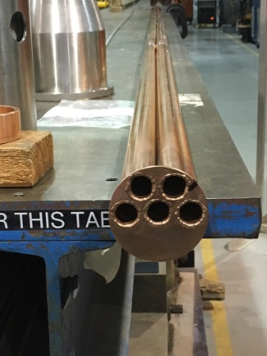
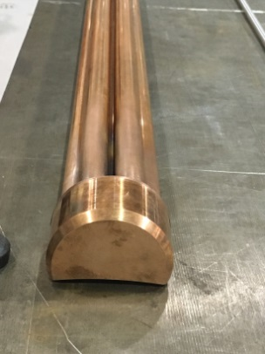
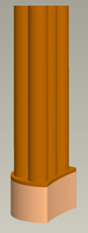
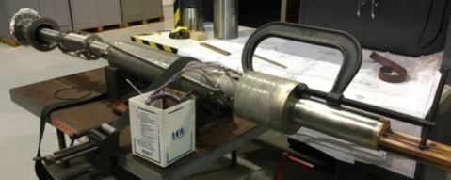
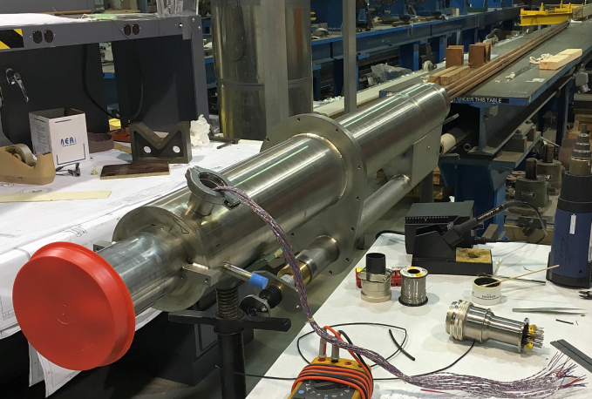
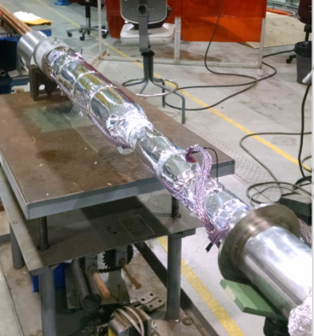
2K Heat Exchanger Assembly
ASSEMBLY COMPLETE
top hx end
bottom hx end

