Slide 1
QXF Design
G. Ambrosio
LARP Magnet System L2
DOE Review of LARP
FNAL, July 13th – 15th, 2016

Slide 2
Outline
Overview of MQXF design
Strand and insulated cable
Coil design, magnetic analysis, magnet parameters
Support structure and mechanical analysis
Cold Mass
Quench protection & Cooling

Slide 3
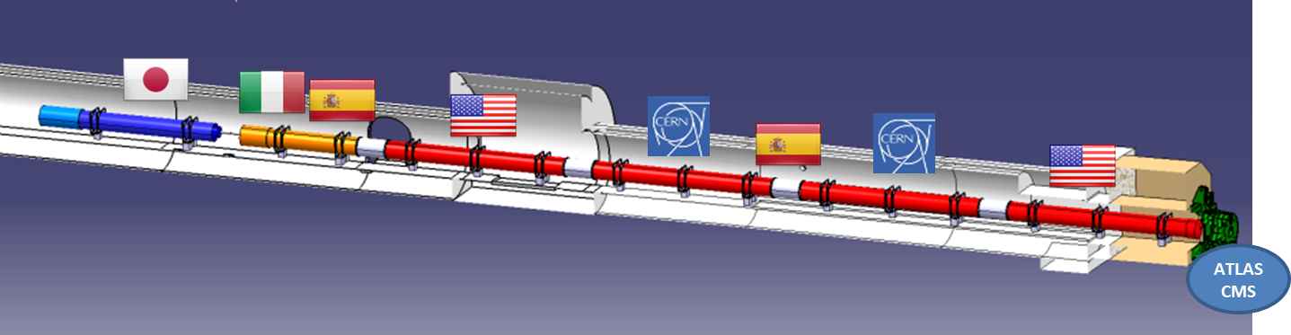
US Contribution to HL-LHC Inner Triplets
Baseline plan:
Q1/Q3 cold masses by US (LMQXFA)
  magnetic length: 4.2 + 4.2 m (MQXFA)
Q2 cold masses by CERN
  magnetic length: 7.15 m (MQXFB)
All cryostats and integration by CERN
Part of plan under discussion:
Q1/Q3 Cryostats assembled in the US
  Cryostat parts provided by CERN (kit)
US cold mass

Slide 4
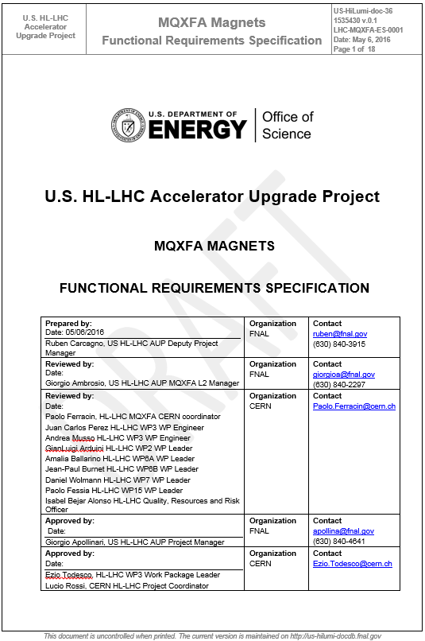
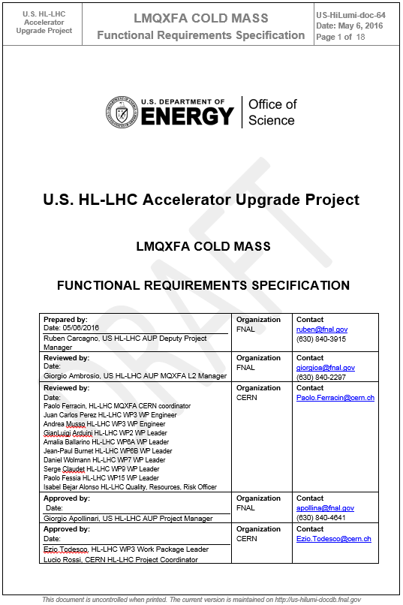
Requirements
MQXF (magnet) requirements
  Complete, out for signatures
LMQXF (cold mass) requirements in progress
  Cold mass & cryostat designs in progress

Slide 5
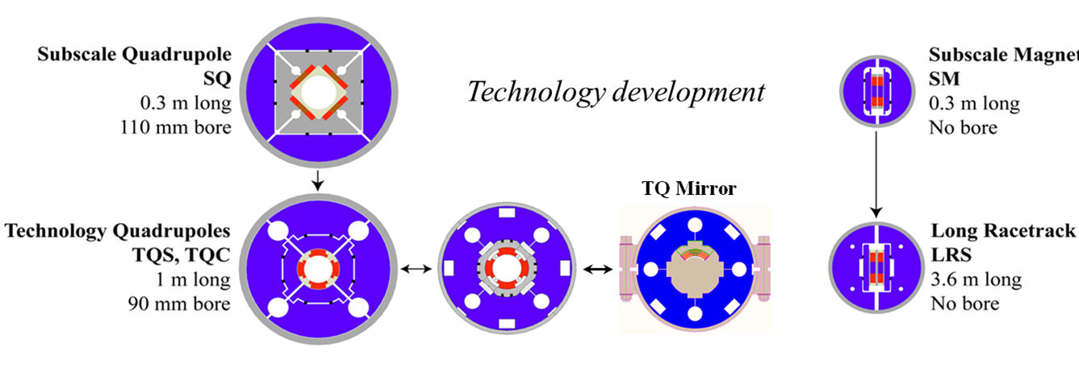
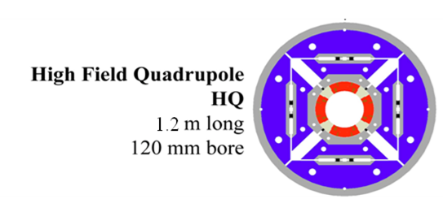
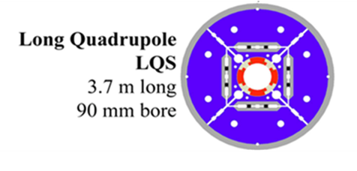
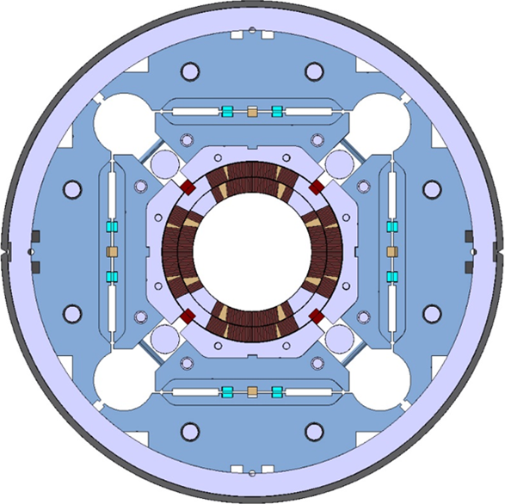
MQXF Design based on LARP Development
2003
Technology Development
Coil design selection
Structure selection
Lessons learned
2015
Long quadrupoles
Large aperture quadrupoles

Slide 6
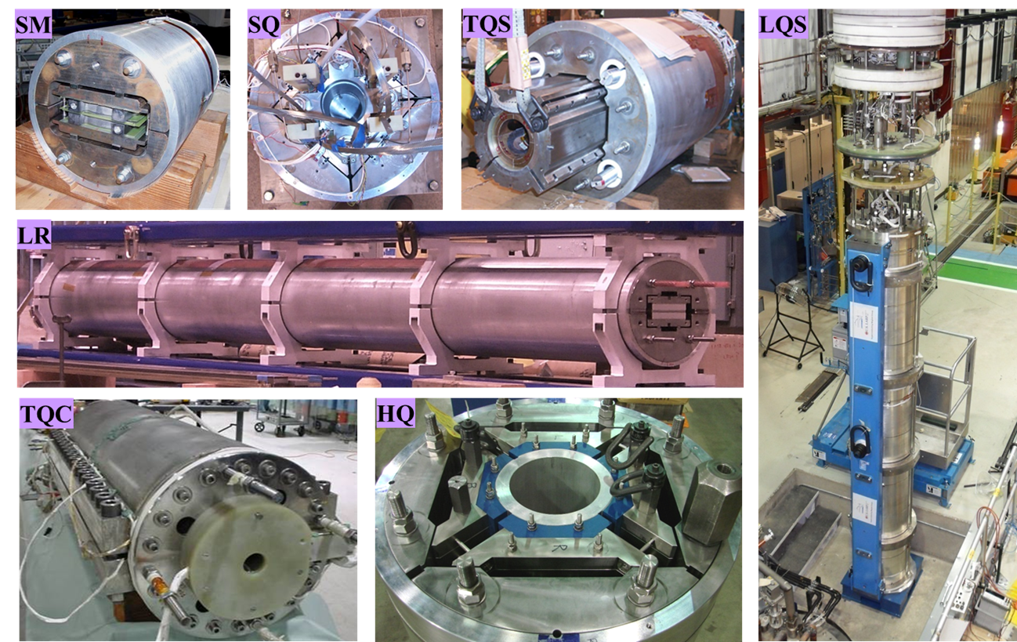
LARP Magnets Zoo

Slide 7
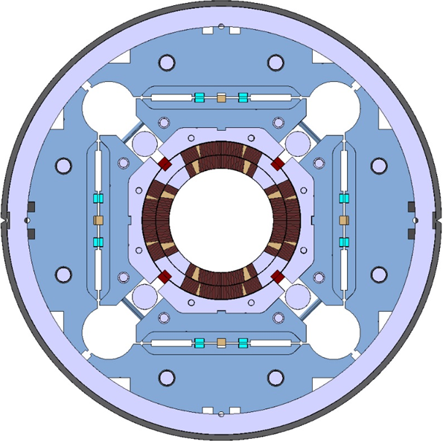
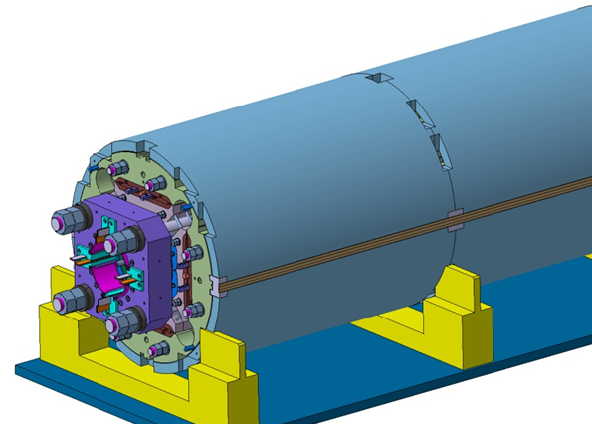
MQXFA/B Main Parameters
Parameter | Unit | MQXFA/B
Coil aperture | mm | 150
Magnetic length | m | 4.2/7.15
N. of layers |  | 2
N. of turns Inner-Outer layer |  | 22-28
Operation temperature | K | 1.9
Nominal gradient | T/m | 132.6
Nominal current | kA | 16.5
Peak field at nom. current | T | 11.4
Stored energy at nom. curr. | MJ/m | 1.2
Diff. inductance | mH/m | 8.2
Strand diameter | mm | 0.85
Strand number |  | 40
Cable width | mm | 18.15
Cable mid thickness | mm | 1.525
Keystone angle |  | 0.4
G. Ambrosio et al., “MQXFS1 Quadrupole Design Report” LARP DocDB 1074

Slide 8
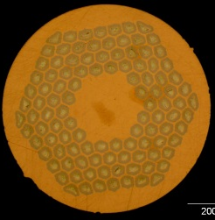
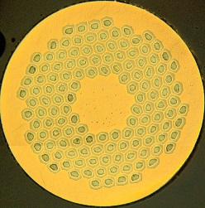
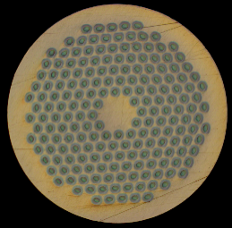
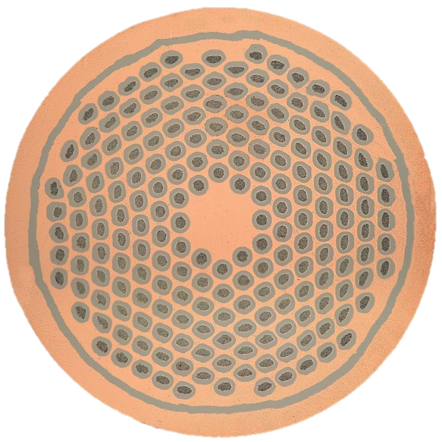
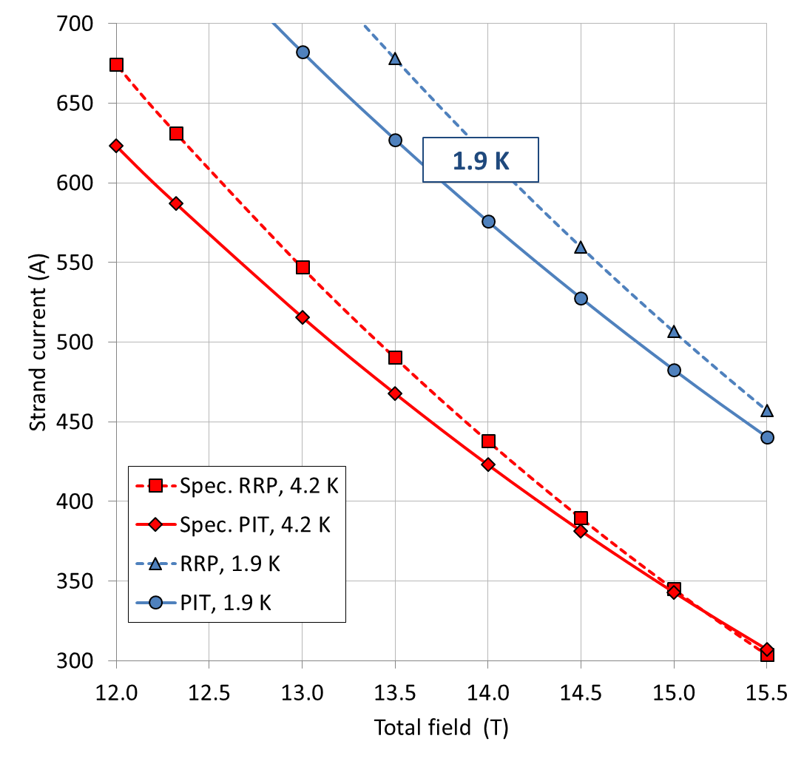
Superconducting Strand
OST-RRP 108-127
EAS-PIT 192
0.85 mm strand,
Specifications:
  Ic at 4.2 K:
    632 A (2450 A/mm²) at 12 T
    331 A (1280 A/mm²) at 15 T
  Cu/SC: 1.2 +/- 0.1
  RRR > 150
  Filament ∅ ≤ 55 µm
LARP prototype program
  OST RRP 108/127
CERN prototype program
  OST RRP 108/127
  EAS Bruker PIT 192

Slide 9
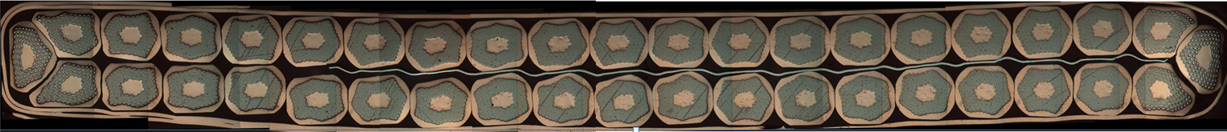
Superconducting Cable
40-strand cable
Mid-thickness after cabling
  1.525 +/- 0.010 mm
Width after cabling
  18.150 +/- 0.050 mm
Keystone angle
  0.40 +/- 0.10 deg.
Pitch length
  109 mm
SS core 12 mm x 25 μm thick
Assumed expansion during reaction
  4.5% in thickness: ~70 μm
    same keystone angle
  1.2 % in width: ~210 μm
Mid–thickness after reaction
  1.594 mm
Width after reaction
  18.363 mm
70 μm
210 μm
Cable Insulation: S2-glass with silane sizing
Thickness: 145 ±5 μm at 5 MPa
Cable cross-section with SS core

Slide 10
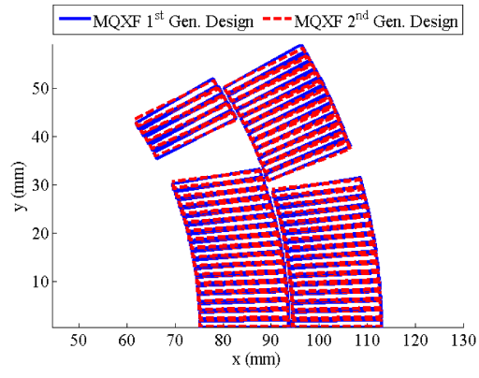
From 1st to 2nd generation
Coil design fine-tuning
Final cable geometry
  Smaller keystone angle (0.55° ➔ 0.40°)
  Smaller width after reaction (2% ➔ 1.2 %)
Reduced space for coil azimuthal growth
Corrected the impact of coil mechanical deformation
Optimized harmonics at 123 T/m
  Operational current will be between 90% and 100% of nominal, depending on the LHC final energy
Compensated end effects on the integrated harmonics
Added S2-glass shims on mid-plane and pole

Slide 11
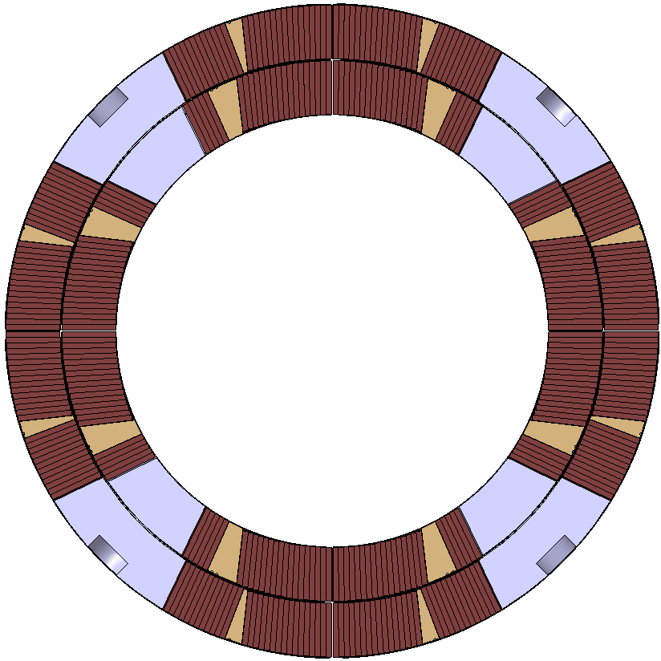
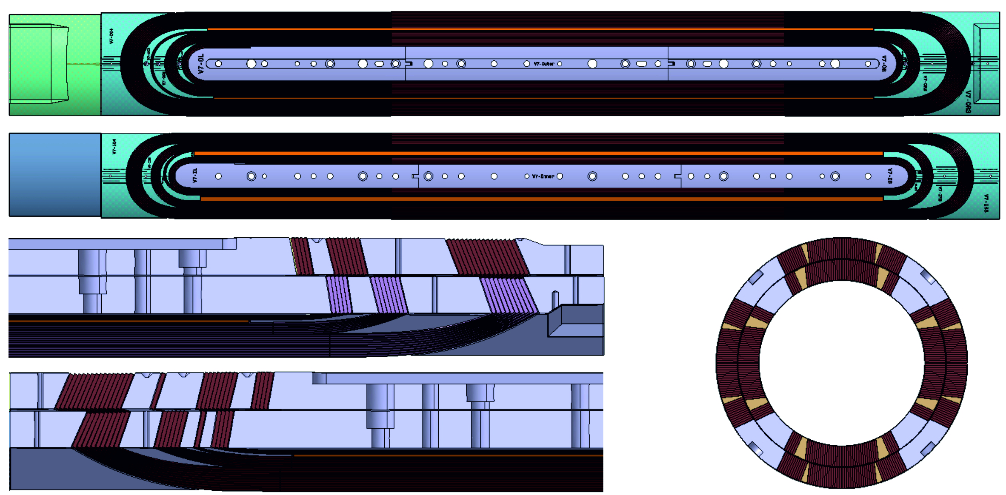
Coil Design
Two-layers, four-blocks design
22+28 = 50 turns
No inter-layer splice
Pole impregnated with the coil
2 end spacers for peak field reduction (1%) and field quality
Very similar to HQ (120 mm) design
150 mm
Short model coils

Slide 12
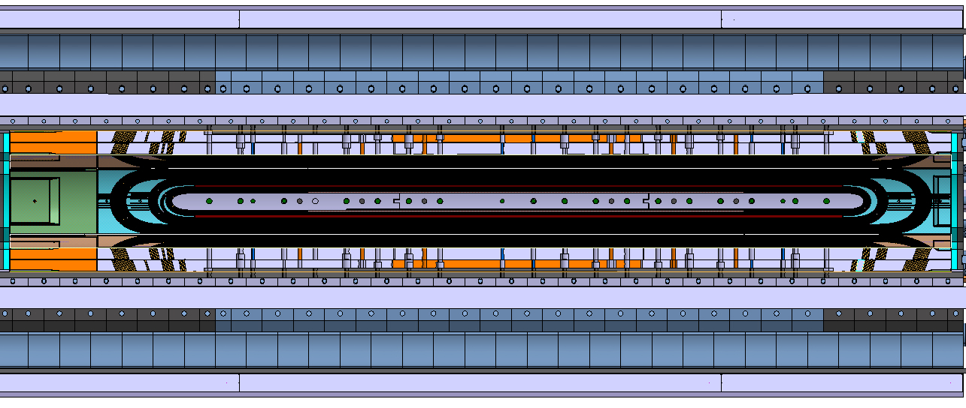
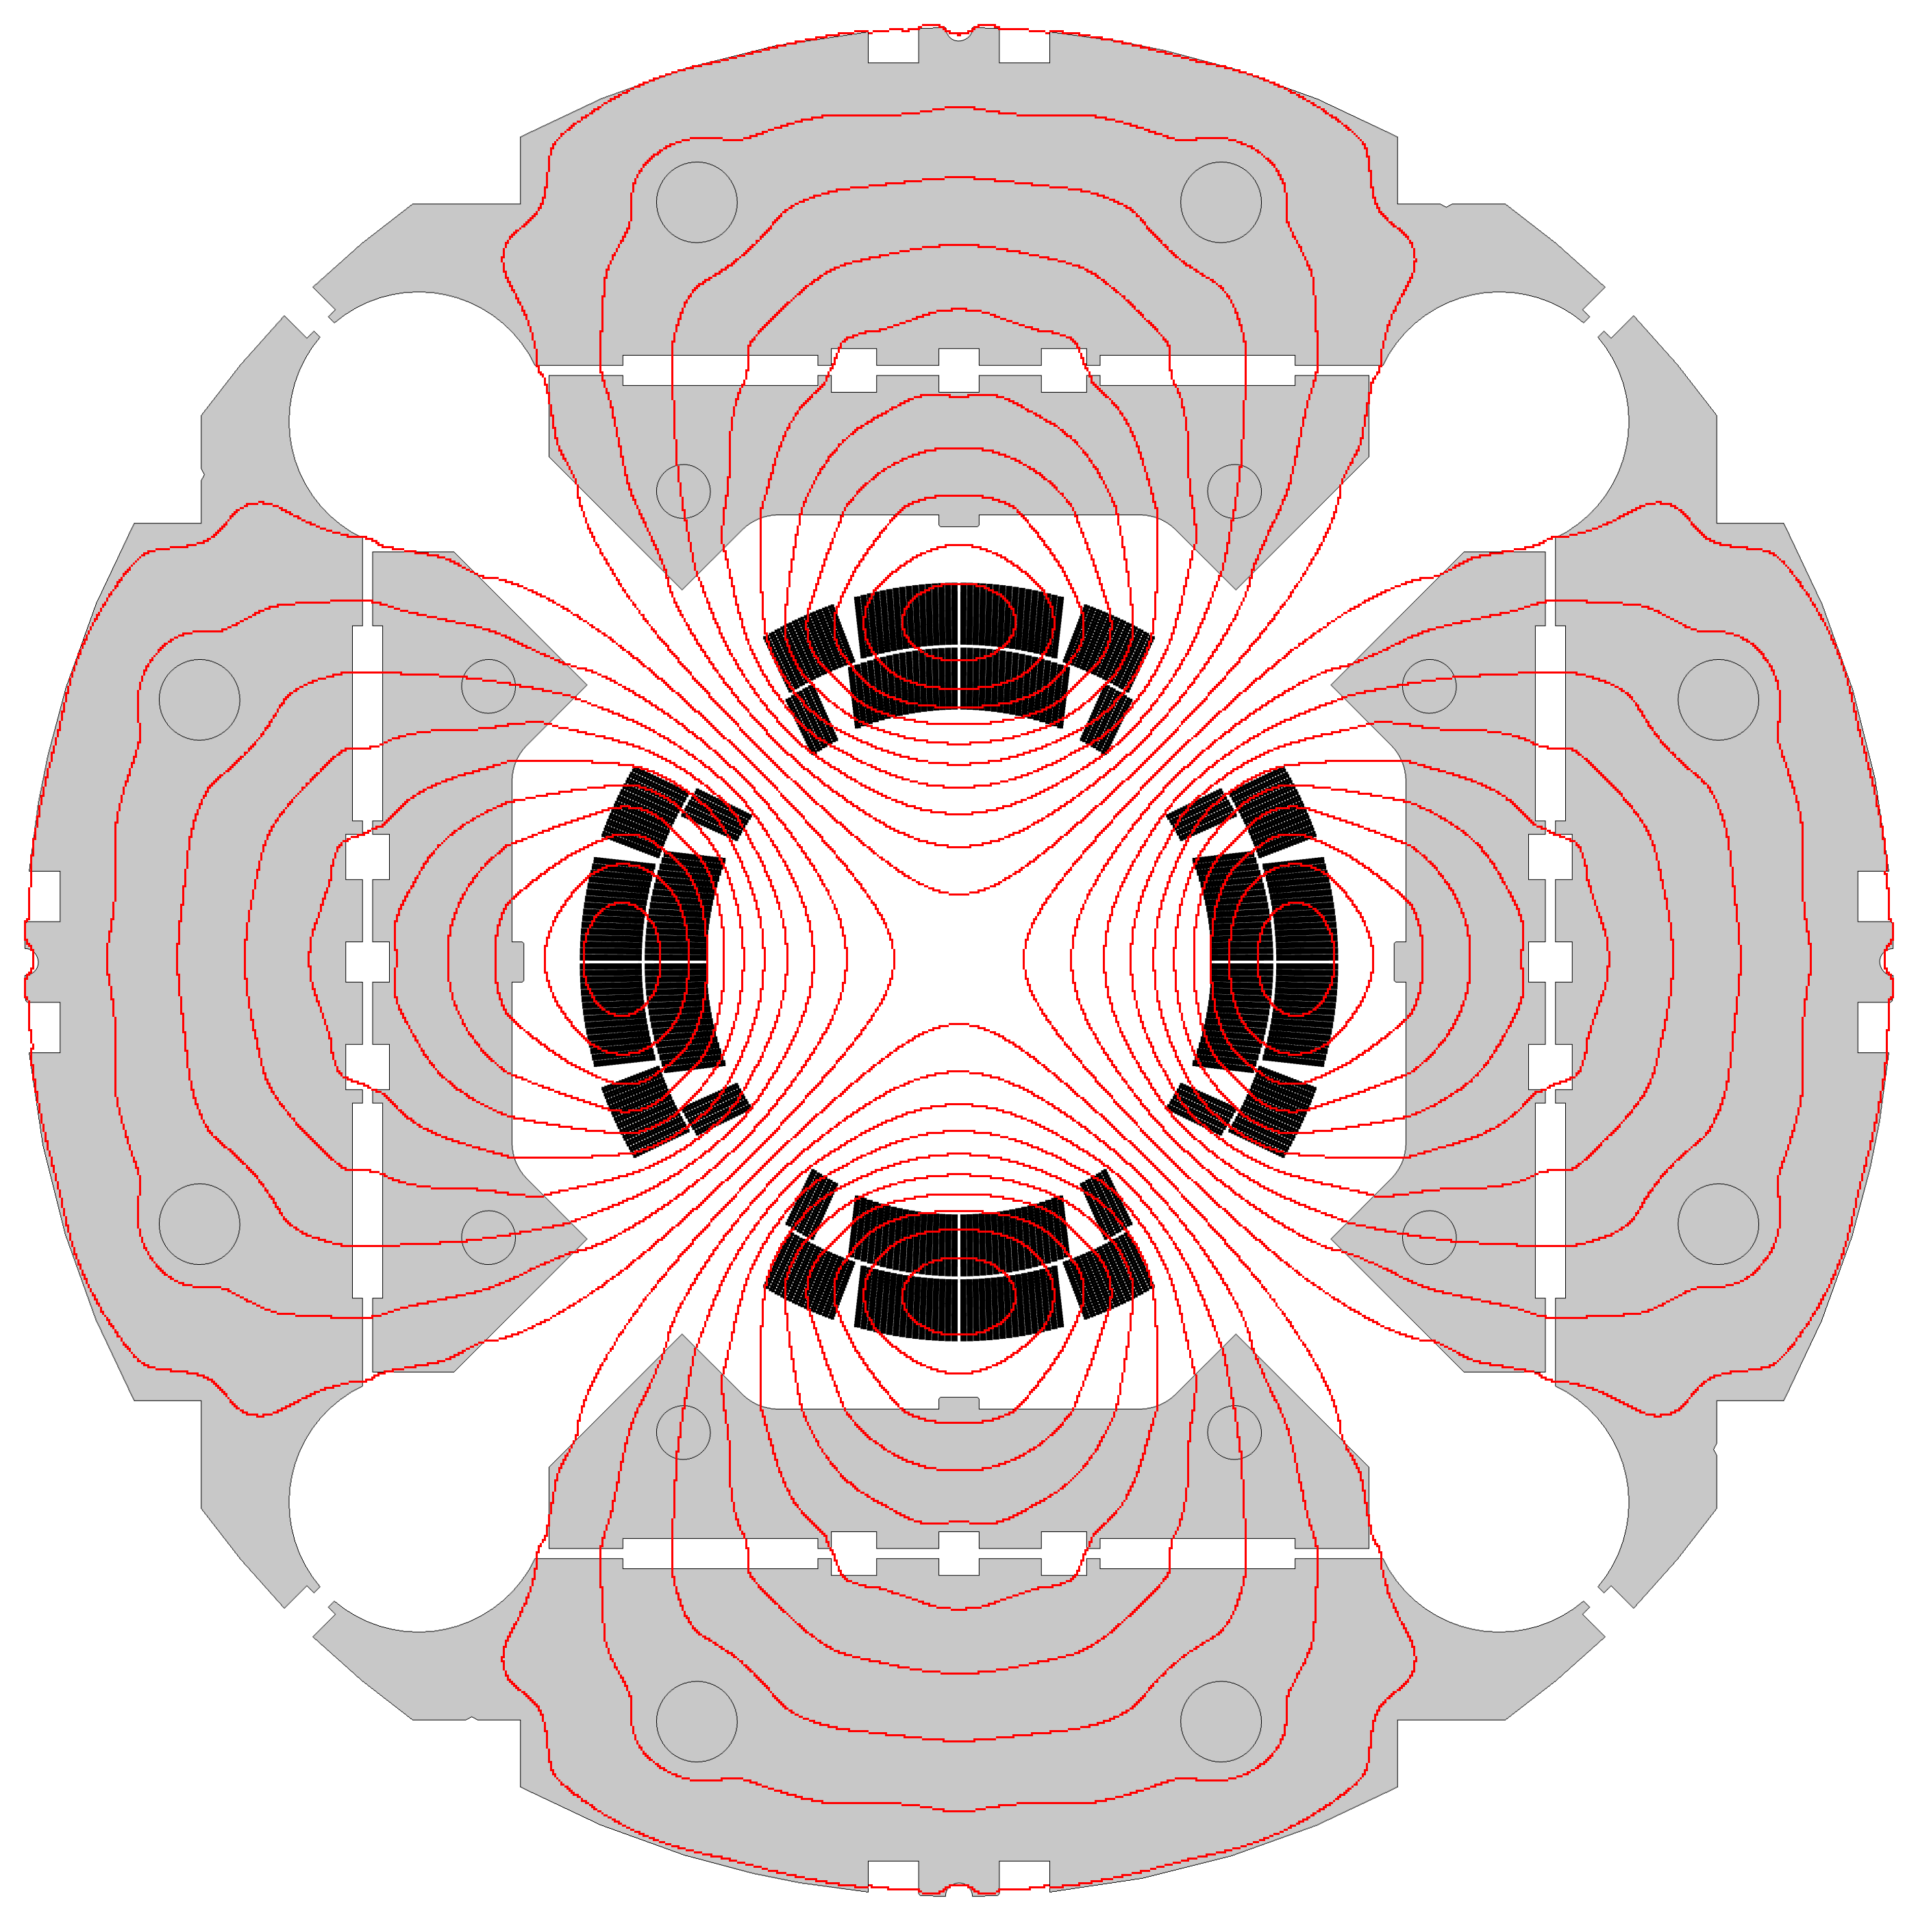
Magnetic Design
Coil longitudinal section showing
Coil blocks and end spacers
Allowed harmonics below 1 units
  Confirmed by measurements
6 blocks in the ends
  Minimized integrated harmonics
  1% lower peak field in the ends wrt straight section
    Non-magnetic pads in the ends
Iron pads
Iron yoke
Short model longitudinal section

Slide 13
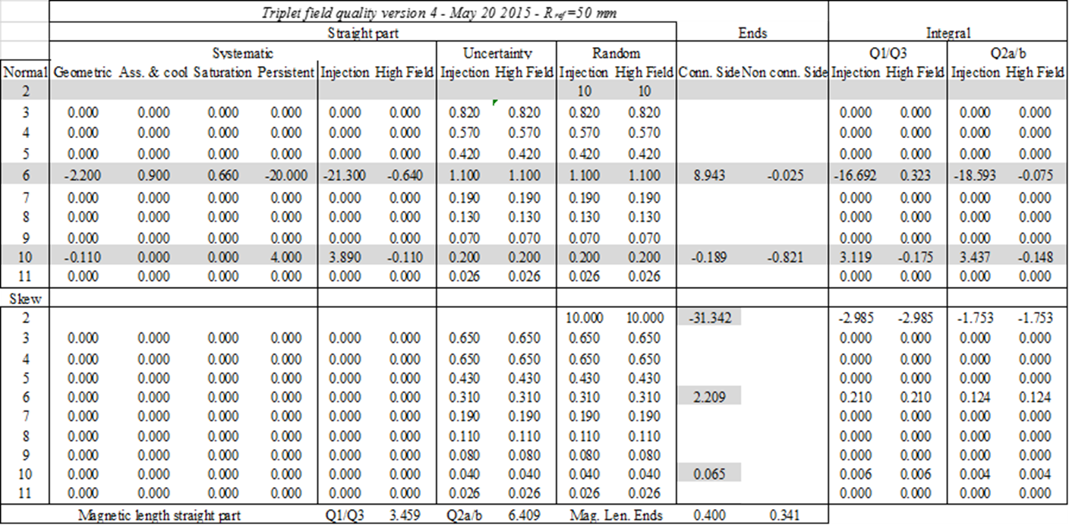
Magnetic Analysis & F.Q. Targets

Slide 14
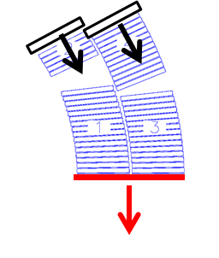
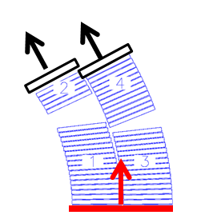
Magnetic analysis
Corrective strategies
Allowed harmonics
  Pole/mid-plane shims (S2-glass)
Un-allowed harmonics
  Magnetic shims (iron)

Slide 15
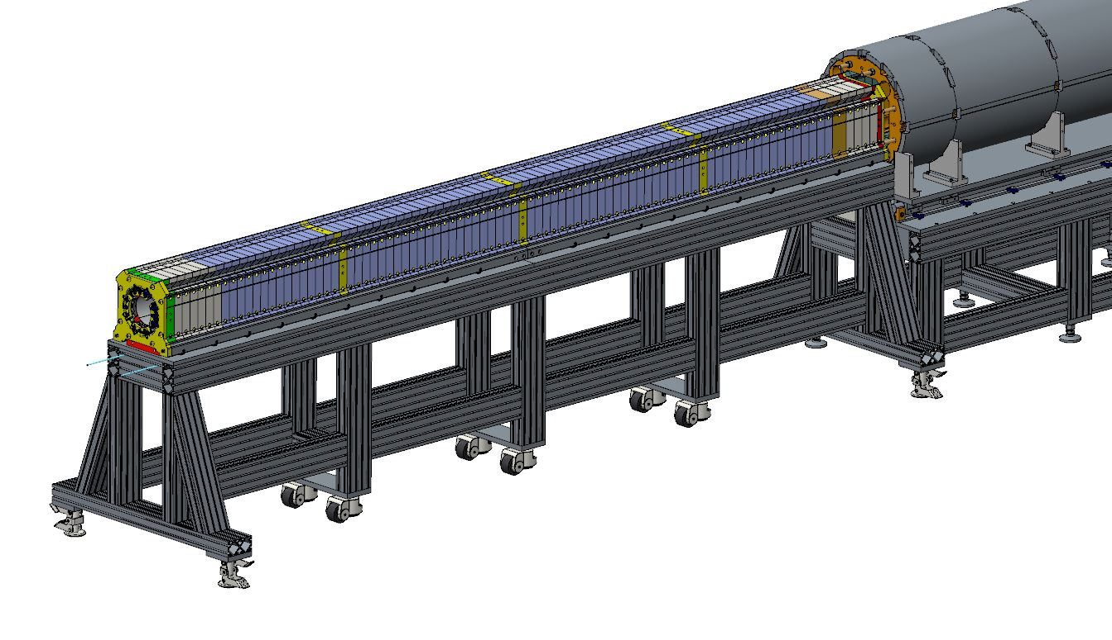
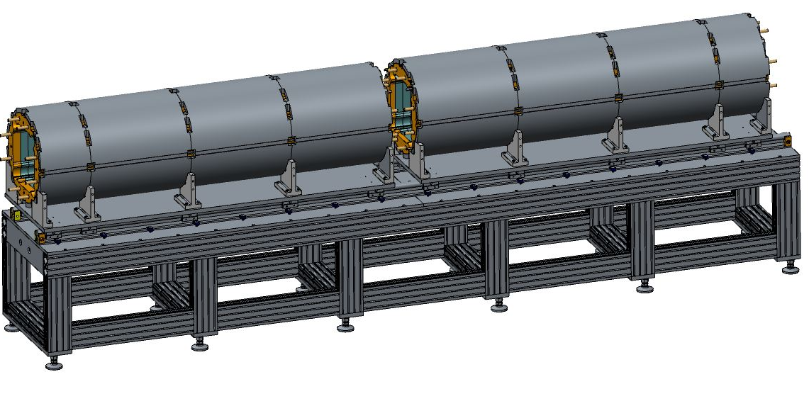
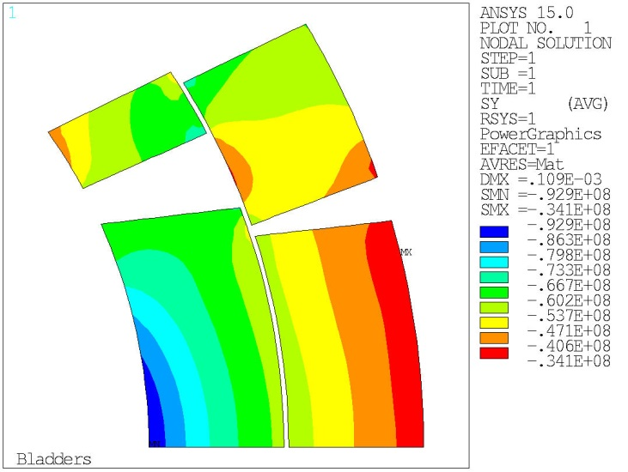
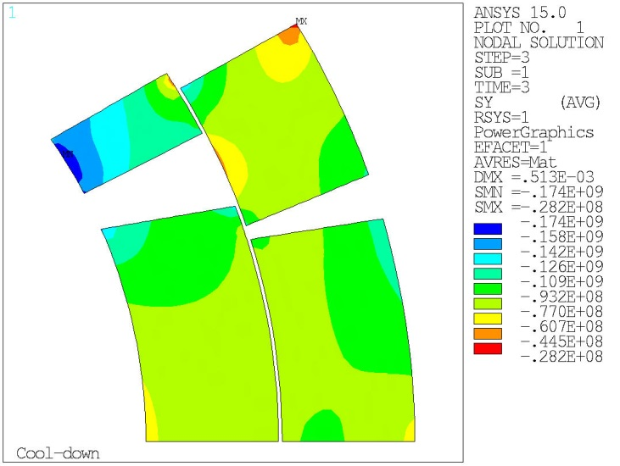
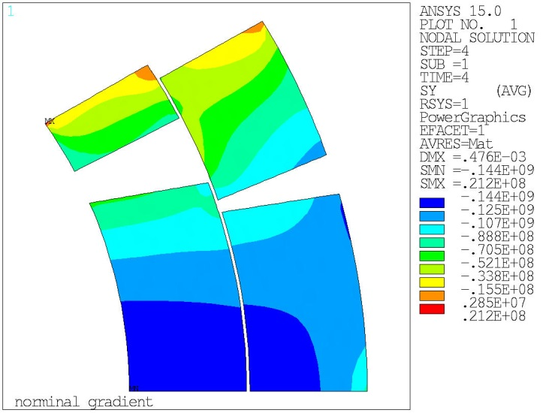
Magnet assembly and pre-loading
Shell-yoke modules combined
Insertion of coil-pack sub-assembly
Then bladder operation
Coil peak azimuthal stress:
Max bladders: -90 MPa
After cooldown: -160 MPa
Nominal gradient: -140 MPa
Bladder operation at 300 K
Cooldown to 1.9 K
F_mag at I nominal

Slide 16
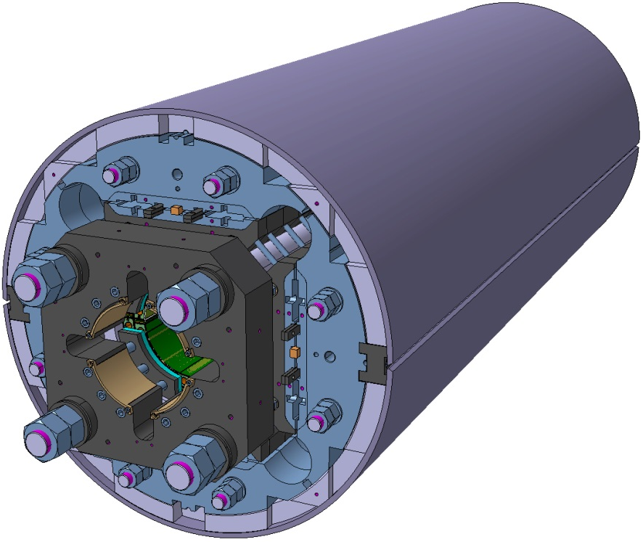
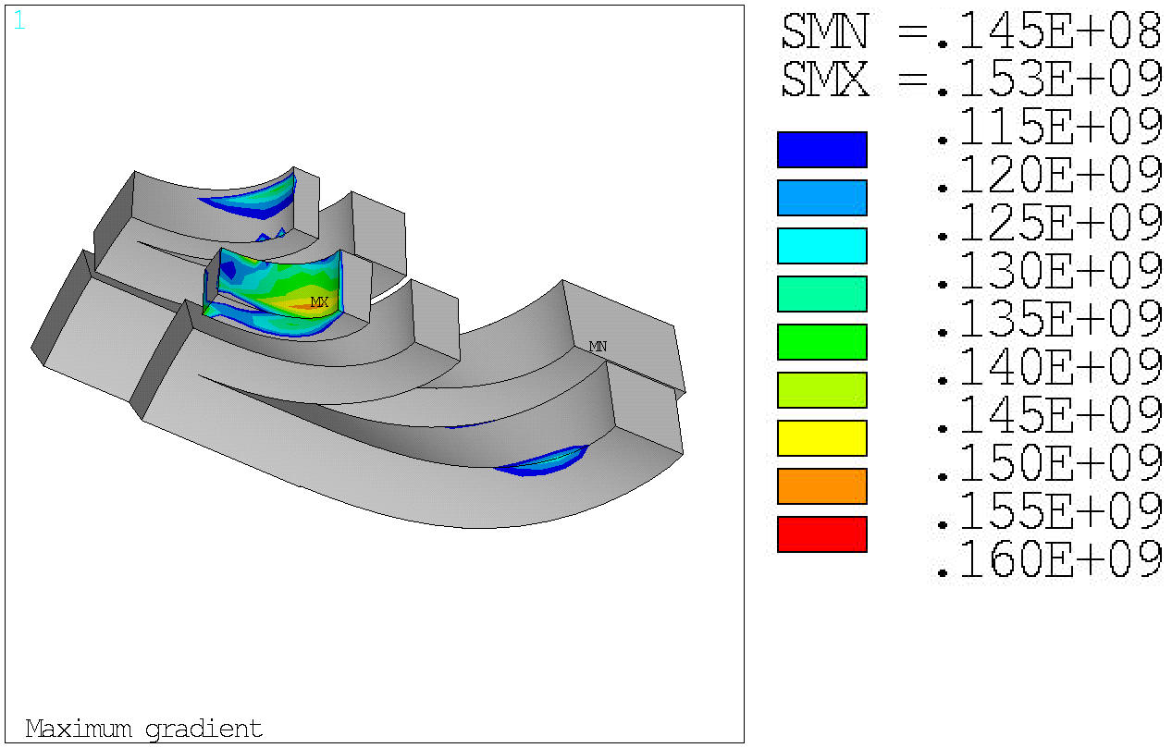
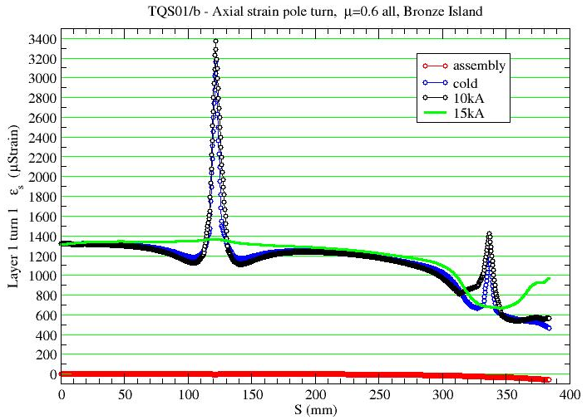
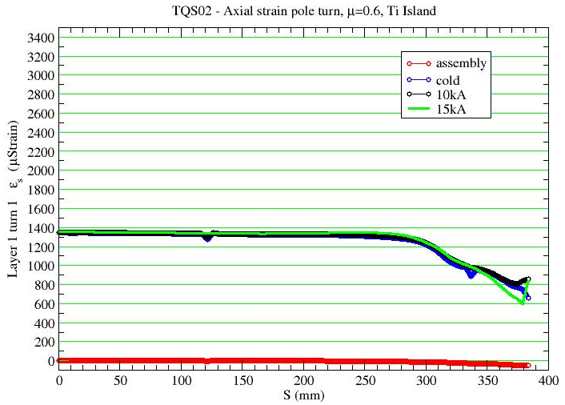
Axial Loading and Axial Strain
Axial preload:
SS rods free to contract
Possible to maintain coil – end-parts contact pressure
MQXF axial strain: <1600 με
OK based on TQ study w different materials

Slide 17
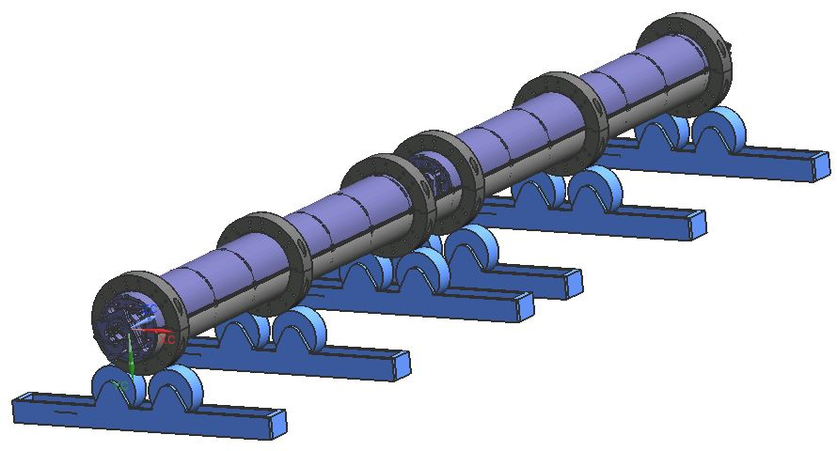
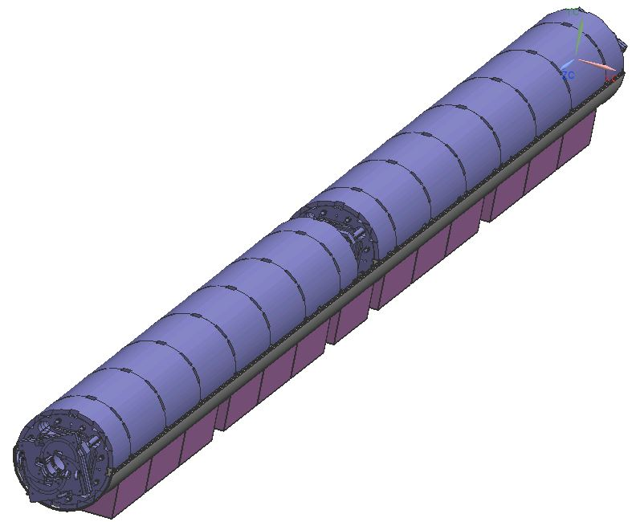
Cold Mass (LMQXFA)
Based on CERN design
Helium vessel by welding two half SS shells
Shell cut-outs to align magnet during module assembly and tack welding process
Stainless steel shell welded with 50-100 MPa tension (in contact after cool-down)
Alignment verification by magn. meas.

Slide 18
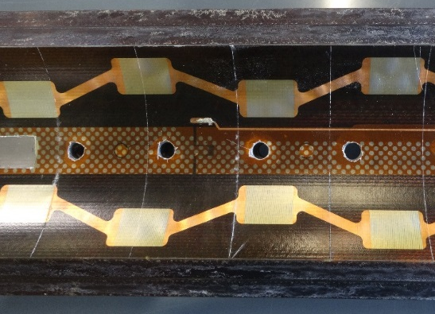
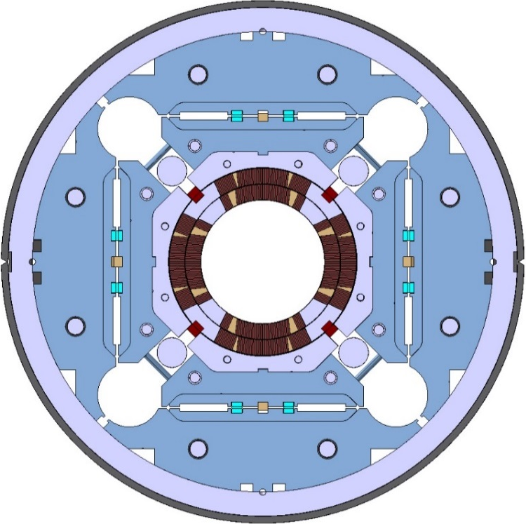
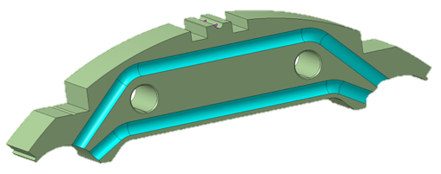
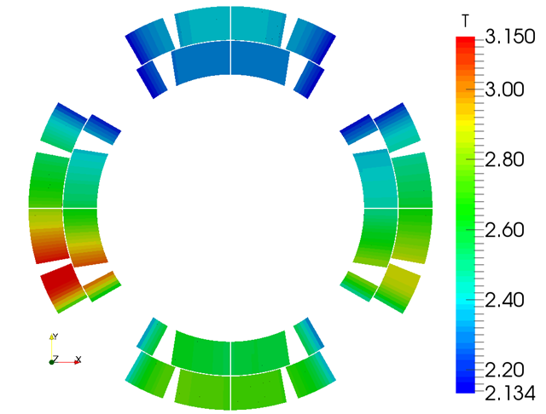
Cooling & Rad Hardness
W beam screen in Q1
W beam screen reduces heat load and dose to LHC levels
Requirements & Design Features:
  All materials OK up to 30 MGy
  Perforated inner layer trace (40%)
  77 mm heat exchanger holes
    Top for bus-bars, bottom for cooling
  Pole: 8 mm holes every 50 mm
    Same in the pole key
  Clear path around axial rods
  Cross-talk channels in the yoke
    8 mm diameter, every ~700 mm
  Free helium section of 150 cm²
Coil temperature map
in operating condition

Slide 19
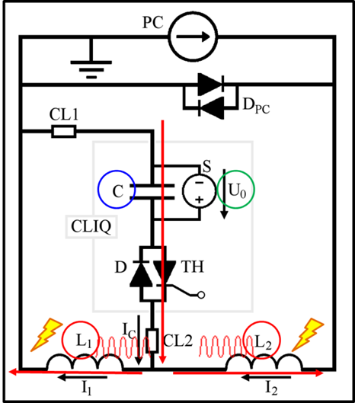
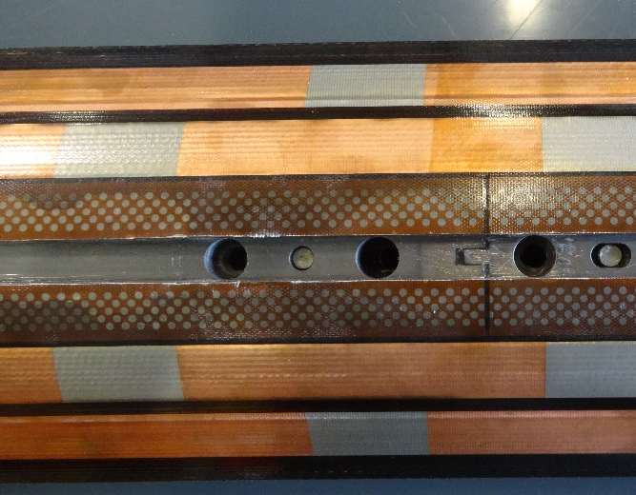

Quench protection
Requirements:
  Hot-spot temperature < 350 K
  High Voltage tests RT/1.9K: Coil-Ground 3/1.5 kV; Heaters-Coil 3/2.3 kV
  Compatibility with CERN QP system
Challenge: 1.5 times energy density of LHC MB
No dump (only 5% of energy, due to high inductance)
Outer layer QH: ~350 K reached (failure scenarios)
For peak Temp reduction and additional redundancy
  Inner layer QH: Cooling and detachment issues
  CLIQ (Coupling-Loss-Induced-Quench) system
    Tested on HQ and MB

Slide 20
Conclusions
The design of the MQXF magnets is complete and meets all requirements (on paper)
  QP final configuration is TDB
The MQXF design is based on past LARP magnets (HQ and LQ) and on technologies and procedures developed by LARP
LARP has a leading role in demonstrating the scale-up through the prototypes
The design of the cold mass is in progress, and is based on CERN design ➔ addressing cryostat interfaces

Slide 21
Back up Slides

Slide 22
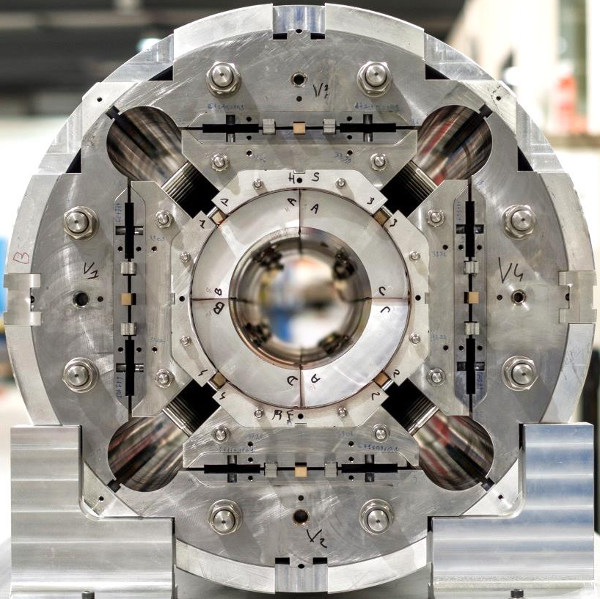
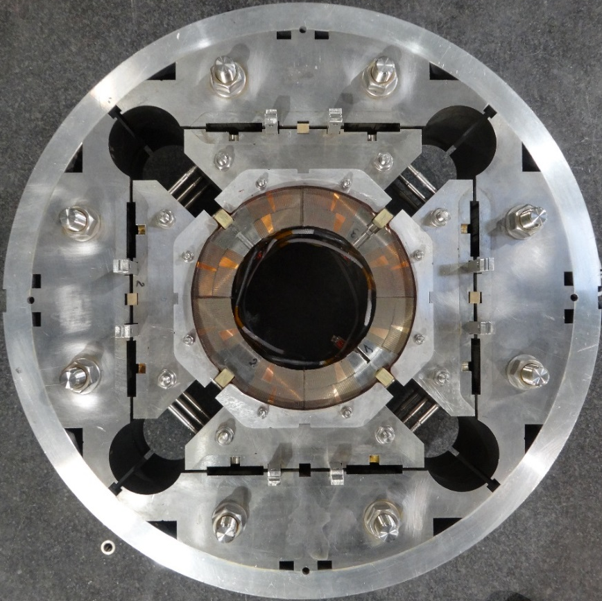
Overview of MQXF design

Slide 23
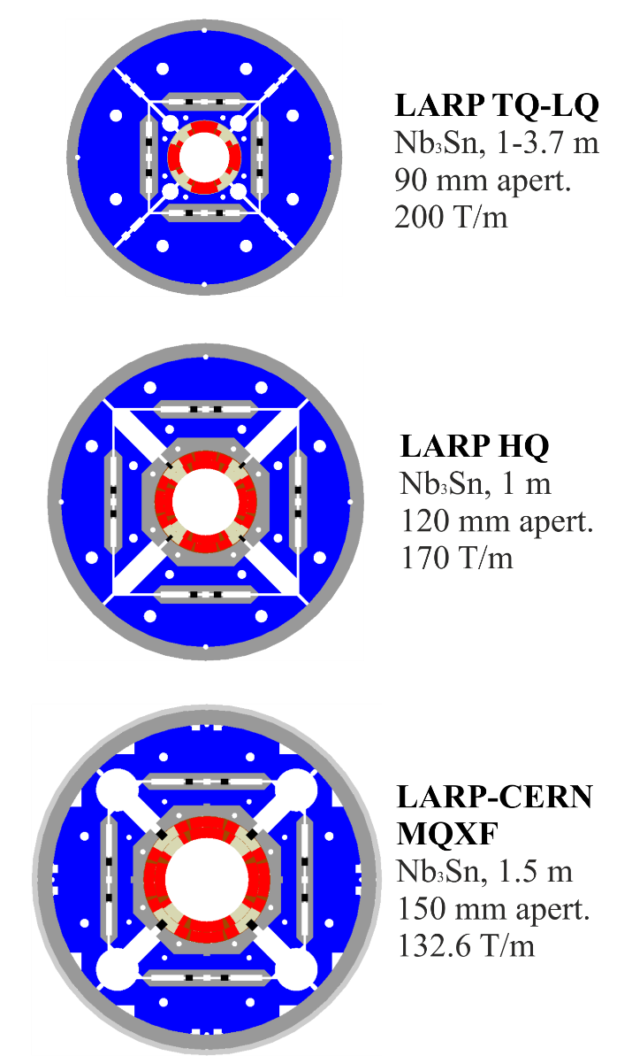
Overview of MQXF design
LARP
LHC Accelerator Research Program (since 2003)
  R&D on Nb₃Sn quadrupoles for LHC luminosity upgrade
From TQ/LQ series to MQXF
  From 90 to 150 mm
MQXF scale-up of HQ
  Similar coil lay-out
  Same structure concept
  Successfully tested

Slide 24
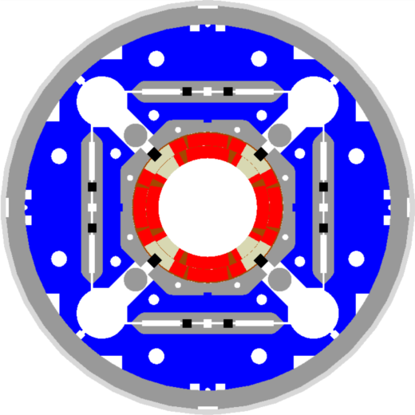
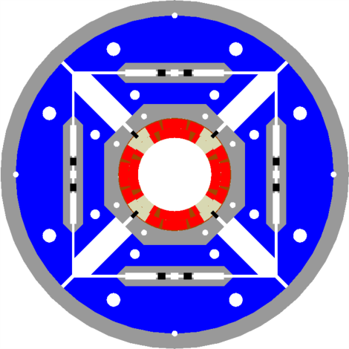
Overview of MQXF design
From HQ to MQXF
Aperture from 120 mm to 150 mm
  Strand increased from 0.778 mm to 0.85 mm
  Cable from 15 to 18 mm width (similar stress with +30% forces)
Same coil lay-out
Same structure concept
  Pre-load capabilities of HQ design qualified and successfully tested
Larger OD: from 570 to 630 mm
Additional accelerator features
HQ
MQXF

Slide 25
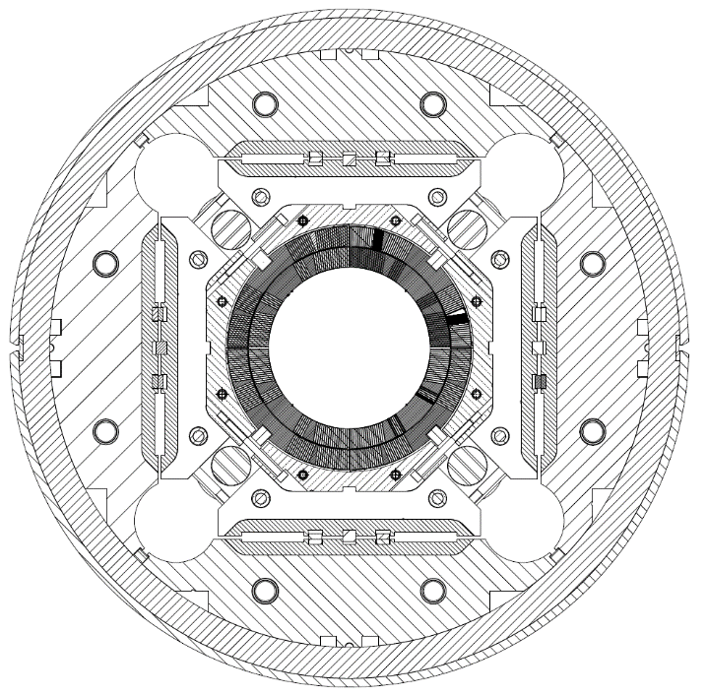
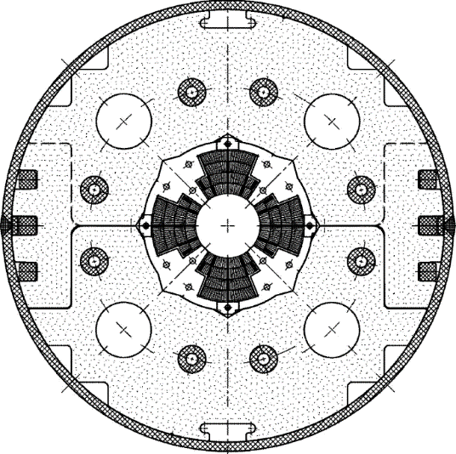
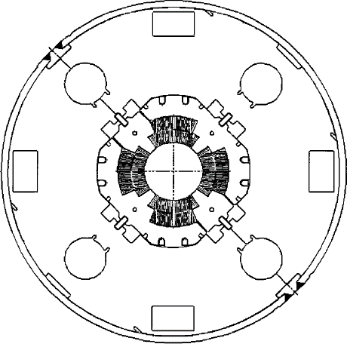
Overview of MQXF design
LHC low-β quadrupole support structures
Cold mass OD from 490/420 to 630 mm
More than double the aperture: from 70 to 150 mm
~4 times the e.m. forces in straight section
~6 times the e.m. forces in the ends
MQXA
MQXB
MQXF
In scale

Slide 26
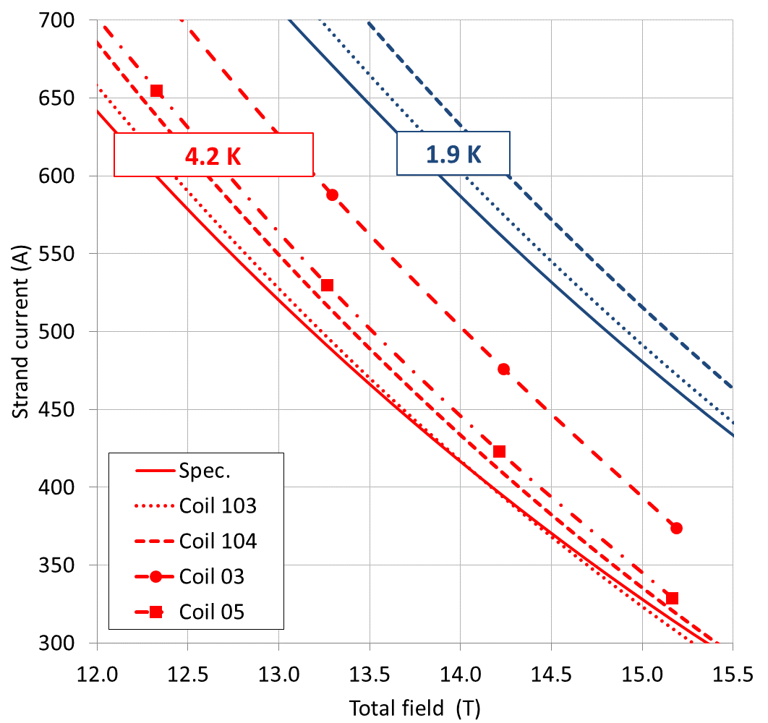
Superconducting Strand
The MQXF1 case: all coils within specs.

Slide 27



Coil design
Coated parts with cuts
Image analysis of cable contours
  Good fit of end-spacers
  But, up to 0.5 mm azimuthal and radial shift in straight section
Space for expansion reduced for 2nd generation coils
  From 2 to 1% on width
  Assumed ins. thickness in Roxie from 150 to 145 μm

Slide 28
From 1st to 2nd generation
Insulated cable design
Keystone angle reduced from 0.55° to 0.40°
  Critical current degradation due to cabling reduced to <5% both for RRP and PIT
Assumed width expansion
  From 2% to 1.2 % → increased coil compaction
Thickness of insulation
  From 0.150 to 145 µm → increased coil compaction

Slide 29

Magnet parameters
Self field corr. (ITER barrel)
5% cabling degradation
G_{op}= 132.6 T/m
  I_{op}: 16.47 kA
  B_{peak_op}: 11.4 T
RRP: 78%of I_{ss} at 1.9 K
PIT: 79% of I_{ss} at 1.9 K
Stored energy: 1.2 MJ/m
Inductance: 8.2 mH/m

Slide 30

Mechanical analysis
See G. Vallone
Shell force shared by collars and key at room T
25% intercepted at 1.9 K
Coil compressed at G_{op}
  Alignment maintained
Coil peak azimuth. Stress:
-90 MPa
-160 MPa
-140 MPa

