Slide 1
All Experimenters’ Meeting
Daniel Johnson
Accelerator Complex Status
20 June 2016

Slide 2
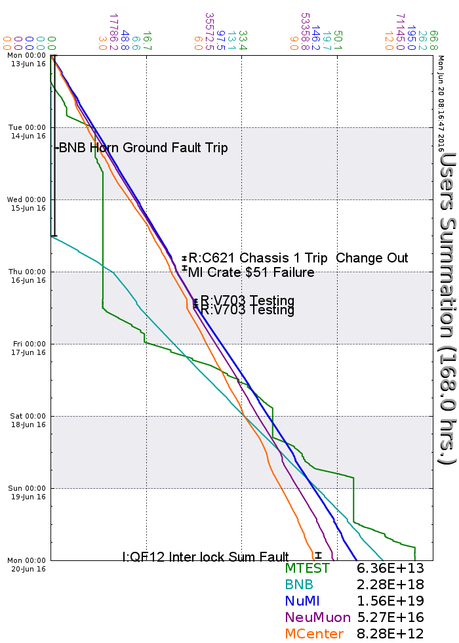
Accelerator Operations Summary
From: June 13, 2016 (0000 hours)
To: June 20, 2016 (0000 hours)
Calendar Week # 24
NuMI Weekly Integrated Intensity 1.56 E19 protons
Beam Hours To NuMI 158.4 hours
BNB Weekly Integrated Intensity 2.17 E18 protons
Beam Hours To BNB 103.9 hours
NMuon Weekly Integrated Intensity 5.26 E16 protons
Beam Hours To NMuon 157.4 hours
MTest Weekly Integrated Intensity 6.29 E13 protons
Beam Hours To MTest 55.6 hours
MCenter Weekly Integrated Intensity 7.90 E12 protons
Beam Hours To MCenter 159.7 hours

Slide 3
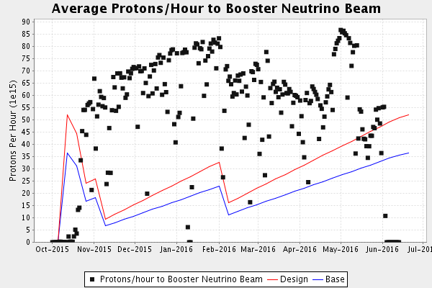
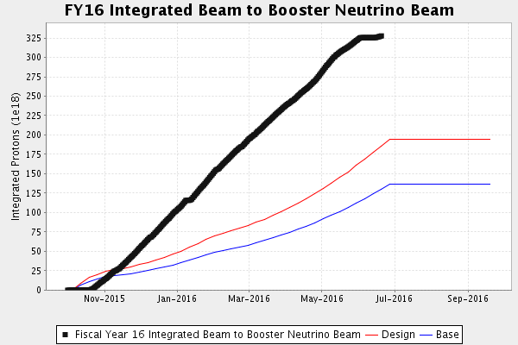
Performance measures: BNB

Slide 4
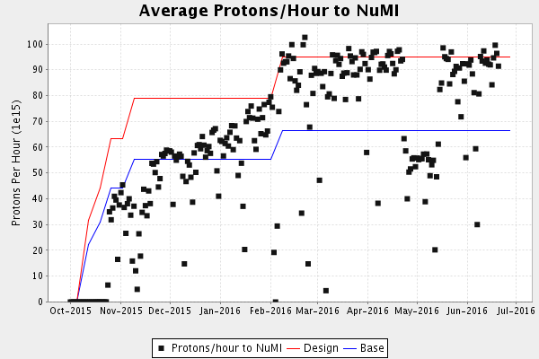
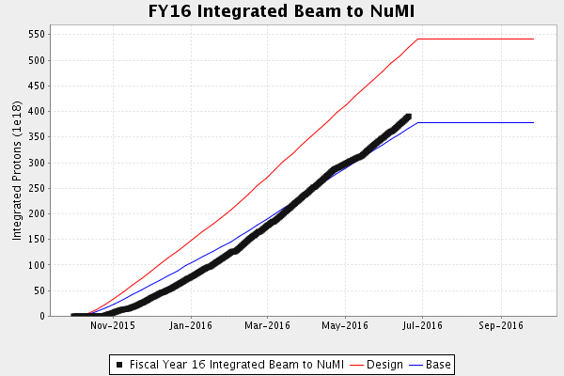
Performance measures: NuMI

Slide 5
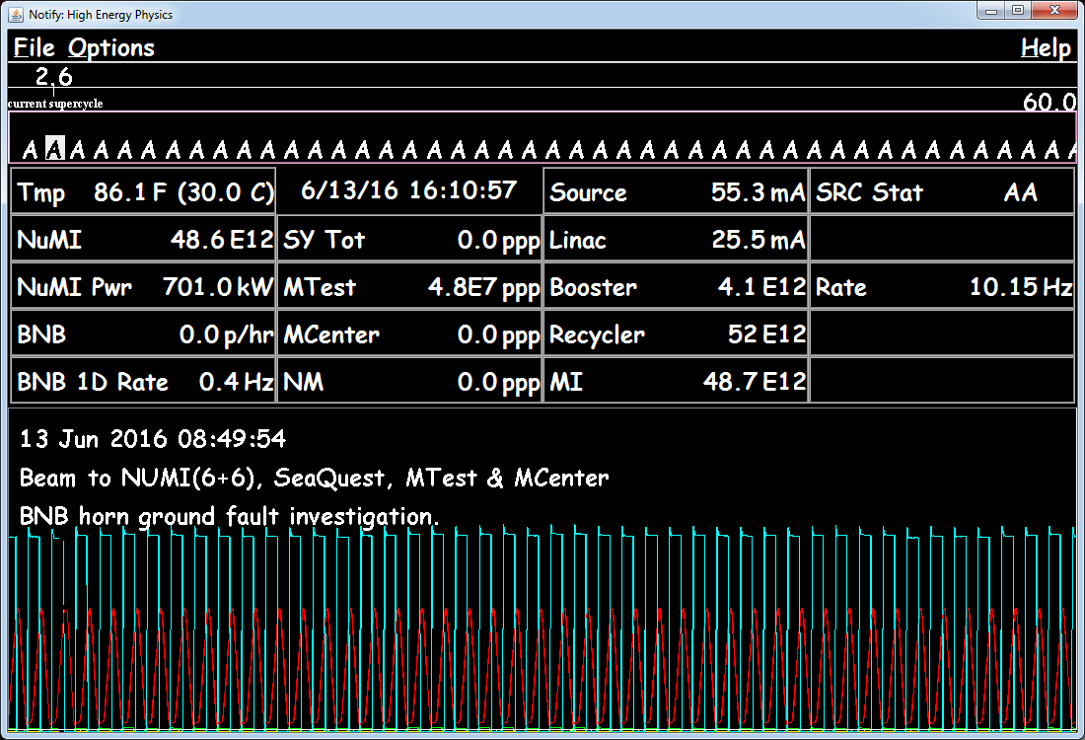
NuMI Internal Goal – 700kW

Slide 6
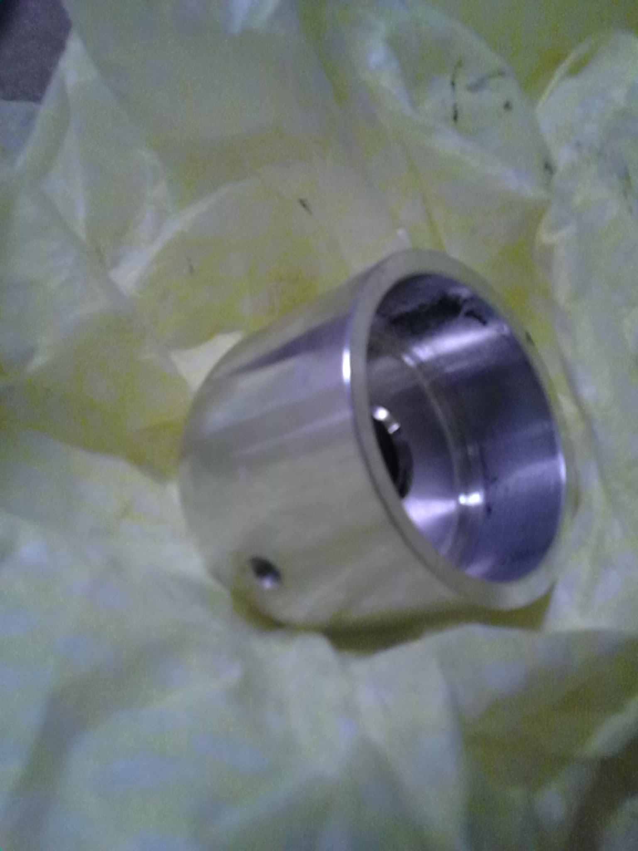
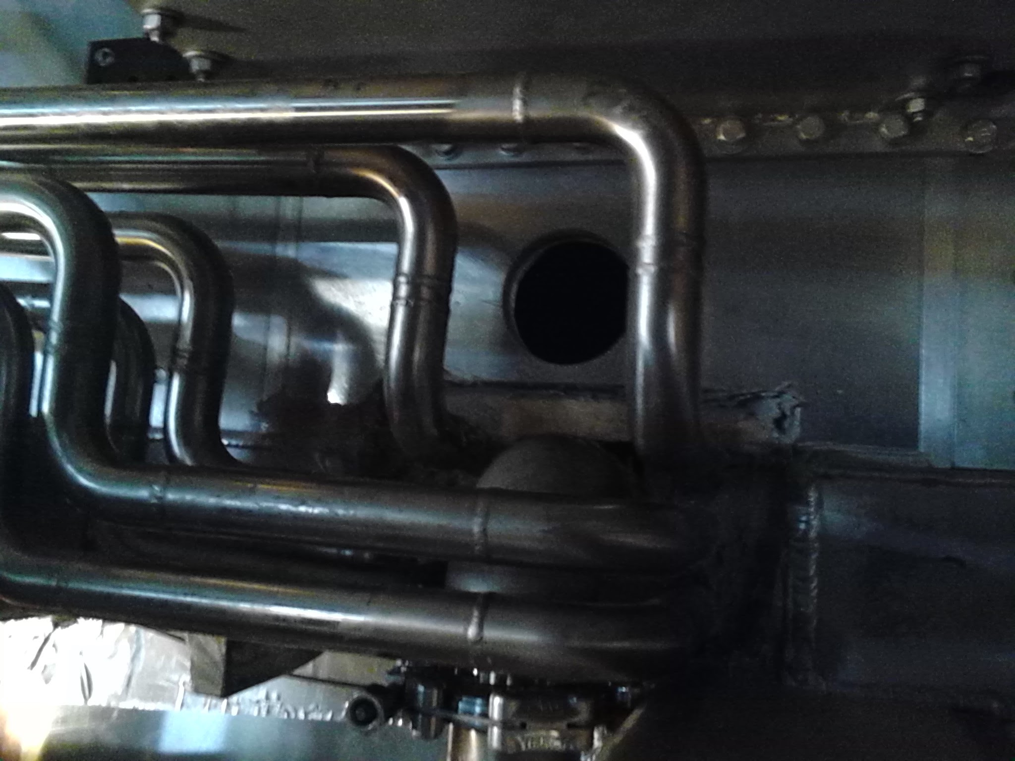
BNB Horn Repair

Slide 7
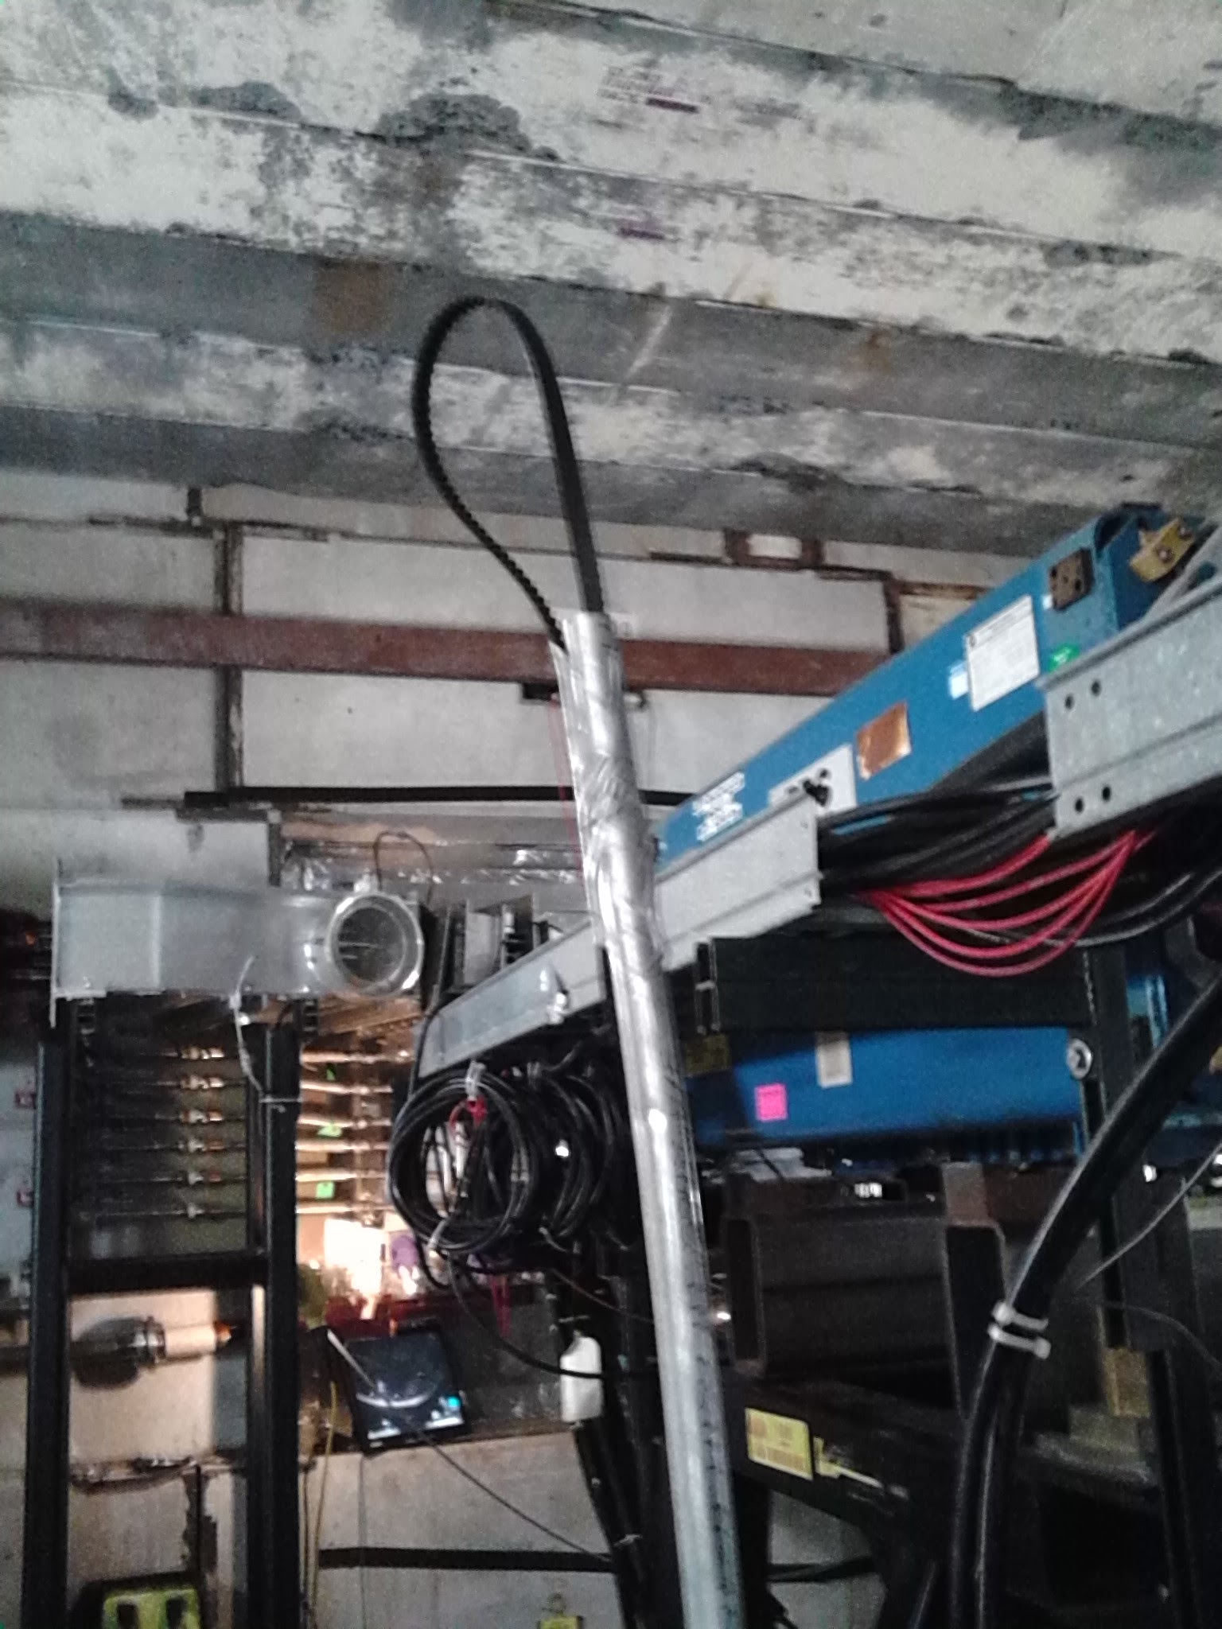
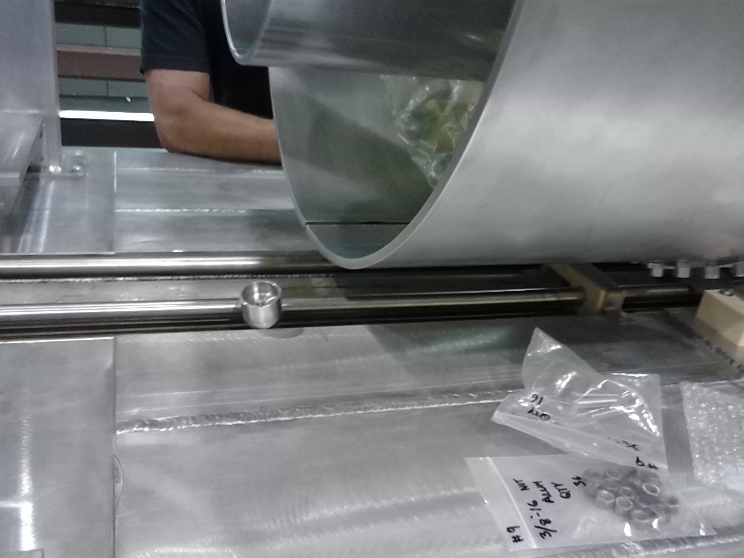
BNB Horn Repair

Slide 8
Complex Status
LINAC
  Running well
Booster
  Booster rate: ~11 Hz
  Tuning up / studies
    Beam to Main Injector
MI/RR
  Delivering beam to NuMI & Switchyard
  Standard operation: 2As (1.33 Sec MI ramp rate) with 6+6 slip stacking
NuMI
  Using beam
    Beam Power ~550 kW (6+6)
    Proved 701 kW for one Super Cycle
Booster Neutrino Beamline (BNB)
  Using Beam
    Started up on Wednesday
Switchyard
  Meson beam
    MTest using beam
    MCenter using beam
  SeaQuest
    Using beam
General
  Wednesday, June 29th
    Next scheduled shutdown day
  Monday, August 1st
    Start Date of Summer Shutdown
    Beam probably off on Saturday @ 0001
    Checking on needs for lower intensity operation the week prior.

Slide 9
Controlled Accesses
Controlled Access Event (3/01/2016)
  Four people performed a controlled access into Booster
  One had the wrong key (Verification is important)
  Enclosure dropped as training requires
  Similar to incident in 2014
  Controlled accesses were not permitted
Controlled Access Modification (3/02/2016)
  No more group controlled accesses
  Controlled accesses can resume in pairs
  Each person must manipulate their key for entry
  Interim procedure until investigation has been completed, corrective actions identified/implemented

Slide 10
Schedules and Links
Schedule can be accessed from the Operations Home Page
  - Schedules -> Operations Schedule
Direct link to schedule
  - http://www-ad.fnal.gov/ops/schedule.html

