Slide 1
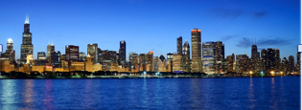
Physics of Sustainable Energy -IV
Short Course on
Using Energy Efficiently and Producing it Renewably
University of Chicago
June 17-18, 2016
Pushpa Bhat, Fermilab

Slide 2
Organizers
Thanks to EPIC for hosting
Pushpa Bhat, Fermilab
George Crabtree, Argonne National Lab
Robert Knapp, Evergreen State COllege
Robert Rosner, EPIC/ Physics
Michael Greenstone
Sam Ori
Bethel Haile
Victoria Eckstrom High
Eric Hernandez
75 Registrants, speakers

Slide 3
PSE Series
The APS Forum on Physics & Society, initiated, sponsored and organized three previous meetings
Intense 2-day weekend courses
All three held at UC Berkeley
March 2008
March 2011
March 2014

Slide 4
Why Berkeley?
Because of the inspiring presence of Art Rosenfeld, one of the stalwarts of “Energy Efficiency”
Rosenfeld got his Ph.D. under Enrico Fermi, here at University of Chicago, and went to work under Luis Alvarez (Nobel 1968), who also had gotten a Ph.D. from UChicago.
Rosenfeld switched his research focus to Energy Efficiency in 1974
Served as advisor at DOE/EERE
Led the California Energy Commission
Received Fermi Award, Carnot award, Global Energy Prize, National Medal of Technology and Innovation

Slide 5
Rosenfeld receiving the National Medal

Slide 6
Goals for PSE
Goals for the short-courses
To inform, educate and inspire
To provide a survey of status, progress and outlook on sustainable energy, covering both production and use
“What once seemed too hard has become what simply must be done”
-- Robert Socolow, Princeton University

Slide 7
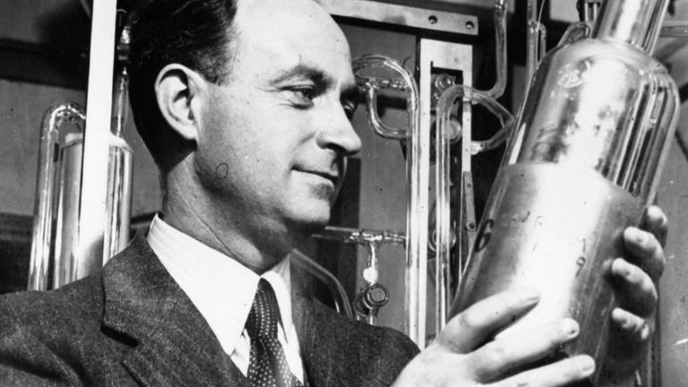
PSE-IV in Chicago!!
Chicago was at the forefront of the energy revolution!
In December 1942, Fermi achieved the first self-sustained nuclear chain reaction, demonstrating the potential for nuclear energy. (75th anniversary next year)

