Slide 1
Physics of Sustainability
Peter Littlewood
pblittlewood@anl.gov

Slide 2
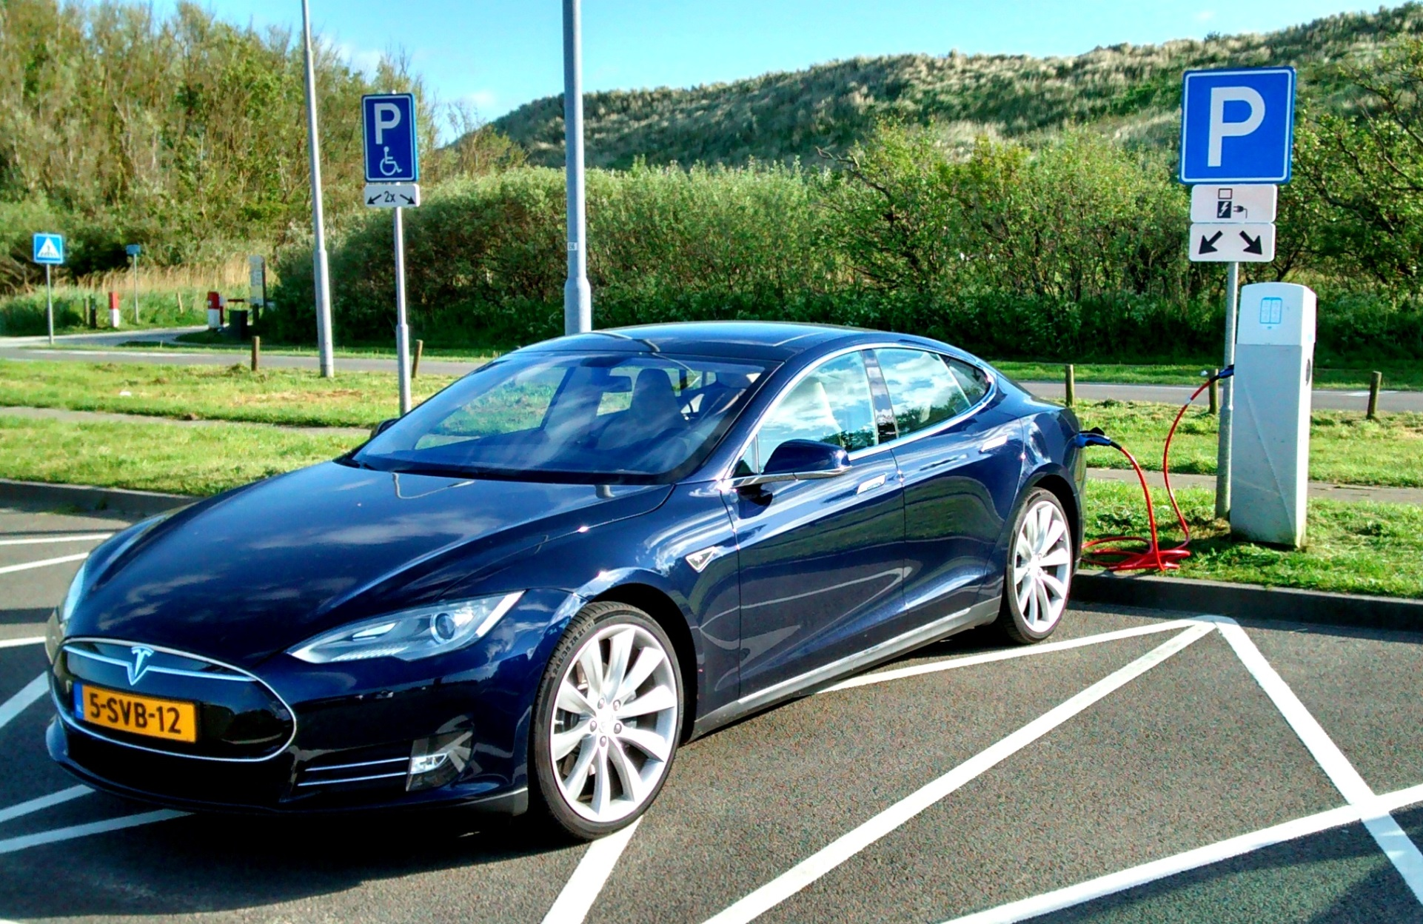
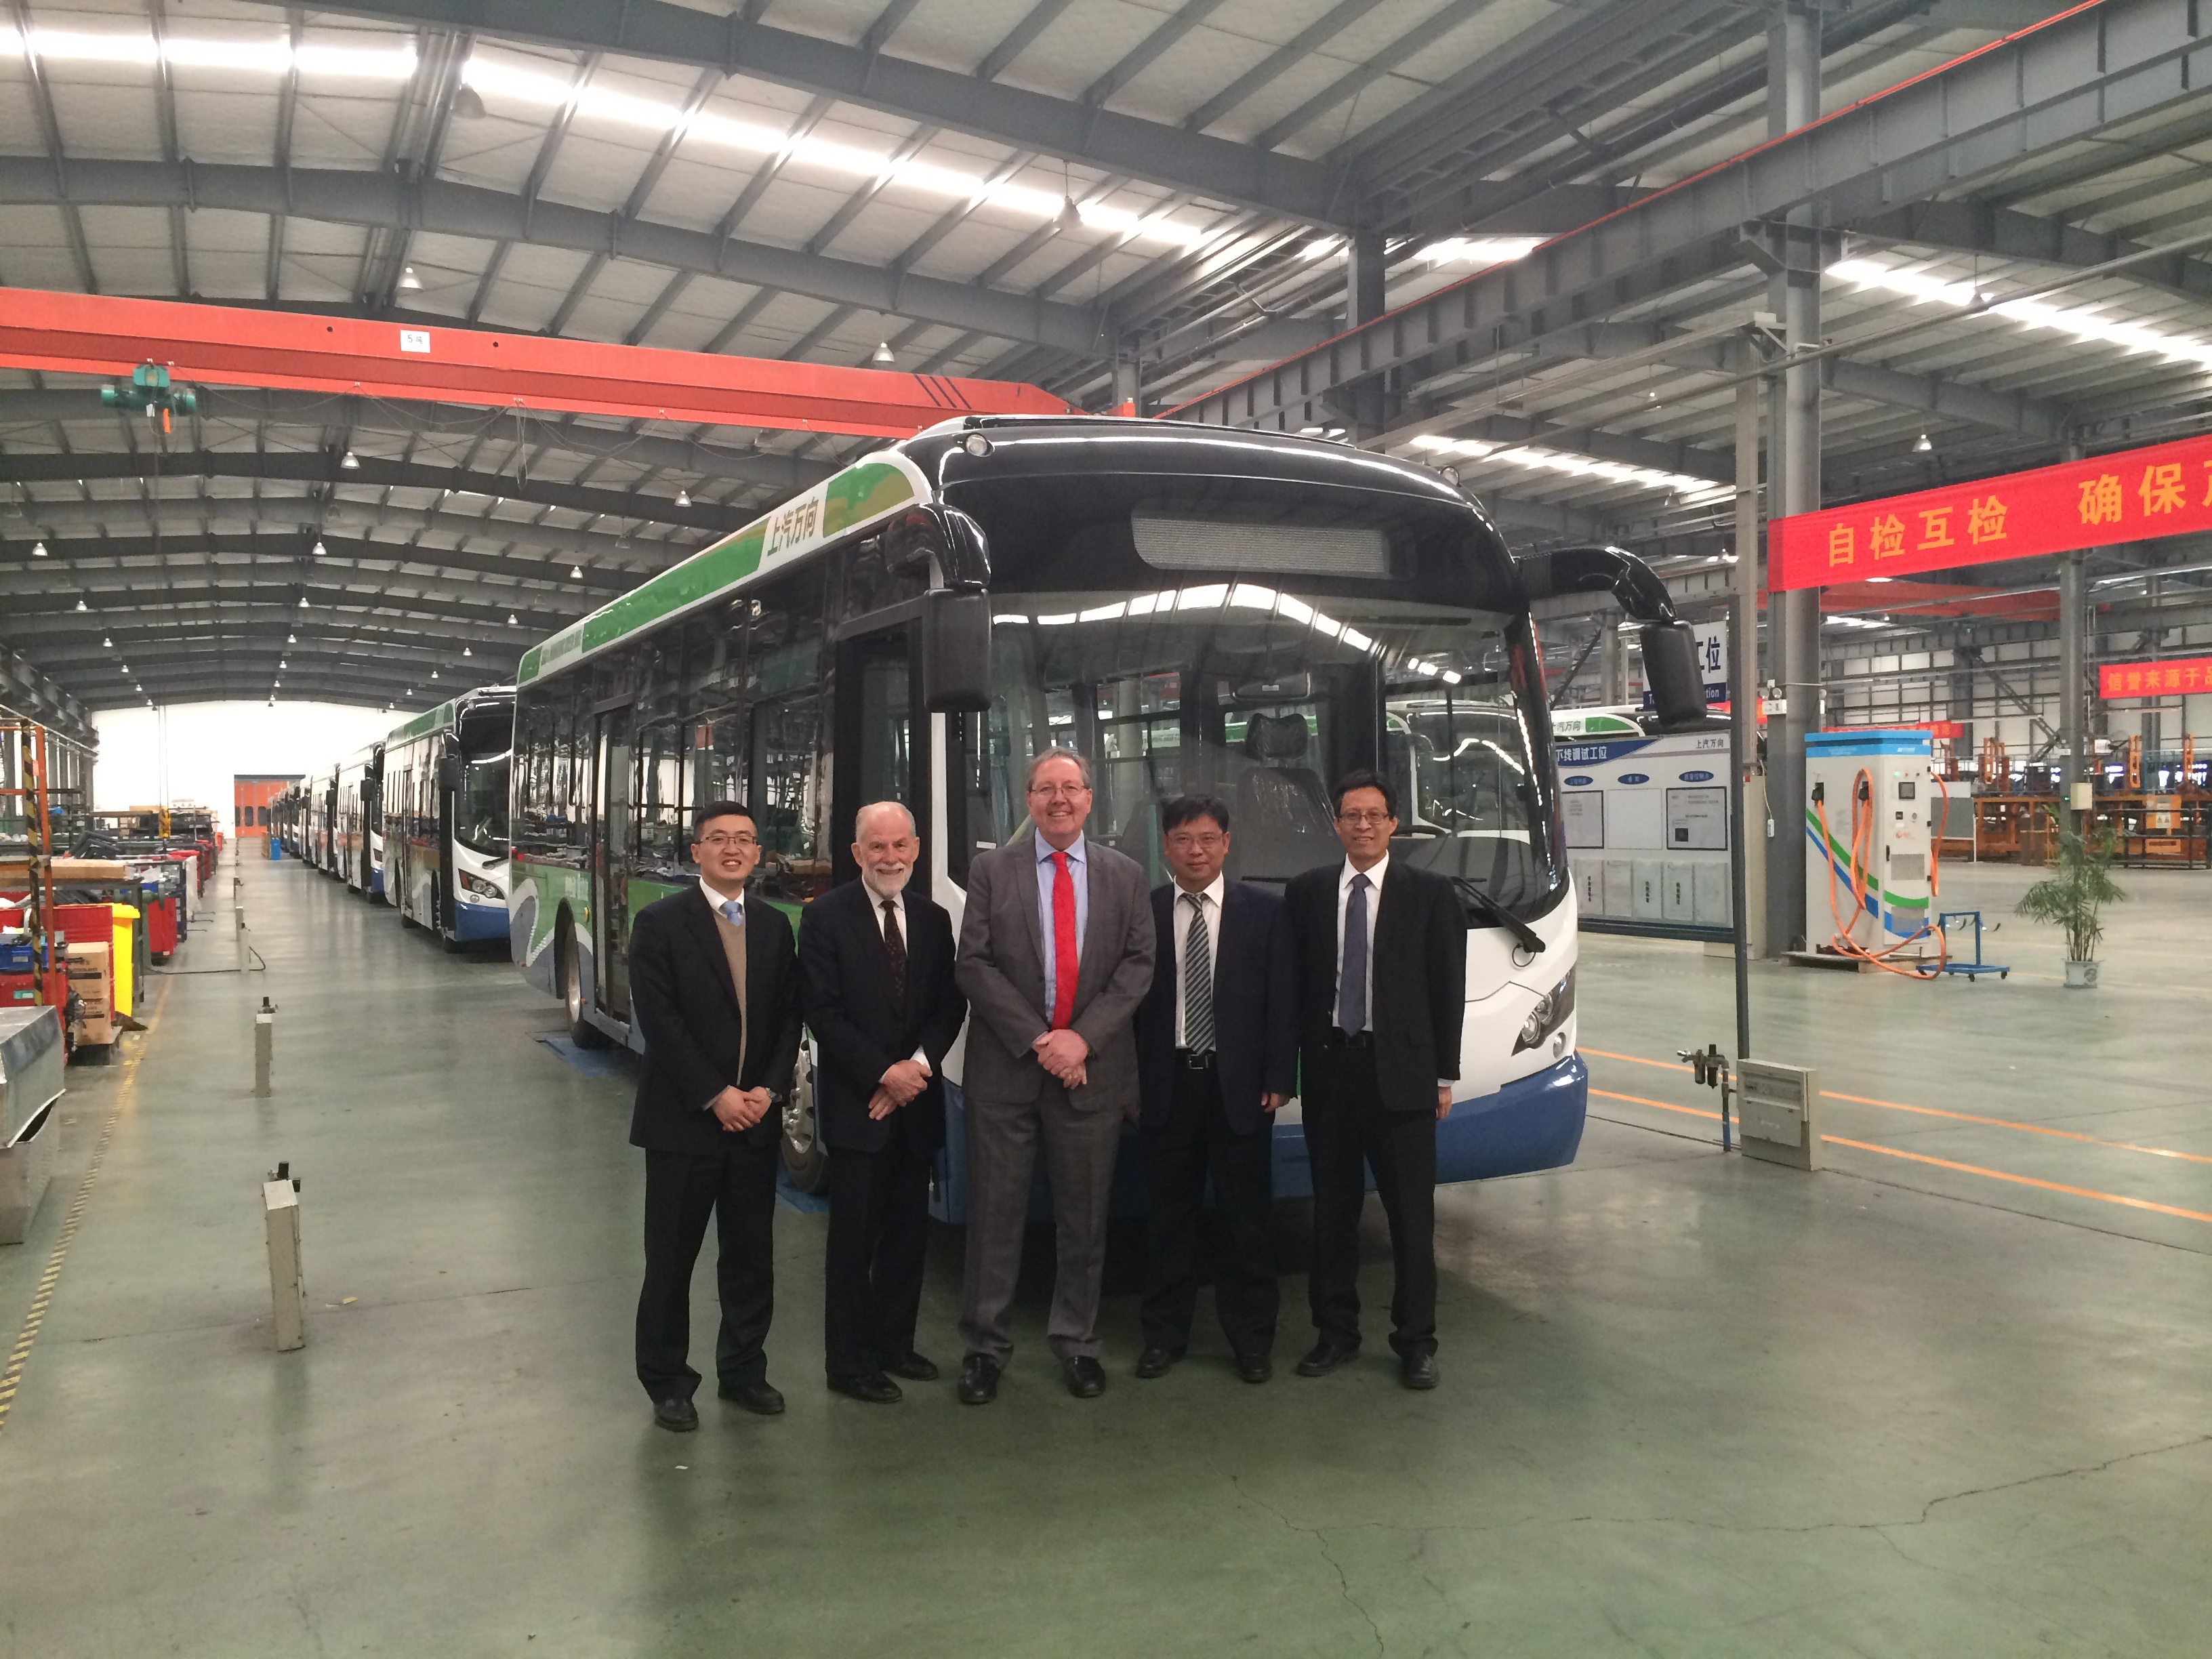
Sustainable transportation?

Slide 3
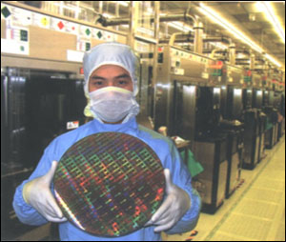
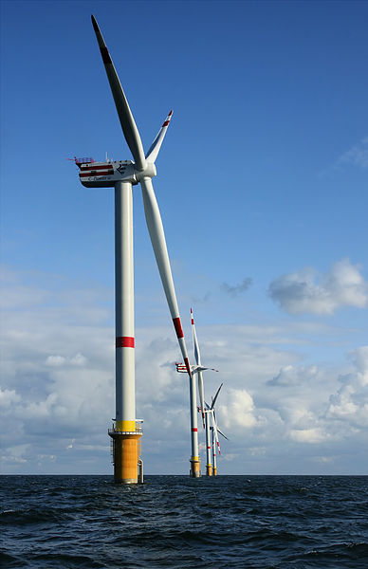
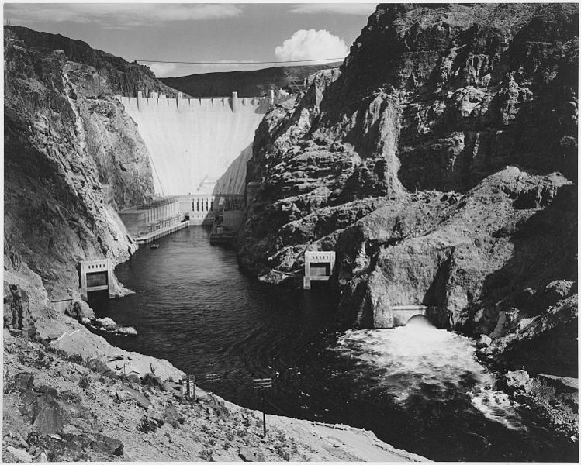
Some numbers
USA uses 3 TW power on average
5 billion microwave ovens
Total solar input on 10,000 km² (area of Rhode Island & Delaware)
Or at 10% efficiency, Arizona
1000xannual global shipments of Si wafers
Average wind capacity of plains states (5-10% of US land area)
Backup
1000 Hoover dams ….

Slide 4
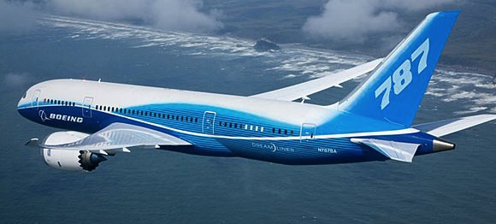
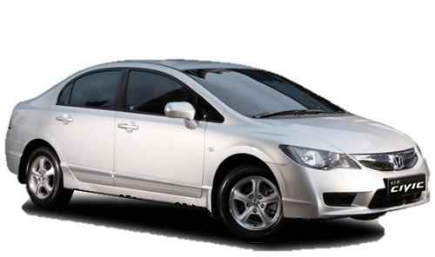
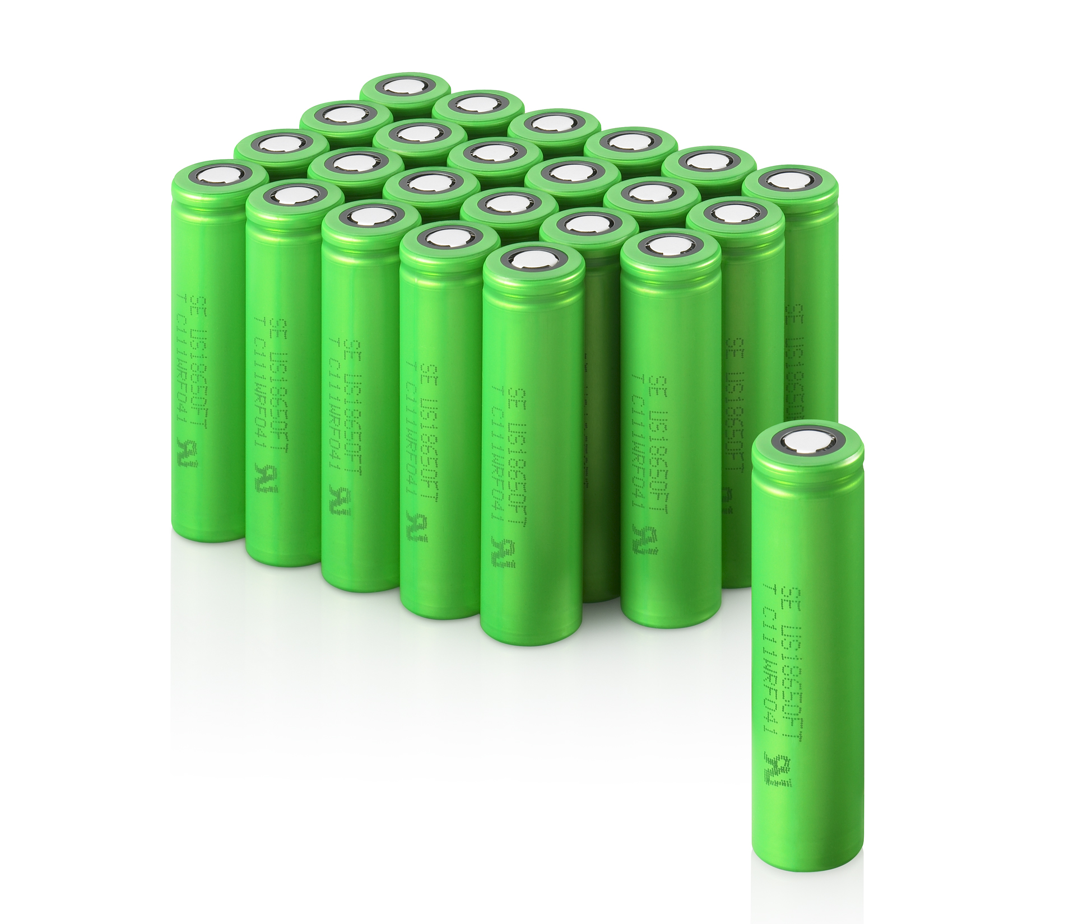
Materials are energy and energy is money
Energy input accounts for 1/3 cost of steel ($1/kg) and 1/2 cost of aluminum ($2.50/kg)
Boeing 787-9
$243M 180,000kg
$1,500/kg
iPad
Cost: $500
Weight: 0.6 kg
$1,000/kg
Enercon E-126
7.58 MW
$10M
6,000 tons
$1.5/kg
Payback
in 3-4 years
at 10¢/kWh
Wheat flour $1/kg
Ground beef
$10/kg
Honda Civic 1.8
$16,000
1,210 kg
$13/kg
Li-ion 18650 cell
$100/kg

Slide 5
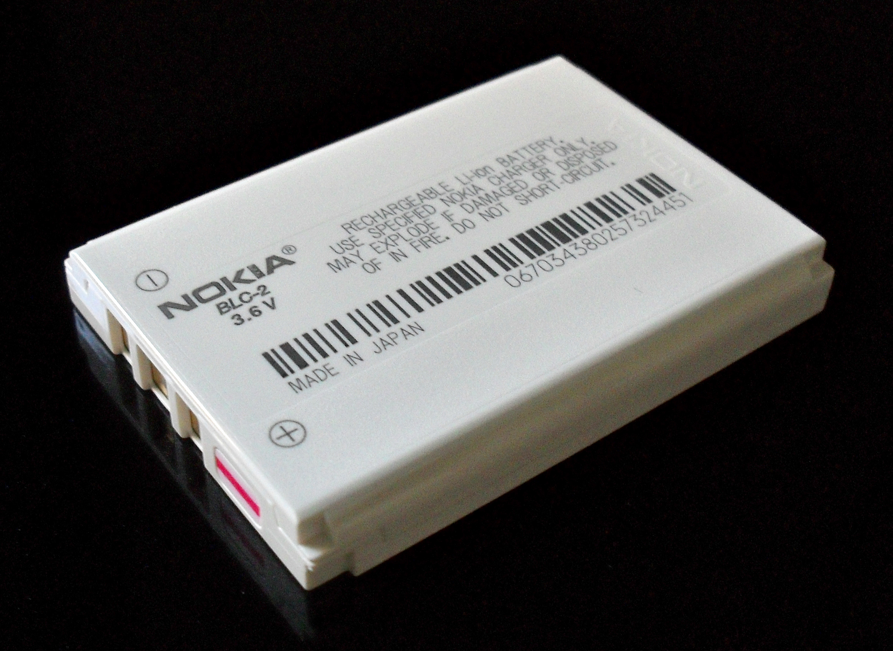
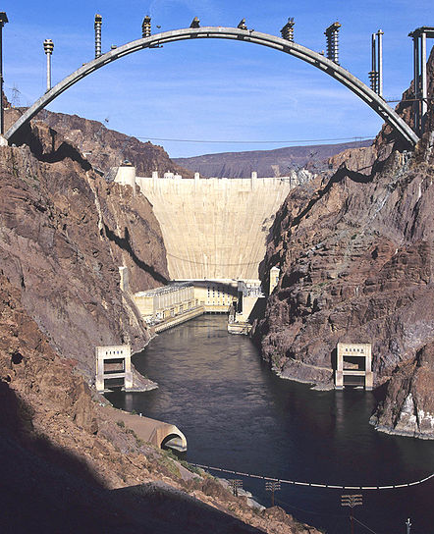
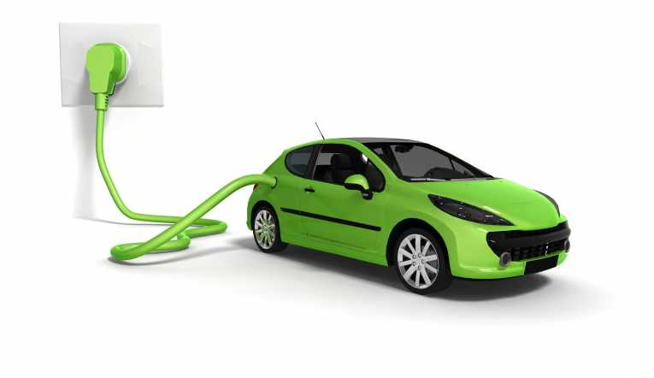
Why electrical storage needs a revolution
Market – lithium-ion batteries already a $30B business
Cost reducing at few % per year
Can we do this faster?
Laggard technology
Around 1% theoretical capacity; (lighting ~80%, solar PV ~30%)
Can we do this much better?
Scale – To back up USA power used for 12 hours would take
9x annual energy production of the Hoover Dam
1,000x the annual production of Li-ion batteries
Can we do this at scale?
Impact – an efficient battery is a bank for electrons
- Can we make energy a currency?

Slide 6
Argonne overview
June 4, 2016
www.anl.gov

Slide 7
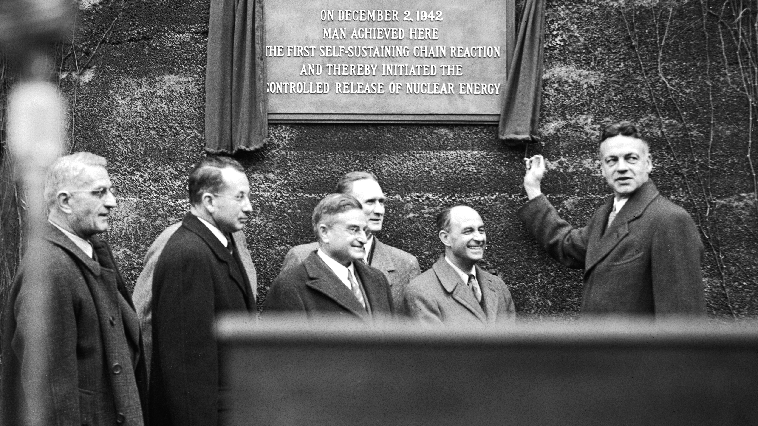
REFLECT
HONOR
CELEBRATE
Notes:
Argonne was founded in 1946, four years after Enrico Fermi led the experiments on Chicago Pile-1, leading to the first man-made controlled nuclear reaction.
Almost every nuclear reactor around the world is built on principles discovered at Argonne.

Slide 8
Argonne by the numbers (FY15)
$760 M
3,300
1,620+
operating budget
employees
scientists & engineers
124
7,150+
Invention disclosures
FACILITY USERS
Notes:
Who we are
• $760 million operating budget in FY 2015
• 3,300 employees
• including more than 1,620 scientists and engineers
Most of our funding comes directly from the U.S. Department of Energy, but some comes from other federal agencies and contractors, such as the Department of Defense, the Nuclear Regulatory Commission, and the Department of the Interior. In addition, we do substantial work with private industry, state and local government, universities, and foreign governments.

Slide 9
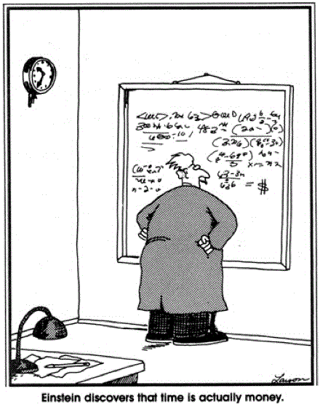
Einstein discovers that time is actually money

