Slide 1
EPIC Sustainable Energy

Slide 2
Invenergy drives innovation in energy.
Powered by decades of entrepreneurial experience and unparalleled execution, we solve the energy challenges facing our customers and communities.
We provide power generation and storage solutions at scale around the world to create a cleaner energy future.
We develop. We build. We own. We operate. We are Invenergy.

Slide 3

About Invenergy
84 large-scale projects
$20 billion in capital raised
750+ employees
3,400+ wind turbines placed in service

Slide 4




Broad Expertise
Invenergy develops, builds, owns and operates large-scale power plants across four core technologies:
Wind
65 projects
6,900 MW
Solar
8 projects
140 MW
Natural Gas
11 projects
5,800 MW
Battery Storage
5 projects
88 MW

Slide 5
Global Reach
*As of February 1 2016; includes projects that are under construction, build
transfer or in advanced development (have an off-take agreement)

Slide 6
Sustained Growth
Invenergy has developed projects totaling more than 13,000 megawatts.
*As of February 1 2016; includes projects that are operating, under construction or under
contract. Renewables includes wind, solar and storage.

Slide 7
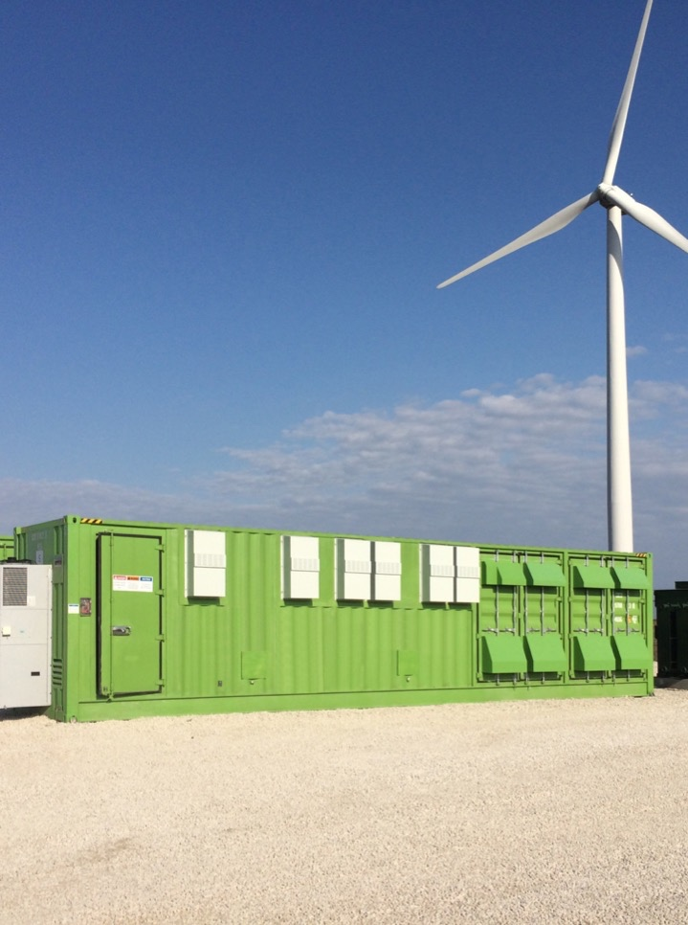
Industry Recognition
2015 Innovation Award -- Grand Ridge Energy Center
Energy Storage North America, 2015
Project of the Year – Grand Ridge Energy Center
Power Engineering & Renewable Energy World Magazine, 2015
Project Finance Borrower of the Year
Power Finance & Risk, 2012 & 2013
AWEA Achievement in Operations Award
American Wind Energy Association, 2011

Slide 8
Superior Results
Invenergy performs most work in-house, leading to superior results, lower costs and satisfied customers.
Project Development
Marketing & Finance
Engineering & Construction
Ownership & Operations
Strategic Siting
Land Acquisition
Permitting
Interconnection
PPAs, Tolls, Hedges
REC Derivatives
Flexible Structures
$20+ Bil. Capital Raised
In-House Design
Construction
Management
Operations &
Maintenance
Asset Management
Community Relations

Slide 9
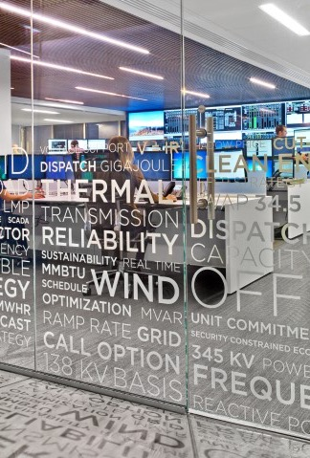
Operations
97.4% wind fleet availability
On-site techs perform maintenance throughout the year and inspect turbines 3-4 times more than other O&M providers.
State-of-the-art control center
The 24/7 Invenergy Control Center provides constant remote monitoring and fleet optimization. A redundant off-site operations center and regular drills ensure flawless backup in case of emergency.
Data-driven fleet management
Power schedulers, Sales & Marketing, operations engineers and asset managers collaborate closely to maximize performance based on market conditions.

Slide 10

Finance
Over $20B in capital raised
Invenergy’s team of 20+ in-house finance professionals have broad capital markets, project finance and investor relations experience, including having raised more than $20B in corporate and project capital.
Strong relationships
Our partners include a broad range of international and domestic banks, multilateral development banks and export credit agencies.
Reputation for excellence
In 2012 and 2013, we were recognized as Project Finance Borrower of the Year by Power Finance and Risk Magazine.

Slide 11
Renewable Energy Technologies
What drives adoption of different technologies
Comparitive LCOE
Negative Forces that Challenge Development

Slide 12
Development
Create projects from concept through construction
Start up a new business – each project is a new venture and needs to be a stand-alone business
Key Inputs for a successful project
  Land
  Governmental Approvals (municipal/state/federal)
  Public Relations
  Fuel – wind/solar/natural gas
  Transmission
  Competitive technology

Slide 13
Ne Generation Drivers
Load growth.
Diversity of resource.
Generation profile.
Dispatchability.
Renewable portfolio standards (RPS).
Economics.
Clean Power Plan.

Slide 14
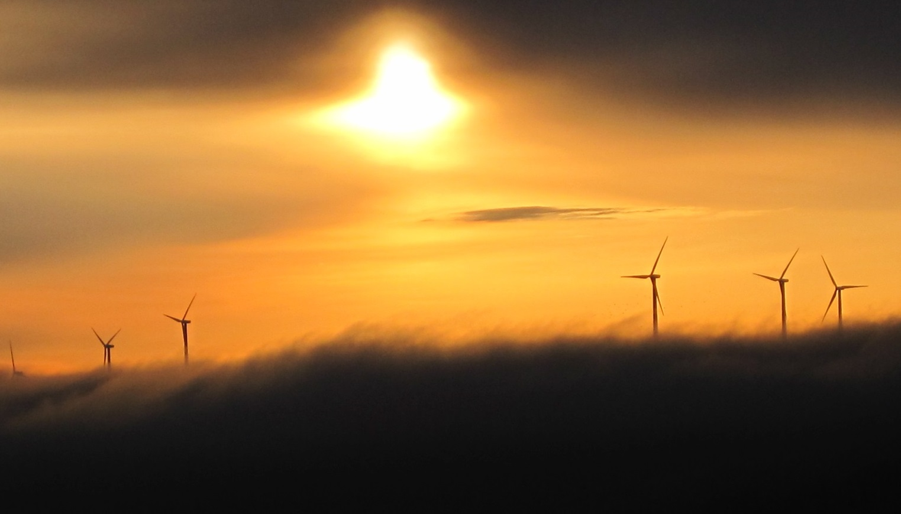
Wind
#1
2015 Wind Highlights Contracted 8 projects, totaling over 1,200 MW Developed and built 592 MW of wind projects Developed 1,061 MW of wind projects for MidAmerican
PRIVATELY
HELD WIND
POWER COMPANY
68
PROJECTS DEVELOPED
7,654
MW

Slide 15
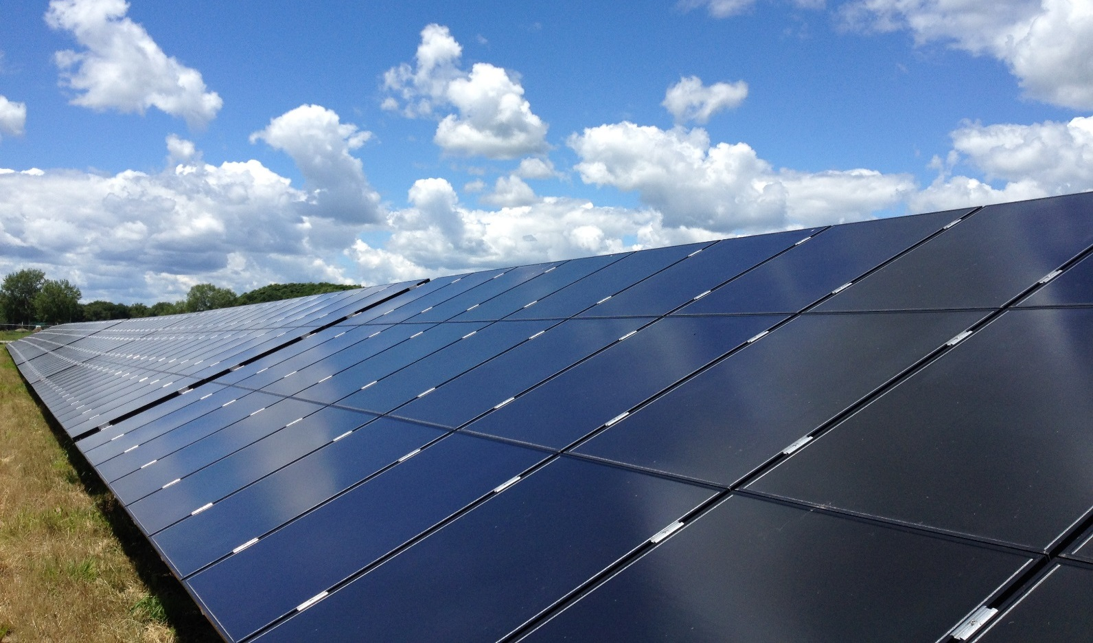
Solar
2015 Solar Highlights Built and sold a 20 MW project to Dominion Contracted a 50 MW project under a built-transfer to Liberty Utilities Multiple large-scale sola projects are currently under development
8
144
PROJECTS DEVELOPED
MW

Slide 16
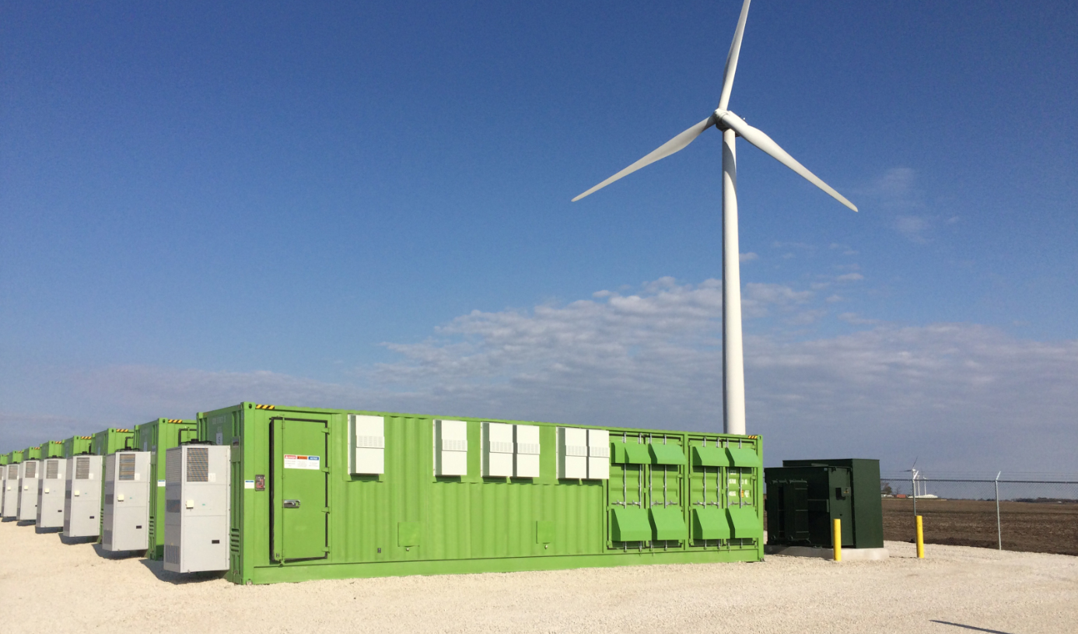
Storage
#1
2015 Storage Highlights Completed 64 MW of energy storage projects in PJM in 2015 Won the Energy Storage North America’s 2015 Innovation Award for centralized storage
PRIVATELY HELD
ADVANCED ENERGY
STORAGE OWNER/OPERATOR
6
88
PROJECTS DEVELOPED
OPERATING
MW

Slide 17
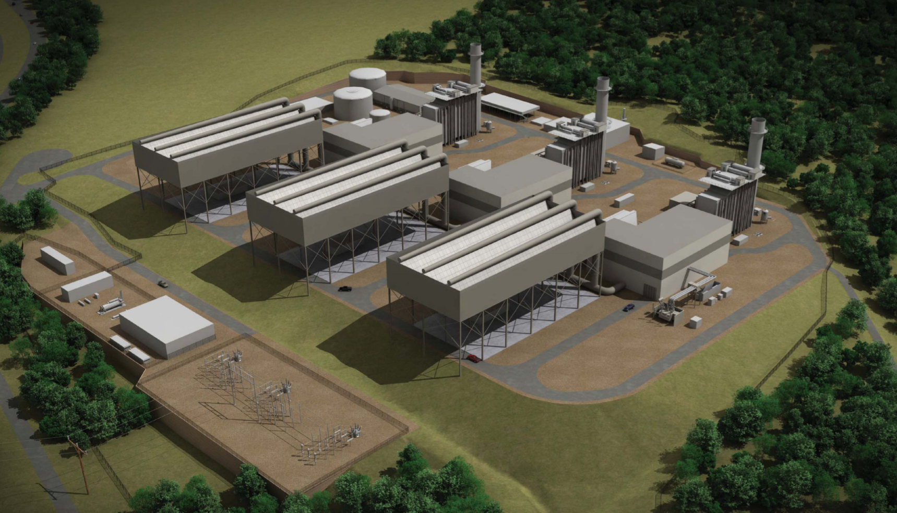
Natural Gas
2015 Thermal Highlights Completed over 800 MW of thermal projects in 2015 Developing the 2nd largest combined cycle project in North America Developing multiple cogen projects for large industrial users
11
PROJECTS DEVELOPED
5,833
MW

Slide 18
Development Drivers
Source: Lazard

Slide 19
Development Drivers
Source: DSIRE

Slide 20
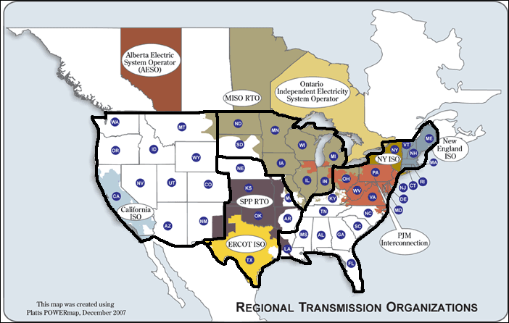
Regions

Slide 21
Development Drivers
Source: IHS

Slide 22
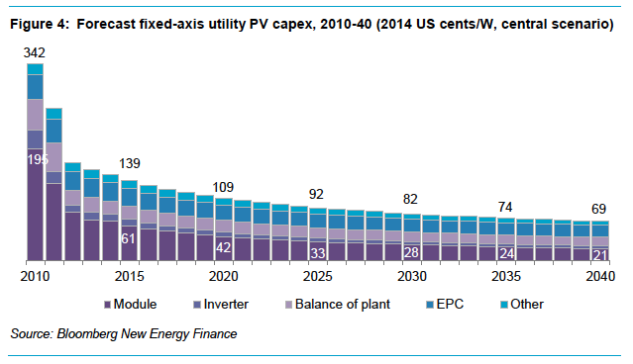
Development Drivers

Slide 23
Energy Storage

Slide 24
Storage Applications & Solutions
 | APPLICATIONS
Battery Duration | Frequency Regulation | Voltage Control | Reactive Support | Backup Power (UPS) | Cloud Transient Management | Renewable Firming & Shaping | Demand Management/ Peak Shifting | Substation Upgrade Deferral | Time Shift | Black-start
15 to 30 minutes | ✓ | ✓ | ✓ | ✓
1 – 2 hours | ✓ | ✓ | ✓ | ✓ | ✓ | ✓ | ✓
2 – 4 hours + | ✓ | ✓ | ✓ | ✓ | ✓ | ✓ | ✓ | ✓ | ✓ | ✓
Power
Energy
Ancillary Services
SUITE OF SOLUTIONS
Renewable Energy
Services
T&D
Management
Energy
On-Demand

Slide 25
Regions

Slide 26
Storage Fleet
Over 65 MW of energy storage projects in operation, construction and development
Strategic focus on the advanced energy storage asset class
Technology agnostic – focus on using “the right tool for the job”
Project Name | Location | Technology | Power Rating | COD
Grand Ridge IV | Illinois | Lithium Ion | 1.5 MW | 2012
Goldthwaite | Texas | Molten Salt | 0.6 MW | 2014
Grand Ridge | Illinois | Lithium Ion | 31.5 MW | 2015
Beech Ridge | West Virginia | Lithium Ion | 31.5 MW | Est 2015
 |  |  | Total: 65.1 MW

Slide 27
Energy Storage RFP Requirements
“ At a minimum provide the following:
1. Provide Spin/Non-Spin Reserves
2. Provide automatic ramping
3. Provide Frequency Regulation
4. Provide Capacity (20-40 MW)
5. Support intermittent renewable integration
6. Peak shift energy
7. Provide Black Start Capability
8. Provide ancillary service capacity
9. Smooth intermittent resource output
10. Improve short-duration performance
11. Improve system reliability
12. Improve power quality
13. Integrate intermittent distributed generation
14. Provide uninterruptible power supply ”
“Although Utility Y will not require a minimum for annual cycles, Utility Y will give priority to systems with a minimum of 50 cycles per year”
Utility X will “consider any options that provide increased service and value to its members”

Slide 28

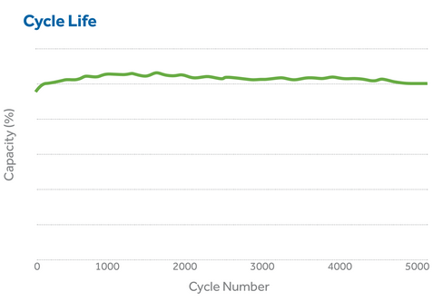
Assessing Batteries for an Opportunity
“ Greater than 3,000 cycles at 80% DoD”

Slide 29
Challenges to Development
Keeping a positive public opinion and addressing a lot of mis-information.
Timing of permitting and interconnection studies.
Changing regulations and permitting requirements.
Organized opposition (NIMBY), particularly when it is not their backyard.
Local regulations not set up for power projects.

Slide 30
Development – Challenges and Impediments
Some are predictable and some are not, but there are always challenges.
  Case #1 – Organized Opposition – Forward
  Case #2 – Changing Regulations – Raleigh
  Case #3 – Local Politics – Cannon Falls
  Case #4 – Flight Patterns - Scotland
  Case #5 – FAA Determinations – SC/GR
  Case #6 – Land – comparison of projects
  Case #7 – Internal Factors

Slide 31
Development – Case #1 Organized Opposition
The Forward Energy Center in WI faced a local opposition group during the CPCN permitting process. This required ongoing public relations, information campaigns and grass roots development to overcome.
  Information mailings
  Coordination to have support at public meetings
  Creation of a landowner team to speak out in support which typically doesn’t happen

Slide 32
Development – Case #2 Changing Regulations
The Raleigh, Ontario project was nearing the issuance of its municipal and provincial approvals.
Provincial government issued new regulations modifying the process for issuing necessary approvals.
Project went into limbo as the draft regulations were finalized.
Had to lobby the government heavily to modify the regulations to avoid material impact to the project.

Slide 33
Development – Case #3 Local Politics
The Cannon Falls Energy Center in MN needed to obtain a legislative property tax abatement. The legislation required all taxing bodies to support the project.
  These were the county, city and school district and we needed each to pass a supporting resolution.
  Traditional split of taxes 52/36/12.
  We had to overcome existing political turmoil between the groups as they all wanted control of payment in lieu of taxes that we offered.
  The public relations and lobbying effort took over a year to resolve this issue. With some compromise from most parties the resolutions were obtained.

Slide 34
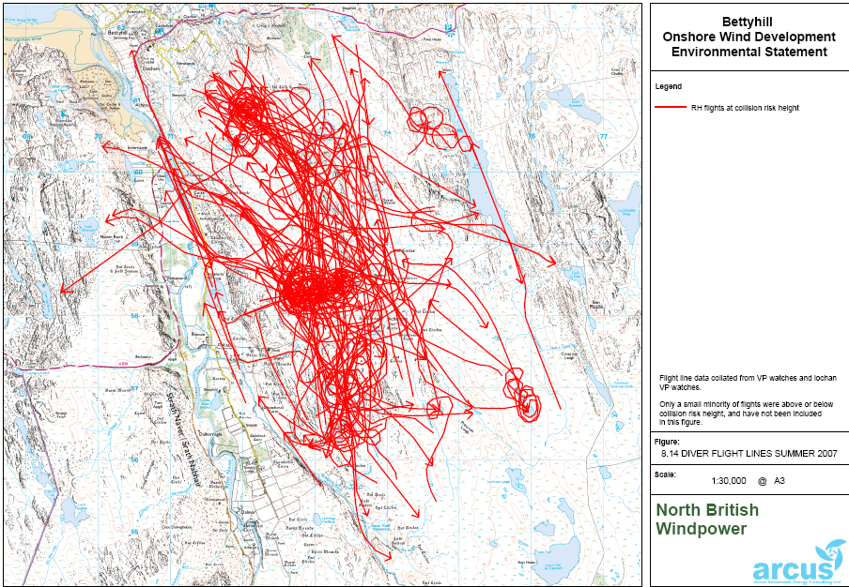
Development – Case #4 Flight Patterns

Slide 35
Development – Case #5 FAA
For wind projects the FAA determinations of no hazard have become one of the more difficult approvals to secure.
  Spring Canyon, CO – a VOR was located at the Sydney, NE airport and it was determined that the location of the projects turbines might impact the operation of the VOR.
  Negotiation to agree to a pre and post construction flight tests to determine impact with a financial obligation to remedy if operation of the VOR degraded.
  Grand Ridge, IL - the Joliet radar utilized by the department of defense is potentially obstructed.

Slide 36
Development – Case #6 Land
A gas turbine peaker like Cannon Falls occupies an approximate 30 acre site acquired from a single owner.
The Beech Ridge project in WV is a wind project with one main landowner, MWV, for the site and 13 landowners for the transmission line.
The Gratiot project in WI had over 200 landowners involved for the project site.
When executing a wind project each landowner for a wind project:
  Will have an agreement with Invenergy.
  Will need to concur with the location of the facilities to be constructed.
  Will have to enter into an estoppel to support financing.
  Will have to sign off on the final reclamation of construction on their property.

Slide 37
Development - Summarized
Development is having the persistence to push forward to create a project by overcoming whatever challenges are encountered

Slide 38
Contact Information
Charles Murray, P.E.
312-582-1265
CMurray@invenergyllc.com
Website: www.invenergyllc.com

