Slide 1
Installation of New Inflector Cold Mass: The Concept
Del Allspach, Hogan Nguyen, PPD
June 24th 2016

Slide 2
2 Major Steps
Extracting the Inflector Cryostat from Magnet Gap
To Be Performed Primarily by PPD Staff
Swapping the Inflector Cold Mass
To Be Performed Primarily by TD Staff

Slide 3
Extracting the Inflector Cryostat From Magnet Gap
PPD Staff will be doing this step in Fall 2016
but in REVERSE
All the Tooling are essentially in Place
This Step is essentially known

Slide 4
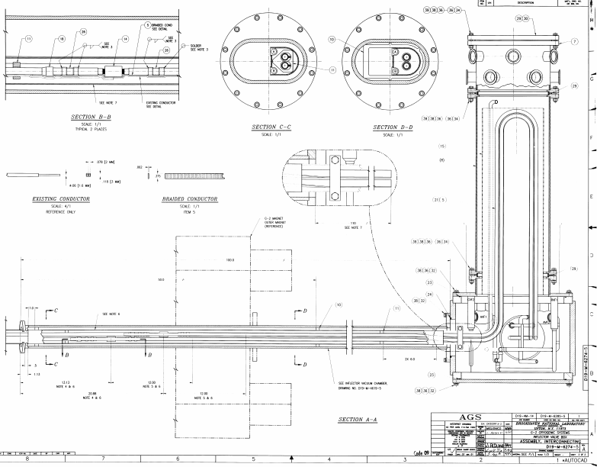
Lead
Can and
Valve
Box
To Inflector
Magnet
Magnet Yoke
Perform `Cut’ thru the service
Line

Slide 5
`Cutting’ Thru Service Line
Cut Thru Vacuum Jacket
Remove MLI and Kapton
Disconnect Instrumentation Cables
Unsolder Superconductors
(To be done by TD Staff in E. Barzi’s Group)

Slide 6
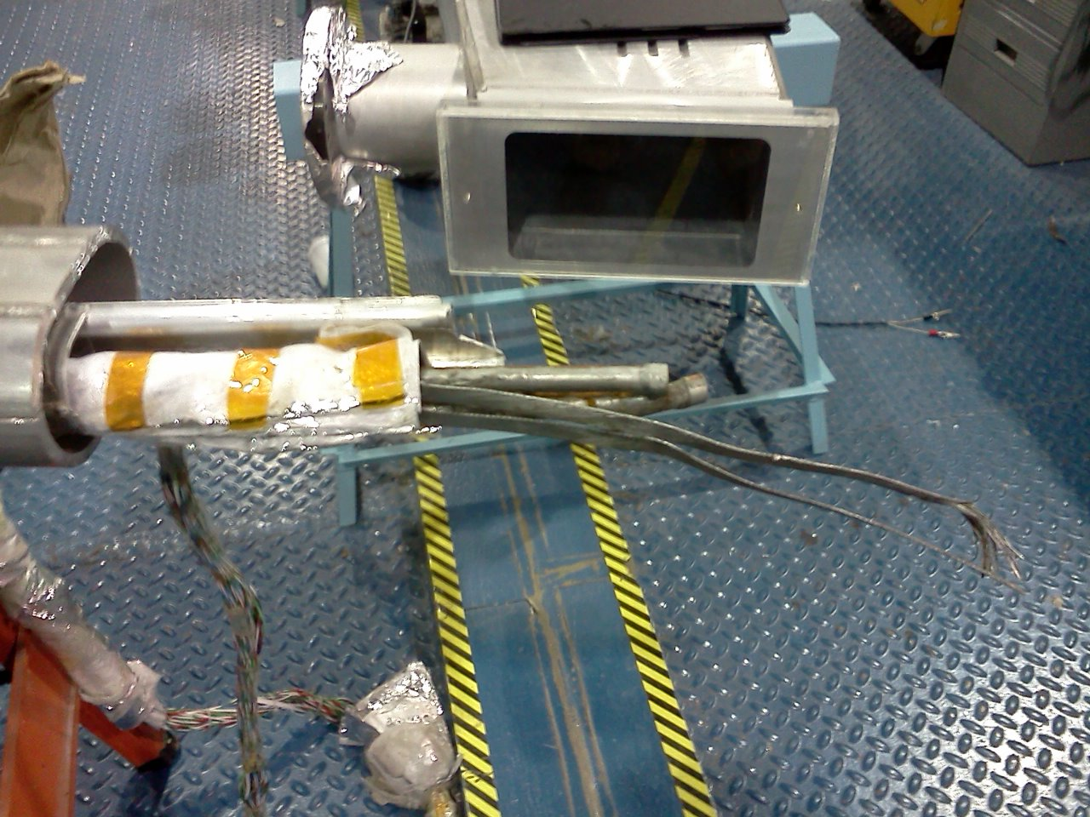
Result Would Look Something Like This
Rutherford Cable
Super Conductor
5K LHe Super
Conductor
Cooling Lines
50K He Gas Heat
Shield Cooling Lines
To Lead Box
And Valve Box
Cryogenic
Instrumentation Cables

Slide 7
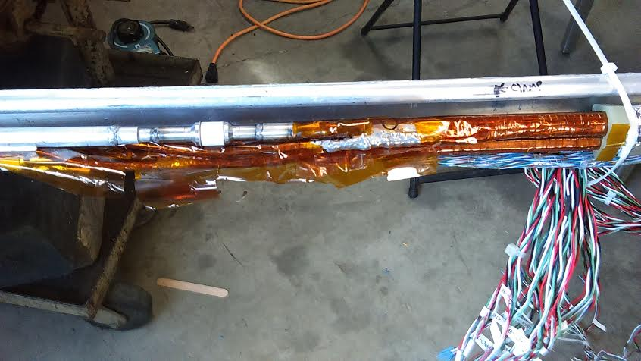
Super Conductors in the Inflector Service Line

Slide 8
Super Conductors in the Service Line (Part 1)
Electrical
Isolator
Aluminum D-Tube Cooling
Copper Cooling Tube
A Pair of Aluminum-Stabilized
Super Conductor, wrapped with
Aluminum strips and soldered
THE ALUMINUM SC IS NOT
ACID-ETCHED.
Heavily Soldered Region
Rutherford
Cable
Continue Next Page

Slide 9
Super Conductors in the Service Line (Part 2)
Perform Unsolder HERE
Rutherford Cable
Rutherford Cable
Cu cooling tube
To Lead/Valve Box
To Previous Page

Slide 10
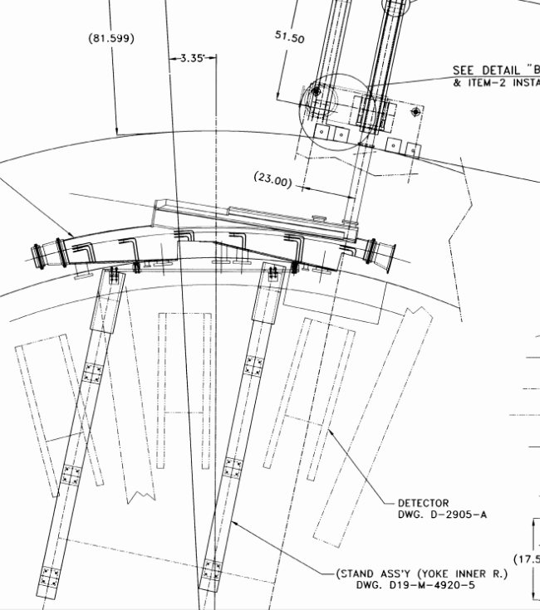
Slide Chamber Out from Magnet Gap Using the Rail System
Many detailed preparation steps related to the vacuum System and magnetic field system are omitted for Clarity
Rails
Rails
Slide out
On Rails

Slide 11
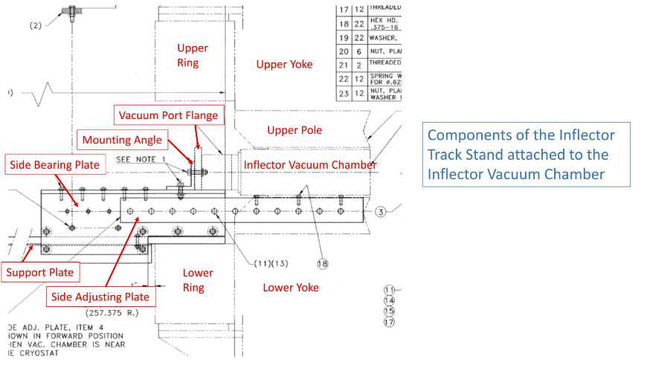
Sliding Rail Details

Slide 12
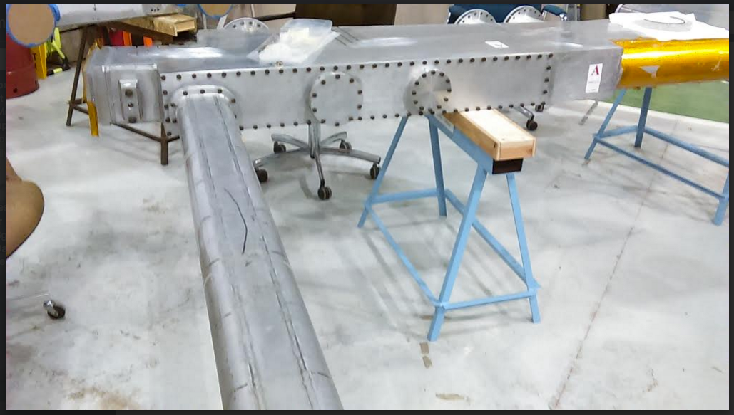
Swapping the Cold Mass
Access Panel to Remove
The Cold Mass
Note: We have never removed this access panel since it would change the inflector alignment. So we rely on (limited) drawings of the interior and guidance from BNL.

Slide 13
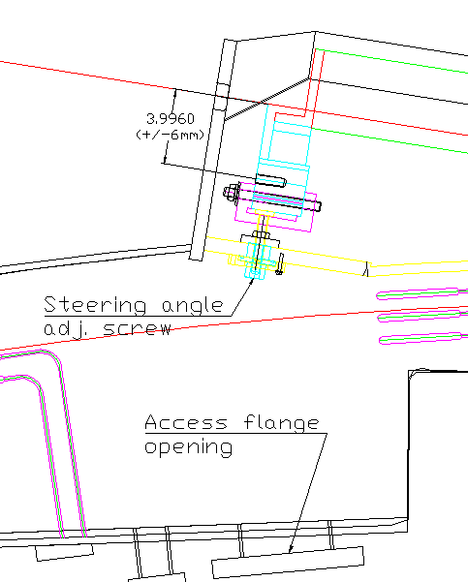
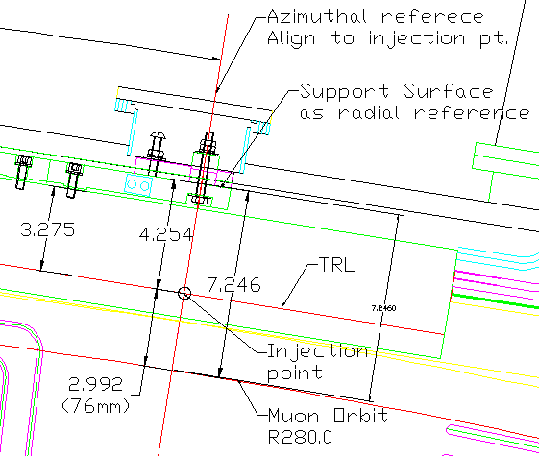
Remove the Cold Mass Alignment Screw
Downstream
Upstream

Slide 14
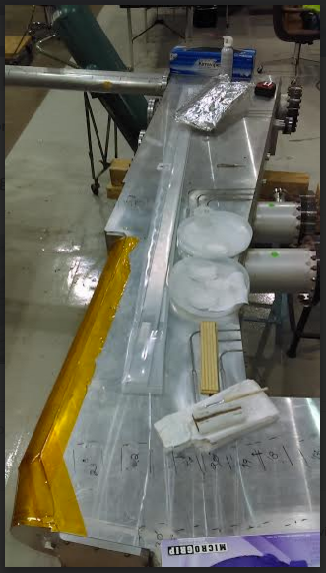
Extract
Pivot

Slide 15
Remarks
We have limited drawings of how the Cold Mass is supported Off the Cryostat.
Emails from Chien Pai at BNL indicates:
Upstream End: Cold Mass is Cantilevered Off of G10 Support Blocks sitting on Teflon Slide
Down Stream End: Cold Mass is Cantilevered Off of G10 Supports bolted to an access port

Slide 16
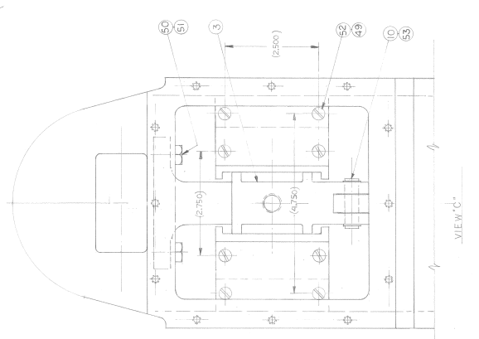
Upstream Support Block
Support Bolts
Upstream Window
Cold
Mass

Slide 17
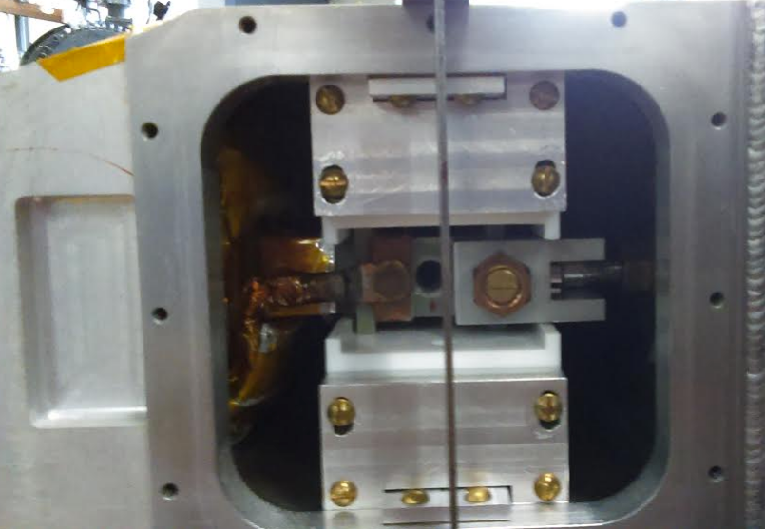
Upstream Block

Slide 18
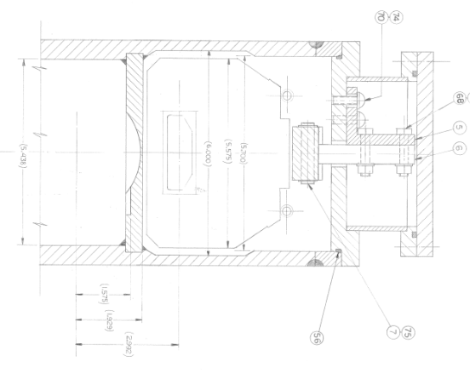
Down Stream Support
Pivot Point

Slide 19
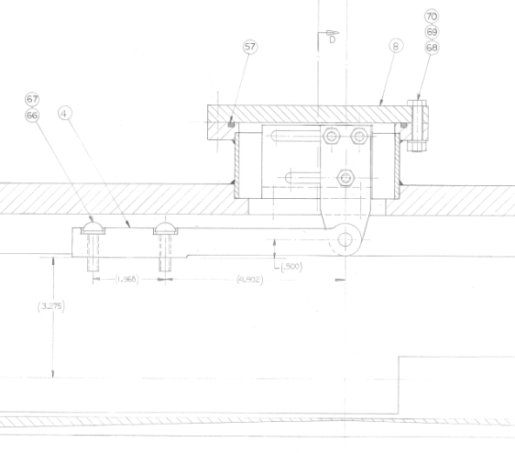
Down Stream Support
Sliding Adjustment
Support Bolts
Pivot Point

Slide 20
Summary
There are many Superconductor Splices in the service line. New Windings made by TD will have to be soldered to existing Rutherford Cable SC.
The Steps to extract the Inflector Cryostat should be straight forward. PPD Staff is doing the Reverse Step this Fall.
There is limited information on how the Cold mass is supported. However, we feel that there is sufficient experience and expertise to figure this out.

