Slide 1
Protodune Cosmic Ray tagger (CRT)
Camillo Mariani
ProtoDUNE DAQ Review
November 3rd and 4th

Slide 2
Introduction
CRT motivations
System overview and trigger signals
CRT Readout
CRT Event Builder

Slide 3
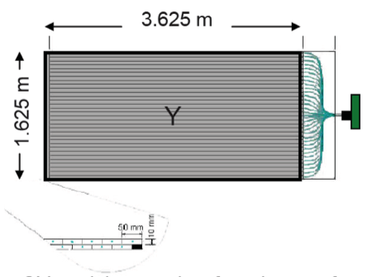
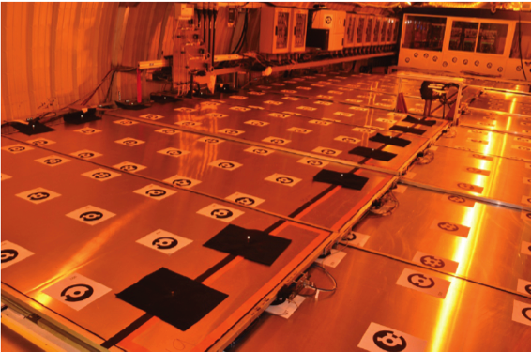
ProtoDUNE CRT
System will be positioned in the front and back of the TPC
identify muon present in beam halo
tag this muon send trigger info to TPC
System will also have some panel on top of the TPC
Muon veto, send trigger info to TPC
Trigger will be generated as an OR of the X and Y panels
Send to the TPC trigger board within 500 ns.
Hit info or ADC info in separate data stream.
CRT modules consist of two layers of 64 scintillator strips with WLS fibers connected to a single multi-anode PMT
CRT Readout Electronics

Slide 4
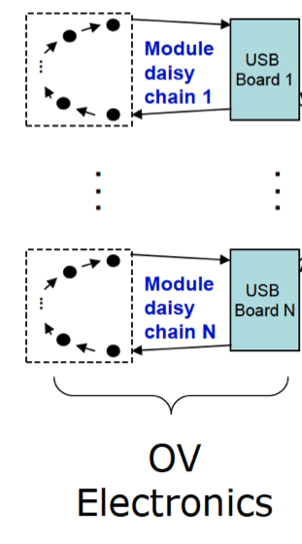
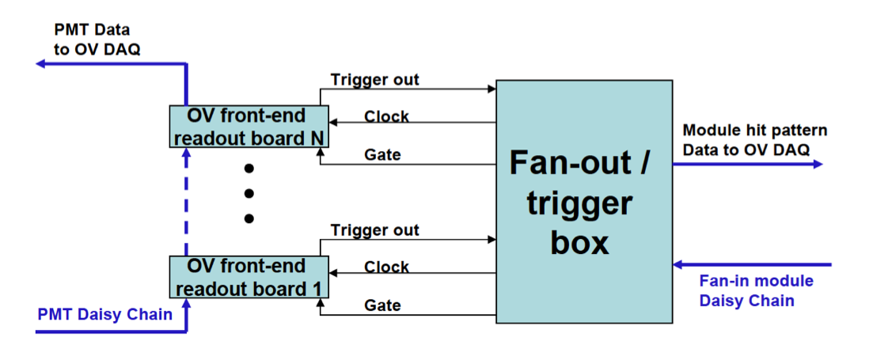
System Overview and Trigger Signals
Each PMT board:
Readout 64 channels - provide hits or ADC info
Hits processing require 120 ns
ADC processing require 32 μs
Board trigger does not know about other boards
Trigger board:
Collect info from all PMT boards
Provide hit info pattern (through DAQ)
Form a trigger signal (based on single board info)
2 trigger out available
Geometrical overlapping modules in < 500 ns
OR of all modules in < 500 ns
DAQ
CRT
Electronics
PMT data
to CRT DAQ
Data stream contains 32 bit timestamp can be used for data merging offline, only when a proper bit is asserted in the main data stream.
CRT front-end
readout board N
Module hit Pattern
Data to CRT DAQ
CRT front-end
readout board 1

Slide 5
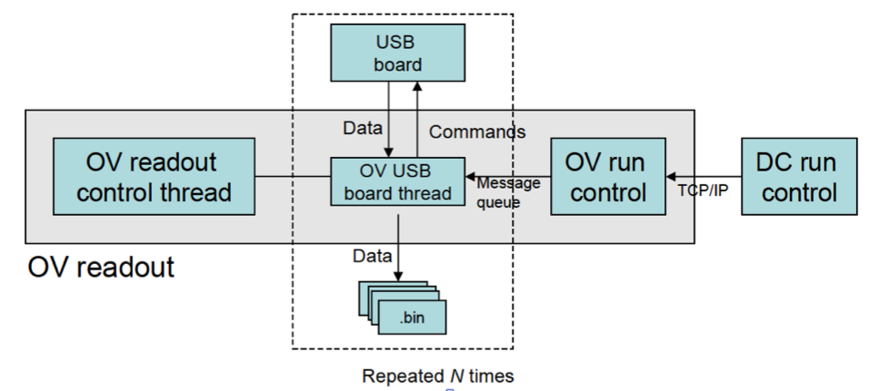
CRT Readout
Launches independent threats (C++) to manage each USB board
USB communication using libusb
Separate CRT run control process (perl/python) connect to the ProtoDUNE run control via TCP/IP sockets
CRT run control communicate with the USB streams using message queues
Binary data are written independently for each of the USB stream on disk
CRT Readout
control thread
CRT USB board thread
CRT Run Control
ProtoDUNE Run Control

Slide 6
CRT Event Builder
CRT Event Builder written in C++ and designed to:
Read raw data from the CRT DAQ
Independent, unsorted data stream for each of the USB, consisting of data packets from individual CRT modules
Compute and apply pedestal calculation
Apply offline thresholds
Time-order hits within individual data USB stream
Merge all USB data stream in time-order, grouping them into CRT events
CRT Readout
control thread
CRT USB board thread
CRT Run Control
ProtoDUNE Run Control

Slide 7
Component testing
All components tested already
Component that need to be produced will be visually inspected after production and then tested
Plan to have a full electronic test stand at Virginia Tech

Slide 8
Risks
No rick identified for now

Slide 9
Conclusion
System was used in 3 different experiments - did not cause major issues.
Have years of running and extensive commissioning experience
Full test stand planned
Detector is very new to ProtoDUNE so lots of specific details of the system needs to be addressed
i.e. cable length need to be decided
location of the electronics boards for triggering
We will use similar triggering and data margining schemes as the beam instrumentation.

