Slide 1
Responses to reviewers questions
DAQ design team
CERN, 4th November 2016

Slide 2
1. Produce an orgchart with leadership & person power in each box -is there a steering group?
[
See next slides

Slide 3
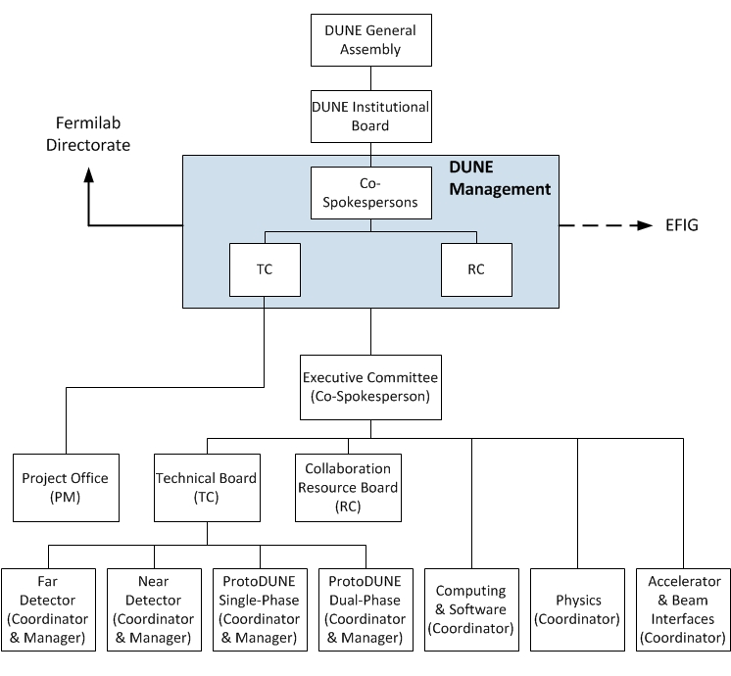
DUNE Organization

Slide 4
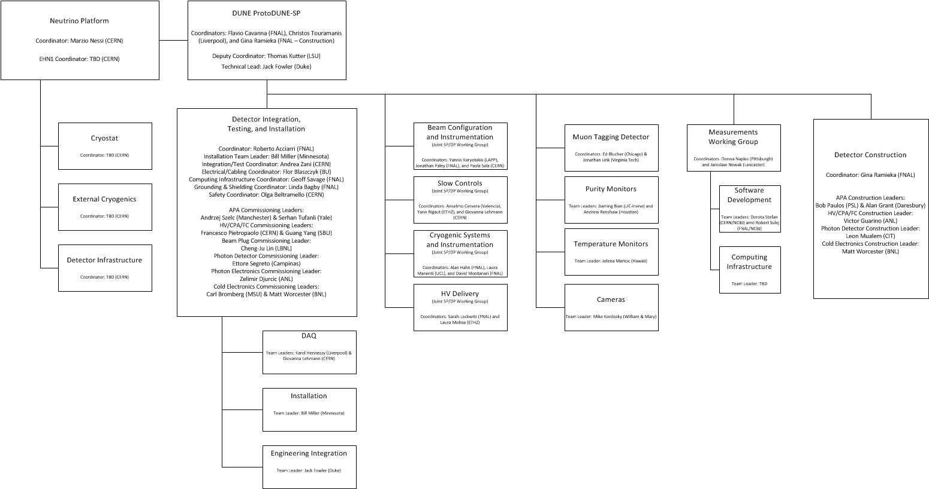
ProtoDUNE-SP Organization Chart

Slide 5
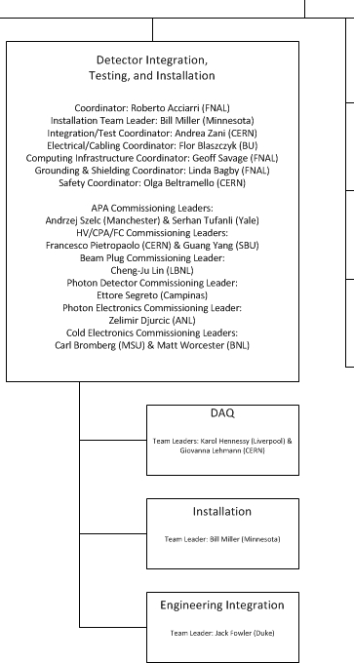
Detector Integration, Testing, & Commissioning
CERN will provide overall coordination for the activities in the EHN1 area
This is the on-ground team that will look after ProtoDUNE-SP installation, commissioning, and operation
With one exception, all of these individuals have agreed to re-locate to CERN for extended periods over the next two years

Slide 6
ProtoDUNE-SP DAQ Organization
DAQ
CERN, Liverpool
RCE Readout
SLAC, UC-Davis
FELIX Readout
CERN, NIKHEF, PNNL
ARTDAQ
FNAL, Oxford, RAL
SSP Readout
ANL, Warwick
Trigger/Timing
Bristol, Penn
Run Control
CERN, FNAL
Cosmic Tagger Readout
Virginia Tech
Monitoring
Sheffield, Sussex
Beam Instr. Readout
CERN, FNAL

Slide 7
ProtoDUNE-SP DAQ On-ground Team
K. Hennessey, G. Lehmann
DAQ
CERN, Liverpool
J. Wang, SLAC R.S.
B. Abi, G. Barr, F. Azfar
RCE Readout
SLAC, UC-Davis
FELIX Readout
CERN, NIKHEF, PNNL
ARTDAQ
FNAL, Oxford, RAL
Z. Djurcic, M. Haigh
N. Fiuza De Barros, D. Newbold
W. Ketchum
SSP Readout
ANL, Warwick
Trigger/Timing
Bristol, Penn
Run Control
CERN, FNAL
C. Mariani
J. Paley, CERN B.D.
Cosmic Tagger Readout
Virginia Tech
Monitoring
Sheffield, Sussex
Beam Instr. Readout
CERN, FNAL

Slide 8
2. Produce a global diagram (with tables if needed) with all links, boxes, bandwidths etc.
(Next page)

Slide 10
Bandwidth displayed from view of main switch
To switch: 0.3Gb each
From switch: 0
To switch: 0.3 Gb each
From switch: 0.3 Gb each
To switch: 10Gb each
From switch: 0
To switch: 0.6 Gb each
From switch: 0
To switch: 1Gb each
From switch: 0
To switch: 0
From switch: <1 Gb each
8 TPC
To switch: 0.3Gb each
From switch: 0.3Gb each
2 SSP
To switch: 1Gb each
From switch: 1Gb each

Slide 11
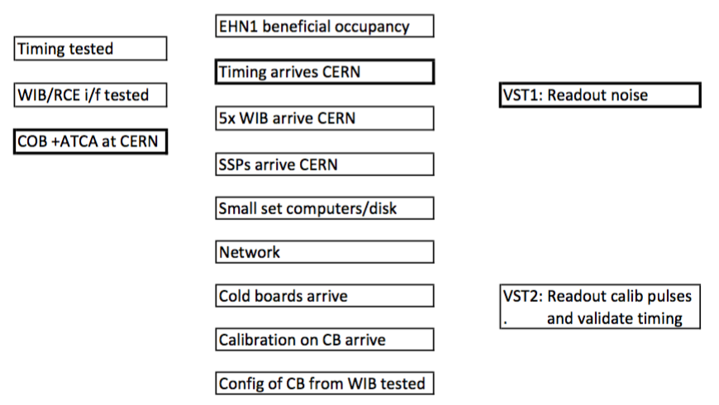
3. For exploitation talk tomorrow (or after), would like to see how things phase together (who depends on who) towards vertical slice

Slide 12
4. For exploitation talk (or after), would like to understand how expert functionality will be delivered on necessary timescale for experts
We have already implemented changes compared to the 35t to ensure experts are available much more and there are more of them
Increase number of people who are ‘almost full time’ at CERN working on this. e.g. K. Hennessey, G Lehmann-Miotto, G. Savage, W. Ketchum. There are a lot of people (several representatives from each main component listed for Q1) signed up to come for periods of O(3months) in addition.
Run control is strategic choice to be developed at CERN. This gives the onsite experts immediate access (and training opportunities) to interface to most of the other parts of the system; thus accumulating and sharing expertise effectively.
Step though weekly meeting list giving expertise.

Slide 13
5. Timing diagram showing tolerances, also showing where timestamps get put in, how things get aligned
[See next slides]

Slide 14
Timing Alignment
Step 1: Timing system provides ‘absolute reference’ across system
  A phase-adjusted clock and timestamp, identical in each system
  Triggers / calibration pulses marked with a single reference timestamp at source
  (Blocks of) data samples are marked with a timestamp
  Data blocks to board reader carry the trigger timestamp and event number in the header
Step 2: For each detector, define a sampling window around trigger
  Some data before trigger, and window sized to capture earliest / latest possible signals
    e.g. for TPCs, slightly more than one drift period
  Trigger latency is ~1μs; data path latency varies – detector-dependent trigger / data offset
    e.g. data arrives before trigger in SSP, after trigger (due to compression stage) in RCEs
  In SSP, the offset between trigger and data is fixed, compensated for on a per-board basis
  In RCE and FELIX, the (compressed) blocks are timestamped, correlated with trigger
Step 3: ‘Fine alignment’ done offline after timing calibration
  May be time-dependent, calibration-dependent or have sub-sample precision
Timing tolerance
  Phase alignment should be a small fraction of the fastest sampling period
    150MHz sampling in the SSPs -> alignment precision of ~1ns; matches the effective precision of BI timestamps
  Timing jitter should be a small fraction of alignment precision

Slide 15
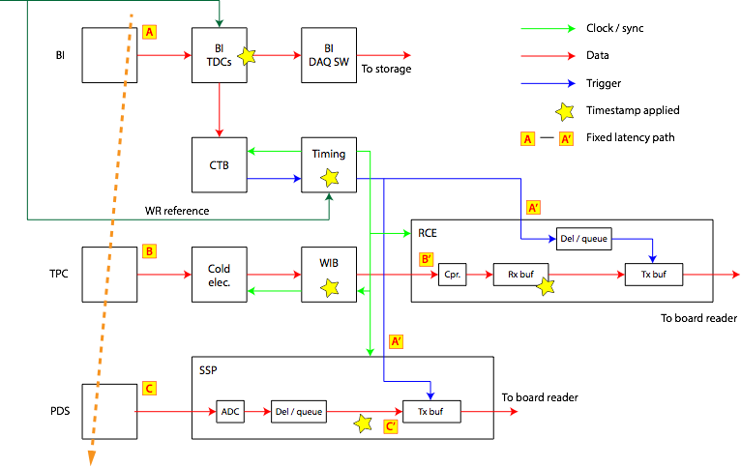
Timestamp Application

Slide 16
6. How much data can the system take from SSP for full waveform/continuous readout around a beam trigger
1.1Gbit/s is used to read out all the headers based on the rates we have been given.
If we allocate a further 0.1Gbit/s to the photon detector readout, the size of the waveform that could be read on every channel is 6us.
We consider 2Gbit/s from the SSPs a manageable amount of data that we can afford to collect in normal data taking mode.
For special runs, much more bandwidth can be allocated to the photon detectors, so we should be able able to take data for much longer.5.

Slide 17
Trigger
5ms
TPC

Slide 18
7. Where and when exactly is the beam information merged into the data stream? Locally or at Tier-0? CRT data?
Our initial answer is that this merging will wait until tier-0, because that is the simplest (which is a guiding principle for our DAQ design, see M.Thomson’s talk)
If it emerges that merging beam data is necessary to adequately do online data quality monitoring, we have several ideas for providing this locally (e.g.
  Write beam data to a database and associate it keyed by event time at the point of reconstruction
  BI information could be extracted like other conditions data during the processing stage, not implying necessarily a complete rewrite of data.
  Write a parallel file for each spill
This is an area where new people can come in with good ideas over the next year, so it could be fixable more elegantly than indicated here.

Slide 19
Backup

Slide 20
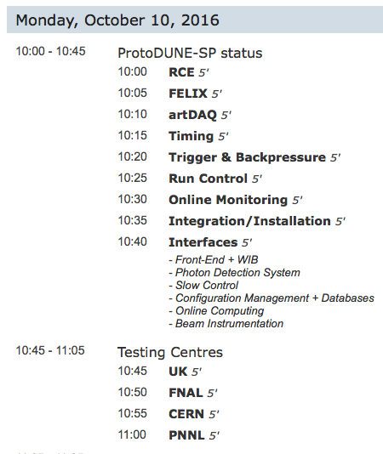
Backup for question 1
Communication and knowledge of leadership of each part is exchanged through weekly meetings status rundown.
We think that no steering group is needed, the weekly run-through of status among all collaborators is sufficient.
Upper level ProtoDUNE management has just gone through an evolution (past few weeks) and we are optimizing how we are plugged in to that new structure

Slide 21
Backup for question 5
In ProtoDUNE, since the headline numbers (5ms drift, 2MHz digitization) are much slower than a normal detector, this is exceptionally easy.
The latencies of the incoming trigger decisions and data arrival times are fixed and are very small compared to this.
So alignment is done by
  Establishing a clean trigger from the beam (coincidence of two beam counters
  Collect data with TPC and photon system. Measure drift distance of start of track (we need to do this to about 1ms accuracy which is easy), use this to verify that track ends appear in correct location in detector and correct if necessary
  This also requires drift velocity measurement, obtained by cosmic tracks passing from cathode to anode plane
  By averaging over several events, look for accumulation of photon detector hits in the expected time bin in SSPs or nearby.

Slide 22
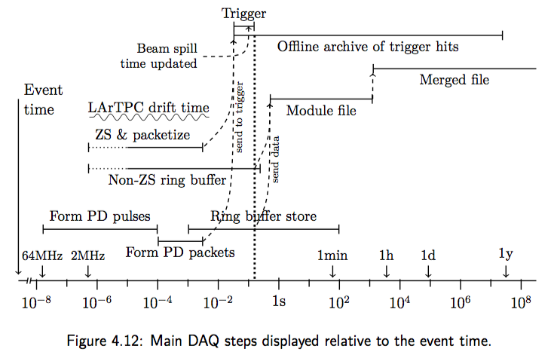
From CD1R: (About 1 year out of date)

