Slide 1
Analysis of bucking solenoid
Aleksandr Romanov
FAST department meeting
10 June 2016

Slide 2
Gun setup

Slide 3
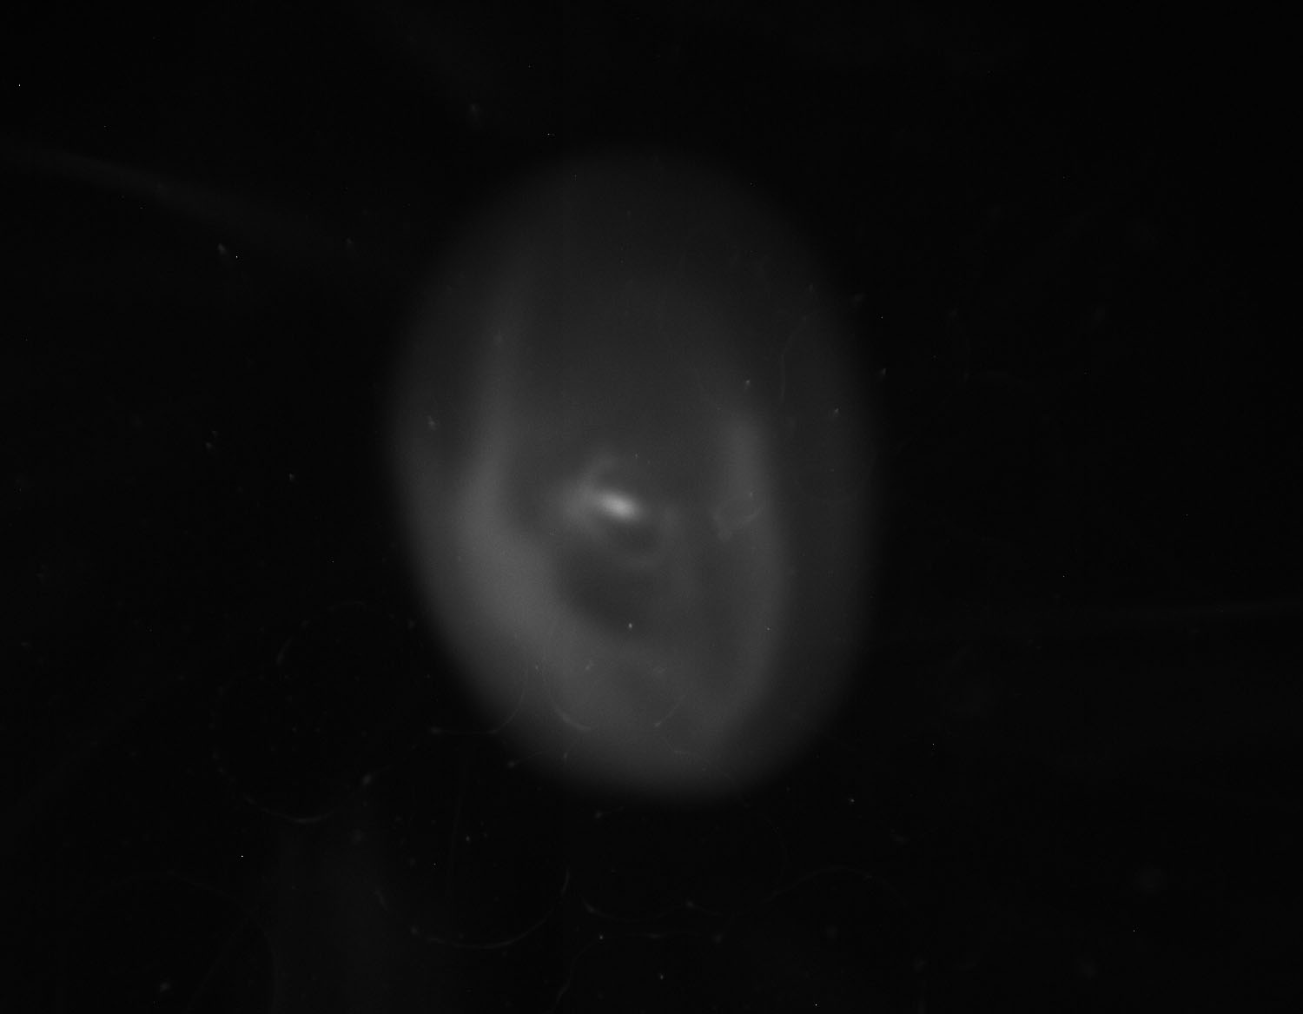
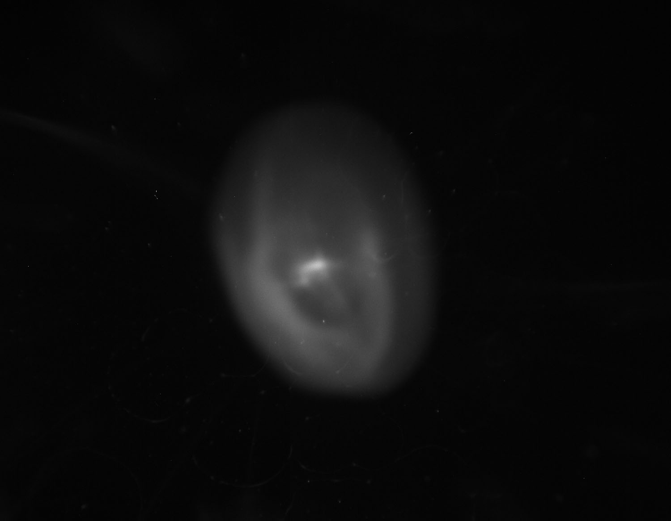
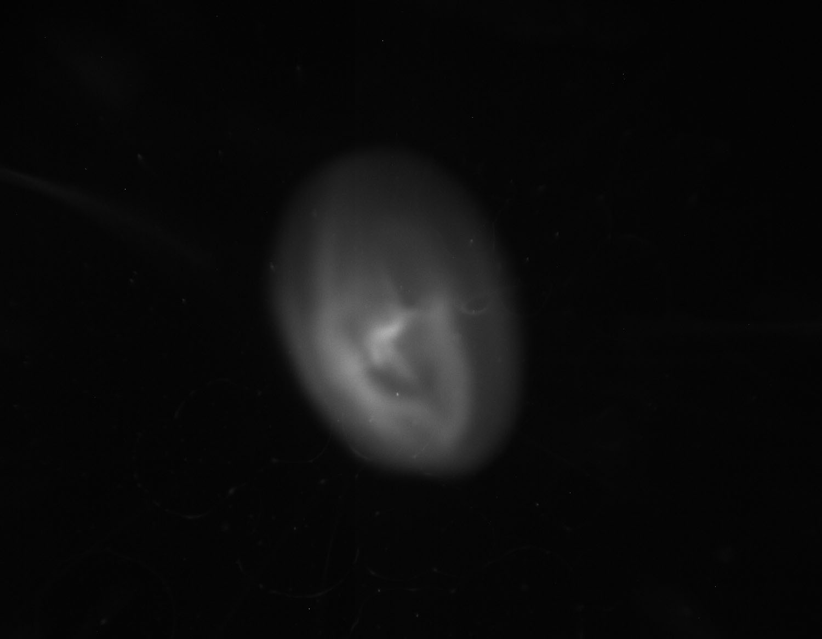
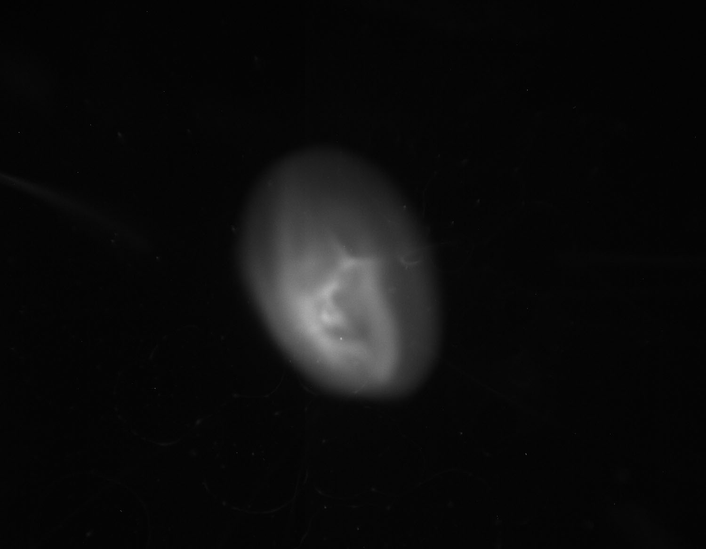
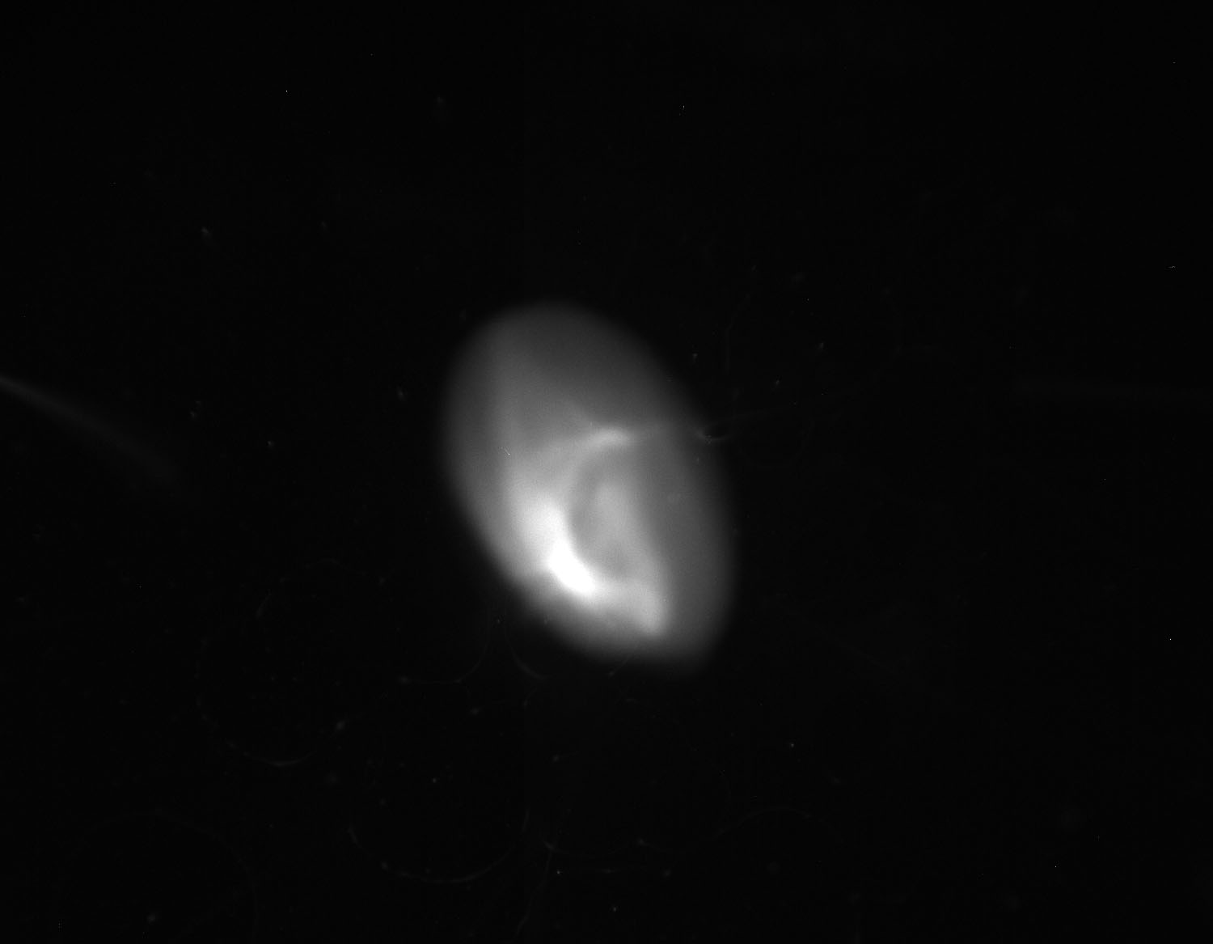
Experimental data: scan of bucking solenoid (main ~310A)
100A
70A
50A
30A
0A

Slide 4
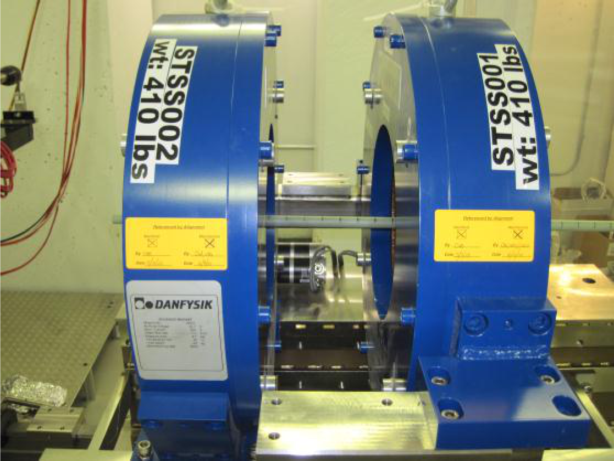
Measurements of FAST solenoids
Darren J Crawford et al.

Slide 5
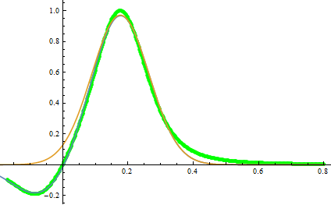
ASTRA and toy models for solenoids
H, arb
Ibuck/Imain=0.2
Green – initial ASTRA model
Blue – two gaussian fit
Orange – only “main” Gaussian
Red – toy model (also E = E gun from start)
S, m

Slide 6
Toy model
Second moments, pixels^2
Bucking Solenoid, A

Slide 7
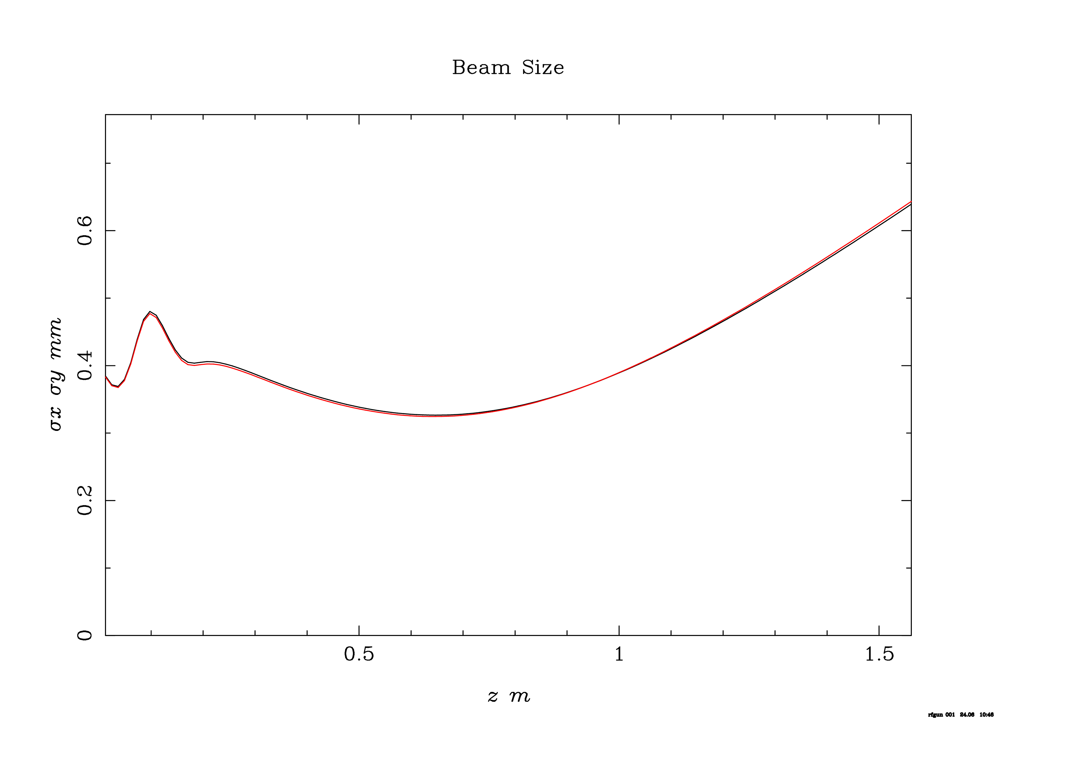
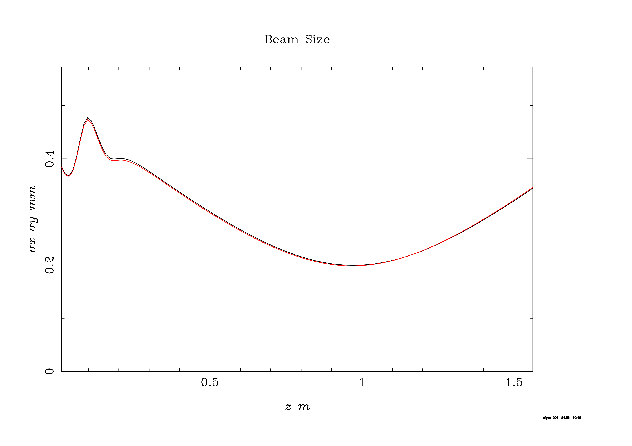
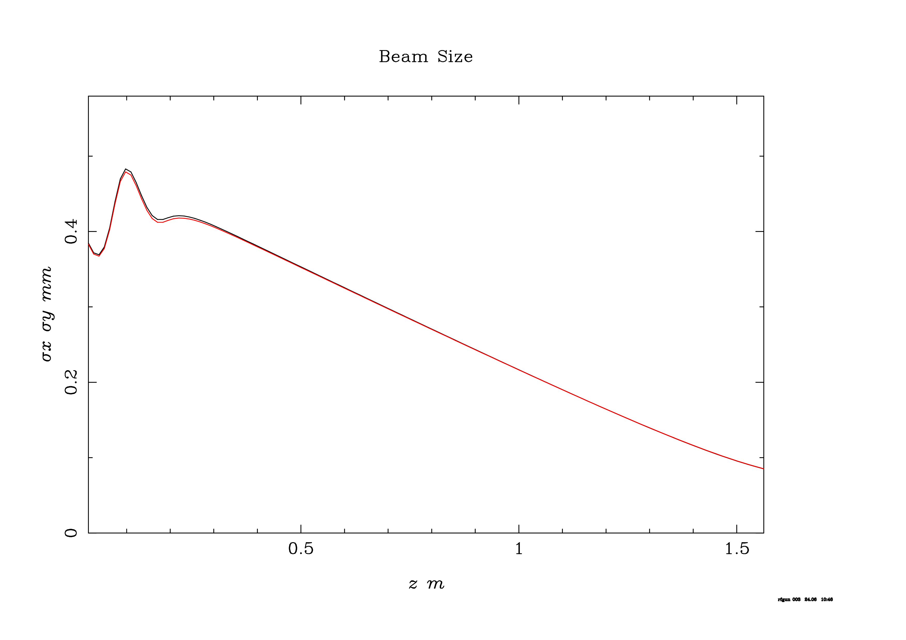
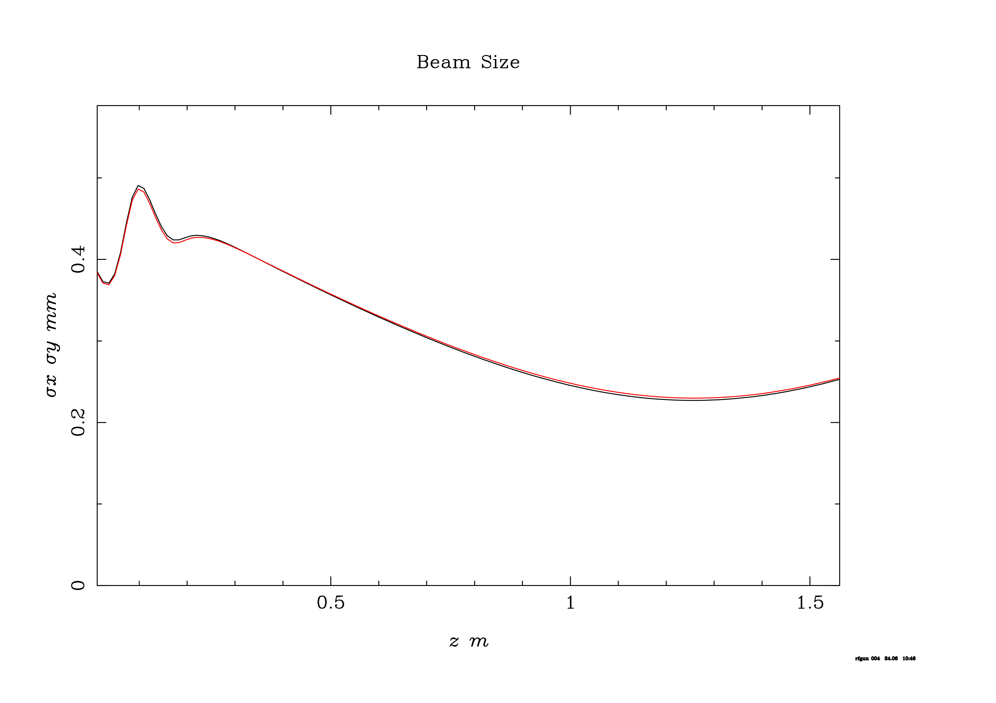
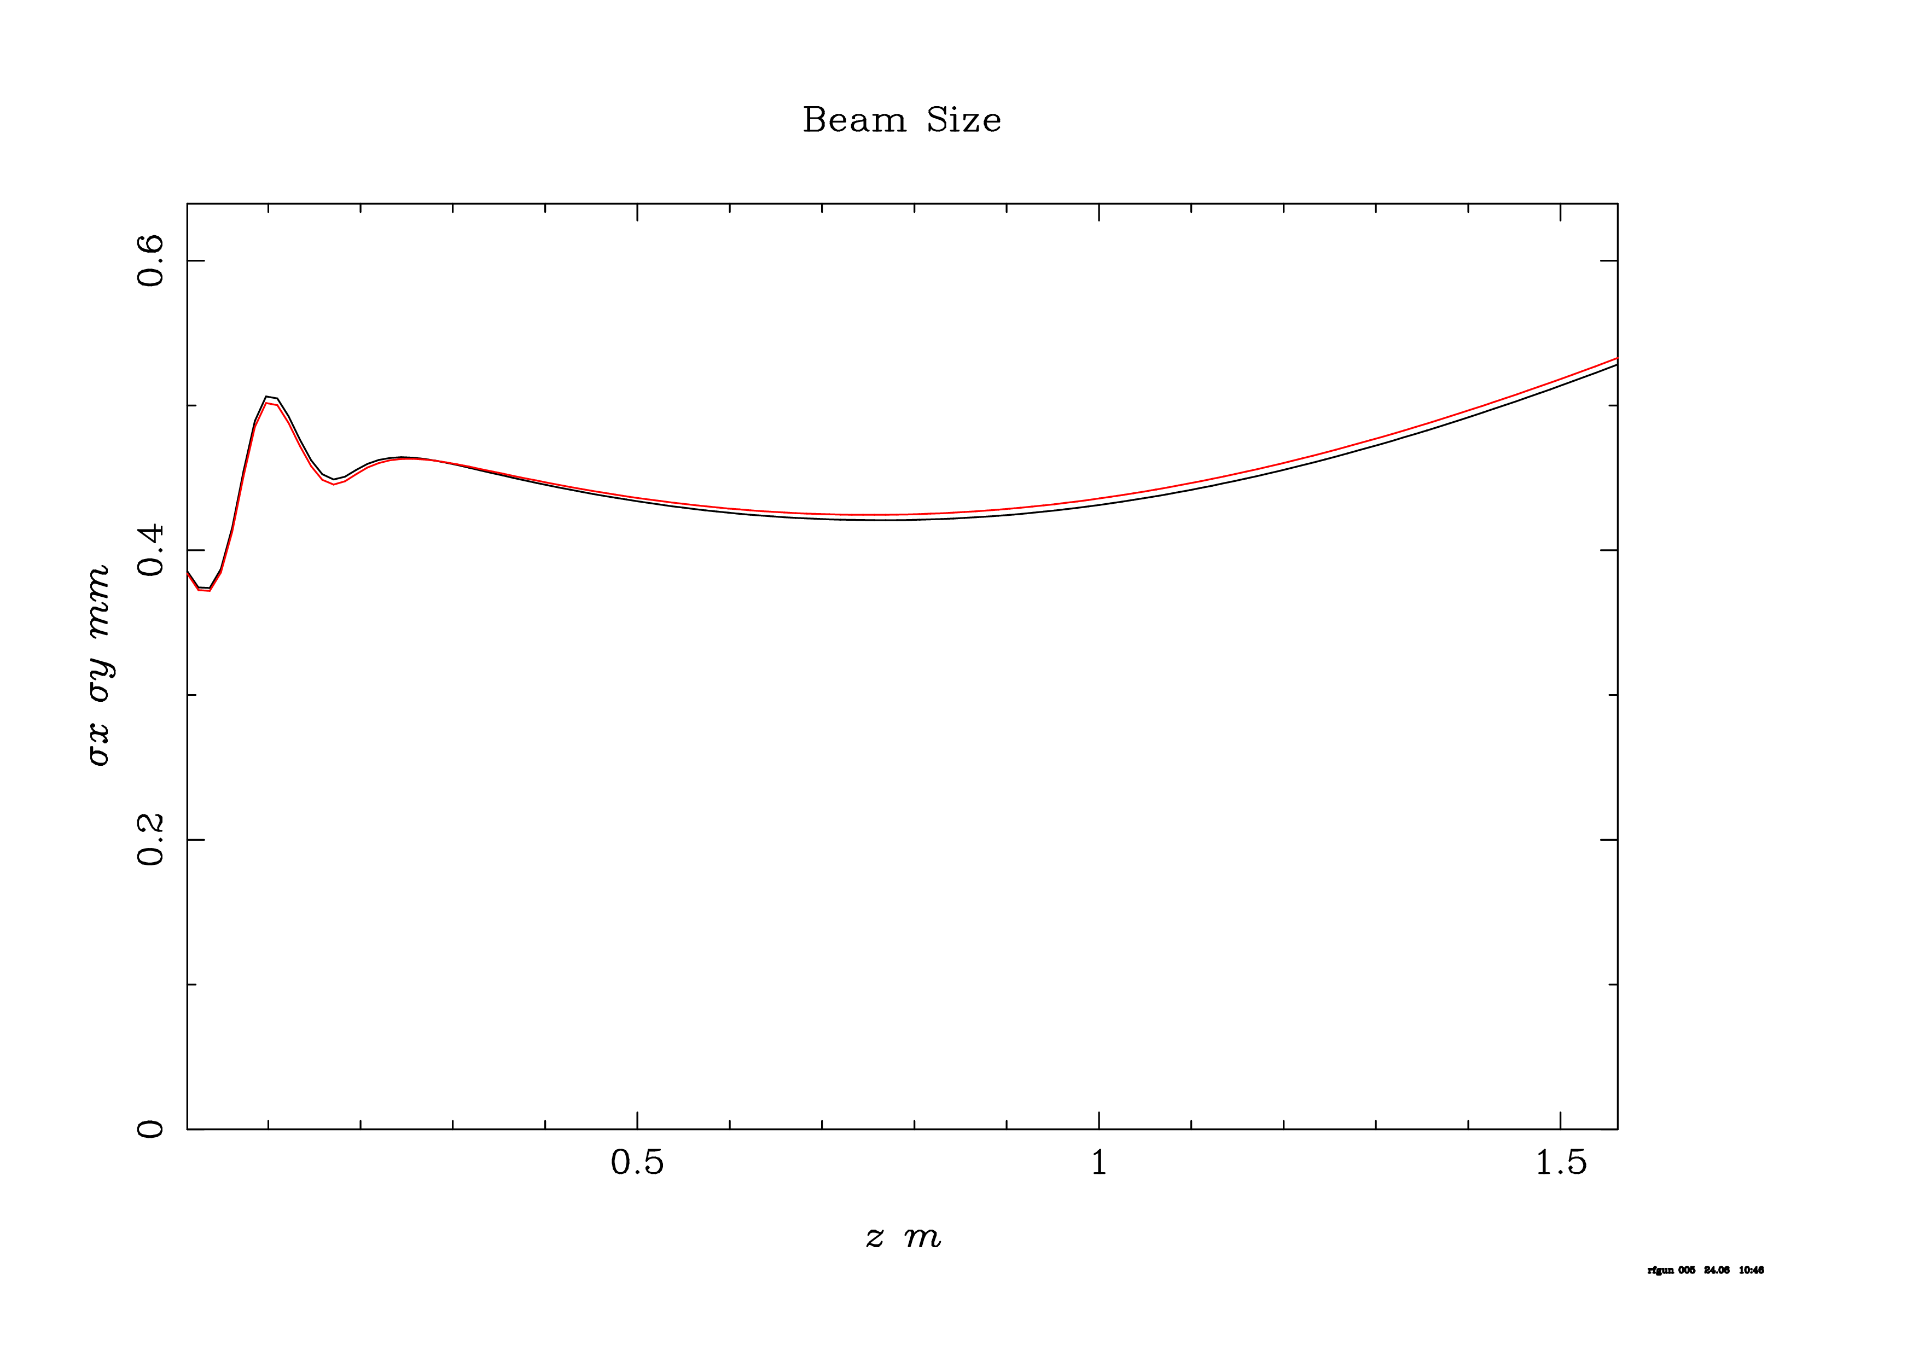
ASTRA results: bucking scan
No bucking
Inverted
Full comp
Over comp
Strong over comp

Slide 8
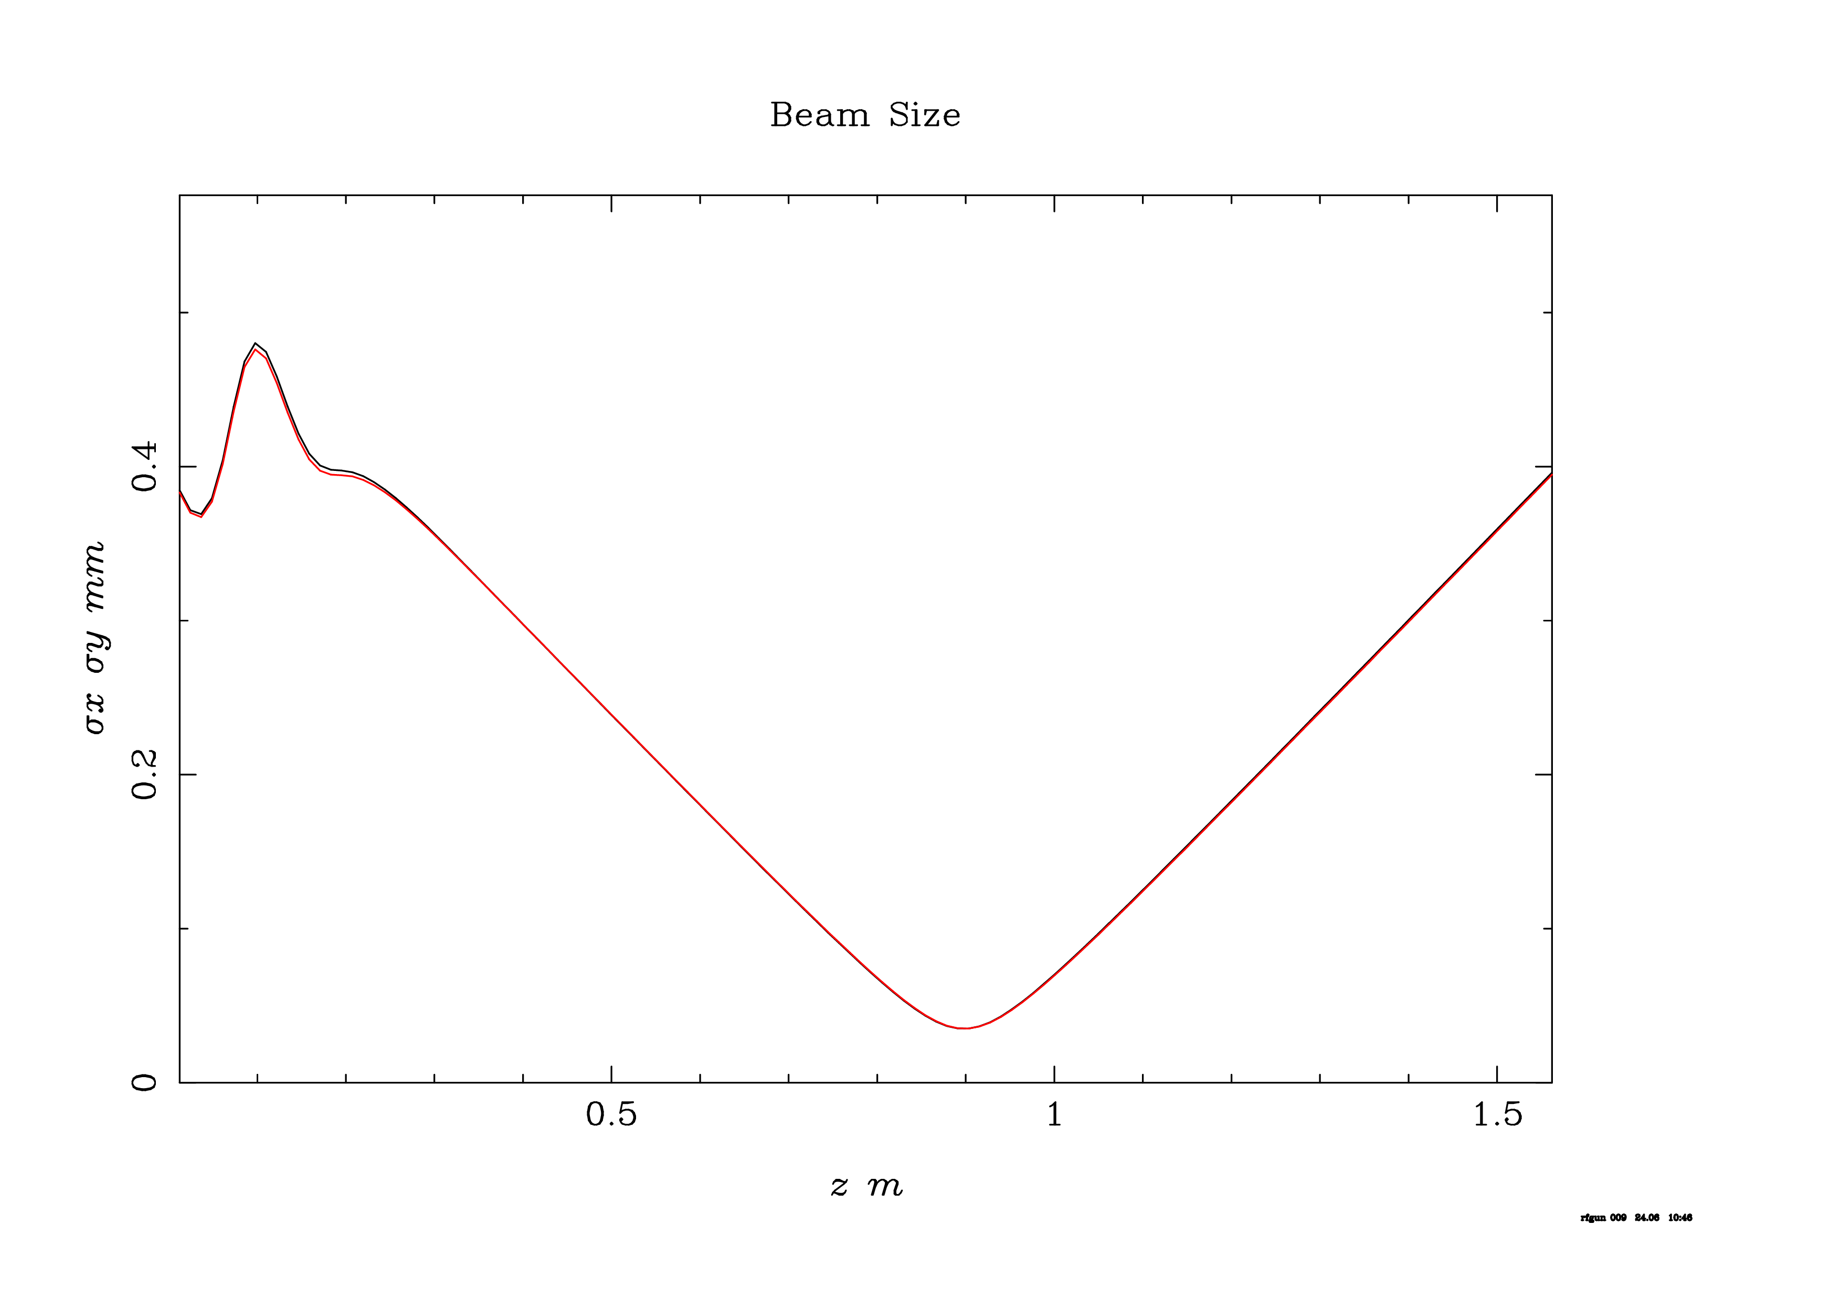
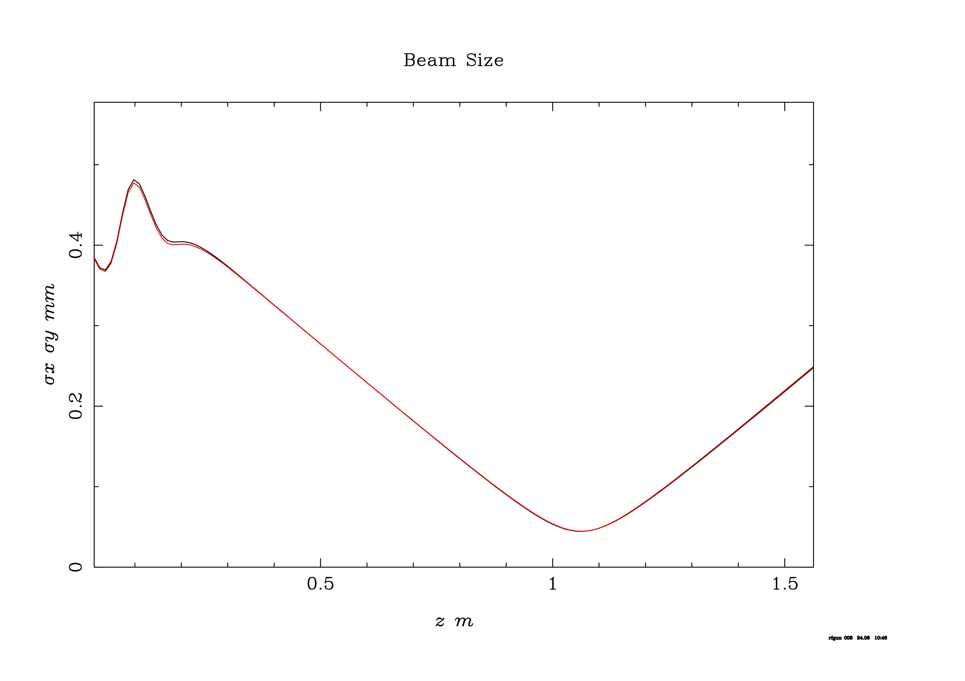
ASTRA results: main scan

Slide 9
Conclusion
Bucking solenoid scan dose not indicate that we can cross conditions with zero solenoidal field at cathode.

